Slide 1
BCN 3727
Construction Sitework
Fall 2010
Lecture #3

Slide 2
What did we cover in Lecture 2 ?
Raw Land
Soil vs. Rock
Soil Properties (Digging Resistance, Rippability)
Soil Index Properties (Textural Classification, Density)
Field Density Tests
  Sand Cone Method
  Nuclear Method

Slide 3
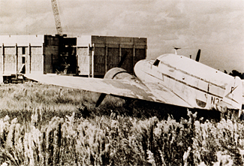

Construction Sitework
“Exposition and critical analysis of practical and sequential aspects of converting raw land to finished product. Course will define various steps and discuss techniques of accomplishment.”
Raw Land
Finished Product

Slide 4
Raw Land
Characteristics
  natural state
  no manmade improvements (e.g. clearing, digging, grading … etc.)
Challenges
  type of soil (soil vs. rock)
  groundwater table
  site preparation
  connection to infrastructure systems (e.g. water, sewer, power … etc.)

Slide 5
Soil vs. Rock
In geology, all soils are some rock formation
Soil is loose surface material
Rock is the hard crust of the earth, which underlies soil
Contractor’s definition
  “rock is any material which cannot be dug or loosened by available machinery”
  Rock - needs blasting or ripping
  Hard digging - compacted, cemented, or rock dirt
  Easy digging - soft or fine, firm or loose deposit

Slide 6
Rock
Classified by the way they were formed
Igneous
solidified from molten state
volcanic
(e.g. Basalt)
plutonic
(e.g. Granite)
Sedimentary
(e.g. Sandstone)
Metamorphic
(e.g. Marble)
Built up of soil, plant or animal remains
Igneous or sedimentary but have been altered

Slide 7
Soil
REGOLITH
  Geologists refer to the very upper part of the crust, between the surface of the earth and solid rock, as the Regolith (rhegos=blanket, lithos=stone).
  The Regolith is primarily composed of loose, unconsolidated mineral sediments, weathered rock fragments and decomposed organic matter.
SOIL
  Geotechnical engineers refer to the upper part of the Regolith as Soil.

Slide 8
Soil (contd.)
Soil not only includes rocks and sediments, but may also contain organics, plants and other living matter.
The four possible components of soil are:
  Mineral Matter
  Organic Matter
  Air
  Water

Slide 9
Digging Resistance
Is defined as:
  “resistance which must be overcome to dig a formation”
  Hardness → resistance to penetration (packing, void filling, moisture)
  Coarseness → more power to penetrate coarse or firmly packed soils
  Friction → absorbs an increasing portion of penetration force
  Adhesion → adhesion of soil to the digging parts
  Cohesion → resistance to tearing apart
  Weight

Slide 10
Rippability
Is a measure of:
  “the ease or difficulty with which rock can be broken by heavy rippers”
  Resistance to breakage
    → Depends on the material itself
  Bedding layers, joint cracks, or fault movement
    → Weakens rocks
  Weathering
    Weakens rocks
  Impact of depth
  Non-rippable rocks
(igneous: basalt, granite, felsite and lava)

Slide 11
Soil
SOIL AS A CONSTRUCTION MATERIAL
  From the point of view of the Engineer & Contractor, Soil is just another construction material.
  Soil, however, is heterogeneous (not uniform) in nature, therefore posing special problems for its use as a construction material.
  Ideal construction materials, such as steel, e.g., are homogeneous & behave in a predictable manner. This behavior can then be determined and described by “rational analysis.” (Example: Deflection of steel beam.)

Slide 12
SOIL (Contd.)
INDEX PROPERTIES
  Soil does behave in a somewhat predictable manner if certain of its properties are known.
  These properties are called Index Properties.
  Geotechnical Engineers rely more on empirical data (results of physical tests indicating soil performance under differing conditions), as opposed to analytical data, to predict soil behavior.

Slide 13
SOIL (Contd.)
INDEX PROPERTIES (Contd.)
  Analytical data results from rational analysis.
  Some important Index Properties are:
    Particle Size and shape
    Water Content
    Unit Weight
    Density
  Although not an Index Property, ORGANIC MATTER in soils must also be addressed. Usually derived from plant or root growth, these materials, commonly referred to as humus (geology), muck or peat, can significantly affect soil behavior.

Slide 14
SOIL (Contd.)
PARTICLE SIZE
  Particle size is a major determinant of soil behavior.
  Soil is divided into four major groups for the purpose of textural classification:
    Gravel
    Sand
    Silt
    Clay
  Defined in the Unified Soil Classification System.
    The USCS was formulated by U.S. Army Corps of Engineers in 1953 and is described in ASTM D 2488.

Slide 15
SOIL (Contd.)
TEXTURAL CLASSIFICATION
  Textural classification is based on:
    Particle Size
    Particle Size Distribution
    Grain characteristics.
  Particle Size Distribution is obtained by performing a Sieve Analysis of a soil sample using a set of test sieves with standard openings and a test fixture:

Slide 16
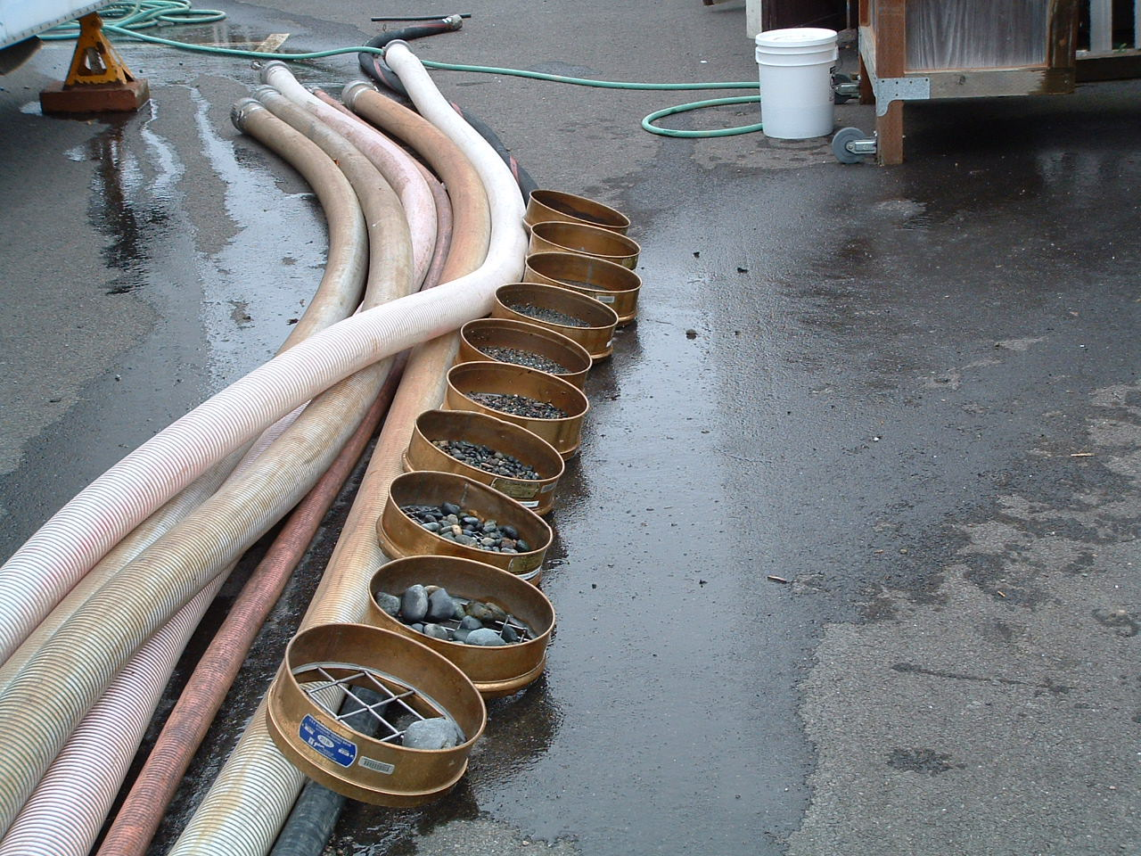
SIEVE ANALYSIS TEST SIEVES

Slide 17
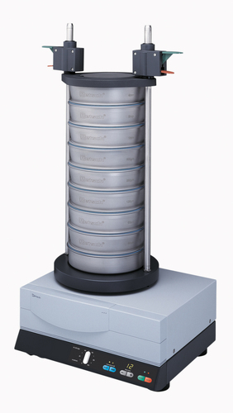
SIEVE ANALYSIS TEST FIXTURE

Slide 18
Soil (Contd.)
TEXTURAL CLASSIFICATION (Contd.)
  Particle size ranges of different classes:
    “Boulders” Over 12”
    “Cobbles” 12” to 3”
    Coarse Gravel 3” to ¾”
    Fine Gravel ¾” to #4 Sieve [4.76mm (0.187in)]
    Coarse Sand #4 (4.76mm)-#10 [1.68mm (0.066in)]
    Medium Sand #10 (1.68mm)-#40 [0.425mm (0.01in)
    Fine Sand #40(0.425mm)-#200[0.074mm(0.003)
    Silt 0.050mm - 0.005mm
    Clay 0.005mm – 10 Å
    Å = Angstrom Unit = 1/10¹⁰ m (one ten billionth of a meter)
    μ = Micron = 1/10⁶ m (one millionth of a meter)

Slide 19
Soil (Contd.)
TEXTURAL CLASSIFICATION (Contd.)
  As can be seen from this table, soils are described as either gravel, sand, silt or clay, or combinations of these four types
  Soils are also described as coarse grained, fine grained or organic, or combinations thereof
  Coarse grained soils have over 50% of the test sample retained on the #200 sieve, while fine grained soils have over 50% passing the #200 sieve (0.0029 inches)

Slide 20
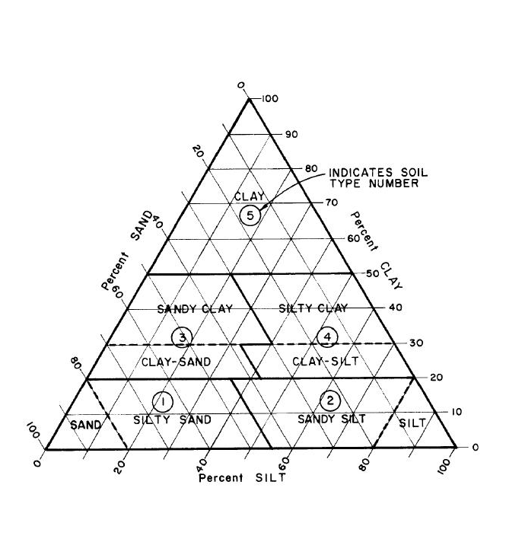
Soil Classification
CLASS | Sand | Silt | Clay
Sand | 80-100 | 0-20 | 0-20
Sandy Loam | 50-80 | 0-50 | 0-20
Loam | 30-50 | 30-50 | 0-20
Silt Loam | 0-50 | 50-100 | 0-20
Sandy Clay Loam | 50-80 | 0-30 | 20-30
Clay Loam | 20-50 | 20-50 | 20-30
Silty Clay Loam | 0-30 | 50-80 | 20-30
Sandy Clay | 55-70 | 0-15 | 30-45
Silty Clay | 0-15 | 55-70 | 30-45
Clay | 0-55 | 0-55 | 30-100

Slide 21
SOIL (Contd.)
SOIL DENSITY
  The term Density in scientific usage is defined as mass per unit of volume.
    D = m/V
  In soil mechanics, however, we define the density of a soil as its weight per unit of volume.
    D = W/V
  This can be easily done, since mass and weight are simply related by:
    W = mg [Special case of F = ma (Newton’s 2nd Law)]
  Soil Density, or Unit Weight, as it is often called, is expressed in the units of pounds per cubic foot (PCF or #/ft³ or lbs/ft³)

Slide 22
SOIL (Contd.)
SOIL DENSITY (contd.)
  The term “Soil Density” refers to the concentration or packing of the solid particles of a given mass of soil.
  Loosely packed soils would therefore have a low density or concentration of solids.
  Closely packed soils would then have a high, or higher, density.
  Soil Density is, therefore, an index of Compressibility (ability to be compressed) of a particular soil and also of its Bearing Capacity.

Slide 23
SOIL (Contd.)
SOIL DENSITY (contd.)
  Since soil may either be in a dry or wet state when found in-situ (in-place), we usually refer to the unit dry weight in geotechnical reports to provide a uniform basis for comparison.
  The Unit Dry Weight, also referred to as “Dry Density,” is a commonly used Index Property of soil to predict soil behavior.

Slide 24
SOIL (contd.)
LOOSE
DENSE

Slide 25
SOIL (contd.)
SOIL DENSITY (contd.)
  In construction of building pads and roadways, loose soils must be compacted to improve their strength by increasing their density.
  Compaction is the densification of soil by removing air voids using mechanical equipment (vibratory plates and rollers, or static rollers).
  The degree of compaction is measured in terms of a soil’s dry density.

Slide 26
SOIL (Contd.)
SOIL DENSITY (contd.)
  FIELD DENSITY TESTS
    The in-place (in-situ) density of soil in the field can be determined or measured in the field (on the construction site) by:
      Sand Cone Method (ASTM D 1556)
      Nuclear Method (ASTM D 2922)
      Both test methods give accurate results, but since the Sand Cone Method is quite cumbersome to conduct in the field, the Nuclear Method is used almost exclusively today.

Slide 27
SOIL (Contd.)
SOIL DENSITY (contd.)
  FIELD DENSITY TESTS (Contd.)
    SAND CONE METHOD
      In the Sand Cone Method, a sample of soil about the size of a large grapefruit is carefully extracted manually from the ground surface, leaving a small hole in the ground.
      The hole is then filled with pure sand of a known unit weight (Ottawa Sand) from the sand cone fixture-this determines the hole volume.
      The soil sample is then weighed and both wet and dry densities are determined by dividing the wet and dry sample weights by the volume of the hole.

Slide 28
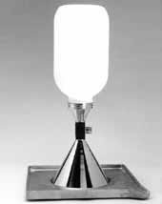
SAND CONE DENSITY TEST APPARATUS

Slide 29
SOIL (Contd.)
SOIL DENSITY (contd.)
  FIELD DENSITY TESTS (Contd.)
    NUCLEAR METHOD
      In the Nuclear Method, a device called a “Nuclear Density Gage” is employed.
      The gage consists of a rectangular metallic box with a vertical metal handle at one end.
      The handle can slide up and down and when the gage is placed on the ground, the handle is pushed downward, allowing a probe fabricated out of a radioactive metal (Cesium) to penetrate the soil a distance of one foot.
      The emitted radiation is measured by the gage and translated into magnitudes of soil density and moisture content.

Slide 30
NUCLEAR DENSITY GAGE

Slide 31
SOIL (Contd.)
SOIL DENSITY (contd.)
  MAXIMUM DENSITY AT OPTIMUM MOISTURE
    Once we have measured the actual density of soil in the building area of our project, how do we know if that magnitude of density is sufficient?
    Since soil density is a measure of compressibility and bearing capacity, how do we know what level of density is acceptable?

Slide 32
SOIL (Contd.)
SOIL DENSITY (contd.)
  MAXIMUM DENSITY AT OPTIMUM MOISTURE
      In 1933, R. R. Proctor, a geotechnical engineer and researcher, determined that, for a particular compaction effort on a particular soil:
        The dry density of the soil depends on the amount of water the soil contained during compaction, and
        There is only one water content, called the Optimum Moisture Content, that will result in the MAXIMUM dry density of the soil, and
        That other water contents, both greater and lesser than this optimum value, will result in dry densities that are LESS than the maximum.

Slide 33
SOIL (Contd.)
SOIL DENSITY (contd.)
  PROCTOR TESTS
      Proctor’s research resulted in standardized tests being formulated to determine maximum density at optimum moisture for a given soil.
      The purpose of these tests was to give builders of roadways and buildings a standard by which to compare field densities with in order to know how much soil compaction would be required for a particular project.
      Two tests were developed - The Standard Proctor and the Modified Proctor.

Slide 34
SOIL (Contd.)
SOIL DENSITY (contd.)
  PROCTOR TESTS (contd.)
      STANDARD PROCTOR – ASTM D 698
        5.5 lb. Hammer
        12 inch drop
        1/30th Ft³ Mold (4” Ø X 4.6”)
        5 Layers of Soil, compacted @ 25 Blows/Layer
      MODIFIED PROCTER – ASTM D 1557
        10.0 lb. Hammer
        18 inch drop
        1/30th Ft³ Mold (4” Ø X 4.6”)
        5 Layers of Soil, compacted @ 25 Blows/Layer

Slide 35
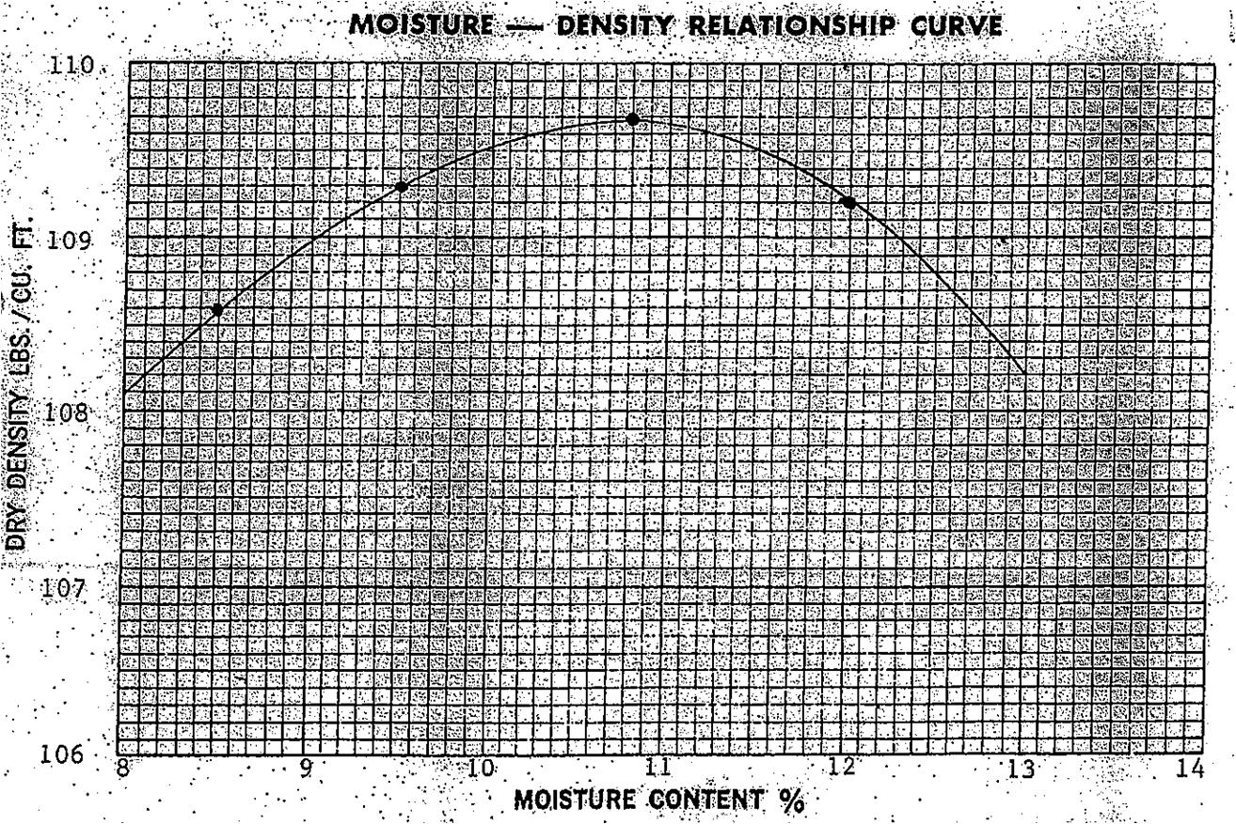

Slide 36
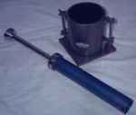
PROCTOR TEST HAMMER & MOLD

Slide 37
SOIL (contd.)
STANDARD PROCTOR
  The Standard Proctor Test was originally developed to simulate compaction effort in the field by compaction equipment prevalent in the 1930’s
  The purpose of the test was to find the optimum moisture content at which a particular soil could achieve its maximum density, at the level of compaction provided by the equipment of the day.

Slide 38
SOIL (contd.)
MODIFIED PROCTER
  As time passed, the Modified Proctor was developed in response to the availability of heavier rollers, to better represent field compaction.
  As the compaction effort increases,
    The maximum dry density of compaction increases, and
    The optimum moisture content decreases somewhat.
    Review In-Place and Proctor Density Reports Handout #1.

Slide 39
SOIL (Contd.)
ARE THERE OTHER SOIL TESTS BESIDES DENSITY TESTS THAT NEED TO BE CONDUCTED?
THE ANSWER IS YES! DENSITY TESTS ONLY TELL US THE CONDITION OF THE SOIL AT THE SURFACE.
HOW DO WE KNOW THAT THE SOILS BELOW THE SURFICIAL SOILS WE TESTED FOR DENSITY ARE OK TO BUILD ON?
ANSWER: WE CONDUCT A SOIL INVESTIGATION. (End of Lecture #2)

Slide 40
SOIL (Contd.)
SOIL INVESTIGATIONS
  The primary purpose of a Soil Investigation or Soil Exploration Program is to discover the nature and character of the subsoils lying beneath the site of a proposed construction project.
  We do this to determine the suitability of these soils to adequately support the structure we are contemplating to build, especially with respect to the type of foundation that will be required.

Slide 41
SOIL (Contd.)
SOIL INVESTIGATIONS (Contd.)
  METHODS OF SOIL EXPLORATION
    The different methods utilized for soil investigations mostly fall into two broad categories:
      INVASIVE
      NON-INVASIVE (Geophysical Methods)

Slide 42
SOIL (Contd.)
SOIL INVESTIGATIONS (Contd.)
  INVASIVE METHODS
    Test Pits, Trenches and Tunnels
    Soil Borings
      Auger Borings
        Hand Augers
        Power Augers
      Rotary Drilling
        Rock Coring (Diamond Tipped Core Barrel)
      Drive-Tube Boring (Jacking or Driving)
        Standard Penetration Test (SPT)
        [Split-Spoon Sampler]
        Shelby Tube
        Dutch Cone Penetrometer

Slide 43
SOIL (Contd.)
SOIL INVESTIGATIONS (Contd.)
  NON-INVASIVE METHODS
    Ground Penetrating Radar (GPR)
    DC Resistivity
    Electromagnetics (EM)
    Seismic Refraction
    Seismic Reflection
    End of Lecture #2

Slide 44
NON-INVASIVE METHODS
GEOTECHNICALINVESTIGATIONS

Slide 45
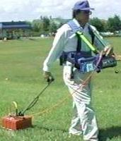
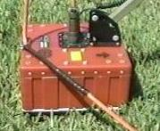
GROUND PENETRATING RADAR
GPR TRANSDUCER (ANTENNA)
HAND-TOWED ANTENNA
Photographs by GeoModel, Inc., Leesburg, VA

Slide 46
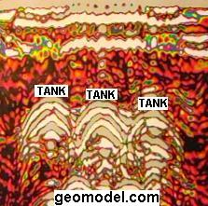
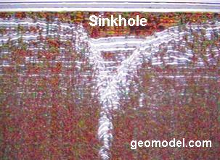
GROUND PENETRATING RADAR
GPR SUBGRADE PROFILE- 3 USTs
GPR PROFILE REVEALING SINKHOLE
Photographs by GeoModel, Inc., Leesburg, VA

Slide 47
SEISMIC REFLECTION/REFRACTION
Seismic techniques involve measuring the travel time of shock (seismic energy) waves from “shots” through subsurface layers to “geophones” (ground motion sensors)
The seismic waves are either reflected or refracted (bent) through soil layers with different densities

Slide 48
SEISMIC REFLECTION/REFRACTION
Seismic waves travel through various subsurface layers with different densities at different velocities.
By measuring travel time and distance, densities and other geotechnical features of the various strata may be determined

Slide 49
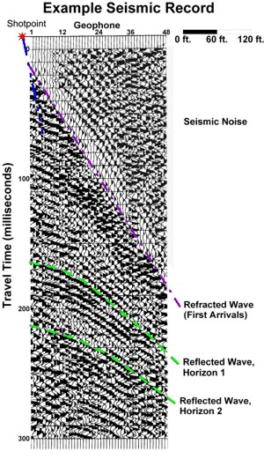
SEISMIC REFLECTION/REFRACTION
EXAMPLE SEISMIC RECORD
ILLUSTRATION BY ENVIROSCAN, INC., LANCASTER, PA

Slide 50
INVASIVE METHODS
GEOTECHNICALINVESTIGATIONS

Slide 51
ROCK CORING
DIAMOND TIPPED CORE BARREL

Slide 52
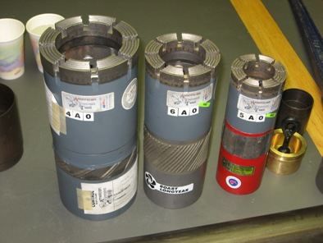
ROCK CORING
DIAMOND TIPPED CORE BARREL (COURTESY: ANDRIL.ORG)

Slide 53
STANDARD PENETRATION TEST
(SPLIT SPOON SAMPLING)

Slide 54
SPLIT SPOON SAMPLING (SPT)
Description of the apparatus
Split Spoon Sampler
Driving the spoon
To what depth?
Availability and cost
Notes:
The split spoon consists off a barrel that is attached to a driver shoe for penetration into the formation and to a head assembly for connection to drill rod. Split spoons are made of steel. The standard dimensions for a split spoon are two inches in outside diameter, and 1.38 inches in inside diameter. The most commonly used split spoons are from 18 to 5 ft. long, normally about two feet. Sampling is accomplished by attaching the spoon to the end of drill rod and lowering to the bottom of a whole where it rests on undisturbed formation. The spoon is usually driven into the formation by a 140 pound weight dropped through a 30 in. interval. Using a standard split spoon and a standard driving force allows an estimation of the formation bearing capacity. As the spoon is driven, the formation sample is forced into the barrel. The sample is retrieved by pulling up the spoon on the drill rod. The spoon is opened along its length for easy retrieval.
The thin wall spoon is not driven, but rather forced into the ground using a hydraulic mechanism. The reason it is not driven is because the walls are too thin to support the blows from the weight.
Most testing that we see done in South Florida using a split spoon will go down about 30 feet. However, it is possible to use these devices down to about 150 feet.
There are many companies that do this type of testing. The data that I have, which is not necessarily current, indicates that you will pay about $50 per whole.

Slide 55
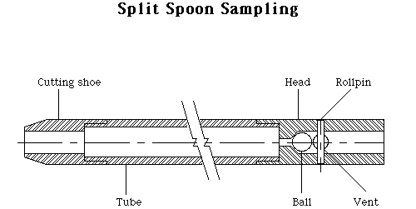

Slide 56



Split spoon sampler driven through an auger

Slide 57
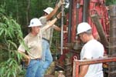
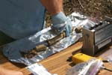
Thin walled split spoon sampler attached to several lengths of drill rod
Sample taken with thin wall split spoon

Slide 58
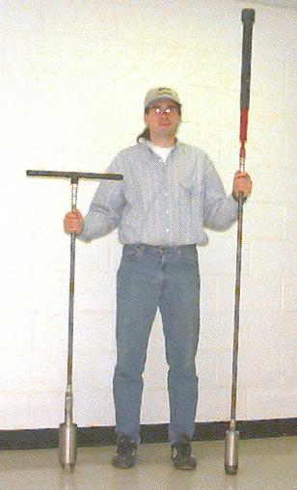
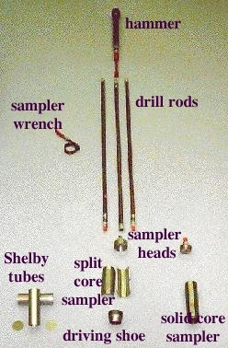
Hand Auger and Sample Equipment

Slide 59
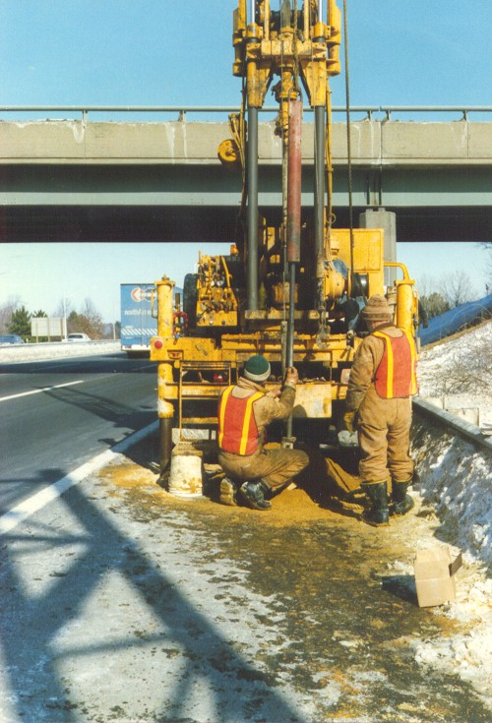
Split Spoon Sampling Rig

Slide 60
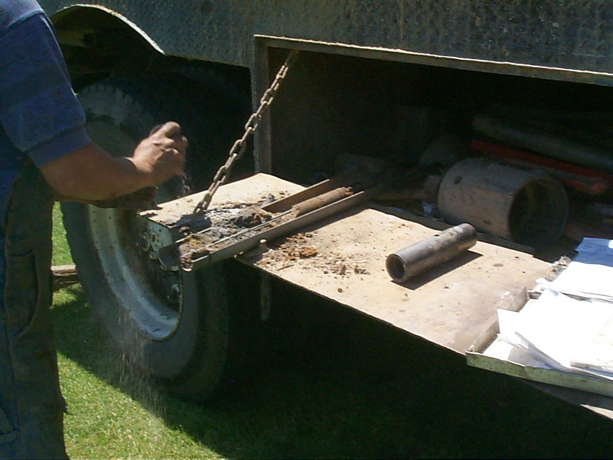
Extracting Soil Sample From Split-Spoon

Slide 61
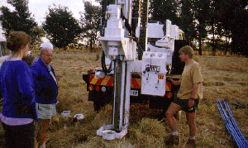
Hollow Stem Push System

Slide 62
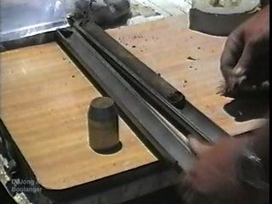
OPEN SPLIT SPOON SAMPLER

Slide 63
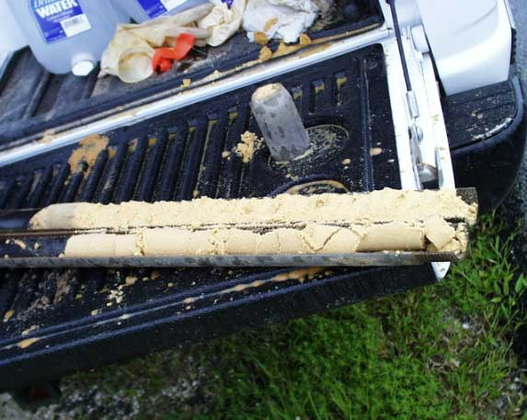
OPEN SPLIT SPOON SAMPLER
COURTESY: US GEOLOGICAL SURVEY

Slide 64
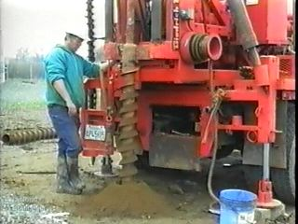
HOLLOW STEM AUGER IN HOLE

Slide 65
DUTCH CONE PENETROMETER
(CONE PENETRATION TEST)

Slide 66
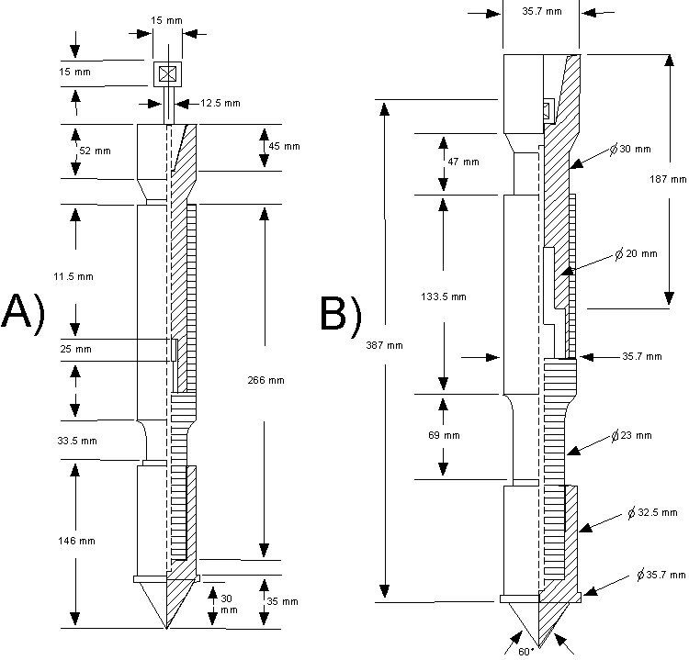
Cone Penetration Test

Slide 67
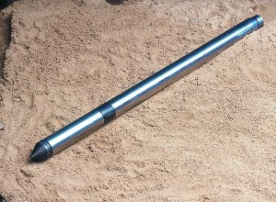
DUTCH CONE PENETROMETER

Slide 68
Potential Problem areas
Is the sample representative?
From your legal course: Differing site conditions.
Reading a soils (geotechnical) report
Notes:
Using the normal thick wall split spoon disturbs the soil. Consequently, what you see in the sample is not exactly what the soil would look like in an undisturbed mode. The thin the wall split spoon does not significantly disturbed the soil. Consequently it is a better sample if detailed analysis is required. Generally speaking, most all of the sampling you will see done in South Florida is the thick wall spoon.
When you read a soil’s report you will find a statement something like this. Due to the fact that soils are naturally deposited materials under verbal conditions, it must be realized that major subsurface discontinuities may occur within very short distances. It is unlikely that the dispersed test used for this investigation revealed all subsurface conditions. We do not warrant or imply that the data collected on our boring walls are indicated of subsurface conditions except at the precise location were borings were taken. In other words if you move an inch away from Bill boring hole we have no idea what the soil is like.
Generally speaking the owner wants the contractor to assume responsibility for what is under the ground and cannot be seen, while the contractor does not want to assume the burden if, in fact, the site conditions are different than shown by the borings.

Slide 69
GEOTECHNICAL ENGINEERING REPORT

Slide 70
Soils Report
Why?
When?
Who gets?
Differing conditions
Limitations: Just one of the reasons you take the legal courses

Slide 71
From your Handout…
Some sort of identification of what the report is about. Normally a plot of where the samples are taken.
How many samples are required?
Things you can tell from the report.

Slide 72
Reading the report – Part 1
The written part
  Introduction
  Project Description
  Test Procedure (what did we do) and Observations (what did we see or find)
  Conclusions
  Recommendations
  Limitations (translate, you can’t sue me)

Slide 73
Reading the report – Part 2
Look at Boring #1
Boring Log
  Location of boring with respect to project
  Column 1, sample number
  Column 2, depth in feet
  Column 3, blows per 6 inch increment of depth
  Column 4, length of sample recovery
  Column 5, blows on casing
  Column 6, depth from top of hole to strata
  Column 7, depth to water table
  Column 8, description of material found in sampler
Notes:
Col 1. Not used in this report. Used if you are keeping the samples for later use or for legal purposes.
Col. 2. Depth in ft from the ground surface. Not related to elevation of the ground. If you have rolling, hilly, etc., land then you still measure from the surface of the soil, not from a predetermined elevation like the elevation of the new slab.
Col 3. More on this later
Col 4. Not used on this boring, but used on others, such as the second boring log.
Col 5. Not used since we are not driving a casing in this case
Col 6. The depth from the top of the whole where we encounter a particular type of soil
Col 7 Depth to water. More on this later.

Slide 74
Questions?

