Slide 1
SAP Crystal Dashboard Design SAP Crystal Reports
EIN 5359 Industrial Financial Decisions
Fall, 2010

Slide 2
SAP Module ERP View
SAP (Systems, Applications, & Products
in Data Processing)
Sales &
Financial
Distribution
Accounting
Materials
Controlling
Mgmt.
Production
R/3
Fixed Assets
Planning
Mgmt.
Integrated Solution
Quality
Client / Server
Project
Mgmt.
Open Systems
System
Plant
Maintenance
Workflow
Human
Industry
Resources
Solutions

Slide 3
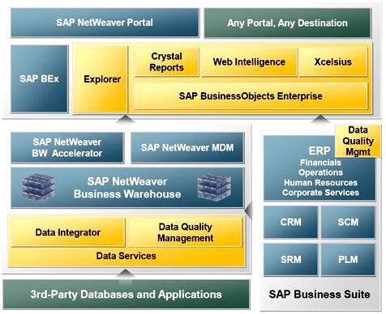
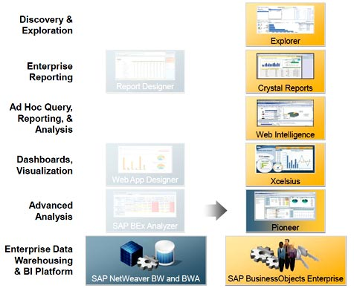
Xcelsius renamed SAP Crystal Dashboard Design
Source: http://en.sap.info/sapphire_business_intelligence/32326

Slide 4
SAP Company
SAP AG
Founded in Walldorf, Germany in 1972
World’s Largest Business Software Company
World’s Third-largest Independent Software Provider
Over 50,000 employees in more then 50 countries
More than 95,000 customers in more than 120 countries
Over 100,000 installations
Over 12 million users

Slide 5
Xcelsius renamed SAP Crystal Dashboard Design
Xcelsius was first released by Information, Inc. in July 2003
Later, Business Objects acquired Information, Inc. The acquisition was all-cash transaction of approximately $40 million US.
Business Objects is a French software company. The company went public on NASDAQ in September 1994. In 2002, the company was in the “Time Magazine” Europe’s Digital Top 25 list. In October, 2007, SAP AG announced that it would acquire Business Objects for $6.8 B. As of 22 January 2008, the company is fully operated by SAP. This is seen as part of a growing consilidation trend in the Business software industry, with Oracle acquiring Hyperion in 2007 and IBM acquiring Cognos in 2008.
Products:
Xcelsius for dashboard design
Crystal reports
BusinessObjects XI
Source: http://en.sap.info/sapphire_business_intelligence/32326

Slide 6
Xcelsius renamed SAP Crystal Dashboard Design
Software: SAP Crystal Dashboard (Xcelsius Engage 2008)
Access SAP Crystal Dashboard Design (Xcelsius Engage 2008) Link:
http://downloads.businessobjects.com/akslm/xcelsius/Xcelsius_engage_30days_trial.zip
Download steps:
Click Open
2. Click on folder xcelsius2008sp3
Click on setup.exe
Choose a language (English)
Follow instructions and read the license agreement
A Xcelsius 2008 setup box will pop-up
Click through the next key steps
The product keycode is CB51D-PU741X7-000VYBJ-58WN
This keycode expires january 31, 2011
Once installation is complete, search for the software by going to Start
Choose All Programs then Xcelsius
Source: http://en.sap.info/sapphire_business_intelligence/32326

