Slide 1
Chapter 9
Inventory Management

Slide 2
Learning Objectives
To determine the costs of holding inventory
To identify the costs associated with a stockout
To understand the EOQ concept
To differentiate the various inventory flow patterns
To appreciate the role of scanners in inventory control

Slide 3
Inventory Management
Key Terms
  ABC analysis
  Complementary products
  Cycle (base) stock
  Dead inventory
  Economic order quantity (EOQ)
  Fixed order interval system
  Fixed order quantity system
  Inventory
Key Terms
  Inventory carrying (holding) costs
  Inventory flow diagram
  Inventory shrinkage
  Inventory turnover
  Just-in-time (JIT) approach
  Nodes
  Pipeline (in-transit) stock

Slide 4
Inventory Management
Key Terms
  Reorder point (ROP)
  Safety (buffer) stocks
  Speculative stock
  Stockout costs
  Substitute products
  Vendor-managed inventory (VMI)

Slide 5
Inventory
Inventories are stocks of goods and materials that are maintained for many purposes, the most common being to satisfy normal demand patterns.
Inventory is an important tool which, when used correctly, can reduce total cost and improve the level of service performance in a logistics system.

Slide 6
Inventory Management
Inventory management
  Decisions drive other logistics activities
  Different functional areas have different inventory objectives
  Inventory costs are important to consider
    Inventory turnover
    Inventory Costs / COGS

Slide 7
Inventory Management
Inventory management (continued)
    Inventory Turnover refers to the number of times that inventory is sold in a one-year period.
    Inventory turnover: cost of goods sold divided by average inventory at cost
    inventory is sold 4 times per year
    Compare with competitors or benchmarked companies

Slide 8
Inventory Management
Low inventory turnover = high inventory carrying costs, little (or no) stockout costs
High inventory turnover = low inventory carrying costs, high stockout costs
Managing the tradeoff is important to maintain service levels

Slide 9
Inventory Management
Questions to answer:
  What items to carry as inventory?
  Where should these be maintained?
  In what form should they be maintained?
  How much of each should be held?
Things to consider in inventory decision
  Benefits of having inventory
  Total cost of inventory
  Potential alternatives for inventory

Slide 10
Inventory Classifications
Cycle or base stock refers to inventory that is needed to satisfy normal demand during the course of an order cycle.
Safety or buffer stock refers to inventory that is held in addition to cycle stock to guard against uncertainty in demand or lead time.

Slide 11
Cycle Stock and Safety Stock
Quantity
Cycle Stock
Q
Safety Stock
Time

Slide 12
Inventory Classifications
Pipeline or in-transit stock is inventory that is en route between various fixed facilities in a logistics system such as a plant, warehouse, or store.
Speculative stock refers to inventory that is held for several reasons, including seasonal demand, projected price increases, and potential shortages of a product.
Psychic stock is inventory carried to stimulate demand (retail).

Slide 13
Fundamental Purpose of Inventory
To reduce total system cost
  To buffer uncertainties in
    Supply
    Demand
    Transportation
  The firm carries safety stock
  To capture scale economies in
    Purchasing
    Production
    Transportation
  The firm carries cycle stock

Slide 14
Inventory Costs
Inventory costs in the twenty-first century represent approximately one-third of total logistics costs.
Inventory cost should factor into an organization’s inventory management policy.
Inventory costs include:
  Carrying cost
  Ordering cost
  Stockout cost

Slide 15
Inventory Carrying Costs
Inventory carrying (holding) costs are the costs associated with holding inventory.
  Obsolescence
  Inventory shrinkage
  Storage costs
  Handling costs
  Insurance costs
  Taxes
  Interest charges
  Opportunity cost

Slide 16
Inventory Costs
Ordering costs refer to those costs associated with ordering inventory, such as order costs and setup costs.

Slide 17
Inventory Costs
Ordering costs refer to those costs associated with ordering inventory, such as order costs and setup costs.
Examples of order costs include:
  Costs of receiving an order (wages)
  Conducting a credit check
  Verifying inventory availability
  Entering orders into the system
  Preparing invoices
  Receiving payment

Slide 18
Inventory Costs
Trade-Off between Carrying and Ordering Costs
Ordering cost = number of orders / year x ordering cost / order
Carrying cost = average inventory x carrying cost / unit

Slide 19
Inventory Costs
Stockout cost is an estimated cost or penalty that is realized when a company is out of stock when a customer wants to buy an item.
Stockout costs involve an understanding of a customer’s reaction to a company being out of stock.

Slide 20
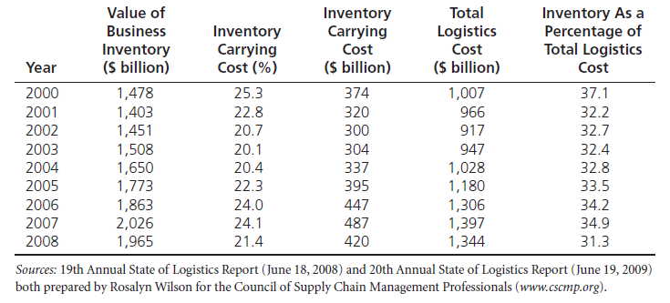
Magnitude of Inventory Costs

Slide 21
Table 9-1: Determination of the Average Cost of a Stockout
Alternative | Loss | Probability | Average Cost
1. Brand-loyal customer | $00.00 | .10 | $00.00
2. Switches and comes back | $37.00 | .65 | $24.05
3. Lost customer | $1,200 | .25 | 300.00
Average cost of a stockout |  | 1.00 | $324.05
These are hypothetical figures for illustration.

Slide 22
Inventory Costs
General Rules Regarding Stockout Costs
  The higher the average cost of a stockout, the better it is for the company to hold some amount of inventory (SS) to protect against stockouts.
  The higher the probability of a delayed sale, the lower the average stockout costs and the lower the inventory that needs to be held by a company.

Slide 23
Dimension of
Inventory Modeling
    Demand
      Constant vs Variable
      Known vs Random
      Continuous vs Discrete
    Lead Time
      Instantaneous
      Deterministic vs Stochastic
    Dependence of Items
      Independence
      Correlated
    Review Time
      Continuous vs Periodic
    Number of Layers
      One vs Many
    Capacity / Resources
      Unlimited vs Limited
    Discount
      None
      All units or Incremental
    Excess Demand
      None
      Backordered
      Lost orders
      Substitution
    Perishability
      None
      Uniform with time
    Planning Horizon
      Single Period
      Finite Period
      Infinite
    Number of Items:
      -- One vs Many

Slide 24
Assumption of
Basic EOQ Inventory Model
    Demand
      Constant vs Variable
      Known vs Random
      Continuous vs Discrete
    Lead Time
      Instantaneous
      Deterministic vs Stochastic
    Dependence of Items
      Independence
      Correlated
    Review Time
      Continuous vs Periodic
    Number of Layers
      One vs Many
    Capacity / Resources
      Unlimited vs Limited
    Discount
      None
      All units or Incremental
    Excess Demand
      None
      Backordered
      Lost orders
      Substitution
    Perishability
      None
      Uniform with time
    Planning Horizon
      Single Period
      Finite Period
      Infinite
    Number of Items:
      -- One vs Many

Slide 25
Inventory Control
Basic EOQ Model
Quantity
Q
Time

Slide 26
How Much to Reorder?
Economic order quantity (EOQ) in units
Where
EOQ = the most economic order size, in units
D = annual demand, in units
B = administrative costs per order of placing the order
C = carrying costs of the inventory (%)
I = dollar value of the inventory, per unit

Slide 27
Inventory Control
Basic Economic Ordering Quantity Model
Break-even charts
$
Total Annual Cost
Carrying Cost
Ordering Cost
EOQ
Order Quantity Q

Slide 28
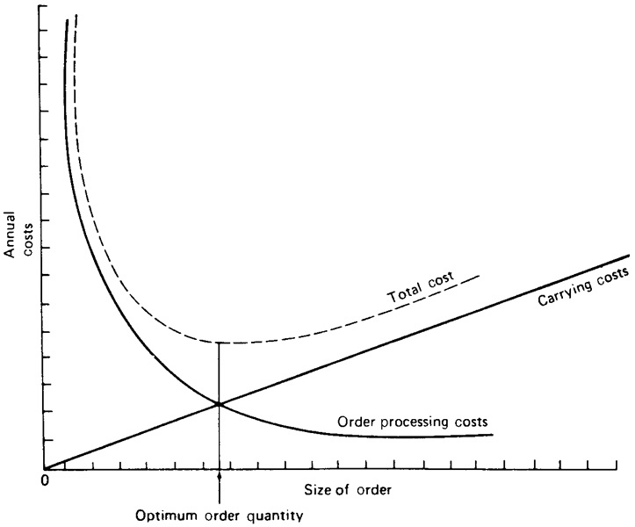
Figure 9-2: Determining EOQ by Use of a Graph

Slide 29
Table 9-3: EOQ Cost Calculations
Number of orders per year | Order size ($) | Ordering cost ($) | Carrying cost ($) | Total cost (sum of ordering and carrying cost) ($)
1 | 1,000 | 25 | 100 | 125
2 | 500 | 50 | 50 | 100
3 | 333 | 75 | 33 | 108
4 | 250 | 100 | 25 | 125
5 | 200 | 125 | 20 | 145

Slide 30
Table 9-2: Determination of Safety Stock Level
Number of Units of Safety Stock | Total Value of Safety Stock ($480 per Unit) | 25% Annual Carrying Cost | Carrying Cost of Incremental Safety Stock | Number of Additional Orders Filled | Additional Stockout Costs Avoided
10 | $4,800 | $1,200 | $1,200 | 20 | $6,481.00
20 | 9,600 | 2,400 | 1,200 | 16 | 5,184.80
30 | 14,400 | 3,600 | 1,200 | 12 | 3,888.60
40 | 19,200 | 4,800 | 1,200 | 8 | 2,592.40
50 | 24,000 | 6,000 | 1,200 | 6 | 1,944.30
60 | 28,800 | 7,200 | 1,200 | 4 | 1,296.20
70 | 33,600 | 8,400 | 1,200 | 3 | 972.15

Slide 31
Determination of Safety Stock Level:
Using Service Level
Safety Stock
= kσ
Service Level
Probability of Stockout
Forecasted Demand
Reorder Point

Slide 32
When to Order
Fixed order quantity system
Fixed order interval system
Reorder point (ROP)
  ROP = DD x RC under certainty
  ROP = (DD x RC) + SS under uncertainty
  Where DD = daily demand
  RC = length of replenishment cycle
  SS = safety stock

Slide 33
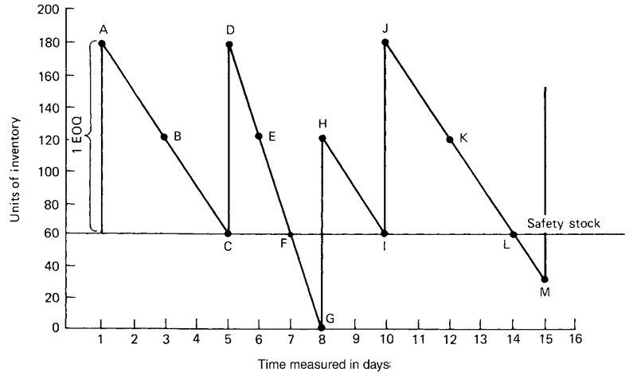
Figure 9-3: Inventory Flow Diagram

Slide 34
Inventory Flows
Safety stock can prevent against two problem areas
  Increased rate of demand
  Longer-than-normal replenishment
When fixed order quantity system like EOQ is used, time between orders may vary
When reorder point is reached, fixed order quantity is ordered

Slide 35
Inventory Management: Special Concerns
ABC Analysis of Inventory recognizes that inventories are not of equal value to a firm and as such all inventory should not be managed in the same way.
Dead inventory (dead stock) is a fourth category to ABC analysis which refers to product for which there is no sales during a 12 month period.

Slide 36
Inventory Management: Special Concerns
Complementary Products are inventories that can be used or distributed together, i.e. razor blades and razors.
Substitute Products refer to products that can fill the same need or want as another product.

Slide 37
Contemporary Approaches to Managing Inventory
Lean Manufacturing
Service Parts Logistics
Vendor-Managed Inventory (VMI)

Slide 38
Case 9-1 Low Nail Company
Product Provided:
One size of nail
Product Information:
Annual Demand: 2,000 kegs to retailers in an even flow
Order Processing Cost: $60 per order
Warehousing Cost: $1 per year per keg
Discussion:
#1: Using the EOQ methods outlined in chapter 9, how many kegs of nails should Low order at one time?
#2: Assume all conditions in question 1 hold, except that Low’s supplier now offers a quantity discount in the form of absorbing all or part of Low’s order processing costs. For orders of 750 or more kegs of nails, the supplier will absorb all the order processing costs; for orders between 249 and 749 kegs, the supplier will absorb half. What is Low’s new EOQ?

Slide 39
Case 9-1 Low Nail Company
Discussion:
#3: Temporarily, ignore your work on question 2. Assume that Low’s warehouse offers to rent Low space on the basis of the average number of kegs Low will have in stock, rather than on the maximum number of kegs Low would need room for whenever a new shipment arrived. The storage cost per keg remains the same. Does this change the answer to Question 1? If so, what is the new answer?
#4: Take into account the answer to question 1 and the supplier’s new policy outlined in question 2 and the warehouse’s new policy in question 3. Then determine Low’s new EOQ.

Slide 40
Case 9-1 Low Nail Company
Discussion:
#5: Temporarily, ignore your work on questions 2, 3, and 4. Low’s luck at the race track is over; he now must borrow money to finance his inventory of nails. Looking at the situation outlined in question 1, assume that the wholesale cost of nails is $40 per keg and that Low must pay interest at the rate of 1.5% per month on the unsold inventory. What is his new EOQ?
#6: Taking into account all the factors listed in questions 1, 2, 3, and 5, calculate Low’s EOQ for kegs of nails.

Slide 41
Case 9-1 Low Nail Company
(Warehousing Cost is based on max. space)
Total Inventory Cost:
Economic order quantity (EOQ) :
Where
EOQ = the most economic order size, in units
D = annual demand, in units
B = administrative costs per order of placing the order
C = carrying costs of the inventory (%)
I = dollar value of the inventory, per unit

Slide 42
Case 9-1 Low Nail Company
(Warehousing Cost is based on avg. space)
Total Inventory Cost:
Economic order quantity (EOQ) :
Where
EOQ = the most economic order size, in units
D = annual demand, in units
B = administrative costs per order of placing the order
C = carrying costs of the inventory (%)
I = dollar value of the inventory, per unit

Slide 43
Case 9-1 Low Nail Company
(Warehousing Cost is based on max. space
Plus Interest)
Total Inventory Cost:
Economic order quantity (EOQ) :
Where
EOQ = the most economic order size, in units
D = annual demand, in units
B = administrative costs per order of placing the order
C = carrying costs of the inventory (%)
I = dollar value of the inventory, per unit
i = interest rate, per year

Slide 44
Case 9-2 Jackson’s Warehouse
Company Facts:
Located in Memphis, Tennessee
Cost Information:
Ordering Cost:
  $30 (if unit cost < $500)
  $75 (if unit cost > $500)
Carrying Cost: 30% of Avg. Inventory
  Avg. inventory = (half order+ safety stock)
Other Requirements:
Order filled 95% of the time

Slide 45
Case 9-2 Jackson’s Warehouse
SKU # | Weekly Demand | Std. Dev. of Demand | Lead Time (weeks) | Unit Cost
402 | 4 | 40 | 2 | $ 1,500
940 | 20 | 50 | 1 | $ 720
660 | 12 | 60 | 2 | $ 500
829 | 30 | 80 | 1 | $ 65
301 | 35 | 90 | 1 | $ 250
447 | 48 | 100 | 1 | $ 190
799 | 8 | 30 | 1 | $ 200
597 | 12 | 35 | 2 | $ 40
27 | 4 | 50 | 1 | $ 210
196 | 20 | 60 | 1 | $ 35
258 | 42 | 115 | 1 | $ 250
62 | 180 | 700 | 1 | $ 8

Slide 46
Case 9-2 Jackson’s Warehouse
Discussion:
#1: Perform an ABC analysis. Is it of much use if the firm maintains only 12 SKUs? Why or why not?
#2: Find the reorder point for each of the SKUs expressed as the point to which existing inventory must drop to trigger a replenishment order.
#3: How large a safety stock should be maintained for each SKU?
#4: How much money will Jackson have as its average investment in inventory?
#5: Interest rates drop, and Jackson’s now assumes that its carrying costs are 20%, rather than 30%. How will this change your answers to questions 2, 3, and 4, if at all? Explain.
#6: Disregard your answers to questions 4 and 5. Answer question 3 again, this time assuming that Jackson’s wants to keep enough of each SKU to fill orders 90% of the time.

