Slide 1
Chapter 7 Transportation Management

Slide 2
Learning Objectives
To examine the background of the transportation management function
To discuss the functions of transportation management
To identify the role negotiations play in the transportation management function
To examine the new options available for private carriage
To understand the purpose of freight consolidation

Slide 3
Transportation Management
Key Terms
Amodal shipper
Bill of lading
Class rate system
Commodity rate
Demurrage and detention
Density
Diver
Documentation
Expediting
Key Terms
Freight bill
Freight claims
Hazardous material
Reconsignment
Routing
Routing Guide
Stowability
Tracing
Private transportation
Weight break

Slide 4
Transportation Management
Transportation management refers to the buying and controlling of transportation service by either a shipper or consignee.
Source: John J. Coyle, Edward J. Bardi, and Robert A. Novack, Transportation, 6th ed. (Mason, OH: South-Western, 2006).
Transportation is the most costly logistics activity
Transportation managers can help:
Marketing
Manufacturing
Outbound shipping
Purchasing

Slide 5
Rate (Pricing) Considerations
Rate Determination
Often located on carrier Web sites
Transportation rates based on three factors
Product
Weight
Distance
Three factors are defined numerically and then tied to a rate of cents per hundredweight (cwt)

Slide 6
Rate (Pricing) Considerations
Rate Determination
Commodity rate
One specific rate for every possible combination of product, weight, and distance
Class rate system
System to simplify rate determination
Freight classification used to simplify the number of commodities
National Motor Freight Classification (NMFC)

Slide 7
Rate (Pricing) Considerations
Rate Determination
Factors used for determine product’s freight classification
Density (higher classification for low-density)
Stowability (how easy to pack into a load)
Ease of handling
Liability to damage and theft

Slide 8
Page from National Motor Freight Classification

Slide 9
National Motor Freight Classification
National Motor Freight Classification Procedures
http://www.nmfta.org/Documents/CCSB/CCSB%20Procedures%202009.pdf
Find classification online
http://freight88.com/NMFC-Codes-Freight_class.html

Slide 10
Rate (Pricing) Considerations
Rate Determination
Weight groups are used to simplify shipment weight
Weight group examples:
<500 lbs (highest rate)
500-999 lbs
1000-1,999 lbs
Distances are simplified through rate basis numbers
Zip codes are replacing rate basis numbers

Slide 11
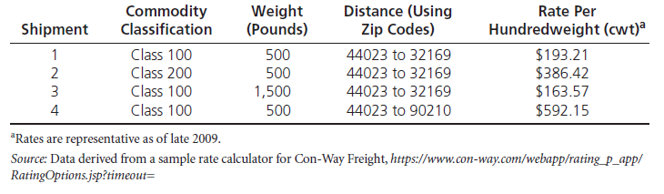
Example of the Class Rate System

Slide 12
Rate (Pricing) Considerations
Rate Determination
Commodity Classification Standards Borad develops and maintains commodity freight classifications
Shippers prefer lower classification number (lower rate)
Carriers prefer higher classification number (higher rate)
Transportation managers can appeal a commodity’s classification

Slide 13
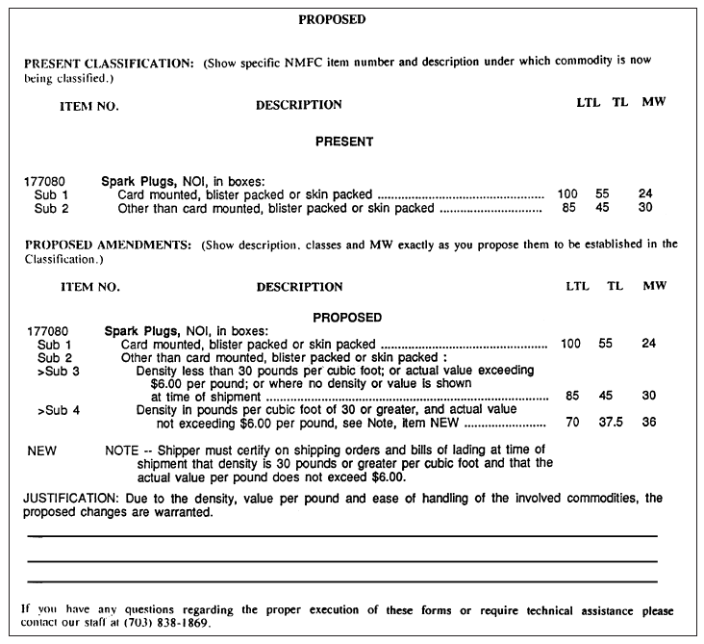
Figure 7-2: Motor Carrier Classification Docket Proposal for Changing the Classification of Sparkplugs

Slide 14
Transportation Rates
To find LTL rates usually need:
Origin and destination zip codes
Weight of shipment
Classification of shipment
Supplemental services needed
Discount awarded to shipper by carrier
Rates may be on carrier Web sites

Slide 15
Rate and Service Negotiations
Both rates and service levels may be negotiated
Long-term relationships are encouraged
Negotiations are subject to antitrust laws
Allows transportation managers to take advantage of trade-offs between price and service

Slide 16
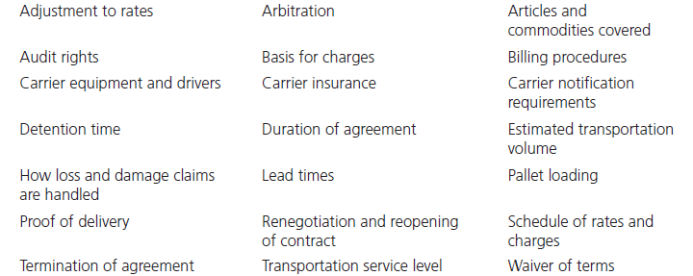
Table 7-1: Representative Rate and Service Items in the Carrier-Shipper Negotiation Process

Slide 17
Rate Regulatory Bodies
U.S. Department of Commerce Foreign Trade Zone Board
Department of Transportation committees
House of Representatives subcommittees

Slide 18
Modal and Carrier Selection
Two-step process
First determine appropriate mode(s)
Then select carrier(s) within the chosen mode(s)
Carrier selection is more challenging
Difficult to be aware of every possible carrier
Lack of agreement on the number of relevant factors

Slide 19
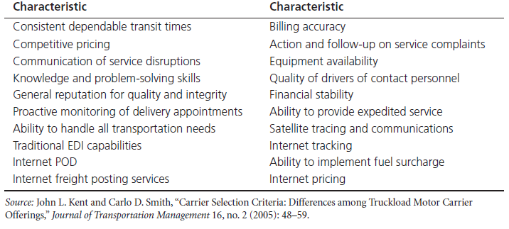
Table 7-2: Possible Carrier Selection Characteristics

Slide 20
Modal and Carrier Selection
Amodal shipper refers to a transportation manager who purchases a prespecified level of transportation service and is indifferent to the mode(s) and or carrier(s) used to provide the actual transportation service.
Research indicates shippers are more interested in transportation metrics than in modes

Slide 21
Documentation
Documentation
Serves practical function (what, where, and how much is being transported
Potentially provides legal recourse
Bill of lading
Straight bill of lading
Order bill of lading
Long-form bill of lading
Preprinted short-form bill of lading
Freight bill
Freight claims

Slide 22
Figure 7-4: A Long-Form Bill of Lading

Slide 23
Figure 7-5: A Preprinted Short-Form Bill of Lading

Slide 24
Documentation
Freight bill
Invoice submitted by the carrier requesting to be paid
Freight bill-paying service
Internal audits
External audits
Freight claims
Refers to a document that notifies a carrier of wrong or defective deliveries, delays, or other delivery shortcomings
Concealed loss or damage is when loss or damage is not apparent until after a shipment has been unpacked and inspected

Slide 25
Making and Receiving Shipments
Consolidating small shipments
Shipments > 150 and < 500 pounds
To get a lower rate, shipment consolidation may occur: aggregating customer orders across time or place or both

Slide 26
Consolidation of Shipments

Slide 27
Consolidation of Shipments
Consolidated Operations
Bus/rail transit
Carpool
LTL
Rail
Airlines
Ocean carriers / liner service
Package delivery
Direct Operations
Taxi
Private car
TL
Unit trains
Charter /private planes
Tramp services
Courier

Slide 28
Freight Payment and Audit Services
Freight bills must be paid within a specific number of days
Payment services are used
To detect duplicate billings
To ensure that proper rate was charged

Slide 29
Demurrage and Detention
Demurrage is a penalty payment made to the railroad for keeping a railcar beyond the time when it should be released back to railroad
Detention is the word used in the trucking industry
Carriers do not want equipment used as temporary warehouse by shipper or consignee

Slide 30
Diversion and Reconsignment
Diversion occurs when the shipper notifies the carrier, prior to arrival, of a change in destination
Reconsignment occurs when the shipper notifies the carrier, after arrival, of a change in destination

Slide 31
Routing
Shippers have the right to select the carriers along the route to shipment destination
More often need to be specified for hazmat
Generally are computer generated
Alternative routes and carriers are also important

Slide 32
Transportation of Hazardous Materials
Hazardous material is a substance or material in a quantity and form which may pose an unreasonable risk to health and safety or property when transported in commerce
Must be moved safely
Labeled with placard
Must have 24-hour hotline used in event of spills

Slide 33
Specialized Container with Sump to Capture Hazardous Waste Leaks from Barrels

Slide 34
Tracing and Expediting
Tracing is the attempt to locate lost or late shipments
Done by computer at no cost
Expediting is rapidly moving a shipment through a carrier’s system.
Both of these are less likely to be used today since shipments can be pinpointed en route and carriers provide better on-time performance

Slide 35
Loss and Damage
Shippers and carriers try to resolve first
What is the full actual loss?
Concealed loss or damage
Who takes possession of damaged goods after claim settled?
If unresolved, moves to court system

Slide 36
Transit Privileges
Transit privileges allow cargo to be stopped en route between origin and destination to be unloaded, stored, or processed and then reloaded for delivery to original destination
Often used in household goods moving and storage industry

Slide 37
Reparations
Reparations are payments made to a shipper by a carrier that has charged illegally high rates in the past
Also collected when carriers do not live up to terms of contracts with shippers

Slide 38
Transportation Service Quality
Macroenvironmental changes have caused organizations to demand higher levels of service quality
Economic deregulation allowed for both price and service competition resulting in a need to measure performance
Can measure performance through the use a performance scorecard

Slide 39
Example of a Carrier Performance Scorecard

Slide 40
Case 7-1 Chippy Potato Chip Company
Company Facts:
Located Reno, Nevada (1947)
Existing Product Facts:
Freight Rating: LTL 200
Package: 24 5-oz containers in a carton (12” x 12” x 36”), weight 14 lbs.
Price: FOB plant $.40/bag
New Product Facts:
Package: 24 8-oz bags in a carton (1 ft³), weight 10 lbs.
Price: FOB plant $.40/bag

Slide 41
Case 7-1 Chippy Potato Chip Company
Discussions:
#1: If you worked for Chippy, what new classification would you ask for? Give your reasons.
#2: Classifications are based on both cost and value of service. From the carriers’ standpoint, how has cost of service changed?
#3: Given the existing LTL classification of 200, how has value of service to the customer changed?
#4: The new tubular containers are much sturdier. If you worked for Chippy, how—if at all—would you argue that this factor influences classification?

Slide 42
Case 7-1 Chippy Potato Chip Company
Discussions:
#5: You work for the motor carrier classification bureau and notice that the relationship between the weight of potato chips and the weight of packaging has changed. How, it at all, should this influence changes in the product’s classification?
#6: One of Chippy’s own trucks, used for local deliveries, has two axles and an enclosed body measuring (inside) seven feet by eight feet by twenty feet and is limited by law to carrying a load of no more than 8,000 pounds. Because the truck is not supposed to be overloaded, what combinations, expressed in terms of cartons of each, of new- and old-style chips can it legally carry?

Slide 43
Case 7-2 Nurnberg Augsburg Maschinenwerke (N.A.M.)
Company Facts:
Located Munich, Germany
Product Facts:
Heavy truck and bus design, engineering, and manuf.
Order Requested:
224 N.A.M. Class #4-G two-section buses
First 25 to be delivered to Santos, Brazil by 11/15 (3 mo.)
190 vehicles to be delivered in 18 mo.

Slide 44
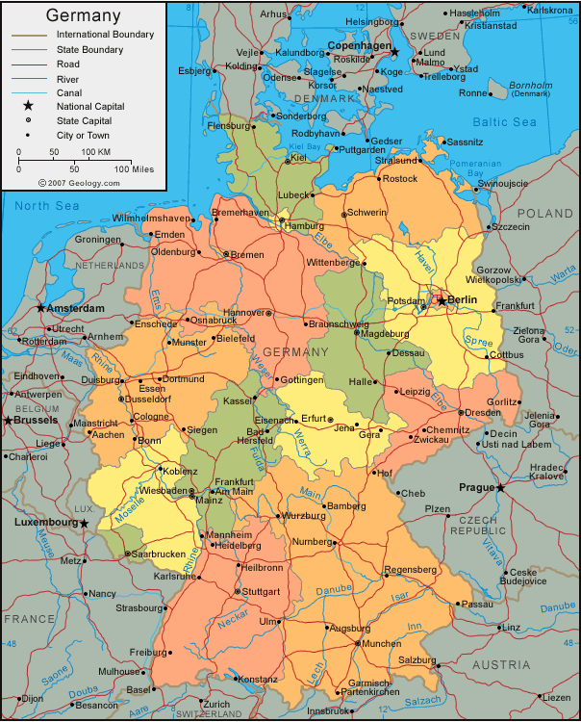
http://www.google.com/imgres?imgurl=http://geology.com/world/germany-map.gif&imgrefurl=http://geology.com/world/germany-satellite-image.shtml&h=750&w=604&sz=116&tbnid=13jTNMl2_b4xhM:&tbnh=141&tbnw=114&prev=/images%3Fq%3Dgermany%2Bmap&hl=en&usg=__0ufwgUo_73opYMIfvnjkEU1M2_E=&ei=mZuWS82VK42wtgfYoazrDQ&sa=X&oi=image_result&resnum=11&ct=image&ved=0CCoQ9QEwCg

Slide 45
Case 7-2 Nurnberg Augsburg Maschinenwerke (N.A.M.)
Production Plan:
First 25 buses manuf. at Prague facility
224 buses split by factories at Prague and Munich
Transportation Info (train, from Prague):
 | Bremerhaven | Hamburg | Rotterdam
Geographic dist. | ~550K | 490K | 640K
Transit time | 3 days | 3 days | 4~5 days
Cost (2 buses) |  | €1643/flatcar | €1943/flatcar
Unloading cost |  | €45/bus | €45/bus
Loading (first 20) |  | €25/bus | €25/bus
Loading (over 20) |  | €40/bus | €40/bus

Slide 46
Case 7-2 Nurnberg Augsburg Maschinenwerke (N.A.M.)
Transportation Info (waterway, from Prague):
 | Bremerhaven | Hamburg | Rotterdam
Transit time |  | 3 days more
Cost |  | €48/bus less
Transportation Info (ocean, to Santos, Brazil):
 | Bremerhaven | Hamburg | Rotterdam
Transit time | 18 days | 18 days
Cost (2 buses) | €6000/bus | €6000/bus
Departing dates |  | 10/24, 27, 31, 11/3 | 10/23, 28, 11/2
Unloading (at Santos) | €94/bus | €94/bus | €94/bus

Slide 47
Case 7-2 Nurnberg Augsburg Maschinenwerke (N.A.M.)
Discussions:
#1: Assume that you are Weiss. How many viable alternatives do you have to consider regarding the initial shipment of 25 buses?
#2: Which of the routing alternatives would you recommend to meet the initial 90-day deadline for the 25-bus shipment? Train or waterway? To which port(s)? What would it cost?
#3: What additional information would be helpful for answering question 2?
#4: How important, in fact, are the transport costs for the initial shipment of 25 buses?
#5: What kinds of “customer service” support must be provided for this initial shipment of 25 buses? Who is responsible?

Slide 48
Case 7-2 Nurnberg Augsburg Maschinenwerke (N.A.M.)
Discussions:
#7: Would you make the same routing recommendation for the second, larger (199 buses) component of the order, after the initial 90-day deadline is met? Why or why not?
#8: How important, if at all, is it for N.A.M. to ship via water to show its support of the “Green” movement’s desires?

