Slide 1
Chapter 14 Organizing and Analyzing Logistics Systems

Slide 2
Learning Objectives
To examine organizational structure for logistics
To learn about traditional and contemporary organizational design for logistics
To explore productivity issues in logistics
To learn about ways to manage theft and pilferage
To introduce you to the concept of logistics social responsibility
To discuss issues associated with reverse logistics
To expose you to programs designed to lessen the impact of terrorism on logistics systems

Slide 3
Organizational and Managerial Issues in Logistics Key Terms
“C-level” position
Centralized logistics organization
Container Security Initiative (CSI)
Customs Trade Partnership Against Terrorism (C-TPAT)
Decentralized logistics organization
Excess capacity
Flexibility
Fragmented logistics structure
Importer Security Filing (ISF) rule

Slide 4
Organizational and Managerial Issues in Logistics Key Terms
Logistics social responsibility
Pilferage
Productivity
Relevancy
Responsiveness
Reverse logistics
Tachograph
Theft
Transportation Worker Identification Credential (TWIC)
Unified logistics structure

Slide 5
Organizing Logistics within the Firm
Two key organizational logistics topics
Organizational structure
Organizational design

Slide 6
Organizational Structure for Logistics
Two basic organizational structures are:
Fragmented logistics structure
Logistics activities are managed in multiple departments throughout an organization
Unified logistics structure
Multiple logistics activities are combined into and managed as a single department

Slide 7
Organizational Structure for Logistics
Two basic organizational structures for logistics departments are:
Centralized logistics organization
Company maintains a single logistics department that administers the related activities for the entire company from the home office
Decentralized logistics organization
Logistics-related decisions are made separately at the divisional or product group level and often in different geographic regions

Slide 8
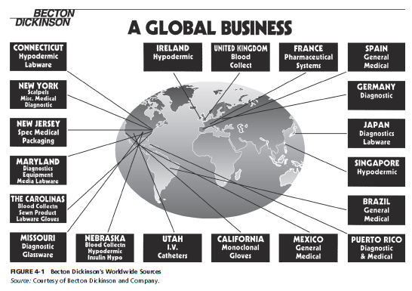
Figure 14-1: Becton Dickinson’s Worldwide Sources

Slide 9
Organizational Structure for Logistics
Job title or corporate rank
Leading edge organizations tend to head the logistics department by senior-level personnel
Generally excluded from holding a “C-level” position

Slide 10
Organizational Design for Logistics
Three primary types of organizational design include:
Hierarchical (functional)
Top-down flow
Matrix
Cross-functional responsibilities
Network
Process philosophy focused on combing tasks into value-creating products and activities

Slide 11
Organizational Design for Logistics
Network organizational design is exhibited in terms of:
Relevancy
Responsiveness
Flexibility

Slide 12
Managerial Issues in Logistics
Productivity
can be defined as the amount of output divided by the amount of input.
Provides insight into the efficiency with which corporate resources are being utilized.
Three ways to improve productivity
Reduce the amount of input while holding output constant
Increase the amount of output while holding input constant
Increase output while decreasing input

Slide 13
Worker Productivity
Warehousing and transportation are heavily dependent on human labor
Human labor is an input
Logistics-operating employees are unionized in some areas
Warehousing facilities have specific work rules
Warehouse employees can be monitored by direct supervision
Transportation employees (truck drivers) can be monitored through technology, i.e. tachograph

Slide 14
Asset Productivity
Asset-related productivity concerns include:
Space utilization
Excess capacity
Improving the output from existing assets

Slide 15
Theft and Pilferage
Thoughts regarding theft
Insurance companies may reimburse for loss, but time and costs tend not to be covered
Theft results in the planned flow of goods being interrupted which can lead to stockouts
Theft can factor into facility location decisions

Slide 16
Theft and Pilferage
Thoughts regarding pilferage
Transportation and warehousing operations are particularly vulnerable to pilferage
Managing pilferage begins with the hiring process
Zero tolerance pilferage policy
Keep goods moving through the system
Recent increase in pirate attacks

Slide 17
Lessening the Impact of Terrorism on Logistics Systems
Terrorism can be defined as “the unlawful use or threatened use of force or violence by a person or an organized group against people or property with the intention of intimidating or coercing societies or government, orfter for idological or polictical reasons.”
Source: Terrorism, The American Heritage® Dictionary of the English Language, 4th ed. (n.d.). Retrieved from Dictionary.com website: http://dictionary.reference.com/browse/terrorism.

Slide 18
Lessening the Impact of Terrorism on Logistics Systems
September 11 terrorist attacks have impacted logistics practices on a worldwide basis
Greater attention given to:
Processes
Procedures
Activities

Slide 19
Lessening the Impact of Terrorism on Logistics Systems
Creation of the Department of Homeland Security (DHS)
Federal agency
Goals are
To prevent terrorist attacks in the U.S.
To reduce the vulnerability of the U.S. to terrorism

Slide 20
Lessening the Impact of Terrorism on Logistics Systems
22 separate government entities were incorporated into DHS
Transportation Security Administration (TSA)
Transportation Worker Identification Credential (TWIC)
Customs and Border Protection (CBP)
Container Security Initiative (CSI)
Customs Trade Partnership Against Terrorism (C-TPAT)
Importer Security Filing (ISF) rule

Slide 21
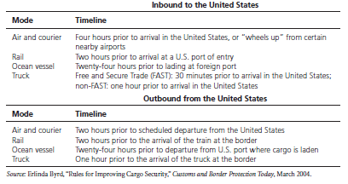
Timeline for Presenting Electronic Advance Manifest Information

Slide 22
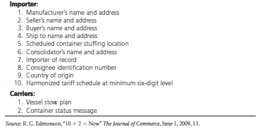
Information Required for 10+2 Rule

Slide 23
What Is Systems Analysis?
Systems analysis refers to the orderly and planned observation of one or more segments in the logistics network or supply chain to determine how well each segment functions

Slide 24
General Questions
Why do we perform each task?
What value is added by it?
Why are the tasks performed in the order they are?
Can we alter the sequence of the processing steps to increase efficiency?
Why are the tasks performed by a particular group or individual?
Could others perform this task?
Is there a better way for the system to operate?

Slide 25
Problems in Systems Analysis
Multiple business functions are impacted
There are trade-offs among conflicting objectives
Logistics system impacts are difficult to precisely evaluate
There are business issues unique to each logistics system
Quantitative analysis is essential for intelligent decisions

Slide 26
Figure 14-2: A Scoring Checklist Used to Determine Logistics Planning or Strategy Study

Slide 27
Partial Systems Analysis
Customer profitability analysis
Warehousing productivity analysis
Transportation cost analysis
Consolidation analysis
Direct product profitability analysis
Benchmarking
Industry standards analysis

Slide 28
Logistics System Design
Establishing objectives and constraints
Quality programs
World-class logistics programs
System constraints
Organization of the study team
Data collection

Slide 29
Logistics System Design (continued)
Product audit
Existing facilities audit
Vendor audit
Customer audit
Channels audit
Competition audit
Environmental sensitivity audit

Slide 30
Figure 14-4: Flexibility Makes It Easier to Work Together

Slide 31
Logistics System Design (continued)
Analysis of the data
Simulation
Design implementation

Slide 32
Case 14-2 Trigo Export Co., Ltd.
Company Facts:
Located in Montreal, Canada
Manufacturer’s export agent for the Ziola Tractor Co. of Winnipeg
Issues:
Bidding 40~100 units of garden tractors

Slide 33
Case 14-2 Trigo Export Co., Ltd.
Facts:
No import duties, permits, or licenses are required
Documentation cost would be CAN$250 per shipment
Ziola would sell to Trigo any quantity of tractors (up to 500) at CAN$700 each, FOB plant (Winnipeg). Packing materials at least 40% recycled contents. Packaged tractors are loaded into 20-ft intermodal containers.
Trigo select Halifax as the port.
Rail charges from Winnipeg to Halifax were CAN$400 per 20-ft container. Travel time was 5 days.
The exterior dimensions of packaged tractor: 1m x 1m x 1m. Weight was 200 kilos for tractor and 20 for package.

Slide 34
Case 14-2 Trigo Export Co., Ltd.
Facts:
The interior dimensions of the 20-ft containers: 2.35m x 6.12m x 2.50m high.
Ocean rates from Halifax to Belem are CAN$110 per ton. Measurement ton: if 1m³ weighs less than 1,000 kilograms, it will be considered as weighing 1,000 kilograms.
Insurance charge: 1% of the shipment’s value (in Canada) and 2% at sea.
Trigo would own the tractors for 25 days. Interest rate is 12%.
10% mark up for all costs to cover overhead and profit.

Slide 35
Case 14-2 Trigo Export Co., Ltd.
Questions:
Ziola’s export packaging materials consisted of at least 40% recycled contents. Should this be mentioned in the quotation given to the potential Brazilian buyer?
Each package in this shipment will be bar coded. Is this an example of supply-chain integration? Why or why not?
What price should be quoted for 40 tractors?
What price should be quoted for 100 tractors?
Is there another quantity between 40 and 100 where the costs per tractor are lower? If so, what is it? What are its costs per tractor?
For how long into the future should the price quotes be made (i.e., Trigo agree to deliver at a certain price)? Why?
In what currency should Trigo ask to be paid? Why?

Slide 36
Case 14-2 Trigo Export Co., Ltd.
Questions:
After preparing the bid, Ziola calls Trigo and says that they are thinking of redesigning the tractor frame so that it can be disassembled, taking up half the space. A Ziola Speedwagon could fit into an export package measuring 1 meter by 1 meter by 0.5 meter. The weight of the packaged tractor would continue to be 220 kilos. By how much, if at all, would this new package size reduce the answers for Questions 3 and 4?

