Slide 1
Chapter 13 Logistics Systems Controls

Slide 2
Systems Controls

Slide 3
Learning Objectives
To understand the use of accounting techniques for logistics system control
To examine the worker productivity issue
To discuss problems and solutions involved in a product recall
To learn how to reduce pilferage, organized theft, and vulnerability to terrorist activity

Slide 4
Logistics Systems Controls
Key Terms
Activity-based costing
Batch number
Container Security Initiative (CSI)
Control
Custom Trade Partnership Against Terrorism (C-TPAT)
Graphical Information Systems (GIS)
Pilferage
Key Terms
Product recall
Productivity
Short-interval scheduling
System Security
Theft (stealing)
Transponders
Transportation Worker Identification Credential (TWIC)

Slide 5
Connecting Strategy to Financial Performance
Logistics managers must find ways to:
communicate how logistics capabilities provide value
support corporate strategy and success in financial terms.
Logistics resides at the functional level of the organization.
Functional units must translate corporate and business unit strategies into discrete action plans.

Slide 6
Connecting Strategy to Financial Performance
Three generic strategies that can be pursued by an organization
Cost leadership strategy
Differentiation strategy
Focus strategy

Slide 7
Connecting Strategy to Financial Performance
Functional level strategies exist in:
Marketing
Finance
Manufacturing
Logistics

Slide 8
Connecting Strategy to Financial Performance
Logistic strategy decisions involve:
Determining the number and location of warehouses
Selecting appropriate transportation modes
Deploying inventory
Investments in technology that support logistics activities

Slide 9
Connecting Strategy to Financial Performance
Logistics strategy is directly influenced by strategic decisions in functional areas of:
Marketing
Product availability, desired customer service levels, and packaging design directly influence logistics decisions
Manufacturing
Strategic decisions by manufacturing to implement just-in-time system would influence logistics decisions in warehousing, transportation and inventory management

Slide 10
Connecting Strategy to Financial Performance
Logistics function can positively affect the financial outcome of an organization by designing a strategy to optimally support the requirement of the business.

Slide 11
Basic Financial Terminology
Income statement shows for a period of time:
Revenues
Expenses
Profit
Also referred to as a profit and loss (P&L) statement

Slide 12
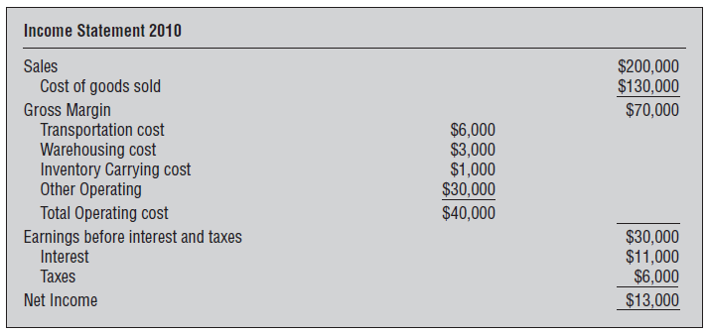
Example Income Statement

Slide 13
Basic Financial Terminology
Balance sheet reflects at any given point in time:
Assets
Liabilities
Owner’s equity

Slide 14
Example Balance Sheet

Slide 15
Strategic Profit Model
Issues with reporting financial figures without appropriate context
Many financial measures reported as ratios
Profitability analysis is useful in assessing logistics activities
Return On Investment (ROI) is a common measure of organizational financial success
Return On Net Worth (RONW) measures profitability of funds invested in the business
Return On Assets (ROA) provides insight on how well managers utilize operational assets to generate profits

Slide 16
Strategic Profit Model
Return On Investment (ROI)
common measure of organizational financial success
Return On Net Worth (RONW)
measures profitability of funds invested in the business
Return On Assets (ROA)
Indicates what percentage of every dollar invested in the business is ultimately returned to the organization as profit

Slide 17
Strategic Profit Model
Strategic Profit Model (SPM)
provides the framework for conducting ROA analysis
Incorporates revenues and expenses to generate net profit margin
Includes assets to measure asset turnover

Slide 18
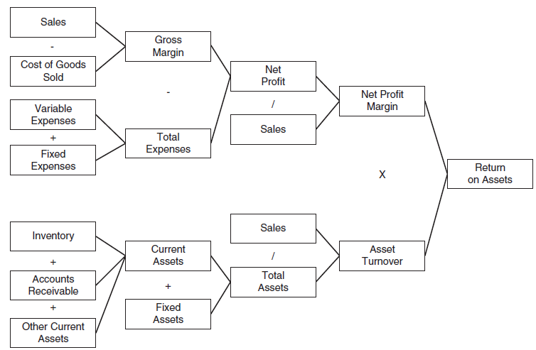
Strategic Profit Model

Slide 19
Strategic Profit Model
Strategic Profit Model (SPM)
Provides a way for managers to examine how a proposed change to their logistics system influences profit performance and ROA
Fails to:
Consider the timing of cash flows
Subject to manipulation in the short run
Fails to recognize assets dedicated to specific relationships

Slide 20
Logistics Connections to Net Profit Margin
Net Profit Margin = net profit/sales
Multiple ways in which net profit margin can be influenced by managerial decisions
Relevant categories include:
Sales
Cost of goods sold
Total expenses

Slide 21
Logistics Connections to Asset Turnover
Asset turnover= total sales/total assets
Inventory is the most relevant logistics asset
Logistics decisions can influence speed at which invoices are paid – accounts receivable

Slide 22
Balanced Scorecard
Balance scorecard (BSC) is a strategic planning and performance management system used in industry, government, and nonprofit organizations.

Slide 23
Balanced Scorecard
Management should evaluate their businesses from four perspectives
Customers
Internal business processes
Learning and growth
Financial
Forces managers to look beyond traditional financial measures (more holistic approach)

Slide 24
Common Logistics Measures
Transportation
Warehousing
Inventory
Design and implementation of measures

Slide 25
Worker Productivity
Warehousing labor
Goal to achieve lowest cost per volume of output
Schedule work in advance
Workers should work to a goal for the day
Short-interval scheduling
Worker productivity
Warehouse work rules

Slide 26
Worker Productivity
Transportation labor
Truck drivers don’t have immediate supervision
They are in contact with customers
Their trucks can be seen by thousands of motorists
May fall behind schedule due to external factors
May use a tachograph to record truck drivers’ driving performance
May use global positioning, photos, or videos

Slide 27
Product Recalls
Product recall occurs when a hazard or defect is discovered in an item that is already in distribution
Reversal in the outward flow of goods is needed
Once recall is in process, new goods must be shipped to take the place of defective ones
Recall channels may be different than distribution channels

Slide 28
Federal Agencies Involved with Recalls
Food and Drug Administration
Consumer Product Safety Commission
National Highway Traffic Safety Administration
The Food Safety and Inspection Service of the U.S. Department of Agriculture

Slide 29
Product Recalls
Publicity, Liability, and Fire Drills
Batch numbers

Slide 30
Controlling Returned and Salvaged Goods
Pilferage and Theft
Building security
Vehicle security
Computer security
Document security
Product identification number security
System security

Slide 31
Additional Controls
Energy-saving controls
Hazardous materials handling
Maintaining channel and supply chain integrity
Protection against terrorism

Slide 32
Case 13-1 Brant Freezer Company
Company Facts:
Located in Fargo, N. Dakota
Warehouses in Atlanta, Boston, Chicago, Denver, LA, Portland, and St. Louis
Products:
Industrial Freezer (1 size)

Slide 33
Case 13-1 Brant Freezer Company
 | 2003 |  |  |  | 2004
 | Units Shipped |  | Warehouse Costs |  | Units Shipped |  | Warehouse Costs
 | 12 Mo. | 5 Mo. | 12 Mo. | 5 Mo. | 12 Mo. | 5 Mo. | 12 Mo. | 5 Mo.
Atlanta | 17,431 | 4,080 | 156,830 | 35,890 | 18,000 | 4,035 | 178,000 | 40,228
Boston | 6,920 | 3,061 | 63,417 | 27,915 | 7,200 | 3,119 | 73,000 | 29,416
Chicago | 28,104 | 14,621 | 246,315 | 131,618 | 30,000 | 15,230 | 285,000 | 141,222
Denver | 3,021 | 1,005 | 28,019 | 8,600 | 3,100 | 1,421 | 31,000 | 14,900
Fargo | 2,016 | 980 | 16,411 | 8,883 | 2,000 | 804 | 17,000 | 9,605
LA | 16,491 | 11,431 | 151,975 | 109,690 | 17,000 | 9,444 | 176,000 | 93,280
Portland | 8,333 | 4,028 | 73,015 | 36,021 | 9,000 | 4,600 | 85,000 | 42,616
St. Louis | 5,921 | 2,331 | 51,819 | 23,232 | 8,000 | 2,116 | 56,000 | 19,191

Slide 34
Case 13-1 Brant Freezer Company
Questions:
When comparing performance during the first five months of 2004 with performance in 2003, which warehouse shows the most improvement?
When comparing performance during the first five months of 2004 with performance in 2003, which warehouse shows the poorest change in performance?
When comparisons are made among all eight warehouses, which one do you think does the best job for the Brant Company? What criteria did you use? Why?
J.Q. is aggressive and is going to recommend that his father cancel the contract with one of the warehouses and give that business to a competing warehouse in the same city. J.Q. feels that when word of this gets around, the other warehouses they use will “shape up.” Which of the seven should J.Q. recommend be dropped? Why?

Slide 35
Case 13-1 Brant Freezer Company
Questions:
The year 2004 is nearly half over. J.Q. is told to determine how much the firm is likely to spend for warehousing at each of the eight warehouses for the last six months of 2004. Do his work for him.
When comparing 2003 figures with the 2004 figures shown in Exhibit 13-A, the amount budgeted for each warehouse in 2004 was greater than actual 2003 costs. How much of the increase is caused by increased volume of business (units shipped) and how much by inflation?
Prepare the firm’s 2005 warehousing budget, showing for each warehouse the anticipated number of units to be shipped and the costs.
While attending classes at the university, J.Q. had learned of logistics partnerships. Should Brant Freezer Company attempt to enter into a partnership relationship with these warehouses? If so, what approach should it use?

Slide 36
Case 13-2 Red Spot Markets Company
Company Facts:
Operates a chain of grocery stores in New England
Distribution Centers in Providence, Rhode Island and Newburgh, NY
Problems:
 | Newburgh | Providence
Throughput | 4% higher
Shrinkage | 3.60% | 5.90%

Slide 37
Case 13-2 Red Spot Markets Company
Questions:
How should Fosdick respond to the immediate situation?
What controls, of the types discussed in this chapter, might have been used by Red Spot Markets to reduce or eliminate the problems discussed in the case?
What longer-range steps should Fosdick take to control the operations of the Providence distribution center?
What longer-range steps should Fosdick take to improve the Providence distribution center’s productivity?
What longer-range steps can Fosdick take to reduce the distribution center’s high rate of shrinkage?

Slide 38
Case 13-2 Red Spot Markets Company
Questions:
Assume that Fosdick decides that the practice of free lunches from the open cases of goods must be stopped. Develop and present arguments he should give in a meeting with a union shop steward.
(This is a continuation of question 6.) Assume, instead, that you are the union shop steward. Develop and present your argument that the free lunches represent a long-standing employee benefit enjoyed by the distribution center’s employees, and that management’s attempt to stop them is a breach of an unwritten contract and will be resisted.
Much of the situation described in the case seems to revolve around the personality of T.D. Bigelow. How should he be treated? Why?

