Slide 1
Chapter 12 International Logistics

Slide 2
Learning Objectives
To identify the reasons for governmental intervention in the area of international trade
To distinguish among the unique activities of international trade specialists
To examine issues involved in international air transportation
To relate activities involved in international ocean transportation

Slide 3
International Logistics
Key Terms
Cargo preference
Certificate of origin
Commercial invoice
Customshouse brokers
Embargos
Export management company
Export packers
Key Terms
Import quotas
Incoterms 2000
International Air Transport Association (IATA)
International freight forwarders
International Logistics

Slide 4
International Logistics
Key Terms
Letter of credit
Load center
Nontariff barrier
Nonvessel-operating common carrier (NVOCC)
Ocean carrier alliances
Key Terms
Shipper’s export declaration (SED)
Shipper’s letter of instruction (SLI)
Shipping conferences
Short sea shipping
Tariffs
Terms of payment
Terms of sale

Slide 5
International Logistics
International logistics are logistics activities associated with goods that are sold across national boundaries.

Slide 6
Macroenvironmental Influences on International Logistics
Macroenvironmental influences refer to the uncontrollable forces and conditions facing an organization and include cultural, demographic, economic, natural, political, and technological factors.
Source: http://www.marketingpower.com/_layouts/Dictionary.aspx?dLetter=M.

Slide 7
Macroenvironmental Influences on International Logistics
Political factors
Political restrictions on international trade can take a variety of forms
Tariffs
Nontariff barriers
Import quota
Embargoes
Degree of federal government in cross-border trade
Balance of payments
Subsidies
Cargo preference rules

Slide 8
Macroenvironmental Influences on International Logistics
Economic factors
Currency fluctuations
Market size
Income
Infrastructure
Economic integration

Slide 9
Macroenvironmental Influences on International Logistics
Cultural factors
Religion
Values
Rituals
Beliefs
Languages

Slide 10
Figure 12-1: Some of the Symbols Used for Packing Export Shipments

Slide 11
Figure 12-2: A Package Marked for Export

Slide 12
Table 12-1: Beginning Dates for the Chinese New Year, 2011-2018

Slide 13
International Documentation
Flow of documentation is as much a part of the main logistical flow as the flow of product
Domestic shipments typically only require several pieces of documentation
Export shipments typically require approximately 10 pieces of documentation
Cross-border trades can require more than 100 separate documents

Slide 14
International Documentation
Necessary documents are required at the point of importation
Commonly used documents include:
Certificate of origin
Commercial invoice
Shipper’s export declaration (SED)
Shipper’s letter of instruction (SLI)

Slide 15
Terms of Sale
Terms of sale involves:
Parties working within the negotiations channel
Looking at the possible logistics channels
Determining when and where to transfer the following between buyer and seller:
Physical goods
Payment for the goods, freight charges, and insurance for the in-transit goods
Legal title to the goods
Required documentation
Responsibility for controlling or caring for the goods in transit, i.e. livestock

Slide 16
Terms of Sale
Terms of sale for international shipments are commonly referred to as Incoterms.
Use is not mandatory, but generally accepted by legal authorities, buyers, and sellers worldwide
Begin with the letters C,D, E, or F

Slide 17
Terms of Sale Incoterms 2000
EX-Works (EXW)
FCA (Free Carrier)
FAS (Free Alongside Ship)
FOB (Free on Board)
CFR (Cost and Freight)
CPT (Carriage Paid To)
CIF (Cost, Insurance, and Freight)
CIP (Carriage and Insurance Paid To)
DES (Delivered Ex Ship)
DEQ (Delivered Ex Quay)
DAF (Delivered at Frontier)
DDP (Delivered Duty Paid)
DDU (Delivered Duty Unpaid)

Slide 18
Methods of Payment
Methods of payment refer to the manner by which a seller will be paid by a buyer.
Much more challenging in international logistics vs. domestic logistics
Four methods of payment include:
Cash in advance
Letters of credit
Bills of exchange
Open account

Slide 19
Figure 12-4: Letter of Credit

Slide 20
Methods of Payment
Payment method
Should be established at the time that a shipment price is decided upon
Can be influenced by key factors such as
the country the product is to be sold in
the seller’s assessment of buyer risk

Slide 21
International Trade Specialists
International Freight Forwarders specialize in handling either vessel shipments or air shipments.
© Pearson Education, Inc. publishing as Prentice Hall

Slide 22
International Trade Specialists
Principle functions of International Freight Forwarders include:
Advising on acceptance of letters of credit
Booking space on carriers
Preparing an export declaration
Preparing an air waybill or bill of lading
Obtaining consular documents
Arranging for Insurance
Preparing and sending shipping notices and documents
Serving as general consultant on export matters

Slide 23
International Trade and Supply Chain Specialists
Nonvessel-operating common carrier (NVOCC)
Export management company (EMC)
Export packers

Slide 24
Figure 12-5: A Forwarder’s Export Quotation Sheet Showing Factors to Include When Determining the Price to Quote a Potential Buyer of a Product

Slide 25
Transportation Considerations in International Logistics
Ocean shipping
International airfreight
Surface transportation

Slide 26
Ocean Shipping
Approximately 60% of cross-border shipments move by water transportation
Variety of ship types include:
Dry-bulk
Dry cargo
Liquid bulk
Parcel tanker
Containerships
Shipping conferences and alliances pool resources and extend market coverage

Slide 27
World’s Busiest Container Ports (2008)

Slide 28
International Airfreight
Three types of international airfreight operations include:
Charted aircraft
Integrated air carriers
Scheduled air carriers

Slide 29
Surface Transport Considerations
Transit times can be significantly impacted by a country’s infrastructure and modal operating characteristics.
Short sea shipping is an alternative to surface transporting

Slide 30
International Trade Inventories
Safety stocks must be large due to greater uncertainties, misunderstandings and or delays.
Inventory valuation is difficult due to continually changing exchange rates.
Product return (reverse logistics) policies must be understood.
Insufficient warehousing practices can lead to higher inventory carrying costs.

Slide 31
Logistics Performance Index (LPI)
Relatively new international logistics concept (2007)
Updated in 2010
Created in recognition of the importance of logistics in global trade
Incorporates data for approximately 155 countries

Slide 32
Logistics Performance Index (LPI)
Measures a country’s performance across six logistical dimensions
Efficiency of the clearance process by border control agencies, including customs
Quality of trade- and transport-related infrastructure
Ease of arranging competitively priced shipments
Competence and quality of logistics services
Ability to track and trace consignments
Timeliness of shipments in reaching the destination within the scheduled or expected delivery time

Slide 33
Highest- and Lowest-Rated Countries Based on Overall LPI Score

Slide 34
Case 12-1 HDT Truck Company
Company Facts:
Located in Crown Point, Indiana (1910)
Products:
Large off-road vehicles (airport snowplows, airport crash trucks, oil-field drilling equipment, etc.)
Plant Capacity:
2 trucks assembled / day (single shift)
Max. 3 for large order of identical trucks
At least 4-mo backlog

Slide 35
Case 12-1 HDT Truck Company
Current Issues:
Received an order of 50 heavy trucks from Saudi Arabia
Deliver on or before July 1, 2003
Priced at $172,000/truck FAS at Doha
Production is scheduled from April 2 ~ April 29 (2.5/day)
People Involved:
Norman Pon (Treasurer)
Chris Reynolds (Production)
Vic Guillou (Sales)
Gordon Robertson (President)
Bob Vanderpool (Traffic)
Bob Guider (Int’l Freight Forwarded, Chicago)
Eddie Quan (Ship Broker, NY)

Slide 36
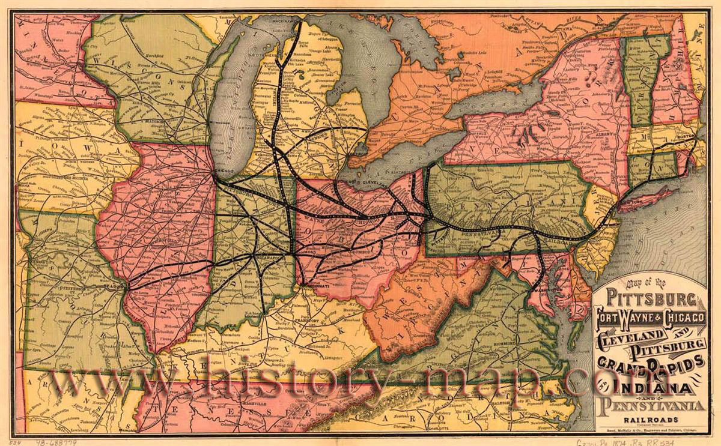
Case 12-1 HDT Truck Company

Slide 37
Case 12-1 HDT Truck Company
Account Payables:
Components will arrive from April 1 to April 10
Term for payment: 1/10 (1% discount if paid in 10 days)
Line of credits: 8%

Slide 38
Case 12-1 HDT Truck Company
Alternatives for Shipping:
Charter from Chicago:
Nola Pino, Ready on May 1, $2,400/day for 30 days
Loading & Unloading: $40/truck
To Chicago (Railroad Flatcar): $180/truck
Travel Time: 1 day + 1 day waiting (L)
Wharfage Charge: $2/ft x 535 ft x 1 day
Loading & Stowing: $4,000 for 50 trucks
Seaway Tolls: $54/truck
Unloading (at Doha): $4,200 for 50 trucks
Marine insurance: $210 / truck
Ship from Baltimore:
To Baltimore (Railroad Flatcar): 2 trucks/flatcar, $1,792/flatcar
Loading & Unloading: $120/flatcar
Travel Time: 4 days + 3 days waiting (L&UL)
Handling at Baltimore: $200/truck
Ocean freight: $1,440/truck + $150/truck for insurance

Slide 39
Case 12-1 HDT Truck Company
Questions:
Assume you are Vanderpool. Draft the comparison Pon just requested.
Which of the two routing alternatives would you recommend? Why?
Assume that the buyer in Saudi Arabia has made other large purchases in the United States and is considering consolidating all of its purchases and loading them onto one large ship, which the buyer will charter. The buyer contacts HDT and, although acknowledging its commitment to buy FAS Doha, asks how much HDT would subtract from the $172,000 per truck price if the selling terms were changed to FOB HDT’s Crown Point plant. How much of a cost reduction do you think HDT should offer the buyer? Under what terms and conditions?

Slide 40
Case 12-1 HDT Truck Company
Questions:
Answer question 3 with regard to changing the terms of sale to delivery at port in Baltimore. The buyer would unload the trucks from the railcars.
Is there an interest rate that would make HDT change from one routing to another? If so, what is it?
Assume that it is the year 2005 and the cost to HDT of borrowing money is 12% per year. Because the buyer will pay for trucks as they are delivered, would it be advantageous for HDT to pay overtime to speed up production, ship the trucks as they were finished via the Port of Baltimore, and collect their payment earlier? Why or why not?

Slide 41
Case 12-2 Belle Tzell Cell Company
Company Facts:
Located in Tucson, Arizona (1945)
Joined Venture: Lead panels at Nogales, Mexico
Products:
Standard-size battery (for portable power tools, and military weapons)
Process:
Lead panels made in Mexico, then shipped to Arizona
Combined with printed circuits (Taiwan) and assembled in plastic cases (local)
Daily production filled two 35-ft trailers, delivered at night

Slide 42
Case 12-2 Belle Tzell Cell Company
Issues:
Narrow building, no room for expansion
Environmental concerns
Goal:
99% or better on-time order filling

Slide 43
Case 12-2 Belle Tzell Cell Company
Original Alternatives:
5 days’ worth of plates between and Tucson
Warehoused in Nogales
Could delay import duties ~$800/trailer
Subject to delays
Warehoused in Tucson
Leasing 5 truck-trailers and parking at either Nogales plant or the parking lot in Tucson
Cost Information:
Warehoused in Nogales: $300/wk + $120/wk for local drayage
Warehoused in Tucson: $350/wk + bond + $150/wk for drayage
Leasing 5 truck-trailers:
Trailers: $7,000/trailer/yr (Leasing)
Truck-tractor: $15,000 (Purchase) with useful life of 5 yrs

Slide 44
Case 12-2 Belle Tzell Cell Company
Modified Alternatives:
5 days’ worth of plates in Nogales; no extra batteries in Tucson
4 days’ worth of plates in Nogales; 1 day’s worth of batteries in Tucson
2 days’ worth of plates in Nogales; 2 days’ worth of batteries in Tucson
No extra plates in Nogales; 3 days’ worth of batteries in Tucson
Cost Information:
Fence in Tucson parking lot: $3,000
Carrying cost: 25% /yr on both WIP and finished goods

Slide 45
Case 12-2 Belle Tzell Cell Company
Questions:
What are the total inventory carrying costs of alternative 1?
What are the total inventory carrying costs of alternative 2?
What are the total inventory carrying costs of alternative 3?
What are the total inventory carrying costs of alternative 4?
Which alternative do you think Kupferman should recommend? Why?
Tzell “wanted enough inventory in reserve that the Tzell Cell Company could fill 99% of all orders on time.” This is, as you may recall, a customer service standard. How reasonable is a 99% level? Why not, say, a 95% level? How would Nell and Kupferman determine the relative advantages and disadvantages of the 95% and the 99% service levels? What kind of cost calculations would they have to make?

Slide 46
Case 12-2 Belle Tzell Cell Company
Questions:
Jedson Electronic Tools invoked a penalty clause on a purchase order that Tzell Cell Company had accepted and the Tzell Cell Company had to forfeit $3,000. Draft, for Nell Tzell’s signature, a memo indicating when and under what conditions the Belle Tzell Cell Company should accept penalty clauses in purchase orders covering missed delivery times or “windows.”
In your opinion, is it ethical for a U.S.–based firm to relocate some of its operations in Mexico so as to avoid the stricter U.S. pollution and worker-safety laws? Why or why not?
Should the firm be willing to pay bribes at the Mexican border to get their shipments cleared more promptly? Why or why not?

