Slide 1
Chapter 11 Procurement

Slide 2
Learning Objectives
To understand the relationship between supply management and logistics
To understand steps in selecting a supplier
To recognize the potential of e-procurement
To learn about quality programs

Slide 3
Procurement
Key Terms
Bribes
E-procurement
Excess (surplus) materials
Global procurement (sourcing)
Investment recovery
ISO 9000
Kickbacks
Key Terms
Malcolm Baldridge National Quality Award
Maverick spending
Obsolete materials
Procurement
Procurement card
Purchasing
Quality

Slide 4
Procurement
Key Terms
Reverse auctions
Scrap materials
Sic sigma
Socially responsible procurement
Supplier development (reverse marketing)
Supply management
Key Terms
Waste materials

Slide 5
Procurement
Refers to the raw materials, component parts, and supplies bought from outside organizations to support a company’s operations
Procurement costs often range between 60%-80% of an organization’s revenues

Slide 6
Procurement Objectives
Supporting organizational goals and objectives
Managing the purchasing process effectively and efficiently
Managing the supply base
Developing strong relationships with other functional groups
Supporting operational requirements

Slide 7
Supply Management
Supply management is “ the identification, acquisition, access, positioning, and management of resources the organization needs or potentially needs in the attainment of its strategic objectives.” Institute of Supply Management
Similar in meaning to procurement, purchasing

Slide 8
Purchase for Use in Manufacturing
Make or buy
Availability of trained labor
Physical capacity
Purchase orders are a commitment to buy
Indicate quantities and qualities desired
Indicate dates by which the materials must be delivered

Slide 9
Purchase for Use in Manufacturing
MRP Systems manage production inventory
Just-in-Time (JIT) and Kanban were initially developed to improve quality
JIT II ties together information systems and employees of suppliers and firms
Supplier Product Integration refers to the acquisition of components, rather than individual parts

Slide 10
Purchasing for Resale
Objective is to buy merchandise that can be marked up and resold to others at a profit
Quality of product and timing of arrival are important

Slide 11
Procuring Services
Request for Proposal (RFP)
Request for Quotation (RFQ)
Examples of procured services
Legal, accounting, computer and software consultants
Building maintenance
Printing
Landscape work
Janitorial services

Slide 12
Supplier Selection and Evaluation
One of procurement’s most important responsibilities
Involves stating an organization’s needs and determining how well various potential suppliers can fulfill these needs

Slide 13
Supplier Selection
Selecting vendors depends on:
Delivery
Facilities and capacity, geographic location
Performance history
Price and quality
Technical capability
Warranties and claim policies

Slide 14
Supplier Selection Framework (Figure 11-1)
Identify Need for Supply
Situation Analysis
Internal factors (e.g. supply policies)
External factors (e.g. legal issues)
Identify and Evaluate Potential Suppliers
Sources of potential information
Establish selection criteria
Assign weights to selection criteria
Select Suppliers
Consideration of company policies (e.g. minority suppliers)
Evaluate Decision
Compare actual and expected performance

Slide 15
Supplier Development (Reverse Marketing)
Refers to “a degree of aggressive procurement involvement not normally encountered in supplier selection”
Can include:
Purchaser initiating contact with supplier
Purchaser establishing prices, terms and conditions

Slide 16
Supplier Development (Reverse Marketing)
Motivation to adopt supplier development include:
Numerous inefficiencies associated with suppliers initiating marketing efforts toward purchasers
Purchaser may be aware of important benefits which are unknown to the supplier
Compel suppliers to meet necessary requirements to achieve competitive advantage in the supply chain

Slide 17
Quality Issues in Procurement
Quality – conformance to mutually agreed-upon requirements
Important to match quality levels of buyers and sellers in the supply chain
Vendors are expected to have quality programs/practices
ISO 9000
Six Sigma
Lean Six Sigma

Slide 18
Quality Issues in Procurement
Malcolm Baldrige National Quality Award
Quality related initiative to recognize U.S. organizations for achievement in quality and performance
Eligibility now includes manufacturers, services, small businesses, health care and educational institutions
Restricted to U.S. headquartered organizations
Interested parties submit a formal application that is evaluated by a committee

Slide 19
Global Procurement (Sourcing)
Refers to buying components and inputs anywhere in the world
Driven by:
Factor-input strategy (organization is seeking low-cost or high-quality)
Market access strategy (organization is sourcing in markets where it plans to do significant business)

Slide 20
Global Procurement (Sourcing)
Components of Global Sourcing Development model:
Planning
Specification
Evaluation
Relationship management
Transportation and holding costs
Implementation
Monitoring and improving

Slide 21
Global Procurement (Sourcing)
Challenges in establishing a successful global sourcing strategy include understanding hidden costs as supply bases are expanded
Examples of hidden costs:
Increased costs of dealing with suppliers outside the domestic market
Duty and tariff changes that occur over supply agreement life
Increased inventory-related costs associated with global supply chains
Rising levels of logistics cost volatility (e.g. ocean freight rates)

Slide 22
E-Procurement
E-procurement is the business-to-business purchase of supplies and services via the Internet
Procurement cards

Slide 23
Investment Recovery
Identifies opportunities to recover revenues or reduce costs associated with:
Scrap
Surplus
Obsolete
Waste materials
Often the responsibility of the procurement manager

Slide 24
Socially Responsible Procurement
Socially responsible procurement refers to “procurement activities that meet the ethical and discretionary responsibilities expected by society.”
Source: Craig R. Carter and Marianne M. Jennings, Journal of Business Logistics

Slide 25
Socially Responsible Procurement
Five dimensions include:
Diversity
The environment
Human rights
Philanthropy
Safety

Slide 26
Socially Responsible Procurement
Ethical considerations
“win at all costs” philosophy can exacerbate unethical behavior
Areas of ethical concern in procurement:
Gift giving and receiving
Bribes and kickbacks
Misuse of information
Improper methods of knowledge acquisition
Lying or misrepresentation of the truth
Product quality (lack of)
Misuse of company assets
Conflicts of interest

Slide 27
Purchasing Ethics
Breaches of purchasing ethics include:
Accepting lavish gifts
Bribes
Kickbacks
Areas of ethical concern:
Handling confidential information
Purchasing for one’s private use
Interfering with a legitimate bidding process
Conflicts of interest

Slide 28
Case 11-1 Easing Ira’s Ire
PERT:
Project Evaluation & Review Technique
Network consists of branches (arrows) & nodes
Activity on arrows (AOA)
Activity on nodes (AON)
A path is a sequence of connected activities running from start to end node in network
The critical path is the path with the longest duration in the network
Project cannot be completed in less than the time of the critical path

Slide 29
Case 11-1 Easing Ira’s Ire
Discussion:
#1: Arrange the tasks shown in Exhibit 11-A in a network or PERT chart.
#2: Determine the critical path. What is the least amount of time it takes between receipt of an order and its delivery to a customer?
#3: Considering your answers to Questions 1 and 2, what areas of activity do you think Wood should look at first, assuming she wants to reduce order processing and delivery times? Why?
#4: Now that she is a Californian ready for the race down the information superhighway, Wood wants to be able to impress Pollack in terms of her knowledge of current technology. Recently a sales representative from a warehouse equipment company called, trying to interest her in installing a “Star Wars-Robotic” order picker for the warehouse. Controlled by lasers and powered by magnetic levitation, the device can pick orders (task H) in 15 minutes, rather than 6 hours (.75 days), the current time. How valuable would such a device be for Wood? Why?

Slide 30
Case 11-1 Easing Ira’s Ire
Discussion:
#5: Another alternative is to use faster transportation. How should Wood choose between paying more for faster transportation and paying more for other improvements? Assume that her only goal is speed.
#6: To offset some of the costs of speeding up the system, does the PERT chart indicate where there might be some potential savings from assigning fewer people to some tasks, thereby increasing the amount of time needed to complete these tasks? If so, which tasks are likely candidates? Why?

Slide 31
Case 11-2 Tempo Ltd.
Company Facts:
Located in Antalya, Terim, Turkey
Deal Considering:
Sell chemicals in exchange of lumber from N. Korea
2 options of shipping lumber
Wonsan (N. Korea) – Constantza (Romania) – Turkey
Wonsan (N. Korea) – Latakia (Syria) – Turkey

Slide 32
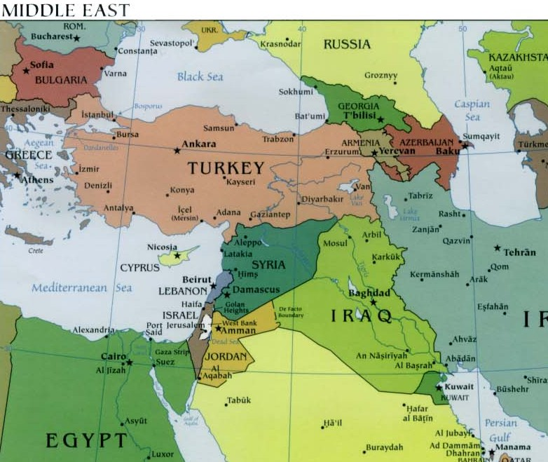
Case 11-2 Tempo Ltd.

Slide 33
Case 11-2 Tempo Ltd.
Discussion:
#1: Should Terim let somebody else complete the transaction because he knows that if he does not sell to the North Koreans somebody else will?
#2: What are the total costs given in the case for the option of moving via Romania?
#3: What are the total costs given in the case for the option of moving via Syria?
#4: Which option should Terim recommend? Why?
#5: What other costs and risks are involved in these proposed transactions, including some not mentioned in the case?
#6: Regarding the supply chain, how—if, at all—should bribes be included? What functions do they serve?
#7: If Terim puts together this transaction, is he acting ethically? Discuss.

Slide 34
Case 11-2 Tempo Ltd.
Discussion:
#8: What do you suggest should be done to bring moral values into the situation so that the developing countries are somewhat in accordance with Western standards? Keep in mind that the risks involved in such environments are much higher than the risks of conducting business in Western markets. Also, note that some cultures see bribery as a way to better distribute wealth among their citizens.

