Slide 1
Chapter 10
Warehousing Management

Slide 2
Learning Objectives
To understand the role of warehouses and distribution centers in a logistics system
To identify the various types and functions of warehouses
To distinguish the various alternatives available in warehouse design
To examine the different types of handling equipment available
To analyze the issue of employee safety in warehousing

Slide 3
Warehousing Management
Key Terms
  Accumulating (bulk-making)
  Allocating (bulk-breaking)
  Assorting
  Bonded storage
  Contract (3rd party) warehousing
  Cross-docking
Key Terms
  Distribution centers
  Dunnage
  Field warehousing
  Fixed slot location
  Multi-client warehousing
  Occupational Safety & Health Administration (OSHA)

Slide 4
Warehousing Management
Key Terms
  Paperless warehousing
  Private warehousing
  Public warehousing
  Regrouping function
  Sorting out
  Throughput
  Variable slot location
  Warehouse
Key Terms
  Warehouse management system (WMS)
  Warehousing

Slide 5
Warehousing Management
Warehousing refers to “that part of the firm’s logistics system that stores products (raw materials, part, good-in-process, finished goods) at an between points of origin and point of consumption.”
Source: Douglas M. Lambert, James R. Stock, and Lisa M. Ellram, Fundamentals of Logistics Management (New York: Irwin McGraw-Hill, 1998), Chapter 8.
Warehousing management has evolved to include value-adding services
  Custom labeling
  Promotional pack
  Grouping and sorting of products
  Kitting for production
  Display building and packaging
  Price marking

Slide 6
Warehousing Management
Warehousing and transportation are substitutes for each other, with warehousing having been referred to as “transportation at zero miles per hour.”

Slide 7
Warehousing Management
Warehousing serves to match different rates or volumes of flow when patterns of production and consumption do not coincide
Distribution centers emphasize rapid movement of products through the facility
Throughput is the amount of product entering and leaving a facility in a given time period
Regrouping function
  Accumulating (increasing quantity)
  Allocating (reducing quantity)
  Assorting (building up a variety of products)
  Sorting (separating products into grades and qualities)

Slide 8
Adding a Warehousing Facility: Shorter-Haul Transportation (Fig. 10-1)
Retailer A
Producer
Retailer B
Retailer C
Retailer A
Producer
Warehouse
Retailer B
Volume
Shipment
Retailer C

Slide 9
Public Warehousing
Public warehouses
  Serve all legitimate users
  Require no capital investment on the user’s part
  Allows users to rent space as needed
  Can be rented on a month-to-month basis
  Offers more locational flexibility
  May provide specialized services
Potential drawback of public warehouses
  Lack of control by the user
Warehousing labor safety practices monitored by Occupational Safety and Health Administration (OSHA)

Slide 10
Private Warehousing
Private warehousing
  is owned or occupied on a long-term lease
  Offers control to owner
  Assumes both sufficient demand volume and stability so that warehouse remains full
Potential drawbacks of private warehouses:
  High fixed cost
  Necessity of having high and steady demand volumes
  May reduce an organization’s flexibility

Slide 11
Contract Warehousing
Contract warehousing (3PL warehousing) is a long-term arrangement providing unique warehousing services to one client
Both vendor and client share the risks associated with the warehousing
Less costly than private warehousing and more costly than public warehousing

Slide 12
Multiclient Warehousing
Multiclient warehousing
  Mixes attributes of contract and public warehouses
  Services are more differentiated than those in a public facility
  Services are less customized than those in a private facility
  Services are purchased through minimum 1 year contracts
  Are attractive to smaller organizations

Slide 13
Design Considerations in Warehousing
General considerations
  Quantity and character of goods must be known—product profiling
  Know the purpose to be served
    Storage
    Distribution
    Cross-docking

Slide 14
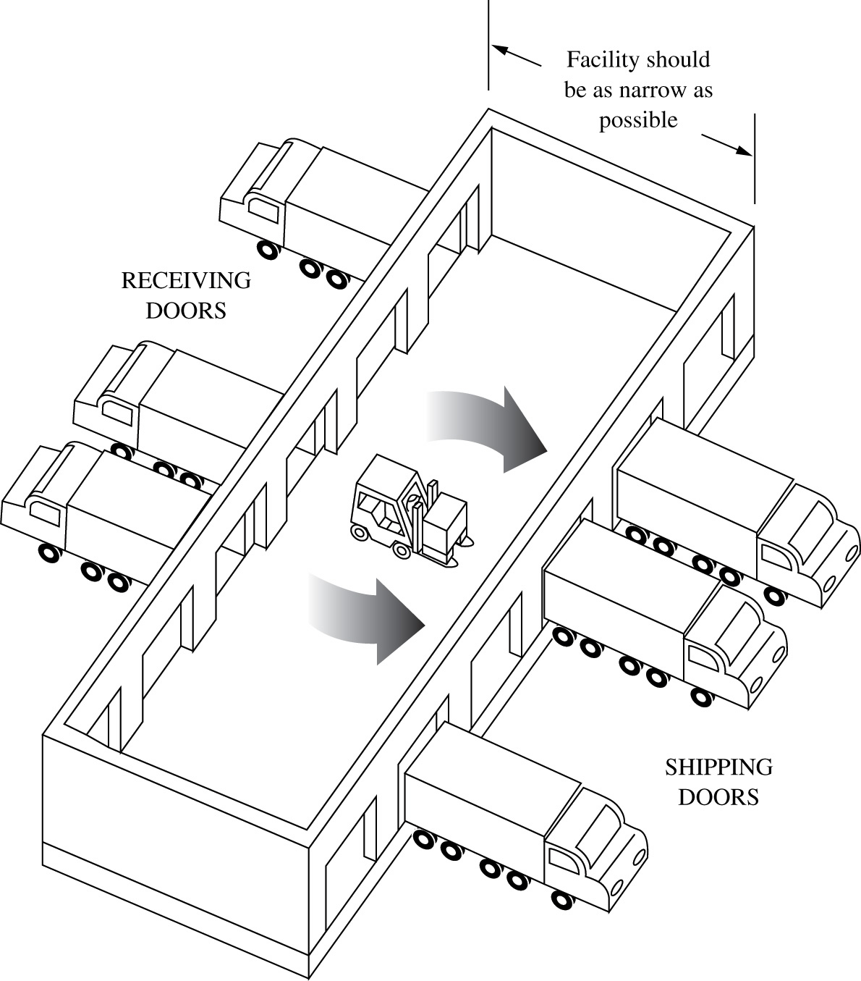
Ideal Facility for Pure Supplier Consolidation (Figure 10-5)

Slide 15
Warehousing Trade-offs
Fixed versus variable slot locations for merchandise
Build out (horizontal) versus build up (vertical)
Order-picking versus stock-replenishing functions
Two-dock versus single-dock layout

Slide 16
Warehousing Trade-offs
Labor-intensive versus mechanization versus automation
Space devoted to aisles versus space devoted to storage
Picker-to-part versus part-to-picker systems

Slide 17
Warehousing Trade-offs
Paperless warehousing versus traditional paper-oriented warehousing operations
Virtual warehouse versus real warehouse
Other space needs
Retail storerooms

Slide 18
Warehousing Operations
Storage and handling equipment
Warehouse management systems
Employee safety
  OSHA oversees
  Proper handling of waste materials
    Dunnage
  Proper handling of breakage

Slide 19
Warehousing Operations
Warehousing security
Hazardous materials
Sanitation issues
Stock controls

Slide 20
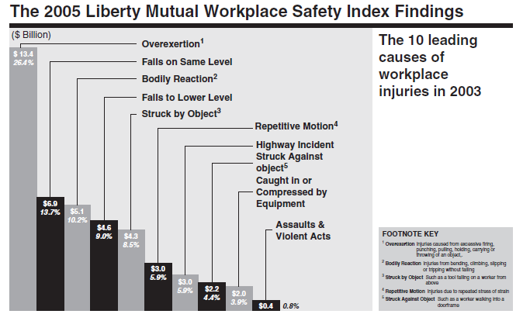
Workplace Safety Issues

Slide 21
Case 10-1 Sandy’s Candy
Company Facts:
Mannix Model Markets - Omaha, Nebraska
Company Information:
55 stores, served by daily deliveries (5 days/week)
Member of a buying cooperative
Some items are delivered directly by vendors
Decisions:
Schoenecker’s candies

Slide 22
Case 10-1 Sandy’s Candy
Company Facts:
Mannix Model Markets - Omaha, Nebraska
Company Information:
55 stores, served by daily deliveries (5 days/week)
Member of a buying cooperative
Some items are delivered directly by vendors
Decisions:
Schoenecker’s candies

Slide 23
Case 10-1 Sandy’s Candy
Discussion:
#1: Using those items of comparison for which costs can be calculated, determine the cost difference between the two delivery systems.
#2: List and compare those factors for which it is difficult to assign precise costs.
#3: Given the data that Sandy has, do you believe that Mannix Model Markets should get its Schoenecker candy through the buying cooperative or continue to rely on direct deliveries by Schoenecker’s drivers-salespeople? Give your reasons.
#4: If you were Sandy, what additional information would you like to have before being asked to make such a recommendation?

Slide 24
Case 10-1 Sandy’s Candy
Discussion:
#5: Candy sales increase during holiday seasons. Which of the two candy distribution systems do you think would do a better job of anticipating and supplying these seasonal increases? Why?
#6: Assume you are in charge of labor relations for Mannix Model Markets. Would you like to see continued reliance on drivers-salespeople to supply the markets’ candy needs? Why or why not?

Slide 25
Case 10-2 Minnetonka Warehouse
Company Facts:
Located in Minnetonka, Minnesota
Company Information:
Single unloading dock
Warehouse workers: $14/hr, must be paid for an entire shift, cannot be assigned other tasks
Trucks arrive randomly at 4/hr
Penalty for idle truck: $60/hr
Alternatives:
Team of 2, 3, 4, or 5 warehouse workers
Unloading rate will be 5, 8, 10, and 11 trucks per hour

Slide 26
Case 10-2 Minnetonka Warehouse
Discussion:
#1: For each of the four work team sizes, calculate the expected number of trucks in the queue waiting to be unloaded.
#2: For each of the four work team sizes, calculate the expected time in the queue—that is, the expected time a truck has to wait in line to be unloaded.
#3: For each of the four work team sizes, what is the probability that a truck cannot be unloaded immediately?
#4: Which of the four work teams has the lowest cost to Wayne?

Slide 27
Case 10-2 Minnetonka Warehouse
Discussion:
#5: Wayne is also considering rental of a forklift to use in truck unloading. A team of only two would be needed, but the hourly cost would be $38 per hour ($28 for the workers and $10 for the forklift). They could unload a truck in five minutes. Should Wayne rent the forklift?
#6: Disregard your answer to question 5. Labor negotiations are coming up and Wayne thinks he can get the union to give way on the work rule that prohibits warehouse workers on the unloading dock from being given other assignments when they are not unloading trucks. How much would Wayne save in unloading dock costs if he could reassign warehouse workers to other tasks when they are not unloading trucks, assuming that he has picked a good team of workers and each worker works 8 hours a day?

Slide 28
Case 10-2 Minnetonka Warehouse
Queuing Theory M/M/1
Markov Model: M/M/1
Where
L = Avg. # of customers in the system
w = Avg. time spent in the system
w_{Q} = Avg. waiting time
λ = Mean arrival rate (#/hr, #/day…)
μ = Mean service rate (#/hr, #/day…)
http://www.win.tue.nl/cow/Q2/

Slide 29
Case 10-2 Minnetonka Warehouse
Queuing Theory M/M/1
Markov Model: M/M/1
Where
L_{Q} = Avg. waiting length
P_{N} = Probability that the system has n customers
λ = Mean arrival rate (#/hr, #/day…)
μ = Mean service rate (#/hr, #/day…)
http://www.win.tue.nl/cow/Q2/

