Slide 1
Chapter 8
Inventory Management

Slide 2
Learning Objectives
To learn about the ways that inventory can be classified
To discuss inventory costs and the trade-offs that exist among them
To identify when to order an how much to order, with a particular emphasis on the economic order quantity
To differentiate the various inventory flow patterns
To discuss special concerns with inventory management
To identify several contemporary approaches to managing inventory

Slide 3
Inventory Management
Key Terms
  ABC analysis of inventory
  Back order
  Complementary products
  Cycle (base) stock
  Economic order quantity (EOQ)
  Fixed order interval system
  Fixed order quantity system
  Inventory
  Inventory shrinkage
Key Terms
  Inventory carrying (holding) costs
  Inventory turnover
  Just-in-time (JIT) approach
  Lean manufacturing (lean)
  Ordering costs
  Pipeline (in-transit) stock
  Psychic stock

Slide 4
Inventory Management
Key Terms
  Reorder (trigger) point (ROP)
  Safety (buffer) stock
  Service parts logistics
  Speculative stock
  Stockout costs
  Substitute products
  Vendor-managed inventory (VMI)

Slide 5
Inventory
Inventories are stocks of goods and materials that are maintained for many purposes, the most common being to satisfy normal demand patterns.
Inventory is an important tool which, when used correctly, can reduce total cost and improve the level of service performance in a logistics system.

Slide 6
Inventory Management
Inventory management
  Decisions drive other logistics activities
  Objectives can differ for different functional areas of an organization
  Must consider inventory costs
    Carrying costs
    Ordering costs
    Stockout costs

Slide 7
Inventory Classifications
Cycle or base stock refers to inventory that is needed to satisfy normal demand during the course of an order cycle.
Safety or buffer stock refers to inventory that is held in addition to cycle stock to guard against uncertainty in demand or lead time.

Slide 8
Fundamental Purpose of Inventory
To reduce total system cost
  To buffer uncertainties in
    Supply
    Demand
    Transportation
  The firm carries safety stock
  To capture scale economies in
    Purchasing
    Production
    Transportation
  The firm carries cycle stock

Slide 9
Cycle Stock and Safety Stock
Quantity
Cycle Stock
Q
Safety Stock
Time

Slide 10
Inventory Classifications
Pipeline or in-transit stock is inventory that is en route between various fixed facilities in a logistics system such as a plant, warehouse, or store.
Speculative stock refers to inventory that is held for several reasons, including seasonal demand, projected price increases, and potential shortages of a product.
Psychic stock is inventory carried to stimulate demand (retail).

Slide 11
Inventory Costs
Inventory costs in the twenty-first century represent approximately one-third of total logistics costs.
Inventory cost should factor into an organization’s inventory management policy.
Inventory costs include:
  Carrying cost
  Ordering cost
  Stockout cost

Slide 12
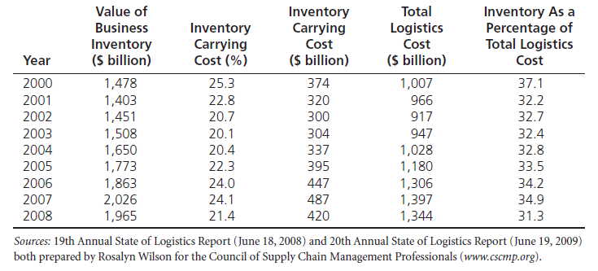
Magnitude of Inventory Costs
Table 8-1

Slide 13
Inventory Carrying Costs
Inventory carrying (holding) costs are the costs associated with holding inventory.
  Obsolescence
  Inventory shrinkage
  Storage costs
  Handling costs
  Insurance costs
  Taxes
  Interest charges

Slide 14
Inventory Costs
Ordering costs refer to those costs associated with ordering inventory, such as order costs and setup costs.
Examples of order costs include:
  Costs of receiving an order (wages)
  Conducting a credit check
  Verifying inventory availability
  Entering orders into the system
  Preparing invoices
  Receiving payment

Slide 15
Inventory Costs
Trade-Off between Carrying and Ordering Costs
Ordering cost = number of orders / year x ordering cost / order
Carrying cost = average inventory x carrying cost / unit

Slide 16
Inventory Costs
Stockout cost is an estimated cost or penalty that is realized when a company is out of stock when a customer wants to buy an item.
Stockout costs involve an understanding of a customer’s reaction to a company being out of stock.

Slide 17
Table 8-3: Determination of the Average Cost of a Stockout
Alternative | Loss | Probability | Average Cost
1. Brand-loyal customer | $00.00 | .10 | $00.00
2. Switches and comes back | $37.00 | .25 | $9.25
3. Lost customer | $1,200 | .65 | 780.00
Average cost of a stockout |  | 1.00 | $789.25
These are hypothetical figures for illustration.

Slide 18
Inventory Costs
General Rules Regarding Stockout Costs
  The higher the average cost of a stockout, the better it is for the company to hold some amount of inventory (SS) to protect against stockouts.
  The higher the probability of a delayed sale, the lower the average stockout costs and the lower the inventory that needs to be held by a company.

Slide 19
Determination of Safety Stock Level
Table 8-4
Number of Units of Safety Stock | Total Value of Safety Stock ($480 per Unit) | 25% Annual Carrying Cost | Carrying Cost of Incremental Safety Stock | Number of Additional Orders Filled | Additional Stockout Costs Avoided
10 | $4,800 | $1,200 | $1,200 | 20 | $8,000.00
20 | 9,600 | 2,400 | 1,200 | 16 | 6,400.00
30 | 14,400 | 3,600 | 1,200 | 12 | 4,800.00
40 | 19,200 | 4,800 | 1,200 | 8 | 3,200.00
50 | 24,000 | 6,000 | 1,200 | 6 | 2,400.00
60 | 28,800 | 7,200 | 1,200 | 4 | 1,600.00
70 | 33,600 | 8,400 | 1,200 | 3 | 1,200.00

Slide 20
Determination of Safety Stock Level:
Using Service Level
Safety Stock
= kσ
Service Level
Probability of Stockout
Forecasted Demand
Reorder Point

Slide 21
Dimension of
Inventory Modeling
    Demand
      Constant vs Variable
      Known vs Random
      Continuous vs Discrete
    Lead Time
      Instantaneous
      Deterministic vs Stochastic
    Dependence of Items
      Independence
      Correlated
    Review Time
      Continuous vs Periodic
    Number of Layers
      One vs Many
    Capacity / Resources
      Unlimited vs Limited
    Discount
      None
      All units or Incremental
    Excess Demand
      None
      Backordered
      Lost orders
      Substitution
    Perishability
      None
      Uniform with time
    Planning Horizon
      Single Period
      Finite Period
      Infinite
    Number of Items:
      -- One vs Many

Slide 22
When to Order
Fixed order quantity system
Fixed order interval system
Reorder point (ROP)
  ROP = DD x RC under certainty
  ROP = (DD x RC) + SS under uncertainty
  Where DD = daily demand
  RC = length of replenishment cycle
  SS = safety stock

Slide 23
Assumption of
Basic EOQ Inventory Model
    Demand
      Constant vs Variable
      Known vs Random
      Continuous vs Discrete
    Lead Time
      Instantaneous
      Deterministic vs Stochastic
    Dependence of Items
      Independence
      Correlated
    Review Time
      Continuous vs Periodic
    Number of Layers
      One vs Many
    Capacity / Resources
      Unlimited vs Limited
    Discount
      None
      All units or Incremental
    Excess Demand
      None
      Backordered
      Lost orders
      Substitution
    Perishability
      None
      Uniform with time
    Planning Horizon
      Single Period
      Finite Period
      Infinite
    Number of Items:
      -- One vs Many

Slide 24
Inventory Control
Basic EOQ Model
Quantity
Q
Time

Slide 25
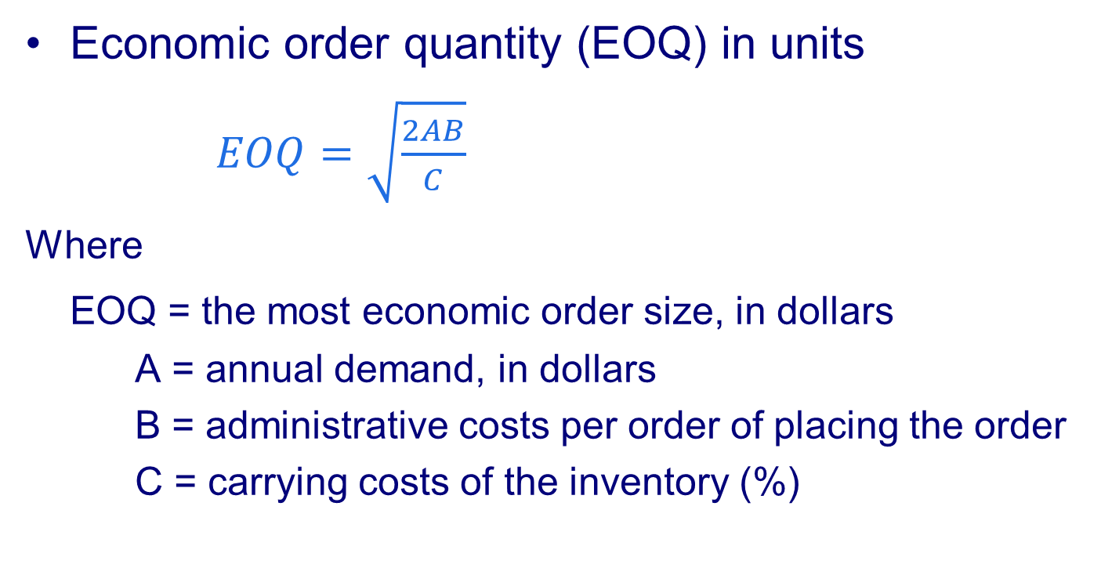
How Much to Order?
Economic order quantity (EOQ) in units
$EOQ=\sqrt{\frac{2AB}{C}}$
Where
EOQ = the most economic order size, in dollars
A = annual demand, in dollars
B = administrative costs per order of placing the order
C = carrying costs of the inventory (%)

Slide 26

How Much to Reorder?
Economic order quantity (EOQ) in units
Where
EOQ = the most economic order size, in units
D = annual demand, in units
B = administrative costs per order of placing the order
C = carrying costs of the inventory (%)
I = dollar value of the inventory, per unit
$$EOQ=\sqrt{\frac{2DB}{IC}}$$

Slide 27
Inventory Control
Basic Economic Ordering Quantity Model
Break-even charts
$
Total Annual Cost
Carrying Cost
Ordering Cost
EOQ
Order Quantity Q

Slide 28
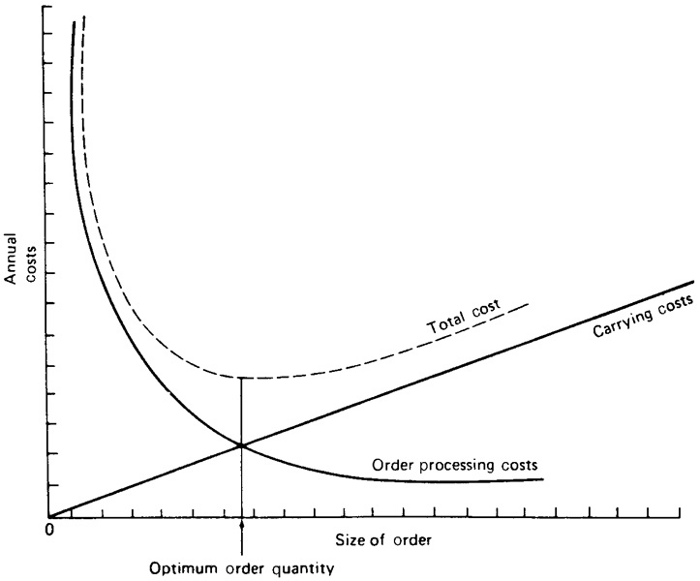
Figure 8-1: Determining EOQ by Use of a Graph

Slide 29
Table 8-5: EOQ Cost Calculations
Number of orders per year | Order size ($) | Ordering cost ($) | Carrying cost ($) | Total cost (sum of ordering and carrying cost) ($)
1 | 1,000 | 25 | 100 | 125
2 | 500 | 50 | 50 | 100
3 | 333 | 75 | 33 | 108
4 | 250 | 100 | 25 | 125
5 | 200 | 125 | 20 | 145

Slide 30
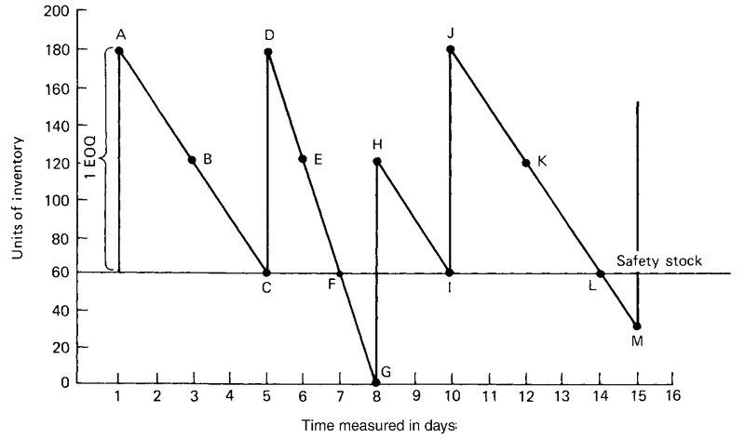
Figure 8-2: Inventory Flow Diagram

Slide 31
Inventory Flows
Safety stock can prevent against two problem areas
  Increased rate of demand
  Longer-than-normal replenishment
When fixed order quantity system like EOQ is used, time between orders may vary
When reorder point is reached, fixed order quantity is ordered

Slide 32
Inventory Management: Special Concerns
ABC Analysis of Inventory recognizes that inventories are not of equal value to a firm and as such all inventory should not be managed in the same way.
Dead inventory (dead stock) is a fourth category to ABC analysis which refers to product for which there is no sales during a 12 month period.
Inventory Turnover refers to the number of times that inventory is sold in a one-year period.

Slide 33
Inventory Turnover
Inventory management (continued)
    Inventory Turnover refers to the number of times that inventory is sold in a one-year period.
    Inventory turnover: cost of goods sold divided by average inventory at cost
    Compare with competitors or benchmarked companies

Slide 34
Inventory Management: Special Concerns
Complementary Products are inventories that can be used or distributed together, i.e. razor blades and razors.
Substitute Products refer to products that can fill the same need or want as another product.

Slide 35
Contemporary Approaches to Managing Inventory
Lean Manufacturing
Service Parts Logistics
Vendor-Managed Inventory (VMI)

Slide 36
Case 8-1 Low Nail Company
Product Provided:
One size of nail
Product Information:
Annual Demand: 2,000 kegs to retailers in an even flow
Order Processing Cost: $60 per order
Warehousing Cost: $1 per year per keg
Discussion:
#1: Using the EOQ methods outlined in chapter 8, how many kegs of nails should Low order at one time?
#2: Assume all conditions in question 1 hold, except that Low’s supplier now offers a quantity discount in the form of absorbing all or part of Low’s order processing costs. For orders of 750 or more kegs of nails, the supplier will absorb all the order processing costs; for orders between 249 and 749 kegs, the supplier will absorb half. What is Low’s new EOQ?

Slide 37
Case 8-1 Low Nail Company
Discussion:
#3: Temporarily, ignore your work on question 2. Assume that Low’s warehouse offers to rent Low space on the basis of the average number of kegs Low will have in stock, rather than on the maximum number of kegs Low would need room for whenever a new shipment arrived. The storage cost per keg remains the same. Does this change the answer to Question 1? If so, what is the new answer?
#4: Take into account the answer to question 1 and the supplier’s new policy outlined in question 2 and the warehouse’s new policy in question 3. Then determine Low’s new EOQ.

Slide 38
Case 8-1 Low Nail Company
Discussion:
#5: Temporarily, ignore your work on questions 2, 3, and 4. Low’s luck at the race track is over; he now must borrow money to finance his inventory of nails. Looking at the situation outlined in question 1, assume that the wholesale cost of nails is $40 per keg and that Low must pay interest at the rate of 1.5% per month on the unsold inventory. What is his new EOQ?
#6: Taking into account all the factors listed in questions 1, 2, 3, and 5, calculate Low’s EOQ for kegs of nails.

Slide 39
Case 8-1 Low Nail Company
(Warehousing Cost is based on max. space)
Total Inventory Cost:
Economic order quantity (EOQ) :
Where
EOQ = the most economic order size, in units
D = annual demand, in units
B = administrative costs per order of placing the order
C = carrying costs of the inventory (%)
I = dollar value of the inventory, per unit

Slide 40
Case 8-1 Low Nail Company
(Warehousing Cost is based on avg. space)
Total Inventory Cost:
Economic order quantity (EOQ) :
Where
EOQ = the most economic order size, in units
D = annual demand, in units
B = administrative costs per order of placing the order
C = carrying costs of the inventory (%)
I = dollar value of the inventory, per unit

Slide 41
Case 8-1 Low Nail Company
(Warehousing Cost is based on max. space
Plus Interest)
Total Inventory Cost:
Economic order quantity (EOQ) :
Where
EOQ = the most economic order size, in units
D = annual demand, in units
B = administrative costs per order of placing the order
C = carrying costs of the inventory (%)
I = dollar value of the inventory, per unit
i = interest rate, per year

