Slide 1
CHAPTER 7 Demand Management, Order Management, and Customer Service

Slide 2
Learning Objectives
To understand the linkages between demand management, order management, and customer service
To learn about demand forecasting models
To examine the order cycle and its four components
To understand the four dimensions of customer service as they pertain to logistics
To familiarize you with select managerial issues associated with customer service

Slide 3
Demand Management, Order Management and Customer Service Key Terms
Activity-based costing
Benchmarking
Cause-and effect (associative) forecasting
Collaborative planning, forecasting and replenishment (CPFR)
Customer profitability analysis (CPA)
Customer service
Demand Management
Judgmental forecasting
Make-to-order
Make-to-stock
Multichannel marketing systems
Order cycle

Slide 4
Demand Management, Order Management and Customer Service Key Terms
Order delivery
Order fill rate
Order management
Order picking and assembly
Order processing
Order to cash cycle
Order transmittal
Order triage
Pick-to-light technology
Service recovery
Time series forecasting
Voice-based order picking

Slide 5
Demand Management
Demand management can be defined as “the creation across the supply chain and its markets of a coordinated flow of demand.”
Source: John T. Mentzer, “A Telling Fortune”, Industrial Engineer, April 2006, 42-47.
Demand (sales) Forecast
Refers to an effort to project future demand
Is a key component in demand management
Is helpful in make-to-stock situations
Is helpful in make-to-order situations

Slide 6
Demand Forecasting Models
Judgmental Forecasting
Surveys
Analog techniques
Delphi method
Time Series Forecasting
Cause-and-Effect (Associative) Forecasting
Simple Regression
Multiple Regression

Slide 7
Demand Forecasting Issues
Factors in Selecting Forecasting Techniques
Situation at hand
Forecasting costs (time & money)
Accuracy
Selecting an inappropriate technique will reduce forecast accuracy
Forecast accuracy can have important logistical implications
Computer forecasting software unable to completely eliminate forecast errors
Collaborative Planning, Forecasting, and Replenishment (CPFR)

Slide 8
Order Management
Order management is the activities that take place in the period between the time a firm receives an order and the time a warehouse is notified to ship the goods to fill that order
Order planning-connected to sales forecasting
Order transmittal
Order processing
Order picking and assembly
Order delivery

Slide 9
Order Management
Order cycle defined by the seller: time from when an order is received to when the goods arrive at the customer’s dock
Order cycle defined by the buyer: time from when an order is placed to when the goods are received. Also called replenishment cycle
Getting shorter
More precise delivery times
Customer can track orders
Quality is important and is benchmarked

Slide 10
Order Management
Order transmittal is the series of events that occur between the time a customer places or sends an order and the time the seller receives the order
Methods of order transmittal
Phone
FAX
Mail
Scanning bar codes-electronic submission
POS registers
Internet

Slide 11
Example of Mail-in Order Form

Slide 12
Order Management
Order processing refers to the time from when the seller receives an order until an appropriate location (i.e. warehouse) is authorized to fill the order

Slide 13
Order Management
Order processing includes:
Checking for completeness and accuracy
A customer credit check
Order entry into the computer system
Marketing department credits salesperson
Accounting department records transaction
Inventory department locates nearest warehouse to customer and advises them to pick the order
Transportation department arranges for shipment

Slide 14
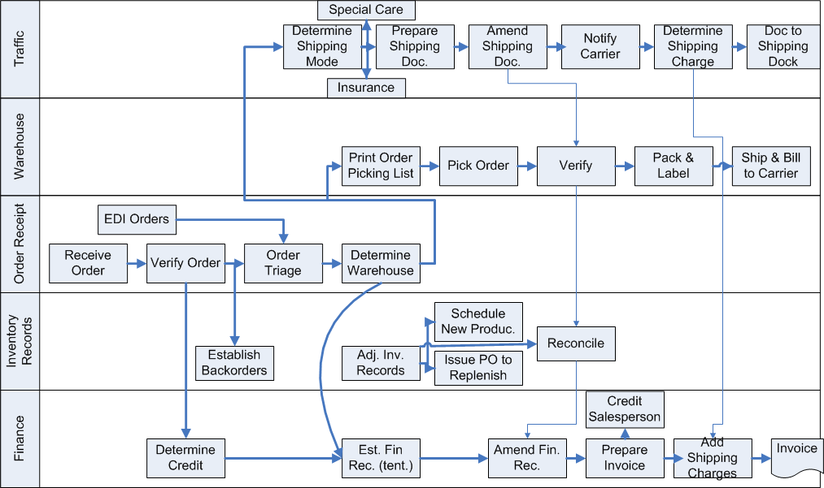
Flowchart of Order Handling (Order Processing) System

Slide 15
Order Management
Order processing
If there is a stockout
Notify the customer as soon as possible of stockout
Notify when shipment will occur
Give the customer the option of accepting in-stock, similar products
Export orders
Need a letter of credit
International freight forwarders prepare documents and arrange shipment

Slide 16
Order Management
Order picking and assembly includes
Notifying the warehouse to assemble a given order
Providing an order picking list, indicating items and order of pick to a warehouse employee
Checking picked orders for accuracy
Stockout information sent to order handling department so that documents can be adjusted
Packing list enclosed with order including employee initials of person who packed order

Slide 17
Order Management
Order picking and assembly includes all activities from when an appropriate location is authorized to fill the order until goods are loaded aboard an outbound carrier

Slide 18
Order Management
Order picking and assembly Often represents the best opportunity to improve the effectiveness and efficiency of an order cycle
Can account for up to 2/3 of a facility’s operating cost and time
Examples of Order Picking and Assembly technology:
Handheld scanners
Radio-frequency identification (RFID)
Voice-based order picking
Pick-to-light

Slide 19
Order Management
Order delivery is the time from when a carrier picks up the shipment until it is delivered to the customer’s receiving dock
Load planning is the arrangement of goods within the trailer or container
Carriers establish their own service standards
Some customers pick up their orders

Slide 20
Order Management
Importance of the order cycle
Short cycle time used as a marketing and sales tool
Monitoring the order cycle can increase firm efficiency
Efficient Consumer Response (ECR)/Quick Response (QR)
Used in grocery industry and by mass merchandisers
POS data used to trigger order
Keyed to more orderly, regular flow of product, smaller inventory

Slide 21
Customer Service
“the ability of logistics management to satisfy users in terms of time, dependability, communication, and convenience.”
Customer service is a collection of activities performed in a way that keeps customers happy and creates in the customer’s mind the perception of an organization that is easy to do business with
Customer service is much more difficult for competitors to imitate than price cuts or other competitive strategies

Slide 22
4 Dimensions of Customer Service
Time
Dependability
Consistent order cycles
Safe delivery
Complete delivery
Communication
Convenience

Slide 23
Managing Customer Service
Four specific customer service considerations include:
Customer profitability analysis (CPA)
Establishing customer service objectives
Measuring customer service
Service failure and recovery

Slide 24
Managing Customer Service
Customer Profitability Analysis (CPA) is the allocation of revenues and costs to customer segments or individual customers to calculate the profitability of the segments or customers

Slide 25
Managing Customer Service
Customer Profitability Analysis (CPA)
Suggests that different customers consume differing amounts and types of resources
Recognizes that all customers are not the same and some customers are more valuable than others to an organization
Can help to identify when an organization should pursue different logistical approaches for different customer groups
Has been facilitated by the acceptance of activity-based costing

Slide 26
Customer Service
Establishing Objectives
Specific
Measurable
Achievable
Cost-effective

Slide 27
Managing Customer Service
Measuring Customer Service
“you can’t manage what you can’t measure”
Must determine data sources to be used
Must determine what factors to measure
Organizations must resist excessive measurement

Slide 28
Measuring and Controlling Customer Service
Time
Order cycle time
Inquiry response time
Dependability
Perfect order
On-time delivery
Communication
Customer complaints
Order status information
Convenience
Return Process
Response to emergency situations

Slide 29
Managing Customer Service
Service Failure and Recovery
Situations will occur where actual performance does not meet the customer’s expected performance (i.e. service failure)
Examples of order-related service failures include:
Lost delivery
Late delivery
Early delivery
Damaged delivery
Incorrect delivery quantity

Slide 30
Managing Customer Service
Service Failure and Recovery
Service recovery
Process for returning a customer to a state of satisfaction after a service or product has failed to live up to expectations
Is often costly
May lead to increases customer loyalty
Unsatisfactory service recovery magnifies the initial failure

Slide 31
Role of Logistics in Establishing Customer Service Levels
Advisor to marketing
Establishing a customer service program
Ask the customer what is important to them
Investigate the service offered by competitors
Consider the cost of alternative service programs
Analyze the information and write the objectives
Using the Internet to improve customer service

Slide 32
Appendix 7-A Activity-based costing
Five steps in ABC
Identify activities
Determine cost for each activity
Determine cost drivers
Collect activity data
Calculate product cost

Slide 33
Appendix 7-A Cost for each Activity
Activity | Cost
Order transmittal | $1,000
Order processing | $3,000
Order picking and assembly | $12,000
Order delivery | $6,000

Slide 34
Appendix 7-A Activity Data and Product Cost
Activity | Cost | Product 1 data | Product 1 cost | Product 2 data | Product 2 cost
Order transmittal | $1,000 | 3 orders | $300 | 7 orders | $700
Order processing | $3,000 | 4 activities | $1,200 | 6 activities | $1,800
Order picking &assembly | $12,000 | 110 boxes | $6,600 | 90 boxes | $5,400
Order delivery | $6,000 | 30 locations | $4,500 | 10 locations | $1,500
Total | $22,000 |  | $12,600 |  | $9,400

Slide 35
Case 7-1 Handy Andy, Inc.
Company Facts:
Located St. Louis, Missouri
Product Facts:
Garbage compactors
Standard Model: 5 colors, 3 trims (15), $310~350
Deluxe Model: 8 colors, 4 trims (32), $390~450
Distribution Channels:
Retailer: no inventory
Dealers (Factory Distributors): carry all 47 items (5 each)

Slide 36
Case 7-1 Handy Andy, Inc.
Discussions:
#1: Is this a customer service problem? Why or why not?
#2: Marketing channels are the arrangement of intermediaries (wholesalers, retailers, and the like) that the firm uses to achieve its marketing objectives. Is the problem discussed in Handy Andy’s marketing channels? Why or why not?
#3: Logistics channels handle the physical flow of goods or service. Is the problem discussed in Handy Andy’s logistics channel? Why or why not?

