Slide 1
Chapter 6
Procurement

Slide 2
Learning Objectives
To understand the relationship between procurement, purchasing, and supply management
To examine procurement objectives
To learn about supplier selection and evaluation
To understand quality issues in procurement
To examine global procurement
To learn about investment recovery
To examine socially responsible procurement

Slide 3
Procurement
Key Terms
  Bribes
  Excess (surplus) materials
  Global procurement (sourcing)
  Investment recovery
  ISO 9000
  Kickbacks
Key Terms
  Lean six sigma
  Malcolm Baldridge National Quality Award
  Multiple sourcing
  Obsolete materials
  Procurement (Purchasing)
  Procurement card

Slide 4
Procurement
Key Terms
  Quality
  Scrap materials
  Single sourcing
  Six sigma
  Socially responsible procurement
  Supplier development (reverse marketing)
Key Terms
  Supply management
  Waste materials

Slide 5
Procurement
Refers to the raw materials, component parts, and supplies bought from outside organizations to support a company’s operations
Procurement costs often range between 60%-80% of an organization’s revenues

Slide 6
Procurement Objectives
Supporting organizational goals and objectives
Managing the purchasing process effectively and efficiently
Managing the supply base
Developing strong relationships with other functional groups
Supporting operational requirements

Slide 7
Supply Management
Supply management is “ the identification, acquisition, access, positioning, and management of resources the organization needs or potentially needs in the attainment of its strategic objectives.” Institute of Supply Management
Similar in meaning to procurement, purchasing

Slide 8
Purchase for Use in Manufacturing
Make or buy
  Availability of trained labor
  Physical capacity
Purchase orders are a commitment to buy
  Indicate quantities and qualities desired
  Indicate dates by which the materials must be delivered

Slide 9
Purchase for Use in Manufacturing
MRP Systems manage production inventory
Just-in-Time (JIT) and Kanban were initially developed to improve quality
JIT II ties together information systems and employees of suppliers and firms
Supplier Product Integration refers to the acquisition of components, rather than individual parts

Slide 10
Purchasing for Resale
Objective is to buy merchandise that can be marked up and resold to others at a profit
Quality of product and timing of arrival are important

Slide 11
Procuring Services
Request for Proposal (RFP)
Request for Quotation (RFQ)
Examples of procured services
  Legal, accounting, computer and software consultants
  Building maintenance
  Printing
  Landscape work
  Janitorial services

Slide 12
Supplier Selection and Evaluation
One of procurement’s most important responsibilities
Involves stating an organization’s needs and determining how well various potential suppliers can fulfill these needs

Slide 13
Supplier Selection
Selecting vendors depends on:
  Delivery
  Facilities and capacity, geographic location
  Performance history
  Price and quality
  Technical capability
  Warranties and claim policies

Slide 14
Supplier Selection Framework
(Figure 6-1)
Identify Need for Supply
Situation Analysis
  Internal factors (e.g. supply policies)
  External factors (e.g. legal issues)
Identify and Evaluate Potential Suppliers
  Sources of potential information
  Establish selection criteria
  Assign weights to selection criteria
Select Suppliers
  Consideration of company policies (e.g. minority suppliers)
Evaluate Decision
  Compare actual and expected performance

Slide 15
Supplier Development
(Reverse Marketing)
Refers to “a degree of aggressive procurement involvement not normally encountered in supplier selection”
Can include:
  Purchaser initiating contact with supplier
  Purchaser establishing prices, terms and conditions

Slide 16
Supplier Development
(Reverse Marketing)
Motivation to adopt supplier development include:
  Numerous inefficiencies associated with suppliers initiating marketing efforts toward purchasers
  Purchaser may be aware of important benefits which are unknown to the supplier
  Compel suppliers to meet necessary requirements to achieve competitive advantage in the supply chain

Slide 17
Quality Issues in Procurement
Quality – conformance to mutually agreed-upon requirements
Important to match quality levels of buyers and sellers in the supply chain
Vendors are expected to have quality programs/practices
  ISO 9000
  Six Sigma
  Lean Six Sigma

Slide 18
Quality Issues in Procurement
Malcolm Baldrige National Quality Award
  Quality related initiative to recognize U.S. organizations for achievement in quality and performance
  Eligibility now includes manufacturers, services, small businesses, health care and educational institutions
  Restricted to U.S. headquartered organizations
  Interested parties submit a formal application that is evaluated by a committee

Slide 19
Global Procurement (Sourcing)
Refers to buying components and inputs anywhere in the world
Driven by:
  Factor-input strategy (organization is seeking low-cost or high-quality)
  Market access strategy (organization is sourcing in markets where it plans to do significant business)

Slide 20
Global Procurement (Sourcing)
Components of Global Sourcing Development model:
  Planning
  Specification
  Evaluation
  Relationship management
  Transportation and holding costs
  Implementation
  Monitoring and improving

Slide 21
Global Procurement (Sourcing)
Challenges in establishing a successful global sourcing strategy include understanding hidden costs as supply bases are expanded
Examples of hidden costs:
  Increased costs of dealing with suppliers outside the domestic market
  Duty and tariff changes that occur over supply agreement life
  Increased inventory-related costs associated with global supply chains
  Rising levels of logistics cost volatility (e.g. ocean freight rates)

Slide 22
E-Procurement
E-procurement is the business-to-business purchase of supplies and services via the Internet
Procurement cards

Slide 23
Investment Recovery
Identifies opportunities to recover revenues or reduce costs associated with:
  Scrap
  Surplus
  Obsolete
  Waste materials
Often the responsibility of the procurement manager

Slide 24
Socially Responsible Procurement
Socially responsible procurement refers to “procurement activities that meet the ethical and discretionary responsibilities expected by society.”
Source: Craig R. Carter and Marianne M. Jennings, Journal of Business Logistics

Slide 25
Socially Responsible Procurement
Five dimensions include:
  Diversity
  The environment
  Human rights
  Philanthropy
  Safety

Slide 26
Socially Responsible Procurement
Ethical considerations
  “win at all costs” philosophy can exacerbate unethical behavior
Areas of ethical concern in procurement:
  Gift giving and receiving
  Bribes and kickbacks
  Misuse of information
  Improper methods of knowledge acquisition
  Lying or misrepresentation of the truth
  Product quality (lack of)
  Misuse of company assets
  Conflicts of interest

Slide 27
Purchasing Ethics
Breaches of purchasing ethics include:
  Accepting lavish gifts
  Bribes
  Kickbacks
Areas of ethical concern:
  Handling confidential information
  Purchasing for one’s private use
  Interfering with a legitimate bidding process
  Conflicts of interest

Slide 28
Case 6-1 Tempo Ltd.
Company Facts:
Located in Antalya, Terim, Turkey
Deal Considering:
Sell chemicals in exchange of lumber from N. Korea
2 options of shipping lumber
  Wonsan (N. Korea) – Constantza (Romania) – Turkey
  Wonsan (N. Korea) – Latakia (Syria) – Turkey

Slide 29
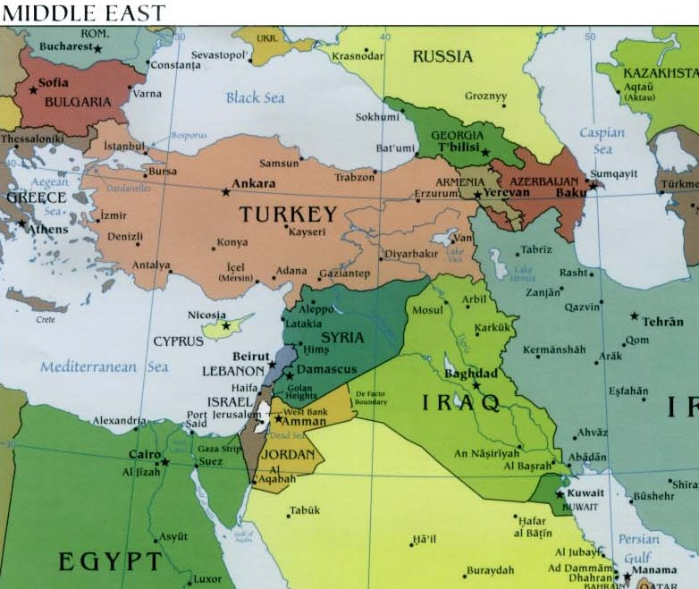
Case 11-2 Tempo Ltd.

Slide 30
Case 6-1 Tempo Ltd.
Discussion:
#1: Should Terim let somebody else complete the transaction because he knows that if he does not sell to the North Koreans somebody else will?
#2: What are the total costs given in the case for the option of moving via Romania?
#3: What are the total costs given in the case for the option of moving via Syria?
#4: Which option should Terim recommend? Why?
#5: What other costs and risks are involved in these proposed transactions, including some not mentioned in the case?
#6: Regarding the supply chain, how—if, at all—should bribes be included? What functions do they serve?
#7: If Terim puts together this transaction, is he acting ethically? Discuss.

Slide 31
Case 6-1 Tempo Ltd.
Discussion:
#8: What do you suggest should be done to bring moral values into the situation so that the developing countries are somewhat in accordance with Western standards? Keep in mind that the risks involved in such environments are much higher than the risks of conducting business in Western markets. Also, note that some cultures see bribery as a way to better distribute wealth among their citizens.

