Slide 1
Chapter 4
Organizational and Managerial Issues in Logistics

Slide 2
Learning Objectives
To examine organizational structure for logistics
To learn about traditional and contemporary organizational design for logistics
To explore productivity issues in logistics
To learn about ways to manage theft and pilferage
To introduce you to the concept of logistics social responsibility
To discuss issues associated with reverse logistics
To expose you to programs designed to lessen the impact of terrorism on logistics systems

Slide 3
Organizational and Managerial Issues in Logistics Key Terms
“C-level” position
Centralized logistics organization
Container Security Initiative (CSI)
Customs Trade Partnership Against Terrorism (C-TPAT)
Decentralized logistics organization
Excess capacity
Flexibility
Fragmented logistics structure
Importer Security Filing (ISF) rule

Slide 4
Organizational and Managerial Issues in Logistics Key Terms
Logistics social responsibility
Pilferage
Productivity
Relevancy
Responsiveness
Reverse logistics
Tachograph
Theft
Transportation Worker Identification Credential (TWIC)
Unified logistics structure

Slide 5
Organizing Logistics within the Firm
Two key organizational logistics topics
Organizational structure
Organizational design

Slide 6
Organizational Structure for Logistics
Two basic organizational structures:
Fragmented logistics structure
Logistics activities are managed in multiple departments throughout an organization
Unified logistics structure
Multiple logistics activities are combined into and managed as a single department

Slide 7
Organizational Structure for Logistics
Two basic organizational structures for logistics departments are:
Centralized logistics organization
Company maintains a single logistics department that administers the related activities for the entire company from the home office
Decentralized logistics organization
Logistics-related decisions are made separately at the divisional or product group level and often in different geographic regions

Slide 8
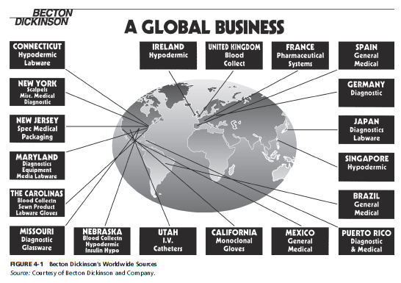
Figure 4-1: Becton Dickinson’s Worldwide Sources (Decentralized)

Slide 9
Organizational Structure for Logistics
Job title or corporate rank
Leading edge organizations tend to head the logistics department by senior-level personnel
Generally excluded from holding a “C-level” position

Slide 10
Organizational Design for Logistics
Three primary types of organizational design include:
Hierarchical (functional)
Top-down flow
Matrix
Cross-functional responsibilities
Network
Process philosophy focused on combing tasks into value-creating products and activities

Slide 11
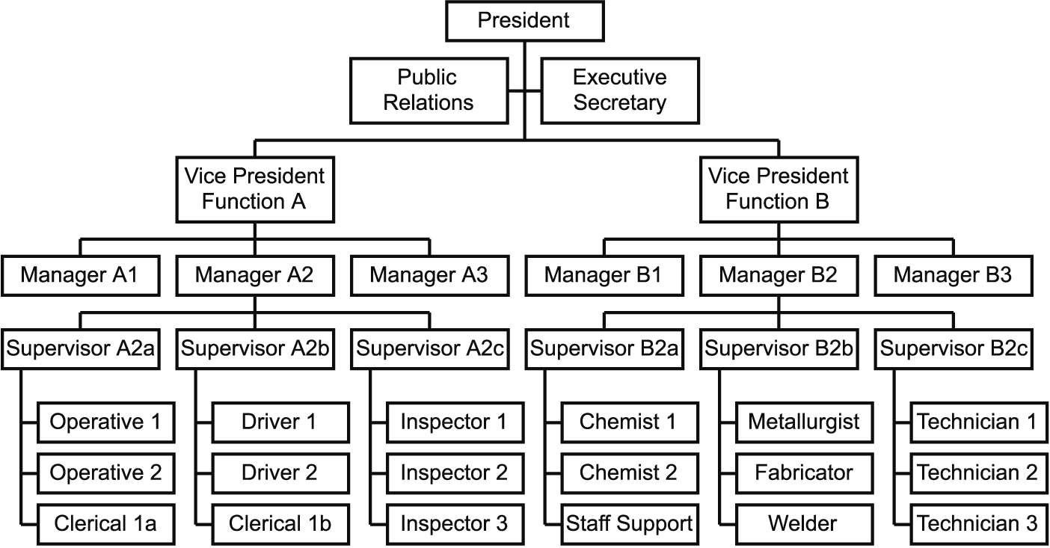
Hierarchical (Functional) Organizational Design
http://www.emeraldinsight.com/content_images/fig/0260230703001.png

Slide 12
Hierarchical (Functional) Organizational Design
Advantages:
Authority and responsibility and clearly defined
Clearly defined promotion path.
Employees very loyal to their department within the organization.
Flexibility in exercising commands
Disadvantages:
Can be bureaucratic and respond slowly to changing customer needs and the market
Communication across sections can be poor
Local optimization
Societal changes

Slide 13
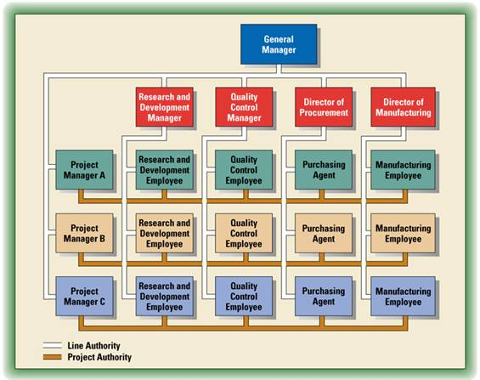
Matrix Organizational Design
http://coolreferat.com/ref-1_1892739354-44921.coolpic

Slide 14
Matrix Organizational Design
Advantages:
Ability to access resources across the old functional and geographic silos.
Better coordination on shared technologies across the organization
Faster decentralized decisions
Increased communication and coordination
Reflects the needs of global or regional customers
Disadvantages:
Conflict of loyalty
Can be difficult to monitor if teams have a lot of independence.
Costs can be increased

Slide 15
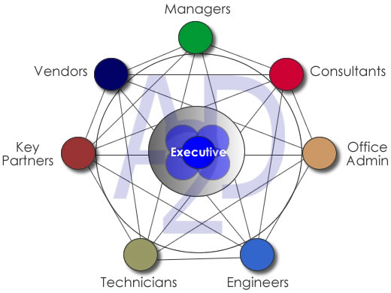
Network Organizational Design
http://www.a2dinc.com/images/a2dnetworkorg.jpg

Slide 16
Network Organizational Design
Management structure is inward-out versus top-down
Tasks are disseminated directly to the responsible member(s) of the company who then assume Direction, Responsibility & Authority (DRA) over that task.
The objective is to utilize whatever resources needed to get the task completed as effectively and as efficiently as possible.
Members who have DRA can request resource support from anyone within in the organization in order to get the task completed.
Across-the-board communication

Slide 17
Network Organizational Design
Advantages:
Anyone within the organization can provide real-time, client-specific support.
Each member is managed based on performance

Slide 18
Network Organizational Design for Logistics
Network organizational design is exhibited in terms of:
Relevancy: satisfying current and emerging customer needs
Responsiveness: accommodating unique or unplanned customer requests
Flexibility: addressing unexpected operational situations

Slide 19
Managerial Issues in Logistics
Productivity
can be defined as the amount of output divided by the amount of input.
Provides insight into the efficiency with which corporate resources are being utilized.
Three ways to improve productivity
Reduce the amount of input while holding output constant
Increase the amount of output while holding input constant
Increase output while decreasing input

Slide 20
Worker Productivity
Warehousing and transportation are heavily dependent on human labor
Human labor is an input
Logistics-operating employees are unionized in some areas
Warehousing facilities have specific work rules
Warehouse employees can be monitored by direct supervision
Transportation employees (truck drivers) can be monitored through technology, i.e. tachograph

Slide 21
Sample Warehouse Work Rules Violations Subject to Discharge on the First Offense
The possession of, drinking of, or use of any alcoholic beverages or narcotic drugs on company property; or being on company premises at any time under the influence of alcohol, or drugs, or while suffering from an alcoholic hangover which materially affects work performance.
The transportation of, or failure to notify the company of, unauthorized persons on company equipment or its property.
Theft or misappropriation of company property or the property of any of its customers or employees.
Deliberate or malicious damage to the company’s equipment and warehouse facilities or to the merchandise and property of its customers.
Intentional falsification of records in any form, including ringing another employee’s time card, or falsifying employment application.

Slide 22
Sample Warehouse Work Rules Violations Subject to Discharge on the First Offense
Fighting while on duty or on company premises or provoking others to fight.
Smoking in a building or van, or any restricted area, or while loading or unloading merchandise and other items.
Immoral or indecent conduct which affects work performance or makes the employee unsuited for the work required.
Unauthorized possession of, or carrying of, firearms or other weapons.
Insubordination — refusal to perform assigned work or to obey a supervisor’s order, or encouraging others to disobey such an order.

Slide 23
Sample Warehouse Work Rules Violations Subject to Constructive Discipline
Excessive tardiness regardless of cause. (Being tardy and not ready to perform work at the designated starting time may at the company’s option result in the employee being sent home without pay.)
Absenteeism without just cause and excessive absenteeism regardless of cause. lf you must be absent for a justifiable reason notify the company in advance. Justified absence will be excused if the company is notified as soon as possible before the beginning of the shift; however, too many justified and excused absences may be grounds for constructive discipline as well as unjustified, unexcused absence. lf you are absent from work for three consecutive work days without notification followed by failure to report for work on the fourth day you will automatically be removed from the payroll with the notification "quit without notice."
Failure to work reasonable overtime.

Slide 24
Sample Warehouse Work Rules Violations Subject to Constructive Discipline
Unauthorized absence from assigned work location.
Failure to observe proper break periods, lunch periods, and quitting times, unless otherwise directed by your supervisor.
Disregard for common rules of safety, safe practices, good housekeeping and sanitation.
Unauthorized or negligent operation or use of machines, tools, vehicles, equipment and materials.
Loss or damage to the property of the company or its customers which could have been reasonably avoided.
Failure to complete work assignments within a reasonable length of time or loafing on such assignments.
Garnishments not satisfied prior to the hearing before the court issuing same.
Gambling on company premises.
Use of immoral, obscene or indecent language on company premises.
Trying to persuade or organize other employees to disobey any of these rules and regulations.

Slide 25
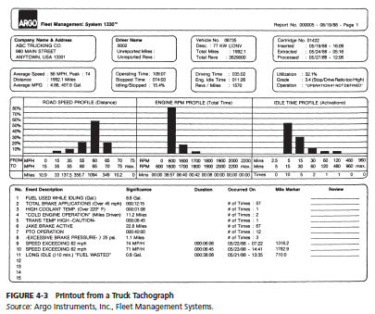
Figure 4-3: Printout from a Truck Tachograph

Slide 26
Asset Productivity
Asset-related productivity concerns include:
Space utilization
Excess capacity
Improving the output from existing assets

Slide 27
Theft and Pilferage
Thoughts regarding theft
Insurance companies may reimburse for loss, but time and costs tend not to be covered
Theft results in the planned flow of goods being interrupted which can lead to stockouts
Theft can factor into facility location decisions

Slide 28
Theft and Pilferage
Thoughts regarding pilferage
Transportation and warehousing operations are particularly vulnerable to pilferage
Managing pilferage begins with the hiring process
Zero tolerance pilferage policy
Keep goods moving through the system
Recent increase in pirate attacks

Slide 29
Logistics Social Responsibility
Logistics Social Responsibility
Corporate social responsibility issues that relate directly to logistics
Source: Craig R. Carter and Marianne M. Jennings, “Logistics Social Responsibility: An Integrative Framework,” Journal of Business Logistics 23, no. 2 (2002): 145-180.
Potential dimensions include:
The environment
Ethics
Diversity
Safety
Philanthropy
Human rights
Others

Slide 30
Managing Reverse Logistics
Reverse logistics
Is the process of managing return goods
Exceeds $100 billion in U.S. alone
Can be 4-5 times more expensive than forward logistics
Process can take 12 times as many steps as forward logistics

Slide 31
Managing Reverse Logistics
Reverse logistics process focuses on:
Why products are returned
How to optimize reverse logistics
Whether reverse logistics should be managed internally or outsourced to a third party

Slide 32
Lessening the Impact of Terrorism on Logistics Systems
Terrorism can be defined as “the unlawful use or threatened use of force or violence by a person or an organized group against people or property with the intention of intimidating or coercing societies or government, often for ideological or political reasons.”
Source: Terrorism, The American Heritage® Dictionary of the English Language, 4th ed. (n.d.). Retrieved from Dictionary.com website: http://dictionary.reference.com/browse/terrorism.

Slide 33
Lessening the Impact of Terrorism on Logistics Systems
September 11 terrorist attacks have impacted logistics practices on a worldwide basis
Greater attention given to:
Processes
Procedures
Activities

Slide 34
Lessening the Impact of Terrorism on Logistics Systems
Creation of the Department of Homeland Security (DHS)
Federal agency
Goals are
To prevent terrorist attacks in the U.S.
To reduce the vulnerability of the U.S. to terrorism

Slide 35
Lessening the Impact of Terrorism on Logistics Systems
22 separate government entities were incorporated into DHS
Transportation Security Administration (TSA)
Transportation Worker Identification Credential (TWIC)
Customs and Border Protection (CBP)
Container Security Initiative (CSI)
Customs Trade Partnership Against Terrorism (C-TPAT)
Importer Security Filing (ISF) rule

Slide 36
Table 4-1: Timeline for Presenting Electronic Advance Manifest Information
Inbound to the United States
Mode | Timeline
Air and courier | 4 hours prior to arrival in the United States, or "wheels up" from certain nearby airports
Rail | 2 hours prior to arrival at a U.S. port of entry
Ocean vessel | Twenty-four hours prior to lading at foreign port
Truck | Free and Secure Trade (FAST): 30 minutes prior to arrival in the US
 | non-FAST: 1 hour prior to arrival in the United States
Outbound from the United States
Mode | Timeline
Air and courier | 2 hours prior to scheduled departure from the United States
Rail | 2 hours prior to the arrival of the train at the border
Ocean vessel | 24 hours prior to departure from U.S. port where cargo is laden
Truck | 1 hour prior to the arrival of the truck at the border

Slide 37
Table 4-2: Information Required for 10+2 Rule
Importer:
1. Manufacturers name and address
2. Seller’s name and address
3. Buyer's name and address
4. Ship to name and address
5. Scheduled container stuffing location
6. Consolidator’s name and address
7. Importer of record
8. Consignee identification number
9. Country of origin
10. Harmonized tariff schedule at minimum six-digit level
Carriers:
1. Vessel stow plan
2. Container status message

Slide 38
Case 4-1 Red Spot Markets Company
Company Facts:
Operates a chain of grocery stores in New England
Distribution Centers in Providence, Rhode Island and Newburgh, NY
Problems:
 | Newburgh | Providence
Throughput | 4% higher
Shrinkage | 3.60% | 5.90%

Slide 39
Case 4-1 Red Spot Markets Company
Questions:
How should Fosdick respond to the immediate situation?
What controls, of the types discussed in this chapter, might have been used by Red Spot Markets to reduce or eliminate the problems discussed in the case?
What longer-range steps should Fosdick take to control the operations of the Providence distribution center?
What longer-range steps should Fosdick take to improve the Providence distribution center’s productivity?
What longer-range steps can Fosdick take to reduce the distribution center’s high rate of shrinkage?

Slide 40
Case 4-1 Red Spot Markets Company
Questions:
Assume that Fosdick decides that the practice of free lunches from the open cases of goods must be stopped. Develop and present arguments he should give in a meeting with a union shop steward.
(This is a continuation of question 6.) Assume, instead, that you are the union shop steward. Develop and present your argument that the free lunches represent a long-standing employee benefit enjoyed by the distribution center’s employees, and that management’s attempt to stop them is a breach of an unwritten contract and will be resisted.
Much of the situation described in the case seems to revolve around the personality of T.D. Bigelow. How should he be treated? Why?

