Slide 1
CHAPTER 1
An Overview of Logistics

Slide 2
Learning Objectives
To understand the economic impacts of logistics
To learn what logistics is
To learn about the increased importance of logistics
To understand the systems and total cost approaches to logistics
To expose you to logistical relationships within the firm
To learn about marketing channels
To provide a brief overview of activities in the logistics channel
To familiarize you with logistics careers

Slide 3
Logistics and the Supply Chain
Key Terms
  Cost trade-offs
  Disintermediation
  Economic utility
  Form utility
  Landed costs
  Logistics
  Marketing channels
Key Terms
  Mass logistics
  Materials management
  Physical distribution
  Place utility
  Possession utility
  Postponement
  Power retailer

Slide 4
Logistics and the Supply Chain
Key Terms
  Sorting function
  Stock-keeping units (SKUs)
  Stockouts
  Sustainable products
Key Terms
  Systems approach
  Tailored logistics
  Time utility
  Total cost approach

Slide 5
Economic Impacts of Logistics
Macroeconomic Impacts

Slide 6
Table 1-1: The Cost of the Business Logistics System in Relation to GDP (US)
(in $ Billion)
Year | Inventory Carrying Costs | Transp. Costs | Adm. Costs | Total U.S. Logistics Cost | Logistics As a % of GDP
1960 | 31 | 44 | 3 | 78 | 14.7
1965 | 38 | 64 | 4 | 106 | 14.7
1970 | 56 | 91 | 6 | 153 | 14.7
1975 | 97 | 116 | 9 | 222 | 13.5
1980 | 220 | 214 | 17 | 451 | 16.1
1985 | 227 | 274 | 20 | 521 | 12.4
1990 | 283 | 351 | 25 | 659 | 11.4
1995 | 302 | 441 | 30 | 773 | 10.4
2000 | 377 | 590 | 39 | 1,006 | 10.1
2005 | 393 | 744 | 46 | 1,183 | 9.5
Source: R. Wilson and R. Delaney, Twelfth Annual State of Logistics Report, 2001

Slide 7
The Cost of the Business Logistics System in Relation to a Country’s GDP (2009)
Country | Logistics As a % of GDP
U.S. | 9.4
Brazil | 12.6
India | 13.0
S. Africa | 15.9
Thailand | 19.0
Finland | 19.8
People’s Republic of China | 21.6
Vietnam | 22.5
Source: The Cost of the Business Logistics System in Relation to a Country’s Gross Domestic Product (GDP)

Slide 8
Importance of Logistics
Size of Market – It Is Big
Strategic Advantage – It Can Drive Strategy
  Manufacturing is becoming more efficient
  SCM offers opportunity for differentiation (Dell) or cost reduction (Wal-Mart)
  Increased use of logistics outsourcing –(3PLs, WH)
Globalization – It Covers The World
  Requires greater coordination of production & distribution
  Increased risk of supply chain interruption
  Increases need for robust and flexible supply chains

Slide 9
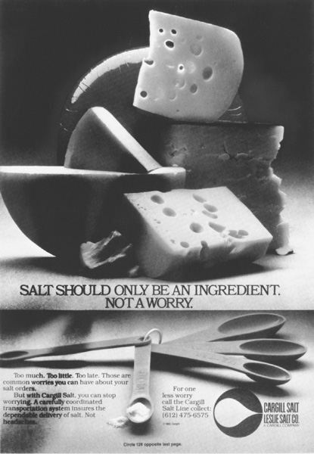
Figure 1-2:
The Utilization of Logistics Service as a Major Selling Point
Salt Should Only be an Ingredient.
Not a Worry.
Too much. Too little. Too late. Those are common worries you can have about your salt orders.
But with Cargill Salt, you can stop worrying. A carefully coordinated transportation system insures the dependable delivery of salt. Not headaches.

Slide 10
Importance of Logistics
At the company level, logistics impacts:
COST - For many products, 20% to 40% of total product costs are controllable logistics costs.
SERVICE - For many products, performance factors such as inventory availability and speed of delivery are critical to customer satisfaction.

Slide 11
Importance of Logistics
Logistics involves intelligent trade-offs:
  Purchase discounts <> Raw Materials Inventory
  Production efficiency <> Finished Goods Inventory
  Freight discounts <> Finished Good Inventory
  Lower planned cost <> More stable costs

Slide 12
Other Economic Impacts of Logistics
Economic Utility
  Possession utility
  Form utility
  Place utility
  Time utility

Slide 13
Logistics: What It Is?
CSCMP (Council of Supply Chain Management Professionals) definition:
  “Logistics is that part of the Supply Chain Management that plans, implements, and controls the efficient, effective forward and reverse flow and storage of goods, services, and related information between the point of origin and the point of consumption in order to meet customers’ requirements.”
Source: clm1.org

Slide 14
Logistics: What It Is?
Supply Chain Management . . . “encompasses every effort involved in producing and delivering a final product or service, from the supplier's supplier to the customer's customer. Supply Chain Management includes managing supply and demand, sourcing raw materials and parts, manufacturing and assembly, warehousing and inventory tracking, order entry and order management, distribution across all channels, and delivery to the customer.”
  The Supply-Chain Council

Slide 15
Logistics: Key Observations
Integrated activity
  X-functions, X-divisions, X-companies, etc.
  Coordination of conflicting goals, metrics, etc.
Responsible for multiple flows:
  Information (orders, status, contracts)
  Physical (finished goods, raw materials, WIP)
  Financial (payment, credits, etc.)
Most analysis involves trade-offs
  Across different entities
  Across metrics: Cost, Service, Time, Risk, etc.

Slide 16
Traditional Logistics Functions
Purchasing / Procurement
Inventory Control
Warehousing
Materials Handling
Order Processing
Transportation
Customer Service
Facility Location / Network Design

Slide 17
Traditional Logistics Management
Purchasing
Raw Materials Inventory
Production
Marketing
Finished Goods Inventory
Typical silo approach –each department operates in isolation
Trade-off inventory versus information, because inventory is expensive, and information is cheap

Slide 18
Integrated Logistics Management
Materials
Purchasing
Marketing
Production
Information

Slide 19
Key Concepts
Design, operate, and control the physical and information flows as though the channel were one seamless corporate entity.
Let the activities (and costs) migrate across corporate boundaries to where they make the most sense.
Rely on the benefits of channel integration to replace the benefits of open market forces.
Share the risks and the rewards between players.

Slide 20
The Systems and Total Cost Approaches to Logistics
Systems Approach
  Interdependence of company and logistics goals
  Interdependence of functional areas
    Stock-keeping units (SKUs)
  Interdependence of logistics activities or
    Intrafunctional logistics

Slide 21
The Systems and Total Cost Approaches to Logistics
Total Cost Approach
  Cost trade-offs: changes to one activity cause some costs to increase and others to decrease
  Total Logistics Concept: to find the lowest total cost that supports an organization’s customer service requirements

Slide 22
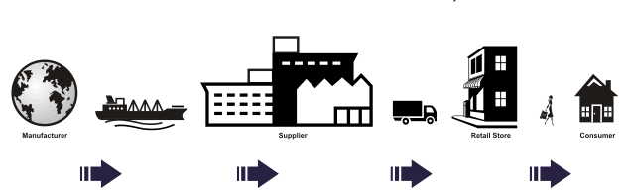
Forward Logistics
Forward Logistics Process
(Traditional Supply Chain)
Merchandise Delivery Path
Source: www.ticsales.com.au/what_we_do.asp

Slide 23
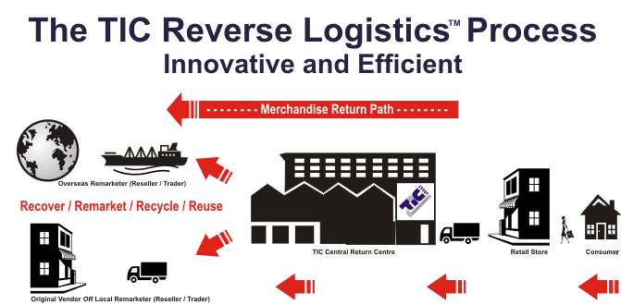
Reverse Logistics
Reverse Logistics Process
Merchandise Return Path
Source: www.ticsales.com.au/what_we_do.asp

Slide 24




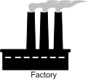


Figure 1-1: Control Over the Flow of Inbound and Outbound Movements
Raw Materials/
Parts/ Components
Warehouses/
Wholesalers
Retailers
Customers
Initial Processing
Finished Goods
Inventory
Factory
Inbound Logistics
Materials Management
Physical Distribution

Slide 25
The Increased Importance of Logistics
A Reduction in Economic Regulation
Changes in Consumer Behavior
  Market Demassification
  Changing family roles
  Rising customer expectations
Technological Advances
The Growing Power of Retailers
Globalization of Trade

Slide 26
Logistical Relationships within the Firm
Finance
  Data Exchange (Decision Making/Cash Flow)
  Budget Allocation
  Inventory
    LIFO
    FIFO
    Inventory Float

Slide 27
Logistical Relationships within the Firm
Marketing
  Place Decisions
    Effective way to move and store
    Co-branding
  Price Decisions
    FOB origin/FOB destination pricing systems
    Landed costs (price + transportation)
    Phantom freight
    Freight absorption

Slide 28
Figure 1-3: Phantom Freight and Freight Absorption
National Single-Zone Pricing
Omaha

Slide 29
Figure 1-3: Phantom Freight and Freight Absorption
Multiple-Zone Pricing
$10.00
$11.95
$11.95
Omaha

Slide 30
Logistical Relationships within the Firm
Marketing
  Product Decisions
    SKUs
    Stockouts
  Promotion Decisions

Slide 31
Logistical Relationships within the Firm
Production
  Production runs
  Postponement concept

Slide 32
Marketing Channels
“sets of interdependent organizations involved in the process of making a product or service available for use or consumption.”
Ownership channel
  Manufacturers
  Wholesalers
  Retailers
    Source: Louis W. Stern and Adel I. El-Ansary, Marketing Channels, 4th edition, Upper Saddle River, NJ: Prentice Hall, 1992, p. 1

Slide 33
Marketing Channels
Negotiations channel
  Buy and sell agreements are reached
Financing channel
  Payments for goods
Promotions channel
  Promoting a new or existing product
Logistics channel
  Moving, sorting, and storing product throughout the channel

Slide 34
Channel Intermediaries/ Facilitators
Ownership channel
  Banks, public warehouses
Negotiations channel
  Brokers
Financing channel
  Banks, insurance companies
Promotions channel
  Advertising agencies, public relations agencies
Logistics channel
  Freight forwarders

Slide 35
Activities in the Logistical Channel
Customer service
Facility location decisions
Inventory management
Order management
Production scheduling
Returned products
Transportation management
Demand forecasting
Industrial packaging
Materials handling
Parts and service support
Procurement
Salvage and scrap disposal
Warehousing management

Slide 36
Responsibilities of
Logistics Managers
A specialist
  Freight rates
  Warehouse layouts
  Inventory analysis
  Production
  Purchasing
  Transportation law
A generalist
  Understands functional relationships
  Relates logistics to other firm operations, suppliers, customers
  Controls large expenditures

Slide 37
Logistics Careers
Most business organizations are potential employers
Logistics is the second-largest employment sector in the United States
The CEO of Wal-Mart began his Wal-Mart career in the logistics area!

Slide 38
Logistics Professionalism
Professional Organizations Dedicated to Advancing the Professional Knowledge of their members:
Council of Logistics Management
Canadian Association of Logistics Management
American Production and Inventory Control Society
American Society of Transportation and Logistics
Association for Transportation Law, Logistics, and Policy
Delta Nu Alpha
International Society of Logistics
Transportation Research Forum
Warehousing and Education Research Council

Slide 39
Case 1-1 Sudsy Soap, Inc.
Company Facts:
Located in Akron, Ohio
Product Facts:
Produced 150 tons (100,000 x 48-ounce cartons) of powdered dish soap each week
Carton size: .5 ft³
Market Facts:
Steady share in “a stable market”

Slide 40
Case 1-1 Sudsy Soap, Inc.
Distribution Facts:
Delivers 15~20 railcar loads / working day
Shipped to various food chain warehouses and large grocery brokers in railcar load
Delivery time: range from 6 days (best) to 43 days (longest) with average of 19 days
Person Involved:
Frank Johnson, Outbound Logistics Manager
E. Gerard Beever (Eager), Sales Manager
CEO
Beever’s Friend

Slide 41
Case 1-1 Sudsy Soap, Inc.
Proposal for Tie-in Promotion:
100,000 each week of 12” dinner plates, 7” pie plates, 9” bread & butter plates, coffee cups, and saucers (free)
Promotion dates: 10/3, 10/10, 10/17, 10/24, & 10/31
One free place setting for purchasing in all 5 weeks
Discussions:
#1: Assume that you are Frank Johnson’s assistant, and he asks you to look into various scheduling problems that might occur. List and discuss them.
#2: What packaging problems, if any, might there be?

Slide 42
Case 1-1 Sudsy Soap, Inc.
Discussions:
#3: Many firms selling consumer goods are concerned with problems of product liability. Does the dish offer present any such problems? If so, what are they? Can they be accommodated?
#4: Should the exterior of the Sudsy Soap package be altered to show what dish it contains? If so, who should pay for the extra costs?
#5: Assume that you are another one of Johnson’s assistants and your principal responsibility is managing the inventories of all the firm’s inputs, finished products, and outbound inventories. What additional work will the dish proposal cause for you?

Slide 43
Case 1-1 Sudsy Soap, Inc.
Discussions:
#6: You are Mr. Beever. Your staff has given many objections to the dish tie-in proposal, but you believe that much of the problem is your staff’s reluctance to try anything innovative. Draft a letter to the company that—although not accepting their proposal—attempts to clarify points that may be subject to misinterpretation and also takes into account some of your staff’s legitimate concerns.

Slide 44
Case 1-2 Kiddiland & the Super Gym
Company Facts:
Retailer of toys
Headquarter located in Chicago
2 Distribution Centers, 70 Stores
  Columbus (Kentucky, Indiana, Michigan, Ohio)
  Chicago (Illinois, Iowa, Minnesota, Wisconsin)
Product (Super Gym) Facts:
Priced at $715
Packaged in 3 boxes weighing a total of 450 lbs
Committed to buy 400 sets
Shipped from Mfr in quantities of 10 or more

Slide 45
Case 1-2 Kiddiland & the Super Gym
Alternatives for delivery to customers:
Purchase a 2-wheeled trailer for each store
Find a local trucking company that can haul the Super Gym from Kiddiland store to the customer
Stock the Super Gym at the 2 Distribution Centers and have the delivery truck runs to the retail stores also make home deliveries
Charge for delivery if the customer cannot get the Super Gym home
Negotiate with the Super Gym Mfr to ship directly to the customer

Slide 46
Case 1-2 Kiddiland & the Super Gym
Information gathered for the alternatives:
Purchase a 2-wheeled trailer for each store
  Trailer costs $1.800, plus $250 for hitches
  $50 per year per store for licensing and insurance
Find a local trucking company that can haul the Super Gym from Kiddiland store to the customer
  $38.21 per set for delivery within 25 miles, $1.50 add’l miles
  85% of customers drive less than 25 miles
  Deliver twice a week

Slide 47
Case 1-2 Kiddiland & the Super Gym
Information gathered for the alternatives:
Stock the Super Gym at the 2 Distribution Centers and have the delivery truck runs to the retail stores also make home deliveries
  Carrier is a consolidator
  Not feasible
Charge for delivery if the customer cannot get the Super Gym home
  $40
Negotiate with the Super Gym Mfr to ship directly to the customer
  Not feasible

Slide 48
Case 1-2 Kiddiland & the Super Gym
Discussions:
#1: List and discuss the advantages and disadvantages of purchasing a two-wheeled trailer for each store to use for delivering Super Gyms.
#2: List and discuss the advantages and disadvantages of having local trucking companies deliver the Super Gym from the retail stores to the customers.
#3: List and discuss the advantages and disadvantages of stocking Super Gyms at the distribution centers and then having the truck that make deliveries from the distribution center to the retail stores and also make deliveries of Super Gyms to individual customers.

Slide 49
Case 1-2 Kiddiland & the Super Gym
Discussions:
#4: List and discuss the advantages and disadvantages of charging the customer for home delivery if they are unable to carry the Super Gym home.
#5: Which alternative would you prefer? Why?
#6: Draft a brief statement (catalog copy) to be inserted in the firm’s spring/summer brochure that clearly explains to the potential customers the policy that is recommended in question 5.
#7: In the first meeting Toth asked about SUVs but there was no further mention of them. How would you follow up on his query?

