Slide 1
Chapter 14 International Logistics

Slide 2
Learning Objectives
To understand macroenvironmental influences on international logistics
To examine documentation as well as terms of sale and methods of payment for international shipments
To distinguish among the unique activities of international trade specialists
To examine transportation and inventory considerations in international distribution
To introduce you to the Logistics Performance Index

Slide 3
International Logistics Key Terms
Balance of payments
Cargo preference
Certificate of origin
Commercial invoice
Embargos
Export management company
Export packers
Import quota
Incoterms
International freight forwarders
International logistics
Letter of credit
Load centers
Logistics performance index (LPI)

Slide 4
International Logistics Key Terms
Macroenvironmental influences
Methods of payment
Nontariff barriers
Nonvessel-operating common carrier (NVOCC)
Ocean carrier alliances
Open account
Open skies agreement
Shipper’s export declaration (SED)
Shipper’s letter of instruction (SLI)
Shipping conferences
Short sea shipping
Tariffs
Terms of sale

Slide 5
International Logistics
International logistics are logistics activities associated with goods that are sold across national boundaries.

Slide 6
Macroenvironmental Influences on International Logistics
Macroenvironmental influences refer to the uncontrollable forces and conditions facing an organization and include cultural, demographic, economic, natural, political, and technological factors.
Source: http://www.marketingpower.com/_layouts/Dictionary.aspx?dLetter=M.

Slide 7
Macroenvironmental Influences on International Logistics
Political factors
Political restrictions on international trade can take a variety of forms
Tariffs
Nontariff barriers
Import quota
Embargoes
Degree of federal government in cross-border trade
Balance of payments
Subsidies
Cargo preference rules

Slide 8
Macroenvironmental Influences on International Logistics
Economic factors
Currency fluctuations
Market size
Income
Infrastructure
Economic integration

Slide 9
Macroenvironmental Influences on International Logistics
Cultural factors
Religion
Values
Rituals
Beliefs
Languages

Slide 10
Figure 14-2: Some of the Symbols Used for Packing Export Shipments

Slide 11
Figure 14-3: A Package Marked for Export

Slide 12
Table 14-1: Beginning Dates for the Chinese New Year, 2011-2018

Slide 13
International Documentation
Flow of documentation is as much a part of the main logistical flow as the flow of product
Domestic shipments typically only require several pieces of documentation
Export shipments typically require approximately 10 pieces of documentation
Cross-border trades can require more than 100 separate documents

Slide 14
International Documentation
Necessary documents are required at the point of importation
Commonly used documents include:
Certificate of origin
Commercial invoice
Shipper’s export declaration (SED)
Shipper’s letter of instruction (SLI)

Slide 15
Terms of Sale
Terms of sale involves:
Parties working within the negotiations channel
Looking at the possible logistics channels
Determining when and where to transfer the following between buyer and seller:
Physical goods
Payment for the goods, freight charges, and insurance for the in-transit goods
Legal title to the goods
Required documentation
Responsibility for controlling or caring for the goods in transit, i.e. livestock

Slide 16
Terms of Sale
Terms of sale for international shipments are commonly referred to as Incoterms.
Use is not mandatory, but generally accepted by legal authorities, buyers, and sellers worldwide
Begin with the letters C,D, E, or F

Slide 17
Terms of Sale Incoterms 2000
EX-Works (EXW)
FCA (Free Carrier)
FAS (Free Alongside Ship)
FOB (Free on Board)
CFR (Cost and Freight)
CPT (Carriage Paid To)
CIF (Cost, Insurance, and Freight)
CIP (Carriage and Insurance Paid To)
DES (Delivered Ex Ship)
DEQ (Delivered Ex Quay)
DAF (Delivered at Frontier)
DDP (Delivered Duty Paid)
DDU (Delivered Duty Unpaid)

Slide 18
Methods of Payment
Methods of payment refer to the manner by which a seller will be paid by a buyer.
Much more challenging in international logistics vs. domestic logistics
Four methods of payment include:
Cash in advance
Letters of credit
Bills of exchange
Open account

Slide 19
Figure 14-4: Letter of Credit

Slide 20
Methods of Payment
Payment method
Should be established at the time that a shipment price is decided upon
Can be influenced by key factors such as
the country the product is to be sold in
the seller’s assessment of buyer risk

Slide 21
International Trade Specialists
International Freight Forwarders specialize in handling either vessel shipments or air shipments.
© Pearson Education, Inc. publishing as Prentice Hall

Slide 22
International Trade Specialists
Principle functions of International Freight Forwarders include:
Advising on acceptance of letters of credit
Booking space on carriers
Preparing an export declaration
Preparing an air waybill or bill of lading
Obtaining consular documents
Arranging for Insurance
Preparing and sending shipping notices and documents
Serving as general consultant on export matters

Slide 23
International Trade and Supply Chain Specialists
Nonvessel-operating common carrier (NVOCC)
Export management company (EMC)
Export packers

Slide 24
Figure 14-5: A Forwarder’s Export Quotation Sheet Showing Factors to Include When Determining the Price to Quote a Potential Buyer of a Product

Slide 25
Transportation Considerations in International Logistics
Ocean shipping
International airfreight
Surface transportation

Slide 26
Ocean Shipping
Approximately 60% of cross-border shipments move by water transportation
Variety of ship types include:
Dry-bulk
Dry cargo
Liquid bulk
Parcel tanker
Containerships
Shipping conferences and alliances pool resources and extend market coverage

Slide 27
World’s Busiest Container Ports (2008)

Slide 28
International Airfreight
Three types of international airfreight operations include:
Charted aircraft
Integrated air carriers
Scheduled air carriers

Slide 29
Surface Transport Considerations
Transit times can be significantly impacted by a country’s infrastructure and modal operating characteristics.
Short sea shipping is an alternative to surface transporting

Slide 30
International Trade Inventories
Safety stocks must be large due to greater uncertainties, misunderstandings and or delays.
Inventory valuation is difficult due to continually changing exchange rates.
Product return (reverse logistics) policies must be understood.
Insufficient warehousing practices can lead to higher inventory carrying costs.

Slide 31
Logistics Performance Index (LPI)
Relatively new international logistics concept (2007)
Updated in 2010
Created in recognition of the importance of logistics in global trade
Incorporates data for approximately 155 countries

Slide 32
Logistics Performance Index (LPI)
Measures a country’s performance across six logistical dimensions
Efficiency of the clearance process by border control agencies, including customs
Quality of trade- and transport-related infrastructure
Ease of arranging competitively priced shipments
Competence and quality of logistics services
Ability to track and trace consignments
Timeliness of shipments in reaching the destination within the scheduled or expected delivery time

Slide 33
Highest- and Lowest-Rated Countries Based on Overall LPI Score

Slide 34
Case 14-1 Nurnberg Augsburg Maschinenwerke (N.A.M.)
Company Facts:
Located Munich, Germany
Product Facts:
Heavy truck and bus design, engineering, and manuf.
Order Requested:
224 N.A.M. Class #4-G two-section buses
First 25 to be delivered to Santos, Brazil by 11/15 (3 mo.)
190 vehicles to be delivered in 18 mo.

Slide 35
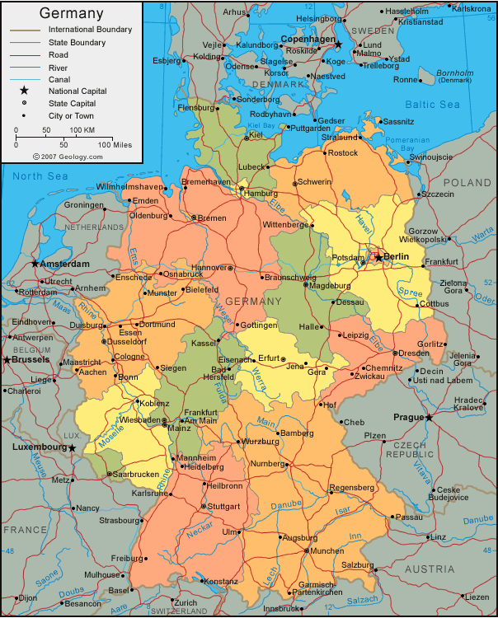
http://www.google.com/imgres?imgurl=http://geology.com/world/germany-map.gif&imgrefurl=http://geology.com/world/germany-satellite-image.shtml&h=750&w=604&sz=116&tbnid=13jTNMl2_b4xhM:&tbnh=141&tbnw=114&prev=/images%3Fq%3Dgermany%2Bmap&hl=en&usg=__0ufwgUo_73opYMIfvnjkEU1M2_E=&ei=mZuWS82VK42wtgfYoazrDQ&sa=X&oi=image_result&resnum=11&ct=image&ved=0CCoQ9QEwCg

Slide 36
Case 14-1 Nurnberg Augsburg Maschinenwerke (N.A.M.)
Production Plan:
First 25 buses manuf. at Prague facility
224 buses split by factories at Prague and Munich
Transportation Info (train, from Prague):
 | Bremerhaven | Hamburg | Rotterdam
Geographic dist. | ~550K | 490K | 640K
Transit time | 3 days | 3 days | 4~5 days
Cost (2 buses) |  | €1643/flatcar | €1943/flatcar
Unloading cost |  | €45/bus | €45/bus
Loading (first 20) |  | €25/bus | €25/bus
Loading (over 20) |  | €40/bus | €40/bus

Slide 37
Case 14-1 Nurnberg Augsburg Maschinenwerke (N.A.M.)
Transportation Info (waterway, from Prague):
 | Bremerhaven | Hamburg | Rotterdam
Transit time |  | 3 days more
Cost |  | €48/bus less
Transportation Info (ocean, to Santos, Brazil):
 | Bremerhaven | Hamburg | Rotterdam
Transit time | 18 days | 18 days
Cost (2 buses) | €6000/bus | €6000/bus
Departing dates |  | 10/24, 27, 31, 11/3 | 10/23, 28, 11/2
Unloading (at Santos) | €94/bus | €94/bus | €94/bus

Slide 38
Case 14-1 Nurnberg Augsburg Maschinenwerke (N.A.M.)
Discussions:
#1: Assume that you are Weiss. How many viable alternatives do you have to consider regarding the initial shipment of 25 buses?
#2: Which of the routing alternatives would you recommend to meet the initial 90-day deadline for the 25-bus shipment? Train or waterway? To which port(s)? What would it cost?
#3: What additional information would be helpful for answering question 2?
#4: How important, in fact, are the transport costs for the initial shipment of 25 buses?
#5: What kinds of “customer service” support must be provided for this initial shipment of 25 buses? Who is responsible?

Slide 39
Case 14-1 Nurnberg Augsburg Maschinenwerke (N.A.M.)
Discussions:
#7: Would you make the same routing recommendation for the second, larger (199 buses) component of the order, after the initial 90-day deadline is met? Why or why not?
#8: How important, if at all, is it for N.A.M. to ship via water to show its support of the “Green” movement’s desires?

