Slide 1
Chapter 13 Transportation Management

Slide 2
Learning Objectives
To learn about contemporary transportation management
To understand how rates are determined
To learn about modal and carrier selection
To distinguish among various transportation documents
To understand select activities associated with making and receiving shipments
To learn about transportation quality

Slide 3
Transportation Management Key Terms
Amodal shipper
Bill of lading
Class rate system
Commodity rate
Concealed loss or damage
Demurrage
Density
Detention
Documentation
Expediting
FOB destination
FOB origin
Freight bill
Freight claims
Rate
Routing
Routing Guide
Stowability
Tracing
Transportation Management
Weight break

Slide 4
Transportation Management
Transportation management refers to the buying and controlling of transportation service by either a shipper or consignee.
Source: John J. Coyle, Edward J. Bardi, and Robert A. Novack, Transportation, 6th ed. (Mason, OH: South-Western, 2006).
Transportation is the most costly logistics activity
Transportation managers can help:
Marketing
Manufacturing
Outbound shipping
Purchasing

Slide 5
Rate (Pricing) Considerations
Rate Determination
Often located on carrier Web sites
Transportation rates based on three factors
Product
Weight
Distance
Three factors are defined numerically and then tied to a rate of cents per hundredweight (cwt)

Slide 6
Rate (Pricing) Considerations
Rate Determination
Commodity rate
One specific rate for every possible combination of product, weight, and distance
Class rate system
System to simplify rate determination
Freight classification used to simplify the number of commodities
National Motor Freight Classification (NMFC)

Slide 7
Rate (Pricing) Considerations
Rate Determination
Factors used for determine product’s freight classification
Density (higher classification for low-density)
Stowability (how easy to pack into a load)
Ease of handling
Liability to damage and theft

Slide 8
Page from National Motor Freight Classification

Slide 9
National Motor Freight Classification
National Motor Freight Classification Procedures
http://www.nmfta.org/Documents/CCSB/CCSB%20Procedures%202009.pdf
Find classification online
http://freight88.com/NMFC-Codes-Freight_class.html

Slide 10
Rate (Pricing) Considerations
Rate Determination
Weight groups are used to simplify shipment weight
Weight group examples:
<500 lbs (highest rate)
500-999 lbs
1000-1,999 lbs
Distances are simplified through rate basis numbers
Zip codes are replacing rate basis numbers

Slide 11
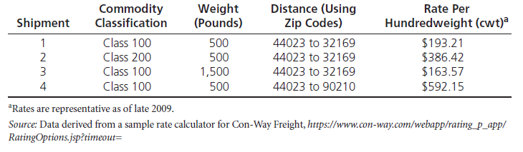
Example of the Class Rate System

Slide 12
Rate (Pricing) Considerations
Rate Determination
Commodity Classification Standards Borad develops and maintains commodity freight classifications
Shippers prefer lower classification number (lower rate)
Carriers prefer higher classification number (higher rate)
Transportation managers can appeal a commodity’s classification

Slide 13
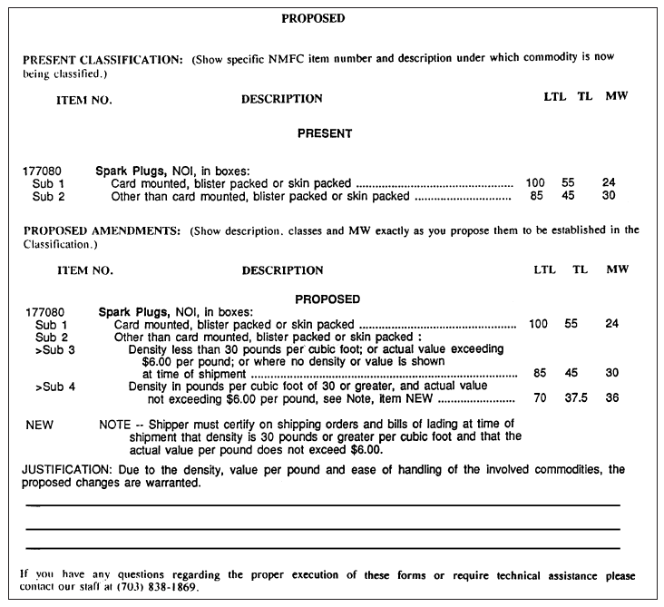
Figure 13-2: Motor Carrier Classification Docket Proposal for Changing the Classification of Sparkplugs

Slide 14
Transportation Rates
To find LTL rates usually need:
Origin and destination zip codes
Weight of shipment
Classification of shipment
Supplemental services needed
Discount awarded to shipper by carrier
Rates may be on carrier Web sites

Slide 15
Rate and Service Negotiations
Both rates and service levels may be negotiated
Long-term relationships are encouraged
Negotiations are subject to antitrust laws
Allows transportation managers to take advantage of trade-offs between price and service

Slide 16
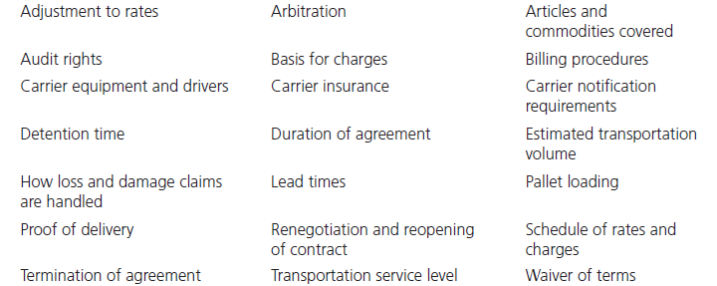
Table 13-2: Representative Rate and Service Items in the Carrier-Shipper Negotiation Process

Slide 17
Modal and Carrier Selection
Two-step process
First determine appropriate mode(s)
Then select carrier(s) within the chosen mode(s)
Carrier selection is more challenging
Difficult to be aware of every possible carrier
Lack of agreement on the number of relevant factors

Slide 18
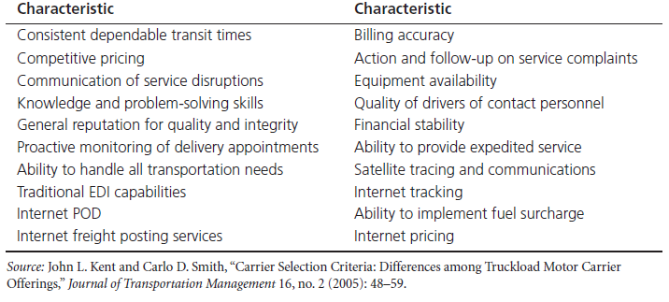
Table 13-3: Possible Carrier Selection Characteristics

Slide 19
Modal and Carrier Selection
Amodal shipper refers to a transportation manager who purchases a prespecified level of transportation service and is indifferent to the mode(s) and or carrier(s) used to provide the actual transportation service.
Research indicates shippers are more interested in transportation metrics than in modes

Slide 20
Documentation
Documentation
Serves practical function (what, where, and how much is being transported
Potentially provides legal recourse
Bill of lading
Straight bill of lading
Order bill of lading
Long-form bill of lading
Preprinted short-form bill of lading
Freight bill
Freight claims

Slide 21
Figure 13-4: A Long-Form Bill of Lading

Slide 22
Figure 13-5: A Preprinted Short-Form Bill of Lading

Slide 23
Documentation
Freight bill
Invoice submitted by the carrier requesting to be paid
Freight bill-paying service
Internal audits
External audits
Freight claims
Refers to a document that notifies a carrier of wrong or defective deliveries, delays, or other delivery shortcomings
Concealed loss or damage is when loss or damage is not apparent until after a shipment has been unpacked and inspected

Slide 24
Making and Receiving Shipments
Consolidating small shipments
Shipments > 150 and < 500 pounds
To get a lower rate, shipment consolidation may occur: aggregating customer orders across time or place or both

Slide 25
Consolidation of Shipments

Slide 26
Making and Receiving Shipments
Demurrage and Detention
Demurrage is a penalty payment made to the railroad for keeping a railcar beyond the time when it should be released back to railroad
Detention is the word used in the trucking industry
Routing
Process of determining how a shipment will be moved between consignor and consignee
Hazmat routing

Slide 27
Figure 13-8: Specialized Container with Sump to Capture Hazardous Waste Leaks from Barrels

Slide 28
Making and Receiving Shipments
Tracing and Expediting
Tracing is the attempt to locate lost or late shipments
Expediting is rapidly moving a shipment through a carrier’s system.

Slide 29
Transportation Service Quality
Macroenvironmental changes have caused organizations to demand higher levels of service quality
Economic deregulation allowed for both price and service competition resulting in a need to measure performance
Can measure performance through the use a performance scorecard

Slide 30
Example of a Carrier Performance Scorecard

Slide 31
Case 13-1 Chippy Potato Chip Company
Company Facts:
Located Reno, Nevada (1947)
Existing Product Facts:
Freight Rating: LTL 200
Package: 24 8-oz containers in a carton (12” x 12” x 36”), weight 14 lbs.
Price: FOB plant $.40/bag
New Product Facts:
Package: 24 5-oz bags in a carton (1 ft³), weight 10 lbs.
Price: FOB plant $.40/bag

Slide 32
Case 13-1 Chippy Potato Chip Company
Discussions:
#1: If you worked for Chippy, what new classification would you ask for? Give your reasons.
#2: Classifications are based on both cost and value of service. From the carriers’ standpoint, how has cost of service changed?
#3: Given the existing LTL classification of 200, how has value of service to the customer changed?
#4: The new tubular containers are much sturdier. If you worked for Chippy, how—if at all—would you argue that this factor influences classification?

Slide 33
Case 7-1 Chippy Potato Chip Company
Discussions:
#5: You work for the motor carrier classification bureau and notice that the relationship between the weight of potato chips and the weight of packaging has changed. How, it at all, should this influence changes in the product’s classification?
#6: One of Chippy’s own trucks, used for local deliveries, has two axles and an enclosed body measuring (inside) seven feet by eight feet by twenty feet and is limited by law to carrying a load of no more than 8,000 pounds. Because the truck is not supposed to be overloaded, what combinations, expressed in terms of cartons of each, of new- and old-style chips can it legally carry?

