Slide 1
Chapter 12 Transportation

Slide 2
Learning Objectives
To provide an overview of transportation infrastructures in several countries
To identify the five modes of transportation and learn about their respective characteristics
To discuss intermodal transportation
To familiarize you with several types of transportation specialists
To learn how different types of regulation impact transportation
To identify the legal classification of transportation carriers

Slide 3
Transportation: Key Terms
Accessorial service
Barge
Broker
Common Carrier
Consignee
Contract carrier
Container
Dept. of Transportation
Dimensional (dim) weight
Excess capacity
Exempt carrier
Freight forwarder
Intermodal transportation
Land bridge services
Less-than-truckload (LTL)
Line-haul
Lock
Parcel carriers
Piggyback transportation

Slide 4
Transportation: Key Terms
Private carriers
Rail gauge
Shippers’ association
Slurry systems
Surface Transportation Board
TEU
Terminal
Ton miles
Transportation
Truckload (TL)
Unit load devices (ULD)
Department of Transportation (DOT)

Slide 5
Transportation
Transportation is the movement of goods and people between two points.

Slide 6
Transportation
Transportation influences or is influenced by the following logistics activities:
Transportation costs are affected by node location
Inventory requirements are influenced by mode
Packaging requirements are dictated by mode
Materials handling equipment and design of the docks are dictated by mode
Maximum consolidation of loads achieved with order-management technology reduces costs
Customer service goals influence carrier choice

Slide 7
Transportation
Five different types or modes of transportation include:
Air
Motor carrier (truck)
Pipeline
Rail
Water

Slide 8
Overview of Transportation Infrastructure
Wide disparities in the various infrastructures exist between highly populated countries
Lack of infrastructure makes it difficult to use that mode domestically

Slide 9
Transportation Infrastructure (2006)
 | Brazil | China | India | UK | US
Air (runway > 10k ft.) | 8 | 54 | 17 | 8 | 191
Highway (paved, km) | 95K | 1448K | 2411K | 388K | 4165K
Pipeline (oil, km) | 5.2K | 14.5K | 5.6K | 6.4K | 244.6K
Broad gauge rail (km) | 4.9K |  | 45.7K | 0.5K
Std gauge rail (km) | 0.2K | 71.9K |  | 16.8K | 227.7K
Narrow gauge rail (km) | 23.9K |  | 14.4K
Water (inland, km) | 50K | 124K | 14.5K | 3.2K | 41K
Area (km²) | 8544K | 9806K | 3167K | 244.8K | 9162K

Slide 10
Transportation Infrastructure (2010)
 | Brazil | China | India | UK | US
Air (runway > 10k ft.) | 7 | 63 | 21 | 9 | 189
Highway (paved, km) | 96K | 3584K | 3320K | 394K | 4375K
Pipeline (oil, km) | 4.5K | 20.1K | 7.7K | .7K | 244.6K
Broad gauge rail (km) | 5.7K |  | 52.8K | 0.3K
Std gauge rail (km) | 0.2K | 77.1K |  | 16.2K | 226.4K
Narrow gauge rail (km) | 22.9K | .8K | 8.5K
Water (inland, km) | 50K | 110K | 14.5K | 3.2K | 41K
Area (km²) | 8544K | 9806K | 3167K | 244.8K | 9162K
https://www.cia.gov/library/publications/the-world-factbook/rankorder/2053rank.htm

Slide 11
Selecting Transportation Modes
Attributes
Cost
Speed (transit time from pickup to delivery)
Reliability (consistency of delivery)
Capability (amount of different types of product)
Capacity (volume/weight can be carried at one time)
Flexibility (ability to deliver the product to customer)

Slide 12
Airfreight
Airfreight
Generally the fastest mode
Expensive
Accessorial service, if needed, adds cost and time
Best suited for high-value, lower-volume urgent, perishable or time-specific deliveries
Dimensional weight used for rates

Slide 13
Airfreight
Advantages:
Speed (line-haul)
Disadvantages:
Cost
Flexibility (need of accessorial service)
Limited capacity
Boeing 737: 10 tons; 777: 60 tons, 747: 100 tons
Airbus A-380: 150 tons
Applicable: high-value, low-volume

Slide 14
Airfreight
Examples of products that move by air:
Auto parts and accessories
Cut flowers and nursery stock
Electronic or electrical equipment, i.e. iPods
Fruits and vegetables
Machinery and parts
Metal products
Photographic equipment, parts, and film
Printed matter
Wearing apparel

Slide 15
Airfreight
Airfreight reliability is problematic due to delays caused by:
Weather
Congestion and resultant delays with air passenger transportation (belly freight)

Slide 16
Motor Carriers
Motor Carriers
Most important business user of the Interstate Highway System
Primary advantage is flexibility
Cost is generally lower when compared to airfreight
LTL vs. TL

Slide 17
Motor Carriers
Advantages:
Flexibility
Capability
Disadvantages:
Cost (only cheaper than airfreight)
Limited capacity: 40 tons (Interstate Hwy)

Slide 18
LTL Carriers
Less-than-truckload (LTL)
150 to 10,000 pounds
Too big to be handled manually, too small to fill a truck
LTL trucks carry shipments from many shippers
Prominent LTL carriers include:
ABF Freight System
FedEx Freight
UPS Freight
YRC (formerly Yellow Freight and Roadway)

Slide 19
LTL Carriers
Less-than-truckload (LTL) (continued)
Process
Local pick-up
Origin terminal used to load aboard line haul
Line haul to terminal near destination
Destination local delivery on smaller trucks
Consignee receives

Slide 20
Pipelines
Pipelines
Only mode without vehicles
Most reliable mode
Tend to be the slowest mode
Accommodates only liquid, liquefiable or gaseous products
Capable of transporting large product volumes
High fixed costs, but relatively low cost per unit due to large product volume

Slide 21
Pipelines
Advantages:
No need for vehicles and vehicle operators
Reliability
Capacity
Disadvantages:
One-way
Limited capability
High Initial Cost
Flexibility

Slide 22
Railroads
Railroads
U.S. dominated by four carriers
Burlington Northern (BN)
CSX
Norfolk Southern (NS)
Union Pacific
Domination limits service and pricing options

Slide 23
Railroads
Neither “best” or “worst” on any of the six attributes
Superior to air, motor, and pipeline, but inferior to water when transporting different kinds of products
Less flexibility, but more when compared to air, water, and pipeline
Superior to air and motor with regards to volume, but inferior to pipeline and water
Less expensive than air and motor, but more expensive than pipeline and water
Faster than pipeline and water, but slower than air and truck
Applicable: low-value, high-volume

Slide 24
Water
Water
Relatively inexpensive
Focus on lower value bulk commodities handled by mechanical means
Many different kinds of products can be carried
Carry greater volumes than rail or truck
Slow average speeds
Somewhat unreliable

Slide 25
Water
Advantages:
Cost
Disadvantages:
Speed (6 mph)
Flexibility
Applicable: low-value bulk commodities

Slide 26
Transportation Mode Comparison
 | Cost ¢/ton-mile | Transit Time | Reliability | Loss & Damage
Rail | 2.28 | 3 | 4 | 5
Truck | 26.19 | 2 | 3 | 4
Water | 0.74 | 5 | 5 | 2
Pipeline | 1.46 | 4 | 2 | 1
Air | 61.20 | 1 | 1 | 3

Slide 27
Intermodal Transportation
Intermodal transportation refers to transportation when using a container or other equipment that can be transferred from the vehicle of one mode to the vehicle of another mode without the contents being reloaded or disturbed.
Two or more modes are employed to utilize advantages of each while minimizing their disadvantages
Piggyback transportation

Slide 28
Figure 12-2: RoadRailer Trailer

Slide 29
Intermodal Transportation
Containers
Large reusable steel boxes used for intermodal shipments
Source: http//en.wikipedia.org/wiki/Shipping_containers.
Provide significant reduction in freight handling costs
Are interchangeable among rail, truck, and water carriers
Airfreight containers (ULDs) are designed specifically for fuselage
Are measured by TEU’s
Allowed for land bridge services

Slide 30
Intermodal Transportation
Advantages:
Uses 2 or more modes to utilize the advantages of each mode while minimizing the disadvantages
Using container or other equipment (transfer from mode to mode without reloading)

Slide 31
Transportation Specialists
Freight forwarders
Buy space at TL (truckload) rate and sell at somewhat less than LTL rate
Pick-up and deliver; motor carriers or railroads do line-haul

Slide 32
Transportation Specialists
Air forwarders
Consolidate shipments
Tender to airlines in containers ready for loading
Forwarders provide retailing function
Airline provides wholesaling function
Shipper’s associations
Similar to air and freight forwarders but are not-for-profit organizations
Primarily focused on achieving the lowest rates for members

Slide 33
Transportation Specialists
Brokers
A facilitator who brings together a buyer and seller
May consolidate LTL shipments and then give to truckers, forwarders, or shippers’ associations
3PLs
Find clients with complimentary needs to maximize equipment utilization

Slide 34
Transportation Specialists
Parcel carriers
Parcels are packages weighing up to 150 pounds
Parcel carriers are companies that specialize in transporting parcels
Parcel carriers include:
USPS
UPS
FedEx
Greyhound Package Express

Slide 35
Transportation Regulation
Five modes are influenced by federal, state and local government regulations
Examples:
Mandatory retirement age for pilots in U.S.
Placement of lighting on truck trailers
Regulation
Costs money
Needs to be codified
Is enforced by government agencies

Slide 36
Transportation Regulation
Level and degree of regulation varies from country to country
i.e. industrialized countries tend to have more stringent transportation equipment emissions regulations when compared to those of less industrialized countries
Logisticians must understand
Relevant transportation regulations
Cost and service implications of regulations

Slide 37
Federal Regulation of Transportation in U.S.
Environmental
Environment Protection Agency (EPA) is the federal regulatory agency established to protect human health and the environment
Current concerns include:
Noise and air pollution
Resource conservation

Slide 38
Federal Regulation of Transportation in U.S.
Safety
Department of Transportation (DOT) is the federal agency responsible for transportation safety regulations for all five modes
Federal Aviation Administration (FAA) has primary responsibility for air transportation safety
Federal Motor Carrier Safety Administration (FMCSA) is focused on reducing crashes, injuries, and fatalities involving large trucks and buses.

Slide 39
Federal Regulation of Transportation in U.S.
Safety (continued)
Office of Pipeline Safety (OPS) is responsible for safety considerations for natural gas and liquid pipelines
Federal Railroad Administration (FRA) has primary responsibility for safety in the U.S. railroad industry
U.S. Coast Guard (USCG) has safety regulation responsibilities for marine safety considerations

Slide 40
Federal Regulation of Transportation in U.S.
Economic
Refers to control over business practices and activities such as entry and exit, pricing, service, accounting, and financial issues, and mergers and acquisitions
Regulation began in the 1870’s due to a belief that transportation companies would not act in the public’s best interest without government regulation

Slide 41
Federal Regulation of Transportation in U.S.
Economic (continued)
Interstate Commerce Commission (ICC) has authority over rail, motor, inland water, and oil pipelines
Civil Aeronautics Board (CAB) has authority over air transportation

Slide 42
Federal Regulation of Transportation in U.S.
Economic (continued)
Due to deregulation
Civil Aeronautics Board (CAB) was eliminated
Interstate Commerce Commission (ICC) was eliminated with functions transferred to a new agency, the Surface Transportation Board (STB)
Economic deregulation has allowed greater freedom with respect to pricing and service options

Slide 43
Legal Classification of Carriers
Transportation carriers are classified as either
For-hire
Common
Contract
Exempt
Private
Classification is important because different levels of economic regulation are applicable to different carriers

Slide 44
Legal Classification of Carriers
Common carriers serve the general public
Contract carriers offer specialized service to customers on a contractual basis
No obligation to serve the general public or to treat customers on an equal basis
Exempt carriers are exempted from economic regulation due to legislation
Private carriers are companies whose primary business is other than transportation and provide their own transportation service
Also exempt from economic regulation

Slide 45
Private Transportation
Private transportation is used when firms own and operate their own trucks, railcars, barges, ships, and/or airplanes
Wal-Mart has largest private truck fleet in U.S.
7,767 tractors and 26,117 trailers
Private trucking provides
Improved level of customer service
Advertising on the trucks
May be less expensive

Slide 46
Case 12-1 HDT Truck Company
Company Facts:
Located in Crown Point, Indiana (1910)
Products:
Large off-road vehicles (airport snowplows, airport crash trucks, oil-field drilling equipment, etc.)
Plant Capacity:
2 trucks assembled / day (single shift)
Max. 3 for large order of identical trucks
At least 4-mo backlog

Slide 47
Case 12-1 HDT Truck Company
Current Issues:
Received an order of 50 heavy trucks from Saudi Arabia
Deliver on or before July 1, 2003
Priced at $172,000/truck FAS at Doha
Production is scheduled from April 2 ~ April 29 (2.5/day)
People Involved:
Norman Pon (Treasurer)
Chris Reynolds (Production)
Vic Guillou (Sales)
Gordon Robertson (President)
Bob Vanderpool (Traffic)
Bob Guider (Int’l Freight Forwarded, Chicago)
Eddie Quan (Ship Broker, NY)

Slide 48
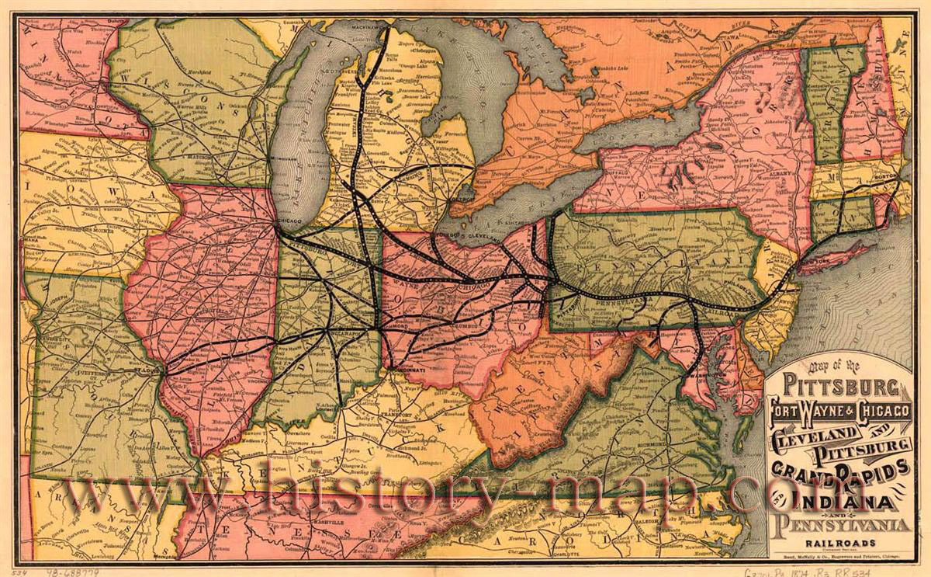
Case 12-1 HDT Truck Company

Slide 49
Case 12-1 HDT Truck Company
Account Payables:
Components will arrive from April 1 to April 10
Term for payment: 1/10 (1% discount if paid in 10 days)
Line of credits: 8%

Slide 50
Case 12-1 HDT Truck Company
Alternatives for Shipping:
Charter from Chicago:
Nola Pino, Ready on May 1, $2,400/day for 30 days
Loading & Unloading: $40/truck
To Chicago (Railroad Flatcar): $180/truck
Travel Time: 1 day + 1 day waiting (L)
Wharfage Charge: $2/ft x 535 ft x 1 day
Loading & Stowing: $4,000 for 50 trucks
Seaway Tolls: $54/truck
Unloading (at Doha): $4,200 for 50 trucks
Marine insurance: $210 / truck
Ship from Baltimore:
To Baltimore (Railroad Flatcar): 2 trucks/flatcar, $1,792/flatcar
Loading & Unloading: $120/flatcar
Travel Time: 4 days + 3 days waiting (L&UL)
Handling at Baltimore: $200/truck
Ocean freight: $1,440/truck + $150/truck for insurance

Slide 51
Case 12-1 HDT Truck Company
Questions:
Assume you are Vanderpool. Draft the comparison Pon just requested.
Which of the two routing alternatives would you recommend? Why?
Assume that the buyer in Saudi Arabia has made other large purchases in the United States and is considering consolidating all of its purchases and loading them onto one large ship, which the buyer will charter. The buyer contacts HDT and, although acknowledging its commitment to buy FAS Doha, asks how much HDT would subtract from the $172,000 per truck price if the selling terms were changed to FOB HDT’s Crown Point plant. How much of a cost reduction do you think HDT should offer the buyer? Under what terms and conditions?

Slide 52
Case 12-1 HDT Truck Company
Questions:
Answer question 3 with regard to changing the terms of sale to delivery at port in Baltimore. The buyer would unload the trucks from the railcars.
Is there an interest rate that would make HDT change from one routing to another? If so, what is it?
Assume that it is the year 2005 and the cost to HDT of borrowing money is 12% per year. Because the buyer will pay for trucks as they are delivered, would it be advantageous for HDT to pay overtime to speed up production, ship the trucks as they were finished via the Port of Baltimore, and collect their payment earlier? Why or why not?

