Slide 1
Chapter 11
Packaging and
Materials Handling

Slide 2
Learning Objectives
To know how product features affect packaging and materials handling
To familiarize you with packaging fundamentals such as packaging functions and labeling
To appreciate select issues that affect packaging such as environmental protection and packaging inefficiencies
To learn about unit loads and the unit load platform
To identify materials handling principles and materials handling equipment

Slide 3
Packaging and Materials Handling
Key Terms
  Building-blocks concept
  Closed-loop systems
  Container
  Cube out
  Ergonomics
  Globally Harmonized System of Classification and Labeling of Chemicals (GHS)
  Materials handling
  Package testing
      Packaging
      Pallet (skid)
      Part-to-picker system
      Picker-to-part system
      Shrink-wrap
      Slip sheet
      Unit loads (Unitization)
      Weighing out

Slide 4
Product Characteristics
Physical Characteristics
  Density of bulk materials
  Ability to withstand exposure to elements
  Respiration
Chemical Characteristics
  Incompatible products
  Products requiring chemicals
Characteristics must be made known to consumers

Slide 5

Figure 11-1: Portion of fabric care label for Levi’s jeans sold in Japan

Slide 6
Packaging Fundamentals
Building-blocks concept
  Smallest unit is consumer package
  Each unit is stocked within the next larger one to protect the product
Packaging
  refers to materials used for the containment, protection, handling, delivery, and presentation of goods
  Serves three general functions
    To promote
    To protect
    To identify (label) the relevant product

Slide 7
Promotional and Protective Functions of Packaging
Protective functions of packaging
  Enclose materials
  Restrain materials from undesired movement
  Separate contents to prevent undesired contact
  Cushion contents from outside vibrations and shocks
  Support the weight of identical containers stacked above
  Position the contents to provide maximum protection
  Provide for uniform weight distribution
  Provide exterior surface for labeling
  Be tamperproof
  Be safe for consumers or others

Slide 8
Checklist for Box Users
(Figure 11-3)
YOUR PRODUCT
1. Have you given your box maker a description of your product and its use, the exact dimensions, weight and physical characteristics?
2. Is the product likely to settle or shift?
3. Is it perishable, fragile, or hazardous in any way?
4. Will it need extra protection against vibration, impact, moisture, air, heat or cold?
5. Will it be shipped fully assembled?
6. Will more than one unit be packed in a box?
7. Will accessories, parts or literature be included with the product?
8. Have you provided your box maker with a complete sample of your product as it will be packed?

Slide 9
Checklist for Box Users
(Figure 11-3)
YOUR PACKING OPERATION
Is your box inventory adequately geared to re-order lead time?
Is your box inventory arranged to efficiently feed your packing lines?
Is your inventory of boxes properly stored?
Will you be setting up the boxes on automatic equipment? (lf so, what type? Size? Method of closure?)
Will your product be packed automatically? (lf so, with what type of equipment?)
lf more than one unit or part goes into each box, have you determined the sequence?
Will inner packing — shells, liners, pads, partitions—be inserted by hand?
Is your closure system—tape, stiches, glue—compatible with the box, packing line speed, customer needs and recycling considerations?
Will the box be imprinted or labeled?
Will a master pack be used for a multiple of boxes to maintain cleanliness or appearance?

Slide 10
Checklist for Box Users
(Figure 11-3)
YOUR STORAGE
1. Have you determined the gross weight of the filled box?
2. Does the product itself help support weight in stacking?
3. Will the bottom box have to support the full weight in warehouse stacking?
4. Will boxes be handled by lift trucks which use clamps, finger lifts or special attachments?
5. Will filled boxes be palletized? (The size of pallet and pallet pattern may justify a change in box design or dimensions, if only to reduce or eliminate overhang.)
6. Would a change in box style or size make more efficient use of warehouse space?
7. Will filled boxes be subject to unusual conditions during storage—high humidity, extreme temperatures. etc.?
8. Is the product likely to be stored outdoors at anytime during its distribution?
9. Would color coding simplify identification of various packed products?

Slide 11
Checklist for Box Users
(Figure 11-3)
YOUR SHIPPING
Have you reviewed the appropriate rules of the transportation service you intend to use (rail, truck, air, parcel post, etc.)?
Is your container authorized for shipment of your product?
If the package is not authorized, have you requested appropriate test shipment authorization from the carrier?
Does your product require any special caution or warning label or legend for shipment?
Have you determined the actual inside dimensions of the transportation vehicle so that you can establish how your filled boxes will be stacked or braced?

Slide 12
Checklist for Box Users
(Figure 11-3)
YOUR CUSTOMER
Does your customer have any special receiving, storage or handling requirements that will affect box design?
Will the box be used as part of a mass display?
Is the box intended as a display-shipper?
Will it contain a separate product display?
Will it be used as a carry-home package, requiring a carrying device?
Does it need an easy-opening feature?
Can surface design. symbols or colors relate to promotional materials or to other products of the same corporate family?
Should instructions or opening precautions be printed on the box?
Can the box be made to better sell your product?

Slide 13
Package Testing and Monitoring
A package system requires 3 types of information to design
  Severity of the distribution environment
  Fragility of the product
  Performance characteristics of various cushion materials

Slide 14
Package Testing and Monitoring
Package testing
  Vibrations
  Dropping
  Horizontal impacts
  Compression
  Overexposure to extreme temperatures or moisture
  Rough handling

Slide 15

Figure 11-4: Kaiser Aluminum’s Moisture-Alert Label

Slide 16
Labeling
Labeling
  Retroflective labels
  Batch numbers
  Weight
  Specific contents
  Instructions for use
  Information to allow passage through customs
  Compliance labeling
  One- or two-dimensional bar codes
  Smart labels or RFID labels

Slide 17
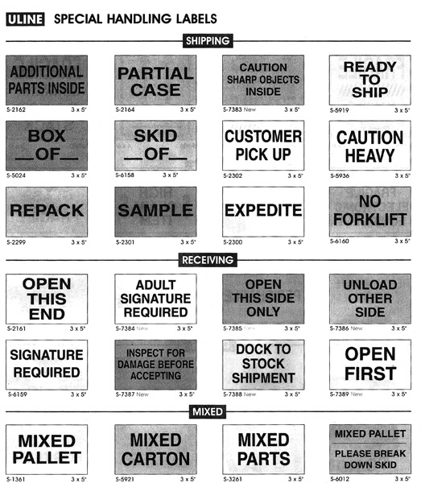
Figure 11-5: Examples of Shipping Labels

Slide 18
Hazardous Materials
Hazardous Materials
  Governmental regulations address labeling of hazardous materials
Requirements involve
  Labeling
  Packaging and repackaging
  Placing warnings on shipping documents
  Notifying transportation carriers in advance
Globally Harmonized System of Classification and Labeling of Chemicals (GHS) is a global system to classify and label hazardous materials.

Slide 19
Issues in Packaging
Environmental Protection
  Reduce packing materials used
  Use packaging materials that are more environmentally friendly with recycled content
  Use reusable containers (closed-loop system)
  Retain or support services that collect used packaging and recycle it (closed-loop system)

Slide 20
Issues in Packaging
Metric System
  U.S., Liberia, and Myanmar (formerly Burma) are the only 3 countries in the world that do not use the metric system of measurement
  Increasing pressure on U.S. exporters to market their products overseas in metric units

Slide 21
Identifying Packaging Inefficiencies
Building-blocks concept is useful for analyzing packaging inefficiencies.
Packaging inefficiencies can have a number of undesirable logistics consequences including:
  Increased loss
  Increase damage
  Slower materials handling
  Higher storage costs
  Higher transportation costs

Slide 22
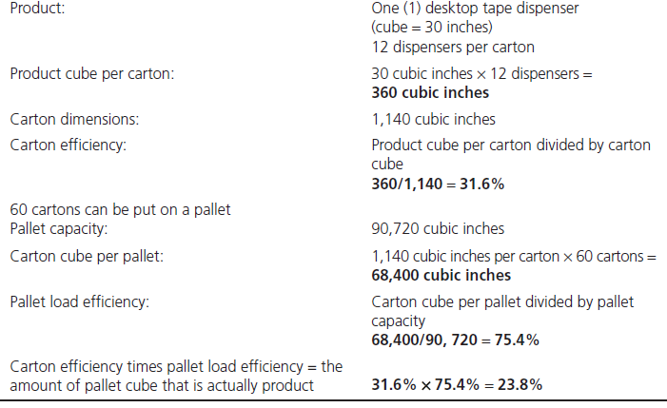
Table 11-1: A Hypothetical Example of Packaging Inefficiency

Slide 23
Packaging’s Influence on Transportation Considerations
Carrier’s tariffs and classifications influence the type of packaging and packing methods that must be used.
Carriers established classifications for two main reasons:
  Packaging specifications determined by product density lead to the best use of the equipment’s weight and volume capabilities
  Carrier specifications for protective packaging reduce likelihood of damage to products thus reducing the loss and damage claims filed against the carrier

Slide 24
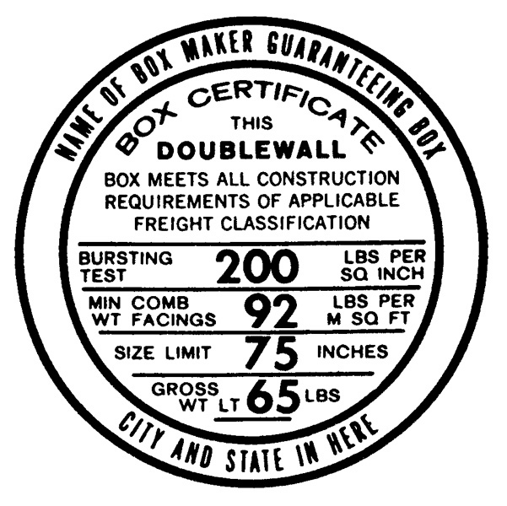
Figure 11-6: Boxmaker’s Certificate
(BMC)

Slide 25
Unit Loads in Materials Handling
A unit load (unitization) refers to consolidation of several units (cartons or cases) into larger units to improve efficiency in handling and to reduce shipping costs.
Source: http://cscmp.org/digital/glossary/glossary.asp
Handling efficiency can be facilitated by mechanical devices (pallet jack or forklift) as well as by using a pallet or skid.

Slide 26
Unit Loads in Materials Handling
Advantages
  Additional protection
  Pilferage is discouraged
  More fragile items can be stacked inside the load
  Mechanical devices can be substituted for hand labor
Disadvantages
  Provides large quantity that sometimes is of limited value to resellers dealing in smaller quantities
  Must use mechanical or automated device to move

Slide 27
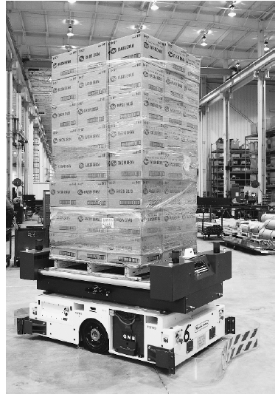
Figure 11-7: Automated Guided Vehicle
© Pearson Education, Inc. publishing as Prentice Hall

Slide 28
Unit Loads in Materials Handling
Basic unit is a pallet or skid
  Can be constructed from wood, wood composites, plastic, paper, and metal
  Each pallet material has advantages and disadvantages
  Should be less than 50 pounds
Pallet or skid alternatives
  Slip sheet
  Shrink-wrap

Slide 29
Unit Loads in Material Handling
Beyond the unit load
  Use of load-planning software
  Bracing
  Inflatable dunnage bags
  Load is subjected various forces including
    Vibration
    Roll
    Pitch
  Weighing out

Slide 30
Materials Handling
Materials handling refers to the “short-distance movement that usually takes place within the confines of a building such as a plant or DC and between a build and a transportation service provider.”
Source: John J. Coyle, C. John Langley, Jr., Brian J. Gibson, Robert A. Novack, and Edward J. Bardi, Supply Chain Management: A Logistics Perspective, 8th ed. (Mason, OH: South-Western Cengage Learning, 2009), Appendix 11-A.
How the products are handled depends on whether they are packaged or in bulk
Handling may change the characteristics of the product

Slide 31
Materials Handling Principles
10 Material Handling Principles Include:
Planning
Standardization
Work
Ergonomic
Unit load
Space utilization
System
Automation
Environmental
Life cycle cost
Source: “The Ten Principles of Material Handling,” www.mhia.org.

Slide 32
Materials Handling Equipment
Two categories of handling equipment
  Storage
    Shelves
    Racks
    Bins
  Handling
    Conveyor systems
    Lift trucks
    Carts
    Cranes

Slide 33
Materials Handling Equipment
The choice of handling equipment can influence the type of storage equipment.
The choice of storage equipment can influence the type of handling equipment.

Slide 34
Materials Handling Equipment
Material handling equipment can also be categorized as:
  Labor intensive
  Mechanized
  Automated
Sufficient volume is needed to justify high cost of automated equipment

Slide 35
Materials Handling Equipment
An organization’s order picking and assembly system can also influence the type of handling equipment.
  Picker-to-part systems
  Part-to-picker systems

Slide 36
Case 11-1 Let There Be Light Lamp Shade Company
Company Facts:
Located Madison, Wisconsin
Product Facts:
5,400 identical Lamp Shade (to Asia)
Design Options:
Style A: cylinder, 11” x 11”
Style B & C: Cone-shaped

Slide 37
Case 11-1 Let There Be Light Lamp Shade Company
Transportation to Port of Oakland:
Land rate: $1,000 per 40-ft container (8’w, 8.5’h, 40’ l)
Max weight: 44,000 lbs
Transportation from Port of Oakland to overseas port:
Ocean rate: $22 per ton (2,000 lbs)
Measurement ton: 40 ft³ = 1 ton
Insurance Cost: 2% of the value of shipment

Slide 38
Case 11-1 Let There Be Light Lamp Shade Company
Packaging Info:
 | Style A | Style B | Style C
Manuf. Cost (per piece) | $4.00 | $5.00 | $6.00
Package size | 12"x12"x12" | 12"x12"x48" | 12"x12"x50"
# of pieces per pack | 1 | 6 | 10
Package Cost (each) | $0.60 | $2.00 | $3.00
Package weight (lbs) | 10 | 62 | 101

Slide 39
Case 5-1 Let There Be Light Lamp Shade Company
Discussions:
#1: How many style A shades can be loaded into an intermodal container?
#2: How many style B shades can be loaded into an intermodal container?
#3: How many style C shades can be loaded into an intermodal container?
#4: What are the total costs of delivering the style A shades to the port of importation?
#5: What are the total costs of delivering the style B shades to the port of importation?
#6: What are the total costs of delivering the style C shades to the port of importation?

