Slide 1
Chapter 10
Warehousing Management

Slide 2
Learning Objectives
To understand the role of warehousing in a logistics system
To learn about public, private, contract, and multiclient warehousing
To expose you to select considerations when designing warehousing facilities
To examine some prominent operational issues in warehousing

Slide 3
Warehousing Management
Key Terms
  Accumulating (bulk-making)
  Allocating (bulk-breaking)
  Assorting
  Contract (3rd party) warehousing
  Cross-docking
Key Terms
  Distribution centers
  Dunnage
  Fixed slot location
  Hazardous materials
  Multi-client warehousing
  Occupational Safety & Health Administration (OSHA)

Slide 4
Warehousing Management
Key Terms
  Paperless warehousing
  Private warehousing
  Public warehousing
  Regrouping function
  Sorting out
  Throughput
  Variable slot location
  Warehouse
Key Terms
  Warehousing

Slide 5
Warehousing Management
Warehousing refers to “that part of the firm’s logistics system that stores products (raw materials, part, good-in-process, finished goods) at an between points of origin and point of consumption.”
Source: Douglas M. Lambert, James R. Stock, and Lisa M. Ellram, Fundamentals of Logistics Management (New York: Irwin McGraw-Hill, 1998), Chapter 8.
Warehousing management has evolved to include value-adding services
  Custom labeling
  Promotional pack
  Grouping and sorting of products
  Kitting for production
  Display building and packaging
  Price marking

Slide 6
Warehousing Management
Warehousing and transportation are substitutes for each other, with warehousing having been referred to as “transportation at zero miles per hour.”

Slide 7
Adding a Warehousing Facility: Shorter-Haul Transportation (Fig. 10-1)
Retailer A
Producer
Retailer B
Retailer C
Retailer A
Producer
Warehouse
Retailer B
Volume
Shipment
Retailer C

Slide 8
Warehousing Management
Warehousing serves to match different rates or volumes of flow when patterns of production and consumption do not coincide
Regrouping function
  Accumulating (increasing quantity)
  Allocating (reducing quantity)
  Assorting (building up a variety of products)
  Sorting (separating products into grades and qualities)

Slide 9
Warehousing Management
Warehouses
  Emphasize the storage of products
  Primary purpose is to maximize the usage of available storage space
Distribution centers emphasize rapid movement of products through the facility
Throughput is the amount of product entering and leaving a facility in a given time period

Slide 10
Warehousing Management
Cross-docking can be defined as “the process of receiving product and shipping it out the same day or overnight without putting it into storage.”
Source: No author, “2008 Cross-Docking Trends Report,” Saddle Creek Corporation, 2008.
Increased emphasis on time reductions in supply chains has led to the growth of cross-docking.

Slide 11
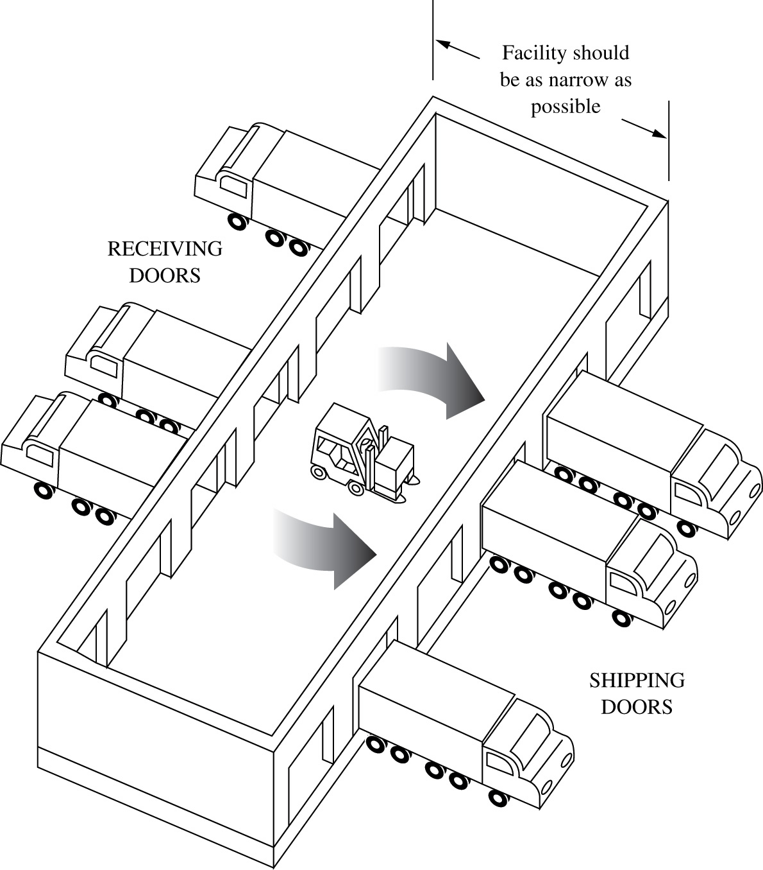
Ideal Facility for Pure Supplier Consolidation (Figure 10-2)

Slide 12
Public Warehousing
Public warehouses
  Serve all legitimate users
  Require no capital investment on the user’s part
  Allows users to rent space as needed
  Can be rented on a month-to-month basis
  Offers more locational flexibility
  May provide specialized services
Potential drawback of public warehouses
  Lack of control by the user
Warehousing labor safety practices monitored by Occupational Safety and Health Administration (OSHA)

Slide 13
Private Warehousing
Private warehousing
  is owned or occupied on a long-term lease
  Offers control to owner
  Assumes both sufficient demand volume and stability so that warehouse remains full
Potential drawbacks of private warehouses:
  High fixed cost
  Necessity of having high and steady demand volumes
  May reduce an organization’s flexibility

Slide 14
Contract Warehousing
Contract warehousing (3PL warehousing) is a long-term arrangement providing unique warehousing services to one client
Both vendor and client share the risks associated with the warehousing
Less costly than private warehousing and more costly than public warehousing

Slide 15
Multiclient Warehousing
Multiclient warehousing
  Mixes attributes of contract and public warehouses
  Services are more differentiated than those in a public facility
  Services are less customized than those in a private facility
  Services are purchased through minimum 1 year contracts
  Are attractive to smaller organizations

Slide 16
Design Considerations in Warehousing
General considerations
  Quantity and character of goods must be known—product profiling
  Know the purpose to be served
    Storage
    Distribution
    Cross-docking

Slide 17
Warehousing Trade-offs
Fixed versus variable slot locations for merchandise
Build out (horizontal) versus build up (vertical)
Order-picking versus stock-replenishing functions
Two-dock versus single-dock layout
Conventional, narrow, or very narrow aisles
Paperless warehousing vs. traditional paper-oriented warehousing operations
Other space needs

Slide 18
Warehousing Operations
Warehousing productivity analysis
Safety considerations
  Regulated by OSHA
  Warehouse safety categories include:
    Employee
    Property
    Motor vehicles
    Hazardous materials
    Warehousing security
    Cleanliness and sanitation issues

Slide 19
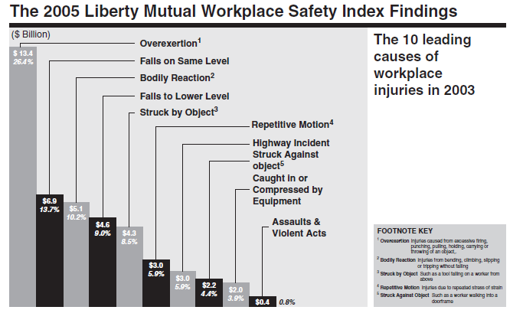
Workplace Safety Issues

Slide 20
Case 10-1 Minnetonka Warehouse
Company Facts:
Located in Minnetonka, Minnesota
Company Information:
Single unloading dock
Warehouse workers: $14/hr, must be paid for an entire shift, cannot be assigned other tasks
Trucks arrive randomly at 4/hr
Penalty for idle truck: $60/hr
Alternatives:
Team of 2, 3, 4, or 5 warehouse workers
Unloading rate will be 5, 8, 10, and 11 trucks per hour

Slide 21
Case 10-1 Minnetonka Warehouse
Discussion:
#1: For each of the four work team sizes, calculate the expected number of trucks in the queue waiting to be unloaded.
#2: For each of the four work team sizes, calculate the expected time in the queue—that is, the expected time a truck has to wait in line to be unloaded.
#3: For each of the four work team sizes, what is the probability that a truck cannot be unloaded immediately?
#4: Which of the four work teams has the lowest cost to Wayne?

Slide 22
Case 10-1 Minnetonka Warehouse
Discussion:
#5: Wayne is also considering rental of a forklift to use in truck unloading. A team of only two would be needed, but the hourly cost would be $38 per hour ($28 for the workers and $10 for the forklift). They could unload a truck in five minutes. Should Wayne rent the forklift?
#6: Disregard your answer to question 5. Labor negotiations are coming up and Wayne thinks he can get the union to give way on the work rule that prohibits warehouse workers on the unloading dock from being given other assignments when they are not unloading trucks. How much would Wayne save in unloading dock costs if he could reassign warehouse workers to other tasks when they are not unloading trucks, assuming that he has picked a good team of workers and each worker works 8 hours a day?

Slide 23
Case 10-1 Minnetonka Warehouse
Queuing Theory M/M/1
Markov Model: M/M/1
Where
L = Avg. # of customers in the system
w = Avg. time spent in the system
w_{Q} = Avg. waiting time
λ = Mean arrival rate (#/hr, #/day…)
μ = Mean service rate (#/hr, #/day…)
http://www.win.tue.nl/cow/Q2/

Slide 24
Case 10-1 Minnetonka Warehouse
Queuing Theory M/M/1
Markov Model: M/M/1
Where
L_{Q} = Avg. waiting length
P_{N} = Probability that the system has n customers
λ = Mean arrival rate (#/hr, #/day…)
μ = Mean service rate (#/hr, #/day…)
http://www.win.tue.nl/cow/Q2/

