Slide 1




Tutorials Presentation
Flow Mater by Bentley System

Slide 2
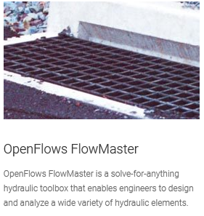
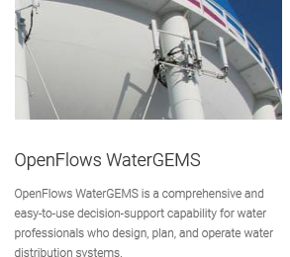
Introduction
Important for students, once hydraulic concepts are understood, the solution process can be repetitive and tedious, so these software could be well suited for these procedures.
Bentley Systems provide innovative software to advance the world’s infrastructure – sustaining both the global economy and environment.
These software solutions are used by professionals for the design, construction, and operations of roads and bridges, rail and transit, water and wastewater, public works and utilities, buildings and campuses, mining, and industrial facilities.

Slide 3
Why should we use Flow Master software?
Computer solutions can be more detailed that hand calculation
The solution process may be less error.
It allows us to avoid algebraic and numeric errors.
Solutions are easily documented and reproducible.
Allows us to create several design trials that could be performed.

Slide 4
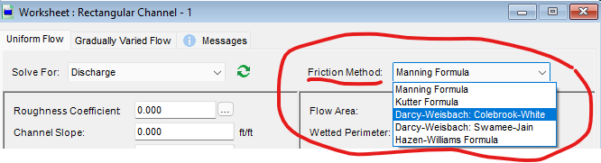
Flow Master
Used for hydraulic design and analysis of pipes, gutters, inlets, ditches, open channels, weirs, and orifices.
Computes flows and pressure using common head loss equations like as Manning’s, Darcy- Weisbach, Kutter’s, and Hazen- Williams.
Notes:
When conducting research, it is easy to go to one source: Wikipedia. However, you need to include a variety of sources in your research. Consider the following sources:
Who can I interview to get more information on the topic?
Is the topic current and will it be relevant to my audience?
What articles, blogs, and magazines may have something related to my topic?
Is there a YouTube video on the topic? If so, what is it about?
What images can I find related to the topic?

Slide 5
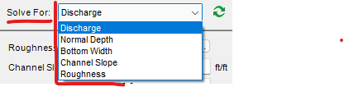
Flow Master
Allows user to find an unknown variable and automatically compute the solution after entering the known parameters.
Calculates rating tables and plots curves and cross-sections.
Notes:
When conducting research, it is easy to go to one source: Wikipedia. However, you need to include a variety of sources in your research. Consider the following sources:
Who can I interview to get more information on the topic?
Is the topic current and will it be relevant to my audience?
What articles, blogs, and magazines may have something related to my topic?
Is there a YouTube video on the topic? If so, what is it about?
What images can I find related to the topic?

Slide 6
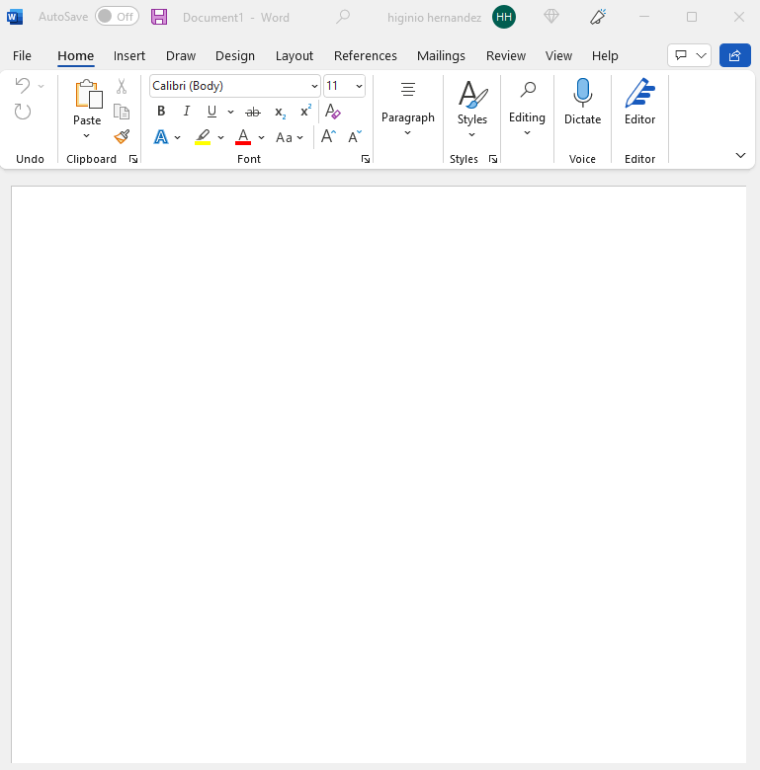
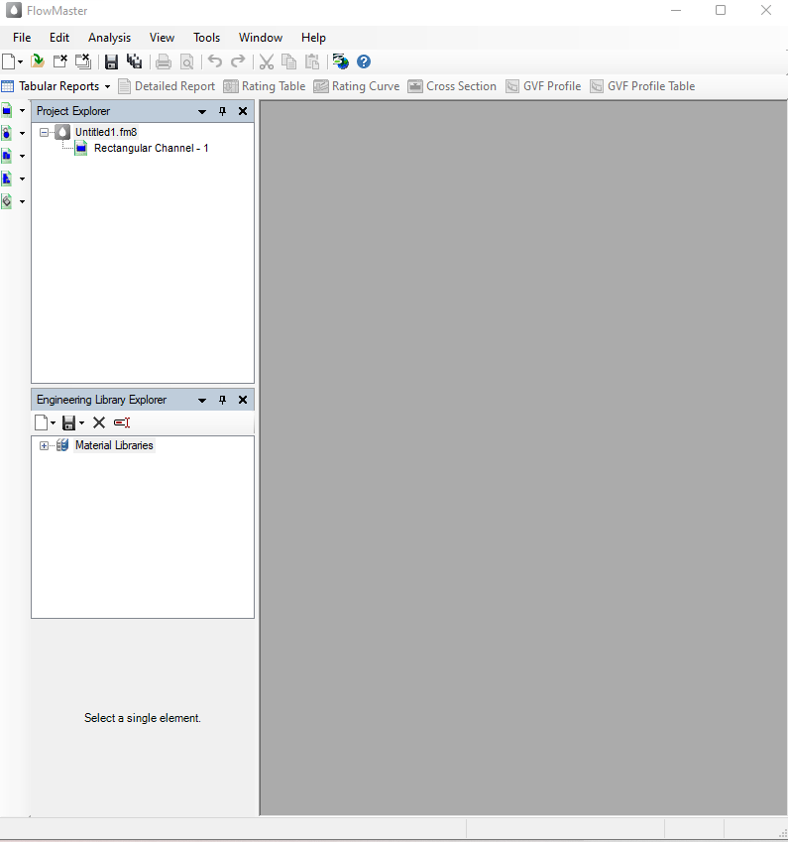


Basic Format
Title Bar
Menu Bar
Title Bar
Standard Toolbar
Menu Bar
Standard Toolbar

Slide 7

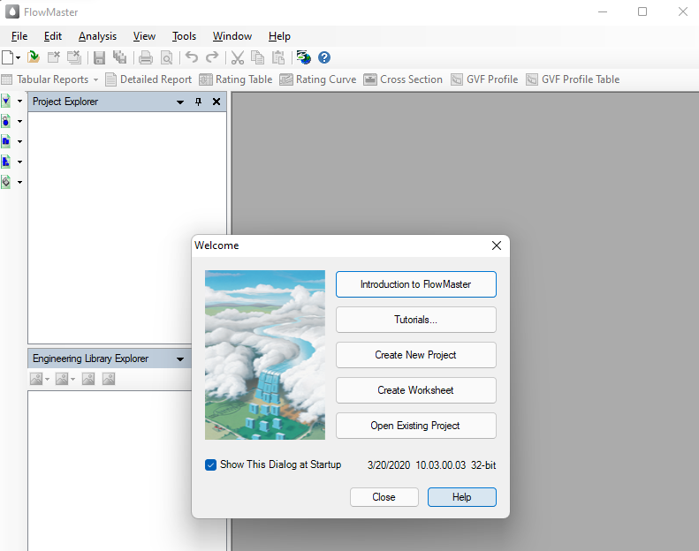
Do a new Project
One way
Created New Project
Save as
Worksheet
Notes:
Once you find your sources, you will want to evaluate your sources using the following questions:
Author:
Who is the author?
Why should I believe what he or she has to say on the topic?
Is the author seen as an expert on the topic? How do you know?
Current:
How current is the information in the source?
When was the source published?
Is the information out-of-date?
Accuracy:
Is the content accurate?
Is the information presented objectively? Do they share the pros and cons?

Slide 8
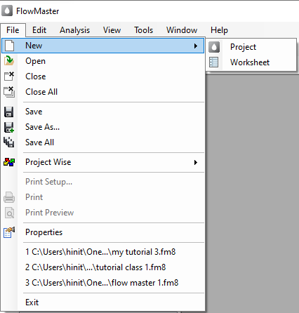


Do a new Project
Second way
File
New
Project
Save as
Worksheet
Notes:
Once you find your sources, you will want to evaluate your sources using the following questions:
Author:
Who is the author?
Why should I believe what he or she has to say on the topic?
Is the author seen as an expert on the topic? How do you know?
Current:
How current is the information in the source?
When was the source published?
Is the information out-of-date?
Accuracy:
Is the content accurate?
Is the information presented objectively? Do they share the pros and cons?

Slide 9
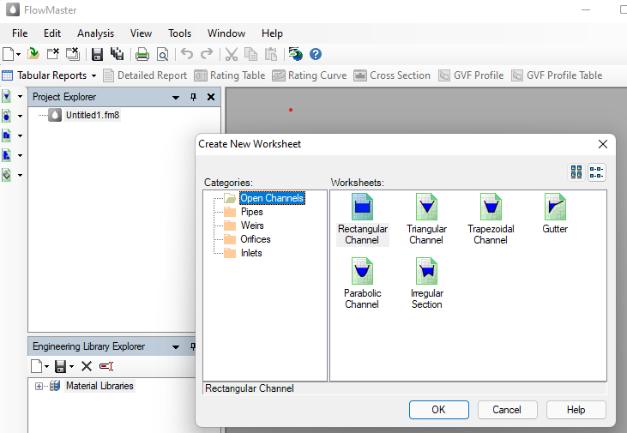
Worksheet
Categories
Open Channels, Pipes, Weirs, Orifices and Inlets
Notes:
After consulting a variety of sources, you will need to narrow your topic. For example, the topic of internet safety is huge, but you could narrow that topic to include internet safety in regards to social media apps that teenagers are using heavily. A topic like that is more specific and will be relevant to your peers. Some questions to think about to help you narrow your topic:
What topics of the research interest me the most?
What topics of the research will interest my audience the most?
What topics will the audience find more engaging? Shocking? Inspiring?

Slide 10
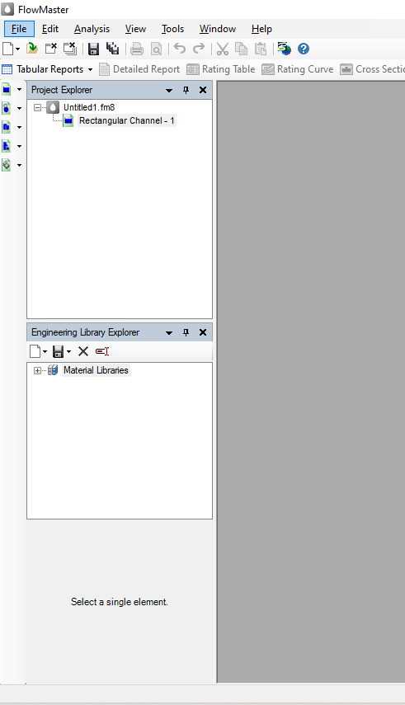

Worksheet
Quick access
Categories
Open Channels, Pipes, Weirs, Orifices and Inlets
Notes:
After consulting a variety of sources, you will need to narrow your topic. For example, the topic of internet safety is huge, but you could narrow that topic to include internet safety in regards to social media apps that teenagers are using heavily. A topic like that is more specific and will be relevant to your peers. Some questions to think about to help you narrow your topic:
What topics of the research interest me the most?
What topics of the research will interest my audience the most?
What topics will the audience find more engaging? Shocking? Inspiring?

Slide 11
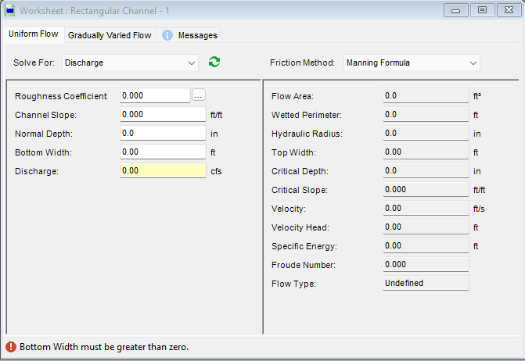
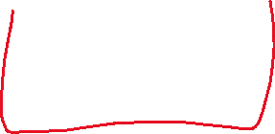
Insert Data
Run the calculation
Units [ US or SI ]
Parameters Given
Yellow color mean, the unknown that we want to find
Notes:
Now, that you have narrowed your topic, you will want to organize your research in a structure that works. There are some common organizational patterns based on the kind of research you are doing.
Organizational Structures:
Cause and Effect- this kind of structure is great for explaining the causes and effects of a topic
Compare and Contrast- in this pattern you highlight the similarities and differences of the topic
Explain process- this structure is great for outlining a series of steps to follow;
Definition- if you want to make sure your audience understands what something is using illustrations, meanings, clarifying misconceptions, you may want to use this structure
Classification- a common organizational structure is grouping like topics or facts from the research together. For instance, in the internet safety about social media apps, you may organize the research where you look at each social media app one at a time

Slide 12
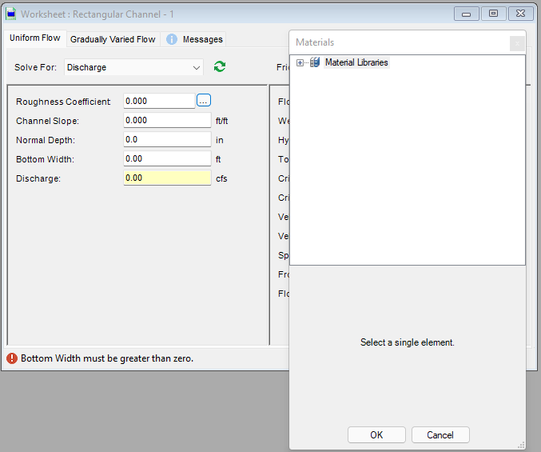
Insert Data
Ellipse
1
2
Material Libraries
Notes:
Now, that you have narrowed your topic, you will want to organize your research in a structure that works. There are some common organizational patterns based on the kind of research you are doing.
Organizational Structures:
Cause and Effect- this kind of structure is great for explaining the causes and effects of a topic
Compare and Contrast- in this pattern you highlight the similarities and differences of the topic
Explain process- this structure is great for outlining a series of steps to follow;
Definition- if you want to make sure your audience understands what something is using illustrations, meanings, clarifying misconceptions, you may want to use this structure
Classification- a common organizational structure is grouping like topics or facts from the research together. For instance, in the internet safety about social media apps, you may organize the research where you look at each social media app one at a time

Slide 13
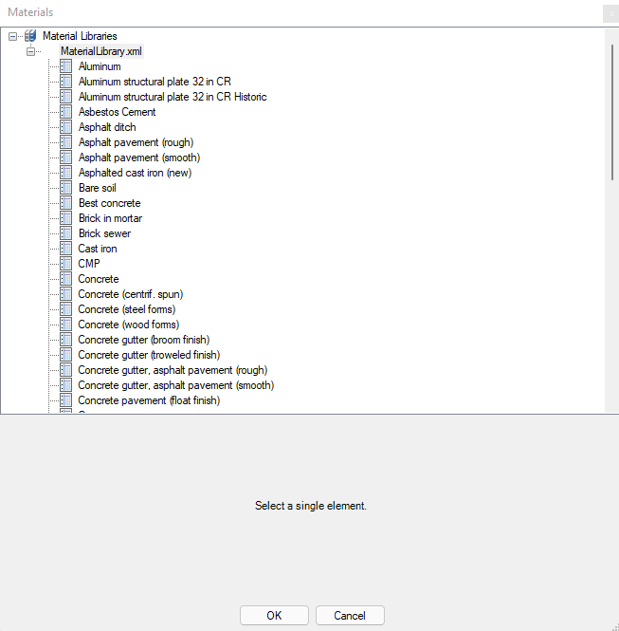
Insert Data
Roughness coefficient for each material
3
2
Material Libraries
Notes:
Now, that you have narrowed your topic, you will want to organize your research in a structure that works. There are some common organizational patterns based on the kind of research you are doing.
Organizational Structures:
Cause and Effect- this kind of structure is great for explaining the causes and effects of a topic
Compare and Contrast- in this pattern you highlight the similarities and differences of the topic
Explain process- this structure is great for outlining a series of steps to follow;
Definition- if you want to make sure your audience understands what something is using illustrations, meanings, clarifying misconceptions, you may want to use this structure
Classification- a common organizational structure is grouping like topics or facts from the research together. For instance, in the internet safety about social media apps, you may organize the research where you look at each social media app one at a time

Slide 14
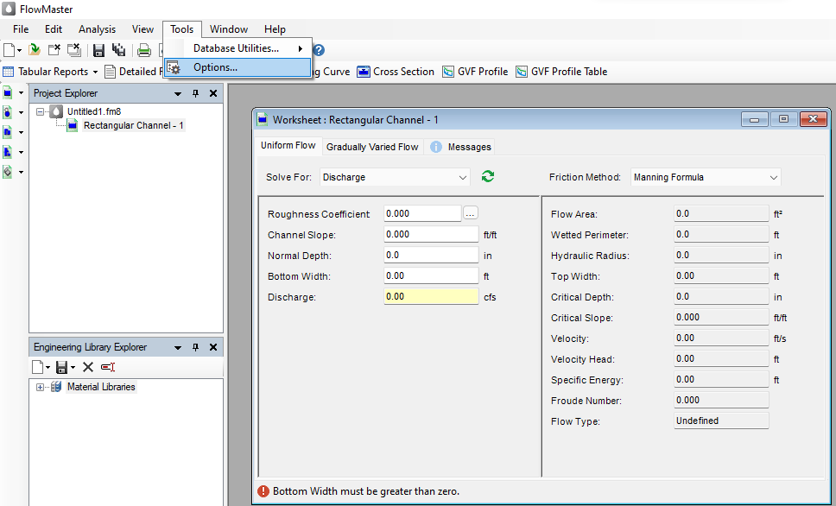
Units
1
Tools
Units [ US or SI ]
Options
Notes:
Now, that you have narrowed your topic, you will want to organize your research in a structure that works. There are some common organizational patterns based on the kind of research you are doing.
Organizational Structures:
Cause and Effect- this kind of structure is great for explaining the causes and effects of a topic
Compare and Contrast- in this pattern you highlight the similarities and differences of the topic
Explain process- this structure is great for outlining a series of steps to follow;
Definition- if you want to make sure your audience understands what something is using illustrations, meanings, clarifying misconceptions, you may want to use this structure
Classification- a common organizational structure is grouping like topics or facts from the research together. For instance, in the internet safety about social media apps, you may organize the research where you look at each social media app one at a time

Slide 15
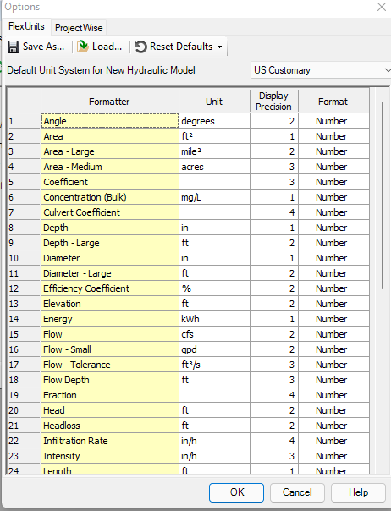
Units
1
Tools
2
Units [ US or SI ]
3
Reset Defaults
Options
Notes:
Now, that you have narrowed your topic, you will want to organize your research in a structure that works. There are some common organizational patterns based on the kind of research you are doing.
Organizational Structures:
Cause and Effect- this kind of structure is great for explaining the causes and effects of a topic
Compare and Contrast- in this pattern you highlight the similarities and differences of the topic
Explain process- this structure is great for outlining a series of steps to follow;
Definition- if you want to make sure your audience understands what something is using illustrations, meanings, clarifying misconceptions, you may want to use this structure
Classification- a common organizational structure is grouping like topics or facts from the research together. For instance, in the internet safety about social media apps, you may organize the research where you look at each social media app one at a time

Slide 16
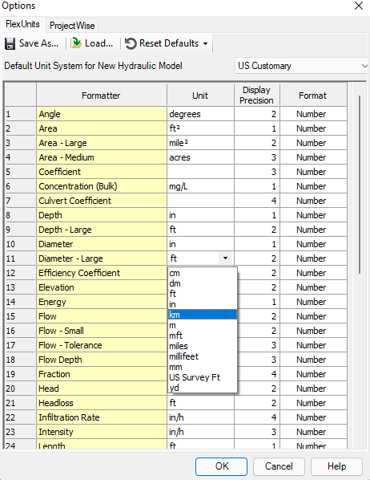
Units
Units [ US or SI ]
Format
Precision
units
Notes:
Now, that you have narrowed your topic, you will want to organize your research in a structure that works. There are some common organizational patterns based on the kind of research you are doing.
Organizational Structures:
Cause and Effect- this kind of structure is great for explaining the causes and effects of a topic
Compare and Contrast- in this pattern you highlight the similarities and differences of the topic
Explain process- this structure is great for outlining a series of steps to follow;
Definition- if you want to make sure your audience understands what something is using illustrations, meanings, clarifying misconceptions, you may want to use this structure
Classification- a common organizational structure is grouping like topics or facts from the research together. For instance, in the internet safety about social media apps, you may organize the research where you look at each social media app one at a time

Slide 17

Tutorial # 1
Open FlowMaster
Use Citrix Account

Slide 18
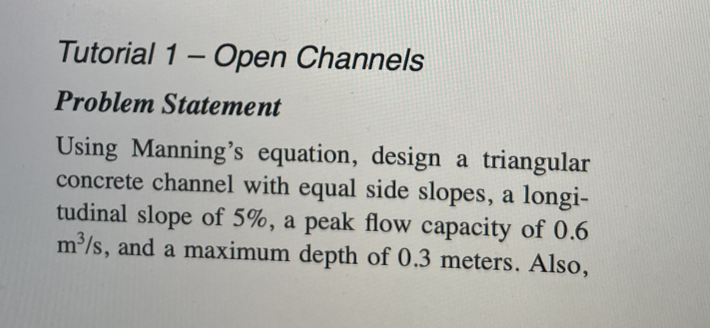
Tutorial # 1 Open Channel

Slide 19
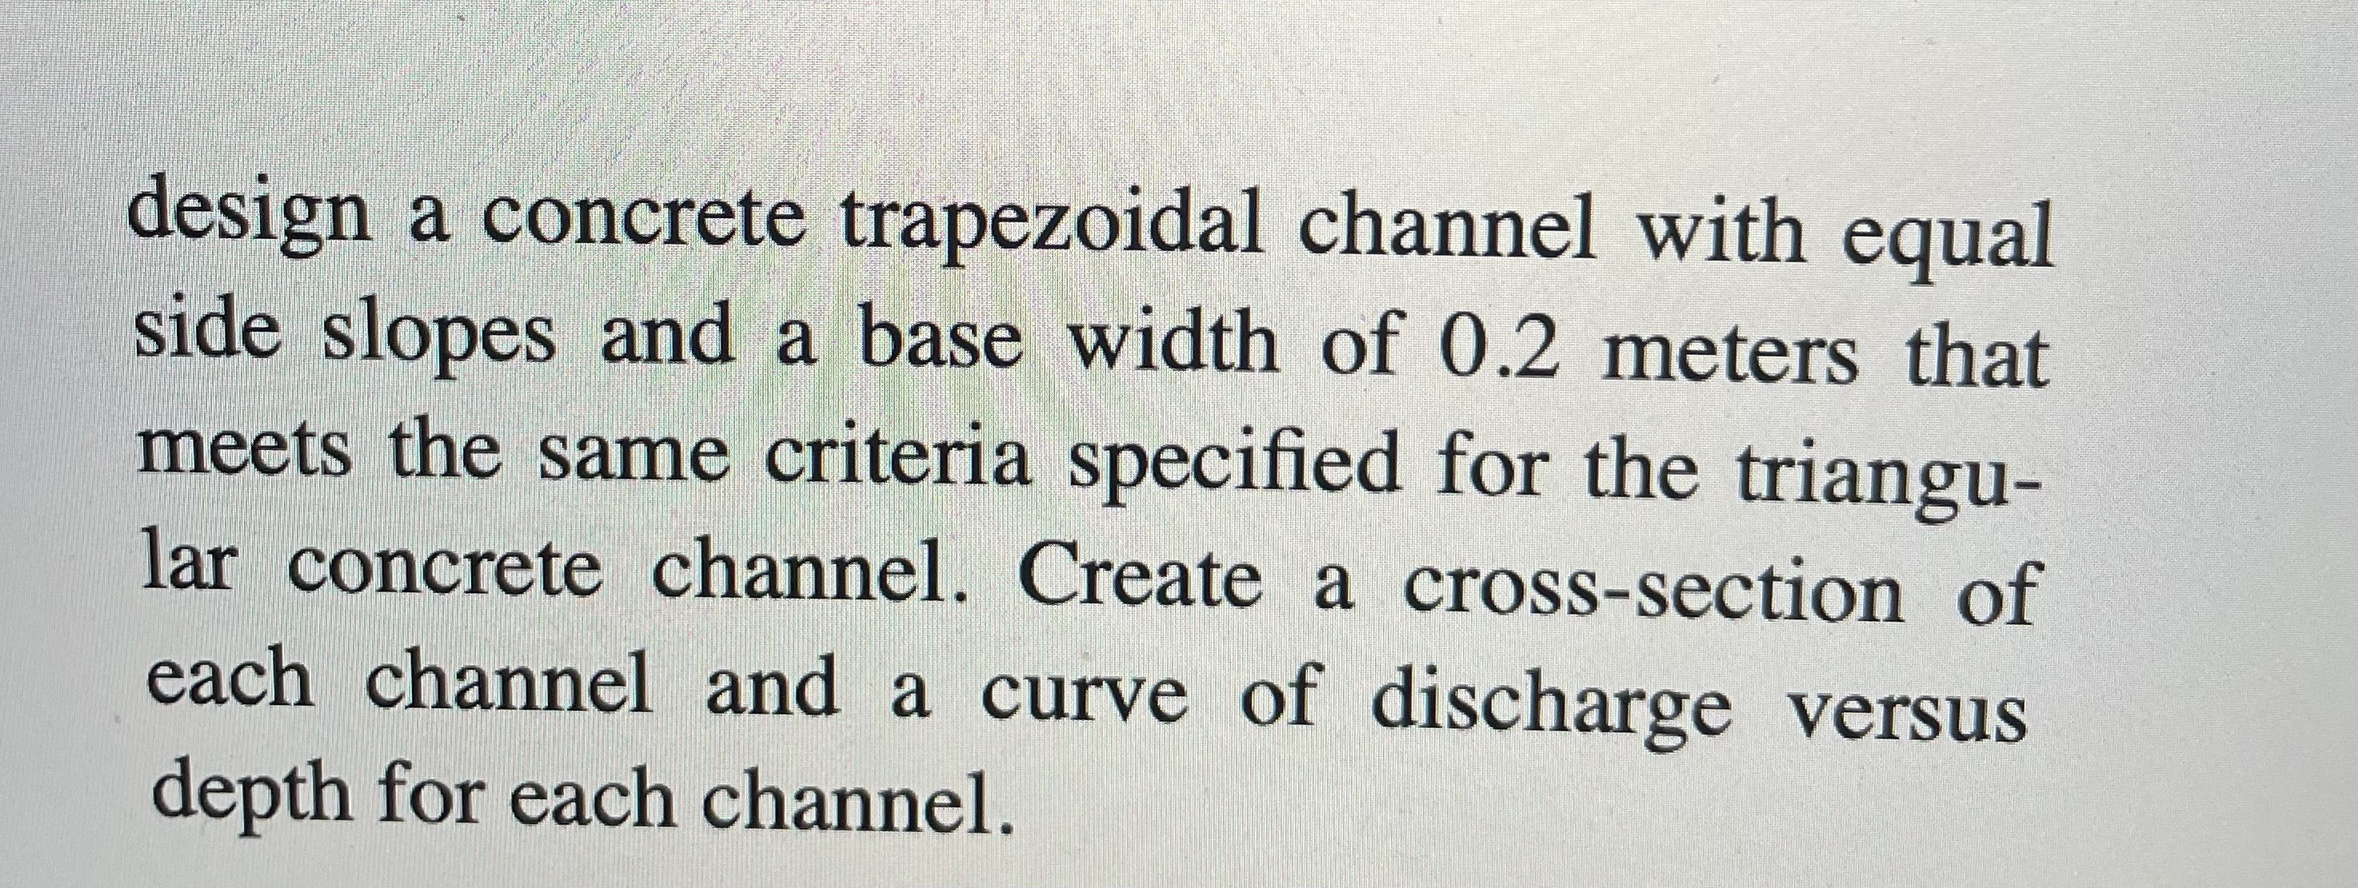
Tutorial # 1
Open Channel

Slide 20
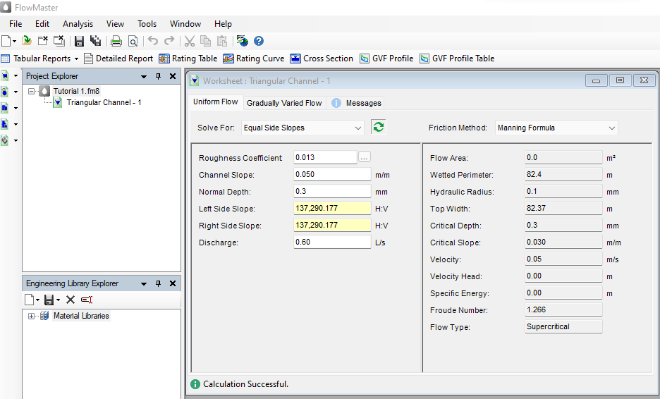


Solution
Note:
Change units for the Normal depth, slope side, and Discharge

Slide 21
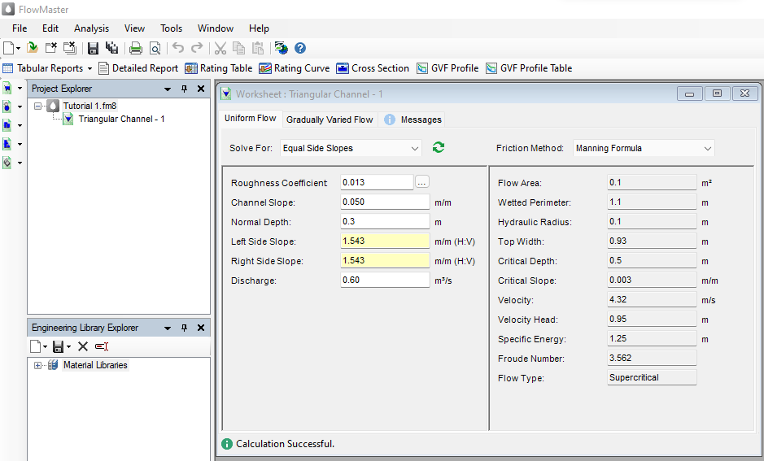


Solution
Correct answer

Slide 22
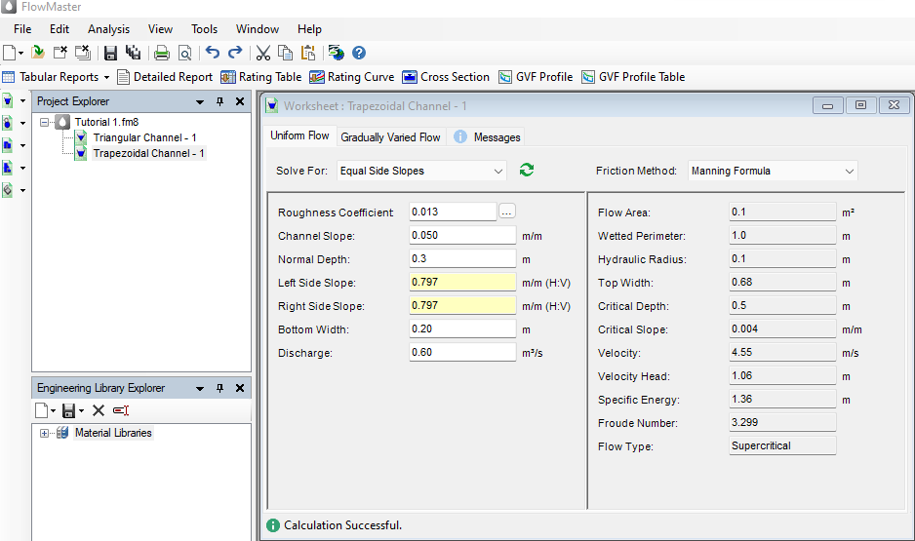

Solution
Trapezoidal section
Change the precision for obtain the exact decimal place
New parameter

Slide 23
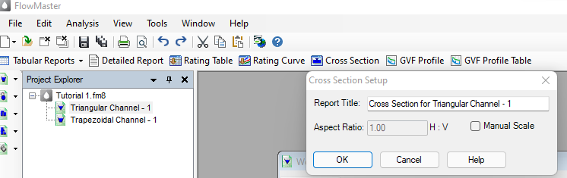
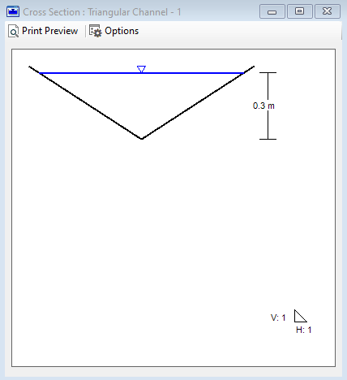

Creating Channel Cross-Section
1
3
2

Slide 24
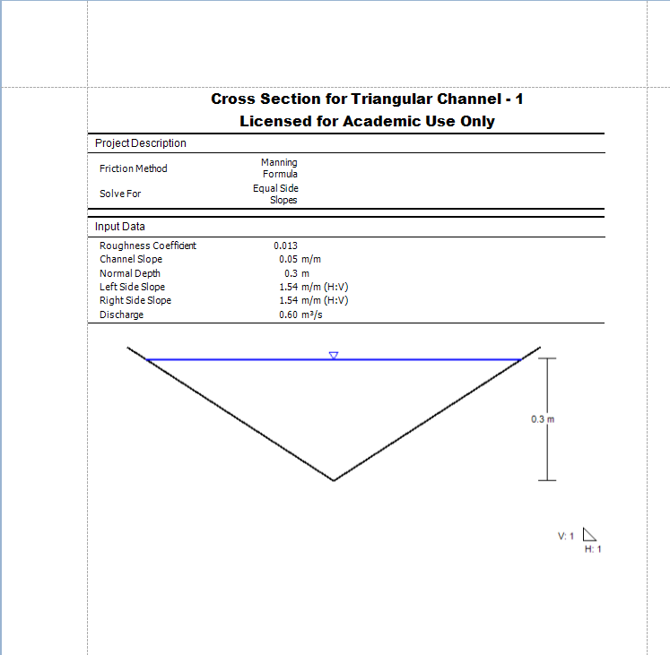
Creating Channel Cross-Section
4
3
2

Slide 25
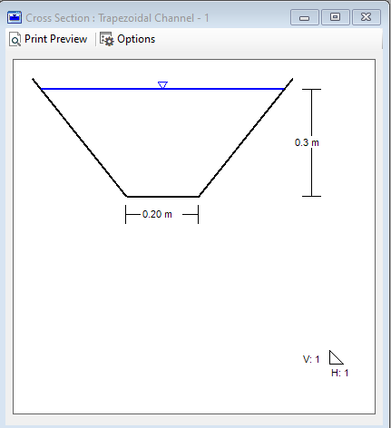
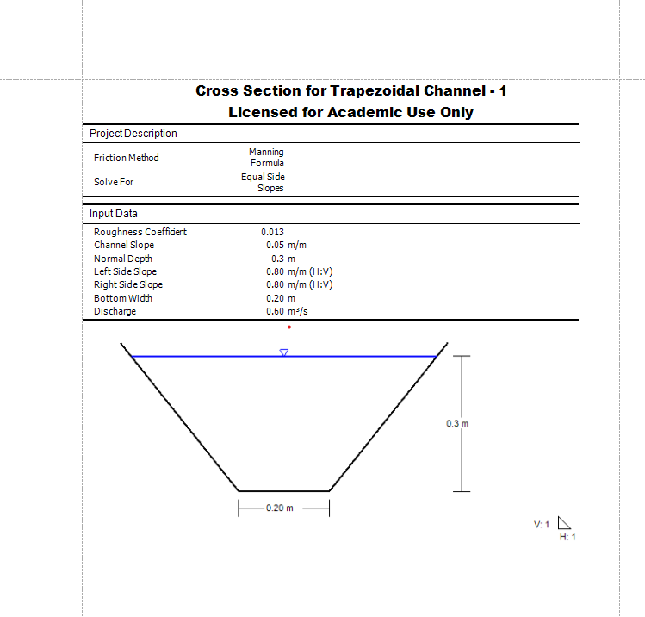
Creating Channel Cross-Section
Follow the same steps for the trapezoidal section

Slide 26
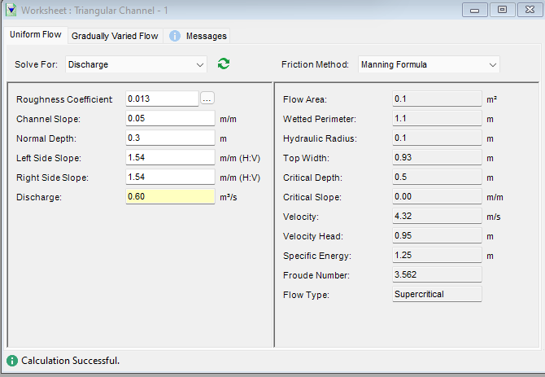
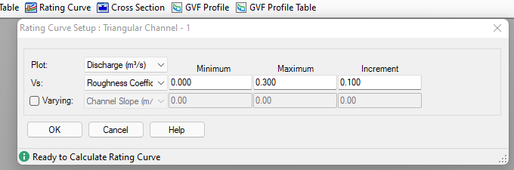



Creating Discharge vs. Depth Curves
1
Solve for Discharge
2
3

Slide 27
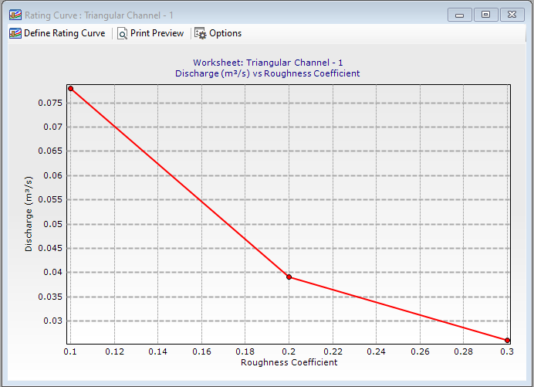
Creating Discharge vs. Depth Curves

Slide 28
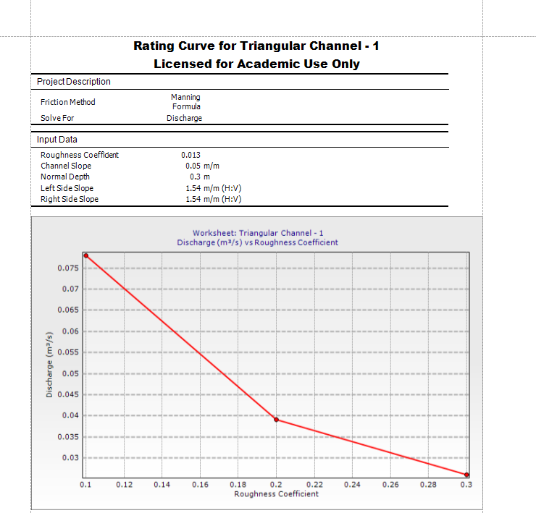
Creating Discharge vs. Depth Curves

Slide 29
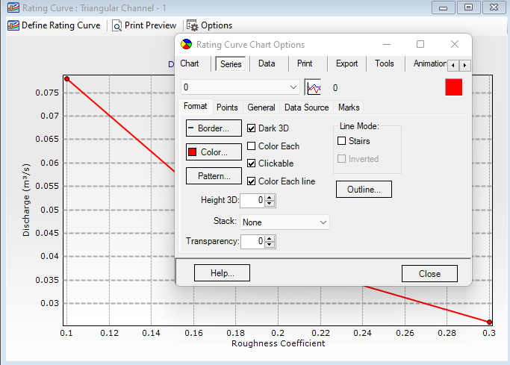
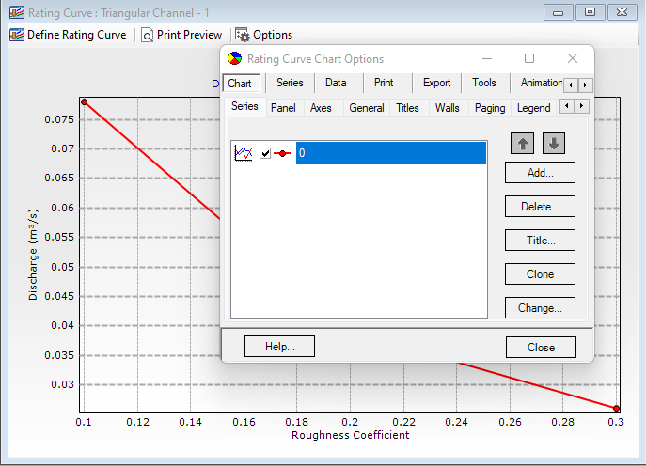
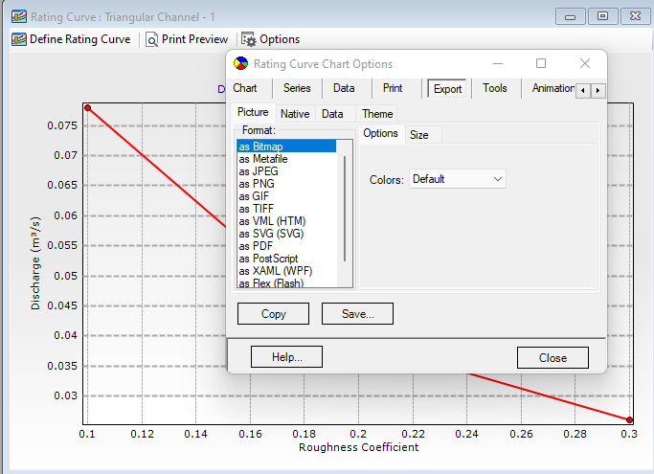
Graph Design

Slide 30
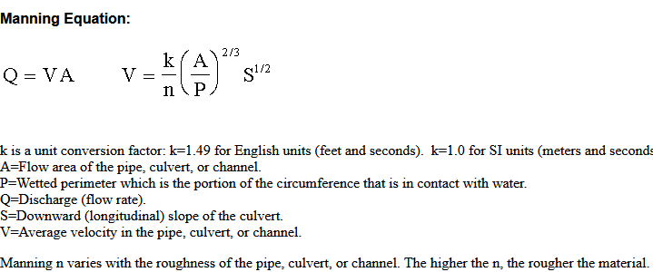
Using hand calculation
Hydraulic radius
Notes:
After you’ve done your research, it’s time to put your presentation together. The first step in the process is to introduce the topic. This is a great time to connect your topic to something that your audience can relate. In other words, why should they listen to all the information you will be sharing in your research presentation? What is in it for them? You may also want to include a graphic or image to grab their attention.
Feel free to duplicate this slide by right-clicking on this slide in the slides pane to the left and select Duplicate Slide.
The next step in your presentation is to state your claim or topic clearly. Your teacher may even call this your thesis. As you state your thesis, you may find that this layout is not the best layout for your claim or topic. You can change the layout by clicking the drop-down menu next to the Layout in the Slides menu section. You can choose Two Content, Comparison, or Picture with Caption. Note: A different layout might change the look of the icons on this page.
You will also want to state your facts. You have done the research now share some of the interesting facts with your audience. Facts do not have to be boring; you can communicate facts in a variety of ways by going to the Insert Tab. In the Insert tab you can:
Insert pictures from your computer or online.
Add a chart
Create some SmartArt
Insert a variety of icons to help your facts come to life. Note: You can change the color of the icons by selecting the icon and then click on the Format tab and then Graphics Fill. From there, you will choose a color from the list or choose More Fill Colors to give you more options.
Since this research presentation is a result of your hard work and searching, you want to make sure you support the claims or points in your presentation with facts from your research findings. Make sure you give the author proper credit for helping you share your ideas. If one of your sources has a video that is relevant to your topic, you can add the video as added support. Keep in mind the length of the video and the amount of time you have for your presentation. For a 5 minute speech, the video should be no longer than 30 seconds.
Questions to consider:
How will you state the author of the source?
Will you need to cite the source on the slide?
What are some ways you can engage your audience so they feel like they are a part of the presentation? Some ideas to consider is by taking a quick poll like: by a show of hands, how many of you think school uniforms are a way to cut down on bullying? Another suggestion is to have them hold up a certain number of fingers to see if they agree or disagree. Finally, you can share a story that the audience can relate to that makes them laugh.
After all the applause, your audience may have some questions. Be prepared to answer some of their questions by making a list of questions you think they might ask. You may also want to share the presentation with them by providing the link to your presentation, if they want more information.

Slide 31
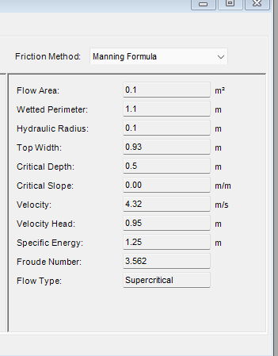
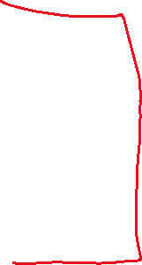
Using hand calculation
Parameter obtained using the software
Notes:
After you’ve done your research, it’s time to put your presentation together. The first step in the process is to introduce the topic. This is a great time to connect your topic to something that your audience can relate. In other words, why should they listen to all the information you will be sharing in your research presentation? What is in it for them? You may also want to include a graphic or image to grab their attention.
Feel free to duplicate this slide by right-clicking on this slide in the slides pane to the left and select Duplicate Slide.
The next step in your presentation is to state your claim or topic clearly. Your teacher may even call this your thesis. As you state your thesis, you may find that this layout is not the best layout for your claim or topic. You can change the layout by clicking the drop-down menu next to the Layout in the Slides menu section. You can choose Two Content, Comparison, or Picture with Caption. Note: A different layout might change the look of the icons on this page.
You will also want to state your facts. You have done the research now share some of the interesting facts with your audience. Facts do not have to be boring; you can communicate facts in a variety of ways by going to the Insert Tab. In the Insert tab you can:
Insert pictures from your computer or online.
Add a chart
Create some SmartArt
Insert a variety of icons to help your facts come to life. Note: You can change the color of the icons by selecting the icon and then click on the Format tab and then Graphics Fill. From there, you will choose a color from the list or choose More Fill Colors to give you more options.
Since this research presentation is a result of your hard work and searching, you want to make sure you support the claims or points in your presentation with facts from your research findings. Make sure you give the author proper credit for helping you share your ideas. If one of your sources has a video that is relevant to your topic, you can add the video as added support. Keep in mind the length of the video and the amount of time you have for your presentation. For a 5 minute speech, the video should be no longer than 30 seconds.
Questions to consider:
How will you state the author of the source?
Will you need to cite the source on the slide?
What are some ways you can engage your audience so they feel like they are a part of the presentation? Some ideas to consider is by taking a quick poll like: by a show of hands, how many of you think school uniforms are a way to cut down on bullying? Another suggestion is to have them hold up a certain number of fingers to see if they agree or disagree. Finally, you can share a story that the audience can relate to that makes them laugh.
After all the applause, your audience may have some questions. Be prepared to answer some of their questions by making a list of questions you think they might ask. You may also want to share the presentation with them by providing the link to your presentation, if they want more information.

Slide 32
Research Presentation End
FlowMaster Software
Notes:
You can use this slide as your opening or closing slide. Should you choose to use it as a closing, make sure you review the main points of your presentation. One creative way to do that is by adding animations to the various graphics on a slide. This slide has 4 different graphics, and, when you view the slideshow, you will see that you can click to reveal the next graphic. Similarly, as you review the main topics in your presentation, you may want each point to show up when you are addressing that topic.
Add animation to images and graphics:
Select your image or graphic.
Click on the Animations tab.
Choose from the options. The animation for this slide is “Split”. The drop-down menu in the Animation section gives even more animations you can use.
If you have multiple graphics or images, you will see a number appear next to it that notes the order of the animations.
Note: You will want to choose the animations carefully. You do not want to make your audience dizzy from your presentation.

