Slide 1
Student comments from SPOTS Surveys from Spring 2022 through Summer 2024

Slide 2
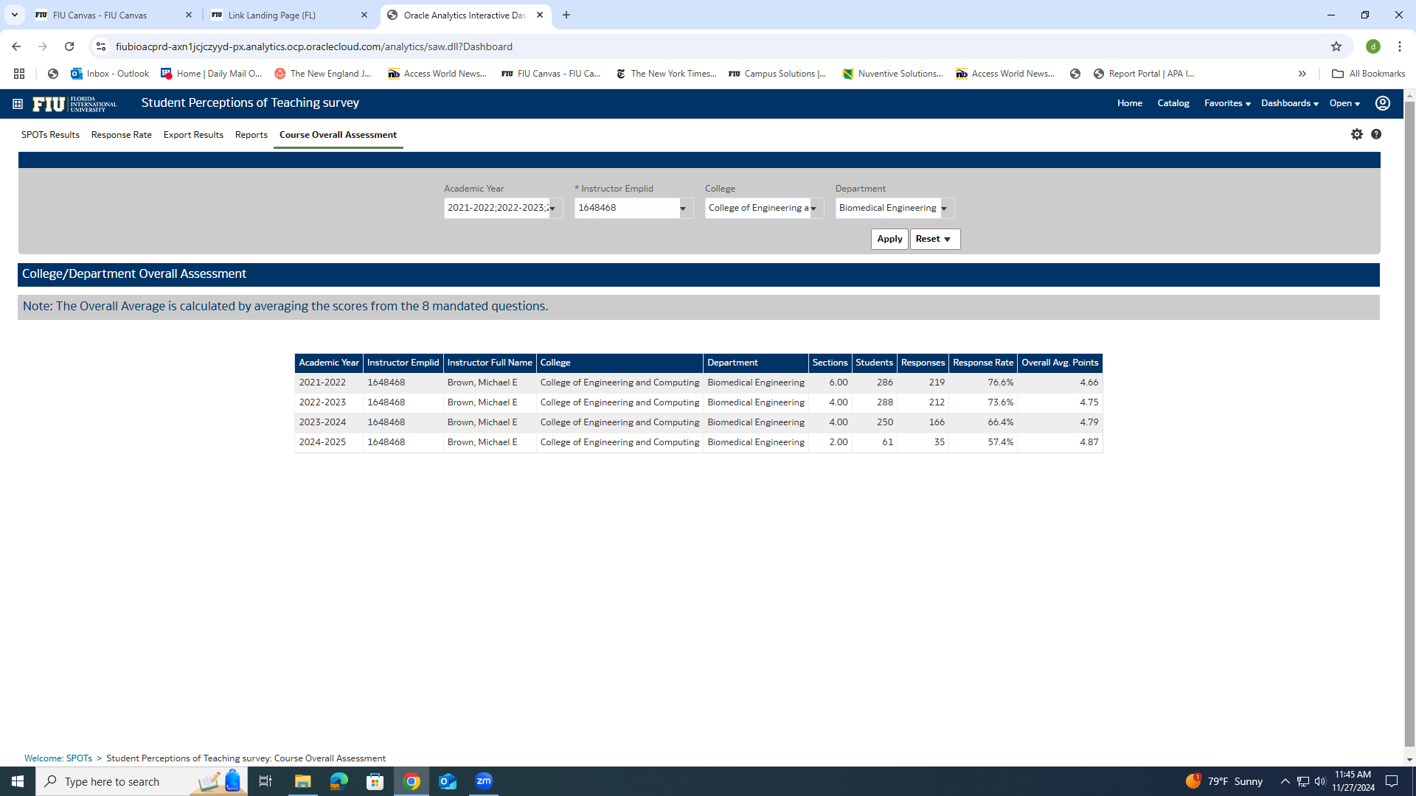
SPOTS scores for the last 4 academic years

Slide 3
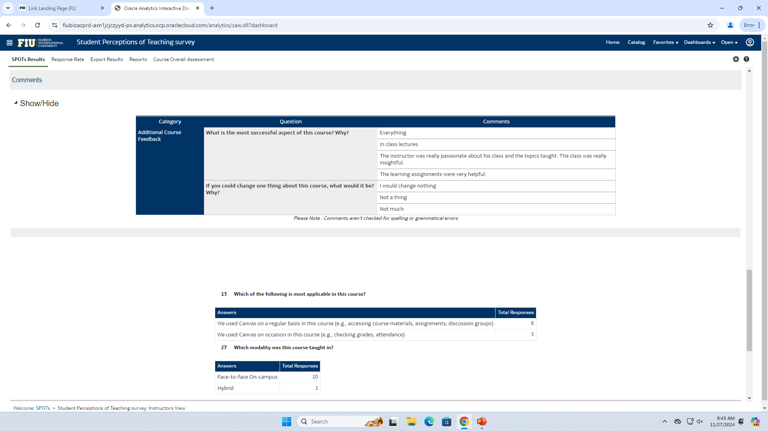
BME 3404 Summer 2024

Slide 4
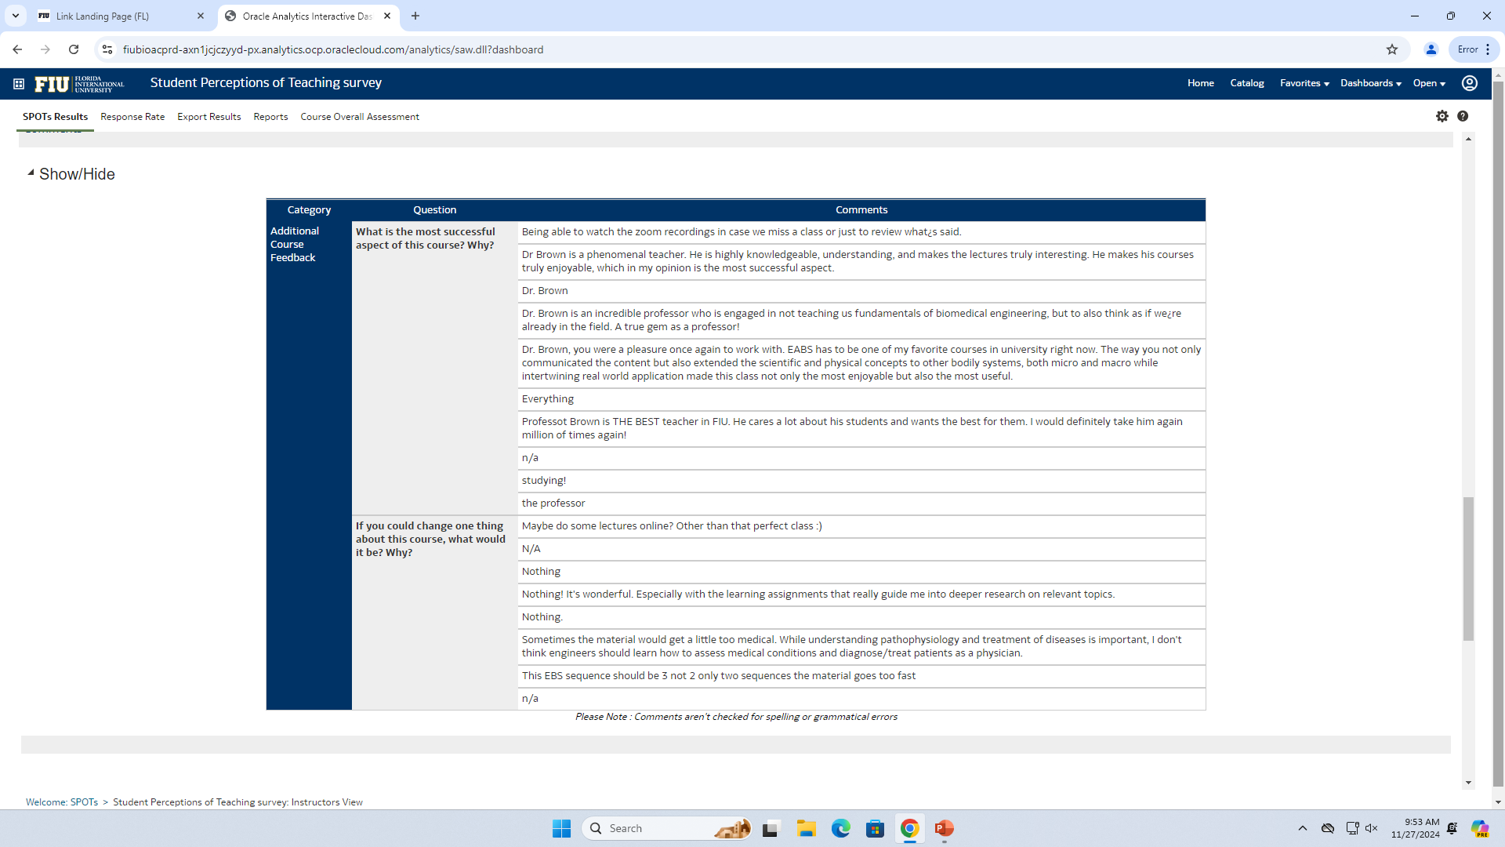
BME 3404 Summer 2024

Slide 5
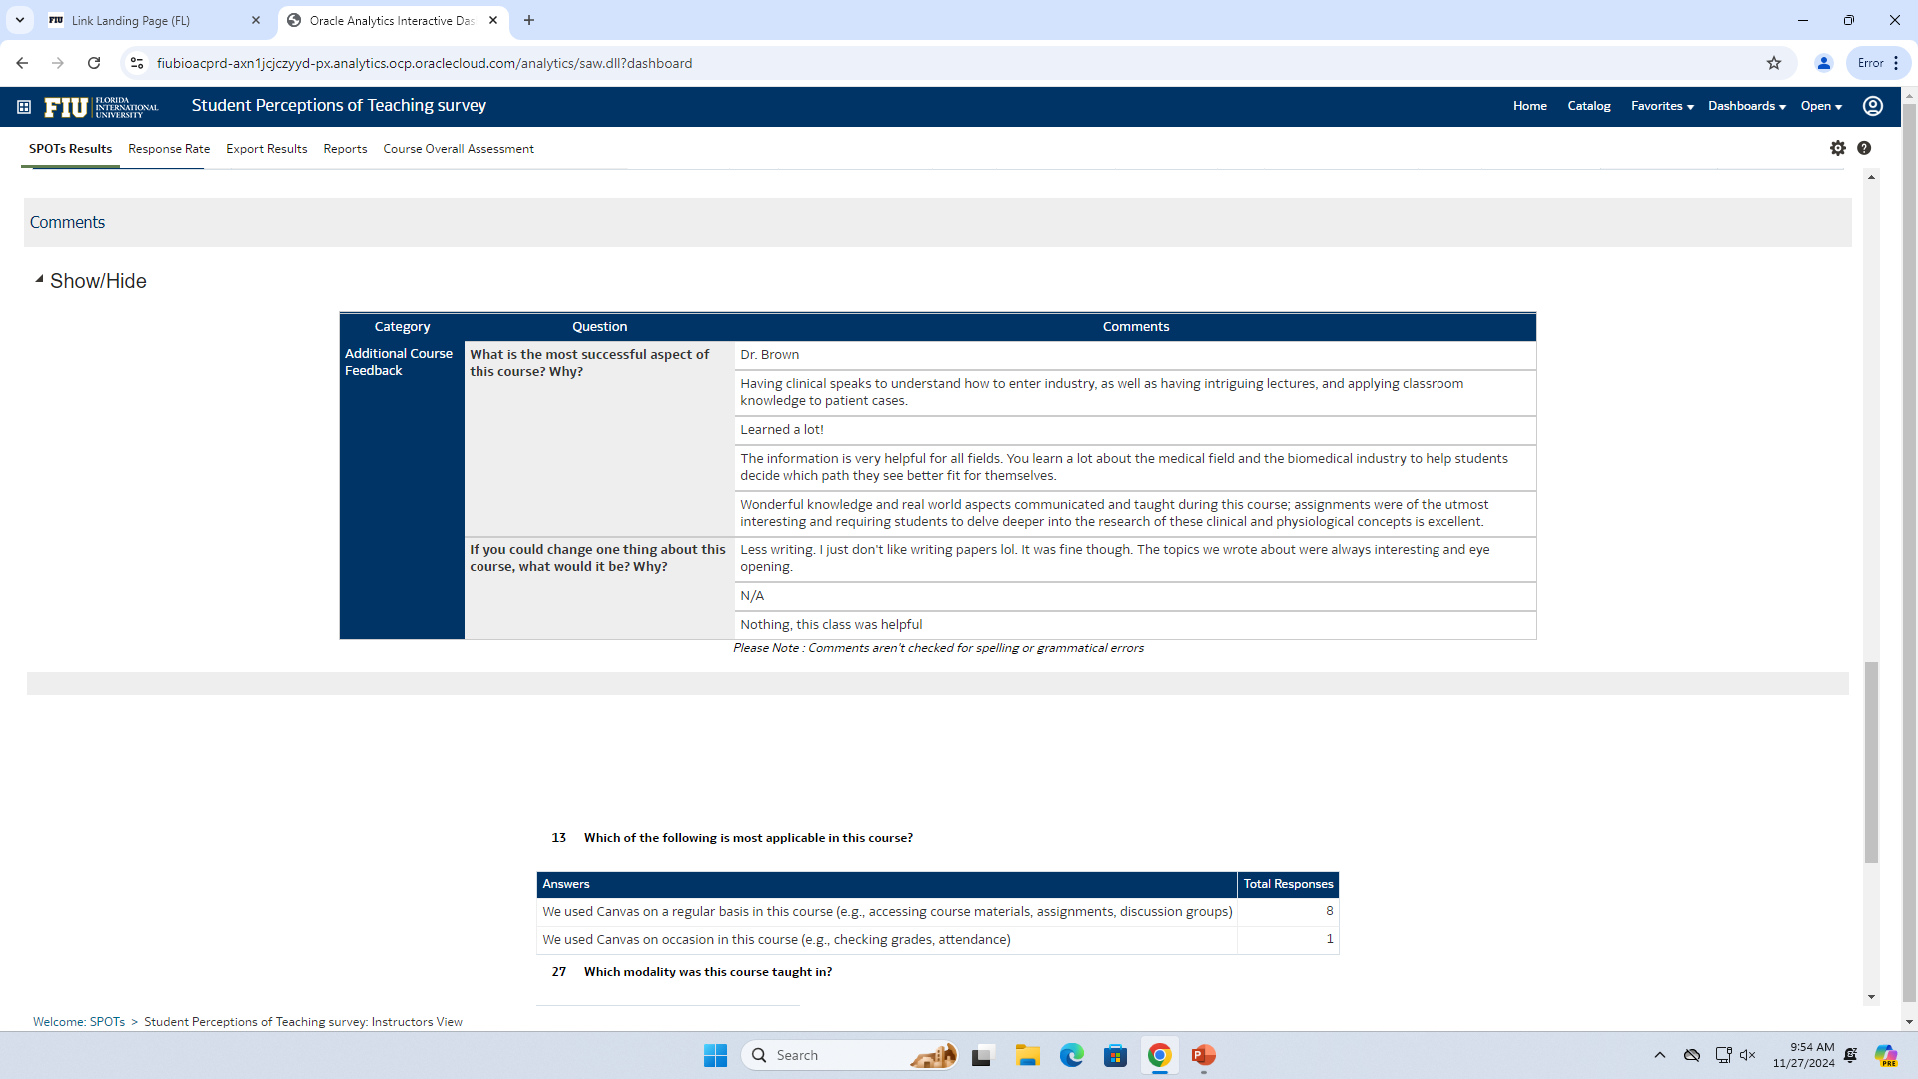
BME 4011 Summer 2024

Slide 6
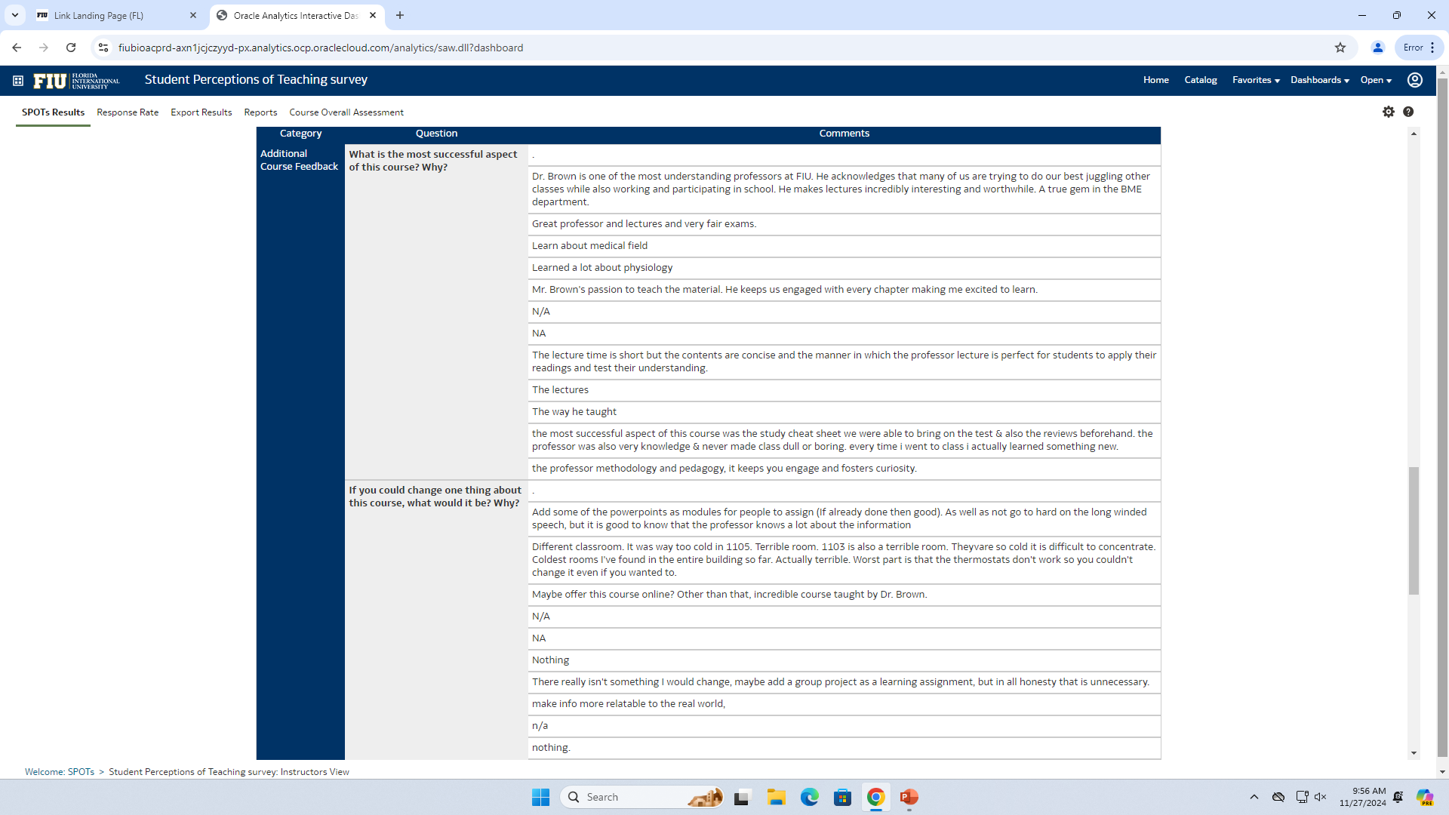
BME 3403 Spring 2024

Slide 7
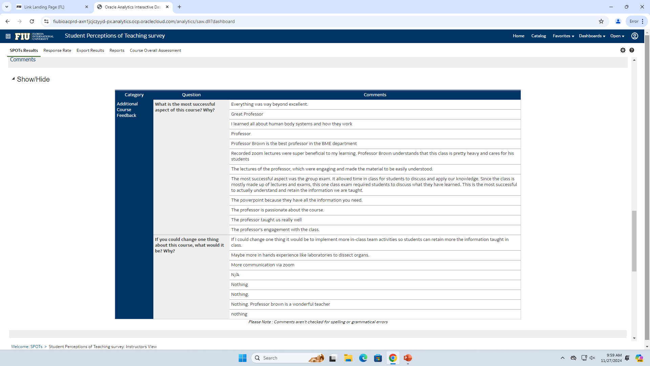
BME 3404 Spring 2024

Slide 8
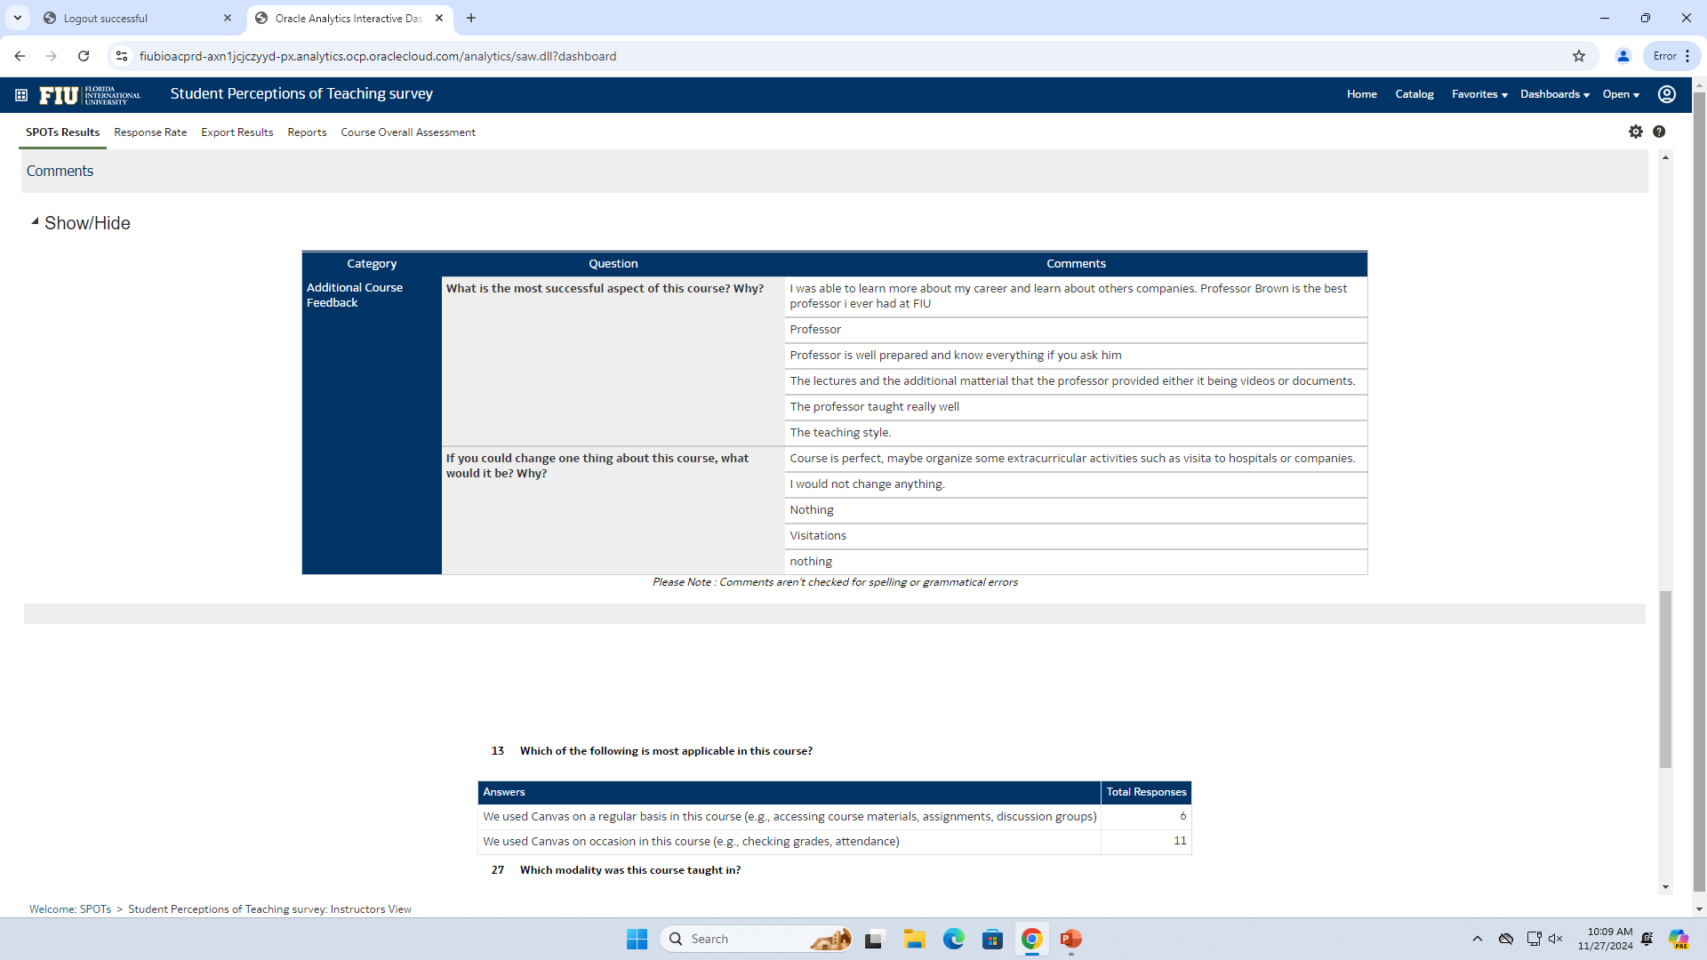
BME 4011 Spring 2024

Slide 9
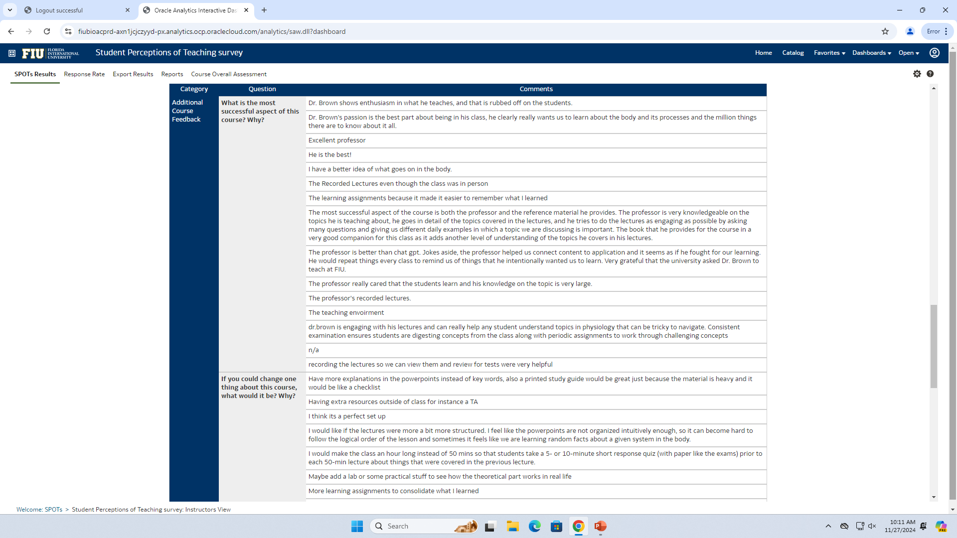
BME 3403 Fall 2023

Slide 10
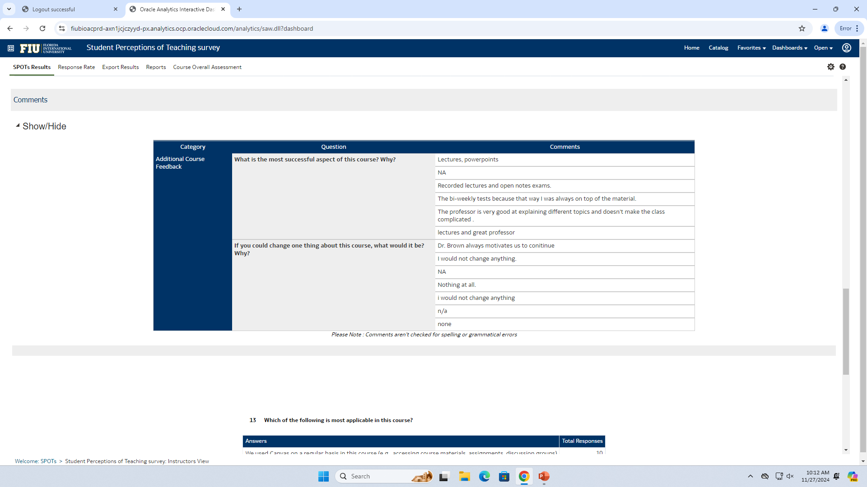
BME 3404 Fall 2023

Slide 11
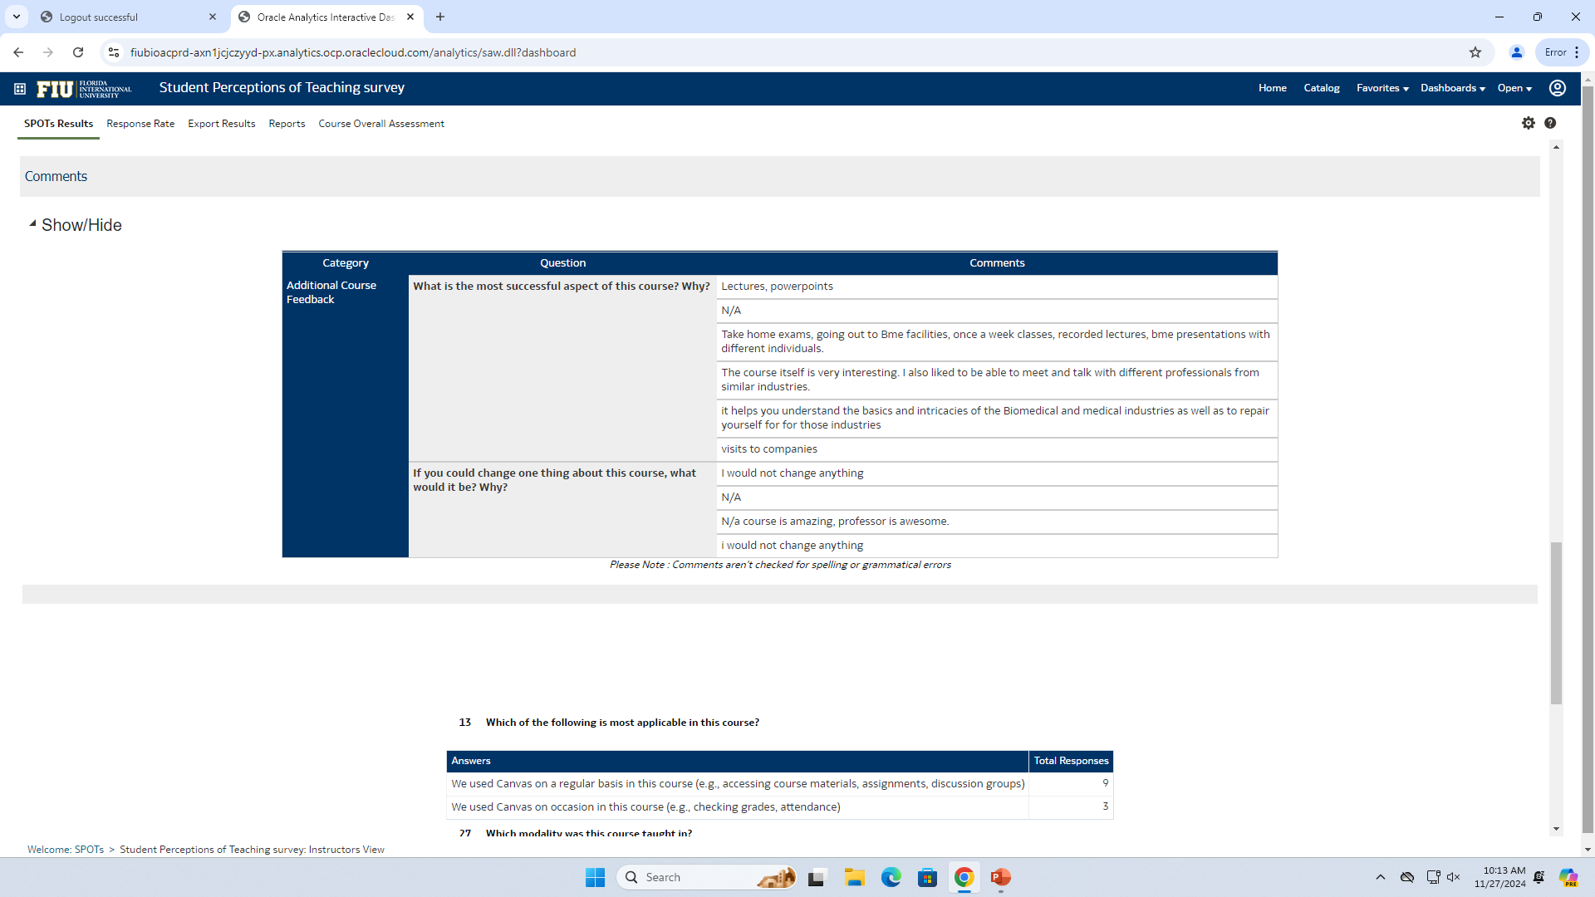
BME 4011 Fall 2023

Slide 12
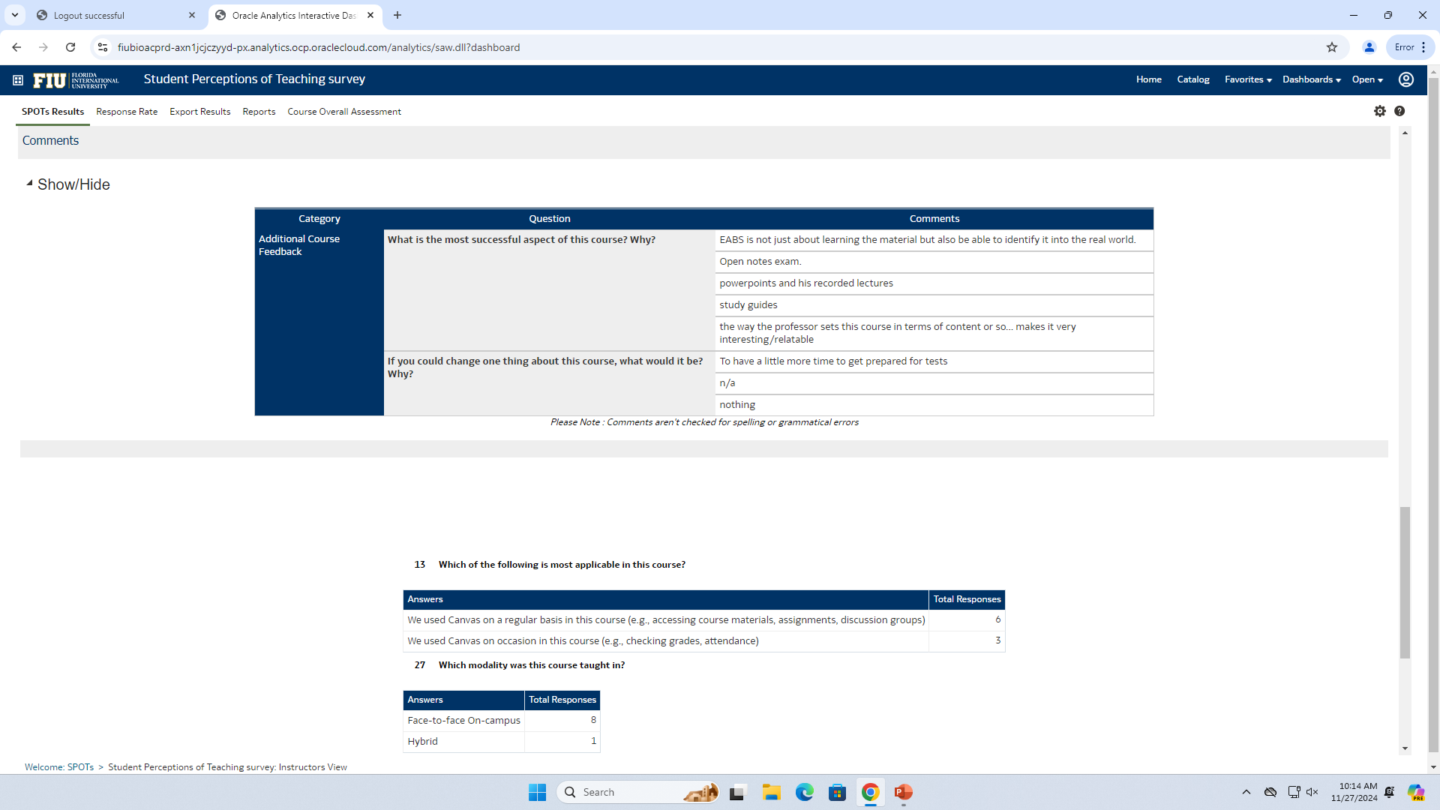
BME 3403 Summer 2023

Slide 13
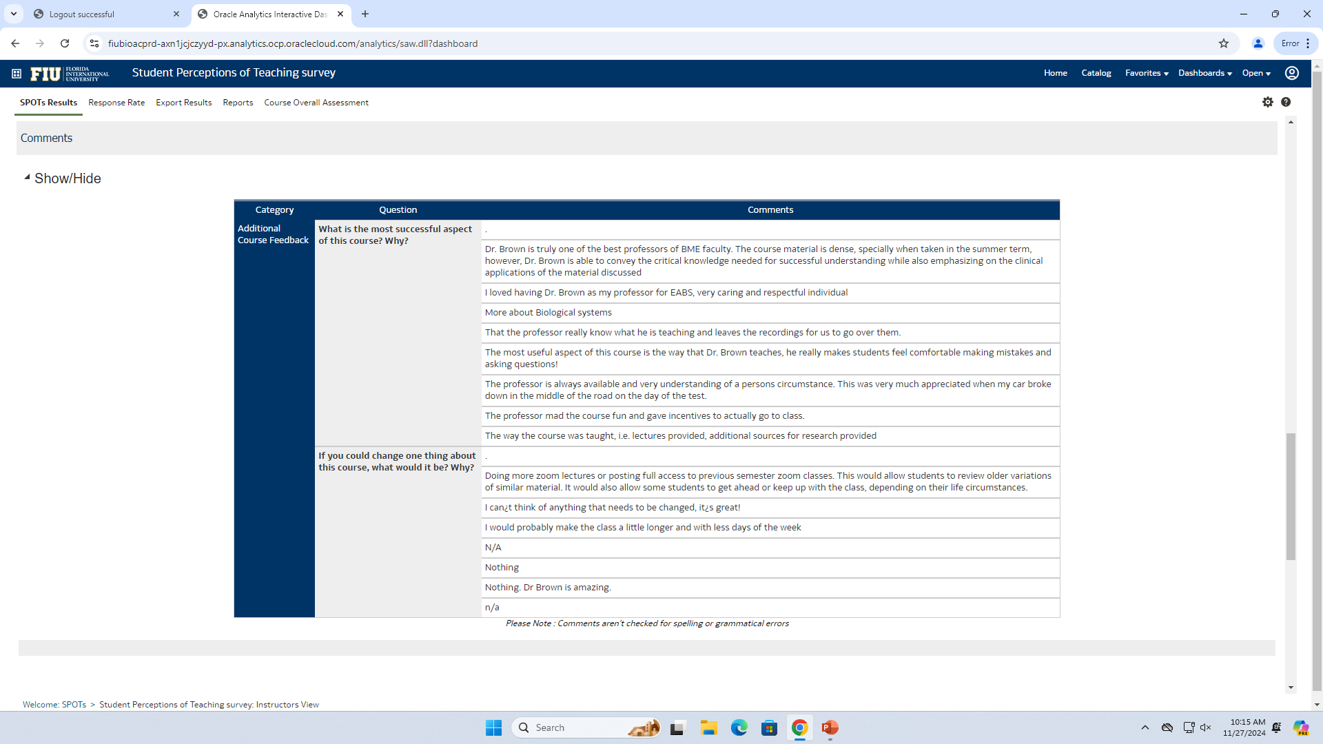
BME 3404 Summer 2023

Slide 14
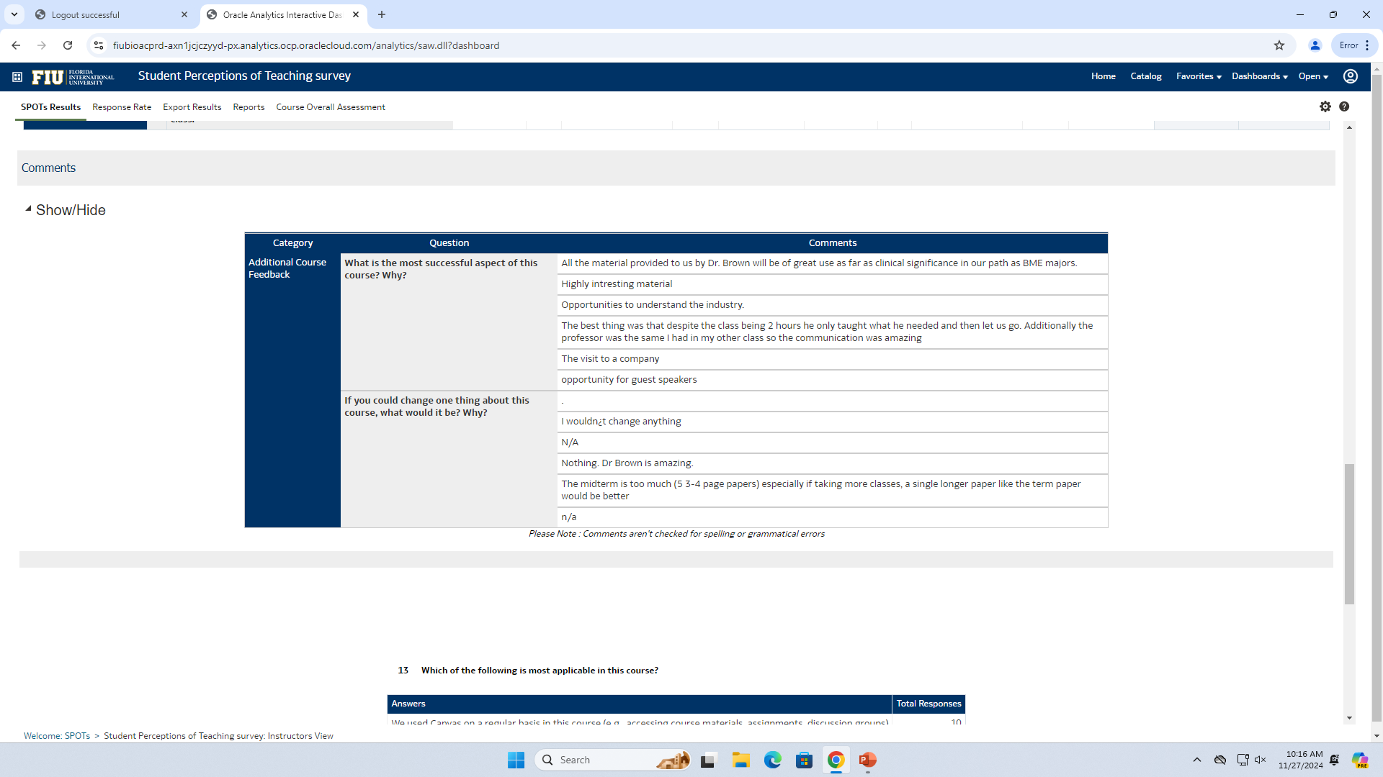
BME 4011 Summer 2023

Slide 15
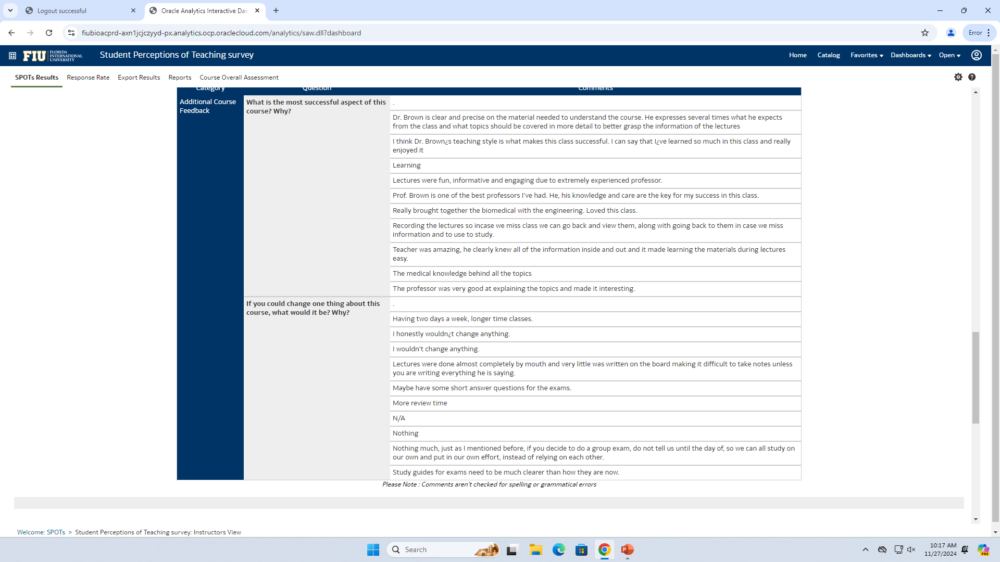
BME 3403 Spring 2023

Slide 16
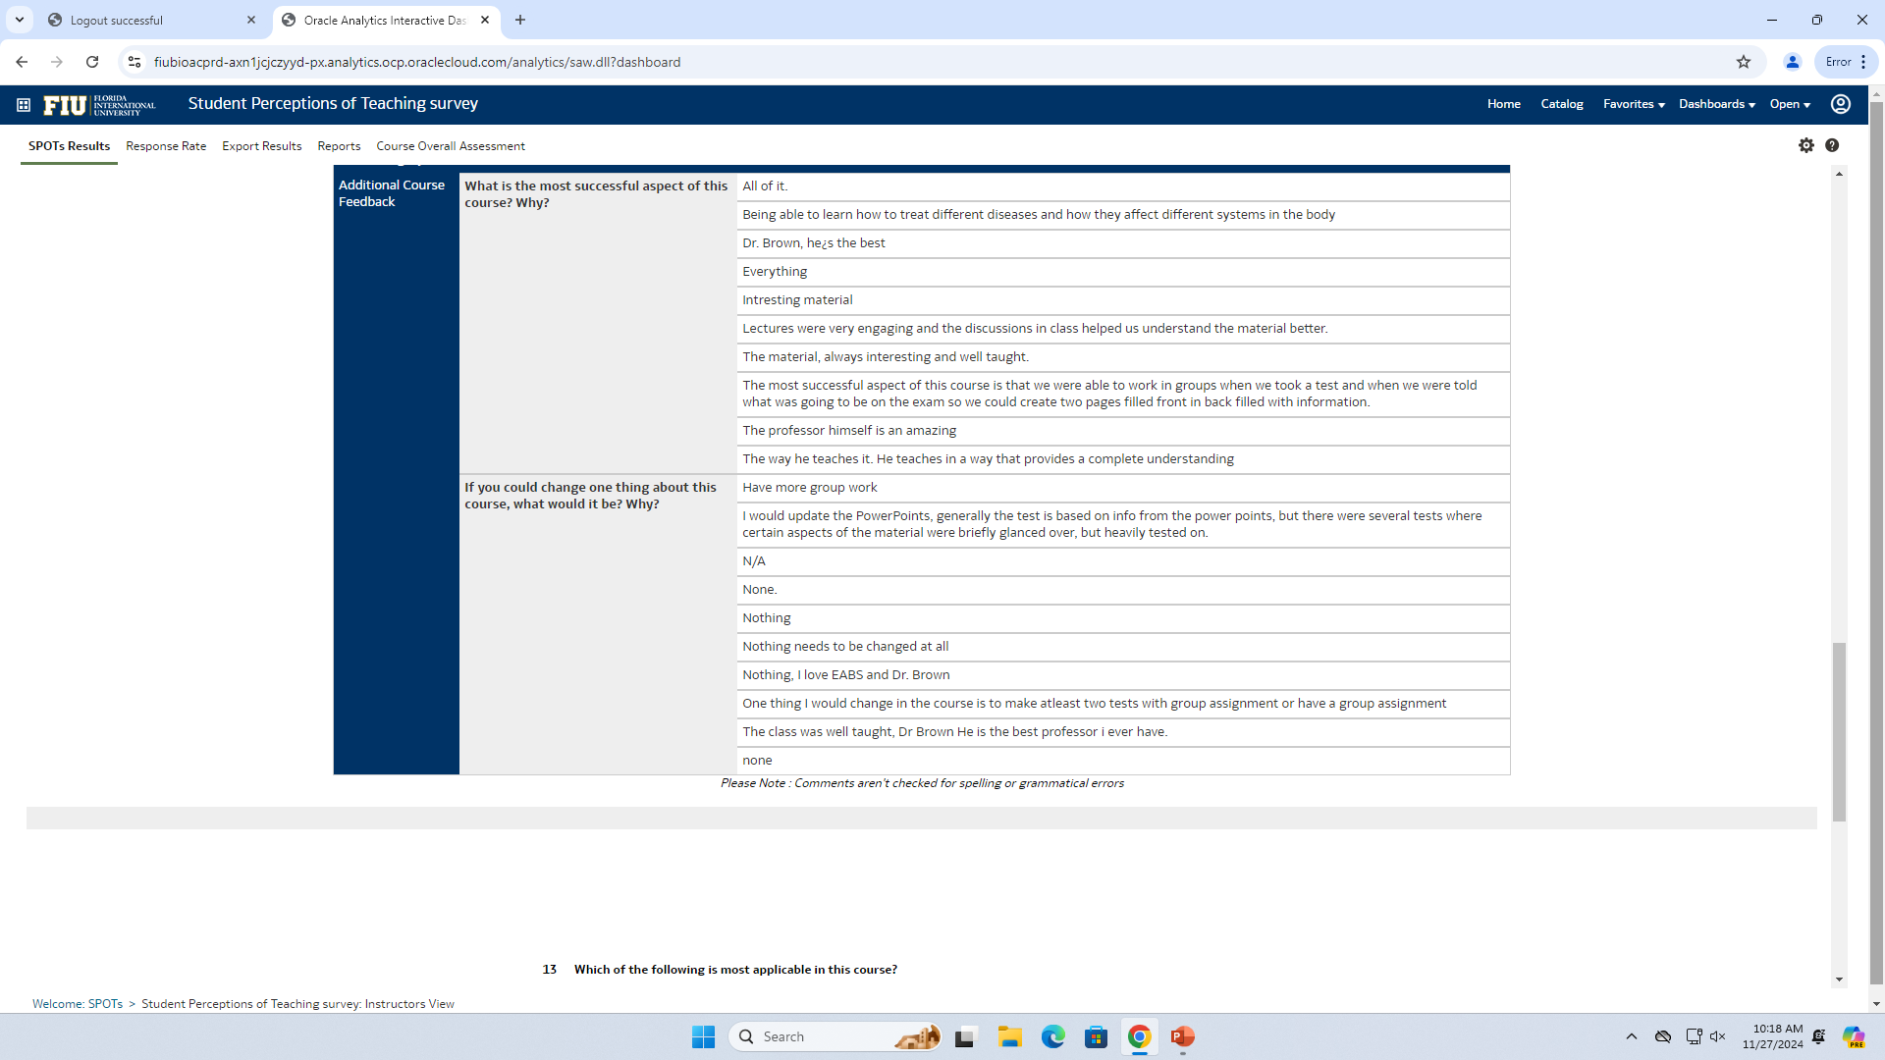
BME 3404 Spring 2023

Slide 17
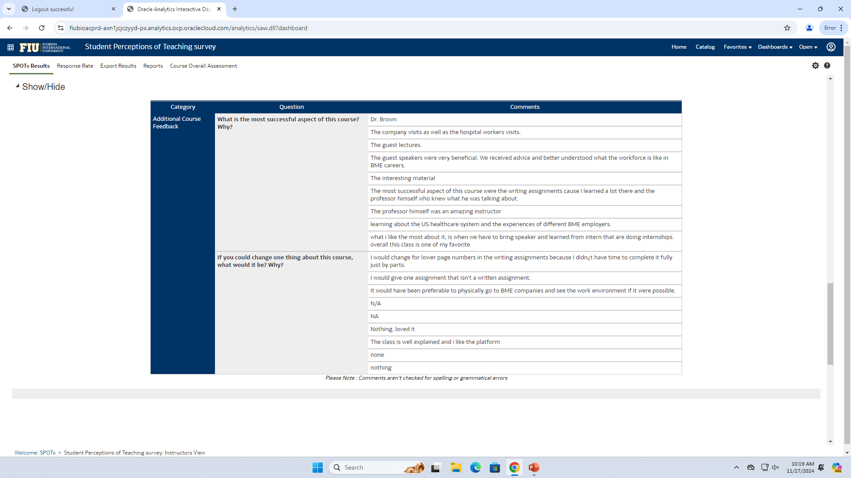
BME 4011 Spring 2023

Slide 18
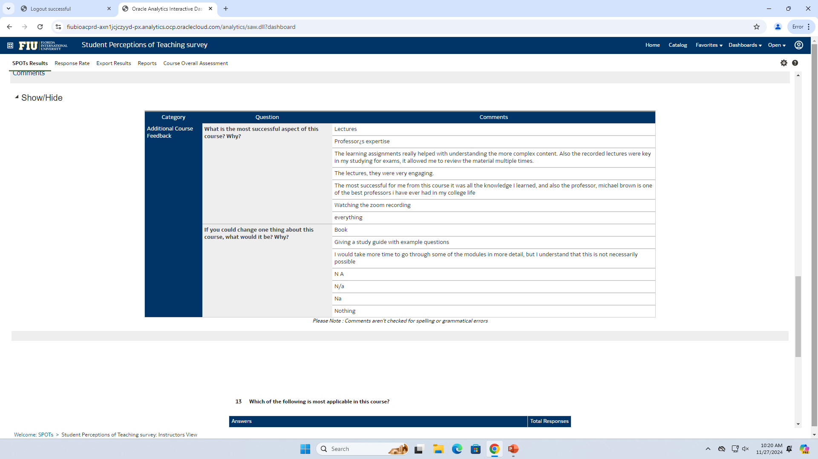
BME 3403 Fall 2022

Slide 19
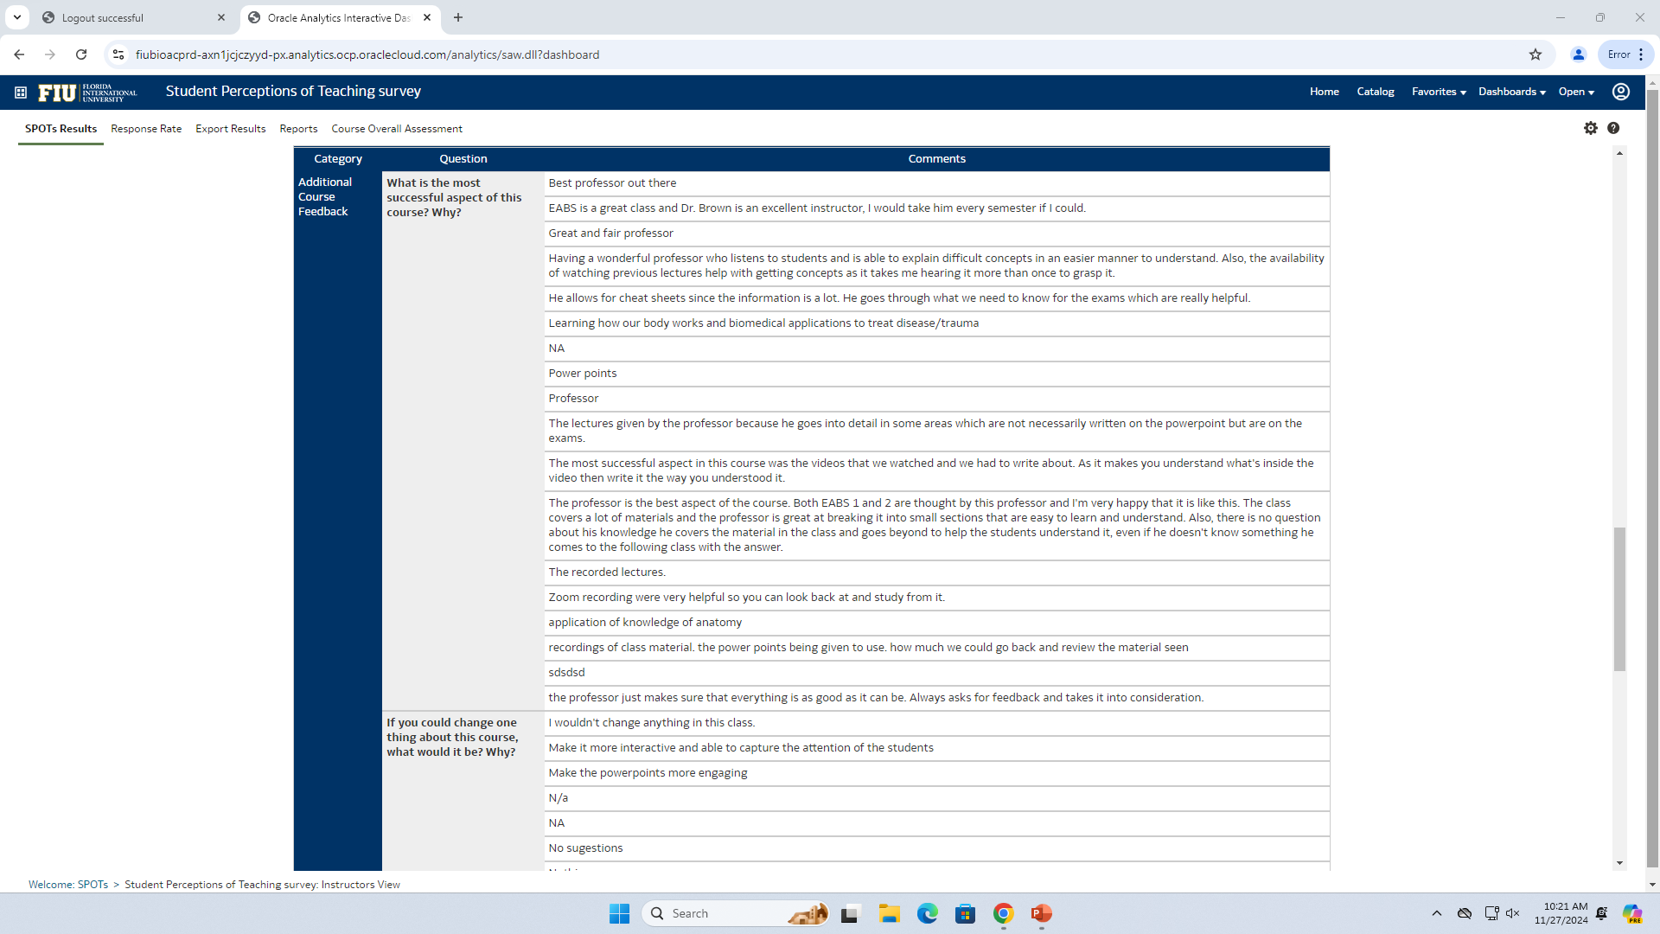
BME 3404 Fall 2022

Slide 20

BME 4011 Fall 2022

Slide 21
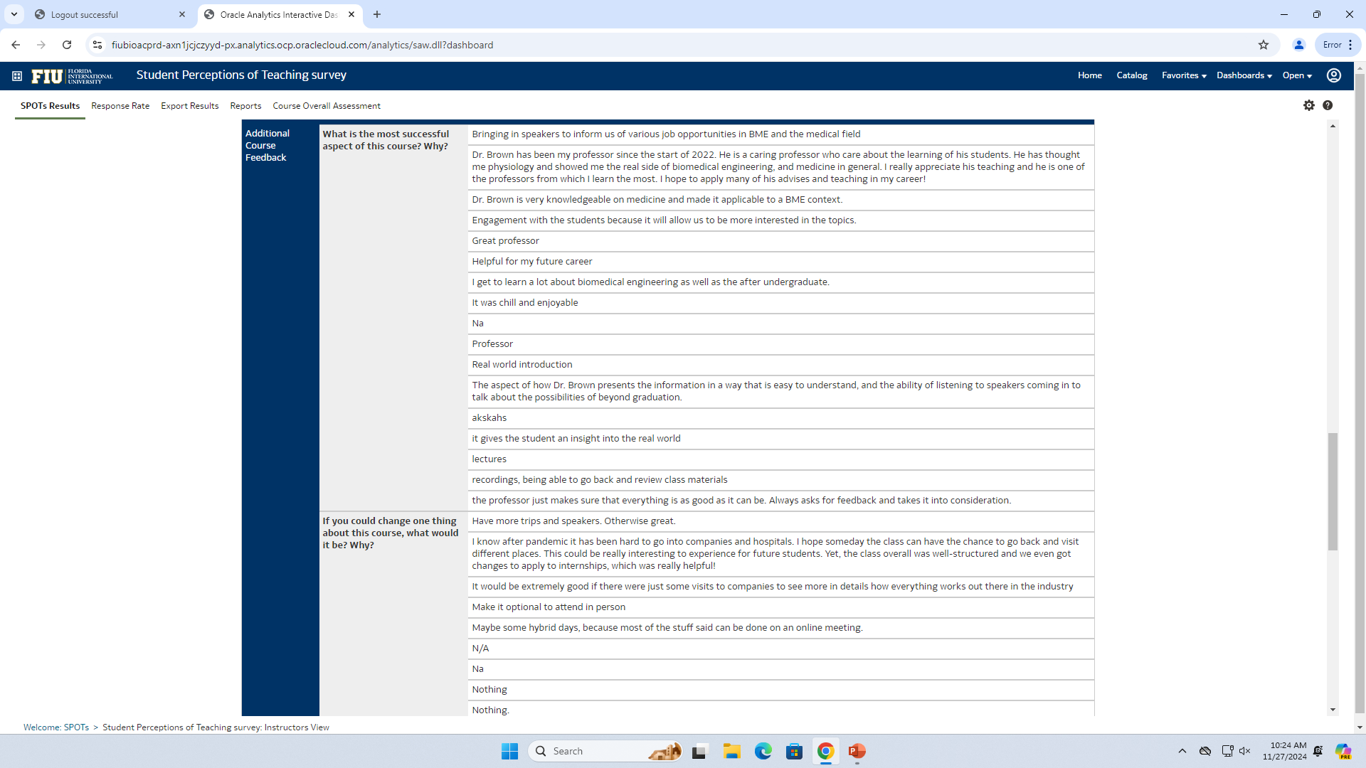
BME 3403 Summer 2022

Slide 22
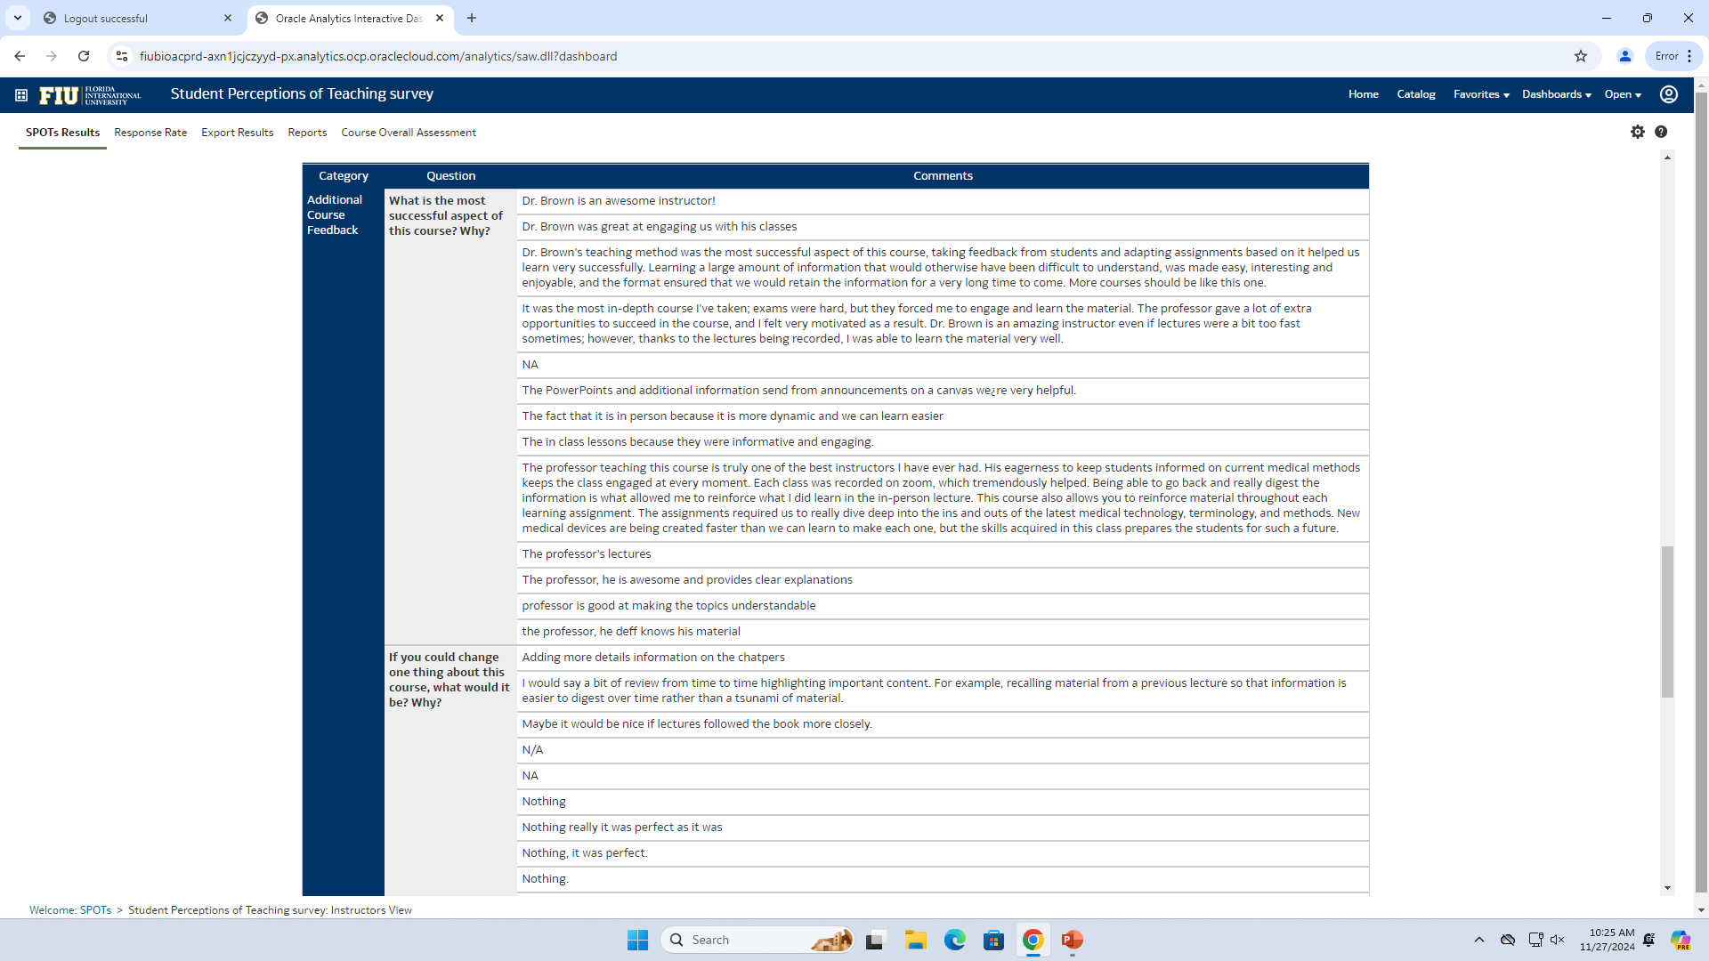
BME 3404 Summer 2022

Slide 23
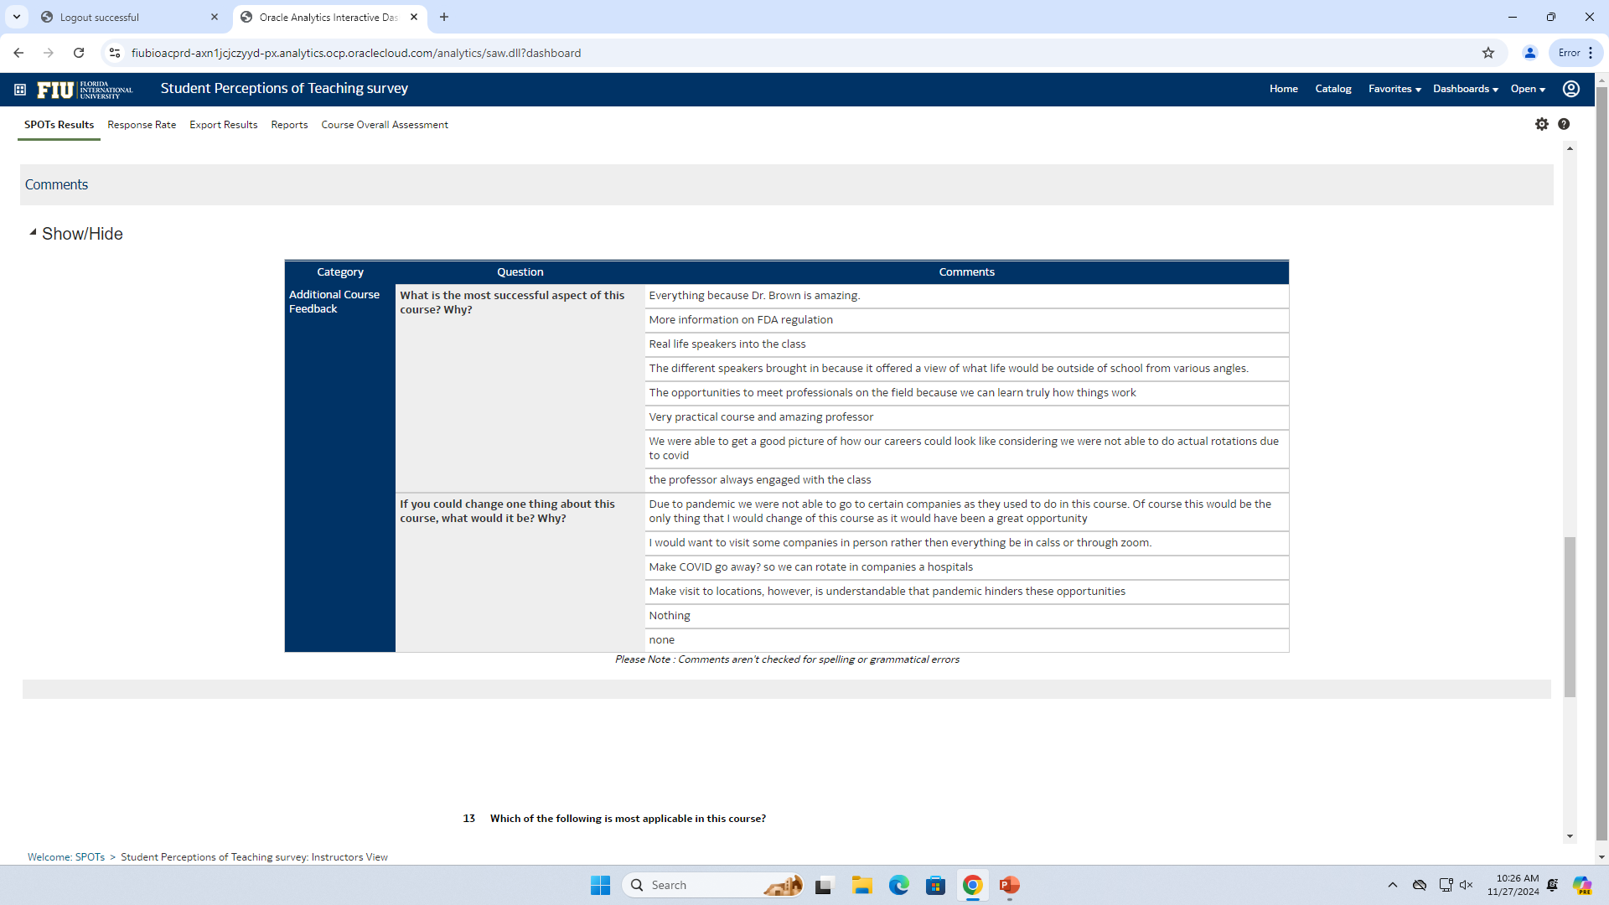
BME 4011 Summer 2022

Slide 24

BME 3403 Spring 2022

Slide 25
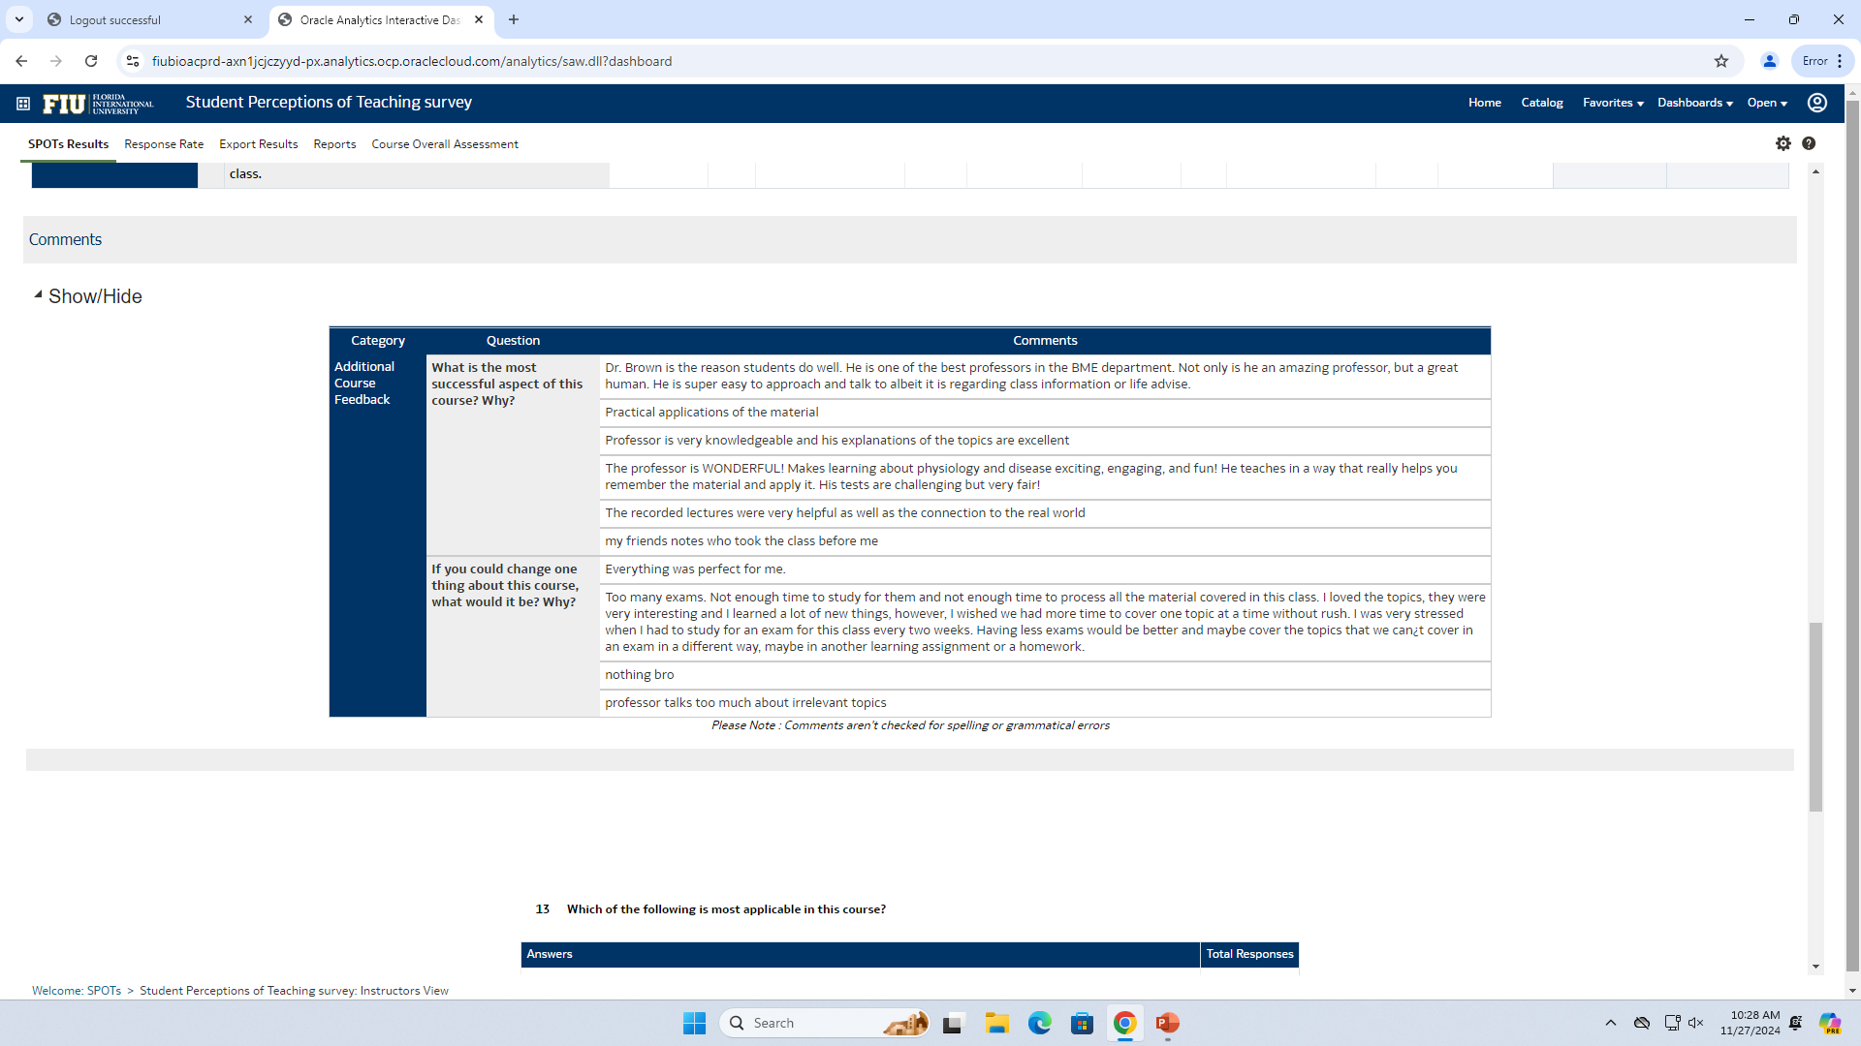
BME 3404 Spring 2022

Slide 26
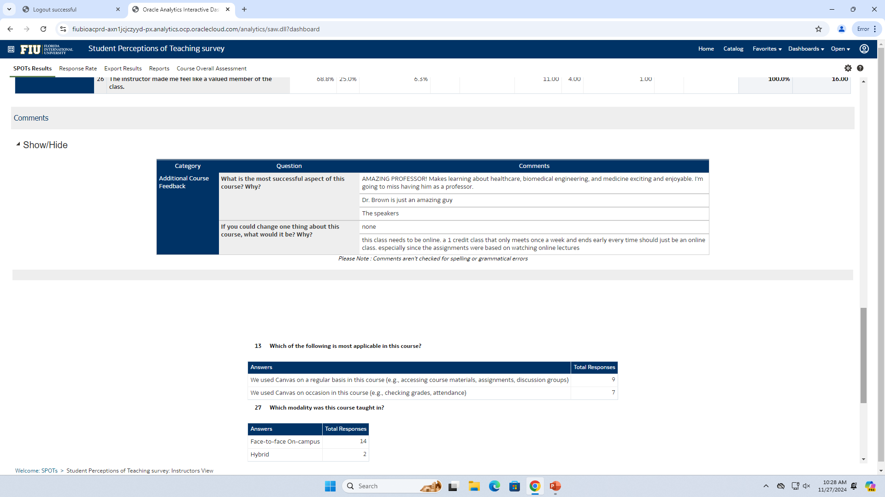
BME 4011 Spring 2022

