Slide 1
Chapter 26
Reproduction and Development

Slide 2
About this Chapter
How male and female reproductive systems differentiate
The reproductive organs and how they work
How gametes are produced and fertilized
Pregnancy, stages of development, birth & lactation
Reproductive and developmental maturation and aging

Slide 3
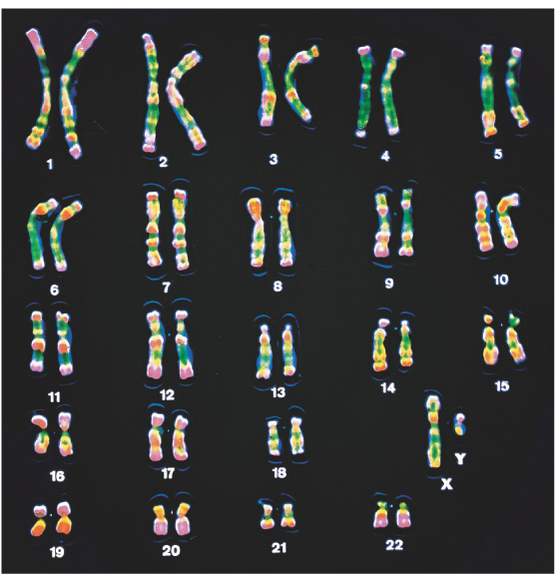
Sex Determination: Overview
Dimorphism:
Males → sperm
Females → eggs
Chromosomes
Autosomes
Sex Chromosomes
X - chromosome
Y - chromosome
Figure 26-1: Human chromosomes

Slide 4
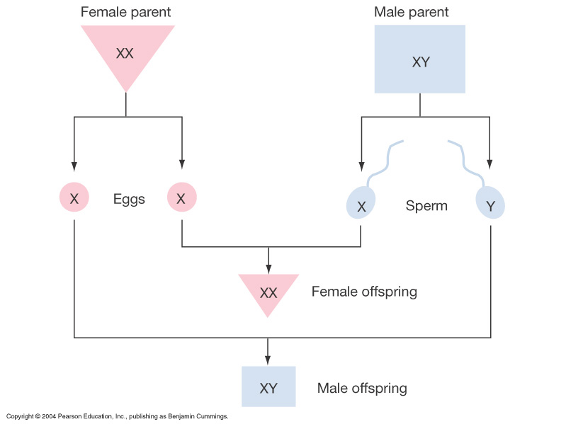
Sex Determination: Overview
Figure 26-2: Inheritance of X and Y chromosomes

Slide 5
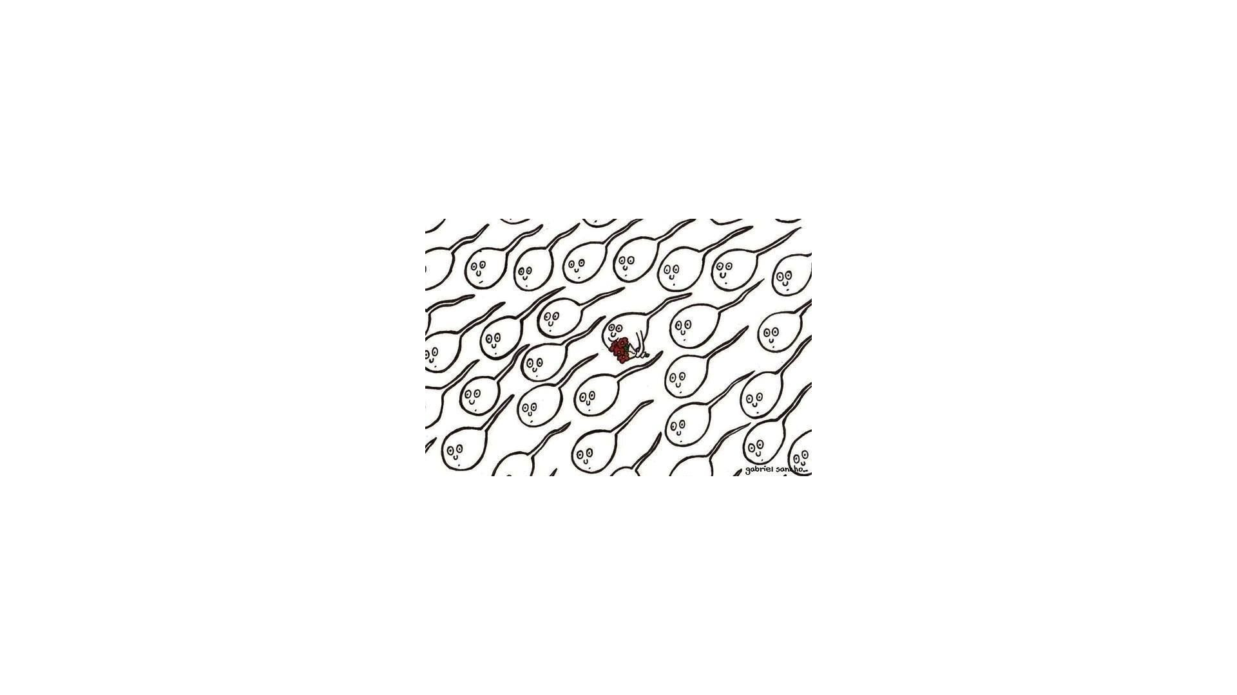

Slide 6
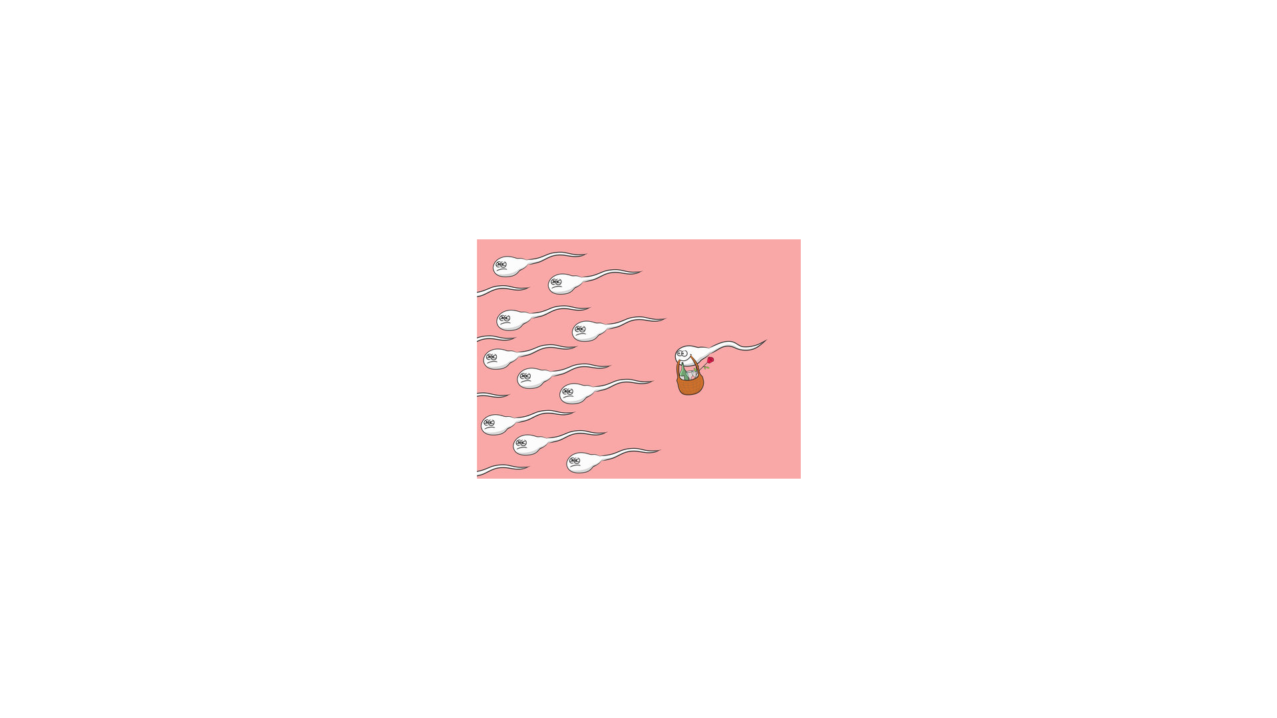

Slide 8
Sesquizygotic Twins

Slide 9
Sesquizygotic Twins
https://www.reuters.com/article/us-health-reproduction-mosaic-twins/doctors-confirm-new-type-of-twin-born-from-one-egg-and-two-sperm-idUSKCN1QG2YH
https://www.nejm.org/doi/full/10.1056/NEJMoa1701313

Slide 10
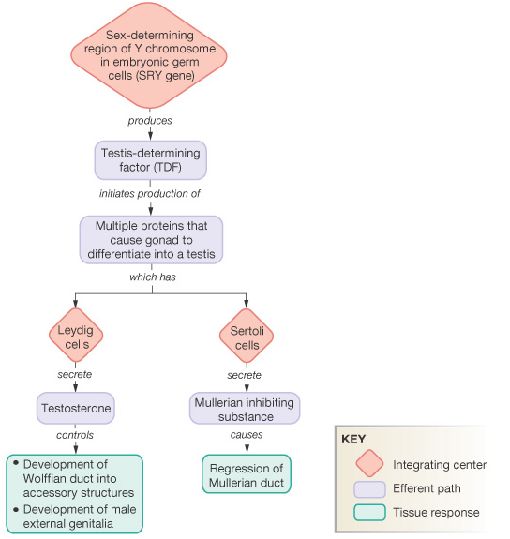
Pathway for Sexual Development: Review for Genes to Organs
Figure 26-4: Role of the SRY gene in male development

Slide 11
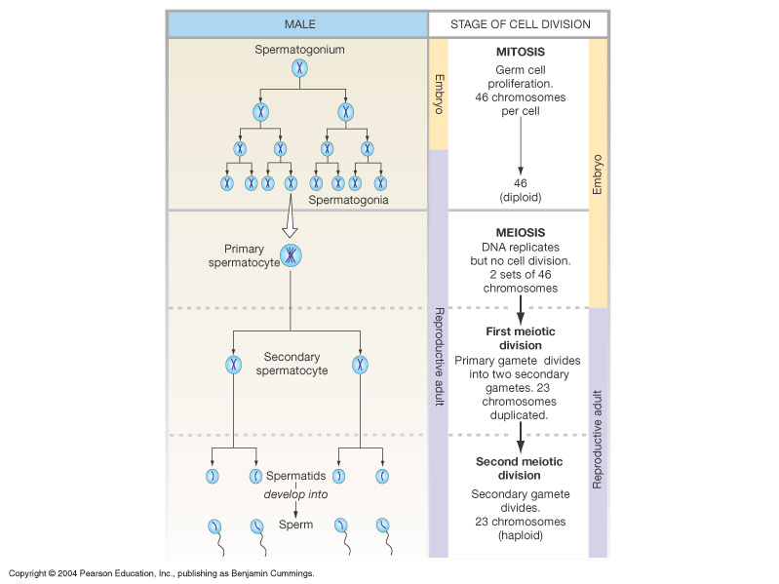
Overview of Gametogenesis: Producing Eggs or Sperm
Figure 26-5: Gametogenesis

Slide 13
Regulation of Reproduction: General Pathways
Hypothalamus: pulse generator
Gonadotropin releasing H
(GnRH)
Anterior Pituitary
Lutenizing H (LH)
Follicle stimulating H (FSH)
Ovary: progesterone
Estrogen, inhibin
Testis: testosterone

Slide 14
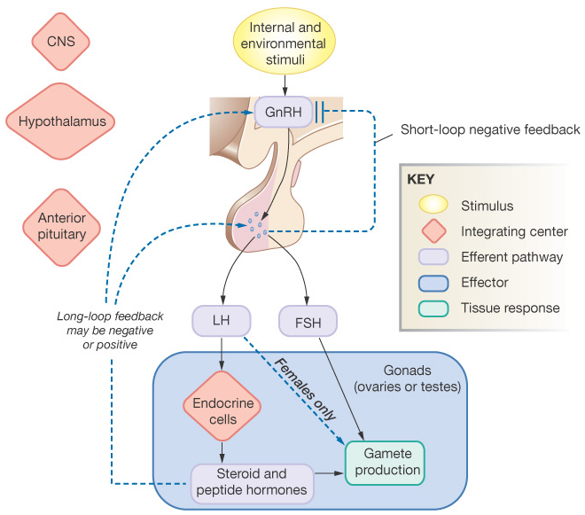
Regulation of Reproduction: General Pathways
Figure 26-7: General pattern of hormonal control of reproduction

Slide 15
Male Reproductive Anatomy and Physiology
Testis
Epididymis
Vas deferens
Seminal vesicle
Prostate
Bulbourethral
Ejaculatory duct
Urethra
Penis

Slide 16
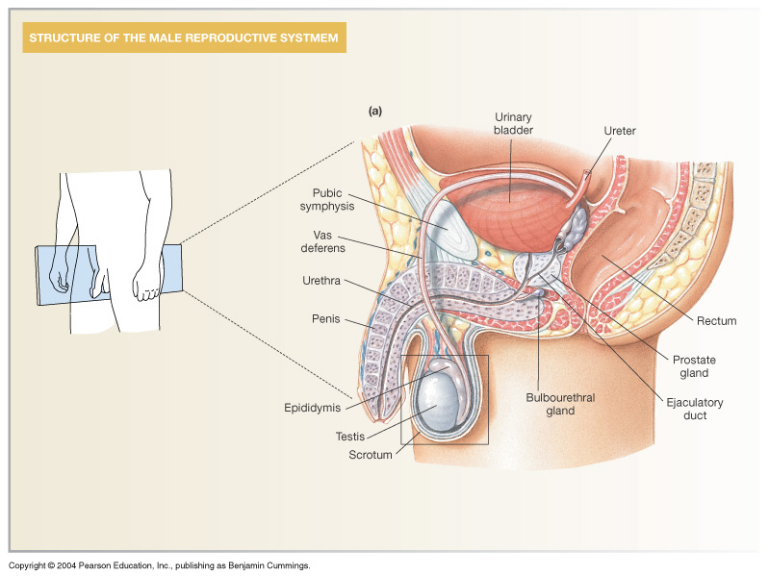
Male Reproductive Anatomy and Physiology
Figure 26-9a: ANATOMY SUMMARY: Male Reproduction

Slide 17
Spermatogenesis: Sperm Production in the Testis
Seminiferous tubules
Spermatids
Spermatocytes
Spermatozoa
Sertoli cells
Interstitial tissue
Leydig cells
Capillaries

Slide 18
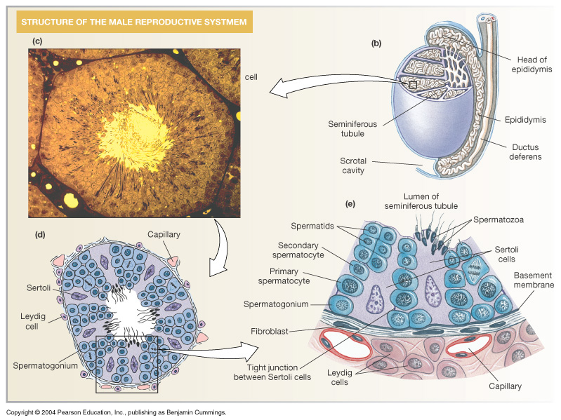
Spermatogenesis: Sperm Production in the Testis
Figure 26-9b-e: ANATOMY SUMMARY: Male Reproduction

Slide 19
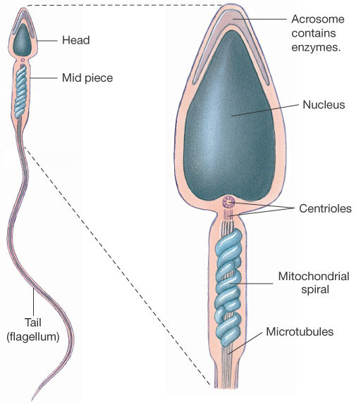
Spermatozoa Structure and Functions in Review
Head
Acrosome:
Nucleus:
Midpiece
Centrioles:
Mitochondria:
Tail: flagellum
Microtubules:
Figure 26-10: Sperm structure

Slide 20
Capacitation of Sperm
Capacitation, Hyperactivation, and Sperm Selection
Although it is difficult to assign a definite starting point to fertilization, sperm capacitation signals the acquisition of competence for fertilization and is commonly thought of as the initiation of the fertilization process. Capacitation is defined as the series of biochemical events requisite for competence to undergo the acrosome reaction and fertilization. Those events include both cytoplasmic events, such as an influx of calcium, and membrane events, such as the removal of sterols and relocation of fertilization-associated proteins. In addition, capacitation is associated with the activation of hyperactive motility.
The most pronounced change during capacitation is membrane remodeling. This remodeling increases the fluidity of the phospholipid bilayer and facilitates the acrosome reaction. As sperm progress through the reproductive tract, cholesterol is removed from the plasma membrane by albumin and high-density lipoproteins found in the female genital tract. Membrane fluidity may also be increased by removal of phospholipids in a second mechanism. In some species, extracellular glycoproteins are stripped from sperm traversing the genital tract. When glycoproteins are removed from the membrane, associated phospholipids are also removed. These modifications of the plasma membrane may expose membrane-bound enzymes and ligands utilized in sperm penetration of the cumulus oophorus and anchoring to the zona pellucida.

Slide 21
Regulation of Spermatogenesis
GnRH → LH → Leydig cells → testosterone → 2⁰ sex characteristics
GnRH → FSH → Sertoli cells → spermatoctye maturation

Slide 22
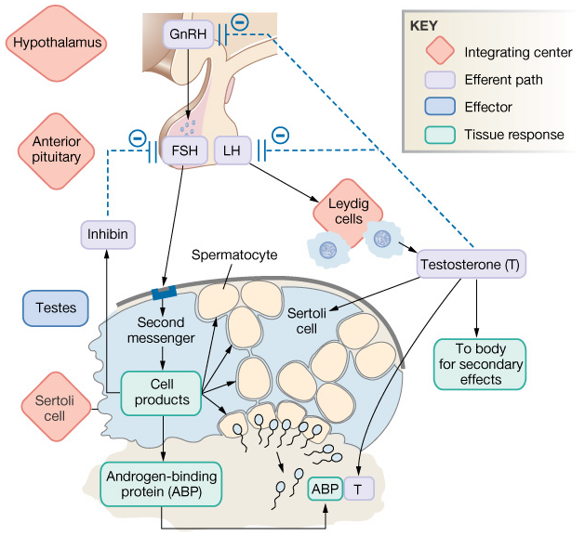
Regulation of Spermatogenesis
Figure 26-11: Hormonal control of spermatogenesis

Slide 23
Female Reproductive Anatomy and Physiology: Overview
Ovary
Fallopian tube
Fimbriae
Uterus
Cervix
Endometrium
Vagina
Clitoris
Labia

Slide 24
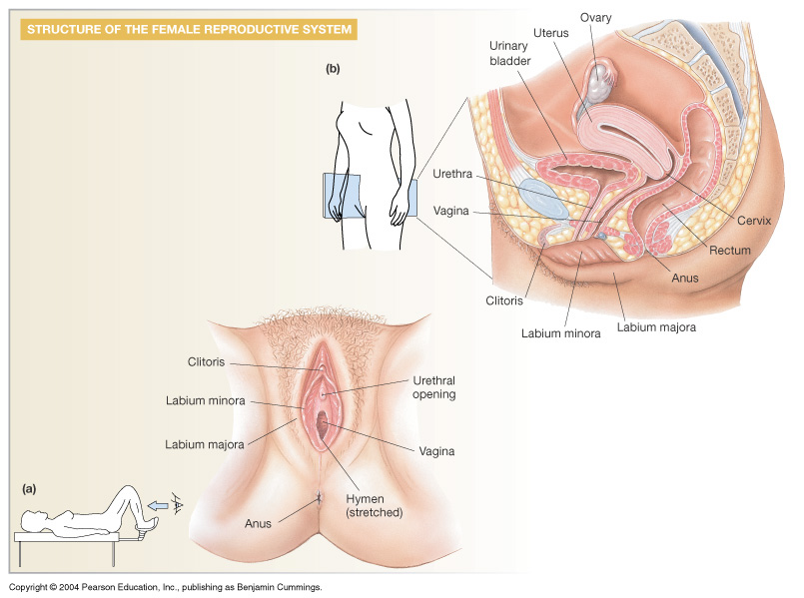
Female Reproductive Anatomy and Physiology: Overview
Figure 26-12b: ANATOMY SUMMARY: Female Reproduction

Slide 25
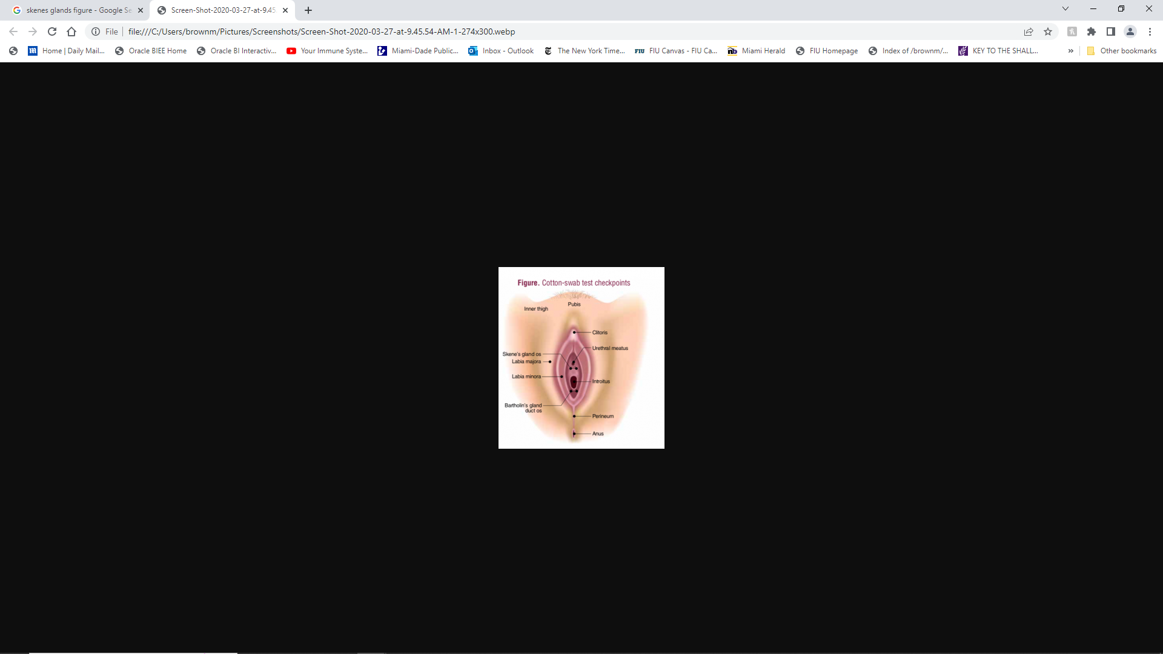

Slide 27
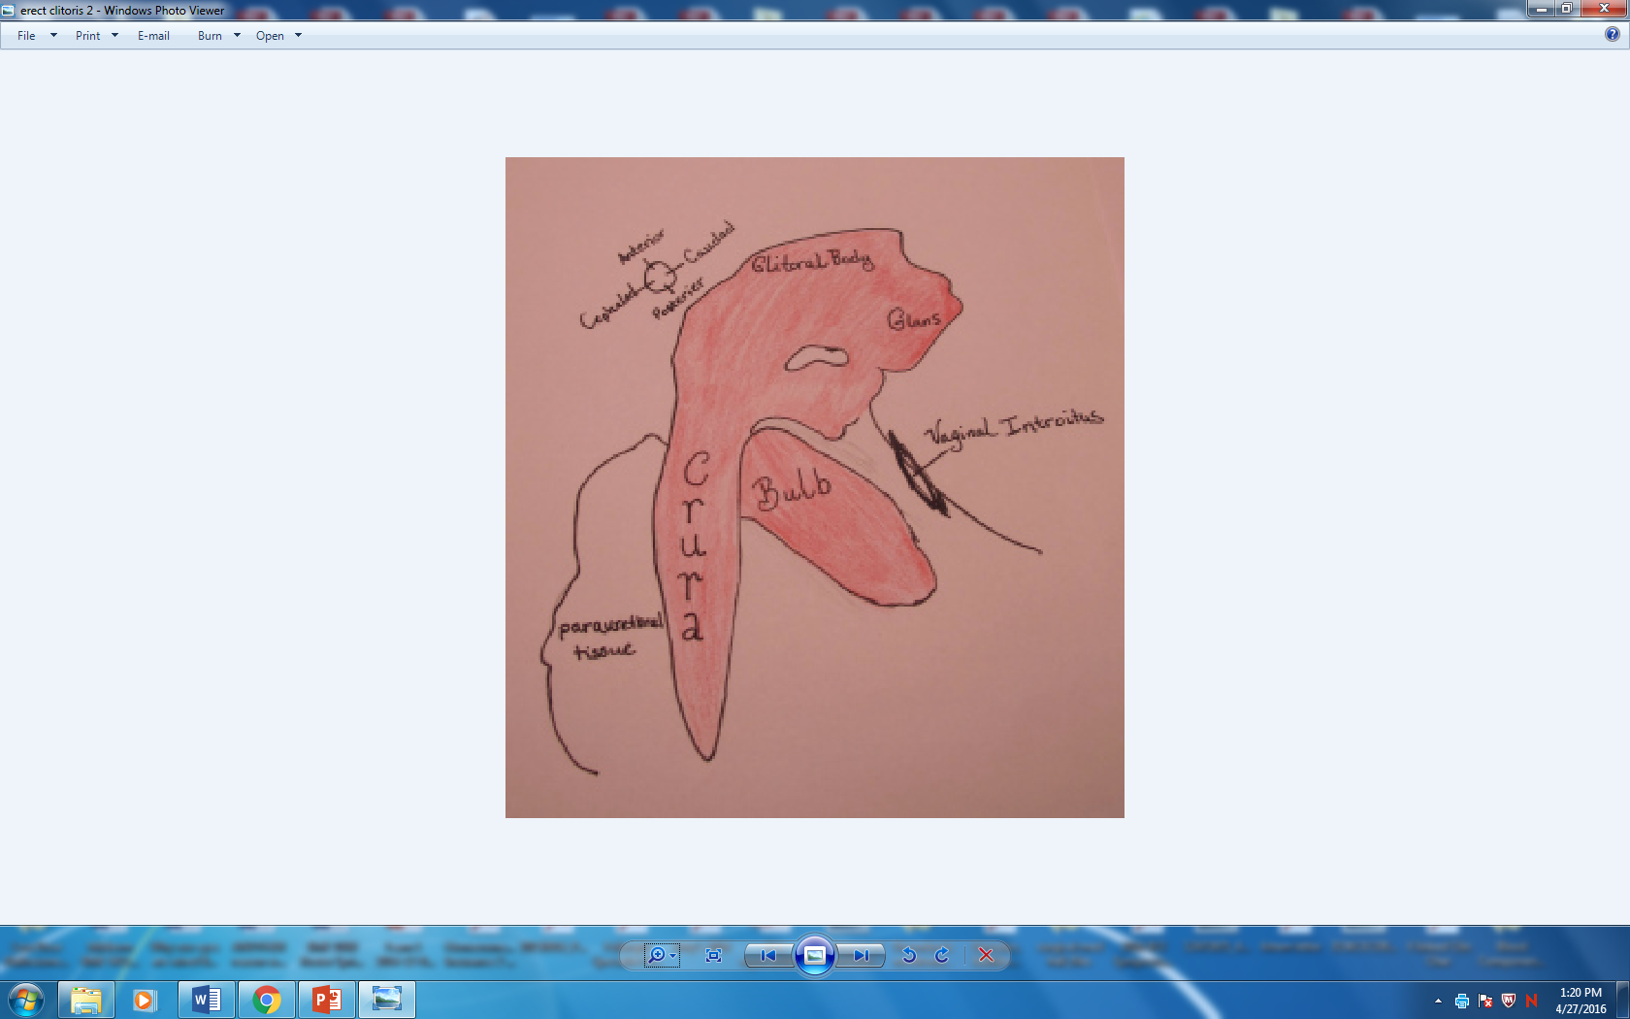

Slide 28
Ovary: Details of Histology & Physiology
Follicle
Oocytes
Thecal cells
Granulosa cells
Estrogen
→ Corpus luteum
Corpus luteum
Progesterone
Inhibin

Slide 29
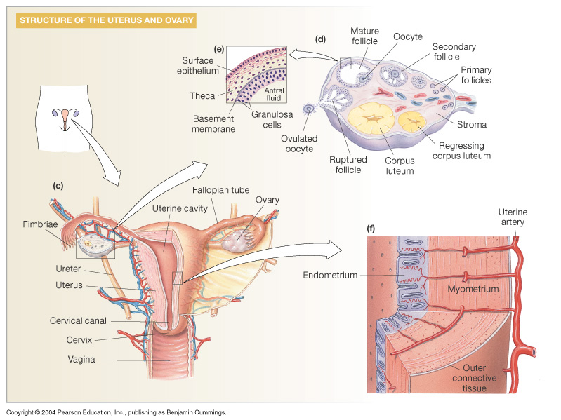
Ovary: Details of Histology & Physiology
Figure 26-12d: ANATOMY SUMMARY: Female Reproduction

Slide 30
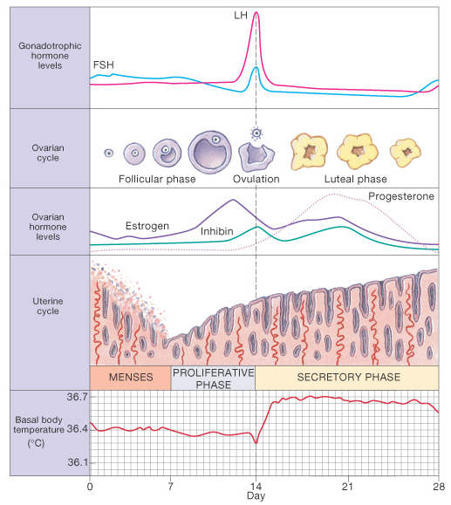
Menstrual Cycle: Egg Maturation, and Endometrial Growth
Follicular phase
Egg matures
Ovulation
Egg released
Luteal phase
Corpus luteum
Endometrium
Prep for blastocyst
No Pregnancy
Menses
Figure 26-13: The menstrual cycle

Slide 32
Endocrine Control of Menstrual Cycle: Ovulation
↑ Estrogen → LH "surge" & FSH spike → egg release
Inhibin↑ pushes FSH down , ↓ new follicle development

Slide 33
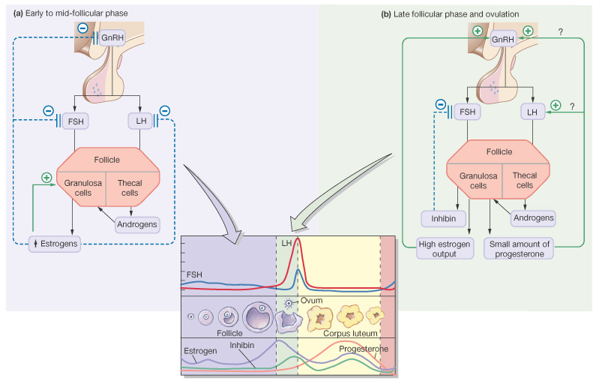
Endocrine Control of Menstrual Cycle: Follicular Phase and Ovulation
Figure 26-14a,b: Hormonal control of the menstrual cycle

Slide 34
Endocrine Control of Menstrual Cycle: Luteal phase
Granulosa cells form corpus luteum → progesterone
↑ progesterone & estrogen maintain endometrium
Inhibin continues to limit new follicular development

Slide 35
Endocrine Control of Menstrual Cycle: Late Luteal phase
Pregnancy: maintain ↑ progesterone, estrogen & inhibin
No pregnancy: ↓ progesterone, estrogen & inhibin
Menses, ↑ FSH & LH → new follicle development

Slide 36
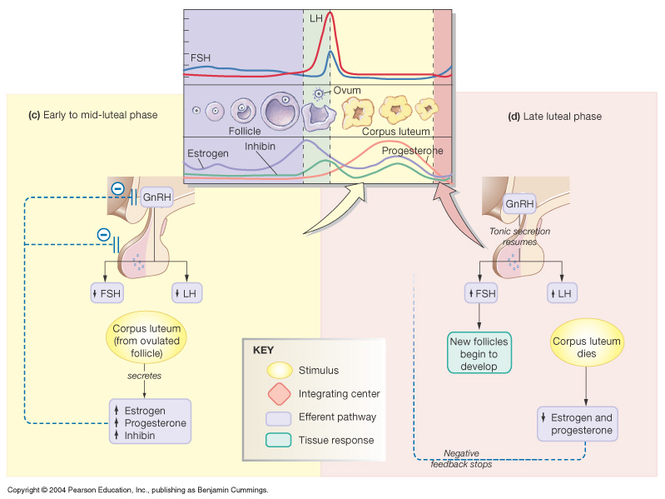
Endocrine Control of Menstrual Cycle: Luteal phase and Late Luteal phase
Figure 26-14c, d: Hormonal control of the menstrual cycle

Slide 37
Fertilization: Union of Male & Female Chromosomes
Sperm capacitation
Swimming & attractants
Egg contact
Penetration
Nuclear fusion
(Zygote)
Figure 26-16b: Fertilization

Slide 38
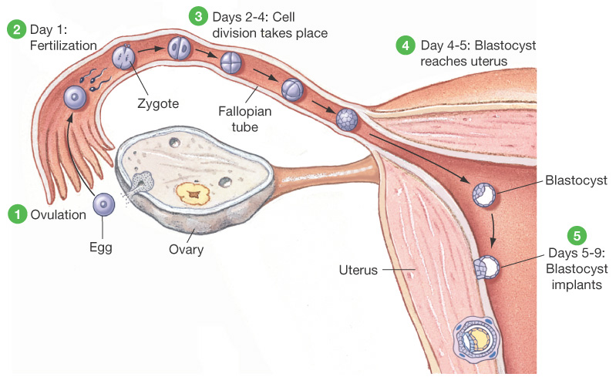
Zygote Development: Cell Division & Implantation
Figure 26-18: Ovulation, fertilization, and implantation of an ovum

Slide 40
Placenta and Further Embroynic Development
Amnion
Chorion
Placenta
Exchange
Hormones
Human chorionic Gonadotropin-hCG
Progesterone

Slide 41
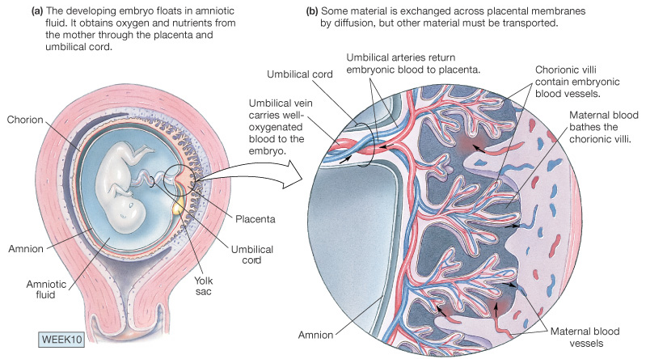
Placenta and Further Embroynic Development
Figure 26- 19a, b: The placenta

Slide 42
Intact amnion following birth of a 3 month premature infant- Extremely rare

Slide 43
In the caul—In the sac 1/80,000 births Associated with premature infants

Slide 44
Birth: Parturition
Labor
Rhythmic
Uterine
Contractions
Cervical dilation
Delivery
Baby
Placenta

Slide 45
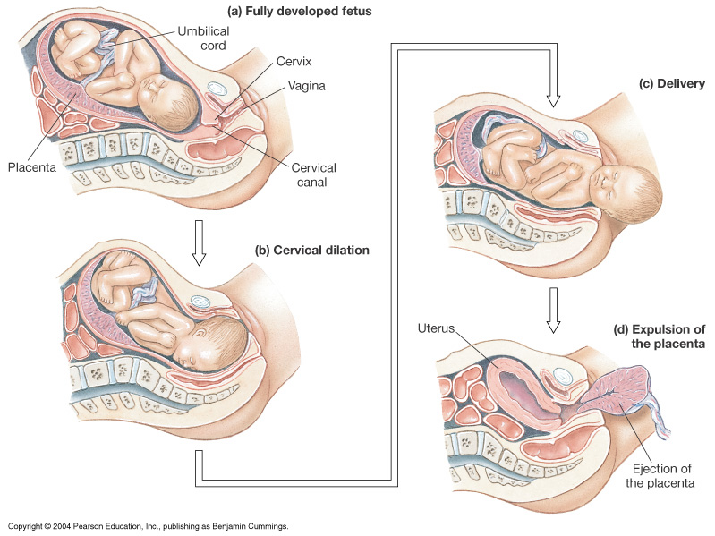
Birth: Parturition
Figure 26-20: Parturition: the birth process

Slide 46
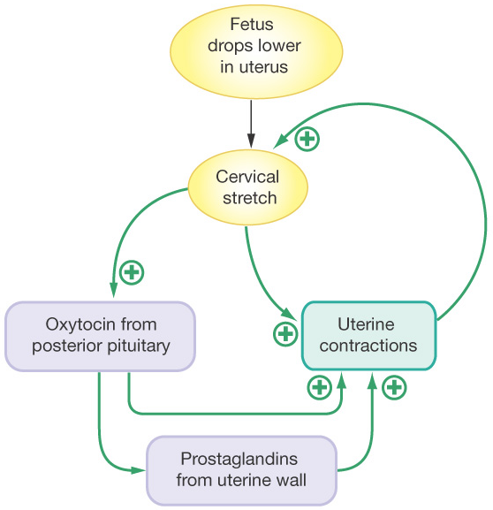
Regulators of Parturition
Labor onset
Stretch stimulus
Oxytocin
Prostaglandins
Positive feedback
↑ Stretch →
↑ Oxytocin
Birth ends
Stimulus
Figure 26-21: The positive feedback loop of parturition

Slide 47
Lactation: Producing and Releasing Milk
Estrogen & progesterone
Preps mammary tissues
Prolactin inhibiting H:
Prolactin → milk production
(other roles in fertility)
Sucking stimulus →
Oxytocin →
"Milk let-down" reflex

Slide 48
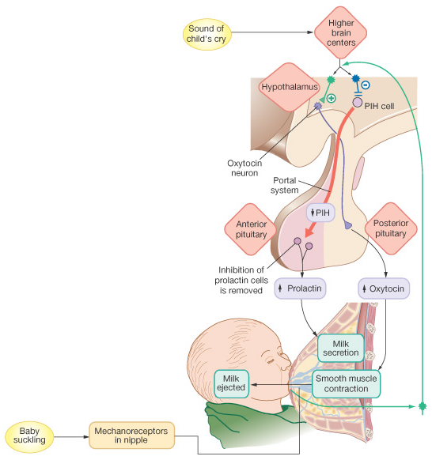
Lactation: Producing and Releasing Milk
Figure 26-23: The hormonal control of milk secretion and release

Slide 49
Reproductive Maturation: Puberty
Increase production of sex hormones
Maturation of reproductive organs & gamete production
2⁰ sexual characteristics
Males: pubic hair, beard, deep voice, "wedge" body form & ↑ muscle mass
Females: menarche, pubic hair, breasts & "pear shape" body form

Slide 50
Later in Life
Menopause: Female "Change-of Life"
Ovaries ↓ responding to GnRH
↓ Levels of estrogen & progesterone produced
Cease egg development
"Hot flashes" , ↑ osteoporosis risk
(hormone replacement debate)
"Andropause" (?): Male changes are gradual
↓ Sex hormones: ↓ muscle mass, ↓ libido, ↓ erections
Viagra: PNS → NO → cGMP → ↓ degradation

Slide 51
Summary
Genes and hormones direct bipotential reproductive tissues to differentiate into males or females
Spermatogenesis is regulated by FSH & LH, testosterone and inhibin influence on spermatocytes, Sertoli & Leydig cells
Menstrual cycle coordinates egg maturation with endometrium, and is regulated by GnRH,→ LH & FSH → estrogen, progesterone & inhibin (and placental hCG)

