Slide 1
Familial Hypercholesterolemia

Slide 2
Familial Hypercholesterolemia
Background
Endothelial Glycocalyx
Purpose of the Study
Methods
Results
Discussion

Slide 3
Familial Hypercholesterolemia
Autosomal dominant disorder
High levels of low density lipoprotein cholesterol (LDL)
Early coronary artery disease (CAD)
Heterozygous ~1 in 500
Homozygous ~1/1,000,000
Greater risk of heart disease (100x for males 20-40 yrs)

Slide 4
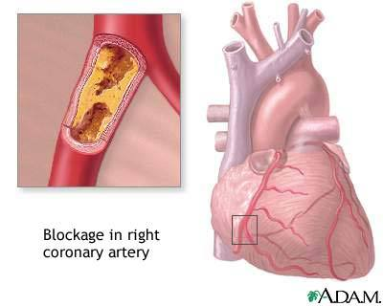
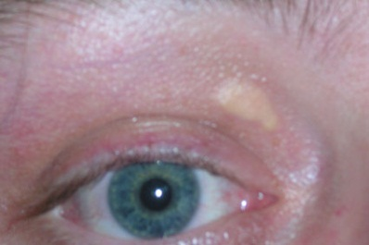
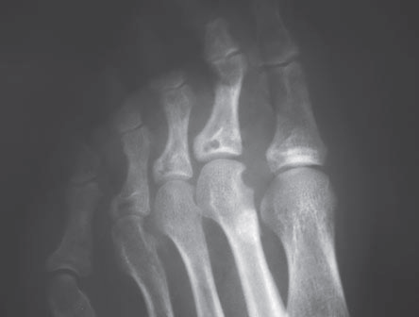
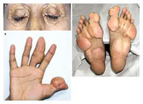
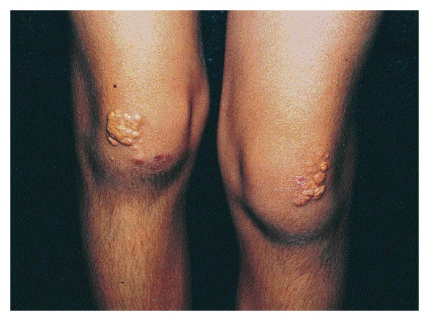
Familial Hypercholesterolemia
Physical symptoms
Xanthomas – fatty skin deposits
Xanthelasmas - Cholesterol deposits in the eyelids
Angina – chest pain

Slide 5
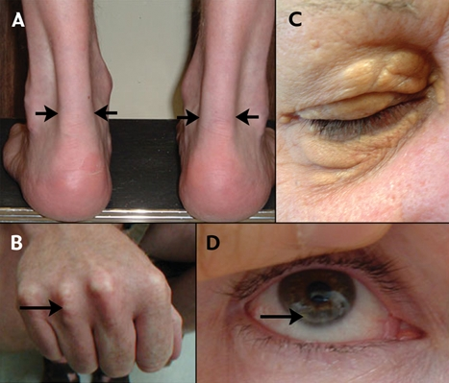
Familial Hypercholesterolemia
Heterozygous Familial Hypercholesterolemia (HeFH)
Monogenic disorder
Heterozygous mutations in the LDLR gene
Cholesterol deposits in the corneas, eyelids and extensor tendons
Elevated plasma concentrations of LDL

Slide 6
Genetics of FH
Mutations in 3 genes
Low-density lipoproteins receptors gene (LDLR)
Apoliprotein B-100 gene (APOB)- involved in LDLR binding
Proprotein convertase subtilisin/kexin type (PCSK9) – cholesterol homeostasis

Slide 7
Genetics of FH
93% of all mutations occur in the LDLR
Coding region of 5kb, 18 exons
Over 1000 mutations reported
5% mutations may be due to large deletions or duplications

Slide 8
Familial Hypercholesterolemia
Early identification
Reduction in morbidity through changes in the lifestyle
Diet and exercise
No smoking
Use of statins to lower cholesterol
Life expectancy now is equal to the general population
(85%) of affected individuals remain undiagnosed

Slide 9
Endothelial Glycocalyx
Protective barrier
Blood
Vessel wall
Shields endothelium luminally
Soluble plasma membrane components bound by
Proteoglycans – “backbone” molecule of glycocalyx
Glycoproteins – connects the glycocalyx to endothelial cell membrane
Glycocalyx thickness
2-3 µm in small arteries
4.5 µm in carotid arteries

Slide 10
Endothelial Glycocalyx
a. Ventricular myocardial capillary
b. Hamster cremaster muscle capillary
c. Common carotid artery

Slide 11
Partial recovery of the endothelial Glycocalyx upon rosuvastatin therapy in patients with heterozygous familial hypercholesterolemia
Purpose:
To evaluated the correlation of Glycocalyx perturbation in FH patients
Restoration of Glycocalyx with statin treatment

Slide 12
Methods
Heterozygous FH – 13 male patients
Based on profile
Control group – 13 male subjects
Normocholesterolemic, non-smoking, healthy
8 wk study
Clinical parameters
Glycocalyx volume (V_{G})
LDL
Other biochemical parameters
V_{G} estimation
(Intavascular V of glycocalyx permeable tracer) - (circular plasma V)
Intravenous injection of Dextran 40 - glycocalyx permeable tracer
Blood sampling at time intervals to measure glucose concentrations
Thickness of endothelial glycocalyx in capillaries using OPS imaging
Circulating blood volume: ([1-Ht] * V_{ERY})/Ht

Slide 13
Results
Student’s t-test (two-tailed)
LDL-cholesterol 225 → 95 vs. 93 (control)

Slide 14
Results
Fig. 1. Systemic glycocalyx volume (VG)
V_{G} of FH is 0.8±0.3L significantly lower vs 1.7±0.6L of control
V_{G} recovered partially to 1.1±0.4L
Glycocalyx thickness in FH increased from 0.4±0.1µm to 0.5±0.1µm
After treatment: r=-0.5 V_{G} vs luekocyte
No statistical correlation between V_{G} and LDL-cholesterol

Slide 15
Results
FH no treatment
FH treatment
Control
Fig. 2. Dextran clearance in hypercholesterolemic and normocholesterolemic subjects.
Clearance rate of dextran 40
Rosuvastatin treatment – no significant affect on dextran clearance

Slide 16
Discussion
Much lower V_{G} in FH patients
V_{G} only partially recovered after statin treatment
Short treatment duration
Normalization of LDL-cholesterol levels after intensive statin treatment (confirmed results)
V_{G} restoration will optimize vascular resistance to atherogenesis
Dextran 40 clearance = ↓ V_{G}
Endothelial Glycocalyx is the essential barrier against capillary permeability
Prevention of LDL uptake in vessel wall
Premature athrosclerosis in FH patients
FH = increased oxidative stress (↑oxLDL) = ↓ V_{G}
Preventable by radical scavengers

Slide 17
Discussion/Conclusion
No correlation between V_{G} and LDL-cholesterol
Possibly inflammatory effects on Glycocalyx perturbation
Hypercholesterolemia possibly = long lasting effects on the endothelial Glycocalyx
Future studies evaluating long-term statin treatments
Statin not designed for restoration of endothelial glycocalyx
↑hyaluronidase breaks down Glycocalyx
Restoration of glycocalyx by modulating glycosaminoglycan metabolism

Slide 18
References
http://www.nejm.org/doi/pdf/10.1056/NEJMoa042000
http://web.ebscohost.com/ehost/pdfviewer/pdfviewer?sid=48ff949a-adff-47f7-91c8-b83002e21dda%40sessionmgr15&vid=2&hid=21
http://www.ncbi.nlm.nih.gov/pubmedhealth/PMH0001429/
http://www.ncbi.nlm.nih.gov/pmc/articles/PMC1915585
http://www.ncbi.nlm.nih.gov/
http://www.pdb.org/
http://dwb.unl.edu/Teacher/NSF/C10/C10Links/www.middlebury.edu/~ch0337/ho/fh.html

