Slide 1
Lipids, Lipoproteins and Atherosclerosis:

Slide 2
Lipoprotein Overview

Slide 3
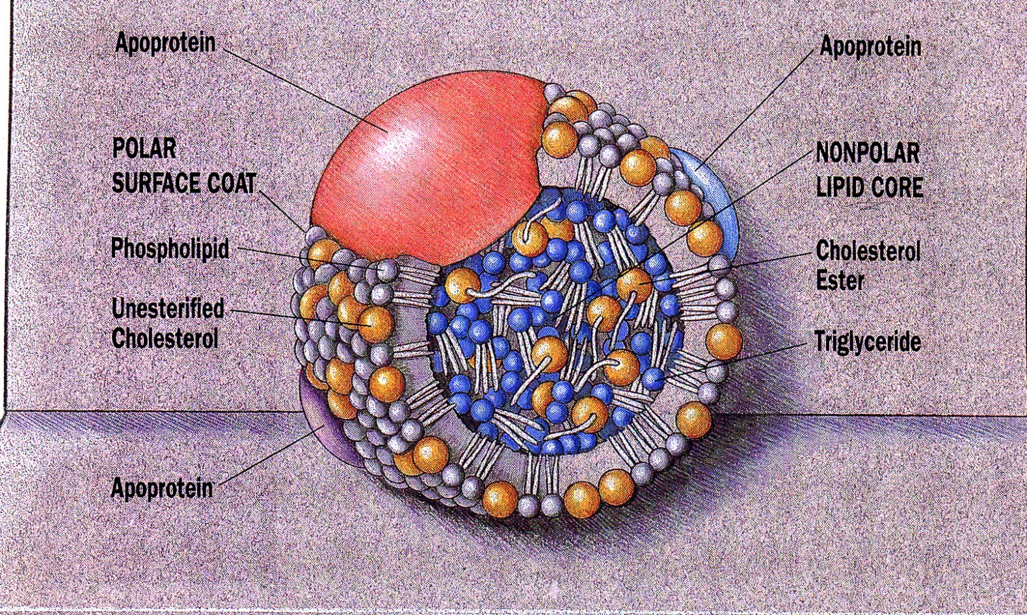
Generic Lipoprotein

Slide 4
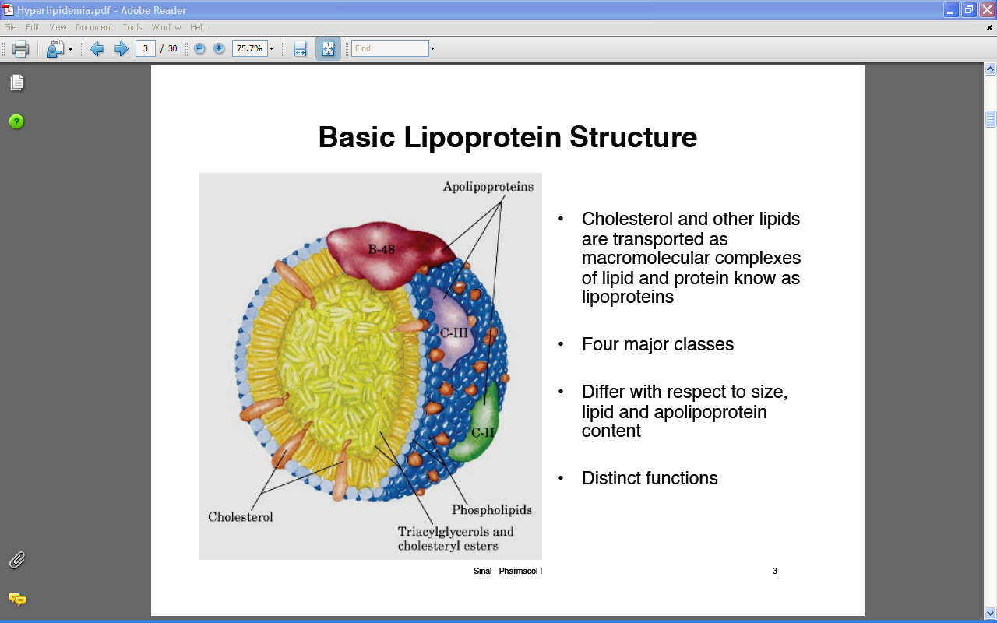

Slide 5
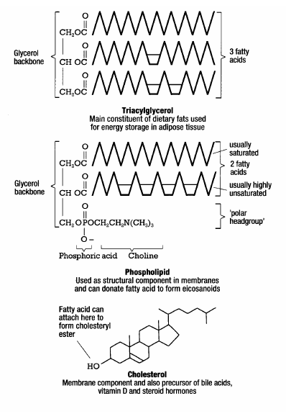
The Players – Lipids
Triacylglycerol
Phospholipids
Cholesterol
Cholesteryl esters

Slide 6
Role of Lipids (Lipoproteins) in Metabolism
Triglycerides Major energy source for cells
Cholesterol Cell growth, cell division, membrane
repair, steroid hormone production
Lipids Transport of fat soluble vitamins

Slide 7
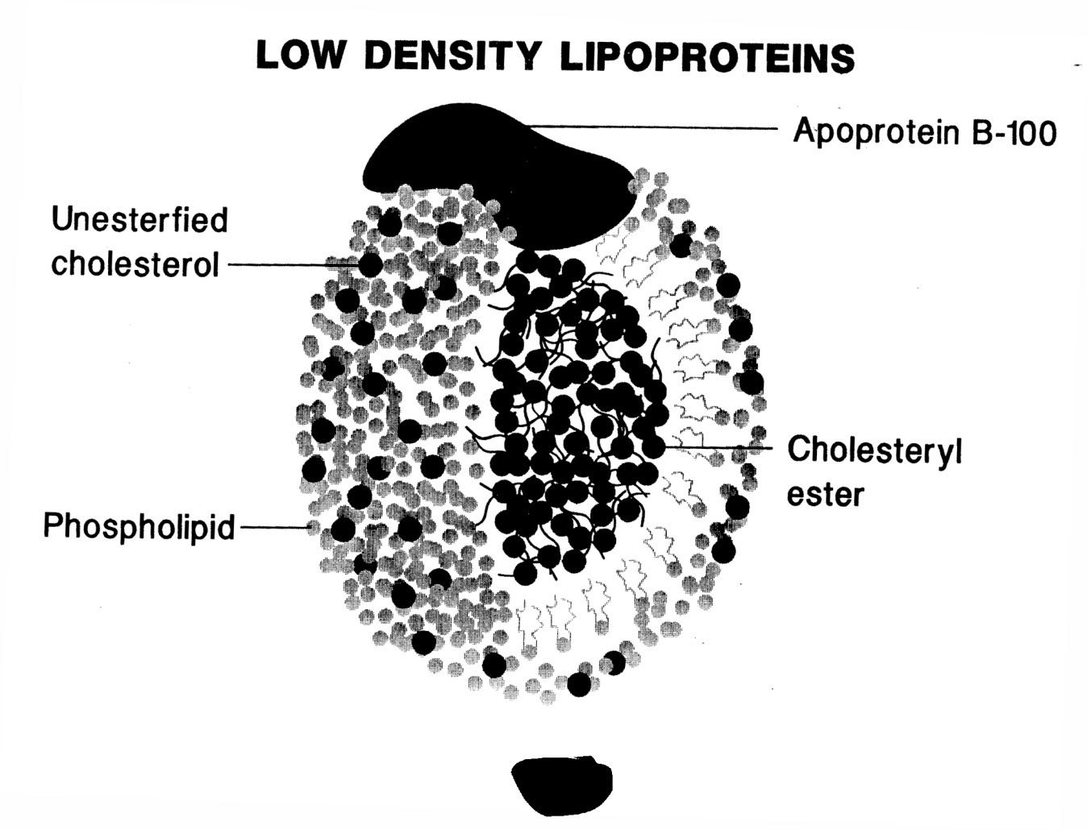
LDL is the dominant circulating lipoprotein. High levels are associated with poor cardiovascular health, particularly atherosclerosis.
LDL is essentially a bag of lipid (~1500 cholesteryl esters) encased in a coating of phospholipid and a little unesterified cholesterol to control membrane fluidity. The apoB-100 lipoprotein is the recognition site for binding to the LDL receptor on target cells.

Slide 8
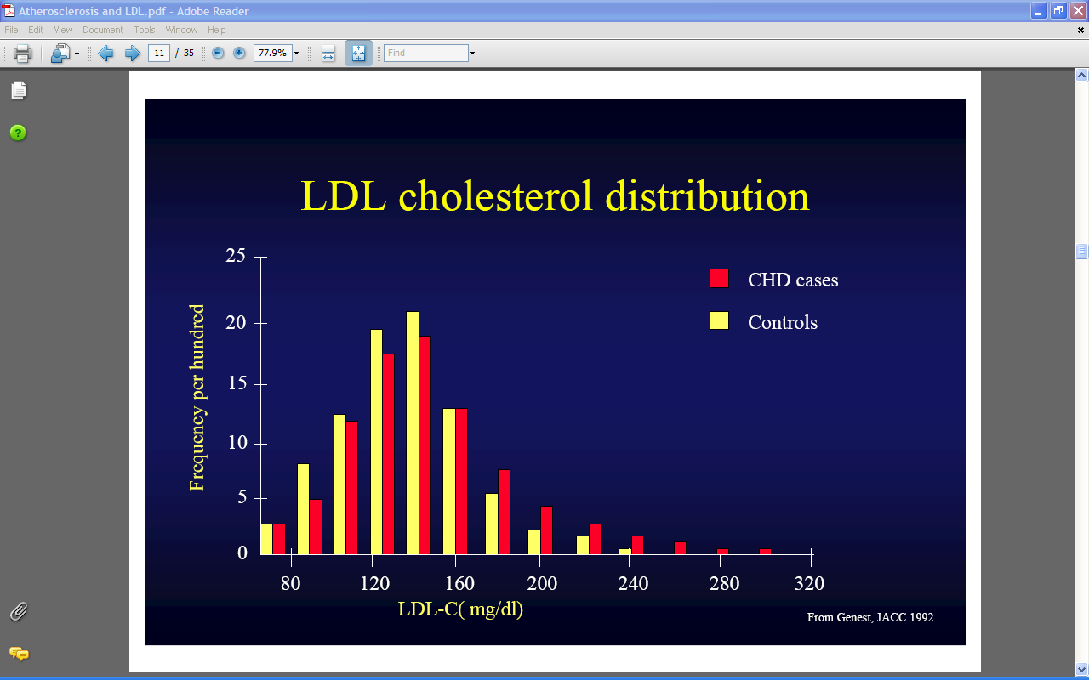
Normal Plasma Lipid Levels (mg/dl)
Triglyceride Total Chol. HDL-Chol TC/HDLC
Adult female 80 190 55 3.5
Adult male 120 200 43 4.7
Neonate 35 70 35 2.0

Slide 9
The Players - Apolipoproteins
Apo AI (liver, small intestine)
  Structural; activator of lecithin:cholesterol acyltransferase (LCAT)
Apo AII (liver)
  Structural; inhibitor of hepatic lipase; component of ligand for HDL binding
Apo A-IV (small intestine)
  Activator of LCAT; modulator of lipoprotein lipase (LPL)
Apo A-V (liver)
  Direct functional role is unknown; regulates TG levels.

Slide 10
Apolipoproteins
Apo B-100 (liver)
  Structural; synthesis of VLDL; ligand for LDL-receptor
Apo B-48 (small intestine)
  Structural; synthesis of chylomicrons; derived from apo B-100 mRNA following specific mRNA editing
Apo E (liver, macrophages, brain)
  Ligand for apoE receptor; mobilization of cellular cholesterol

Slide 11
Apolipoproteins
Apo C-I (liver)
  Activator of LCAT, inhibitor of hepatic TGRL uptake
Apo C-II (liver)
  Activator of LPL, inhibitor of hepatic TGRL uptake
Apo C-III (liver)
  Inhibitor of LPL, inhibitor of hepatic TGRL uptake

Slide 12
Lipoprotein Nomenclature and Composition
CM
VLDL
IDL
LDL
HDL
Major apoB apoB apoB apoB apoA-I
Protein
Major TG TG CE CE CE
Lipid
CM= chylomicron TG=triglyceride
VLDL= very low density lipoprotein CE= cholesteryl ester
IDL= intermediate density lipoprotein
LDL= low density lipoprotein
HDL= high density lipoprotein
Apo = apolipoprotein

Slide 13
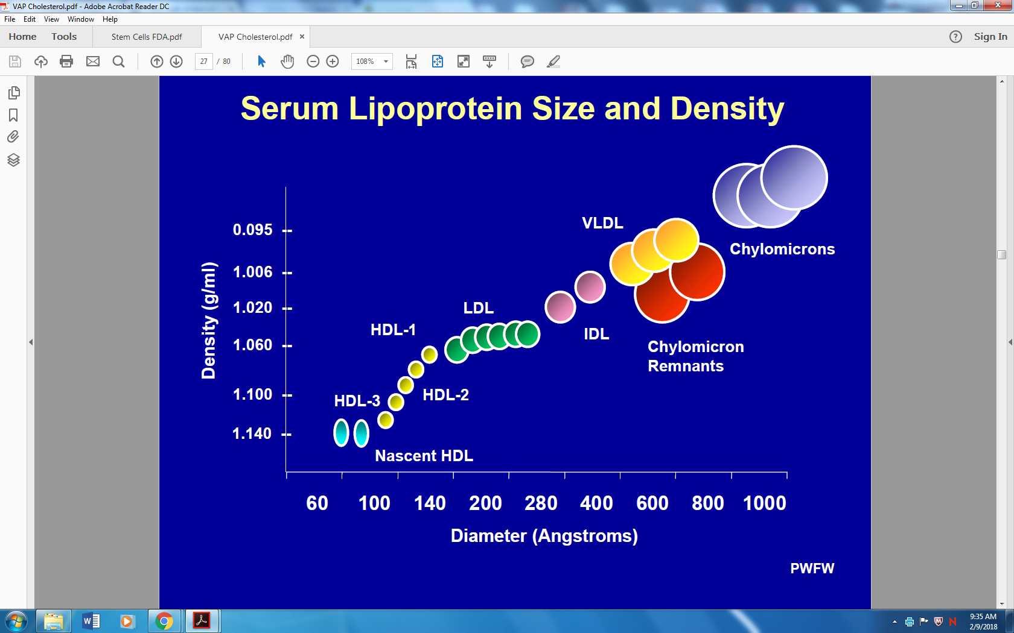
P
C
100%
P
P
P
T
C
80%
C
T
60%
Composition
C
40%
20%
T
T
0%
Chylo-
microns
VLDL
LDL
HDL
Lipoprotein Type
Figure 2. The major classes of lipoproteins and their relative content of triacylglycerol (T), cholesterol (C) and protein (P).

Slide 14
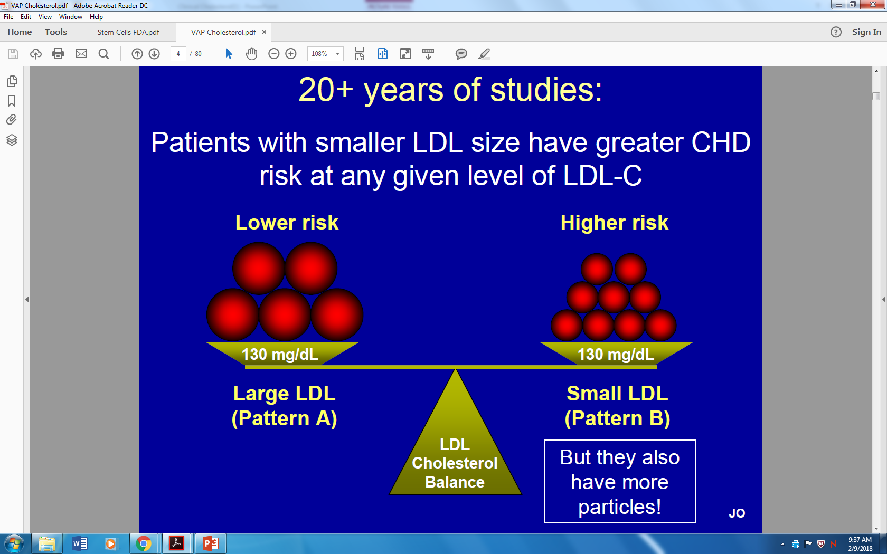

Slide 15
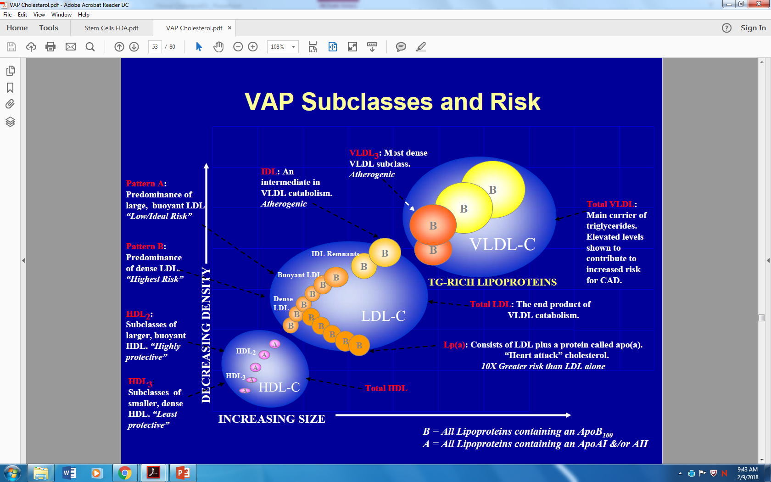

Slide 16
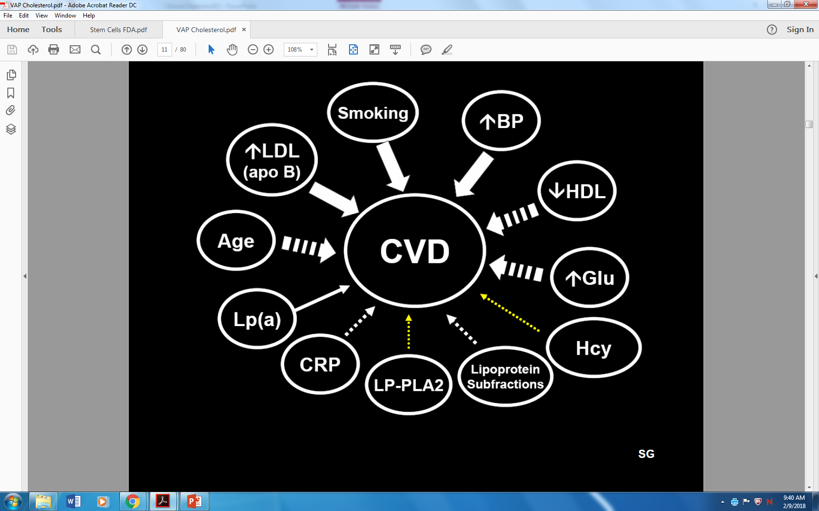

Slide 17
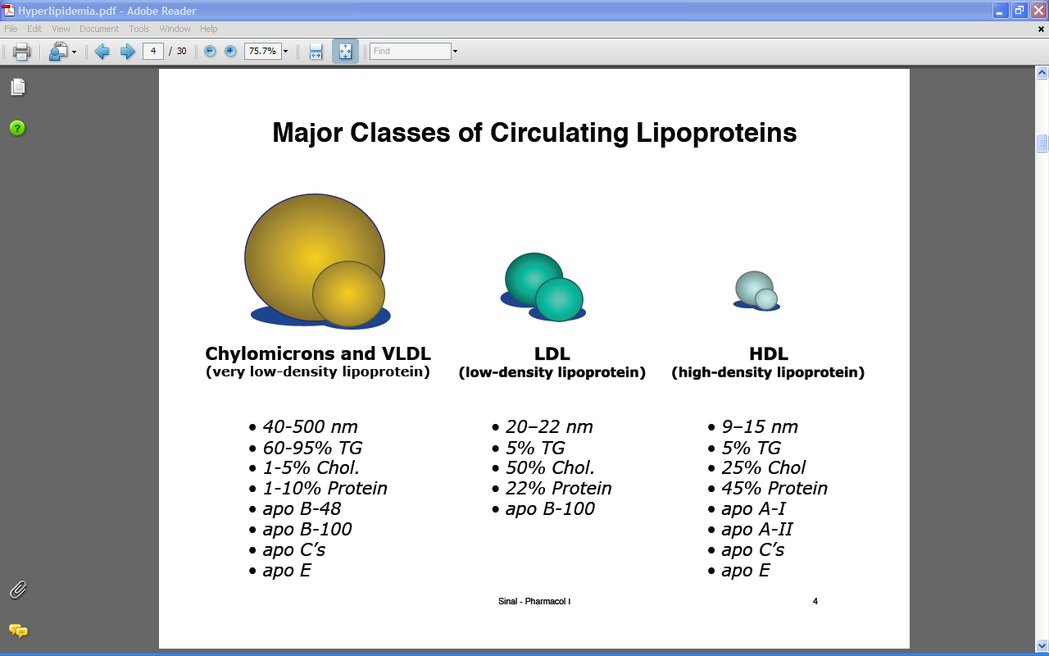

Slide 18
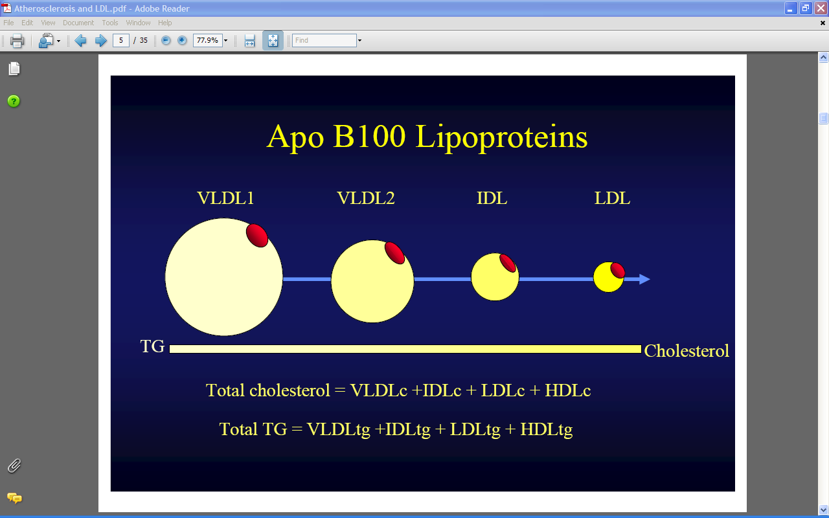

Slide 19
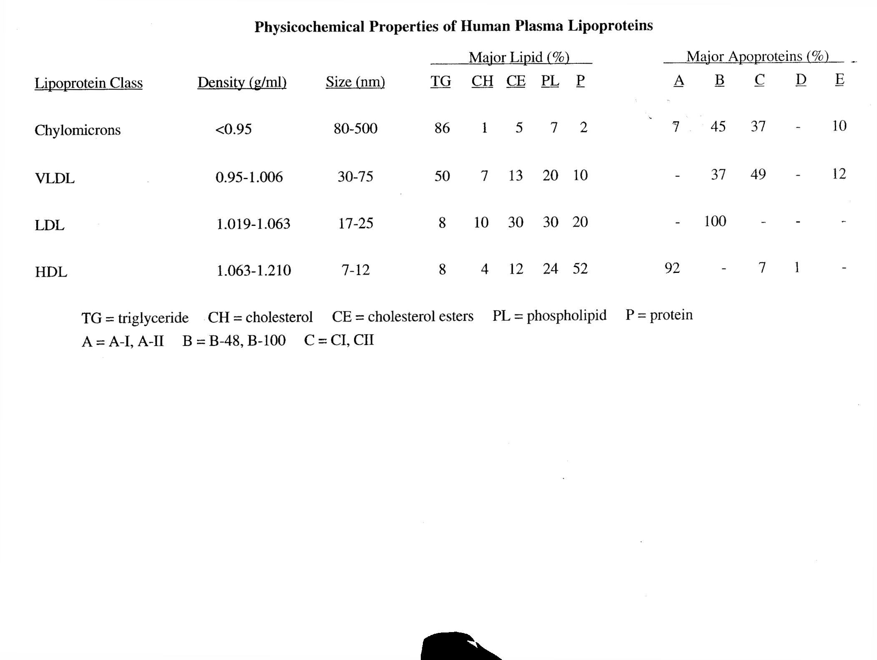

Slide 20
Lipoprotein classes:
Lipo-protein | Source | Apo Proteins in Mature | Protein:Lipid/ Major (minor) Lipid Transported | Function
Chylo-microns | gut | B48, CII*, E* | 1:49 triacylglycerol (CE) | Dietary: FFA → Adipose/muscle CE → Liver via remnants
VLDL | liver | B100, CII*, E* | 1:9 triacylglycerol (CE) | Synthesized: FFA→ adipose/muscle CE → LDL
LDL | blood | B100 | 1:3 cholesterol ester | CE to liver (70%) and peripheral cells (30%)
HDL | liver | A1, CII, E ("ACE") | 1:1 cholesterol ester | supplies apo CII, E to chylomicrons and VLDL; mediates reverse cholesterol transport

Slide 21
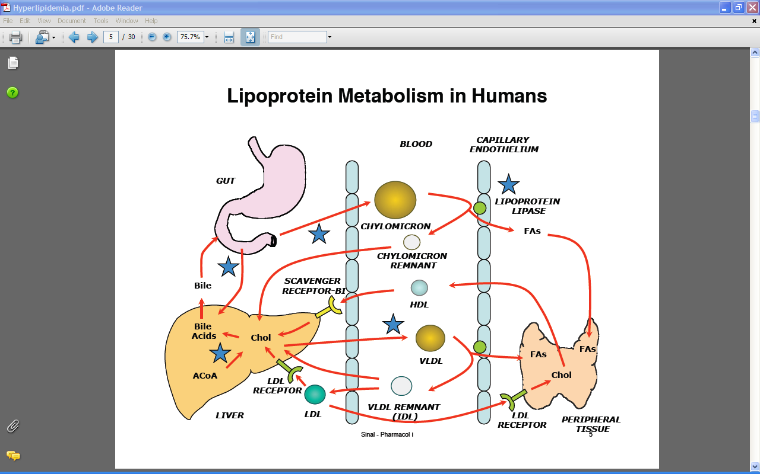

Slide 22
Site of Synthesis of Lipoproteins
Liver
Intestine
apoCs
VLDL
apoA-I
apoCs
Nascent-HDL
apoE
apoA-I
apoB-100
CM
Nascent-HDL
apoE
apoB-100
apoB-48
LDL
IDL
apoB-100

Slide 23
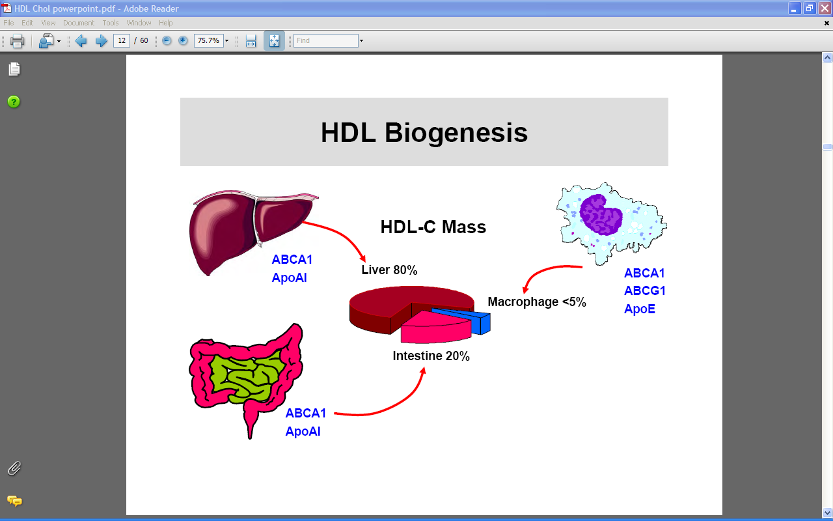

Slide 24
Major Apolipoproteins and Their Function
Apo Lipo Origin Function
ApoA-I HDL Liver, intestine Activate LCAT, Cholesterol efflux via ABCA1 transporter
ApoB-100 VLDL, Liver Ligand LDL receptor, TG
LDL transport from cells
Apo(a) Lp(a) Liver Inhibits fibrinolysis
ApoCII HDL, VLDL Liver Activates lipoprotein lipase
ApoE VLDL, IDL Liver, intestine Ligand, LDL receptor, LRP receptor
LCAT: lecithin:cholesterol acyltransferase
ABCA1: ATP binding cassette protein A1
LRP: LDL receptor related protein

Slide 25
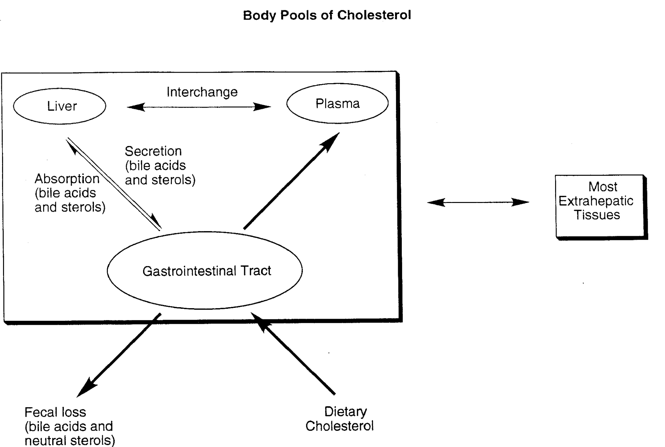

Slide 26
Whole Body Cholesterol Metabolism
Whole Body Cholesterol: 72 g
Plasma Compartment Cholesterol: 5 g

Slide 28
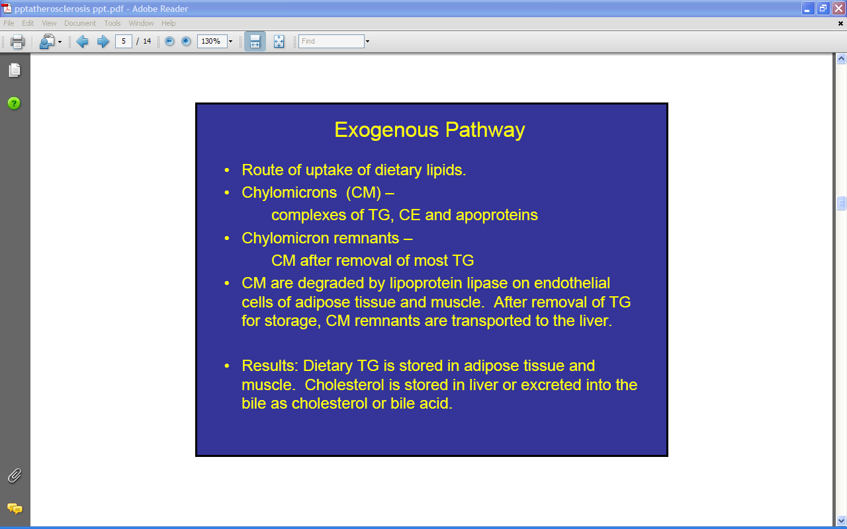

Slide 29
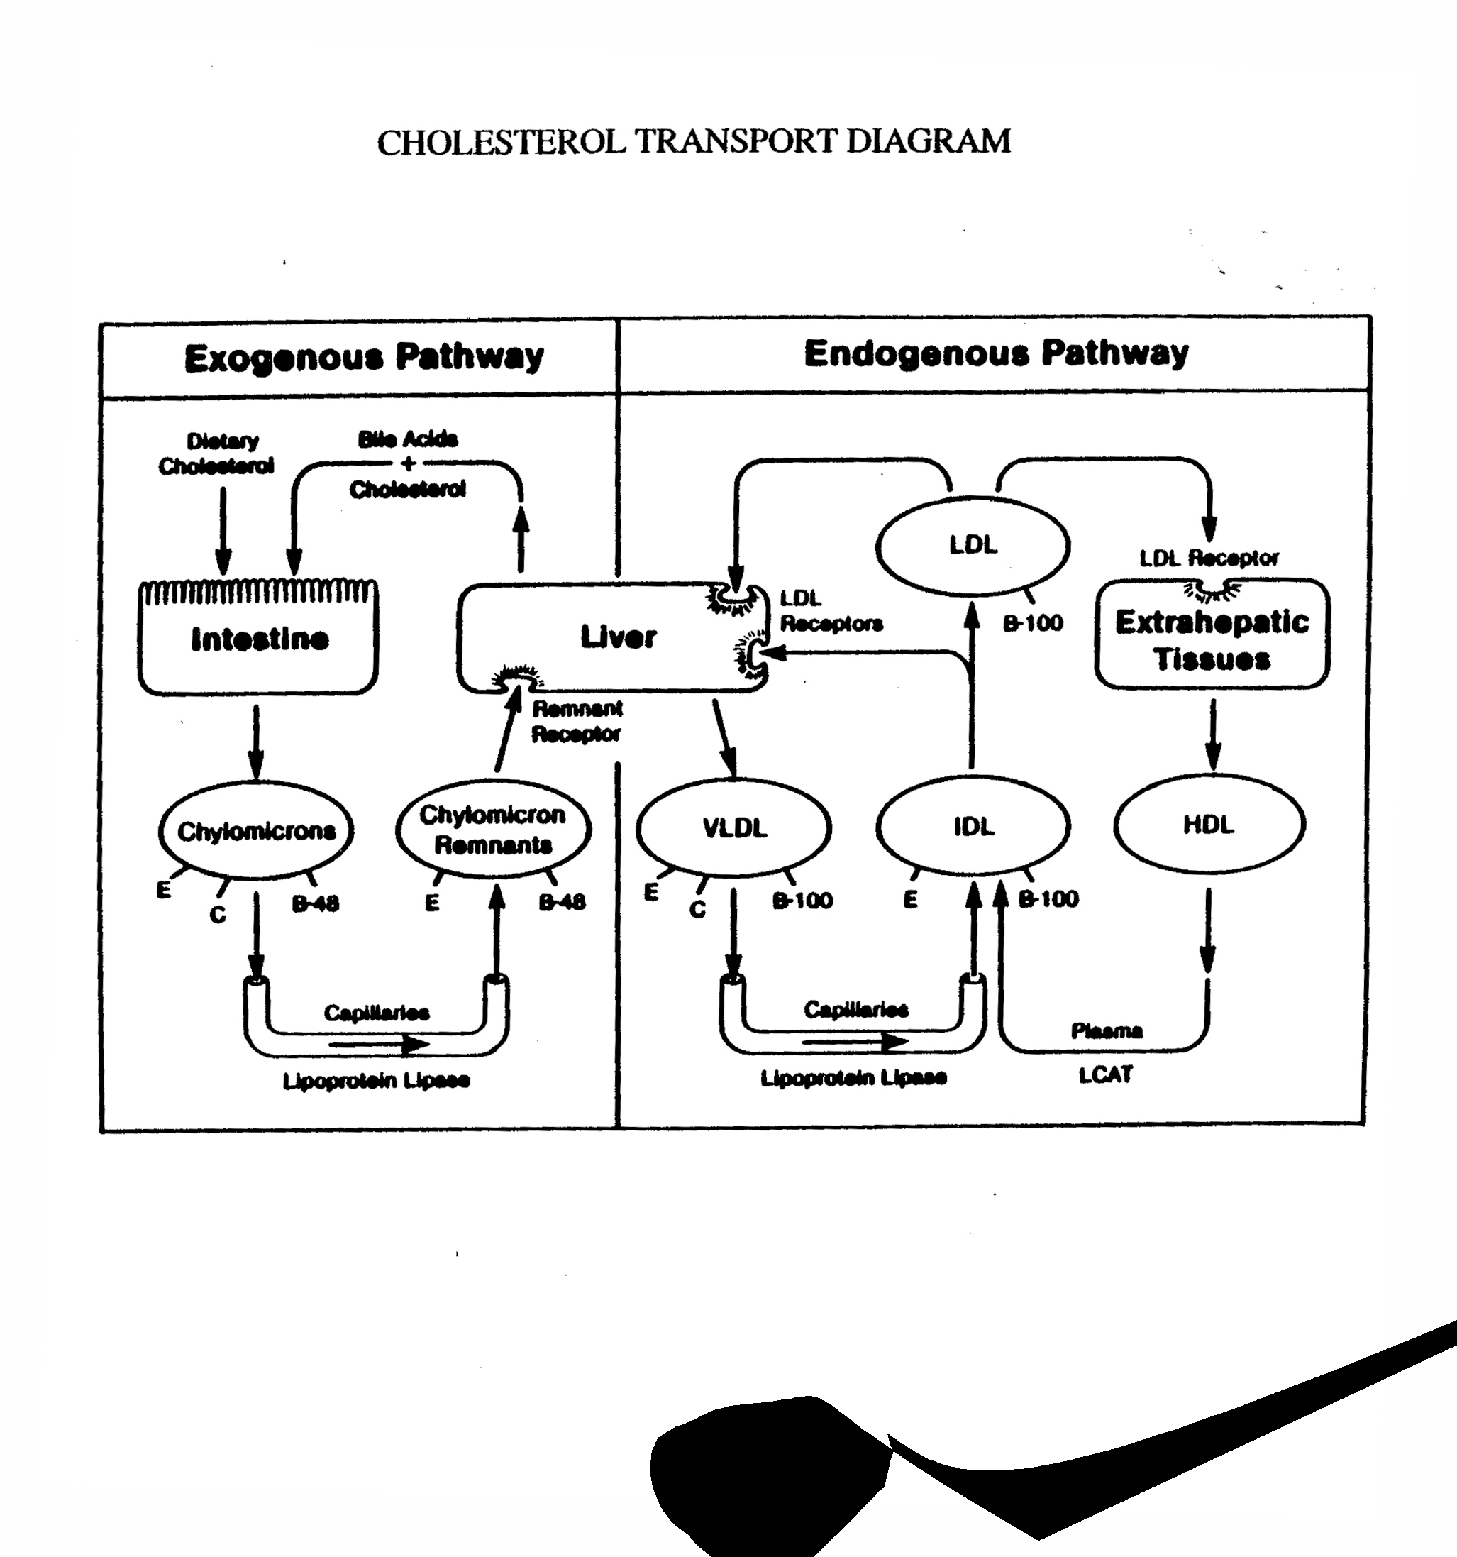

Slide 30
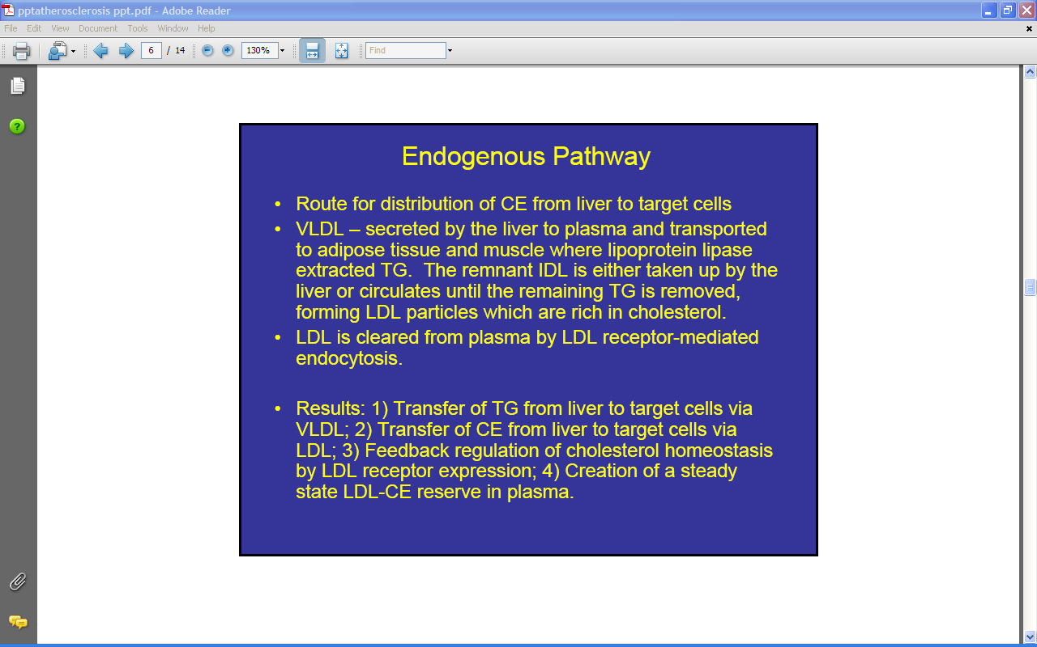

Slide 32
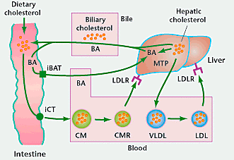
Cholesterol is the dominant sterol in all cells and in the body. It even forms 10% of the dry weight of the brain.
It is introduced through two processes: dietary intake and de novo synthesis. Essentially all cholesterol
elimination is fecal and involves complexation of neutral sterols by bile acids.
While in the body, cholesterol is trafficked through the plasma by lipoproteins carrier particles. The primary
mobilization of cholesterol is in the liver.
Chylomicrons contain triglycerides and cholesterol esters.
Extra-hepatic tissues strip TG’s from CM’s using lipoprotein lipase. Surface apoproteins and lipids are added in
the liver and released as VLDL’s. These are converted into LDL’s which then deliver cholesterol to tissues.

Slide 33
Key Enzymes in Lipoprotein Metabolism
• Lipoprotein lipase (LPL): hydrolysis of triglyceride rich
particles
• Lecithin:cholesterol acyltransferase (LCAT): participates in
removal of excess cholesterol from peripheral cells

Slide 34
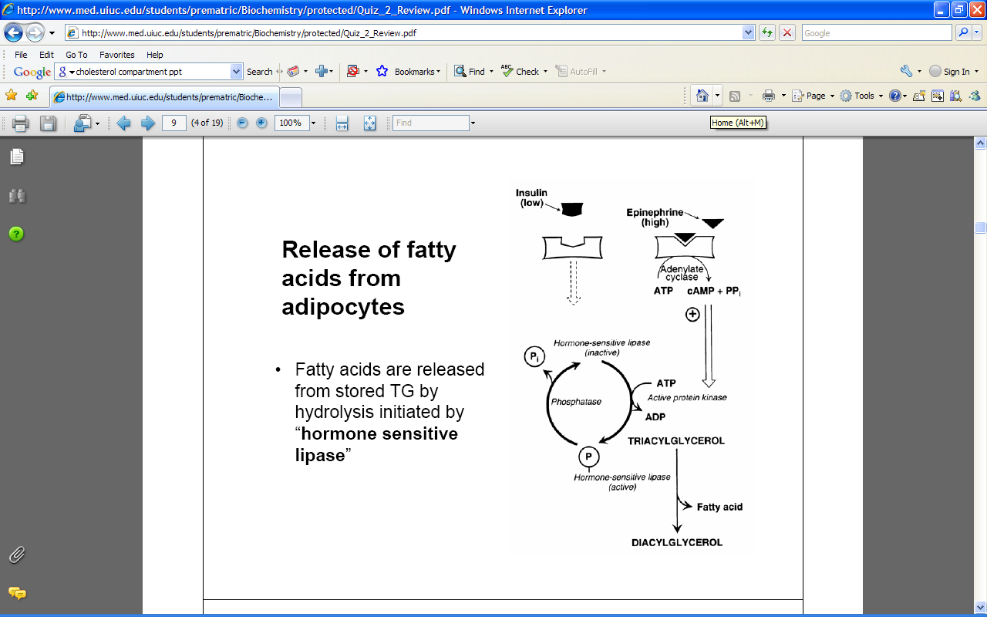

Slide 35
Functions of Apolipoproteins & Enzymes in Lipid Transport/Processing
Protein (Enzyme) | Site of Action | Activator | Function
LPL (Enzyme) | capillary walls | apo CII | excises FFA from TAGs in chylomicrons and VLDLs for adipose and muscle
ACAT (Enzyme) | inside cells | free choles | cholesterol ester storage
LCAT (Enzyme) | blood | apo A1 | cholesterol extraction from cells → HDL carries CE for liver clearance (to bile acids)
CERP | plasma membrane | apo A1 (choles. Induced) | flips cholesterol (and lecithin) to outer layer of lipid bilayer for LCAT action in blood
TTP | intestine/liver smooth ER | none | loads TAGs onto B48 (gut) and B100 (liver)
Apo A1 | blood, plasma membrane | none | activates LCAT and CERP; binds to apo A1 receptors on cells requiring cholesterol extraction
Apo B48 | Gut | none | export of chylomicrons from intestinal cells
Apo B100 | Various cells | none | ligand for LDL receptor; export of liver VLDL
Apo CII | capillary walls | none | activates lipoprotein lipase
Apo E | liver | none | receptor ligand - clears remnants, IDL, and HDL

Slide 36
Lipoprotein Lipase (LPL)
Endothelial Cell
LPL
apoC-II
apoA-I
Fatty Acids
and
Glycerol
cholesterol
TG
CM
phospholipid
apoE
VLDL
Excess Surface
Material
Lipolytic
products
CM
Energy
VLDL
LDL
apoE
“Remnant”
HDL assembly
muscle
Liver
TG = triglyceride
Bile acids

Slide 37
Lecithin:Cholesterol Acyl Transferase (LCAT)
LCAT: Disk to sphere transformation
Free cholesterol Cholesteryl ester
Mature HDL
Nascent HDL
apoA-I
LCAT
CE
Cholesteryl ester (CE)
Phospholipid plus cholesterol
Cholesterol
Cholesteryl ester (CE)
plus lysophospholipid
Phospholipid
ApoA-I

Slide 38
Key Receptors in Lipoprotein Metabolism
• LDL receptor: catabolism of LDL, apoB ligand
• ABCA1 transporter: transports excess cholesterol from cells, apoA-I ligand
• Scavenger receptor A1 (SR-A1): uptake of oxidized and modified LDL by macrophages
• SR-B1 receptor:selective uptake of excess cholesterol from HDL, apoA-I ligand
LDL

Slide 39
ABCA1 Transporter/Receptor
Large plasma membrane spanning ATP dependent protein.
Essential for moving excess intracellular cholesterol and phospholipid to the plasma membrane.
Acts as a flipase, flipping cholesterol and phospholipid from inner leaflet of plasma membrane to outer leaflet.
Necessary for removing excess cholesterol from foam cells and preventing early steps in atherosclerosis.
ApoA-I is required for capturing the cholesterol released from the foam cell.

Slide 40
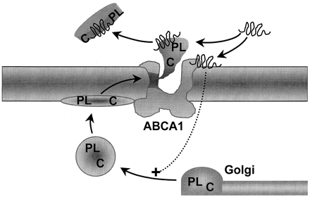
ABCA1 Function
Nascent HDL
apoA-I

Slide 41
Reverse Cholesterol Transport (RCT)
The process whereby excess cholesterol in peripheral cells, especially foam cells, is returned to the liver for degradation and excretion.
RCT involves apoA-I, ABCA1 and LCAT as well as receptors on the liver for uptake of the excess cholesterol.

Slide 42
Reverse Cholesterol Transport
Delivery of peripheral tissue cholesterol to the liver for catabolism
Requires HDL, apoA-I and LCAT
Peripheral
Cell
diffusion
HDL
UC
UC
HDL
Macrophage/ Foam cell
ABCA1
UC
LCAT
PL
LCAT
Nascent
HDL
HDL
CE
CE
CE
apoA-I
SR-B1
UC = unesterified cholesterol
CE = esterified cholesterol
PL = phospholipid
LDLr = LDL receptor
TG
CE
Liver
VLDL
or LDL
apoB
LDLr
Chol
Bile acids
Bile to gut

Slide 43
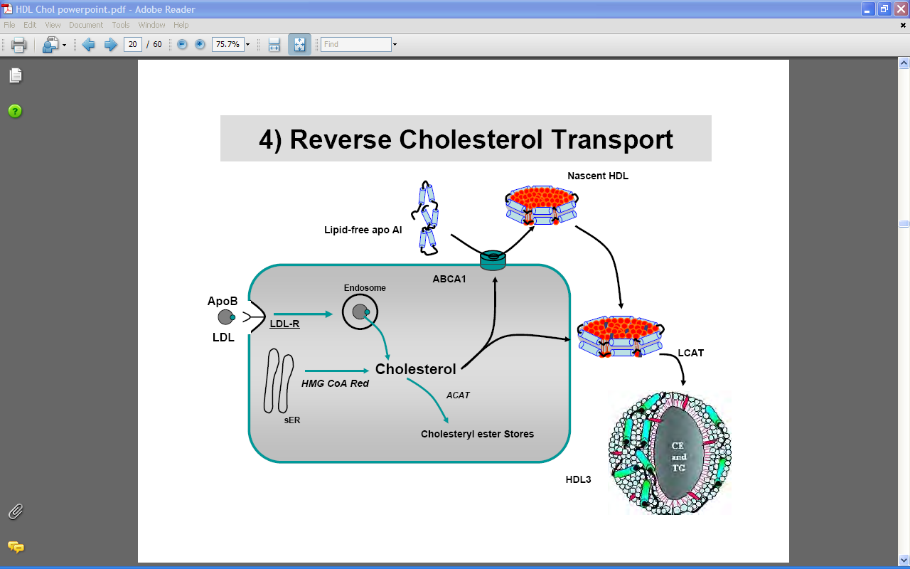

Slide 44
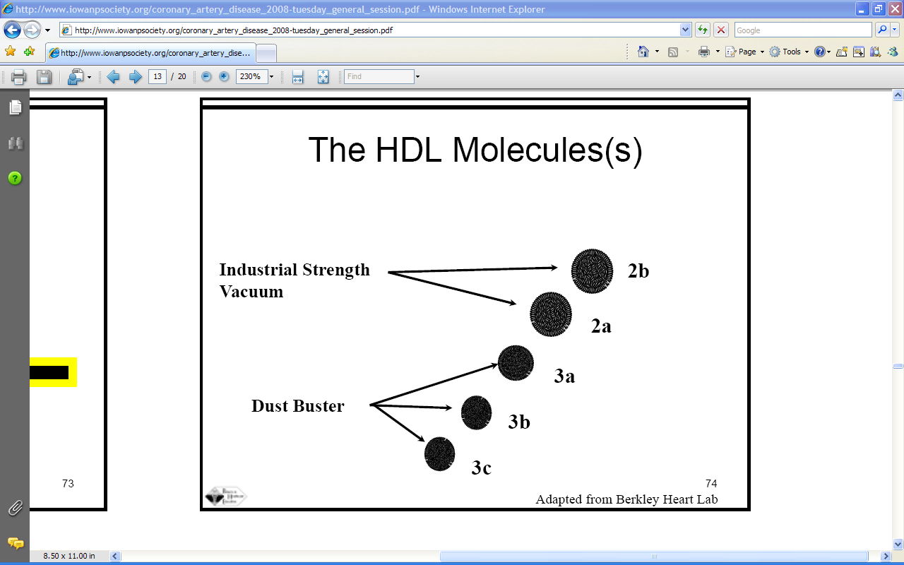

Slide 45
The Scavenger Receptor
(SR-A1 receptor)
How macrophages deal with oxidized or modified LDL
The scavenger receptor recognizes modified and/or oxidized LDL and internalizes the modified LDL.
Accumulation of these modified LDL in the cell leads to the accumulation of cholesterol droplets in the macrophage and the formation of foam cells.

Slide 46
Modification of LDL
LDL
Apo B-100
Derivatization:
Aldehydes
Glucosylation
eg. diabetes
Oxidation:
Degradation of
B-100 by reactive
oxygen species
Derivatized
LDL
Oxidized
LDL

Slide 47
The Scavenger Receptor:
Clearance of modified LDL by macrophages
Macrophage
Macrophage Foam Cell
Oxidized LDL
Lipid droplets
Scavenger
receptor
(SR-A1)
Fatty streaks

Slide 48
LDL and Atherosclerosis
Fitting the pieces together
Elevated LDL: Increased residence time in plasma
Increased modification/oxidation of LDL
Monocyte
Endothelial
cells
Cytokines
oxLDL
Artery
wall
oxLDL (stimulates cytokine secretion)
Cytokines
Macrophage
Smooth muscle cell
proliferation
Macrophage foam cell

Slide 49
Positive and Negative Risk Factors in Atherosclerosis
Positive Negative
Age: Males > 45 years Elevated HDL cholesterol
Females > 55 years Low LDL cholesterol
Family history of early CHD Good genes
Elevated LDL cholesterol (>130 mg/dL) Female gender (estrogen)
Elevated triglyceride (>150 mg/dL) Exercise
Diabetes mellitus
Hypertension
Obesity
Smoking
CHD, coronary heart disease

Slide 50
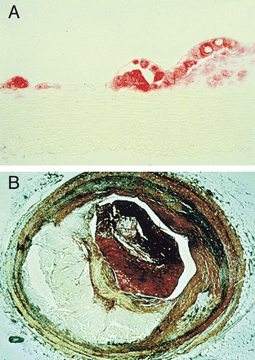
Early and late atherosclerotic lesions
Fatty streak
Thrombotic athero lesion, myocardial infarct

Slide 51
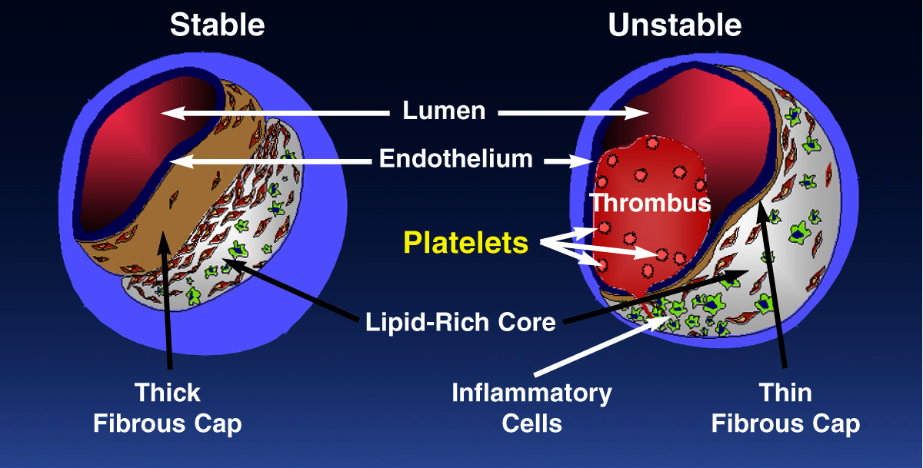
Atherothrombosis: Thrombus Superimposed on Atherosclerotic Plaque
Adapted from Falk E, et al. Circulation. 1995;92:657-671.
Notes:
Atherosclerotic plaque has 2 main components: a soft, lipid-rich core and a hard, collagen-rich fibrous cap. In stable plaques, a thick fibrous cap may represent >70% of plaque volume. It stabilizes the plaque and prevents it from undergoing rupture. In contrast, unstable plaque has a thin fibrous cap and is at greater risk for rupture. In unstable plaque, the lipid-rich core may represent the majority of the plaque volume.
The core is rich in extracellular lipids, which are formed by trapping blood-derived lipids, notably low-density lipoprotein, or by lipid-filled macrophages, known as foam cells. The plaque destabilizes due to inflammation by foam cells and other inflammatory mediators that make the plaque more vulnerable to rupture. This commonly occurs at the junction of the plaque and the less diseased vessel wall. As a result, the lipid core may be exposed to flowing blood leading to platelet-mediated thrombus formation.
Falk reviewed the work of other investigators regarding the severity of stenosis and its association with the risk of MI. Results showed that >86% of MIs resulted from lesions that were <70% stenosed. Most experts prior to Falk thought that patients had heart attacks because of blockages that increased in size until they blocked the blood vessel and caused a heart attack.¹
Based on the findings of Falk, we now know the primary cause of a heart attack is the rupture of unstable plaques that are <70% stenosed and are clinically silent. Approximately 200 patients from 4 studies were studied to generate these results, which have been confirmed in other studies.¹
References
¹ Falk E, Shah PK, Fuster V. Coronary plaque disruption. Circulation. 1995;92:657-671.
² Libby P. Molecular bases of the acute coronary syndromes. Circulation. 1995;91:2844-2850.

Slide 52
Characteristics of Unstable and
Stable Plaque
Unstable
Stable
Lack of
inflammatory
cells
Inflammatory
cells
Thin
fibrous cap
Thick
fibrous cap
Few
SMCs
More
SMCs
Intact
endothelium
Eroded
endothelium
Activated
macrophages
Foam cells
Libby P. Circulation. 1995;91:2844-2850.
Notes:
Atherosclerotic plaques have 2 main components—a soft lipid-rich core and a hard collagen-rich fibrous cap.¹
In stable plaques, a thick fibrous cap may represent >70% of plaque volume. It stabilizes the plaque and prevents it from undergoing rupture.¹
In contrast, unstable plaques have a thin fibrous cap and are at greater risk for
rupture. In unstable plaques, the lipid-rich core may represent the majority of the plaque volume.¹
Falk reviewed the work of other investigators regarding severity of stenosis and its association with the risk of MI. Results showed that >86% of MIs resulted from lesions that were <70% stenosed.¹ Most experts prior to Falk thought that patients had heart attacks because of blockages that increased in size until they eventually blocked the blood vessel and caused a heart attack.
Based on the findings by Falk, we now know the primary cause of heart attacks is
the rupture of unstable plaques that are <70% stenosed and are clinically silent. Approximately 200 patients from 4 studies were used to generate these results,
which have been confirmed in other studies.
References
¹ Falk E, Shah PK, Fuster V. Coronary plaque disruption. Circulation. 1995;92:657-671.
² Libby P. Molecular bases of the acute coronary syndromes. Circulation. 1995;91:2844-2850.

Slide 53
Risk Factors for Plaque Rupture
Local Factors
Systemic Factors
    Cap Fatigue
Smoking
Cholesterol
    Atheromatous Core
    (size/consistency)
    Diabetes
    Mellitus
    Fibrinogen
    Cap Thickness/ Consistency
    Cap Inflammation
    Homocysteine
    Impaired
    Fibrinolysis
Plaque
Rupture
Fuster V, et al. N Engl J Med. 1992;326:310-318.
Falk E, et al. Circulation. 1995:92:657-671.
Notes:
Several local and systemic risk factors for plaque rupture have been identified. Local factors include the size and consistency of the atheromatous core, the thickness and collagen content of the fibrous cap, inflammation within the cap, and “cap fatigue.”¹
Increased size and the consistency of the atheromatous core are associated with a greater risk for plaque rupture. Aortic plaques that have a core that occupies >40% of the plaque volume are especially vulnerable to rupture. The consistency of the extracellular lipids (especially cholesterol) in the core affects the risk for rupture. Cholesterol esters soften plaque and make it less stable and highly thrombogenic.¹
Plaque rupture occurs most commonly at sites where the cap is thinnest, contains lower amounts of collagen, and is infiltrated with macrophages.¹
Ruptured fibrous caps are heavily infiltrated by activated macrophage foam cells, indicating that an inflammatory process is ongoing. Foam cells that infiltrate the fibrous cap weaken the plaque by reducing its tensile strength. By comparison, an increased number of smooth muscle cells in the cap stabilizes the plaque and makes rupture less likely.¹
Finally, in “cap fatigue,” mechanical and hemodynamic forces—including high blood flow velocity and elevated blood pressure—continually stress the cap and are likely to increase the risk for plaque rupture.¹
There is increasing evidence that a number of systemic factors—including smoking, high cholesterol, diabetes, elevated homocysteine, and stress—enhance atherosclerotic processes and increase the risk for plaque rupture and thrombogenesis.^{1,2} These factors may all be related through platelet activation and reduced fibrinolysis associated with elevated fibrinogen levels. High plasma fibrinogen is an independent risk factor for coronary artery disease. Similarly, elevation of factor VII, which is associated with menopause, is also associated with an increase in coronary events. Notably, elevated fibrinogen levels are associated with age, diabetes, smoking, obesity, hyperlipidemia, and emotional stress. Thus, many risk factors may share common final pathways.²
References
¹ Falk E, Shah PK, Fuster V. Coronary plaque disruption. Circulation. 1995;92:657-671.
² Fuster V, Badimon L, Badimon JJ, et al. The pathogenesis of coronary artery disease and the acute coronary syndromes. N Engl J Med. 1992;326:310-318.

Slide 54
Multiple Risk Factors for Atherothrombosis
Generalized
Disorders
Age
Obesity
Lifestyle
Smoking
Diet
Lack of exercise
Systemic
Conditions
Hypertension
Hyperlipidemia
Diabetes
Hypercoagulable states
Homocysteinemia
Genetic Traits
Gender
PlA2
Atherothrombotic Manifestations
(MI, stroke,
vascular death)
Inflammation
Elevated CRP
CD40 Ligand, IL-6
Prothrombotic factors (F I and II)
Fibrinogen
Local Factors
Blood flow patterns
Shear stress
Vessel diameter
Arterial wall structure
% arterial stenosis
MI, myocardial infarction.
Adapted from Yusuf S, et al. Circulation. 2001;104:2746-2753.
Drouet L. Cerebrovasc Dis. 2002;13(suppl 1):1-6.
Notes:
Atherosclerosis is a disease that develops over several decades. Risk factors such as smoking or hypertension, hyperlipidemia, and hyperglycemia, with or without obesity, can promote its development.¹
Risk factors such as age, sex, race or ethnicity, and heredity are not modifiable. Yet, they are important risk factors.²
Stroke incidence doubles each decade after age 55 years, and age is the single most important risk factor for stroke.²
Sex and race, ethnicity, or both are also important risk factors, with the incidence of stroke greater in men and some Hispanic and African American groups being at a greater risk for stroke compared with whites.²
Relative risk is greater if a parent has a history of stroke or a transient ischemic attack, and paternal history carries a greater risk than maternal history.²
Local factors in arterial territories—including blood flow parameters, vessel diameter, and arterial wall structure—participate in atherothrombotic disease manifestation.¹⁻²
Advances in pathophysiological insight into atherosclerosis have provided markers of inflammation that are targets for measurement to assess risk. Potential targets that should be measured to assess risk include C-reactive peptide, interleukin-6, prothrombic factors, and fibrinogen.¹⁻²
The presentation of the multiple risk factors for atherothrombosis simply highlights the importance of a disease that is the leading cause of death worldwide.
References
¹ Yusuf S, Reddy S, Ounpuu S, et al. Global burden of cardiovascular diseases: part I: general considerations, the epidemiologic transition, risk factors, and impact of urbanization. Circulation. 2001;104:2746-2753.
² Drouet L. Atherothrombosis as a systemic disease. Cerebrovasc Dis. 2002;13(suppl 1):1-6.

Slide 55
Metabolic Syndrome: Disease of the Modern Era
Constellation of several risk factors that increase chance of coronary artery disease, peripheral vascular disease, stroke and type 2 diabetes.
Combination of 3 or more of the following risks:
• Abdominal obesity
• Triglyceride levels above 150 mg/dL
• Low HDL cholesterol
• Elevated blood pressure (>130/85 mm Hg)
• Fasting blood glucose > 100 mg/dL
Aging a major contributor: prevalence in 20-29 yr olds = 6.7%; 60-69 yr olds = 43.5%

Slide 56
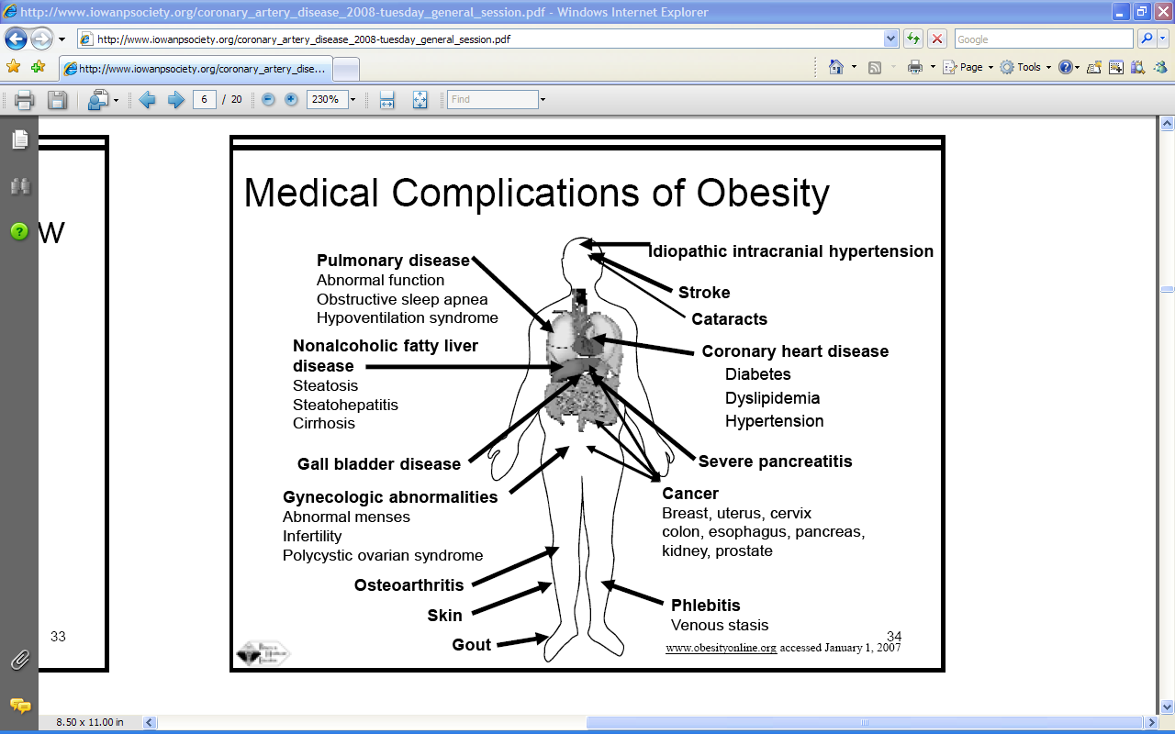

Slide 57
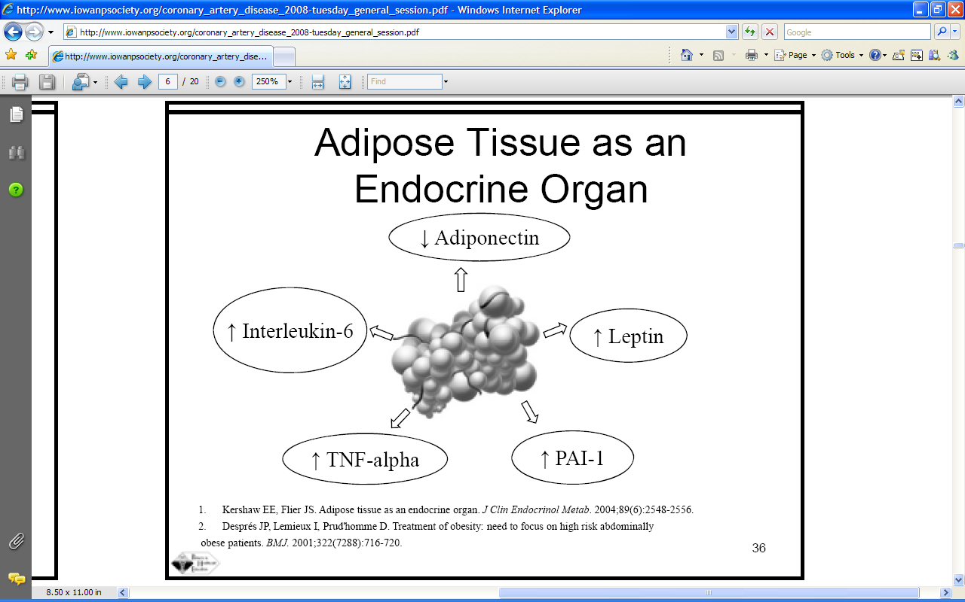

Slide 58
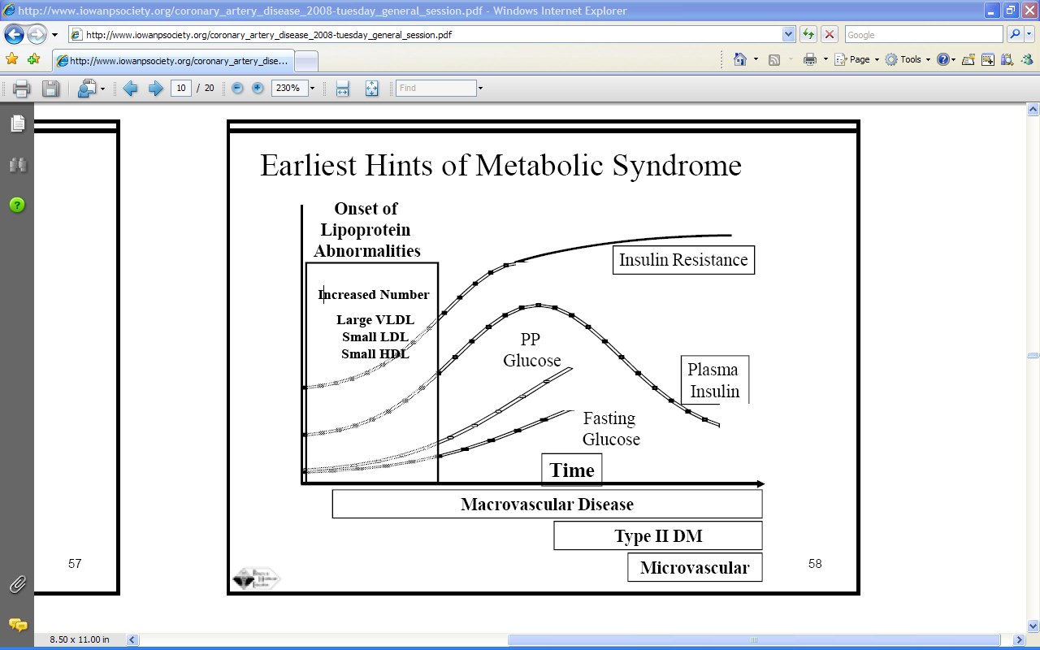

Slide 59
HDL Protective Role
Fitting the pieces together
HDL
Monocyte
Endothelial
cells
oxLDL
HDL
Artery
wall
UC
HDL + UC
apoA-I
ABCA1
PL
UC
oxLDL = oxidized LDL
UC = unesterified cholesterol
Macrophage foam cell
Nascent HDL

Slide 60
Inflammation and atherosclerosis
Immune cells dominate early lesions
Immune effector molecules accelerate lesion progression
Activation of inflammation elicits acute coronary syndromes
Atherosclerosis is an inflammatory disease in which immune mechanisms interact with metabolic risk factors to initiate, propagate and activate lesions in the arterial wall

Slide 61
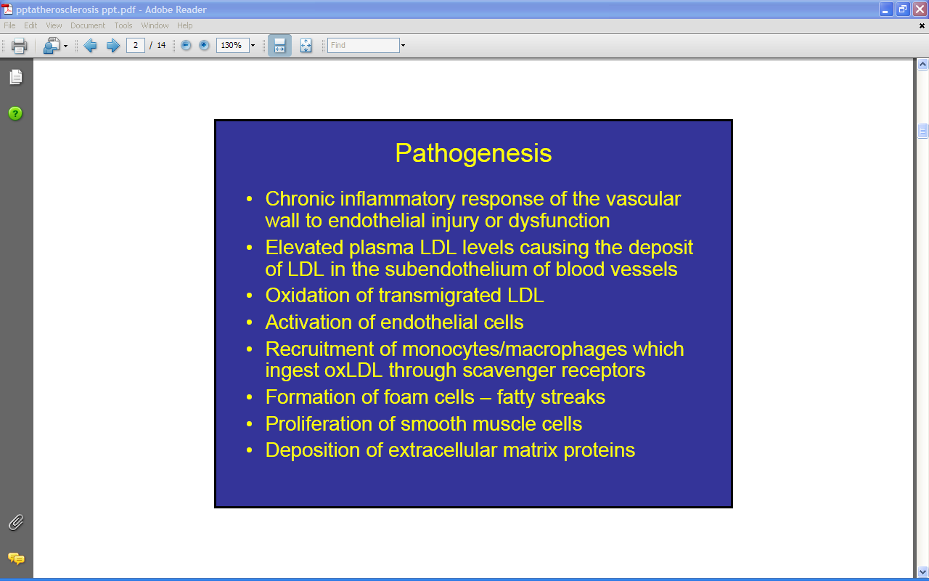

Slide 62
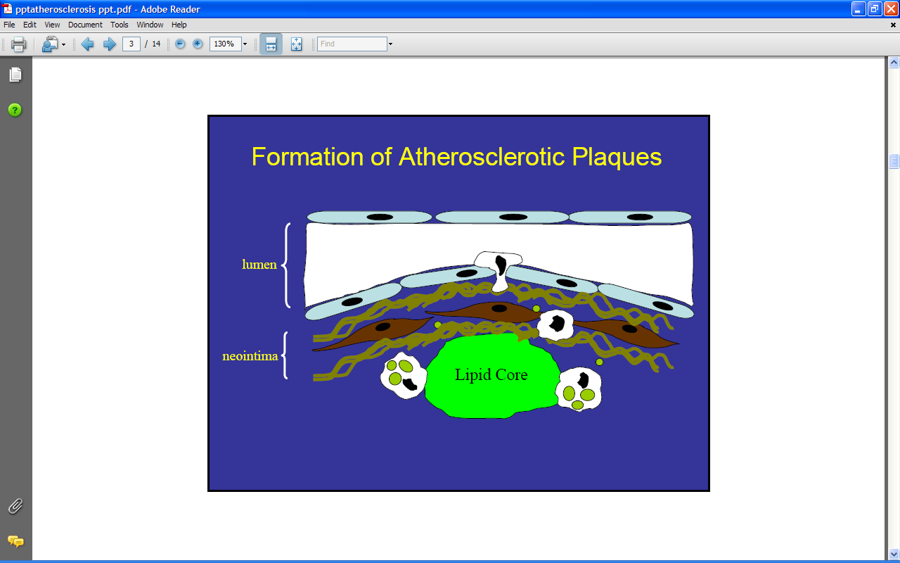

Slide 63
The numbers
CAD causes 38% of all deaths in North America
Most common cause of death in men under 65 y.o. and second most common cause of women
Despite advances in control of hypercholesterolemia (statins), CVD is expected to be the main cause of death globally over the next 15 years due to rapidly increasing prevalence of obesity and diabetes

Slide 64
Preventable Deaths
Approximately 57,000 deaths could be avoided each year
in the US if patients were given appropriate care.
High-blood pressure control
28,300
Diabetes care
13,600
Cholesterol management
6500
Smoking cessation
2700
Breast-cancer screening
2500
β-blocker treatment
1700
Prenatal care
1500
Cervical-cancer screening
700
National Committee for Quality Assurance. Washington, DC 2003.

Slide 65
Hospitalizations in the US
Due to Vascular Disease
Vascular Disease
3.2 Million Hospital Admissions
Cerebrovascular Disease
Coronary
Atherosclerosis
Acute Myocardial Infarction
Other Ischemic
Heart Disease
961,000 Admissions
1,153,000
Admissions
829,000
Admissions
280,000 Admissions
Popovic JR, Hall MJ. Advance Data. 2001;319:1-20.
Notes:
The National Hospital Discharge Survey is an annual survey conducted by the National Center for Health Statistics branch of the Centers for Disease Control and Prevention (CDC).¹
According to the 1999 survey, heart disease accounted for 4.5 million hospital admissions, and cerebrovascular disease accounted for almost a million admissions. Of these, a total of 1.2 million admissions can be attributed to vascular disease.¹
The majority of these admissions were due to cerebrovascular disease and coronary atherosclerosis, each accounting for almost a million hospital admissions.¹
The next largest category was acute myocardial infarction (MI), which accounted for about 829,000 hospital admissions.¹
Other types of ischemic heart disease made up the remaining 280,000 admissions. These diagnoses included unstable angina, coronary occlusion without MI, angina pectoris, coronary aneurysm, and chronic coronary insufficiency.¹
References
¹ Popovic JR, Hall MJ. 1999 National Hospital Discharge Survey. Advance Data. Hyattsville, Md: National Center for Health Statistics;2001;319:1-20.

Slide 66
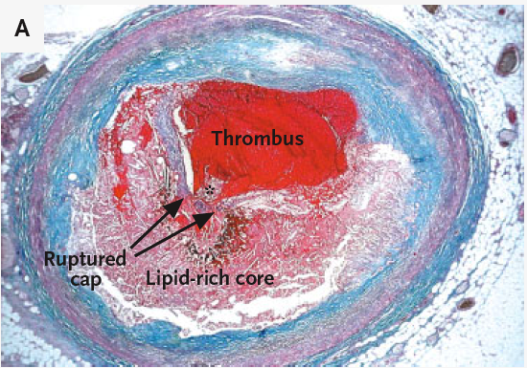
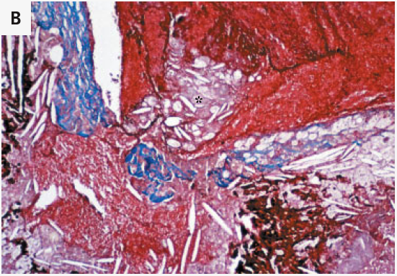
Pathogenesis of coronary artery thrombosis

Slide 67
FUNCTIONING OF THE IMMUNE SYSTEM
HUMORAL (ANTIBODY MEDIATED) IMMUNE RESPONSE
CELL MEDIATED IMMUNE RESPONSE
ANTIGEN (1ST EXPOSURE)
ENGULFED BY
MACROPHAGE
ANTIGENS DISPLAYED BY INFECTED CELLS ACTIVATE
FREE ANTIGENS DIRECTLY ACTIVATE
BECOMES
APC
STIMULATES
HELPER T CELLS
CYTOTOXIC T CELL
B CELLS
STIMULATES
STIMULATES
MEMORY HELPER T CELLS
GIVES RISE TO
GIVES RISE TO
STIMULATES
STIMULATES
STIMULATES
ANTIGEN (2nd EXPOSURE)
PLASMA CELLS
MEMORY B CELLS
STIMULATES
MEMORY T CELLS
ACTIVE CYTOTOXIC T CELL
SECRETE ANTIBODIES
Defend against extracellular pathogens by binding to antigens and making them easier targets for phagocytes and complement
Defend against intracellular pathogens and cancer by binding and lysing the infected cells or cancer cells

Slide 68
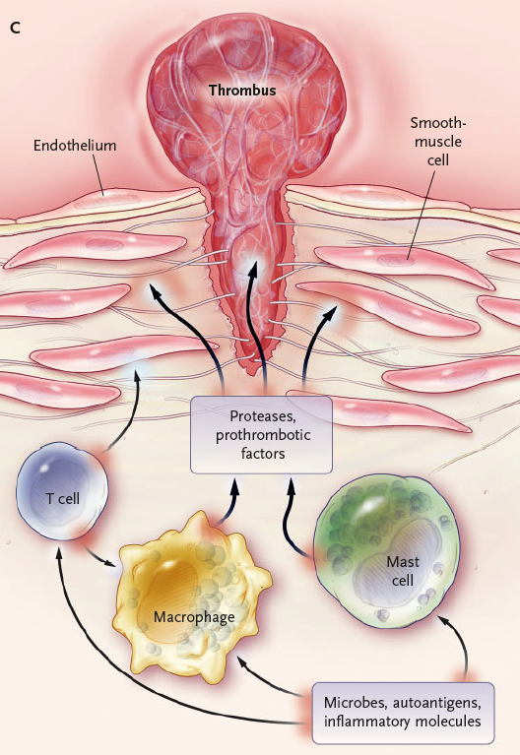
Cellular players in atherogenesis and plaque rupture

Slide 69
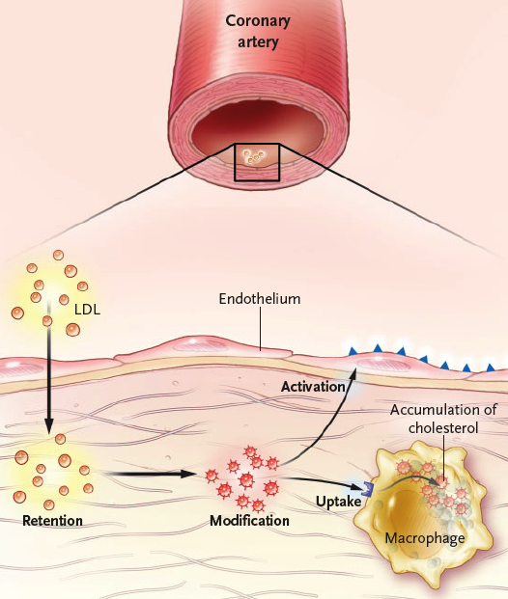
The early lesion: modified lipoproteins and foam cell formation

Slide 70
Role of macrophages
MCSF induces monocytes entering lesion to differentiate into macrophages
Macrophage differentiation associated with TLRs and scavenger receptors
MCSF/apoE KO shows reduced atherosclerosis
Scavenger receptors bind bacterial endotoxins, apoptotic cells and oxLDL
SR/apoE KOs show reduced atherosclerosis

Slide 71
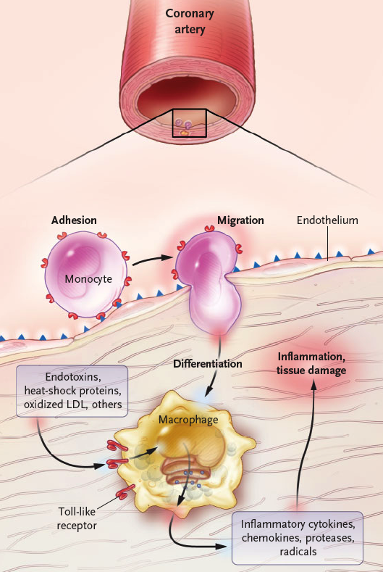
The macrophage as an inflammatory mediator

Slide 72
IL-1R
TNF-R
IFN-γR
Toll-like
MAP
KINASE
NFκB
IRF
JAK/STAT
GENES
Inflammation, Anti-Microbial
Response, Apoptosis, …

Slide 73
TLR receptors and atherosclerosis
10 family members
Recognize pathogen associated molecular patterns (e.g. LPS, dsRNA) as well as oxLDL, HSP60 etc.
Initiate signaling cascades leading to production of inflammatory cytokines, proteases, reactive oxygen species
In addition to macrophages, expressed by dendritic cells, mast cells, endothelial cells

Slide 74
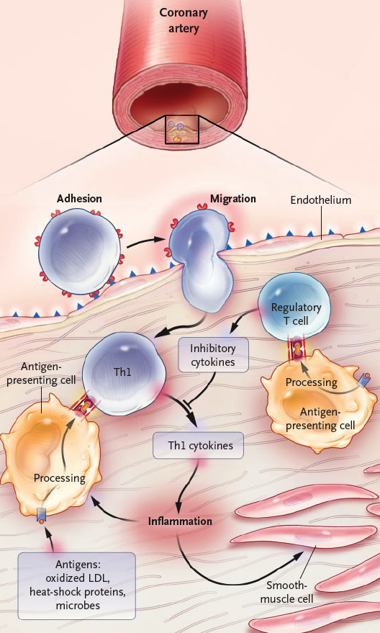
Macrophage-T cell interactions in atherosclerosis

Slide 75
T cells and atherosclerosis
Immune cells patrol tissues in search of antigen
T cell infiltrate is common feature of atherosclerotic lesions
Predominantly CD4+ cells, recognize antigen/MHC II
CD4+ T cells reactive to oxLDL, HSP60, bacterial products detected in human lesions
NK cells present in early lesions, recognize lipid antigens
NK activation increases athero in apoE KO mice

Slide 76
T cell responses
Th1 response activates macrophages and functions in the defense against intracellular pathogens
Th2 response elicits allergic inflammation
Atherosclerotic lesions contains cytokines that promote Th1 responses
Activated Th1 effector cells in lesions produce macrophage activating cytokine IFNγ
IFNγ improves efficiency of ag presentation and augments synthesis of TNFα and IL-1
IFNγ, TNFα and IL-1 in turn stimulate production of many other inflammatory mediators
apoE mice lacking IFNγ or downstream mediators such as IL-18
or T-bet show reduced athero

Slide 77
Anti-inflammatory factors and atherosclerosis
Anti-inflammatory factors such as TGFβ and IL-10 are protective
IL-10 KO increases athero in mice and exacerbates thrombosis
Abrogation of TGF signaling in T cells leads to large unstable atherosclerotic lesions

Slide 78
Immune cells and plaque rupture
Preferentially occurs where fibrous cap is thin
Active immune cells are abundant at site of rupture
Immune cells produce inflammatory molecules and proteolytic enzymes that weaken cap, activate cells in the core and transform stable plaque into vulnerable, leading to plaque rupture
MMPs likely to play important roles

Slide 79
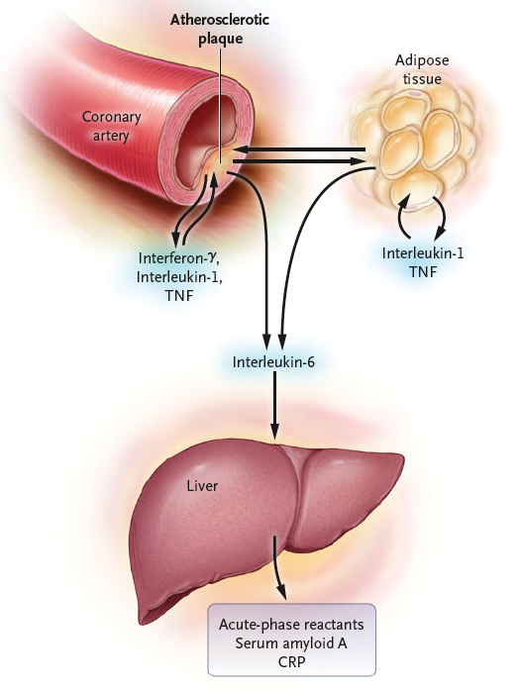
Systemic inflammatory markers in atherosclerosis

Slide 80
Systemic indicators of inflammation
Inflammatory process in lesions may lead to increased plasma levels of cytokines and acute phase proteins
CRP and IL-6 are elevated in patients with unstable angina and MI
Levels correlate with prognosis

Slide 81
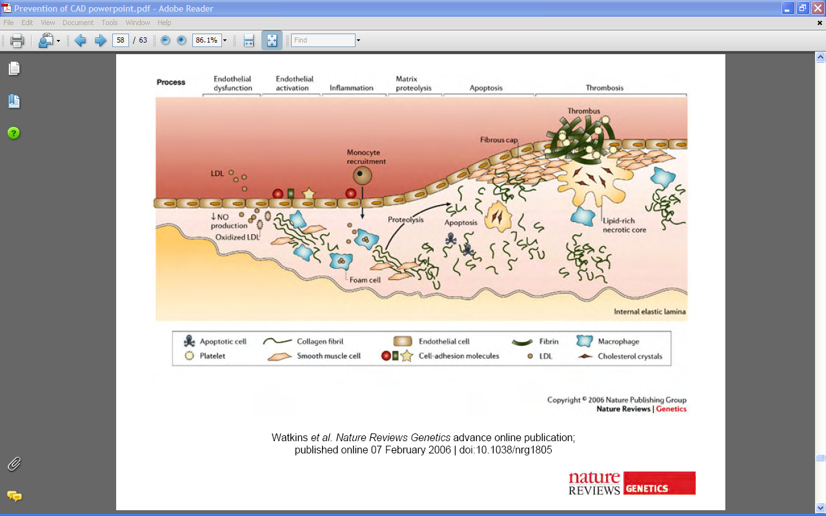

Slide 82
Links between infection and atherosclerosis
Unlikely to be caused by single organism
DiverseUn pathogens have been detected within lesions
Bacteria and viruses accelerate athero in murine models
Unlikely to be caused by a single organism
Diverse Pathogens have been detected within lesions
Bacteria and Viruses accelerate atherosclerosis in murine models

Slide 83
Potential mechanisms
Stimulation of Inflammatory Cytokines
Alteration of Adhesion Molecule Expression
Stimulation of inflammatory cytokines
Alteration of adhesion molecule expression
? Lipid metabolism ?

Slide 84

oxLDL
CD36
cholesterol
Inflammatory
stimuli
CE
ABCA1
LPS, IL-1β, TNFα
oxysterol
RXR
LXR
IL-1R
TOLL4
TNFR
CHOLESTEROL EFFLUX
INFLAMMATION
↑ PLTP
↑ ABCAI
↓ iNOS
↓ IL-1β
↑ ApoE/CII
↑ LPL
↓ IL-6
↓COX2
↓ MMP9
MACROPHAGE

Slide 85

TLR-LXR crosstalk:
potential implications for atherosclerosis
virus
bacteria
cholesterol
efflux
other signals
C
C
?
TLR-3/4
ABCA1
Foam cell formation
↑ Foam cell formation
C
TANK
C
C
TBK-1
IKKi
C
IRF-3
LXR
RXR
ABCA1, ABCG1, apoE

Slide 86
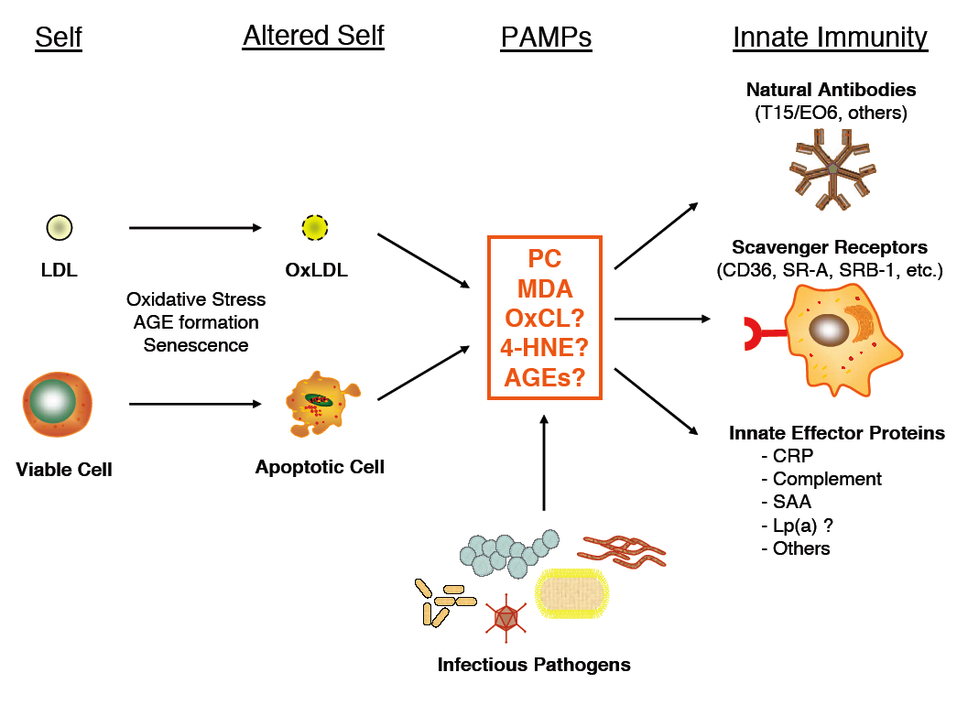

Slide 87
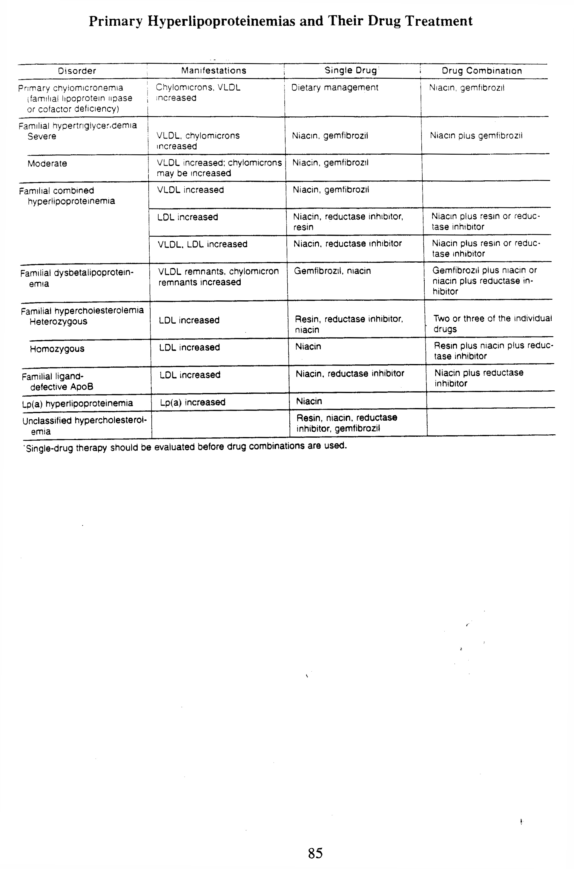

Slide 88
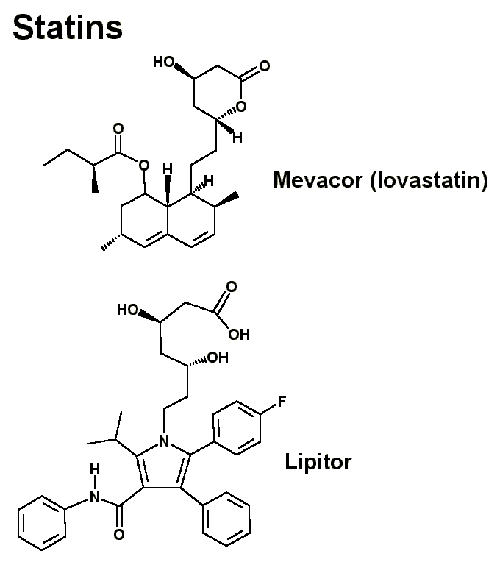
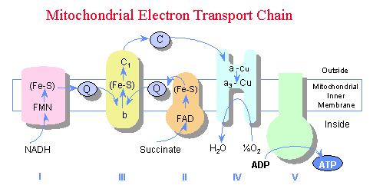
Lowering Cholesterol
Statins – decrease HMG CoA reductase activity
  Muscle weakness
  Why?

Slide 89
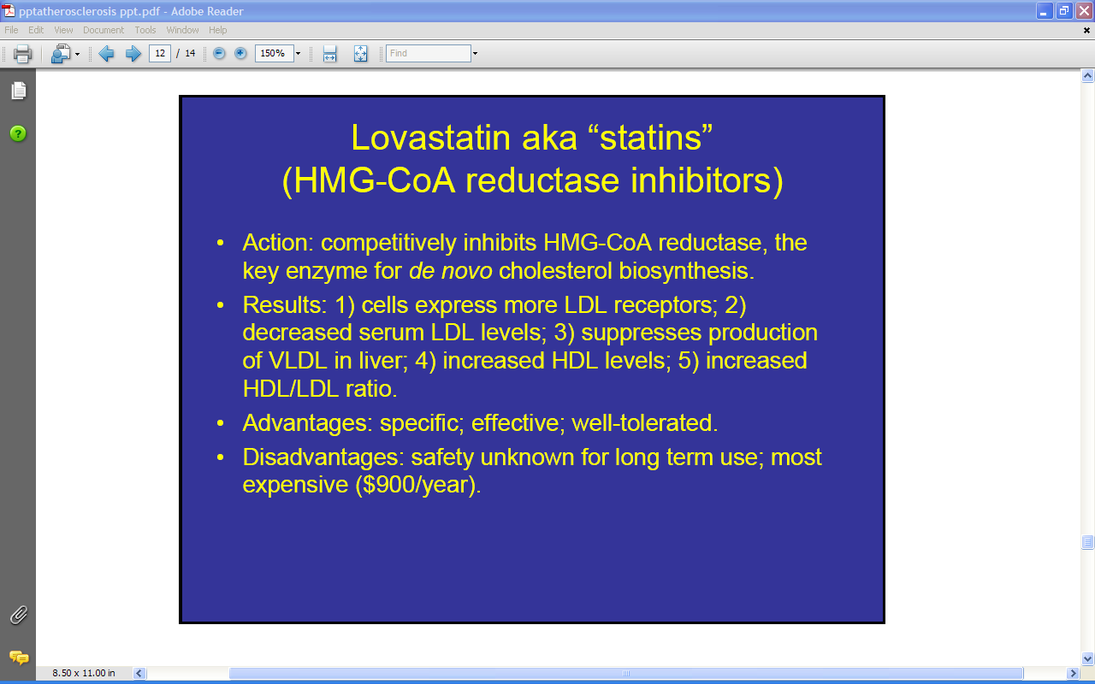

Slide 90
Drugs for Treatment of Hyperlipoproteinemia
Reducing plasma cholesterol
Statins: target the liver, inhibits cholesterol biosynthesis, increases LDL receptors
Liver Cell
Nucleus
HMG-CoA Reductase
LDLr gene
Drugs
Lovastatin, simvastatin, atorvastatin (Lipitor)
Stimulates
LDLr
Cholesterol
ER
LDLr
HMG-CoA (3-hydroxy-3-methylglutaryl coenzyme A) reductase
LDLr, LDL receptor; ER, endoplasmic reticulum

Slide 91
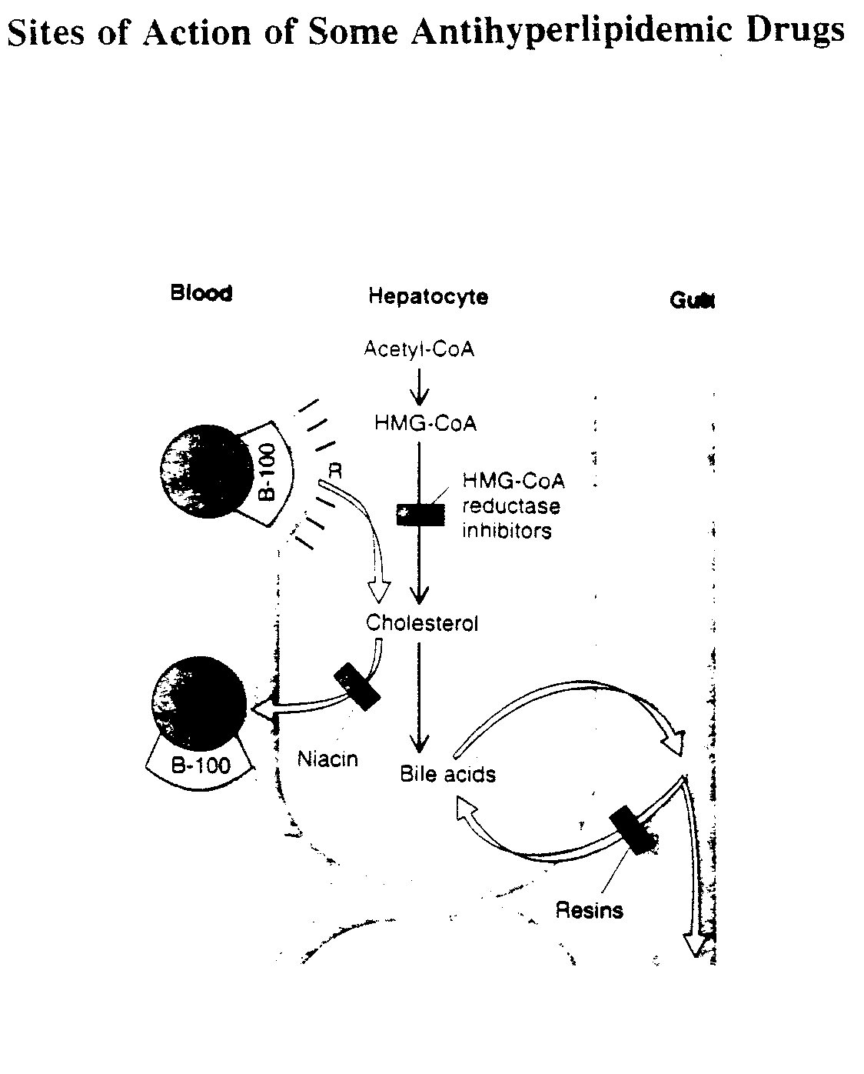

Slide 92
Lowering Cholesterol
Bile sequestering agents
liver
NH₃+
NH₃+
Bile
acids
Bile acids
95 % reabsorbed
Bind bile acid
Utilize more cholesterol
to make bile acids
5% in feces

Slide 93
Bile Acid Seqestrants
Bind and remove bile in intestine
• Increases cholesterol conversion to bile
• Increases LDL clearance
• Lowers plasma cholesterol
Drugs
Cholestyramine
Colestipol

Slide 94
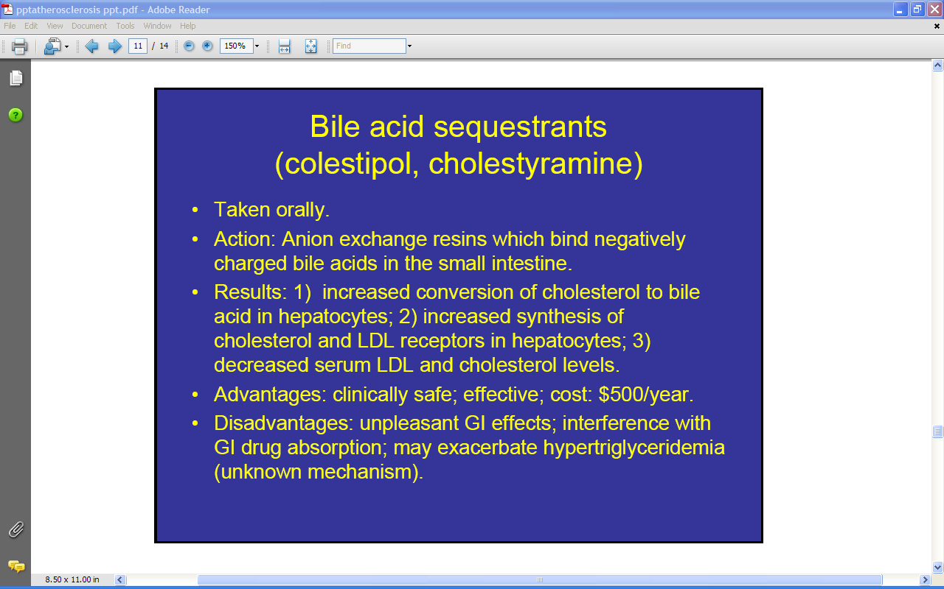

Slide 95
Triglyceride Reducers
Fibric Acids
Reduces synthesis of VLDL in liver
Increases catabolism of VLDL
Lowers plasma TG
Increases HDL
Drugs
Gemfibrozil
Fenofibrate

Slide 96
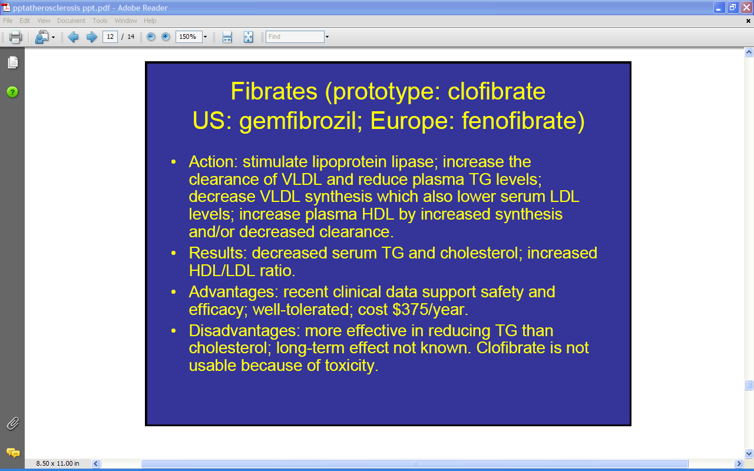

Slide 97
Cholesterol Absorption Inhibitor
Ezetimibe-Zetia
• Blocks uptake of dietary cholesterol in small intestine.
• Inhibits ABC transporter receptors on surface of intestinal absorptive cells.
• Lowers plasma cholesterol
• Used together with statin (lipitor): extremely powerful in reducing plasma cholesterol

Slide 98
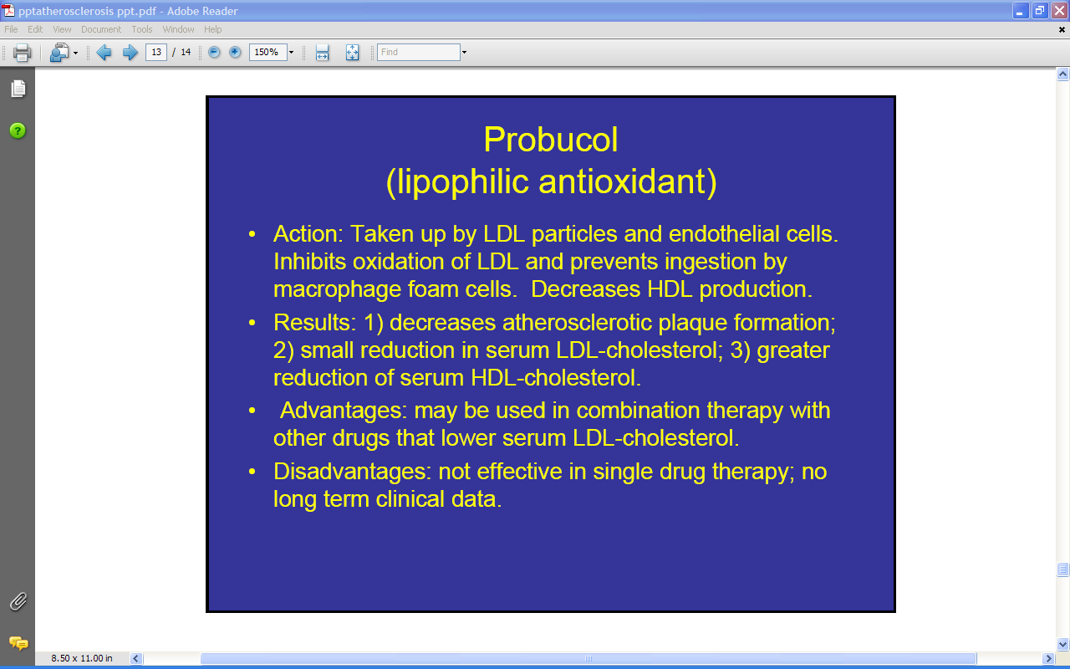

Slide 99
Lowering Cholesterol
Oat bran
  Soluble fiber
  Bind bile acids?
Niacin
  3-8 grams / day (need 60 mg)
  Inhibits VLDL excretion ? (fatty liver)
  Flushing and liver damage

Slide 100
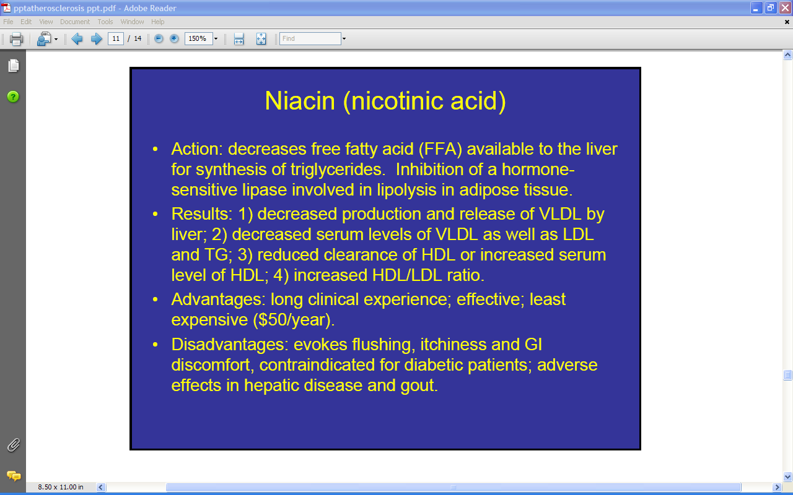

Slide 101
Is Cholesterol Absorption
Specific or Protein Mediated?
Reduction in Absorption:
Ezetimibe 54%
Phytosterols 35%

Slide 102
Cholesterol Absorption Inhibitor
Ezetimibe-Zetia
• Blocks uptake of dietary cholesterol in small intestine.
• Inhibits ABC transporter receptors on surface of intestinal absorptive cells.
• Lowers plasma cholesterol
• Used together with statin (lipitor): extremely powerful in reducing plasma cholesterol

Slide 103
Phytosterols
Perform Membrane Functions of Cholesterol in Plants
Structurally Similar to Cholesterol
Not Absorbed
Block Cholesterol Absorption

Slide 104
1. Cholesterol Absorption is a Key Regulatory Point in Lipid Metabolism and Controls the Reverse Transport of Cholesterol
Phytosterols – Both in Natural Foods and Supplements – Reduce LDL Levels when Formulated Properly
3. Cholesterol Absorption is Sterically Specific and Not Diffusion-Mediated. Both the Enterocyte and the Liver Confer Specificity

Slide 105
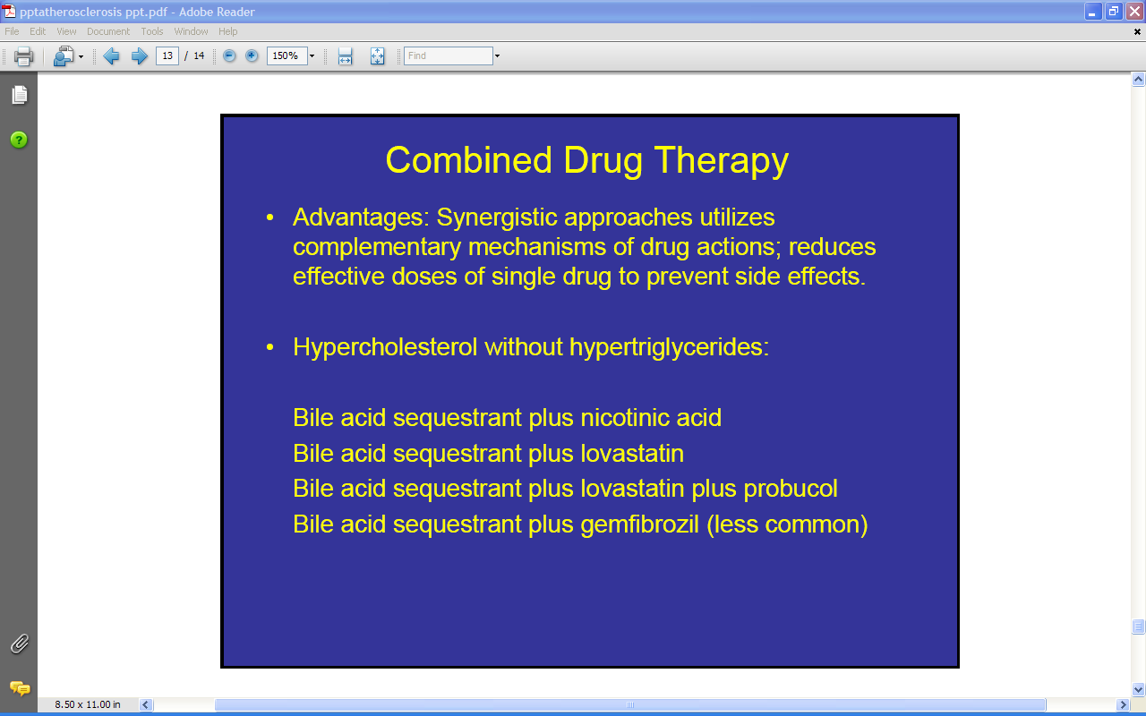

Slide 106
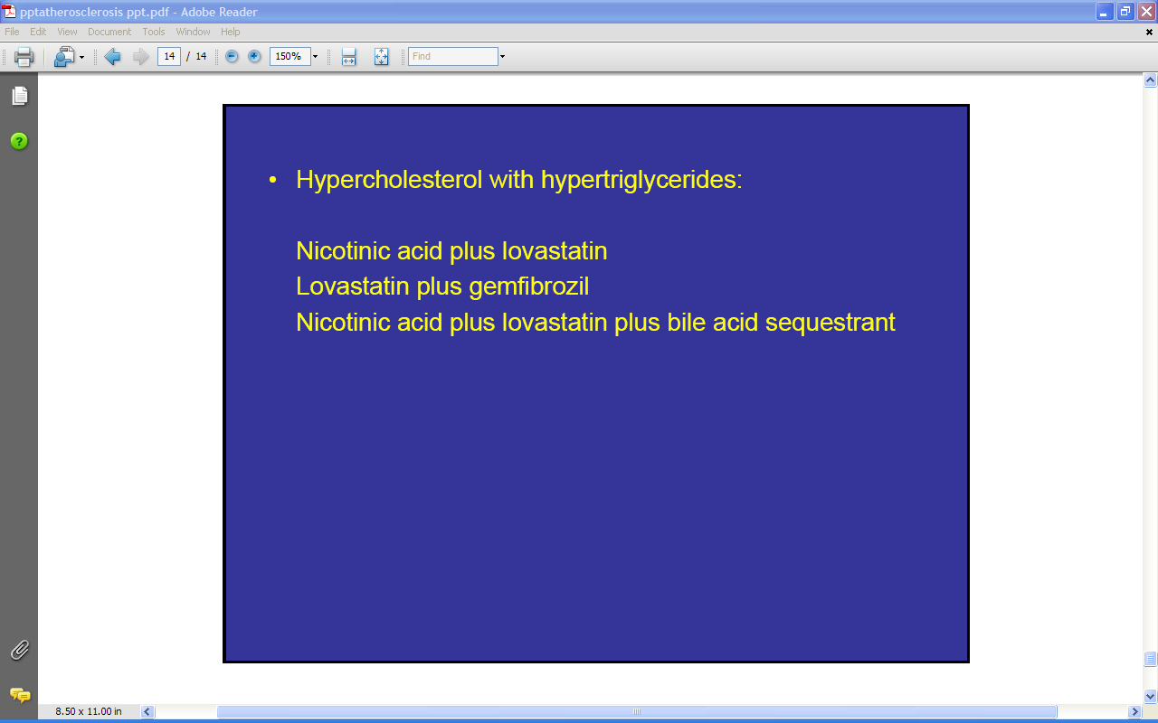

Slide 107

Regulation of Cholesterol Levels
Cells sense and regulate levels of cholesterol using the SREBP transcription factor system. The synthesis
of cholesterol and the uptake of extracellular cholesterol are regulated coordinately. When cholesterol levels
drop, the synthesis of LDL receptors is up-regulated, the activity of cholesterol esterase is increased and the
synthesis of cholesterol is turned on. When cholesterol levels rise, these processes are turned off.
Removal of “used” cholesterol is accomplished by transferring into HDL using LCAT (lecithin-cholesterol
acetyl transferase). HDL then transfers cholesterol in the plasma to IDL (intermediate density lipoproteins)
and VLDL (very low density lipoproteins) which carry it to the liver for disposal as bile acids.

Slide 108

Cholesterol Structure
FA for esterification

Slide 109
Roles of Cholesterol
Membrane component
Steroid synthesis
Bile acid/salt precursor
Vitamin D precursor

Slide 110
Sources of Cholesterol
Cholesterol synthesized
in extrahepatic tissues
Diet
De novo synthesis
Liver cholesterol
pool
Secretion of HDL
and VLDL
Free cholesterol
In bile
Conversion to bile salts/acids

Slide 111
Dietary Cholesterol
Assume 400 mg intake / day
200 mg is absorbed
1000 mg is excreted
800 mg from de novo synthesis
Lowering cholesterol in diet has very little effect on blood cholesterol !!!

Slide 112
Dietary Cholesterol
Animal products – eggs
Absorb about 50%
Increase intake = decreased absorption
Excrete – 1 g/day (bile acids)

Slide 113
Cholesterol Synthesis
Similar to ketogenic pathway
Occurs in cytosol
Requires NADPH and ATP
Highly regulated
80 % in liver, ~10% intestine, ~5% skin

Slide 114


Slide 115
HMG CoA Reductase : Regulation
Short-term regulation
  Inhibited by phosphorylation
    AMP-dependent protein kinase
    When AMP is high (or ATP low!), why waste energy on cholesterol synthesis
Long-term regulation
  Proteolysis
  Degradation stimulated by cholesterol and cholesterol metabolites
  Sterol-sensing domain

Slide 116
HMG CoA reductase - Phosphorylation
HMG CoA reductase – OH
(active)
HMG CoA reductase – P
(inactive)
AMP-Activated
Protein Kinase (high activity)
(+)
phosphatase
AMP
kinase
(+)
(+)
AMP-Activated
Protein Kinase
(low activity)
increase cAMP
insulin
Glucagon/epi

Slide 117
HMG CoA Reductase : Regulation
Transcriptional regulation
  SREBP-2
  Responds to cellular levels of sterols

Slide 118

SREBP cleavage
activating protein

Slide 119

Site 1 and site 2 protease -

Slide 120


Slide 121
LP
LDL
receptor
Negative
Feedback (-)
synthesis
Free Cholesterol Pool
Negative
Feedback (-)
acat
Steroid synthesis
CE
C
HDL

Slide 122


Slide 123


Slide 124


Slide 126


Slide 127
  LDL
    Highly correlated with artherosclerosis
    LDL-containing plaques in vessel walls
    Initiated by injury to vascular endothelial cells
    Macrophage infiltrate
      Endocytose LDL
      Foam cells
    Macrophages induce smooth muscle to produce connective tissue
  Bulges into the lumen
  HDL
    Carrys cholesterol back to the liver
    Associated with decreased risk of artherosclerosis

Slide 128


Slide 129
Do You Know Your Cholesterol Number?
High cholesterol rarely has symptoms.
Know your cholesterol number!
Have a blood test done called the
“Lipoprotein Profile”
Notes:
When our cholesterol or triglyceride levels are too high, we often do not feel any symptoms. That is why the first step to controlling your cholesterol and triglycerides is to know what your numbers are by having a blood test called a “lipoprotein profile.” Your doctor may automatically give you this test, but if not, be sure and ask to have this test done.

Slide 130
Lipoprotein Profile
Includes:
Total Cholesterol
LDL Cholesterol
HDL Cholesterol
Triglycerides
Notes:
A lipoprotein profile gives you information about your total cholesterol, LDL cholesterol, HDL cholesterol, and triglycerides. Can you tell me the definition of total cholesterol, LDL cholesterol, HDL cholesterol and triglycerides? (Give time to answer then give out and review the cholesterol definition handout).
Answers: Total cholesterol is the entire amount of cholesterol circulating in your blood. LDL cholesterol is just part of the total cholesterol. It is the Low Density Lipoprotein that increases risk for heart attack and stroke. HDL cholesterol or High Density Cholesterol is also just part of the total cholesterol, but this type of cholesterol protects you from cardiovascular disease. Triglycerides are blood fats that may also increase your risk for heart disease and stroke if they are high in your blood.

Slide 131

What Are Some Ways To Control Blood Cholesterol and Triglycerides?
Healthy Eating
Physical Activity
Weight Loss
Medication
Notes:
There are a variety of things that you can do to control your blood cholesterol and triglycerides. What are some things you can do to lower your blood cholesterol and triglyceride levels? (let the audience answer, then click on the mouse to see answers). (Possible Answers: healthy eating - reduced saturated fat, trans fatty acids and cholesterol, replaced with unsaturated fats; controlling high amounts of carbohydrate, moderate physical activity, weight control and medication).

Slide 132
Eating Healthy
Choose more fruits, vegetables, and whole grain breads, cereals and pastas.
Choose baked, skinless chicken and fish, and low-fat dairy products.
Eat less fat
  Saturated fat
  Trans fatty acids
Notes:
By eating a healthy diet you should see improvements in your blood cholesterol and triglyceride levels. Choose more fruits, vegetables, and whole grain breads, cereals and pastas. Choose baked, skinless chicken and fish, and low-fat dairy products. Eat less fat, especially saturated fat found in whole milk, cheese, red meat and other higher fat foods. Saturated fat and, to a lesser extent, cholesterol in the foods we eat make our blood cholesterol levels go up. Trans fatty acids, which are another form of fat in our foods, can also can raise LDL cholesterol and reduce HDL-cholesterol.

Slide 133
Improving Fats
Eat fewer solid fats
  Shortening
  Stick butter/margarine
  Excess fat on meats
Substitute liquid or soft fats “Heart-Healthy Fats”
Monounsaturated oils
  Olive, Canola, Peanut oil
Notes:
How do you lower the amounts of these fats? Overall we recommend that you eat fewer solid fats like in shortening or stick butter and margarine or the fat on meat. Instead, substitute liquid or soft fats, such as soft tub margarine, which are unsaturated fats or “heart-healthy” fats. Oils high in monounsaturated fat , which include olive oil, canola oil and peanut oil, seem to lower the bad cholesterol or LDL-cholesterol in your blood while keeping the good cholesterol or HDL-cholesterol up.

Slide 134

Trans Fatty Acids
Limit Trans fats
  Fried foods, cookies, cakes, crackers, snack foods
Notes:
Limit the amount of trans fatty acids that are eaten. Trans fats are found in fried foods and foods made with hydrogenated or partially hydrogenated oils such as cookies, cakes, crackers and other snack foods. There is no safe level for intake of trans fatty acids so eating as few as possible is recommended.

Slide 135
Triglycerides
Limit sugar and refined carbohydrates
Eat Fiber (Soluble)
  Dried beans, peas, oats, fruits and vegetables
Notes:
Triglyceride levels can go up for some people who consume a diet high in sugar and refined carbohydrates, so try to limit these foods. Adding fiber, especially soluble fiber, to your diet will help lower LDL-cholesterol, by helping to remove cholesterol from the body. Soluble fiber is found in dried beans and peas, oats, and fruits and vegetables.

Slide 136

Physical Activity
Important even as we get older!
  HDL Cholesterol
  LDL Cholesterol
  Lower triglycerides
30 minutes or more on most days.
  Moderate activity
Notes:
Regular physical activity throughout our lives is important. It can help raise the good HDL cholesterol and lowerthe bad LDL cholesterol. Regular exercise is especially important if you have high triglyceride levels. The recommendation is at least 30 minutes on most, if not all days. The physical activity does not have to be strenuous, but should be moderate, such as walking, water aerobics, swimming or bicycling to prevent injuries and benefit your health. You can also break the exercise period into small segments of 10-15 minutes if you cannot do the total time all at once.

Slide 137
Weight Management
Weight loss can…
  LDL
  Triglycerides
  HDL
Just 5 to 10 pounds will help show improvements!!!
Be sure to talk with your doctor.
Notes:
Excess weight tends to increase your LDL cholesterol levels. Losing weight, if you are overweight and have a high LDL cholesterol level, can help lower your LDL cholesterol. Weight loss may also help to lower triglyceride levels and help to raise beneficial HDL cholesterol. You do not have to lose a lot of weight in order to show results. The loss of just 5 to 10 pounds will help improve cholesterol levels. Before you begin any weight loss program, but sure to talk with your doctor.

Slide 138

Points to Remember
Know your cholesterol and triglyceride numbers!
Eat plenty of fruits and vegetables, whole grains, low-fat dairy products, and less fat and cholesterol.
Exercise regularly
Lose weight if overweight.
Talk with your doctor about medicine if lifestyle changes aren’t enough
Notes:
Today we have talked about ways to control your blood cholesterol and triglycerides. We talked about the first step in controlling your cholesterol is to know what your cholesterol and triglyceride numbers are by having a blood test. Next we talked about specific ways to improve your cholesterol and triglyceride levels by eating a healthy diet of fruits and vegetables, whole grains, low-fat dairy products, and to limit fat and cholesterol in the foods we eat. Also, it is important to get regular exercise and lose weight if you are overweight. And lastly, if you are not able to control your cholesterol and triglycerides with these lifestyle changes, be sure and talk with your doctor about taking a medication to lower your cholesterol and triglyceride levels.
Think about how you can personally control your blood cholesterol and triglycerides. Maybe it’s going for a walk every day, or maybe it’s using small amounts of vegetable oil instead of a lot of animal fat or shortening in your cooking. Whatever you choose, it will be your first step to improving your health.

Slide 139


Slide 140


Slide 141


Slide 142


