Slide 1
Fundamentals of Hydraulic Engineering Systems
Fifth Edition
Chapter 3 c
Friction Loss in Pipe Flow
Slides in this presentation contain hyperlinks. JAWS users should be able to get a list of links by using INSERT+F7
Copyright © 2017, 2010, 1996 Pearson Education, Inc. All Rights Reserved
Notes:
If this PowerPoint presentation contains mathematical equations, you may need to check that your computer has the following installed:
1) MathType Plugin
2) Math Player (free versions available)
3) NVDA Reader (free versions available)

Slide 2
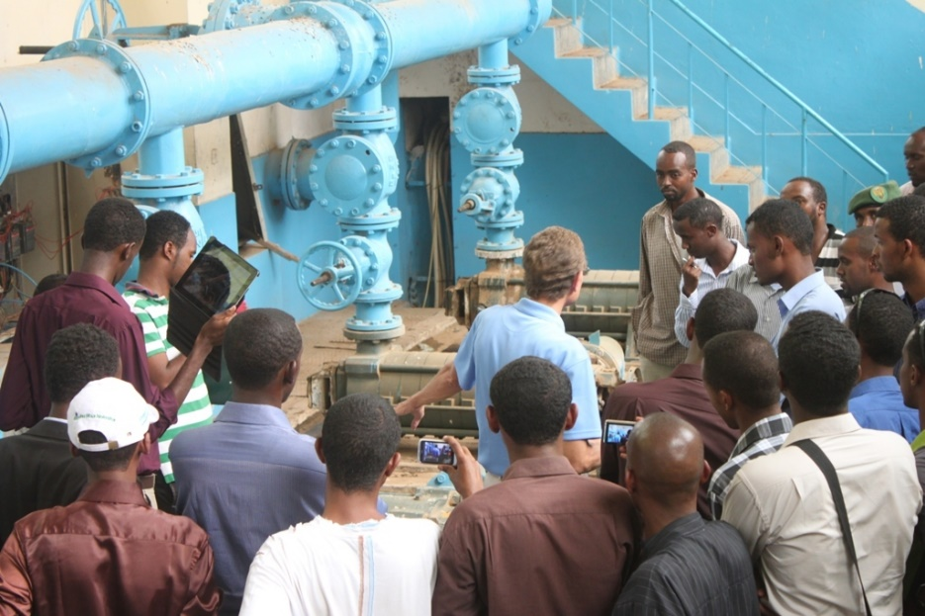
Friction Losses in Pipe Flow
Relationship to Fluid and Pipe Properties
The magnitude of the friction loss in a pipeline is:
Proportional to Pipe Length
Inversely Proportional to Pipe Diameter
Proportional to some Power of Velocity
Related to Pipe Roughness (Turbulent Flow)
Independent of Pressure
Darcy-Weisbach equation:

Slide 3
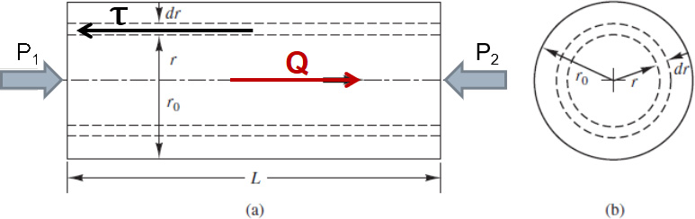
Description of Pipe Friction
Definitions and Visualization
Question: What forces cause and resist the flow of water in the figure below (cylindrical pipe section of radius “r”).
Cause Motion: Pressure difference between the two ends.
Resist Motion: Viscous force caused by shear stress
In laminar flow:
Figure 3.7 Geometry of a circular pipe

Slide 4
Friction Factors for Various Types of Flows (1 of 2)
The Darcy-Weisbach Equation
Determination of the Friction Factor
Laminar Flow:
Turbulent Flow:
Complete Turbulence:
Turb. (smooth pipe):
e = roughness height for pipe material (Table 3.1 see slide 7 and 8)

Slide 5
Table 3.1 Roughness Heights, e, for Certain Common Pipe Materials (1 of 2)
Pipe Material | e (mm) | e (ft)
Brass | 0.0015 | 0.000005
Concrete | Blank | Blank
Steel forms, smooth | 0.18 | 0.0006
Good joints, average | 0.36 | 0.0012
Rough, visible form marks | 0.60 | 0.002
Copper | 0.0015 | 0.000005
Corrugated metal (C M P) | 45 | 0.15
Iron (common in older water lines, except ductile or D I P, which is widely used today) | Blank | Blank
Asphalt lined | 0.12 | 0.0004

Slide 6
Table 3.1 Roughness Heights, e, for Certain Common Pipe Materials (2 of 2)
Pipe Material | e (mm) | e (ft)
Cast | 0.26 | 0.00085
Ductile; D I P—cement mortar lined | 0.12 | 0.0004
Galvanized | 0.15 | 0.0005
Wrought | 0.045 | 0.00015
Polyvinyl chloride (P V C) | 0.0015 | 0.000005
Polyethylene, high density (H D P E) | 0.0015 | 0.000005
Steel | Blank | Blank
Enamel coated | 0.0048 | 0.000016
Riveted | 0.9 similar to 9.0 | 0.003–0.03
Seamless | 0.004 | 0.000013
Commercial | 0.045 | 0.00015

Slide 7
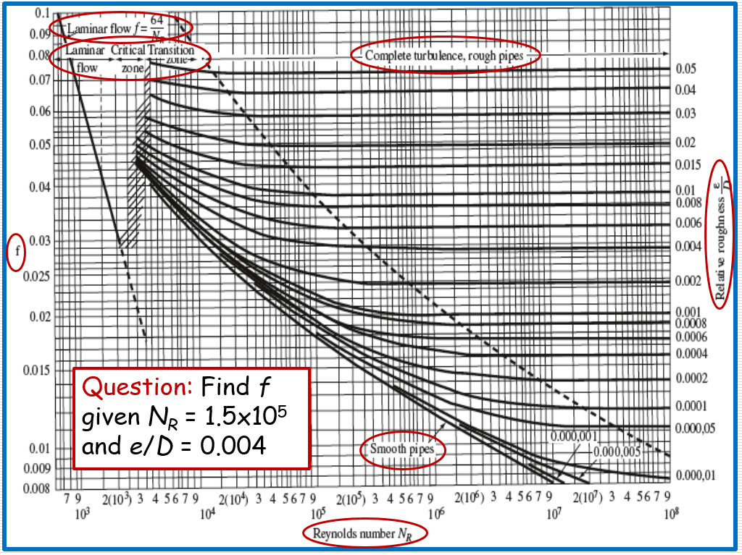
Friction Factors for Various Types of Flows (2 of 2)

Slide 8
Friction Losses and the Energy Eq’n (1 of 2)
Example Problems – Solve on White Board
Water at 20°Celsius flows (3,500 L/sec) through a 1.5-m-diameter, commercial steel pipe. Find the flow regime and the friction factor.
Solution:
From the Moody Diagram, f = 0.011 (turbulent, transition zone)

Slide 9
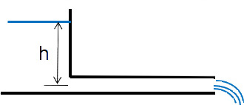
Friction Losses and the Energy Eq’n (2 of 2)
Find Q (in L/sec) in a horizontal, 6-kilometer long, cast iron pipeline if h = 408 meter and D = 30 centimeter. (Assume complete turbulence.)
Solution:
Homework Problems:

Slide 10
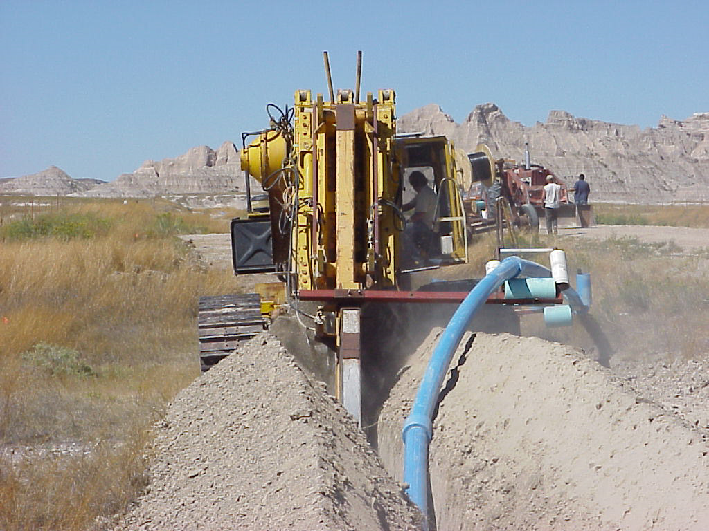
Water Pipeline Installation
www.usbr.gov/gp/multimedia/2010_contest/content/images/full/Redshirt_Pipeline_Construction.jpg

Slide 11

Copyright

