Slide 1
Chapter 8 Distribution Center, Warehouse, and Plant Location

Slide 2
Learning Objectives
To examine the screening or focusing concept of plant/warehouse location
To describe the major factors that influence location decisions
To explain the general process of determining the optimum number of facilities
To explain systems to determine the location that minimizes transportation costs
To examine a site’s specialized location characteristics
To learn about free trade zones

Slide 3
Distribution Center, Warehouse, and Plant Location
Key Terms
Brownfields
Center-of-gravity approach
Empowerment zone
Expatriate workers
Facility closing
Facility location
Facility relocation
Free trade zone
Grid system
Intermodal competition
Key Terms
Intermodal competition
Inventory tax
Maquiladoras
Pure materials
Quality-of-life
Right-to-work laws
Supplier parks
Sweatshops
Weight-gaining products
Weight-losing products

Slide 4
Distribution Center, Warehouse, and Plant Location
Facility location refers to choosing the locations for distribution centers, warehouses, and production facilities to facilitate logistical effectiveness and efficiency.

Slide 5
Facility Location
Accommodates the movement of inventories to customers
Near markets
Resource availability
Labor availability
Transportation system

Slide 6
Figure 8-1: Advertisement Showing a Site’s Location as an Advantage in Reaching British and Continental European Markets

Slide 7
The Strategic Importance of Facility Location
Factors that can influence facility location decisions include:
Cost considerations
Customer service expectations
Location of Customer or Supply Markets

Slide 8
Five Most Populous States in the United States – 1960, 1980, 2005
 | 1960 | 1980 | 2005
1 | New York | California | California
2 | California | New York | Texas
3 | Pennsylvania | Texas | New York
4 | Illinois | Pennsylvania | Florida
5 | Ohio | Illinois | Illinois
www.census.gov

Slide 9
Annual Population Estimates: 2009
California | 36,961,664
Texas | 24,782,302
New York | 19,541,453
Florida | 18,537,969
Illinois | 12,910,409
Pennsylvania | 12,604,767
Ohio | 11,542,645
Michigan | 9,969,727
Georgia | 9,829,211
N Carolina | 9,380,884
New Jersey | 8,707,739
Virginia | 7,882,590
Washington | 6,664,195
Arizona | 6,595,778
Massachusetts | 6,593,587
Indiana | 6,423,113
Tennessee | 6,296,254
Missouri | 5,987,580
Maryland | 5,699,478
Wisconsin | 5,654,774
Minnesota | 5,266,214
Colorado | 5,024,748
Alabama | 4,708,708
S Carolina | 4,561,242
Louisiana | 4,492,076
Kentucky | 4,314,113
Oregon | 3,825,657
Oklahoma | 3,687,050
Connecticut | 3,518,288
Iowa | 3,007,856
Mississippi | 2,951,996
Arkansas | 2,889,450
Kansas | 2,818,747
Utah | 2,784,572
Nevada | 2,643,085
New Mexico | 2,009,671
W Virginia | 1,819,777
Nebraska | 1,796,619
Idaho | 1,545,801
New Hampshire | 1,324,575
Maine | 1,318,301
Hawaii | 1,295,178
Rhode Island | 1,053,209
Montana | 974,989
Delaware | 885,122
S Dakota | 812,383
Alaska | 698,473
N Dakota | 646,844
Vermont | 621,760
Dist of Columbia | 599,657
Wyoming | 544,270
http://www.census.gov/popest/states/NST-ann-est.html

Slide 10
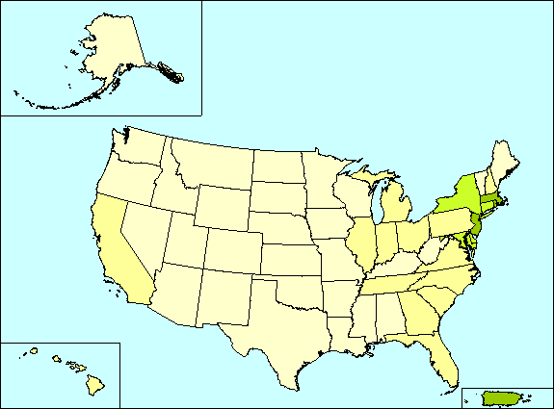
Persons per Square Mile: 2009
http://factfinder.census.gov/leg2/23/172269323.gif

Slide 11
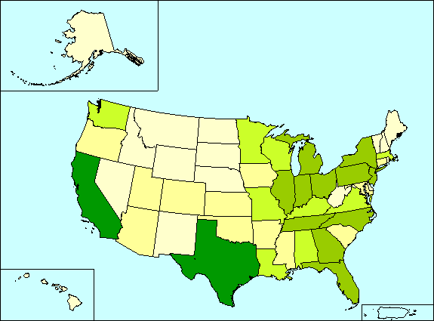
Shipment Characteristics by Origin Geography by Mode: 2007 and 2002
http://factfinder.census.gov/leg2/96/172595396.gif

Slide 12
Determining the Number of Facilities
Facilities are generally added when service levels become unacceptable
Software packages exist to help in determining the number and location of facilities
Key issue—time it takes to get from facility to majority of the U.S. (or target) population
Moving from 2 to 5 facilities saves 1 day lead time
Moving from 5 to 10 facilities saves ½ day lead time

Slide 13
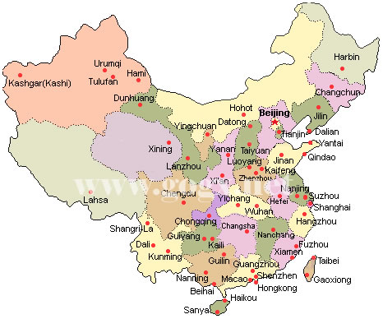
Capitals of all the Provinces Map of China
http://www.panasianbiz.com/india/map-of-china-the-15-most-useful/

Slide 14
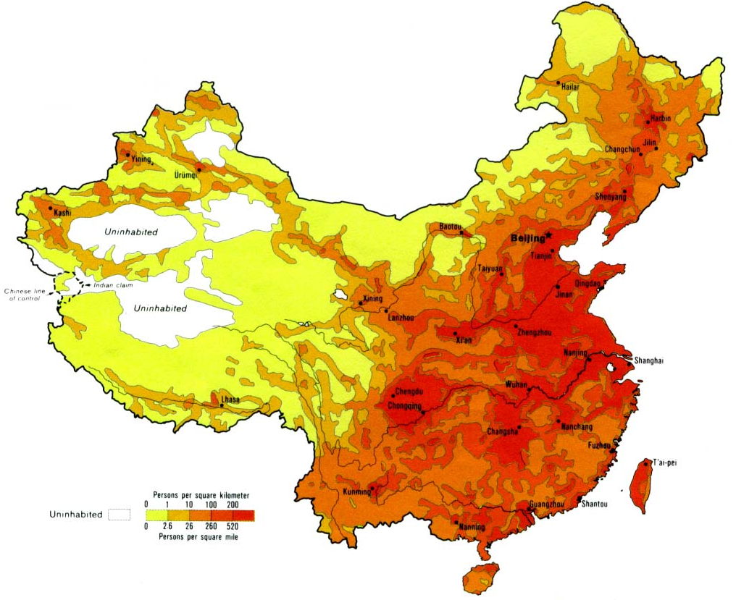
Population Density
http://www.lib.utexas.edu/maps/middle_east_and_asia/china_population_83.jpg/

Slide 15
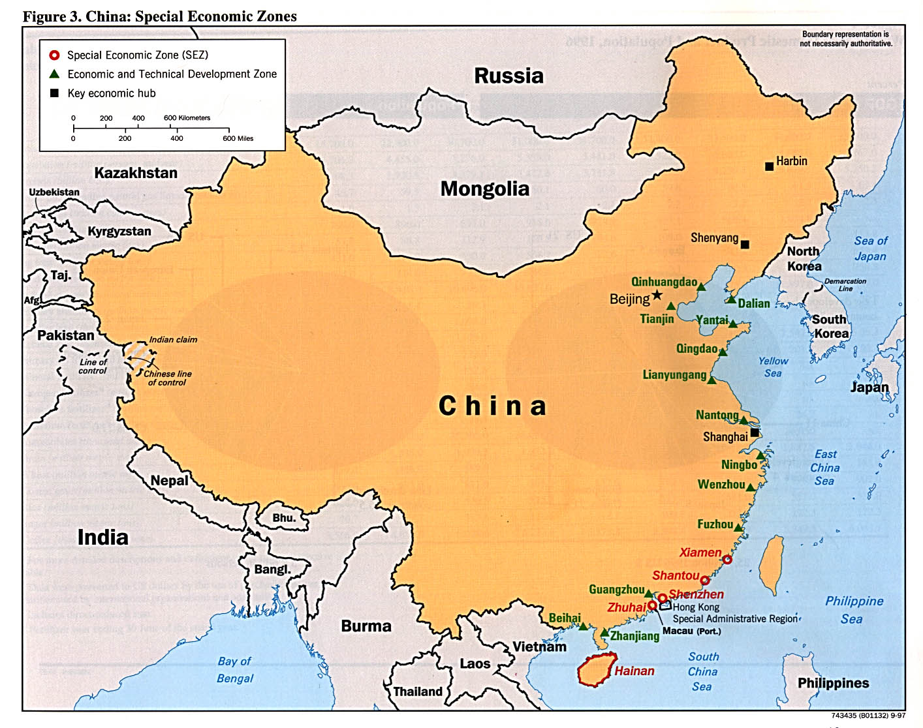
Special economic zones and Economic and Technical Development Zones
http://www.lib.utexas.edu/maps/middle_east_and_asia/china_specialec_97.jpg/

Slide 16
General Factors Influencing Facility Location
Natural Resources
Pure materials
Weight-losing products
Weight-gaining products
Population Characteristics—Market for Goods
Population Characteristics—Labor
Maquiladoras
Sweatshops
Right-to-work laws
Expatriate workers

Slide 17
General Factors Influencing Facility Location
Taxes and Subsidies
Tax-free bonds
Empowerment zones
National competitive strategy
Transportation Considerations
Customer Considerations
Trade Patterns

Slide 18
Figure 8-4: Truck Distances from Oklahoma

Slide 19
General Factors Influencing Facility Location
Quality of Life Considerations
Locating in Other Countries
Specialized Location Characteristics
Free trade zone

Slide 20
Specialized Location Characteristics
Current zoning of the land
Local unions
Title search
Engineers examine site for proper drainage, etc.
Brownfields – previous use of land
Weather
Free Trade Zone

Slide 21
Finding the Lowest-Cost Location
Grid systems
Center-of-gravity approach

Slide 22
Figure 8-6: Center-of-Gravity Location for a Warehouse Serving Five Retail Stores

Slide 23
Table 8-1: Weighted Center-of-Gravity Example
Store | North location | East location | Mo. volume (tons) | North x volume | East x volume
1 | 3 | 1 | 3 | (3x3)=9 | (1x3)=3
2 | 3 | 3 | 5 | (3x5)=15 | (3x5)=15
3 | 2 | 4 | 4 | (2x4)=8 | (4x4)=16
4 | 1 | 2 | 2 | (1x2)=2 | (2x2)=4
5 | 3 | 6 | 6 | (3x6)=18 | (6x6)=36
Total |  |  | 20 | 52 | 74
Weighted average |  |  |  | 2.6 | 3.7

Slide 24
Facility Relocation and Facility Closing
Facility relocation occurs when a firm decides that it can no longer continue operations in its present facility and must move operations to another facility to better serve suppliers or customers.
Example leading to facility relocation:
Lack of room for expansion at current site

Slide 25
Facility Relocation and Facility Closing
Facility Closing occurs when a company decides to discontinue operations at a current site because the operations may no longer be needed or can by absorbed by other facilities.
Examples leading to facility closure:
Eliminating redundant capacity in mergers and acquisitions
Improving supply chain efficiency
Poor planning
Insufficient volume of business

Slide 26
Case 8-1 Aero Marine Logistics
Company Facts:
Located in South Delhi, India (1996)
Service Provided:
Customized solutions and services
Import consolidation
Door-to-door services
Exports
Consultancy on customs and logistics
Current Capability:
1,000 m² covered warehouse space
Two 407 Tata trucks, 5 low-bed trailers
Handles 200+ TEUs of imports and exports per mo.

Slide 27
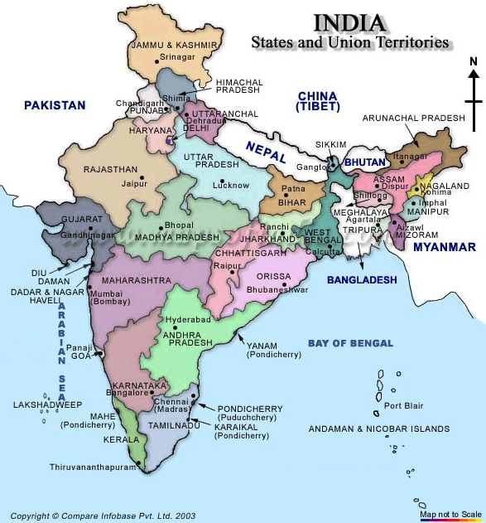
Case 8-1 Aero Marine Logistics

Slide 28
Case 8-1 Aero Marine Logistics
New Opportunity:
Frozen mushroom @150,000 kg/mo from Amsterdam to Mumbai to Delhi at US$0.20/kg
New Equipment Needed:
Upgrades to Flatbed Trailers (each)
Retrofit Cost: 9 lakhs (US$19,998)
Energy Cost: 3 lakhs/yr (US$6,666/yr)
20-foot containers (used)
Purchase Price: 7 lakhs (US$15,554)
Service Charge: 1 lakhs/yr (US$2,222/yr)
10 containers needed
Expected life: 5 years

Slide 29
Case 8-1 Aero Marine Logistics
New Equipment Needed:
40-foot containers (new)
Purchase Price: 15 lakhs (US$33,330)
Service Charge: First year free
5 containers needed
Expected life: 10 years
Transportation Costs:
 | 20-foot container | 40-foot container
From Amsterdam to Mumbai | US$1,700 | US$2,600
From Mumbai to Delhi | US$300 | US$500
Return Charge | 50% | 50%
Probability of finding backhaul cargo | 10% | 10%

Slide 30
Case 8-1 Aero Marine Logistics
Discussions:
#1: What would the first-year costs be to AML if they purchased the 10 used 20-foot containers? How long would it take to recoup the investment, assuming that the mushroom traffic continued?
#2: What would the first-year costs be to AML if they purchased 5 new 40-foot containers? How long would it take to recoup the investment, assuming that the mushroom traffic continued?
#3: Is either of the alternatives covered in questions 1 and 2 riskier? Why?
#4: Mr. Singh has read about the supply-chain concept that attempts to identify and link all the participants from suppliers’ suppliers to customers’ customers. Who are all of the participants in the supply chain, a part of which has been discussed in the case?
#5: Logistics partnerships involve sharing costs and risks. What are all the costs and risks that this venture entails? How might they be shared?

Slide 31
Case 8-2 Alberta Highway Dept.
Region VI
Headquarter:
West of Lethbridge, Calgary, and Red Deer
Task:
Keep Canadian Route 1 open
Area of Interest:
A 6-mile stretch between Lake Louise and B.C. boarder
Elevation increase 500’/mile (west bound)
Highway Maintenance Station:
Near Lake Louise, 1 mile east of the section
Heavy-duty dump trucks are based (carry 10 tons, for 1 mile spread in both directions)
Sand silos (6,000 tons) from a quarry (40 miles east)

Slide 32
Case 8-2 Alberta Highway Dept.
Region VI
Maintenance Required:
Section | Elevation | Avg. # of days requires sanding
Mile 1 | 3000’~3500’ | 40 days / yr
Mile 2 | 3500’~4000’ | 48 days / yr
Mile 3 | 4000’~4500’ | 53 days / yr
Mile 4 | 4500’~5000’ | 58 days / yr
Mile 5 | 5000’~5500’ | 65 days / yr
Mile 6 | 5500’~6000’ | 70 days / yr
Highway Maintenance Station:
Near Lake Louise, 1 mile east of the section
Heavy-duty dump trucks are based

Slide 33
Case 8-2 Alberta Highway Dept.
Region VI
New Proposal:
Portion of the Lake Louise sand silos be moved west toward the higher elevation
Cost Information:
Trucking sand from quarry: $.03/ton-mile (includes backhaul)
Spreader dump truck: $.10/ton-mile (includes backhaul)
No costs are assigned for spreader trucks to reach silos
No costs are assigned to operating spreader trucks within a mile on either side of the silo
Spreader truck should load sand from the nearest silo

Slide 34
Case 8-2 Alberta Highway Dept.
Region VI
Discussion:
#1: Should one portion of sand silos at the Lake Louise maintenance station be relocated to a point to the west, at a higher elevation? If yes, where should it be relocated, how much capacity should it have, and what are the projected annual savings in truck operating costs? Show your work.
#2: Assume that it is discovered that it would be impossible to split the silo into sections. However, it would be feasible to move the entire silo to a site farther up the slope. The section of highway from the Lake Louise maintenance station stretching west 1 mile to where it reaches the 3,000-foot elevation point must be sanded for 30 days per year. All points east of the Lake Louise maintenance station can be serviced from other points. Should the entire silo be moved to another point? If so, to where? What will the savings be? Show your work.

Slide 35
Case 8-2 Alberta Highway Dept.
Region VI
Discussion:
#3: Ignore all statements made in question 2 and assume, instead, that the silo can be divided into three sections: one remaining at Lake Louise and other two located somewhere along the 6-mile stretch. If two sections are to be located within the 6-mile section, where should they be placed? What will the savings be over the present system? Show your work.
#4: This case was written some time ago, when fuel costs were very low. Assume now that the spreader dump truck costs $.35 per ton-mile to operate (compared to $.10) and that the trailer dump truck used to move sand from the quarry costs $.20 per ton-mile to operate (up from $.03). Answer question 1 again, but this time take into account the new truck operating costs.
#5/6: Answer question 2/3 again but using the new trucking costs outlined in question 4.

