Slide 1
CGN 2420 Matrix Operations in Excel
Instructor: Professor Cora Martinez, PhD
Department of Civil and Environmental Engineering
Florida International University

Slide 2
Objectives
Learn how to define and name arrays.
Learn how to carry out standard matrix math:
Multiplying matrices by scalar values.
Matrix addition.
Matrix multiplication.
Transposing matrices.
Inverting a matrix.
Find the determinant of a matrix.
Solve systems of simultaneous linear equations.

Slide 3
Defining and Naming Arrays
An array is defined by filling a range of cells with the contents of the array.
Naming a range of cells allows you to use the name in place of the cell range.
To give a name to the range of cells that hold an array:
Select the cells containing the array.
Enter the desired name in the name box at the left side of the formula bar.
Alternatively, a selected range can be assigned a name by using the ribbon options:
Formulas/Defined Names/Define Name

Slide 4
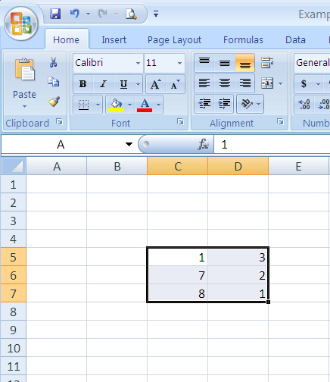
Defining and Naming Arrays (Cont.)
The selected cell range has been named A

Slide 5
Matrix Addition
The two matrices to be added must be the same size.
Matrices can be added using basic cell arithmetic or array math operation.
Matrix addition using array math:
Name the cell ranges containing the arrays that will be added.
Select a cell range with same dimensions as parent matrices.
Then enter the formula= name matrix 1+name matrix 2. Press [Ctrl-Shift-Enter] after entering formula.

Slide 6
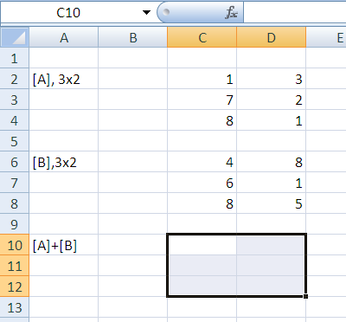
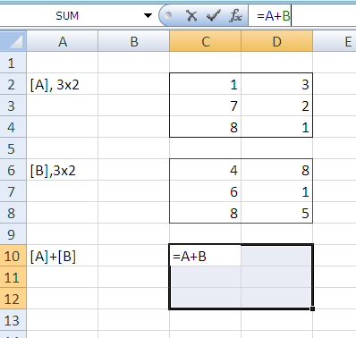
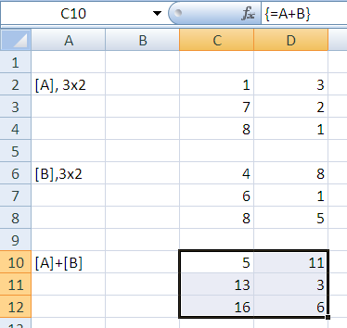
Matrix Addition (Cont.)
Important!
Press [Crtl-Shift-Enter] after entering formula
Select cell range
Enter Formula

Slide 7
Multiplying a Matrix by a Scalar
Multiplying a matrix by a scalar requires to multiply each element of the matrix by the scalar.
Scalar multiplication using array math:
Enter and name the array that will be multiplied.
Indicate the size of the result matrix by selecting the desired cell range.
Enter the formula + [Ctrl-Shift-Enter]

Slide 8
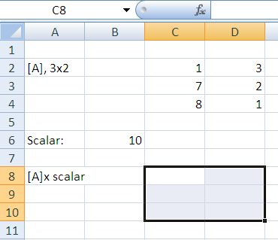
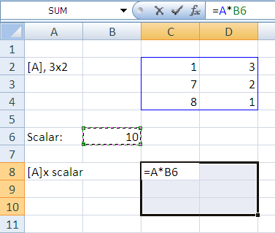
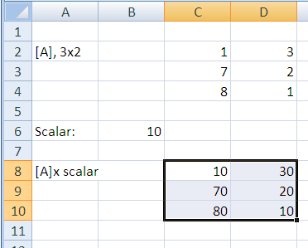
Multiplying a Matrix by a Scalar (Cont.)
Enter Formula
Important!
Press [Crtl-Shift-Enter] after entering formula
Select cell range

Slide 9
Matrix Multiplication
In order to multiply two matrices, the number of columns in the first matrix must equal the number of rows in the second matrix.
Ex:
[A], 3x2
[e], 2x1
To multiply these matrices, “inside” dimensions must match (2,2). The product matrix dimension will have “outside” dimensions (3x1).

Slide 10
Matrix Multiplication (Cont.)
Procedure:
Enter and name the arrays that will be multiplied.
Indicate the size of the result matrix by selecting the desired cell range.
Enter the following function:
MMULT(first matrix, second matrix) + [Ctrl-Shift-Enter]
Note: Alternatively you can use the mouse to indicate the cell ranges instead of using arrays names.

Slide 11
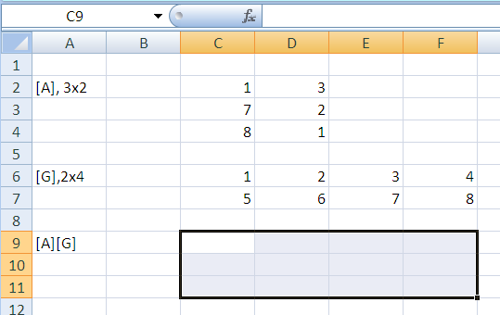
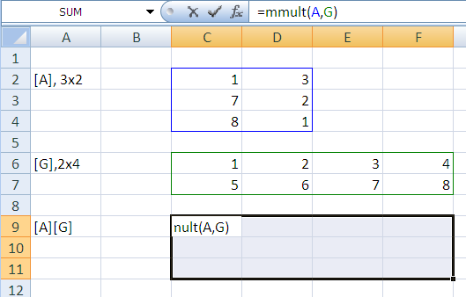
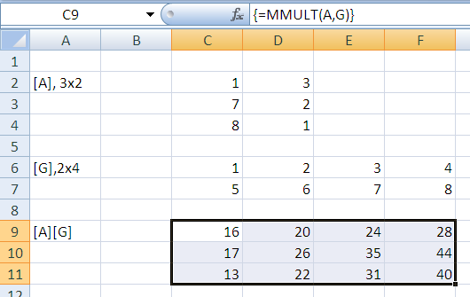
Matrix Multiplication (Cont.)
Enter MMULT Function
Select cell range
(outside dimensions)
Important!
Press [Crtl-Shift-Enter] after entering formula

Slide 12
Matrix Transpose
Any matrix can be transposed. To transpose a matrix, interchange the rows and columns.
Excel features two methods to transpose a matrix:
By using PASTE SPECIAL (does not automatically recalculates)
By using the TRANSPOSE() array function (automatically recalculates)

Slide 13
Matrix Transpose (Cont.)
Using PASTE SPECIAL:
Select and copy the array to be transposed.
Indicate the cell that will contain the top-left corner of the result matrix.
Open the PASTE SPECIAL dialog, using right click or ribbon options Home/Paste(menu)/Paste Special.
Select values in the paste selection, and check the transpose check near the bottom of the dialog.
Click OK button.

Slide 14
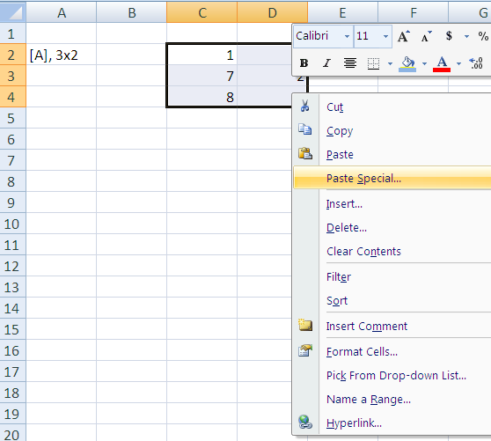
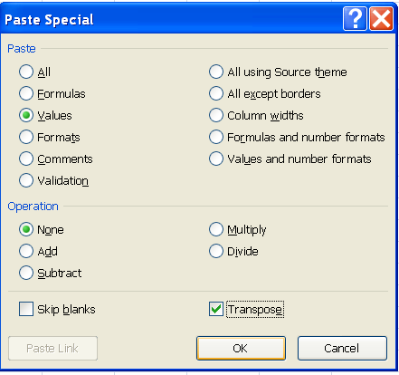
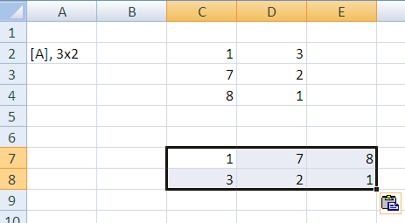
Matrix Transpose (Cont.)

Slide 15
Matrix Transpose (Cont.)
Using TRANSPOSE array function:
Enter the original matrix.
Indicate where the result should be placed, showing the exact size of the transposed matrix.
Enter the TRANSPOSE() array function + [Ctrl-Shift-Enter].

Slide 16
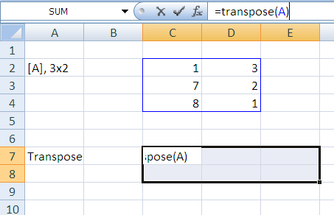
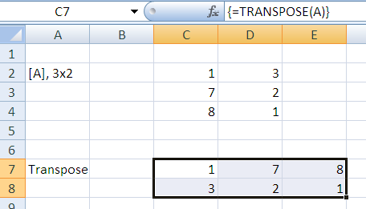
Matrix Transpose (Cont.)

Slide 17
Inverting a Matrix
Only square, non singular matrices can be inverted.
Procedure:
Enter the matrix to be inverted and name it if desired.
Indicate where the result should be placed, showing the exact size (same as original matrix).
Enter the MINVERSE() array function + [Ctrl-Shift-Enter].

Slide 18
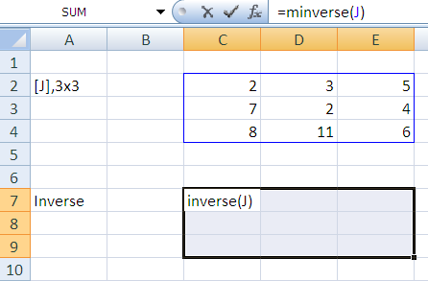
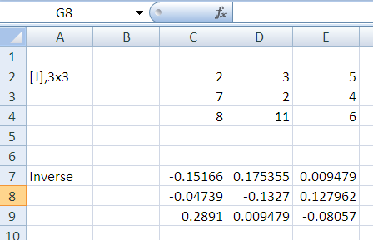
Inverting a Matrix (Cont.)

Slide 19
Matrix Determinant
The determinant of a matrix is a single value . If determinant=0, matrix is singular and can not be inverted.
A matrix is singular if:
Any row or column contains all zeros
Any two rows or columns are identical
Any row or column is a linear combinations of other rows or columns.

Slide 20
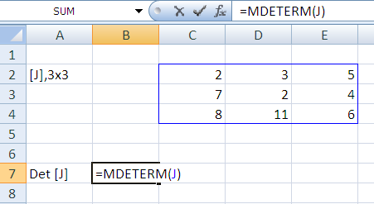
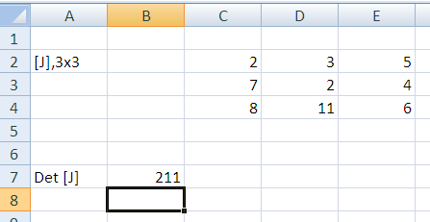
Matrix Determinant (Cont.)
To calculate the determinant of a matrix:
MDETERM() function

Slide 21
Solving Systems of Linear Equations
The process of solving simultaneous equations by using matrices works as follows:
Write equations in matrix form
Where,

Slide 22
Solving Systems of Linear Equations (Cont.)
Calculate the determinant of [C]
If Det (C)=0, Solution undetermined
If Det (C)≠0, Solution can be determined
Invert the coefficient matrix [c]
The solution to the system of equations is given by:

Slide 23
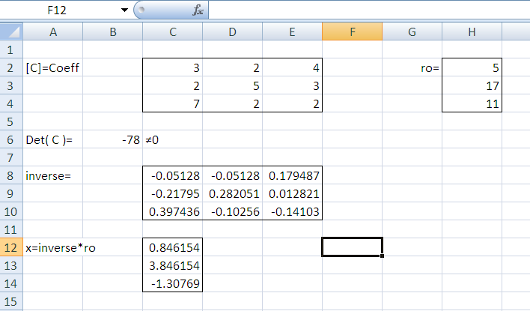
Solving Systems of Linear Equations (Cont.)

