Slide 1
CGN 2420 Graphing with Excel
Instructor: Professor Cora Martinez, PhD
Department of Civil and Environmental Engineering
Florida International University

Slide 2
Objectives
Organize data in a worksheet to make graphing easy
Create and XY scatter graph
Modify plot formatting
Add additional data to the graph
Add trendlines and error bars to an XY graph
Create and format a pie chart
Create and format a column chart
Create and format a combined chart
Work with 3D charts

Slide 3
Creating Charts
A chart, or graph, is a visual representation of a set of data. In order to create a graph in Excel 2007:
Select the data source with the range of data you want to chart.
In the Charts group on the Insert tab, click a chart type, and then click a chart subtype in the Chart gallery.

Slide 4
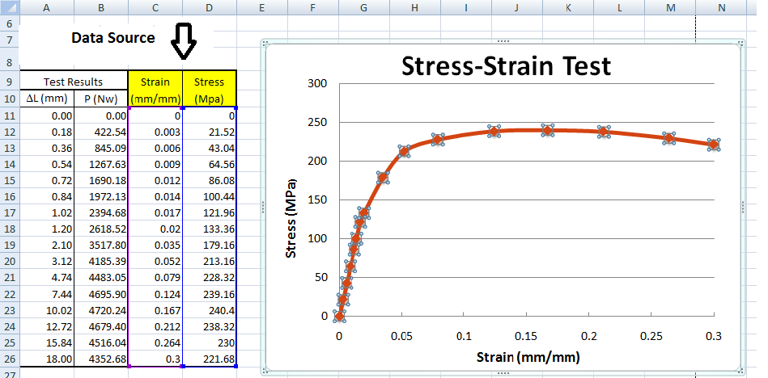
Selecting a Data Source
The data source is the range that contains the data you want to display in the chart.
Series name
Series values
Category values (horizontal axes)

Slide 5
Importing Text Files
Text files are a common way to move data from one program to another. Two types of text files are used to store data,
Delimited: 24,45,67
Fixed width: 0.00 64.25
1.00 45.75
Copy the data from the text file, paste in Excel, and use the Text to Columns button in the Data Tools group on the Data tab to convert the selected text into a table. Then, this data can be used as Data Source for a graph.

Slide 6
Selecting a Chart Type

Slide 7
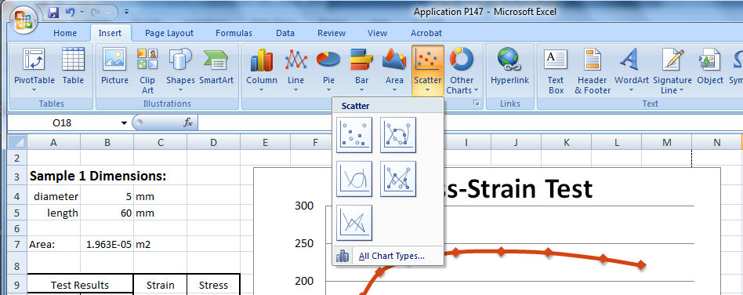
Creating an XY Scatter Plot
Select the range.
Click the Insert tab on the Ribbon.
In the Charts group, click the Scatter button, and then click the desired category.

Slide 8
Formatting your graph
Once the chart is created three new tabs appears on the Ribbon: Design, Layout and Format, these Chart Tools are used to modify the graph.
First:
Choose a quick layout in the Design tab
Edit the Axis Titles and Graph Title
Select a Chart Style to modify the chart

Slide 9
Formatting your graph (Cont.)
The Layout Tab is used to modify in more detail your graph.
Add or modify labels (Title, Axes, Legend, Data)
Modify the appearance of axes and gridlines
Modify the appearance of the plot area
Add trendlines and error bars

Slide 10
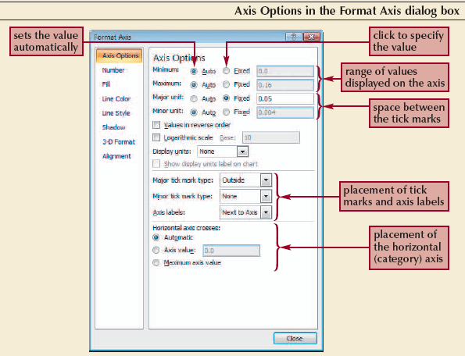
Formatting the Chart Axes
Click the Chart Tools Layout tab on the Ribbon and use the Axes button. Select More Primary Axis Option.

Slide 11
Formatting your graph (Cont.)
The Format Tab is used to modify the graph borders and background. In addition you can modify any shape in the graph.
Modify shapes using Shape Styles
Modify text using WordArt Styles
Modify graph Size
Arrange objects in your spreadsheet to change order and visibility

Slide 12
Formatting your graph (Cont.)
The Current Selection group is available from either the Layout tab or Format tab. If you click on the graph feature you want to modify and then click Format Selection the dialog box for that graph feature will open.
If you are familiar with prior versions of Excel, you can still right-click on a feature and select “Format <feature>” from the pop-up menu.

Slide 13
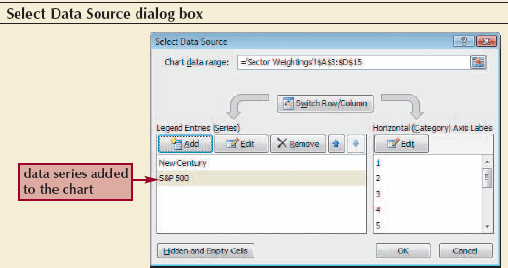
Adding a Data Series to an Existing Chart
In the Data group, on the Design tab, click on Select Data, and the Select Data Source window will open
Use this window to Edit or Add data to the graph

Slide 14
Moving and Resizing Charts
By default, a chart is inserted as an embedded chart, which means the chart is placed in a worksheet next to its data source.
You can also place a chart in a Chart sheet.
In the Location group on the Chart Tools Design tab, click the Move Chart button.

Slide 15
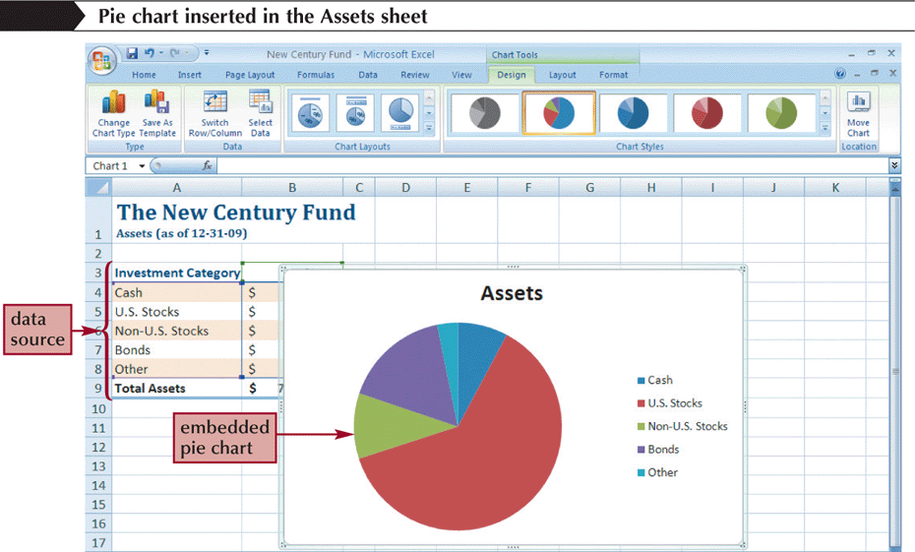
Create a Pie Chart
Click the Insert tab on the Ribbon.
In the Charts group, click the Pie button.

Slide 16
Choosing a Chart Style and Layout
In the Design tab of the Chart Tools select a quick Layout and Style for your chart

Slide 17
Choosing a Chart Style and Layout

Slide 18
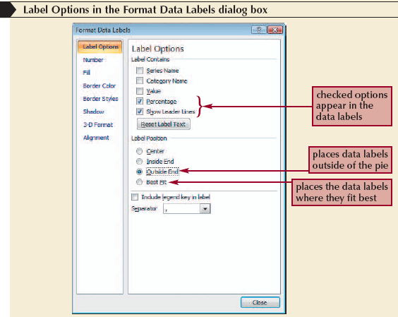
Formatting a Pie Chart
Click the chart to select it.
In the Labels group on the Chart Tools Layout tab, click the Data Labels button, and then click More Data Label Options.

Slide 19
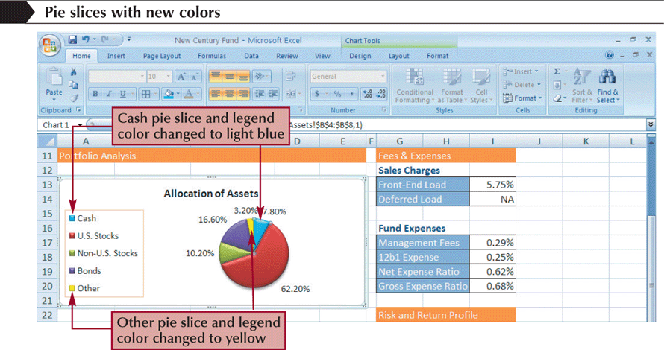
Setting the Pie Slice Colors
In pie charts with legends, it’s best to make the slice colors as distinct as possible to avoid confusion.
Click the pie to select the entire data series, and then click the slice you wish to change.
Change the fill color.

Slide 20
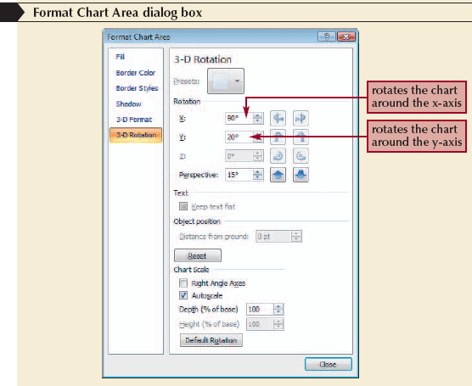
Working with 3D Options
To increase the 3D effect, you need to rotate the chart
Click the Chart Tools Layout tab on the Ribbon, and then, in the Background group, click the 3-D Rotation button

Slide 21
Creating a Column Chart
A column chart displays values in different categories as columns; the height of each column is based on its value.
The bar chart is a column chart turned on its side, so each bar length is based on its value.

Slide 22
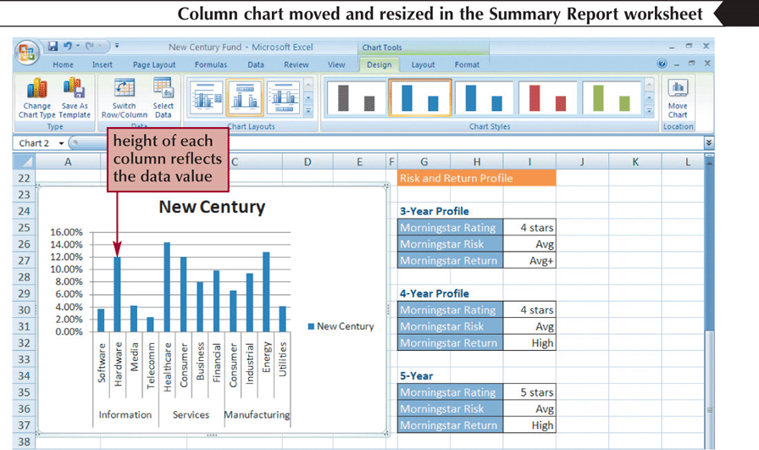
Creating a Column Chart
Select the range.
Click the Insert tab on the Ribbon.
In the Charts group, click the Column button and then choose the chart subtype.

Slide 23
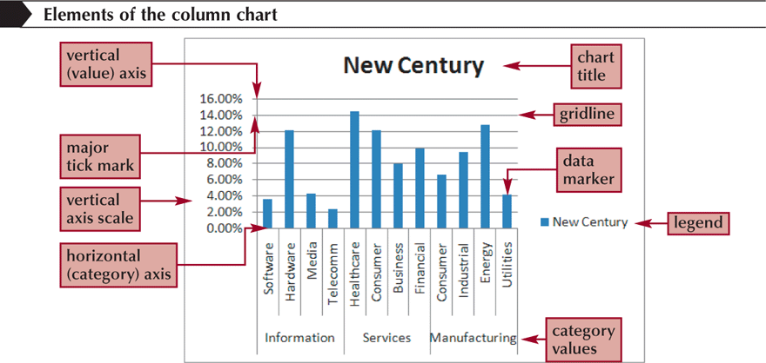
Formatting Column Chart Elements
Click the Chart Tools Layout tab on the Ribbon to modify the different features of this chart.

Slide 24
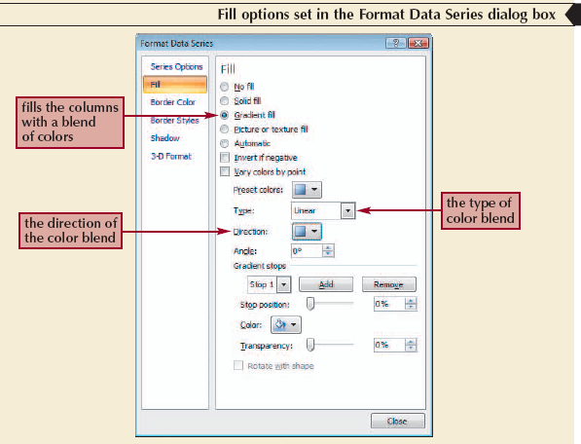
Formatting Chart Columns
Click any column in the chart.
In the Current Selection group on the Chart Tools Layout tab, click Format Selection.

Slide 25
Formatting Chart Columns (Cont.)

Slide 26
Creating a Combination Chart
Add a data series in an existing chart that you want to appear as another chart type.
Select the data series you recently added.
In the Type group on the Chart Tools Design tab, click the Change Chart Type button, and then click the chart type you want.
Click the OK button.

Slide 27
Creating a Combination Chart

Slide 28
Inserting a Shape
Click the Insert tab on the Ribbon.
In the Illustrations group, click the Shapes button, and then choose the shape you want.
Draw the shape in your worksheet

Slide 29
Aligning and Grouping Shapes
Hold down the Shift key and then click each shape to select it.
Click the Drawing Tools Format tab on the Ribbon.
In the Arrange group, click the Align button, and then click your alignment option.
To group several shapes into a single unit, select the shapes, and then click the Group button in the Arrange group on the Drawing Tools Format tab.

Slide 30
Aligning and Grouping Shapes (Cont.)

