Slide 1
CGN 2420 Formatting a Workbook Using Excel’s Ribbon
Instructor: Professor Cora Martinez, PhD
Department of Civil and Environmental Engineering
Florida International University

Slide 2
Objectives
Use Excel Ribbon to access excel features.
Format text, numbers, and dates by controlling:
Font style, size and color.
Borders and background colors.
Text alignment.
Special numeric formats and number precision.
Copy an existing format using format painter.
Use a built-in style or theme to change appearance of a cell.

Slide 3
Objectives (Cont.)
Merge a range of cells into a single cell.
Delete, insert and hide worksheet columns or rows.
Use conditional formatting to highlight cells that meet specified criteria.
Apply a built-in table style.
Lock cells to prevent unwanted alterations to cell contents

Slide 4
Navigating the Ribbon
In Office 2007, the Home tab of the Ribbon is
divided into the following groups:
Clipboard
Font
Alignment
Number
Styles
Cells
Editing

Slide 5
Using the Clipboard group
Windows Clipboard is a temporary storage location that allows you to move or duplicate information without retyping it.
Paste and Paste Option menu
Cut or Copy
Format Painter
Clipboard expand control

Slide 6
Copying Formats with the Paste Options Button

Slide 7
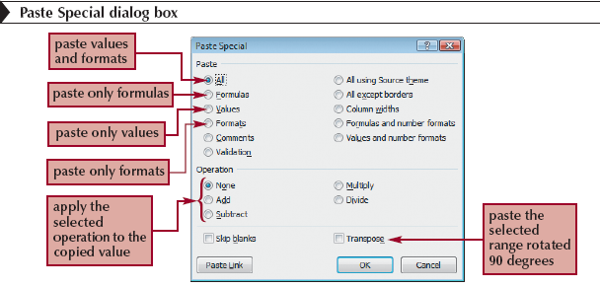
Copying Formats with Paste Special

Slide 8
Copying Formats with the Format Painter
The Format Painter copies the formatting from one cell or range to another cell or range, without duplicating any of the data.
Select the range containing the format you wish to copy.
Click the Format Painter button on the Home tab.
Click the cell to which you want to apply the format.

Slide 9
Using the Font group
Many of the formatting options available through the Font group in Excel 2007 are very similar to
Word processors.
Font typeface and point size
Bolt, Underline and Italic attributes
Border application
Cell background color and font color

Slide 10
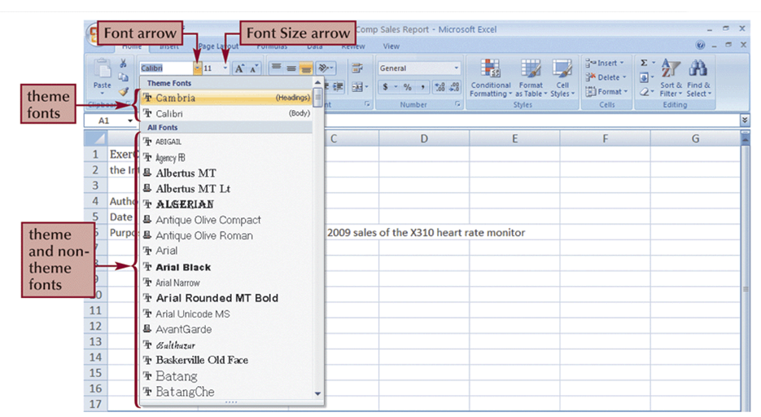
Formatting Text

Slide 11
Working with Color

Slide 12
Formatting Text Selections
The Mini toolbar appears when you select part of the cell text. This bar contains buttons for commonly used text formats.

Slide 13
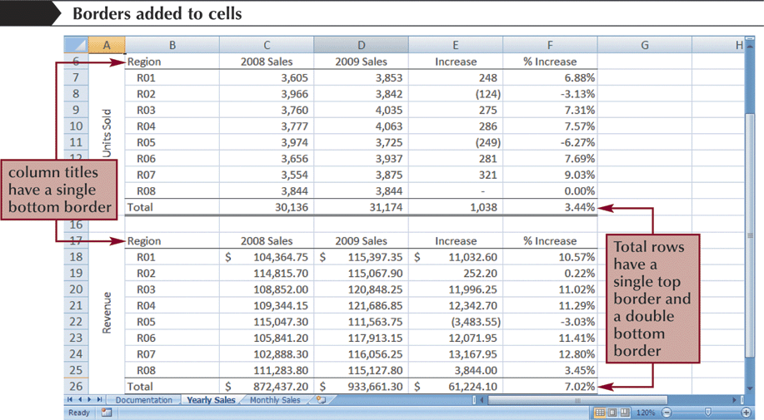
Adding Cell Borders
You can add borders to the left, top, right, or bottom of a cell or range, around an entire cell, or around the outside edges of a range using the Border button arrow.

Slide 14
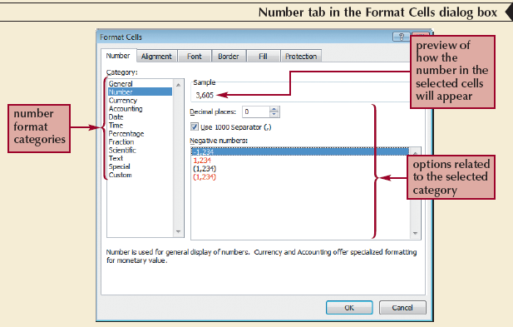
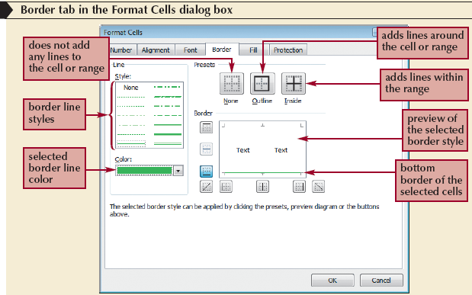
Working with the Format Cells Dialog Box
The Format Cells dialog box has six tabs, each focusing on a different set of formatting options.

Slide 15
Using the Alignment group
The alignment group on the Ribbon’s Home tab provides access to:
Horizontal and vertical alignment
Cell indentation control
Rotate cell content
Wrap text
Merge cells and Center text

Slide 16
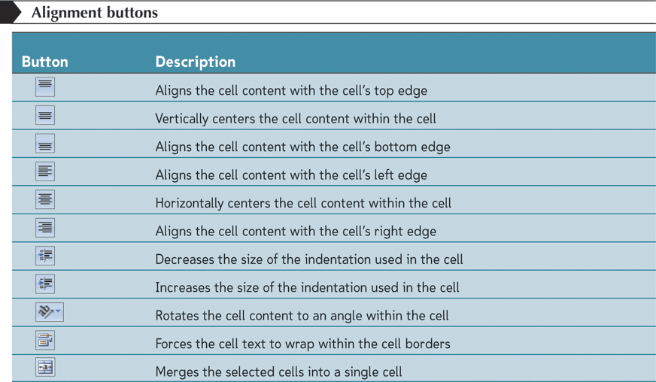
Aligning Cell Content (Cont.)

Slide 17
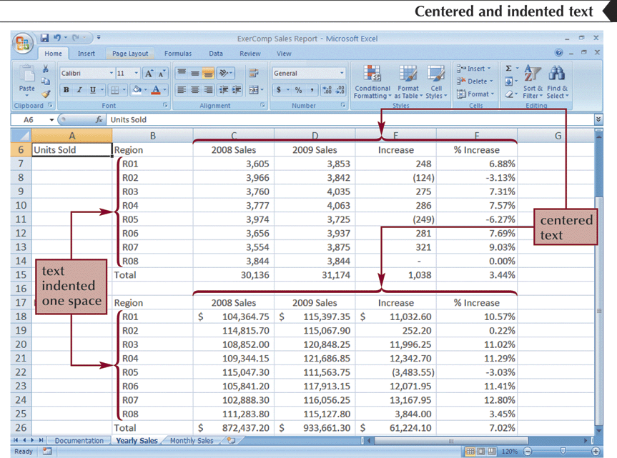
Indenting Cell Content
You increase the indentation by roughly one character each time when you click the Increase Indent button.

Slide 18
Merging Cells
One way to align text over several columns or rows is to merge, or combine, several cells into one cell.

Slide 19
Rotating Cell Content

Slide 20
Formatting Numbers
The number group on the Ribbon’s Home tab provides access to numeric formats, including:
Currency and accounting format
Percentage
Thousands separator (comma)
Increase and decrease decimals
Named formats

Slide 21
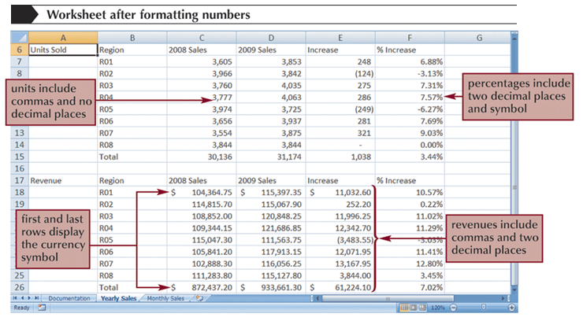
Formatting Numbers (cont.)

Slide 22
Formatting Dates and Times
Although dates and times in Excel appear as text, they are actually numbers that can be used to measure interval between the specified dates.

Slide 23
Using the Styles group
The Styles group on the Ribbon’s Home tab can be used to:
Apply pre-defined styles to cells
Create and modify styles
Create a table within a worksheet
Apply conditional formatting to highlight parts of a data set

Slide 24
Applying Styles (Cont.)

Slide 25
Applying a Table Style to an Existing Table
You can treat a range of data as a distinct object in a worksheet known as an Excel table.
Select the range to which you want to apply the table style.
In the Styles group on the Home tab, click the Format as Table button.
Click a table style in the Table Style gallery.

Slide 26
Applying a Table Style to an Existing Table (Cont.)

Slide 27
Introducing Conditional Formats
Select the range in which you want to highlight cells that match a specified rule.
In the Styles group, click the Conditional Formatting button, point to Highlight Cells Rules or Top/Bottom Rules, and then click the appropriate rule.
Select the appropriate options in the dialog box, and then click the OK button.

Slide 28
Adding Data Bars
A data bar is a horizontal bar added to the background of a cell to provide a visual indicator of the cell’s value.
Select the cell(s).
In the Styles group on the Home tab, click the Conditional Formatting button, point to Data Bars, and then click the DataBar option you wish to apply.

Slide 29
Adding Data Bars (Cont.)

Slide 30
Using the Cells group
The Cells group on the Ribbon’s Home tab provide access to buttons allowing you to:
Insert cells, rows and columns
Delete cells, rows and columns
Resize rows and columns
Hide and unhide rows, columns and worksheets
Protect sheet

Slide 31
Inserting a Column or Row
Select the column(s) or row(s) where you want to insert the new column(s) or row(s); Excel will insert the same number of columns or rows that you select.
Use Ribbon options Home/Cell/ Insert or
Right-click the mouse and then click Insert on the shortcut menu.

Slide 32
Inserting a Column or Row (Cont.)

Slide 33
Deleting and Clearing a Column or Row
Clearing data from a worksheet removes the data but leaves the blank cells.
Deleting data from the worksheet removes both the data and the cells.

Slide 34
Inserting or Deleting a Cell range

Slide 35
Changing Column Width and Row Height
Autofitting eliminates any empty space by matching the column to the width of its longest cell entry or the row to the height of its tallest cell entry.
Double-click the right border of a column heading or the bottom border of a row heading to AutoFit the column or row to the cell contents (or select one or more column or rows, click the Home tab on the Ribbon, click the Format button in the Cells group, and then click AutoFit Column Width or AutoFit Row Height).

Slide 36
Changing Column Width and Row Height (Cont.)
Or
Drag the right border of the column heading left to decrease the column width or right to increase the column width.
Drag the bottom border of the row heading up to decrease the row height or down to increase the row height.

Slide 37
Protecting Worksheets
Protecting the worksheet limits user’s access to the calculations in locked cells.
Cells with Normal style are, by default, locked.
Select cells to be unlocked.
Use Format cells window to unlocked them.
To protect worksheet use Home/Cells/Format/Protect Sheet.
Enter a password (password will be used to unprotect the sheet again).

Slide 38
Using the Editing group
The Editing group on the Ribbon’s Home tab provide access to buttons allowing you to:
Insert functions
Fill cells, rows and columns
Clear cells, rows and columns
Sort and filter data
Use commands Find and Select

Slide 39
Using Find and Replace
You can use the Find command to locate numbers and text in the workbook and the Replace command to overwrite them.

Slide 40
Using the Spelling Checker
The spelling checker verifies the words in the active worksheet against the program’s dictionary.

