Slide 1

DESING AND CONSTRUCTION
PATIO PROJECT
1161 - ESI6455 - Advanced Engineering Project Management - Sections RX2 & RX3 - Spring 2016
Team members
Evis Reyes
Leandro Avila
Danea Bruce
Uri Aszadi

Slide 2
Table of content
Executive Summary
1 Introduction
2 Customer Company
3 Problem Statement
4 Project Scope
5. Project Significance
6. Proposed Approach
7. Proposed Approach
8. Resources
9. Costs
10. Schedule
11. Budget
12. Personnel
13. Evaluation Plan
14. Potential Problems (external risks)
15. Conclusions

Slide 3


Company Background
Miami Contracting LLC is a mid-sized company that specializes in small residential and commercial development construction for the past 50 years.
The company has highly developed craftsman in the field of engineering design.
The mission statement of the organization is “Optimizing Existing Space For Client’s Needs.”
Notes:
About the Company:
Miami Contracting LLC is a mid-size construction company that specializes in small residential and commercial development construction for the past 50 years. The main focus of the organization is to provide for our clients’ needs by helping them maintain their home or business in the most effective way possible; meaning not necessarily by removing and/or replacing existing features or structures. If the contractor can remedy the problem without replacement, it will be done to the best of our ability. However, if the existing building or features are deteriorated to a point of no return, then we will replace it with the most upgraded features available.
The company has highly developed craftsman in the field of engineering design, architecture, wood work, roofing, electrical, plumbing, and interior design. There is no job to small that we cannot handle for our clients. Our work adheres to the latest building and municipality codes. There is ‘no cutting corners’ in our business, and we always encourage our staff to be innovative and creative in order to ensure the customer is satisfied once the job is completed.
The mission statement of the organization is “Optimizing Existing Space For Client’s Needs.” We will assist the customer in utilizing their space in the best way possible by guiding them with how we can implement their vision with safety and innovation and ensuring commercial and residential quality of living.

Slide 4
Executive summary
Miami LLC was requested to render their contracting service in constructing a enclosed patio.
The customer needs more livable space and will use the new feature as an area for recreational or dinning purposes
Many interior or exterior options are available to the customer.
Methods and procedures used to execute this project will comply with the Municipality and City of Miami Building Codes and all construction materials will be per the American Society of Testing Materials (ASTM, 2016).
During the life of the project inspections will be provided
Any problems that occur during the construction will be trouble-shooted as they arise and prioritized accordingly.
Illustrations and pictures are included in the report to show the customer examples of what the enclosed patio can look like from the inside and outside.
The cost of the project including design, labor, and material is $65,583

Slide 5
1.Introduction
Design and construct a patio room in the back of single family house.
Includes a foundation, framing, sliding doors, windows, roof, ceramic tiles and paint.
The total area of the patio room is five hundred square feet.
The proposal will be completed in about 102 days
It is design to create smooth environment bringing comfort to the family.

Slide 6
2.Problem statement
The owner of the residence has hired Miami LLC to mitigate the issue of not having enough living space within the home.
During the rainy and hot weather months, the family misses the opportunity to have barbeques.
focus of this project is to demonstrate to the customer that spending the time, resources, and money to construct the patio room will benefit the owner in the long-run
Notes:
The owner of the residence has hired Miami LLC to mitigate the issue of not having enough living space within the home. Utilization of adding this enclosed patio room will grant the owner the ability to have an extra place to lounge or have a recreational room for the family. The owner lives in a medium-sized home with a larger backyard. During the rainy and hot weather months, the family misses the opportunity to have barbeques. They do not have the ability to relax for a long period of time in the backyard due to large breeds of mosquito populations and very humid weather. The construction of the patio room will have air conditioning and the owner can add a small dining table and lounge chairs. This new structure will solve the issue of not using the backyard.
The focus of this project is to demonstrate to the customer that spending the time, resources, and money to construct the patio room will benefit the owner in the long-run in various ways. The property can be optimized and the owner will be satisfied knowing the new addition will promote an opportunity to live more comfortably.

Slide 7
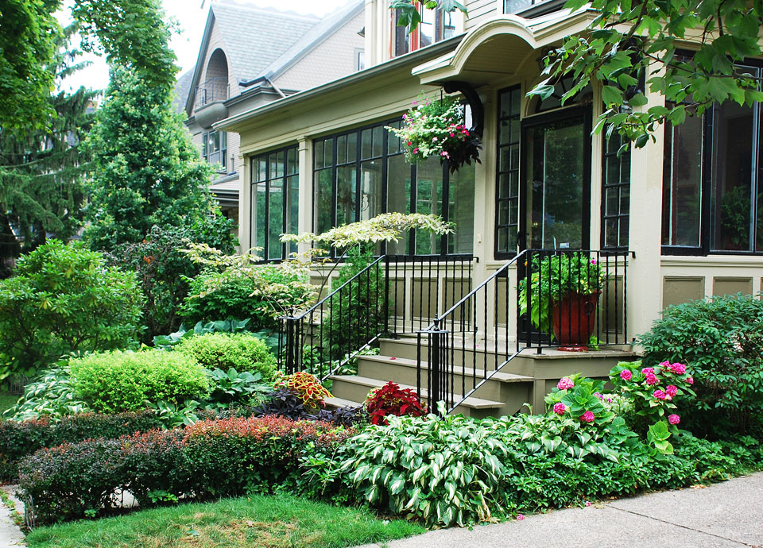
3.Project scope
Construct an enclosed patio for a multifamily single unit home for improvement. This addition will optimize the living space and appreciate the value of the home.
Notes:
The scope of the project is to construct an enclosed patio for a multifamily single unit home for improvement. This addition will optimize the living space and appreciate the value of the home. This area could also be utilized for dining and recreation. The aesthetics of this project will accentuate the architecture style and size of the home which could promote better living conditions for the owner.

Slide 8

Specifications:
3.Project scope
City Requirements and municipality building codes and Design Standards For construction of the per. 450 Florida Statute.
Materials will be in accordance of the American Society of Testing Materials (ASTM, 2016.)
Inspections will be implemented throughout duration of the project
Notes:
The specifications and design codes used to construct the patio enclosure will be per the city’s requirements and municipality building codes and standards of construction of the 450 Florida Statute. The construction activities and materials used in implementing the project will be followed by the strict guidelines of American Society of Testing Materials (ASTM, 2016.) Building inspections will be implemented throughout the duration construction of the project.

Slide 9
3.Project scope
Additional Work:
Out of Scope Activates
Unexpected Change Orders
Change Construction Schedule
Notes:
If the property owner feels that additional work needs to be achieved during construction, Miami Contractor LLC will be flexible to work with the owner to make any necessary revisions. If the improvements are within reason, do not escalate the time schedule or require consultation with a different expert, and the new materials are provided by the owner, then the construction activity could potentially be achieved with no additional costs to the owner. Otherwise, if any scope and design changes must be reestablished for this project, the owner will be responsible for the additional costs and will have to understand that the schedule could delay the closing of the project. Miami LLC may have to investigate if their resources are available and if they could be adapted to the revised design changes of the project. When the investigation is completed, Miami LLC will coordinate with the owner and explain the additional work needed, the anticipated time table for the construction to be completed, and the extra costs it will take to finish the project.

Slide 10

4.Project significance
To improve a multi-family home
To provide valuable space
Increase value of home
Reduce cost on future repairs
Provide visibility of the outdoors
Protect from inclement weather, bugs, and debris
Versatility of the area
Notes:
The significance of this project is to improve a multi-family home by constructing a 1000 square footage patio room that will provide valuable space for the family. In doing so there will be no additional home property taxes to incur and would add great value to it, which will increase its market price. Further benefits would include the reduction in cost of any future repairs as the materials to be used will be durable and of high quality. The enclosed infrastructure with large double glazed storm windows will allow for maximum visibility of the outdoors and protection from inclement weather, bugs, and debris. The room will also allow for versatility in the type of area the family chooses to create, whether it may be for entertainment, work, play or study.

Slide 11
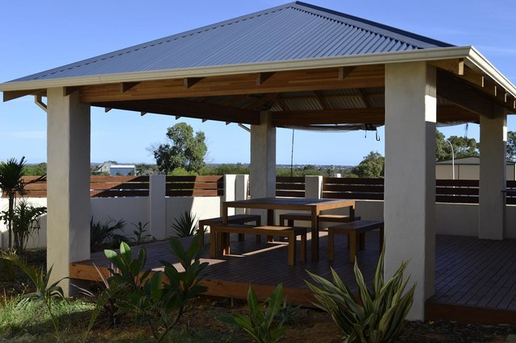
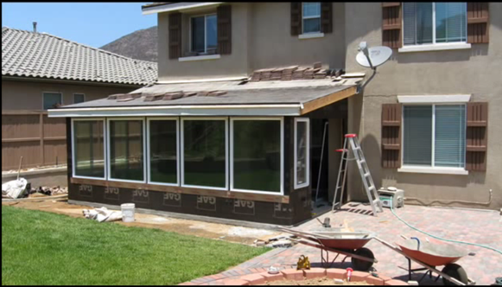
5.Patio proposal
Freestanding Patio
Porch roof patio

Slide 12
5.Proposed approach Break down
Patio Project
Design
Phase
Customer survey
Project design
Execution
Phase
Concrete
Inspection & Approval
Phase
Framing
Electrical
Interior
Roofing
Pre Final
Final walk through with customer
Major Project
Deliverables
Porch Roof Patio

Slide 13

6.Contractual aspect
The Work and Construction Standards
What is not Included
Change Orders
Time for Starting and Completion
Delays
Punch List Items
Allowances
Payment
Permits, Fees, Tests and Inspections
Warranty
Dispute Resolution
Notes:
This section includes the contract for this project and highlights the rules and procedures for the following areas as seen listed above. The work and construction standards for the patio room will be done according to the plans and specifications provided by the contractor and will comply with the building code that is in affect at the time this agreement is signed. There are specific repairs and testing that will not be included in this contract. The owners however may request changes in the work and it must be in writing and agreed upon by the owner and contractor. This project will be completed within approximately 102 calendar days which start the day this contract is signed. If there are any delays the date of completion will be extended accordingly. The owners are to give a punch list to the contractor within 5 working days when notified by the contractor and the contractor has 5 working days to complete the list. Under allowances it will include both materials and delivery, installation, and sales tax unless expressly noted otherwise. The owner needs to provide down payment of 13,000 before construction begins and there will be 5 draw payments at different times of the project which have to be made within 5 business days. The owner shall secure any pay for permits, fees, tests and inspections. The contractor guarantees work will meet trade standards and good quality materials will be selected. There are no implied warranties that are not included in the contract documents. The contractor is not liable for destruction or deterioration of any work constructed. In the matter of dispute, All parties will corporate with each other both formally and informally.

Slide 14
7.Resources
Work Element | Resource Type |  |  | Time (Hrs) | Duration (Days)
 | Worker | Material / Software / Tools
Survey | Land Surveyor | Transit Level |  | 24 hrs | 3 days
Design Plans/ Permit Application | Engineer | Building Permit Application CAD Software |  | 80 hrs | 10 days
Pour Foundation | Mason | Concrete Mix Concrete Mixer Gravel Packable fill Anchor bolts, 1/2-in. Steel mesh Roll | Forming lumber Rebar, 1/2-in. Tie wire 6-mil plastic Nails | 40 hrs | 5 days
Frame Exterior walls | Carpenter | 2’ x 4’ x 8’ Studs 2’ x 6’ x 8’ Studs Nails Hardwood Plywood |  | 80 hrs | 10 days
Frame Interior Walls | Carpenter | 2’ x 4’ x 8’ Studs 2’ x 6’ x 8’ Studs Nails Hardwood Plywood Sliding Door Glass Windows |  | 80 hrs | 10 days
Notes:
Here is an example of some of the resources that will be used for this project. In this table under work element the tasks for the project are listed. the resource type section highlights the worker that will be assigned to the tasks and the material, software and tools that they will use. For the last two columns they identify the time and duration for each resource type.

Slide 15
8.Material cost
Item | Material | Unit Cost | Total Cost
1 | Building Permit | 1 @ $900 | 900
 | Foundation | Quantity | Cost
2 | Gravel | 150 Cu Ft @ $4.36 | $654
3 | Rebar | 30 1/2 x 4 FT @ $3.15 | $95
4 | Steel Mesh Roll | 2 Roll @ $107.00 | $214
5 | Concrete Mix | 167 Cu Ft @$11.47 | $1915.49
 | Framing
6 | 2’ x 4’ x 8’ Studs | 67 studs @ $2.42 | $162.14
7 | 2’ x 6’ x 8’ Studs | 74 Studs @ $4.36 | $35.36
8 | Nails | 2 Roll @ $49.78 | $100
9 | Sheetrock ½” X 4’ x 8’ | 20 Sheets @ $10.00 | $200
10 | Hardwood Plywood | 20 Sheets @ $9.75 | $195
11 | Roll Roofing Underlayment | 20 Roll @ $16.75 | $335
12 | Roof Shingles | 20 Roll @ $26 | $520
13 | Stucco Mesh | 4 Roll @ $8.65 | $35.00
14 | Fiberglass Insulation | 10 Roll @ $14.98 | $149.80
15 | Sliding Door | 2 Door | $800
16 | Glass Windows | 8 @ 400 | $3,200
17 | Electrical Wire | 1 Roll @ $14.57 | $14.57
18 | Floor Tile | Ceramic 550 SQ/FT @ 1.00 | $550
19 | Paint | 3 Gallon @ $28.96 | $89.00
20 | Rent of concrete mixer | 1 Day @ $250 | $300
 |  | Total $ | $10,463.15

Slide 16
8.Labor cost
Labor | Unit Cost | Total Cost
Mason | 16 Hours x 3 @ $40 | $4,800
Carpenter | 288 Hours x 3 @ $40 | $29,760
Design | 80 hours @ $100 | $12,800
Painter | 16 Hours x 3 @ $40 | $1,280
Electrical | 40 Hours @ $40 | $3200
Floor | 500 SQ/FT @ 2.00 | $2,000
Insulation | 8 Hours x 2 @ $40.00 | $640
Cleaning | 8 Hours x 2 @$40.00 | $640
Total Cost $55,120.00
Total Cost = $10,463.15 + $55,120 = $65,583.56

Slide 17
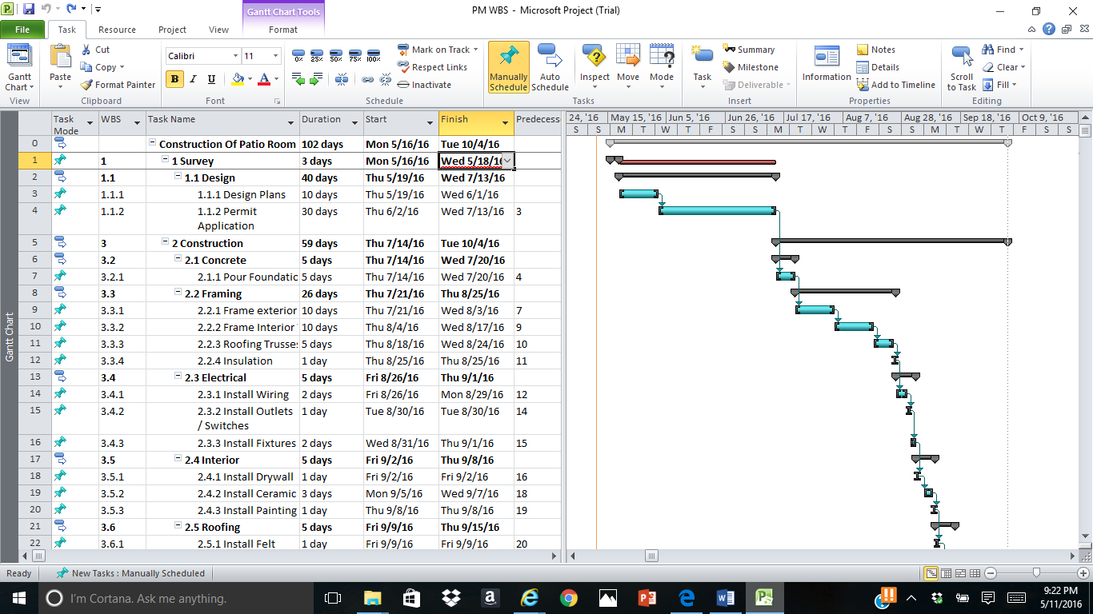
9.Schedule

Slide 18
10.Budget
Construction Budget Estimate by percentage of hard Cost
Construction Permit 0.013%
Design Plants/Permit 0.19%
Foundation 0.04%
Structure 0.016%
Exterior Closure 0.123%
Electrical 0.009%
Equipment 0.004%
Interior Construction 0.027%
Labor 0.635%

Slide 19
10.Budget
Budget Item | Total Project Budget | Estimated Budget
 | Construction Cost
1 | Construction Permit | $900
 | Design Plans/Permit | $12,800
2 | FOUNDATION
 | Footer and Slab on Grade | $2,878
3 | STRUCTURE
 | Roof Construction | $1,050
4 | EXTERIOR CLOSURE
 | Exterior Walls | $4,975
 | Windows | $3,200.00
5 | ELECTRICAL
 | Wire and Fixtutes | $514.57
6 | EQUIPMENT
 | Rent of Concrete Mixer | $300
7 | INTERIOR CONSTRUCTION
 | Sheetrock | $200
 | Fiberglass Insulation | $149
 | Sliding Doors | $800
 | Floor Titles | $550
 | Paint | $89.00
8 | LABOR
 | Mason | $4,800
 | Carpenter | $29,760
 | Painter | $1,280
 | Electrical | $3,200
 | Floor Titles | $2,000
 | Insulation | $640
 | Cleaning | $640
 | Total | $65,583.56

Slide 20
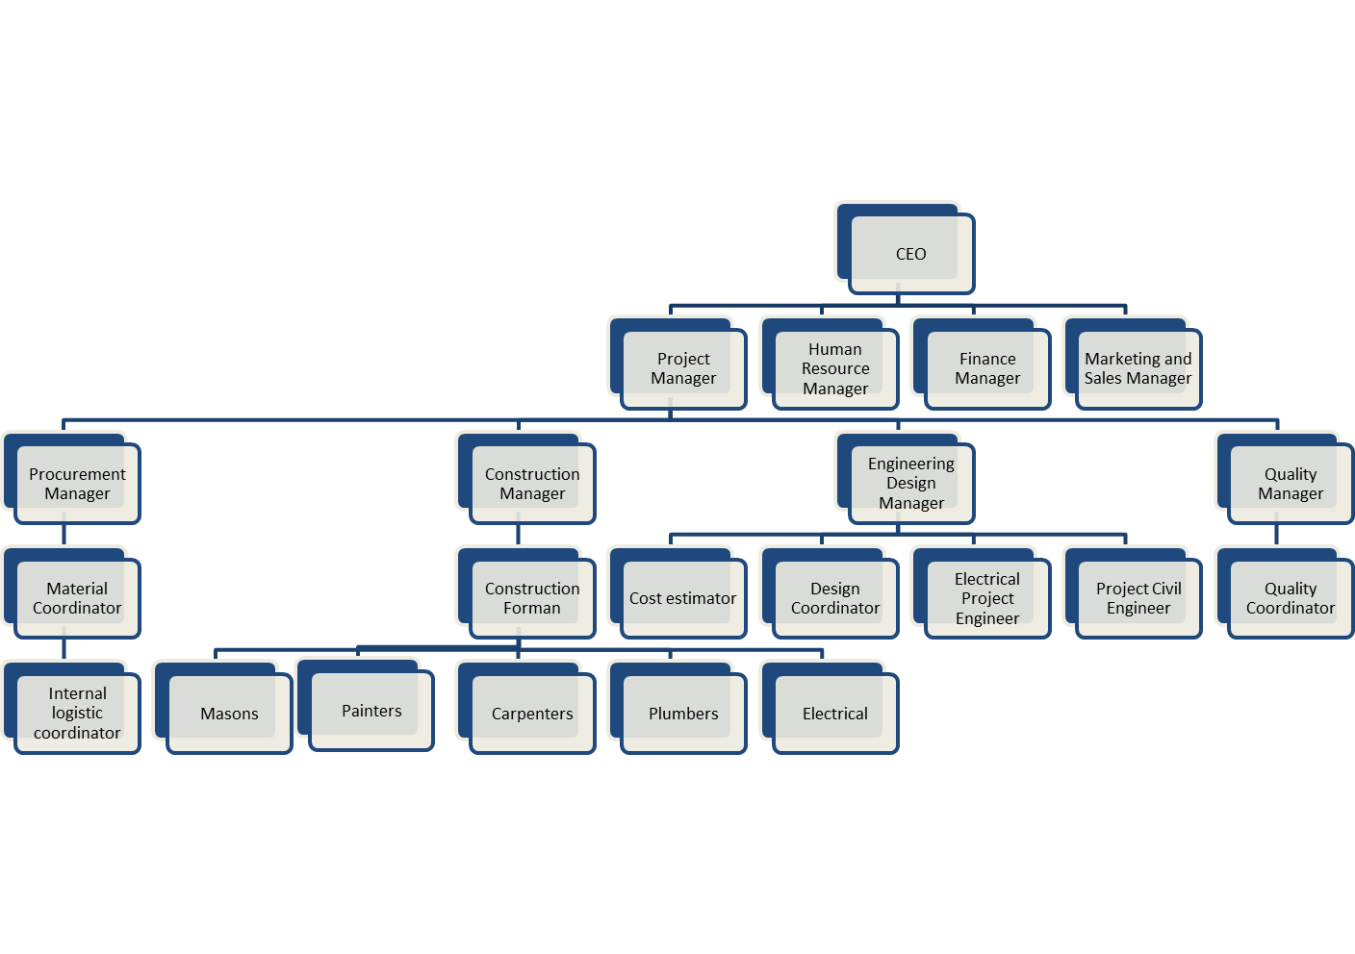
11.Organization Break Structure
Project Manager
Project Oriented Organization

Slide 21
11.Staff Management Plan
Patio Construction project
Staff management plan
Role | Skill & Knowledge | From | To | % Req | Comments
Project Manager | Experienced PM 10yrs+ | 07/01 | 09/18 | 100 % | Construction and Interior design experience preferred
Design Engineer Manager | Requirements,modeling, design | 07/01 | 07/30 | 30% | Interior and exterior design
Procurement Manager | Quoting, Material management | 07/15 | 08/15 | 50% | Prices analysis capability
Construction & operations Manager | Construction, Regulations, | 07/15 | 09/18 | 80% | Construction human resources experience
Quality Manager | Six Sigma, Quality standards, regulations | 07/15 | 09/18 | 80% | Black belt certification

Slide 22
11.Communication Management Plan
 | Patio Construction
 | Project Team Communication Plan
 | Deliverable | Description | Delivery Method | Frequency | Owner | Audience
Reports | Project status report | Regular update on critical project issues | E-mail | Weekly | Project Manager | Project Manager Project Sponsor Project Team
 | Quality audit report | Regular update on project quality performance | E-mail | Weekly | Quality Manager | Project Manager Project Sponsor Project Team Quality Manager
Presentations | Project review | Project status update | Meeting | Monthly | Project Manager | Project Manager Project Sponsor Project Team
Project Announcements | Task reminders | Task owner schedule reminders | E-mail | Daily | Project Coordinator | Project Manager Project Team
Reviews and Meetings | Team meeting | Meeting to review project status | Meeting | Weekly | Project Coordinator | Project Manager Project Sponsor Project Team Quality Manager
Team Morale | Team event | Regularly schedule, Team morale events, | Event | Quarterly | Project Sponsor | Project Manager Project Sponsor Project Team

Slide 23
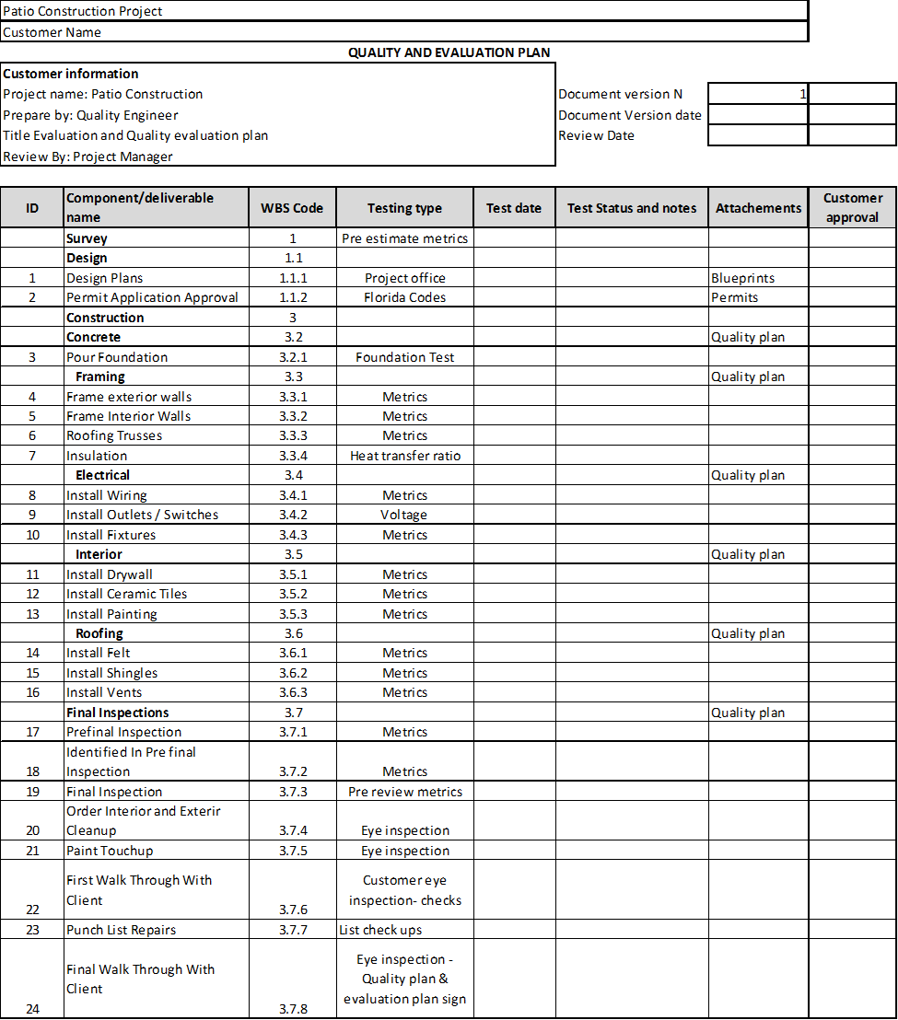
12.Evaluation method plan
Evaluations Plan
Defined by deliverables
And compared
Against quality metrics

Slide 24
13.Potential external risk
Major Potential risks
Utilities Supply
Workforce
Natural disasters
Risk contingency plan
Equipment
Technology
Permissions
Raw Material

Slide 25
13.Risk Contingency plan
Patio Construction project
 | RISK CONTINGENCY PLAN
 | How Long can you do without | Impact of doing without | Vulnerability | Contingency in case of disaster
Raw Material | 3 Days | None until on hand exhausted | Single supplier relationship | Search for alternative suppliers
Personnel | 5 Days | Degraded operations Low operating level | Lack of personnel’s ability | Best effort shifting of available temporary staff
Equipment | 0 days | Extra working hours | Equipment replacement cost and time | Rent extra equipment
Communications & project follow up | 1 Day | After one day without a way to schedule production and project follow up | No computer, Hadwares | Use paper reports for 1 day, then manually input information into Information system
Power & water supply | 0 Hours | Shuts down, lines waste collection | Single power feed, no generator or backup water supply | Alternative power plant and water tank
Natural disasters | 0 days | No work | Project schedule | Work on Non site duties

Slide 26
Conclusions
Miami LLC was requested by customer to design and construct a patio enclosure in order to optimize their space and living conditions.
The family will have the ability to use their back yard for dinning and recreational purposes.
A Reasonable budget was developed based on the size and the architectural features of the patio.
High quality resources will be used to provide the most probable outcome.

Slide 27
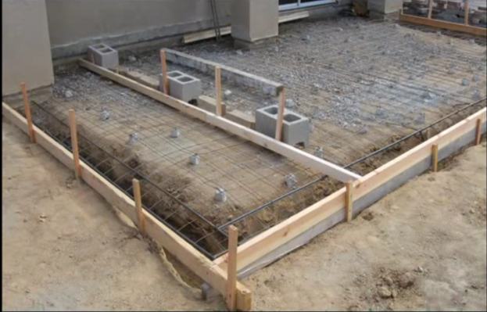
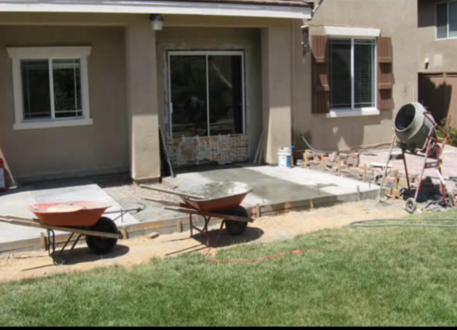
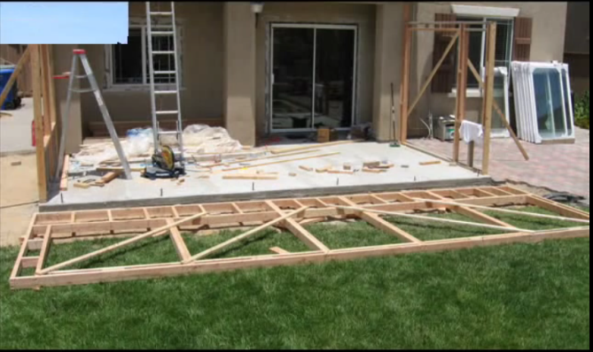
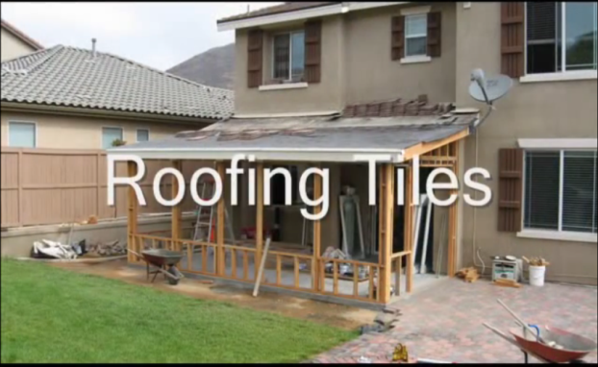
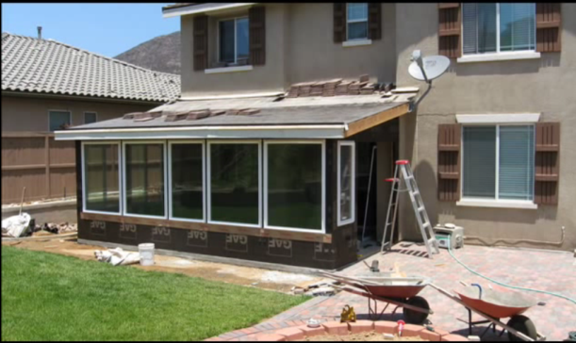
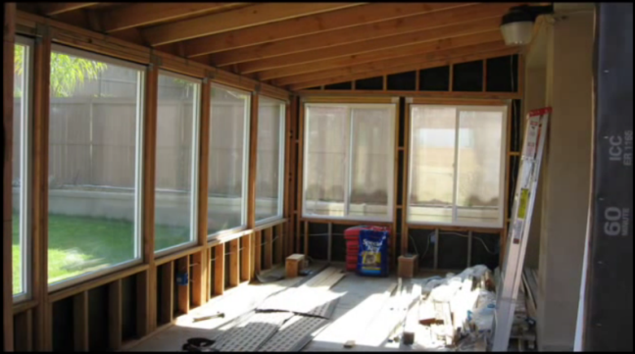
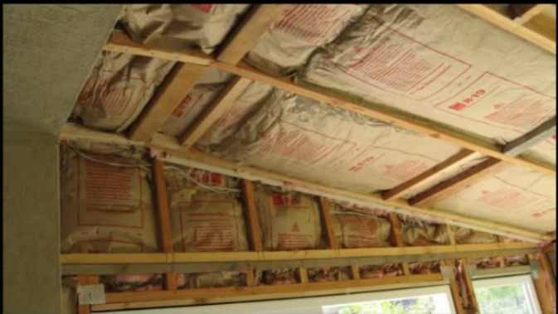
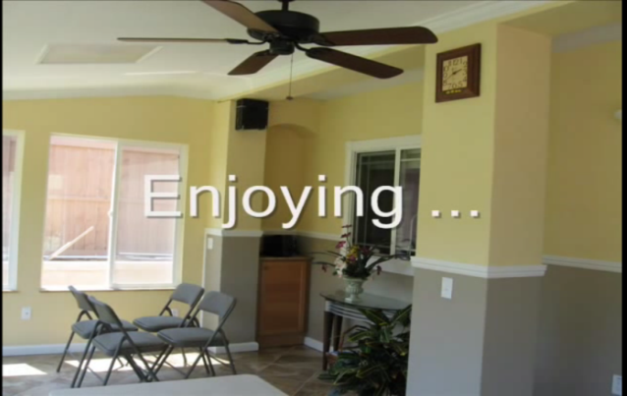
Appendix -Patio Project

