Slide 1
FIU Clinical Rotations Spring 2017
Tuesday April 11th, 2017

Slide 2
Direction to MAKO Surgical
MAKO Surgical
Address: 2555 Davie Road, Fort Lauderdale, FL 33317
Exit Davie Road from I-595 and head South
Office located on the Right side of the street (see map)
Park in either lots in the North/South building (see map)
Lobby entrance located in South Building

Slide 3
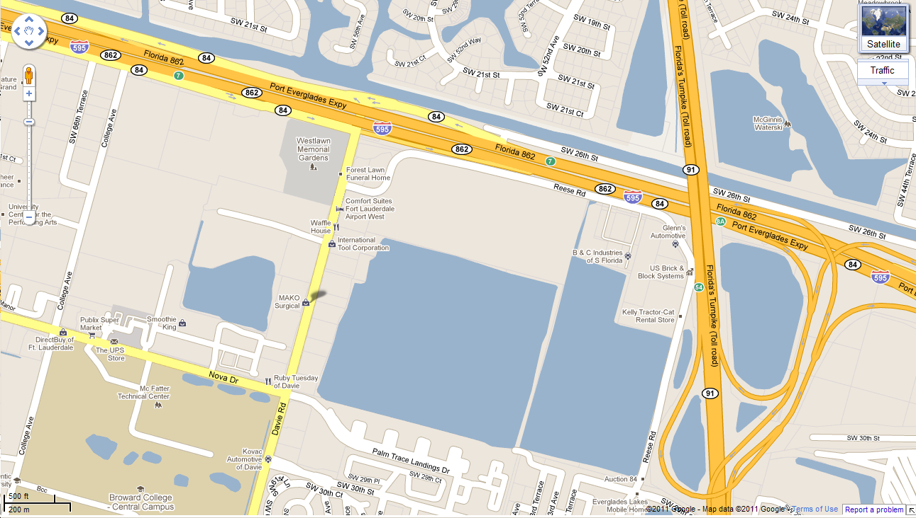
Location of MAKO Office

Slide 4
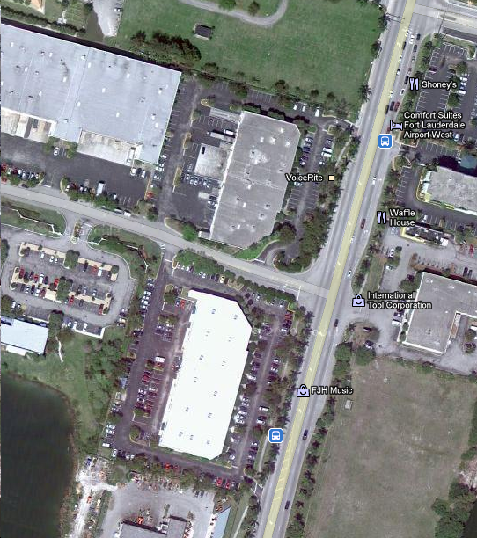
Parking and Lobby
Parking is located in either lots (highlighted in Yellow)
Lobby Entrance located on South Building towards Davie Road Street
Davie Road
Lobby
Entrance

Slide 5
Thank You.
© MAKO Surgical Corp. 2010
CONFIDENTIAL - For limited use only. Not for distribution.

