Slide 1
Calcium Metabolism

Slide 2
Overview
Calcium in cellular processes
Calcium absorption
Calcium distribution
Calcium homeostasis
Reabsorption by tubules
Calcium regulating hormones
CaSR
Diuretics
Novel proteins
Ciclosporine and tacrolimus
Hypertension
Summary

Slide 3
Calcium in cellular processes
An abundant cation in the body - approx 1000g in adults
RDA – 1000-1500mg/day

Slide 4
Critical role in
Nerve conduction
Coagulation
Enzyme activation
Exocytosis
Bone mineralization
Regulated by
Intestinal absorption
Renal absorption
Bone turnover
Hormones – PTH, calcitriol, iCa2+

Slide 5
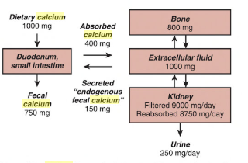
Calcium absorption

Slide 6
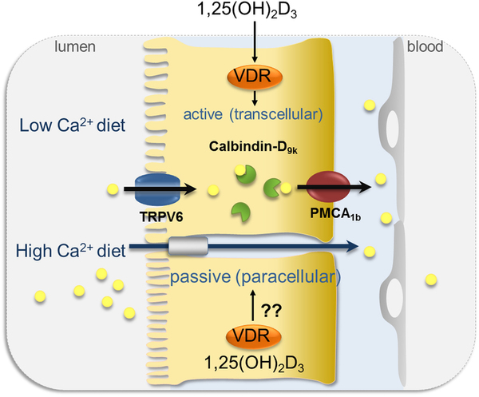
Intestinal calcium absorption
Small intestine by both active and passive mechanisms
Active – duodenum and jejunum
Passive – entire length

Slide 7
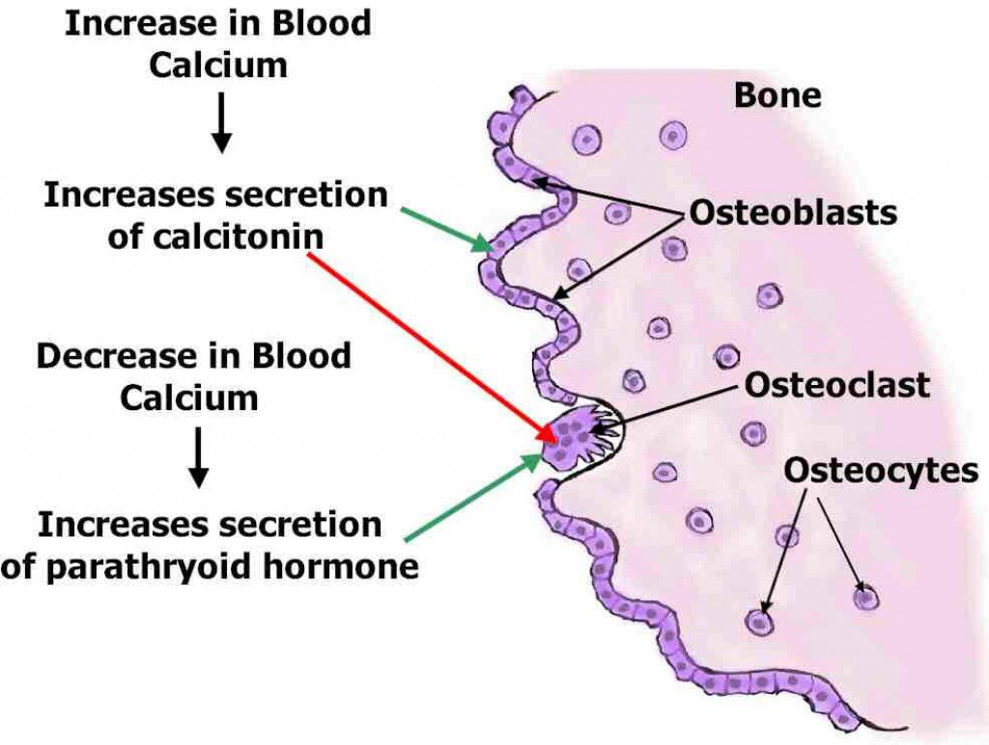
Calcium and bone metabolism
Major Ca2+ in the body
Osteoclast and osteoblast maintain homeostasis

Slide 8
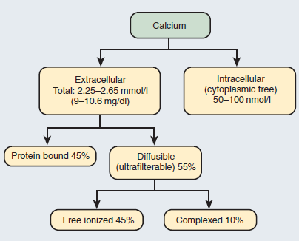
Calcium distribution
Calcium in plasma is
Filterable (60%)
Bound (40%)

Slide 9
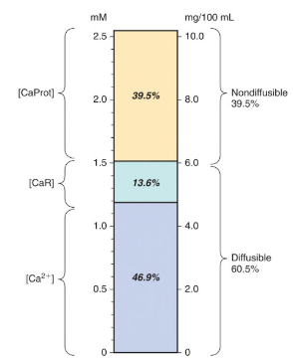
Filterable calcium is complexed with citrate , sulfate, phosphate (10%)
Ionized calcium – 50%
% of calcium bound depends on pH
Alkalemia - ↓ free calcium
Acidemia - ↑ free calcium
1-g/dl change in albumin = o.8-mg/dl change in calcium
1-g/dl change in globulin = 0.16-mg/dL change in calcium

Slide 10
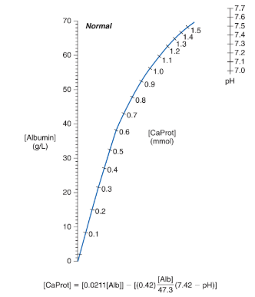
Calcium and pH

Slide 11
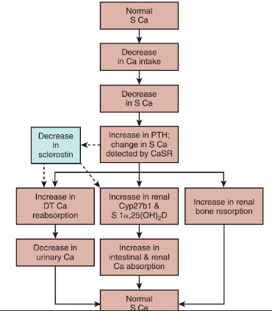
Regulation of calcium homeostasis by PTH- Vitamin D
In states of neutral calcium balance , absorption = excretion

Slide 12
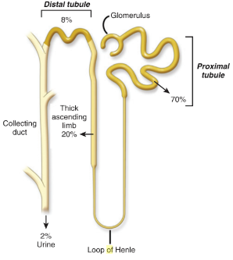
Reabsorption of calcium along the tubules
Glomeulus filters 9000 – 10000 mg of complexed and iCa in 24 hours
250 mg excreted per day in urine
Reabsorption – PT & DT
Only 1-2% of filtered calcium appears in urine

Slide 13
Proximal Tubule
Passive reabsorption
70 % reabsorbed by paracellular processes linked with Na+ reabsorption
Absorption not altered by PTH, cAMP, chlorthiazide, furosemide, acetazolamide
Ca2+ permeates through claudin-2 and inhibits Na+ conductance
Transcellular absorption– undefined calcium channels and intra-cellular calcium proteins

Slide 14
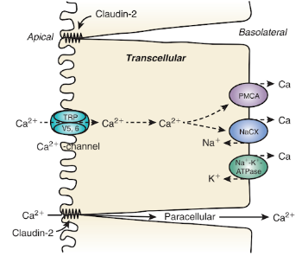
Na+-K+-ATPase - In
Na+ –Ca2+ exchanger – out
Volume depletion – PT Na+ absorption increases along with Ca2+
Saline administration – decrease Na+ absorption and therefore Ca2+

Slide 15
In loop of Henle
Thin ascending and descending limbs do not transport
20-25 % of Ca2+ reabsorbed by thick loop of henle (TALH)
Para cellular route – Claudin 16 & 19
Express furosemide sensitive NKCC2
Mediates re-absorption of Na+ and driving force for Ca2+
Through NKCC2 , a lumen-positive transepithelial potential is generated by 2 mechanisms
Apical recycling of K + via ROMK channel
NaCl diffusion potential generated by reabsorbed NaCl creating a concentration gradient Na-selective pathway
This trans epithelial voltage – driving force for passive Ca2+ reabsorption

Slide 16
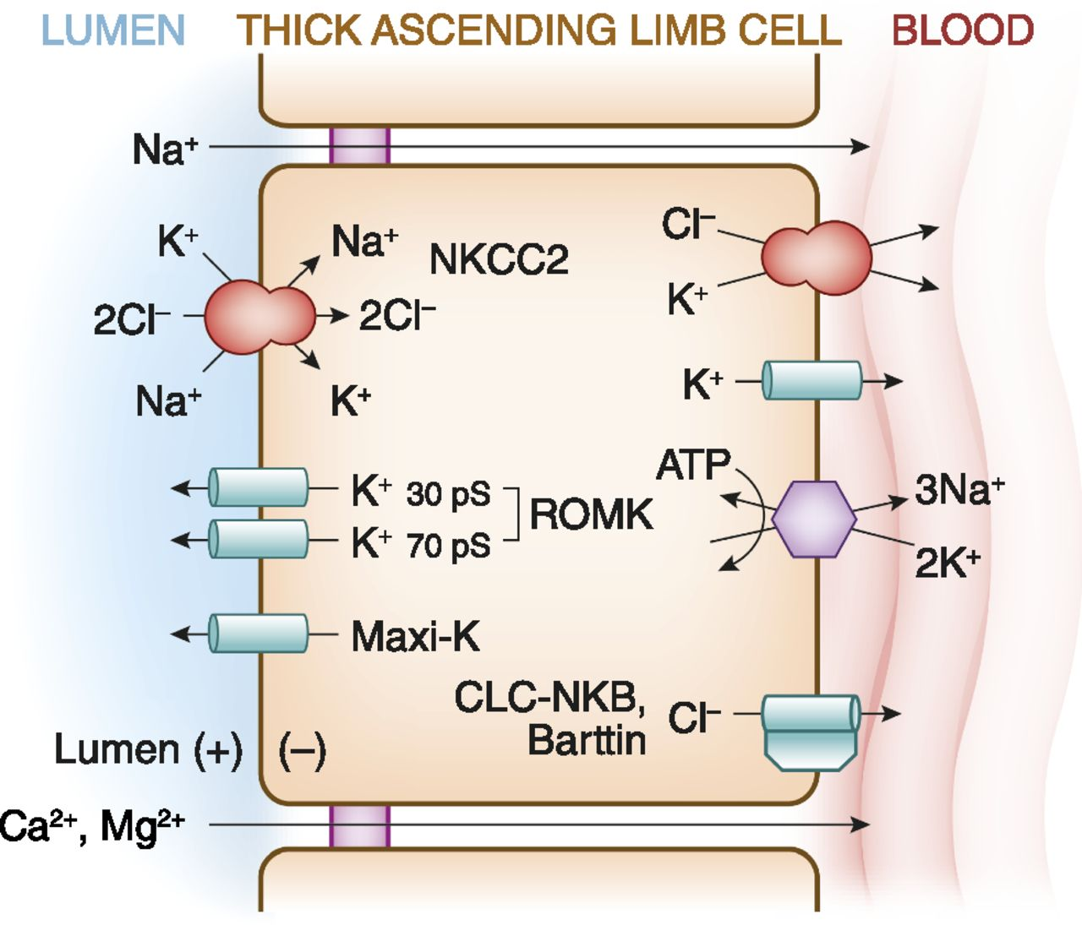

Slide 17
Claudin 16 & 19 form a paracellular pore and regulates the tight junction
Responsible for permeating Ca2+ ,Mg2+
Alternative hypothesis – Claudins 16 & 19 form Na+ channels
Form transepithelial NaCl diffusion potential – divalent cation absorption
Loss of function mutations in genes encoding Claudin 16,19 – familial hypomagnesemia , hypercalciuria , nephrocalcinosis
NKCC mutations – Bartter’s syndrome

Slide 18
In distal tubule
Hormonally regulated
Transcellular
Active transport
Mediated by channels , proteins and pumps
In DCT & CT – 5 to 10% of Ca2+ reabsorbed by active processes against electrical & concentration gradient
Regulated by PTH, calcitonin , 1 α,25(OH)2D3 which increase efficiency of Ca2+ reabsorption
Mediators - apically situated , transient receptor potential cation channel – types 5 & 6(TRPV5,6) which increase Ca 2+ uptake from lumen into cell
TRPV5 is the gatekeeper of Ca2+ re-absorption (mice)

Slide 19
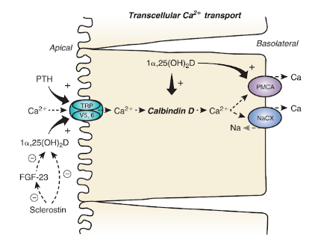
Intracellular Ca2+ binding proteins – calbindin D9K, D28K facilitate Ca2+ across the cell
Plasma membrane calcium pump (PMCA)
Na+Ca2+ exchanger (NaCX)
NaCa2+K+ exchanger (NaCKX)
increase rate of extrusion of Ca2+ across basolateral membrane

Slide 20
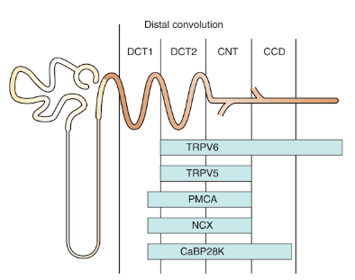
Distribution of channels across DCT

Slide 21
Regulation of Ca2+ transport
Calcium regulating hormones
Extra- cellular calcium
Diuretics
Estrogen
Thyroid
Magnesium
Metabolic acidosis and alkalosis

Slide 22
Ca 2+ regulating hormones
Alter expression of calcium channels , binding proteins, pumps & exchangers in kidney
Most important -
PTH
1 α,25(OH)2D3 (calcitriol)

Slide 23
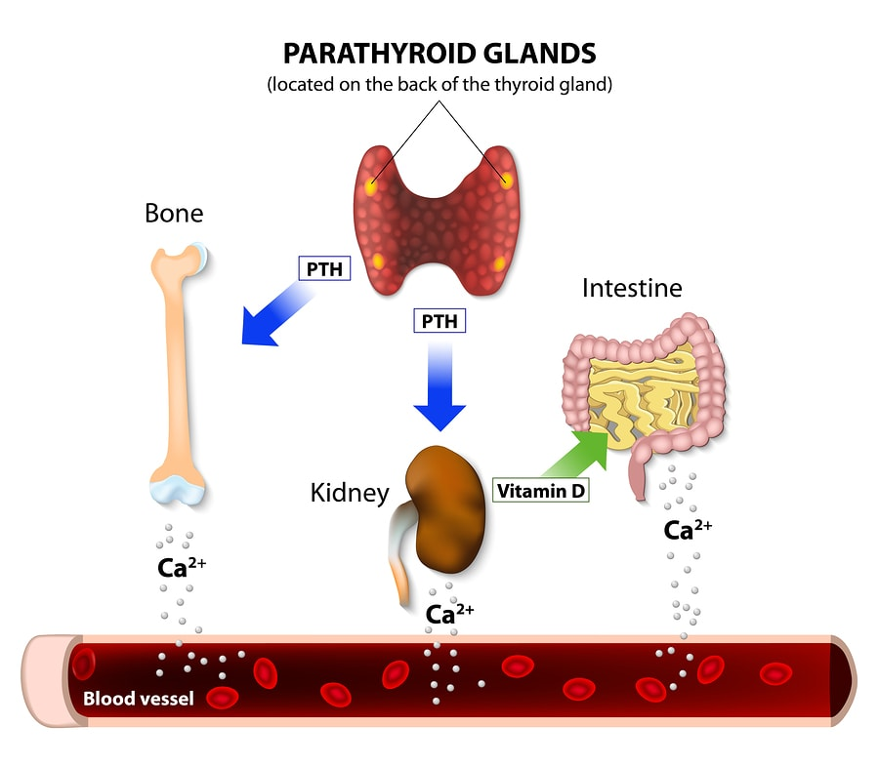
PTH
Released in response to low serum Ca2+
Via PTHrP, promotes reabsorption

Slide 24
Kidney
Present in glomerular podocytes, PT, TALH,DT, CT
Increases activity of TRPV5 by activating cAMP-PKA signalling & phosphorylation - ↑opening of the channel
Activates PKC pathway - ↑ number of TRPV5 on surface of tubular cells by inhibiting endocytosis
Decreases excretion and increases re-absorption
Intestine and bone
Enterocytes increase Ca2+ reabsorption when stimulated with PTH
PTHrP – on osteoblasts and secrete RANKL
Induces both bone formation and resorption , increasing total bone turn over

Slide 25
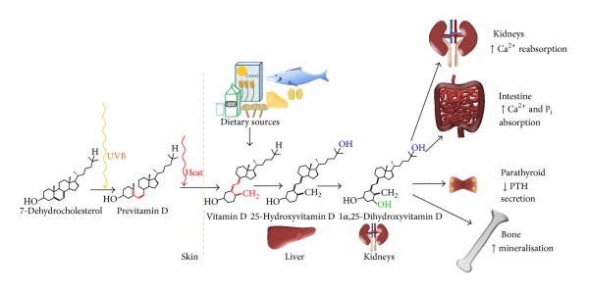
1 α,25(OH)2D3

Slide 26
From renal proximal tubular cells
Increases in response to low dietary Ca2+ and serum levels
Physiological effect by interaction with Vitamin D receptor (VDR)
Intestine
Active Ca2+ transport
Increases transcription of TRPV5, TRPV6, calbindins , NCX1,PMCA

Slide 27
Kidney
Ca2+ reabsorption in DCT
?secondary to PTH increase
Increases expression of TRPV5 and TRPV6 in DT, CT, CCD by increasing mRNA concentration
Increase expression of calbindin D9K, D288K, PMCA pump
Bones
Regulation of bone metabolism and Ca2+ homeostasis
VDR – osteoblasts , osteoclasts , chondrocytes
?inhibit osteoblast differentiation and bone matrix mineralization
Via RANKL activates osteoclasts
Increases serum Ca2+

Slide 28
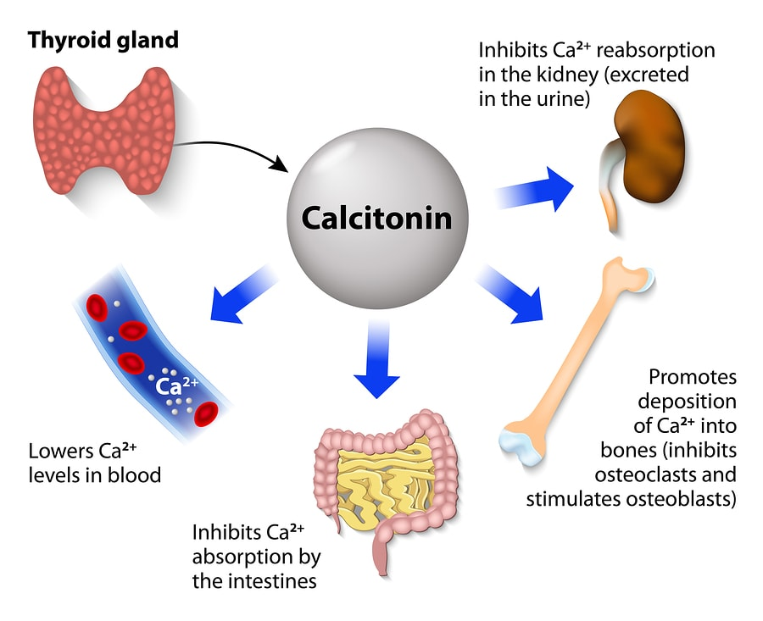
Calcitonin
Thyroid C cells
Ca2+ lowering hormone
Used in malignant hypercalcemia, osteoporosis , Pagets disease

Slide 29
Estrogens
Postmenopausal women have higher calcium excretion than premenopausal
In early post-menopausal women , estrogen administration decreases urinary Ca2+ excretion , increases PTH and 1 α,25(OH)2D3
In mice lacking estrogen receptor alpha – reduced duodenal TRPV5

Slide 30
Thyroid hormones
Thyrotoxicosis – hypercalcemia
Correlates with bone demineralization and altered biochemical markers of bone turnover
Hyperthyroid – lower Ca2+ transport rates

Slide 31
Extra-cellular Calcium- CaSR
Regulates renal Ca2+ reabsorption by signaling via Calcium Sensing Receptor on cell membrane (CaSR)
Allows homeostasis even in minor changes in extracellular Ca2+ levels
Present in
PTH secreting parathyroid
Calcitonin secreting thyroid
Intestines
Kidneys
Determines
how much Ca2+ moves in and out of the body via intestine and kidney
How Ca2+ moves between bone and ECF

Slide 32
In proximal tubule
Sub-apical region – regulation of phosphate excretion
Tight control of 1 α,25(OH)2D3 synthesis
Luminal Ca2+ via CaSR modulate Na+ dependent proton secretion and water reabsorption
Loop of Henle
Basolateral side of TALH
Modulates paracellular and transcellular NaCl and divalent cation transport
CaSR activation induces Ca2+ loss

Slide 33
Activation of CaSR –
↓ renal tubular Ca2+ reabsorption
Induces calciuresis in response to Ca2+ load
Inhibits NKCC2 activity
Regulates paracellular permeability
CaSR antagonist - ↑ Ca2+ permeability , no Na flux
Due to upregulation of Claudin-14 → inhibits channels formed by claudin-16 & 19
Involves CaSR inhibiting calcineurin – that activates nuclear factor of activated T calls (NFAT) which downregulates claudin 14 expression
↓ Ca2+

Slide 34
In DCT
Apical membrane and sub-apical vesicles
Along with TRPV5
CaSR activation increase TRPV5 and therefore Ca2+ reabsorption
In collection duct
Urine Ca2+ levels influence acid excretion and water absorption in intercalated cells
Prevent renal stones
Hypercalciuria induces polyuria via CaSR in medullary CD
Expressed in principal cells along with aquaporin 2 in apical membrane

Slide 35
Claudin-14 knockout mice
Were unable to increase excretion of calcium in response to high Ca2+ diet
Had complete loss of urinary Ca2+ excretion in response to CaSR agonist or antagonist

Slide 36
Diuretics
Loop diuretics
↑ urinary calcium losses
Due to its ability to bind to and inhibit furosemide-sensitive NKCC2 on TALH
NaCl absorption ↓ , K+ recycling ↓
Reduces lumen positivity and therefore Ca2+ reabsorption
Bartter’s syndrome with mutation of NKCC2 → calciuria
Compensatory ↑ occur in DT channels and proteins such as TRPV5, TRPV6, Calbindin D28K with furosemide but does not compensate excretion

Slide 37
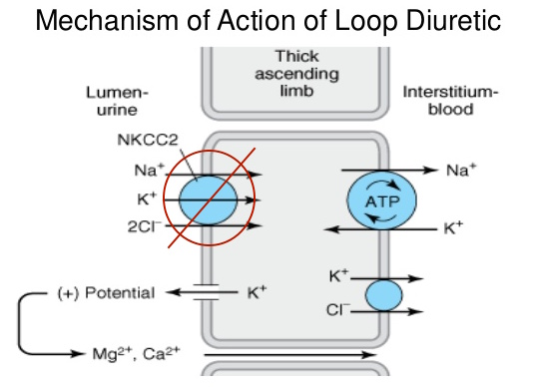

Slide 38
Thiazide diuretics
Cause hypocalciuria
Independent of PTH
Bind to and inhibit Na-Cl cotransporter in DT
Chronic use
ECF reduction which enhances Na+ & Ca2+ reabsortion in PT
DT Ca2+ transport unaffected
Development of Hypocalciuria – compensatory increase in Na+ reabsorption secondary to initial natriuresis
Upregulation of Na+H+ exchanger which is responsible for PT reabsorption of Na+ & Ca2+

Slide 39
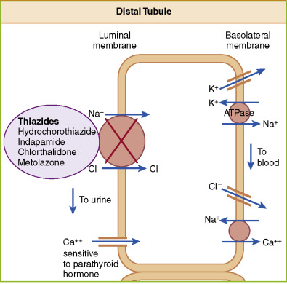

Slide 40
Gitelman’s syndrome & inactivating mutations of thiazide sensitive Na-Cl transporter
Hypocalciuria, hypomagnesemia , volume depletion

Slide 41
Magnesium
Hypercalciuria
Ca2+ uptake by TRPV5 is inhibited
Mg2+ supplementation prevent renal stone formation

Slide 42
Metabolic acidosis & alkalosis
Acidosis – hypercalciuria , bone loss , osteoporosis
Affect reabsorption in DT, expression & activity ofTRPV5

Slide 43
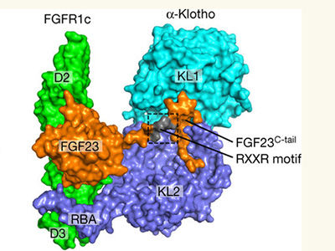
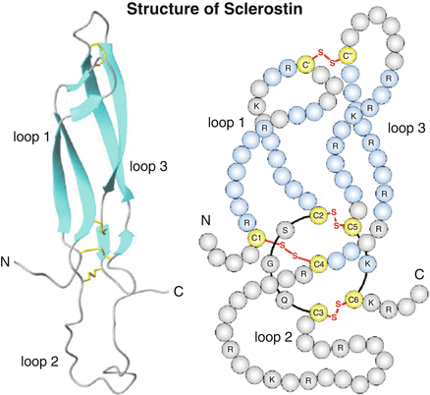
Regulation of Ca2+ transport by Novel proteins
Klotho
Sclerostin

Slide 44
Klotho
Co-receptor for phosphaturic peptide -FGF 23
Kidney and parathyroid specific protein
Influences epithelial Ca2+ transport by deglycosylating TRPV5
Traps the channel in plasma membrane and sustains its activity

Slide 45
Sclerostin
Osteocyte derived glycoprotein
Influences bone mass
Sclerosteosis – inactivating mutation of sclerostin gene
Van Buchem’s – milder form - down streaming of sclerostin gene
Dense bone and skeletal over growth – constricts cranial nerve foramina, foramina magnum - premature death
Sclerostin
Alters synthesis of 1 α,25(OH)2D3
Influences Ca2+ reabsorption in kidney
No change in PTH

Slide 46
Increases excretion of calcium as opposed to PTH and 1 α,25(OH)2D3
Reduced sclerostin expression enhances Ca2+ reabsorption directly or through changes in 1 α,25(OH)2D3 synthesis
1 α,25(OH)2D3 synthesis – direct or via FGF-23

Slide 47
Ciclosporine & Tacrolimus
Cause increase bone turn over and hypercalciuria
Osteoporosis
Tacrolimus
Increases urinary Ca2+ excretion by downregulating mRNA and protein expression of TRPV5 and Calbindin
Ciclosporine
Reduce expression of VDR on DCT – Vit D resistance
Inability to retain Ca2+ inspite of high Vit D levels

Slide 48
Hypertension
Hypercalciuria
20% increase of Ca2+ excretion at any given urine sodium levels
Low PMCA1b level and increase Calbindin levels
Upregulation of Ca2+ proteins when compared to normotensives
? Due to decreased tubular reabsorption of Ca2+ along DCT

Slide 49
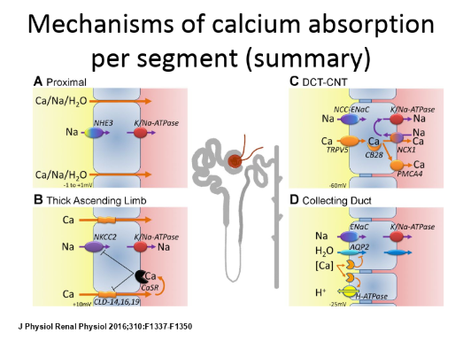
To summarize

