Slide 1
Chapter 26
Reproduction and Development

Slide 2
About this Chapter
How male and female reproductive systems differentiate
The reproductive organs and how they work
How gametes are produced and fertilized
Pregnancy, stages of development, birth & lactation
Reproductive and developmental maturation and aging

Slide 3
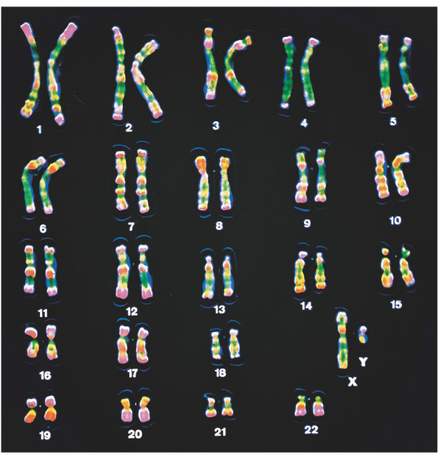
Sex Determination: Overview
Dimorphism:
Males → sperm
Females → eggs
Chromosomes
Autosomes
Sex Chromosomes
X - chromosome
Y - chromosome
Figure 26-1: Human chromosomes

Slide 4
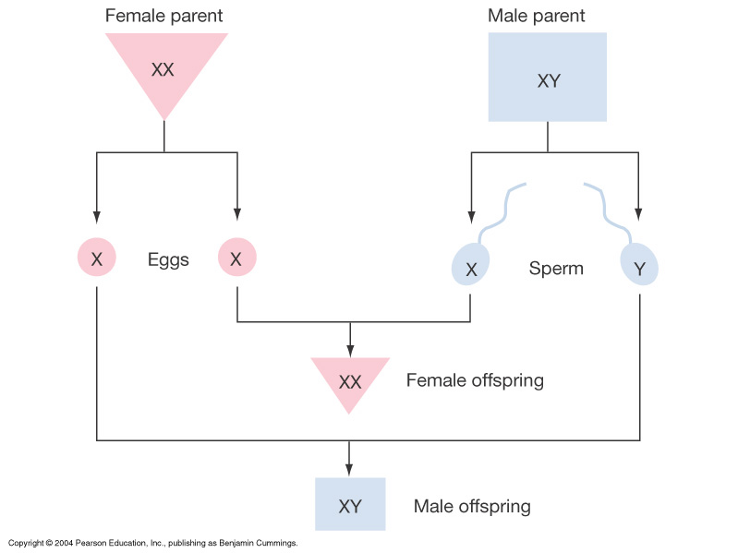
Sex Determination: Overview
Figure 26-2: Inheritance of X and Y chromosomes

Slide 5
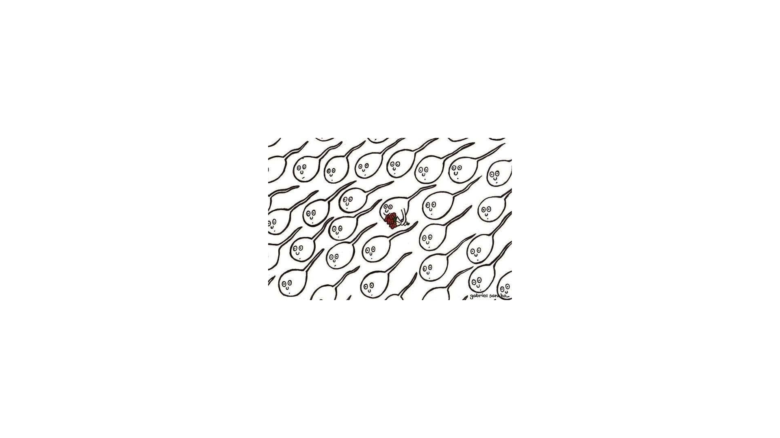

Slide 6
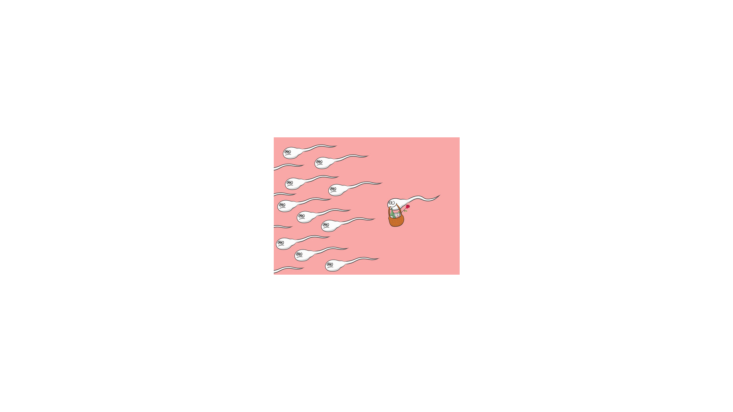

Slide 7
Sesquizygotic Twins
https://www.reuters.com/article/us-health-reproduction-mosaic-twins/doctors-confirm-new-type-of-twin-born-from-one-egg-and-two-sperm-idUSKCN1QG2YH
https://www.nejm.org/doi/full/10.1056/NEJMoa1701313

Slide 8
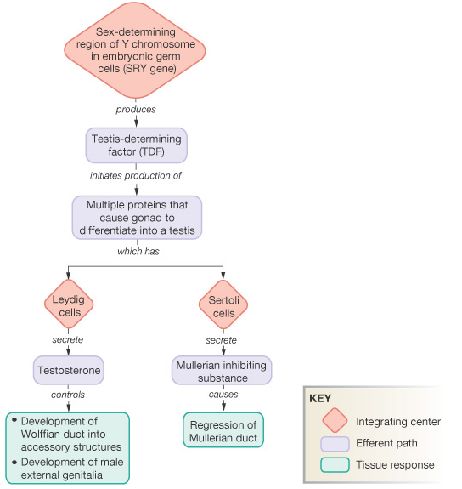
Pathway for Sexual Development: Review for Genes to Organs
Figure 26-4: Role of the SRY gene in male development

Slide 9
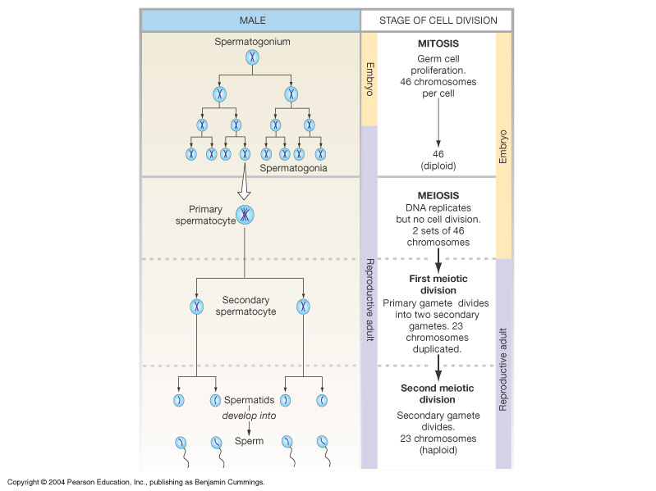
Overview of Gametogenesis: Producing Eggs or Sperm
Figure 26-5: Gametogenesis

Slide 11
Regulation of Reproduction: General Pathways
Hypothalamus: pulse generator
Gonadotropin releasing H
(GnRH)
Anterior Pituitary
Lutenizing H (LH)
Follicle stimulating H (FSH)
Ovary: progesterone
Estrogen, inhibin
Testis: testosterone

Slide 12
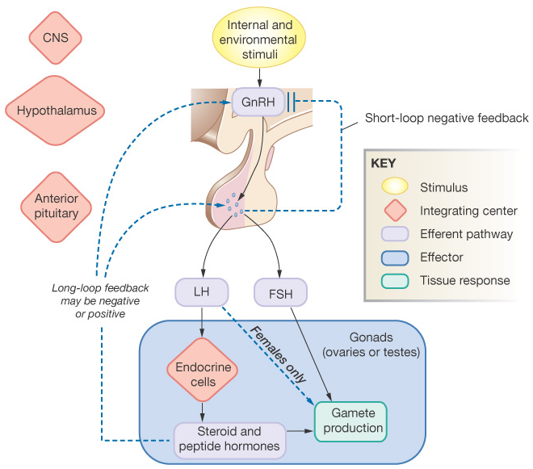
Regulation of Reproduction: General Pathways
Figure 26-7: General pattern of hormonal control of reproduction

Slide 13
Male Reproductive Anatomy and Physiology
Testis
Epididymis
Vas deferens
Seminal vesicle
Prostate
Bulbourethral
Ejaculatory duct
Urethra
Penis

Slide 14
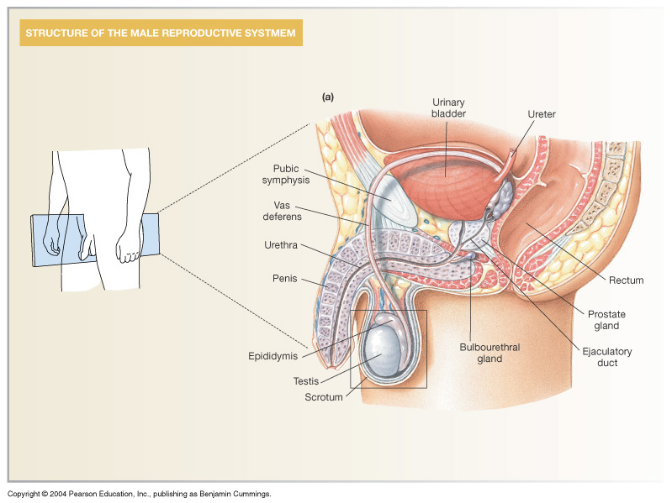
Male Reproductive Anatomy and Physiology
Figure 26-9a: ANATOMY SUMMARY: Male Reproduction

Slide 15
Spermatogenesis: Sperm Production in the Testis
Seminiferous tubules
Spermatids
Spermatocytes
Spermatozoa
Sertoli cells
Interstitial tissue
Leydig cells
Capillaries

Slide 16
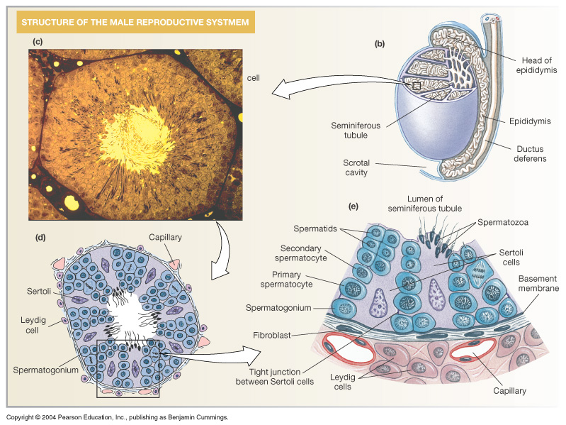
Spermatogenesis: Sperm Production in the Testis
Figure 26-9b-e: ANATOMY SUMMARY: Male Reproduction

Slide 17
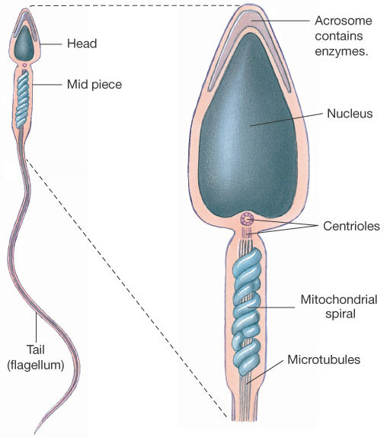
Spermatozoa Structure and Functions in Review
Head
Acrosome:
Nucleus:
Midpiece
Centrioles:
Mitochondria:
Tail: flagellum
Microtubules:
Figure 26-10: Sperm structure

Slide 18
Regulation of Spermatogenesis
GnRH → LH → Leydig cells → testosterone → 2⁰ sex characteristics
GnRH → FSH → Sertoli cells → spermatoctye maturation

Slide 19
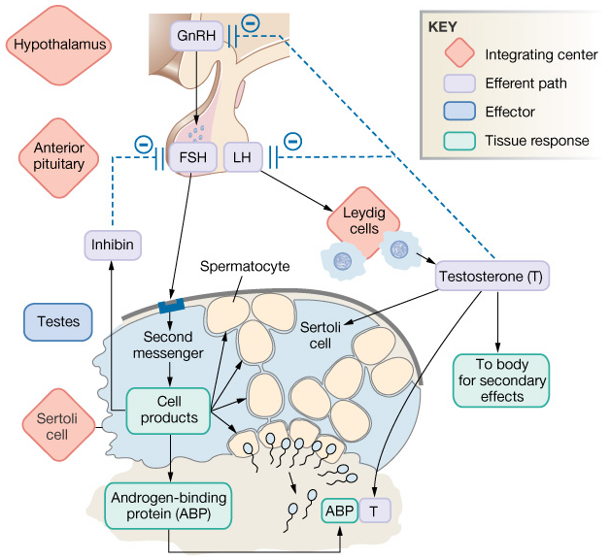
Regulation of Spermatogenesis
Figure 26-11: Hormonal control of spermatogenesis

Slide 20
Female Reproductive Anatomy and Physiology: Overview
Ovary
Fallopian tube
Fimbriae
Uterus
Cervix
Endometrium
Vagina
Clitoris
Labia

Slide 21
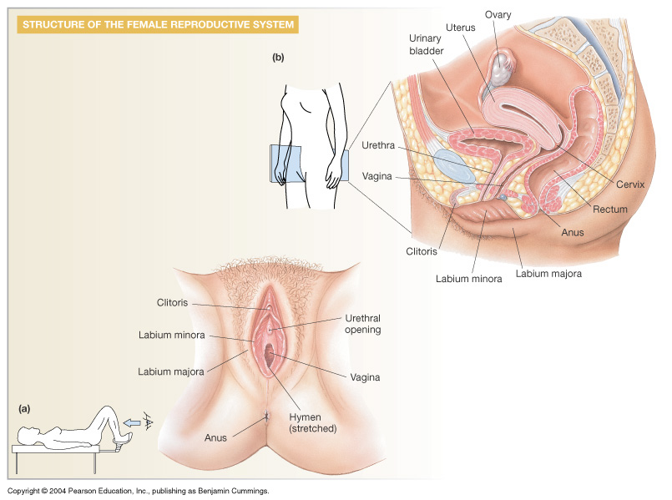
Female Reproductive Anatomy and Physiology: Overview
Figure 26-12b: ANATOMY SUMMARY: Female Reproduction

Slide 22
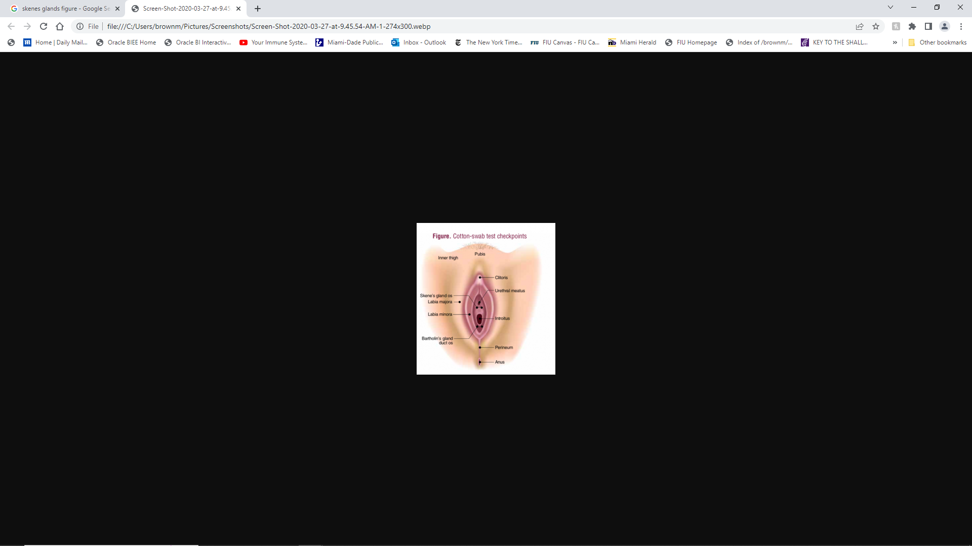

Slide 24
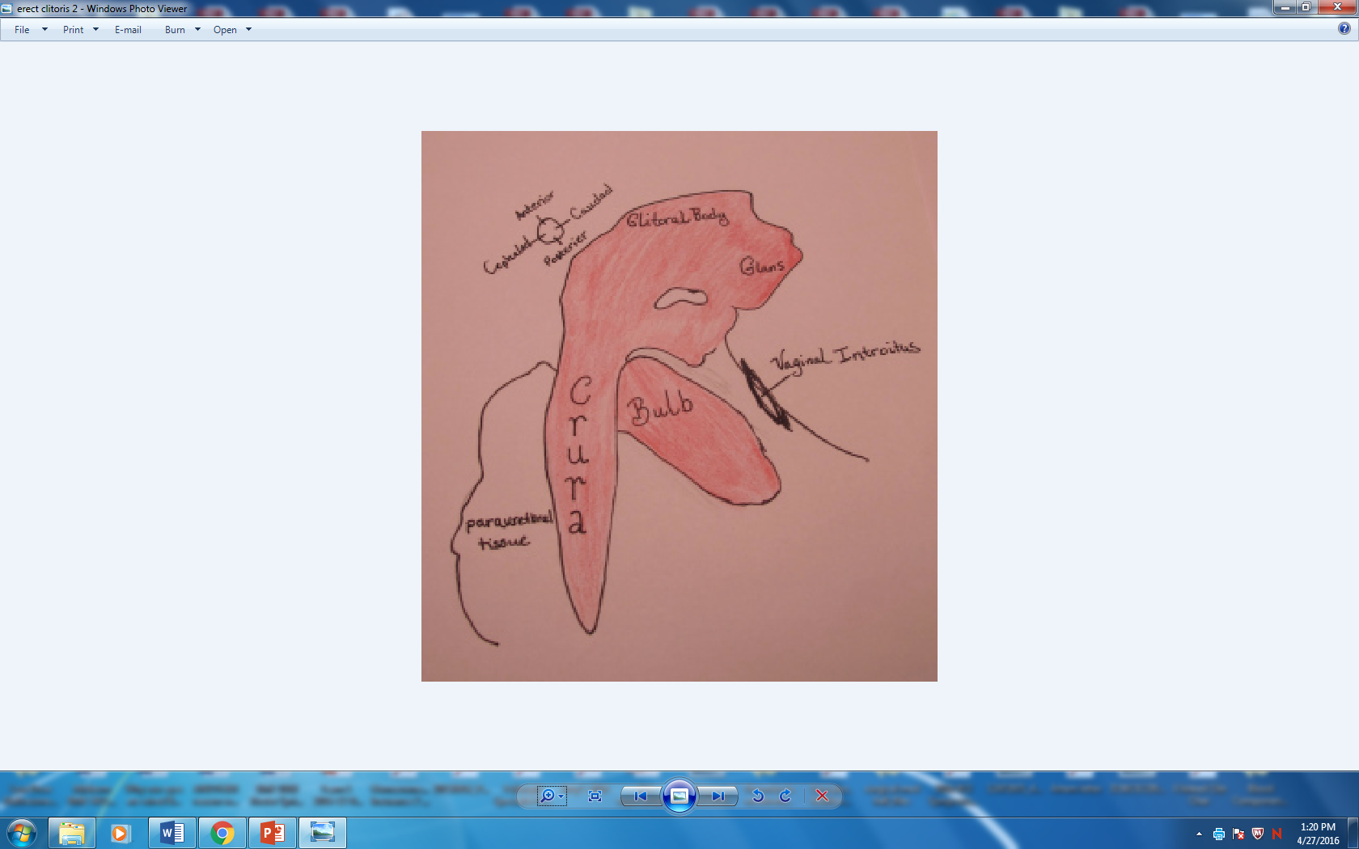

Slide 25
Ovary: Details of Histology & Physiology
Follicle
Oocytes
Thecal cells
Granulosa cells
Estrogen
→ Corpus luteum
Corpus luteum
Progesterone
Inhibin

Slide 26
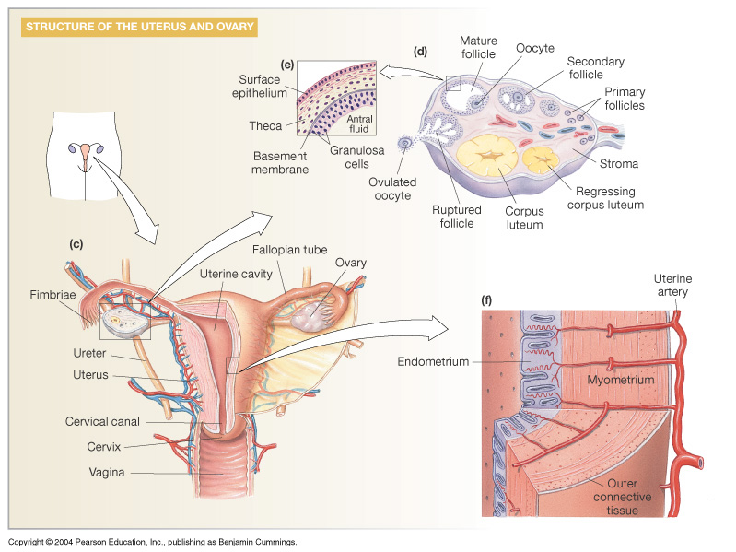
Ovary: Details of Histology & Physiology
Figure 26-12d: ANATOMY SUMMARY: Female Reproduction

Slide 27
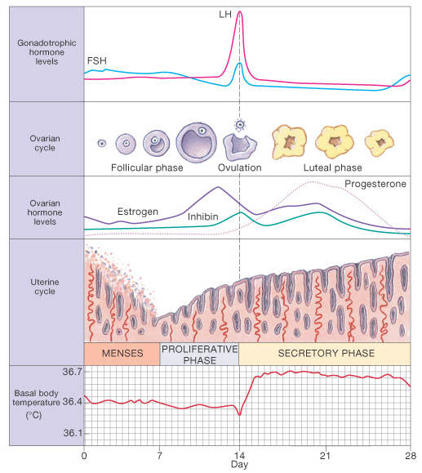
Menstrual Cycle: Egg Maturation, and Endometrial Growth
Follicular phase
Egg matures
Ovulation
Egg released
Luteal phase
Corpus luteum
Endometrium
Prep for blastocyst
No Pregnancy
Menses
Figure 26-13: The menstrual cycle

Slide 28
Endocrine Control of Menstrual Cycle: Ovulation
↑ Estrogen → LH "surge" & FSH spike → egg release
Inhibin↑ pushes FSH down , ↓ new follicle development

Slide 29
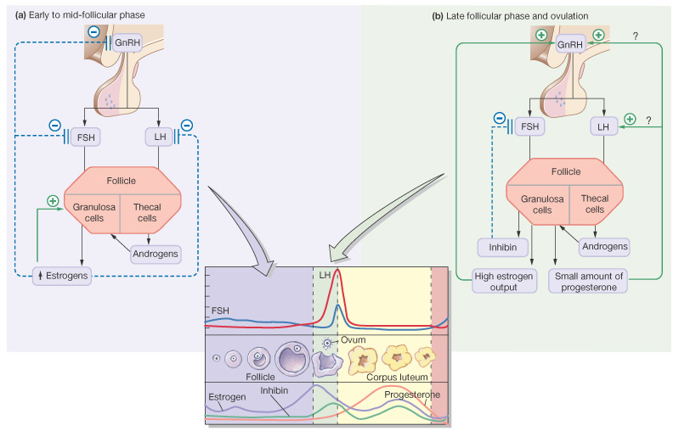
Endocrine Control of Menstrual Cycle: Follicular Phase and Ovulation
Figure 26-14a,b: Hormonal control of the menstrual cycle

Slide 30
Endocrine Control of Menstrual Cycle: Luteal phase
Granulosa cells form corpus luteum → progesterone
↑ progesterone & estrogen maintain endometrium
Inhibin continues to limit new follicular development

Slide 31
Endocrine Control of Menstrual Cycle: Late Luteal phase
Pregnancy: maintain ↑ progesterone, estrogen & inhibin
No pregnancy: ↓ progesterone, estrogen & inhibin
Menses, ↑ FSH & LH → new follicle development

Slide 32
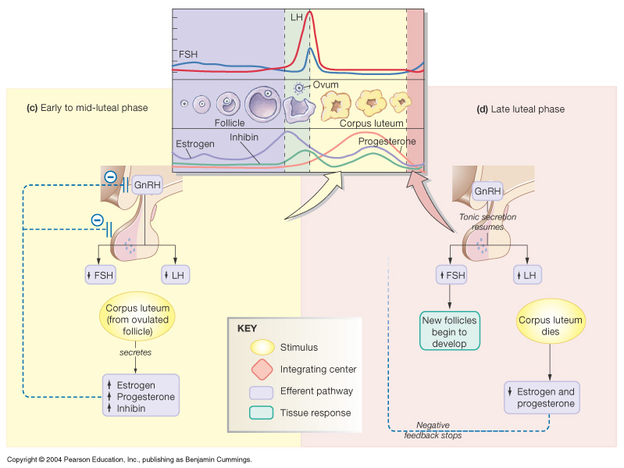
Endocrine Control of Menstrual Cycle: Luteal phase and Late Luteal phase
Figure 26-14c, d: Hormonal control of the menstrual cycle

Slide 33
Fertilization: Union of Male & Female Chromosomes
Sperm capacitation
Swimming & attractants
Egg contact
Penetration
Nuclear fusion
(Zygote)
Figure 26-16b: Fertilization

Slide 34
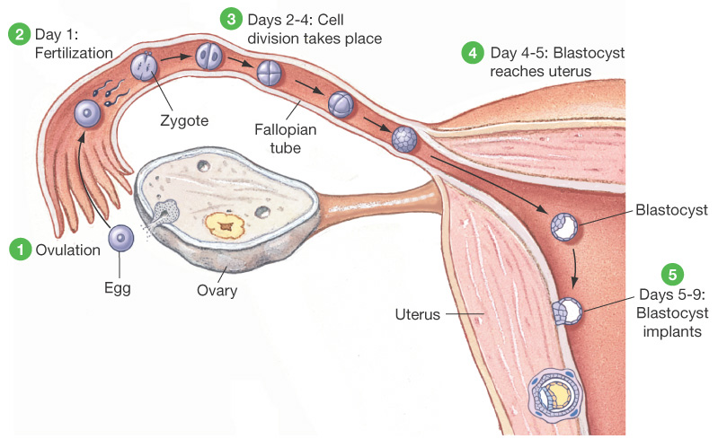
Zygote Development: Cell Division & Implantation
Figure 26-18: Ovulation, fertilization, and implantation of an ovum

Slide 35
Placenta and Further Embroynic Development
Amnion
Chorion
Placenta
Exchange
Hormones
Human chorionic Gonadotropin-hCG
Progesterone

Slide 36
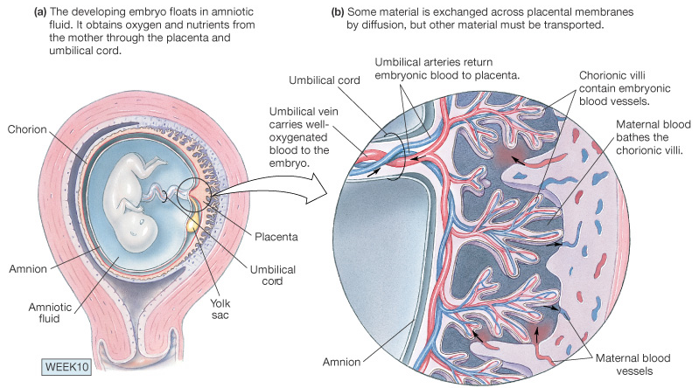
Placenta and Further Embroynic Development
Figure 26- 19a, b: The placenta

Slide 37
Intact amnion following birth of a 3 month premature infant- Extremely rare

Slide 38
In the caul—In the sac 1/80,000 births Associated with premature infants

Slide 39
Birth: Parturition
Labor
Rhythmic
Uterine
Contractions
Cervical dilation
Delivery
Baby
Placenta

Slide 40
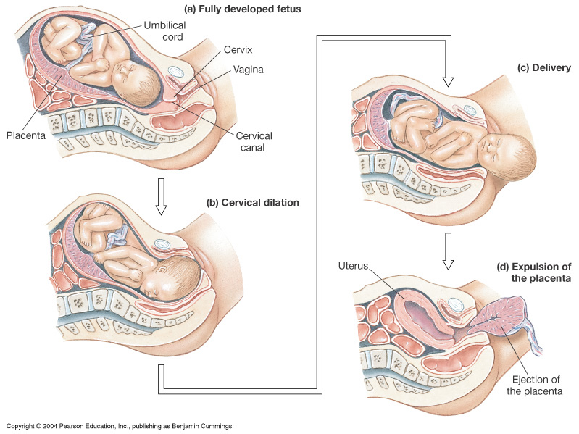
Birth: Parturition
Figure 26-20: Parturition: the birth process

Slide 41
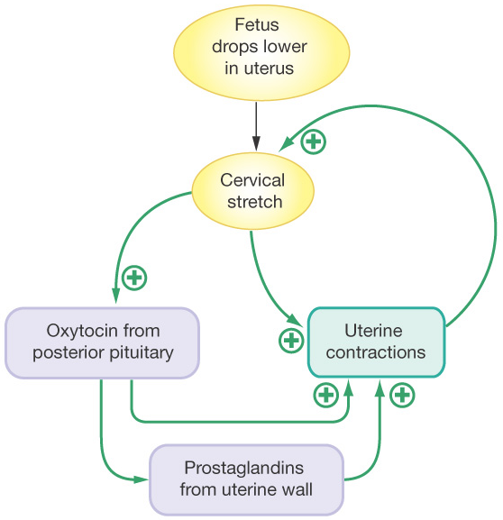
Regulators of Parturition
Labor onset
Stretch stimulus
Oxytocin
Prostaglandins
Positive feedback
↑ Stretch →
↑ Oxytocin
Birth ends
Stimulus
Figure 26-21: The positive feedback loop of parturition

Slide 42
Lactation: Producing and Releasing Milk
Estrogen & progesterone
Preps mammary tissues
Prolactin inhibiting H:
Prolactin → milk production
(other roles in fertility)
Sucking stimulus →
Oxytocin →
"Milk let-down" reflex

Slide 43
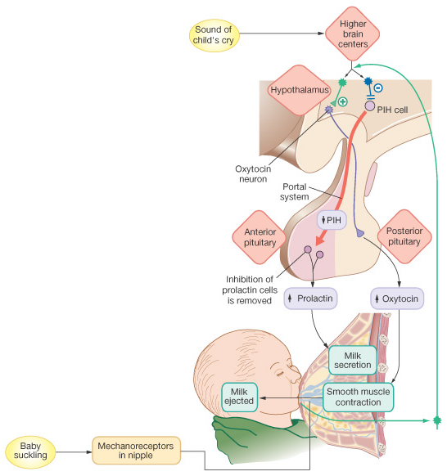
Lactation: Producing and Releasing Milk
Figure 26-23: The hormonal control of milk secretion and release

Slide 44
Reproductive Maturation: Puberty
Increase production of sex hormones
Maturation of reproductive organs & gamete production
2⁰ sexual characteristics
Males: pubic hair, beard, deep voice, "wedge" body form & ↑ muscle mass
Females: menarche, pubic hair, breasts & "pear shape" body form

Slide 45
Later in Life
Menopause: Female "Change-of Life"
Ovaries ↓ responding to GnRH
↓ Levels of estrogen & progesterone produced
Cease egg development
"Hot flashes" , ↑ osteoporosis risk
(hormone replacement debate)
"Andropause" (?): Male changes are gradual
↓ Sex hormones: ↓ muscle mass, ↓ libido, ↓ erections
Viagra: PNS → NO → cGMP → ↓ degradation

Slide 46
Summary
Genes and hormones direct bipotential reproductive tissues to differentiate into males or females
Spermatogenesis is regulated by FSH & LH, testosterone and inhibin influence on spermatocytes, Sertoli & Leydig cells
Menstrual cycle coordinates egg maturation with endometrium, and is regulated by GnRH,→ LH & FSH → estrogen, progesterone & inhibin (and placental hCG)

