Slide 1
Engines, Motors, Turbines and Power Plants: an Overview
Presentation for EGN 1002 Engineering Orientation

Slide 2
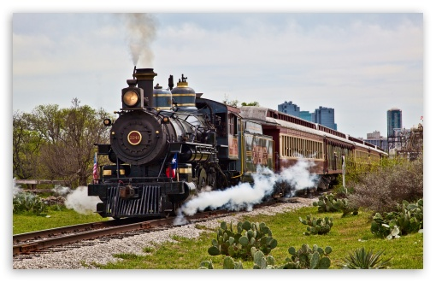
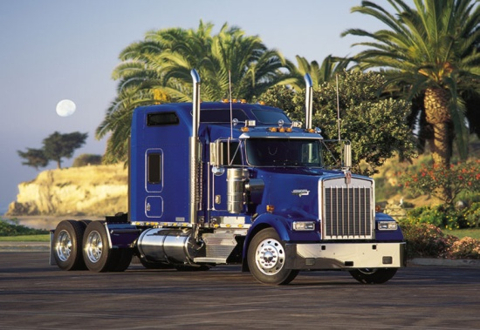
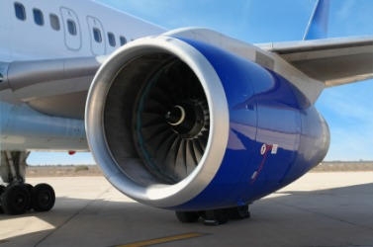
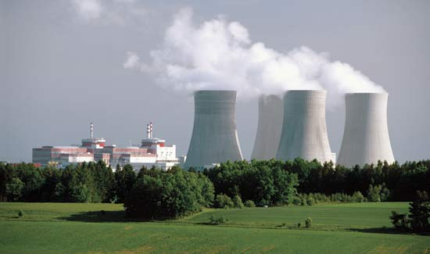
What to these have in common?

Slide 3
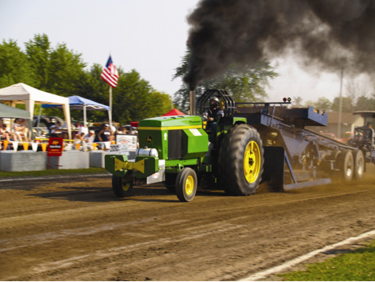
They produce work through the conversion of heat energy to mechanical energy.

Slide 4
History – The Steam Engine
Notes:
Frees men of wind, water and muscle power
Steam enters one end of a cylinder and pushes piston back. Then it enters the other end of the cylinder and pushes it the other way. Steam comes from boiler filled with water that is heated.
1st steam engine: build about 2000 years ago by Heron – more as a novelty.

Slide 5
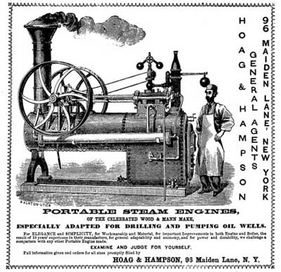
History – The Steam Engine (1705-1770)
Notes:
1705: 1st steam engine was used to pump water out of mines, using a piston within an enclosure called a cylinder.
No gears were available to convert reciprocal motion into circular motion until 1770 (James Watt).
(A governor was an important innovation that helped the steam engine running steadily.)

Slide 6
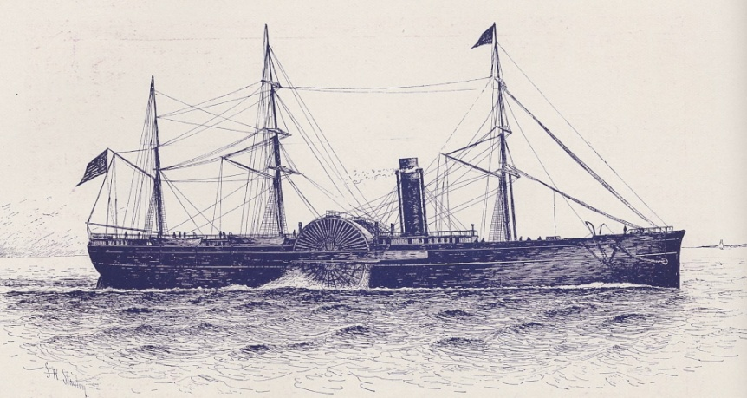
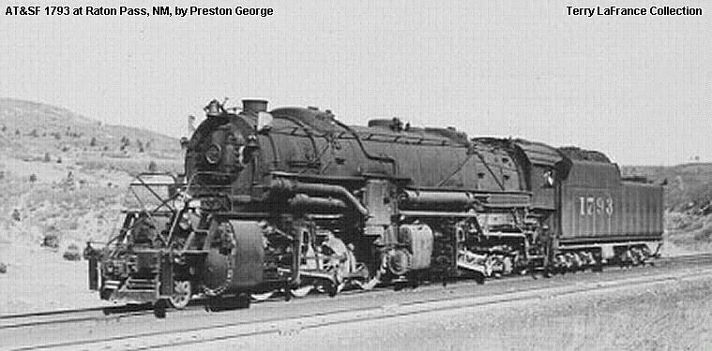
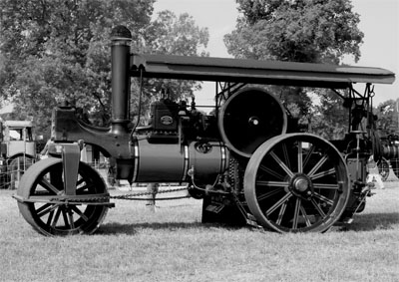
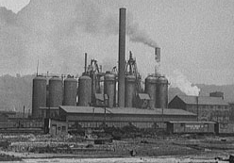
History – The Steam Engine (1800s)
Notes:
By 1800 steam engines were powering factory machines in England, helping it to become the first industrialized country.
Steam powered ships and later locomotives were then invented, reducing distances dramatically.
They were later applied to farm equipment, making it very adaptable and using almost any fuel you can burn.

Slide 7
History – The Steam Turbine (late 1800s)
Notes:
In the late 1800s, a new type of steam engine (pistonless) was invented by Parsons and Delavalle in Europe.
Only type of steam engine still in wide use today.
Steam Turbines: blades on a rotor are pushed by high pressure steam instead of wind.
Much more compact that steam piston engines.
Can use higher temperature and pressure steam, better expansion, which means more power.

Slide 8
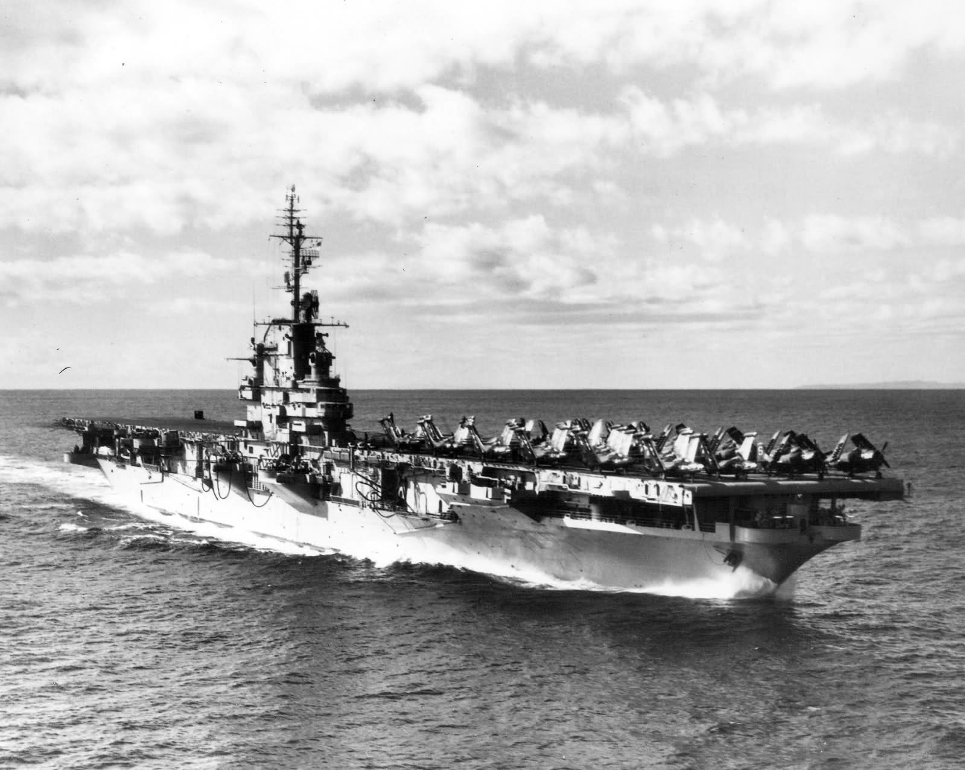
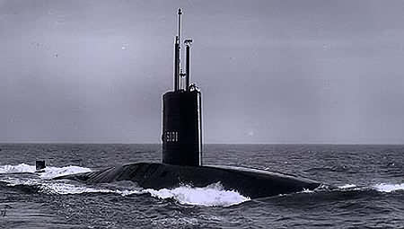
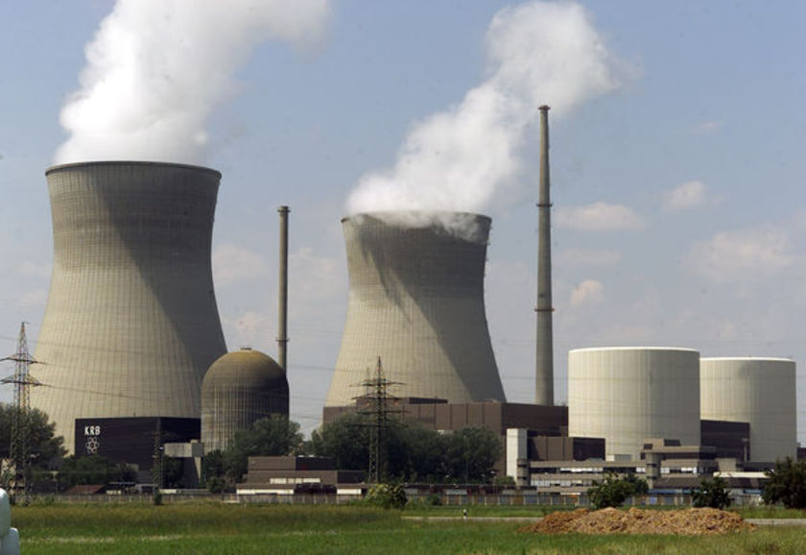
History – The Steam Turbine (20th Century)
Notes:
Early 1920’s: steam turbine engine had replaced all steam piston engines in ships such as transatlantic liners.
Steam piston engines were last made in the 1950s.
Currently US aircraft carriers and submarines use nuclear steam turbine power plants.
Most us power plants in the US use steam turbine power engines.
Powerplant engines are steam engines, regardless if the power source to make steam is nuclear fuel, coal or natural gas.
Still widely used today to generate most electricity.

Slide 9
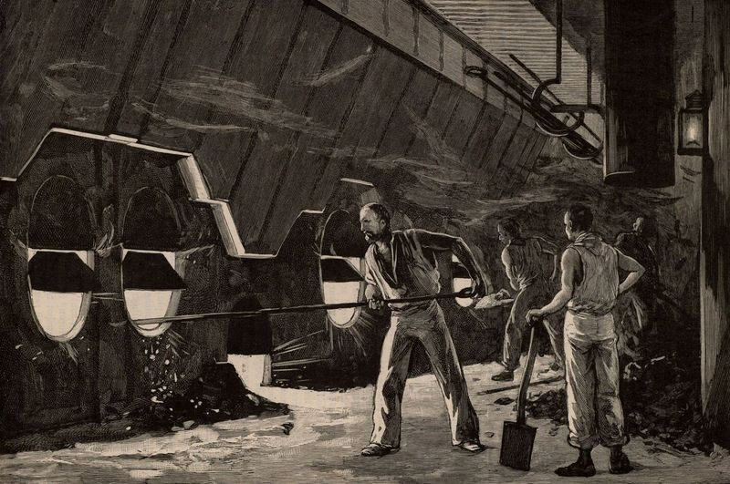
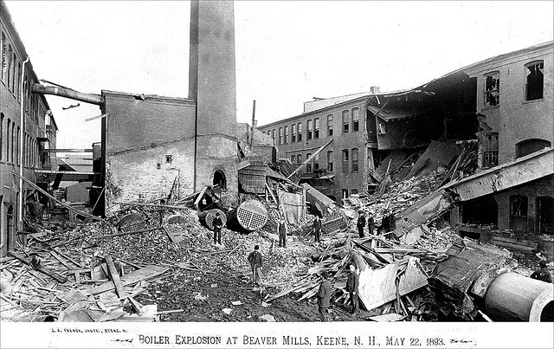
Problems of Steam Engines
Notes:
Heat transfer is a slow process.
High power output, but big, bulky, dangerous.
Boilers need to contain high pressure steam.
Needs to transfer heat from one hot fluid (the burnt fuel combustion gases) to the working fluid that produces the power (steam).
How to transfer heat more quickly? By using an internal combustion engine, the fluid that is burnt and the fluid that produces power is one and the same material (the fuel air mixture) can get much more power out of a given size engine.

Slide 10
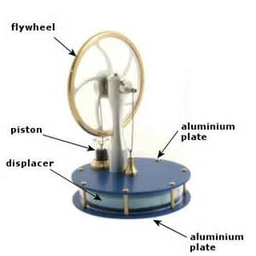
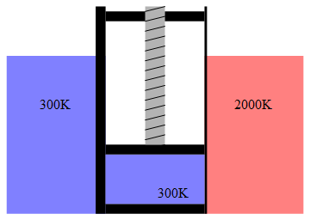
The Sterling Engine (Early 1800s)
Video
Notes:
Reverend Robert Sterling (clergyman- early 1800’s) wanted to do something about exploding steam engines.
New Engine Design: hot air engine (Stirling Engine)
– low pressure engine (cannot explode if it failed).
One side of the engine is heated; the other side of the engine is cooled.
Mechanism inside moves air back and forth between the hot side to the cold side.
hot side it expands, pushes up on a piston.
When the air is on the cold side, it contracts and pulls down on a piston.
Need to keep one side hot, the other cold (create / maintain a temperature difference).

Slide 11
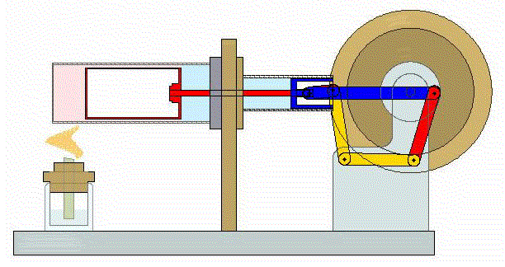
The Sterling Engine: most efficient but not practical yet.
Notes:
Issues:
Metals during the 1800’s could not withstand the high temperatures and heat engine could not be made as durable as steam engine.
Today it could be viable given today’s metallurgical advances.
It would be an expensive engine, more expensive than gas or diesel.
Hard to make it work on a vehicle, since we are constantly accelerating, decelerating.
Makes it difficult for this type of engine to stay efficient all the time.

Slide 12
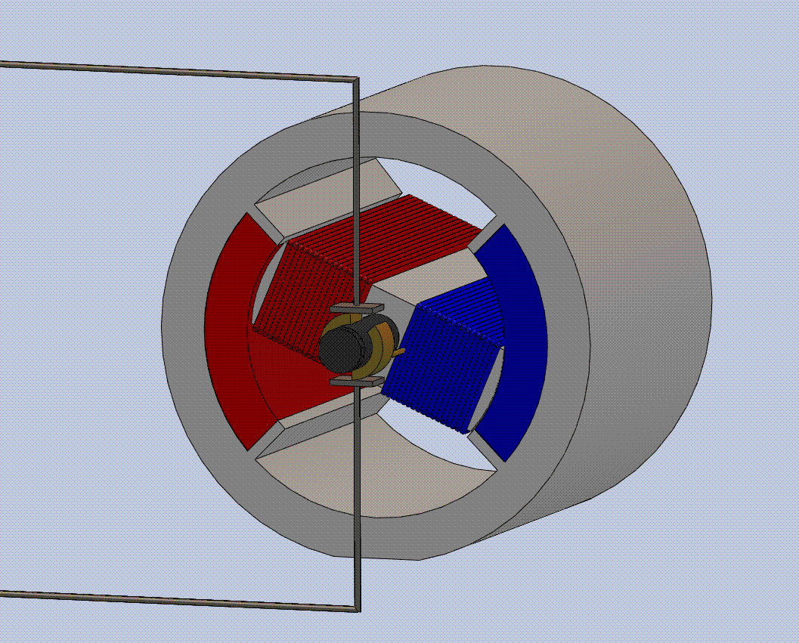
The Electric Motor (DC – Faraday 1824)
Notes:
Powered when electricity is passed through a wire, an EMF is created. Wire is temporarily magnetized.
When electricity is turned off, it ceases to be a magnet. Reversing the polarity makes the rotor continue to move.
1824: Michael Faraday patents the DC motor.

Slide 13
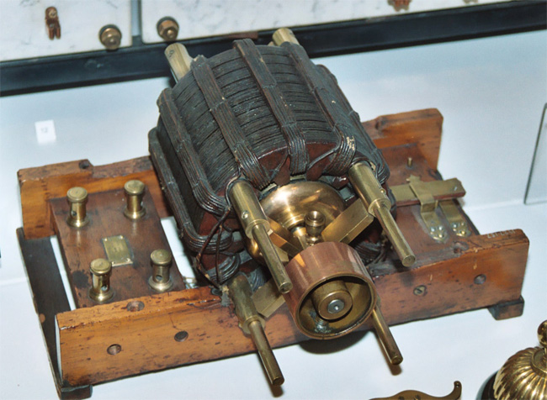
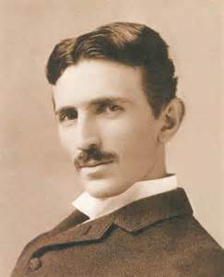
The Electric Motor (AC – Tesla 1888)
Notes:
1888: Nicola Tesla patents the AC motor. In this motor, polarity is alternated 50-60 times per second.
(Thomas Edison fires Tesla, goes to work for George Westinghouse.)
AC current can be transmitted over miles in contract with DC current.
1891: Westinghouse installs first electrical transmission lines.

Slide 14
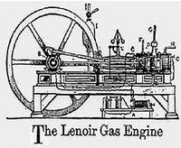
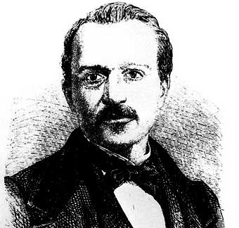
The Internal Combustion Engine (Lenoir 1860)
Notes:
The Internal Combustion Engine
1860: (first ICE) by Etienne Lenoir
Used to pump water out of cold mines

Slide 15
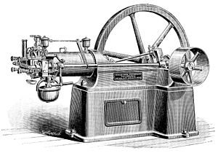
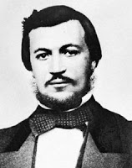
First Four-Stroke Version of ICE (Nicholas Otto 1876)
Component arrangement still used in all cars today
Notes:
1876: Nicholas Otto patents the first four stroke version of the ICE; used in all our cars today.
Arrangement: Four stroke cycle.
Piston cylinder arrangement
Connecting rod
Crank coverts up and down motion into circular motion / driveshaft rotation.

Slide 16
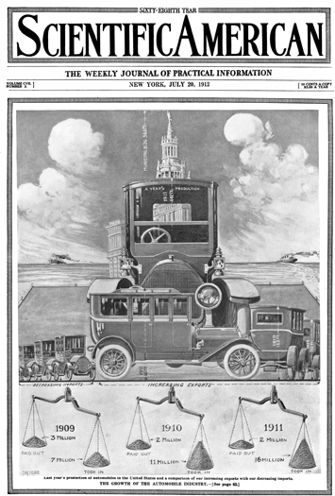
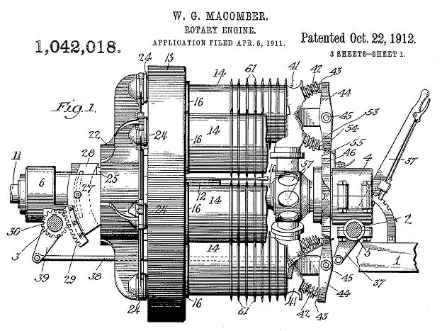
The Internal Combustion Engine
Notes:
Steam was now competing with Internal Combustion Engines and Electric Motors.
Around 1912, the ICE wins as the power course for cars, in combination with an electric motor (the starter).
This was the demise of the Electric Car and the Steam Powered car.

Slide 17
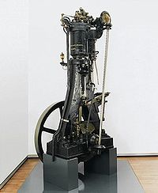
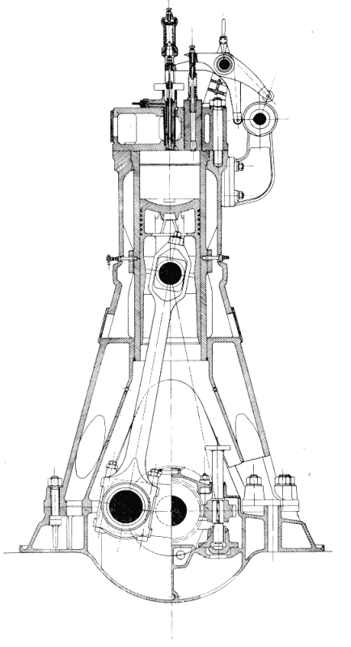
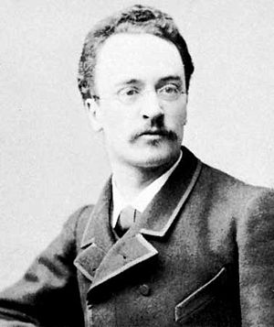
1892: Rudolf Diesel patents the Diesel Engine
Video
Notes:
Similar to ICE but has no spark plugs.
Oil is injected, oil-air mixture ignites.
High brute power, rugged
Widely used in trucks, heavy equipment, generators, yachts, tanks.

Slide 18
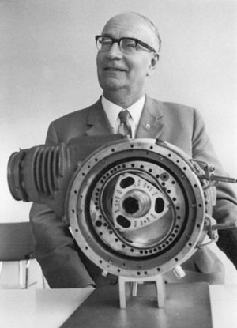
Wankel Rotary (non-reciprocating) Engine (1957)
Video
Notes:
Felix Wankel – 1924 – built first functional engine in 1957
An ICE in which a three lobe rotor rotates in a combustion chamber to provide the same cycle as in a reciprocating engine.
Radical design, rotates (does not go up and down) – reduces vibration.
No other geometry has been invented / produced for mass production.
Pros – powerful, high rpm range.
Cons – not too popular yet, hard, costly to maintain.

Slide 19
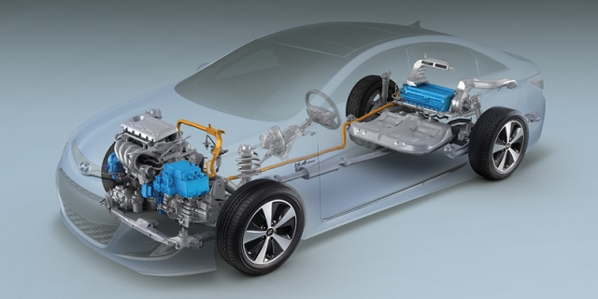
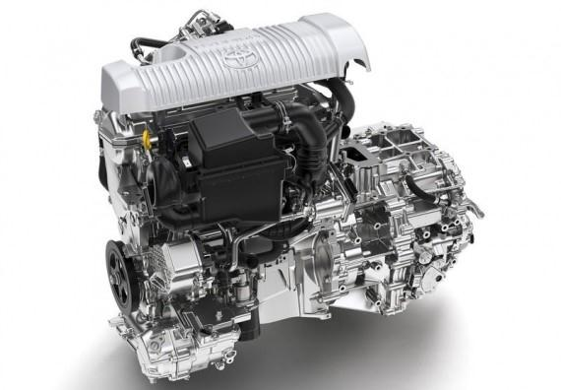
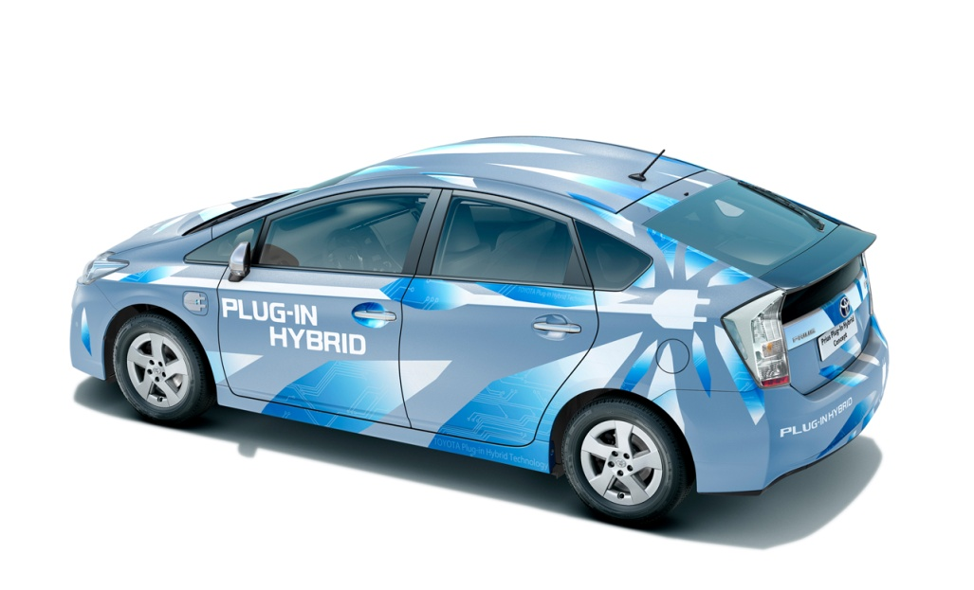
The Hybrid Engine (1997)
Notes:
In 1901 Ferdinand Porsche developed the Lohner-Porsche Mixte Hybrid, the first gasoline-electric hybrid automobile in the world.
The hybrid-electric vehicle did not become widely available until the release of the Toyota Prius in Japan in 1997, followed by the Honda Insight in 1999.
Propelled by gas engine and electric motor (separately or together)
0- 15mpg: Electric Power
Gas engine takes over
Electric cars need to be charged, hybrids charge themselves while moving. Regenerating is done by taking energy from the tires to the motor and to the battery pack
Regenerative braking: to slow down, car uses motor as generator, which acts as a brake, creating drag on driveline, and charging the battery.
By acting as a brake, the electric motor creates energy, does not waste it as heat.
Added cost: motor, battery, peripherals.
Attractive for driving short distances, stop and go traffic, slower speeds.
Not as useful for driving long distances, highway driving/speeds.

Slide 20
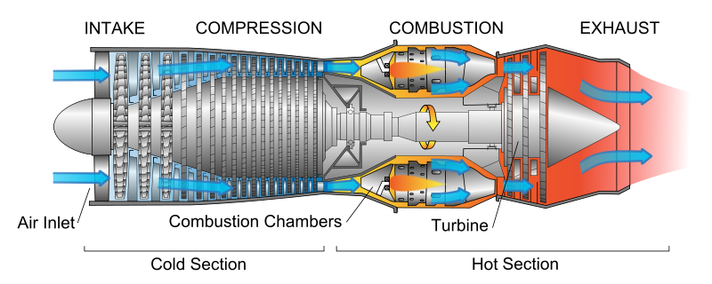
The Turbojet Engine (1930)
Video
Notes:
Gas turbine
Exhaust hot gases from combustion are thrown out fast on the back end of the engine to provide thrust.
Compressor and turbine compress incoming air to provide you with high flow
Turbine provides the work to drive the compressor.
Continuous process
Turbojet engines inject fuel to ignite compressed air.
The combustion drives a turbine that produces thrust.

Slide 21
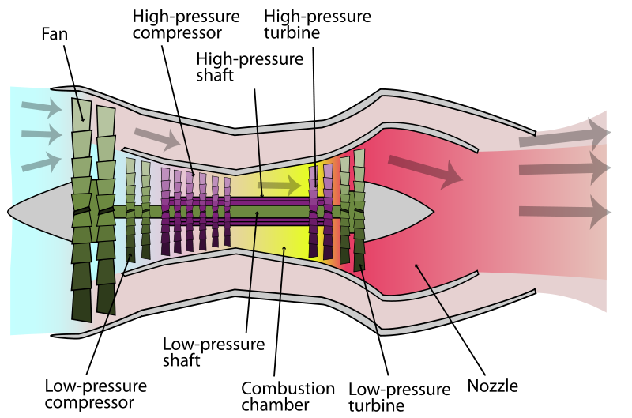
The Turbofan Engine (1960s production)
Notes:
A turbojet engine with an external fan, similar to a propeller.
Fan provides additional thrust with airflow that bypasses the jet engine.
Produces additional power and fuel efficiency.

Slide 22
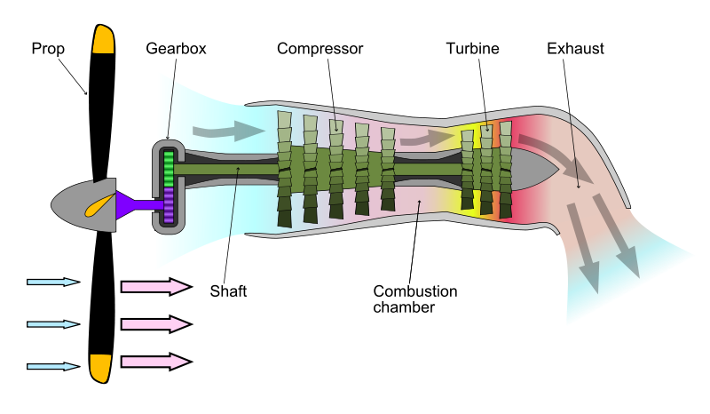
The Turboprop Engine (1930)
Video
Notes:
Turboprop engines extract work from the hot-exhaust jet to turn a rotating shaft.
A portion of the engines' thrust is produced by spinning a propeller, rather than relying solely on high-speed jet exhaust.
While many turboprops generate the majority of their thrust with the propeller.
Turboprops generally have better performance than turbojets or turbofans at low speeds where propeller efficiency is high.
Become increasingly noisy and inefficient at high speeds.

Slide 23
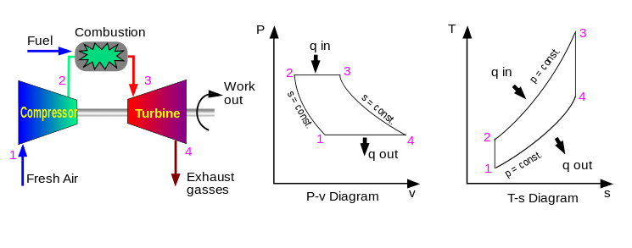
Thermodynamic (Power) Cycles
A collection of thermodynamic processes transferring heat and work, while varying pressure, temperature, and other state variables, which eventually returning a system to its initial state.

Slide 24
Thermodynamic (Power) Cycles ?
During a cycle, the system may perform work on its surroundings (a heat engine)
During a cycle, cumulative variation of such properties adds up to zero.
Cumulative heat and work are non-zero.
In a cycle the change in internal energy (a state quantity) of a cycle is zero.
The first law of thermodynamics dictates that the net heat input is equal to the net work output over a cycle.

Slide 25
Types of Power Cycles
Power cycles: convert some heat input into a mechanical work output.
Heat pump cycles: transfer heat from low to high temperatures using mechanical work input (heaters, refrigeration)
A cycle can operate as power or heat pump by controlling the process direction.

Slide 26
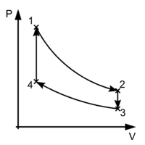
The Power Cycle
Because the net variation in state properties during a thermodynamic cycle is zero, it forms a closed loop on a PV diagram.
A PV diagram's Y axis shows pressure (P) and X axis shows volume (V).

Slide 27
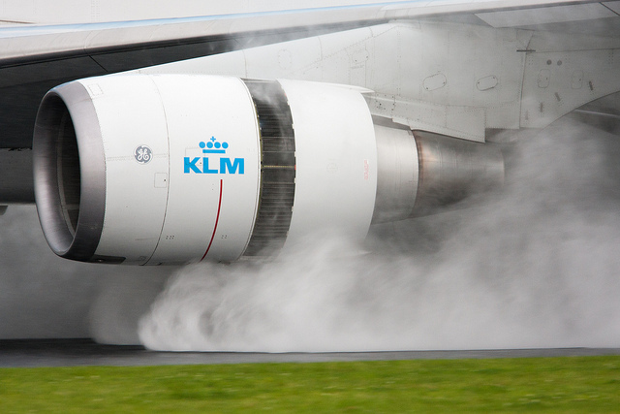
Thermodynamic Cycles
May be used to model real devices and systems.
The actual device is made up of a series of stages, each modeled as an ideal process (in reality they are complex)
For example, a gas turbine or jet engine can be modeled as a Brayton cycle.

Slide 28
The Thermodynamic (Power) Cycle

Slide 29
Processes in a Cycle
1→2: Isentropic Expansion: Constant entropy (s), Decrease in pressure (P), Increase in volume (v), Decrease in temperature (T)
2→3: Isochoric Cooling: Constant volume(v), Decrease in pressure (P), Decrease in entropy (S), Decrease in temperature (T)
3→4: Isentropic Compression: Constant entropy (s), Increase in pressure (P), Decrease in volume (v), Increase in temperature (T)
4→1: Isochoric Heating: Constant volume (v), Increase in pressure (P), Increase in entropy (S), Increase in temperature (T)

Slide 30
Work Calculation
= Area under curve 1 -2

Slide 31
Work Calculation

Slide 32
Carnot (ideal) Cycle
Composed of totally reversible processes:
- isentropic compression and expansion & isothermal heat addition and rejection
The thermal efficiency of a Carnot cycle depends only on the absolute temperatures of the two reservoirs in which heat transfer takes place,
and for a power cycle is:
where is the lowest cycle temperature
And the highest.

Slide 33
Rankine Cycle
Rankine cycle – used to models steam turbines

Slide 34
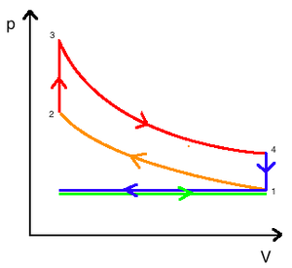
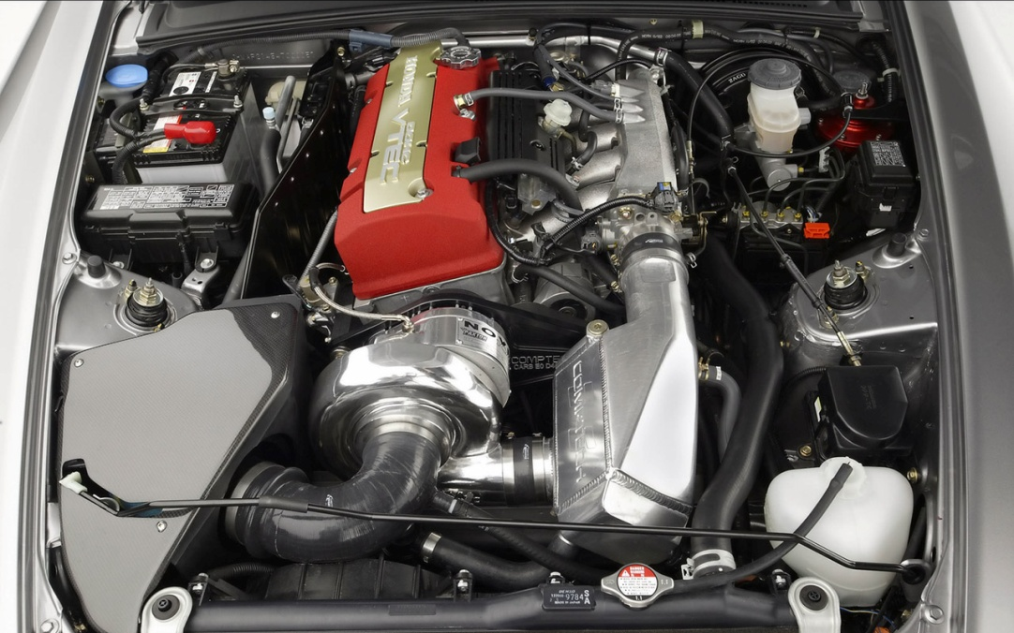
Otto Cycle
Otto cycle - used to model gas engines
• Process 1-2: intake and isentropic compression of the air-fuel mix.
• Process 2-3 : constant-volume heat transfer (ignition and burn of the fuel-air mix
• Process 3-4 : isentropic expansion (power stroke).
• Process 4-1: constant-volume process - heat is rejected from the air while the piston is a bottom dead centre.

Slide 35
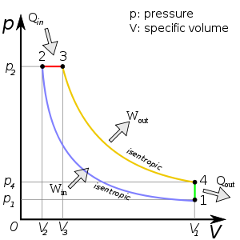
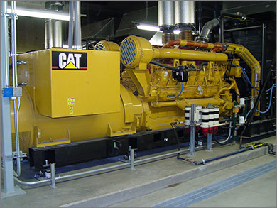
Diesel Cycle
Diesel cycle – approximates pressure and volume in combustion chamber of Diesel engine
• How does ignition take place in a Diesel Engine?

Slide 36
Brayton Cycle
Brayton cycle – used to model gas turbines

Slide 37
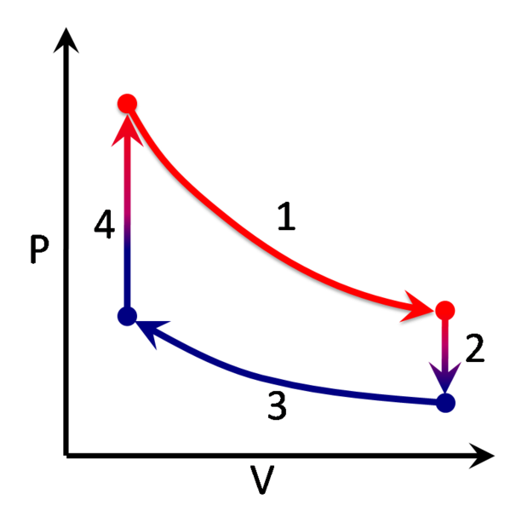
Stirling Cycle
Stirling cycle – used to model Stirling type devices
The cycle is reversible -can function as a heat pump for heating or cooling, and even for cryogenic cooling.
Closed regenerative cycle with a gaseous working fluid.

Slide 38
Comparative efficiency of Engine Types
Gas engine: 25-35% in a car
Diesel Engine: 50%
Direct Injection Diesels are most efficient type ~ 40%
Modern turbo-diesel engines: ~50%
Steam Engines / Turbines: 63%
Steam turbine: most efficient steam engine
Universally used for electrical generation.
Gas turbine: ~35–40% thermal efficiency, can go up to 60%
Stirling Engine:
Highest theoretical efficiency of any thermal engine
More expensive to make
Not competitive with other types for normal commercial use.

Slide 39
Steam and Gas Turbine Plants
Video

Slide 40
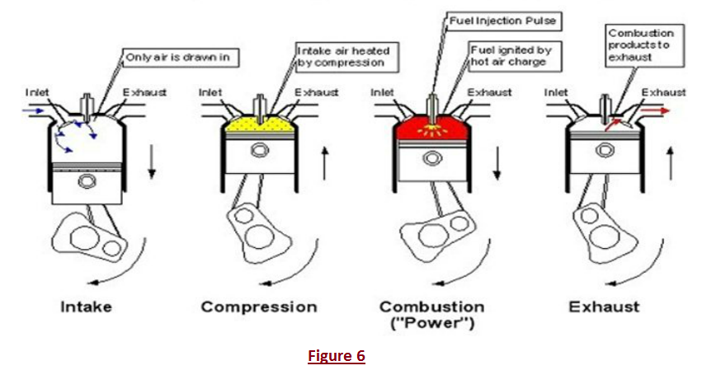
How does ignition take place in a Diesel Engine?

