Slide 1
EFFECTS OF BODY LANGUAGE
By: Professor Wilmer Arellano
FIU Fall 2010

Slide 2
Overview
Kinesics
The Basics and the Origins
An Inter-Species Language?
Gesture Clusters
Some Positive & Negative Expressions

Slide 3
Is Body Language Important?

Slide 6
Kinesics
Kinesics: The study of nonlinguistic bodily movements, such as gestures and facial expressions, as a systematic mode of communication.
The non verbal aspects of communication have been broadly studied only since 1960.

Slide 7
Kinesics
Cicero was already using notions such as ‘body language’ (sermo corporis) or the ‘eloquence of the body’ (eloquentia corporis).
Born: 6 January 106 B.C.
Birthplace: Arpinum (now Arpino, Italy)
Died: 7 December 43 B.C. (assassination)

Slide 8
Kinesics
“I WILL begin by giving the three Principles, which appear to me to account for most of the expressions and gestures involuntarily used by man and the lower animals
The Expression of the Emotions in Man and Animals by Charles Darwin, 1872.

Slide 9
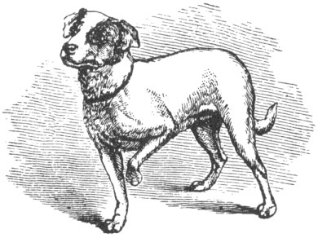
The principle of serviceable associated Habits
The same gesture is often used for similar situations. Pointer dog finding the fox or listening to you. Dog may signal both events as important by lifting one front leg.

Slide 10
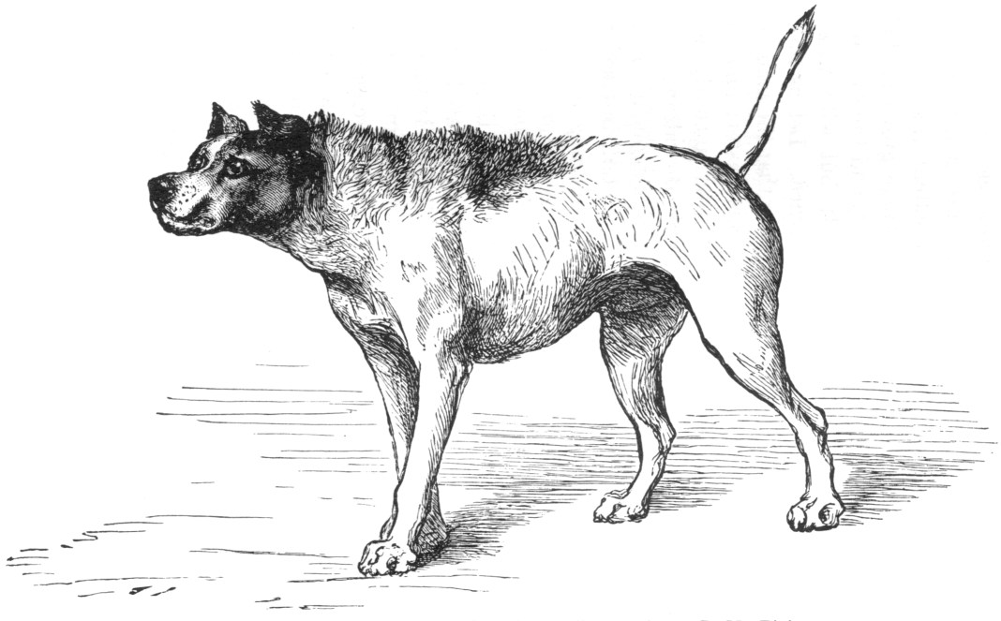
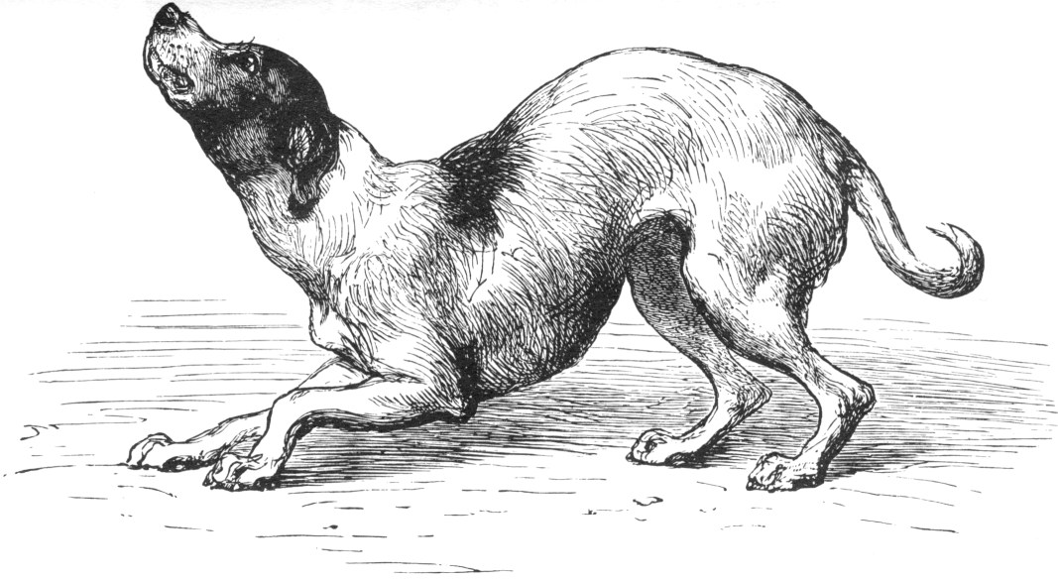
The principle of Antithesis
Situations with opposite meaning are usually accompanied by opposite body language. Body language of aggressive dog (ears and tail up, trying to look big) is opposite to that of submissive dog.

Slide 11
Less Important for Us
The principle of actions due to the constitution of the Nervous System, independently from the first of the Will, and independently to a certain extent of Habit.

Slide 12
The Basics and the Origins
Eibl-Eibesfeld found that the smiling expressions of children born deaf and blind occurs independently of learning or copying which means these are inborn gestures.
When a baby has had enough milk, he turns his head from side to side to reject his mother’s breast. He quickly learns to use the head shaking gesture to show disagreement.

Slide 13
Gesture Clusters
The verbal channel conveys information.
The non verbal channel is used for negotiating interpersonal attitudes.
The non verbal channel can be up to 5 times greater impact.
When the verbal and non-verbal channels are incongruent; the verbal channel may be disregarded.

Slide 14
[This work by American Evaluation Association is licensed under a Creative Commons Attribution-NonCommercial-ShareAlike 3.0 Unported License. Based on a work at http://p2i.eval.org/.]
Notes:
Research that distinguishes good from weak presentations basically says we have two ways of hearing an appeal.
Through rational appraisal – that is, an appeal to logic, to the mind,
[CLICK]
Or through experiential response – which relates to emotions, the heart (and sometimes other areas of the body we can’t talk about today)
Traditionally, as academically-trained evaluators who have to sometimes be presenters, we’ve tended to think that we’ll only be taken seriously if we speak to the brain and that doing so makes us rigorous, scientific, and credible. It seems soft to tap into an emotion.
The problem is that presenting information in that way doesn’t actually do much for our brains. It might feel logical – but because it doesn’t tap into an emotion, it doesn’t get remembered, retained, recalled. And that’s really why we’re here, presenting to one another. To teach and to learn. But to reach that goal, we have to craft a message that speaks to both our logic and our emotion. It’s that planning and crafting of a message that we’ll talk about today.

Slide 15
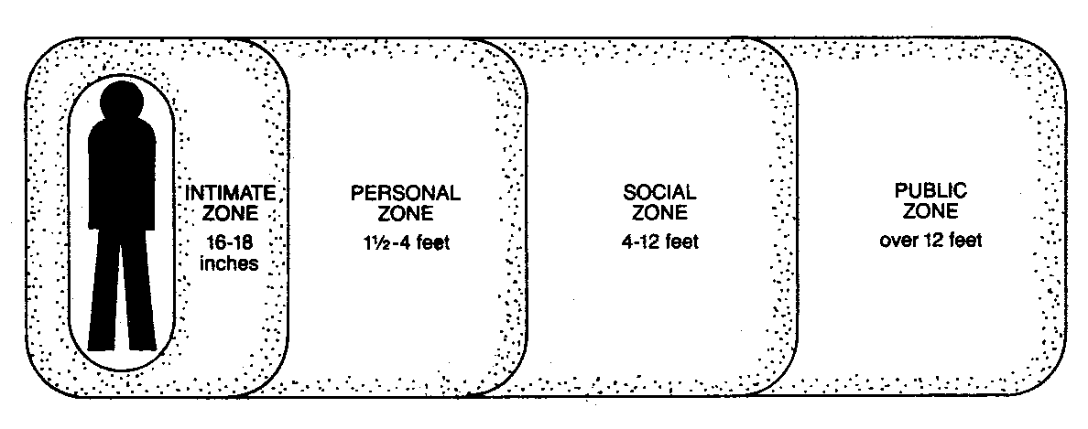
The Zones

Slide 16
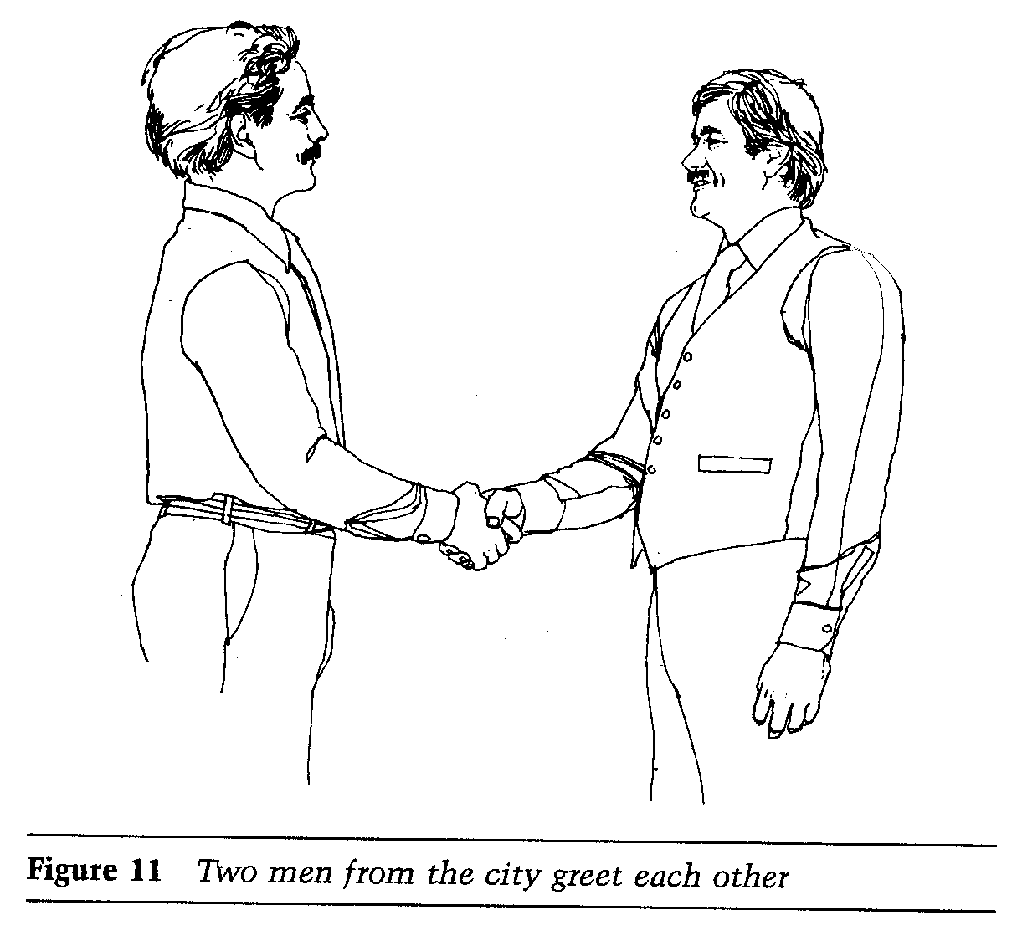
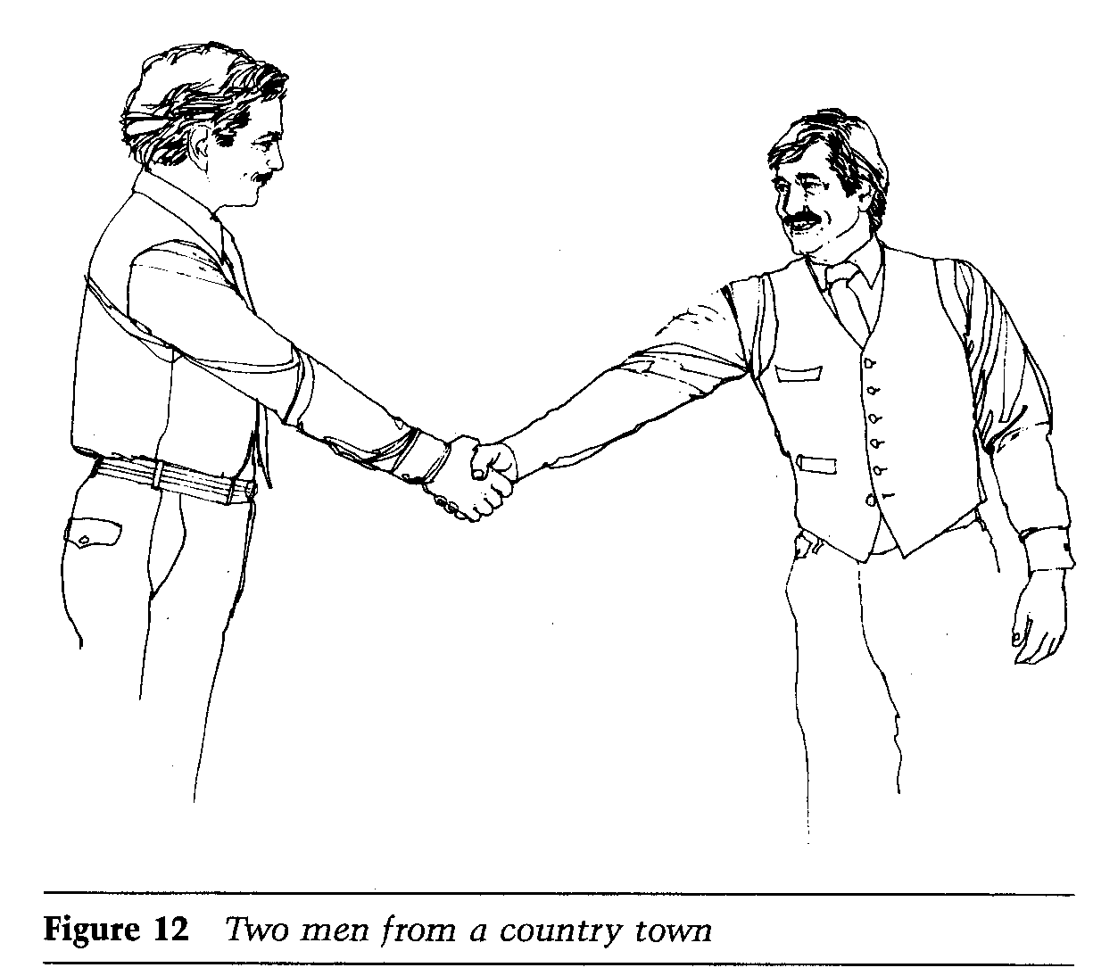
The Zones

Slide 17
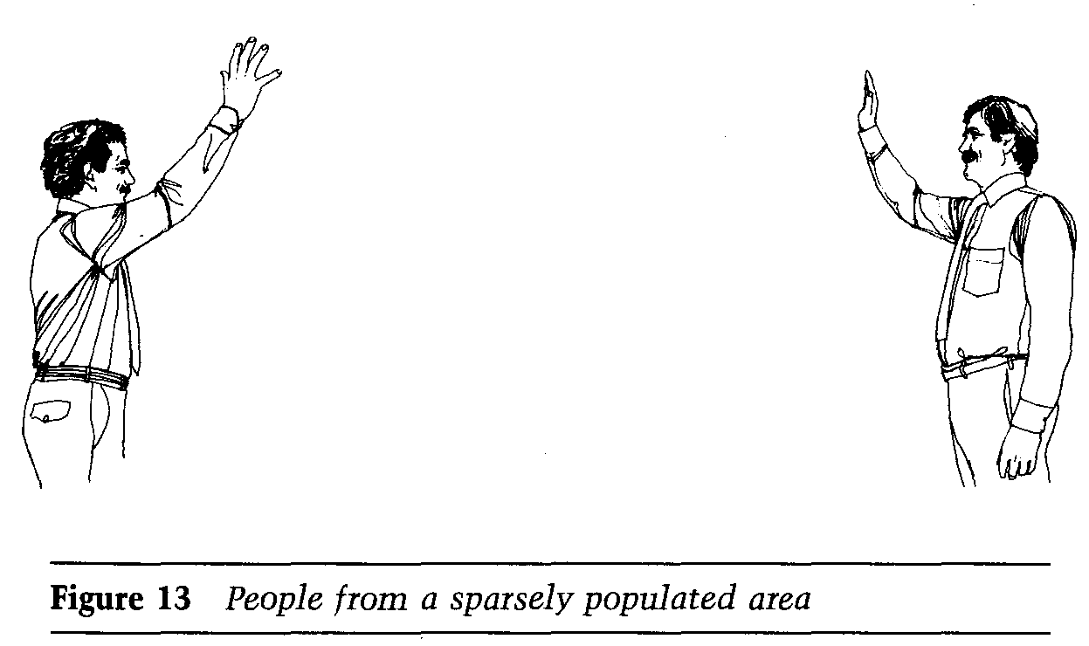

Slide 18
Elevators Rule
You are not permitted to speak to anyone, including a person you know.
You must avoid eye contact with others at all times.
You are to maintain a ‘poker face’, no emotion is permitted to be displayed.
If you have a book or newspaper, you must appear to be deeply engrossed in it.
The bigger the crowd, the less the body movement you are permitted to make.
In elevators, you are compelled to watch the floor numbers above your head.

Slide 19
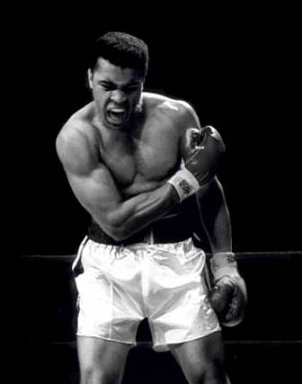
The Basics and the Origins
Some gestures can be traced to our primitive animal past. As in the case of hostile gesture of baring the teeth.
Most of the basic communications gestures are the same all over the world the as the shoulder shrug to show that a person does not know or does not understand what you are talking about

Slide 20
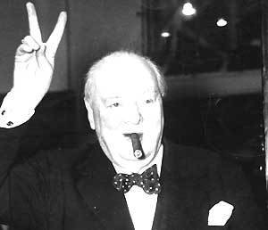
The Basics and the Origins
As verbal language differs from culture to culture, so the non verbal language may also show some differences.

Slide 21
Some Positive & Negative Expressions

Slide 22
Some Positive & Negative Expression
Body Posture
Eyes
Arms, Hands and Legs
Hand to Face Gestures
Other Positive Signs

Slide 23
Body Posture
Relaxed posture and breathing, no visible signs of stiffness or abrupt movements.
Salesmanship. "Do not turn your upper body away from the prospect. It doesn't make you look casual; it makes you look afraid, uninterested, or even unfriendly“

Slide 24
Eyes
Gazing at another's eyes arouses strong emotions. Thus, eye contact rarely lasts longer than three seconds.
Looking to all parts of the audience and not staring at just one particular person.
Not looking back at your visual aid when talking. Or reading too much from your notes.

Slide 25
Eyes
Use eye contact with caution it can be intimidating

Slide 26
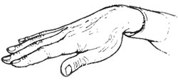
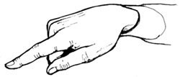
Palms
Cavemen used to expose their palms to show that no weapons were held or concealed.
When someone begins to open up or be truthful, he/she will expose all or part of his/her palms.
Most people find it difficult to lie with their palms exposed.
Positive Sign.
Negative sign.

Slide 27
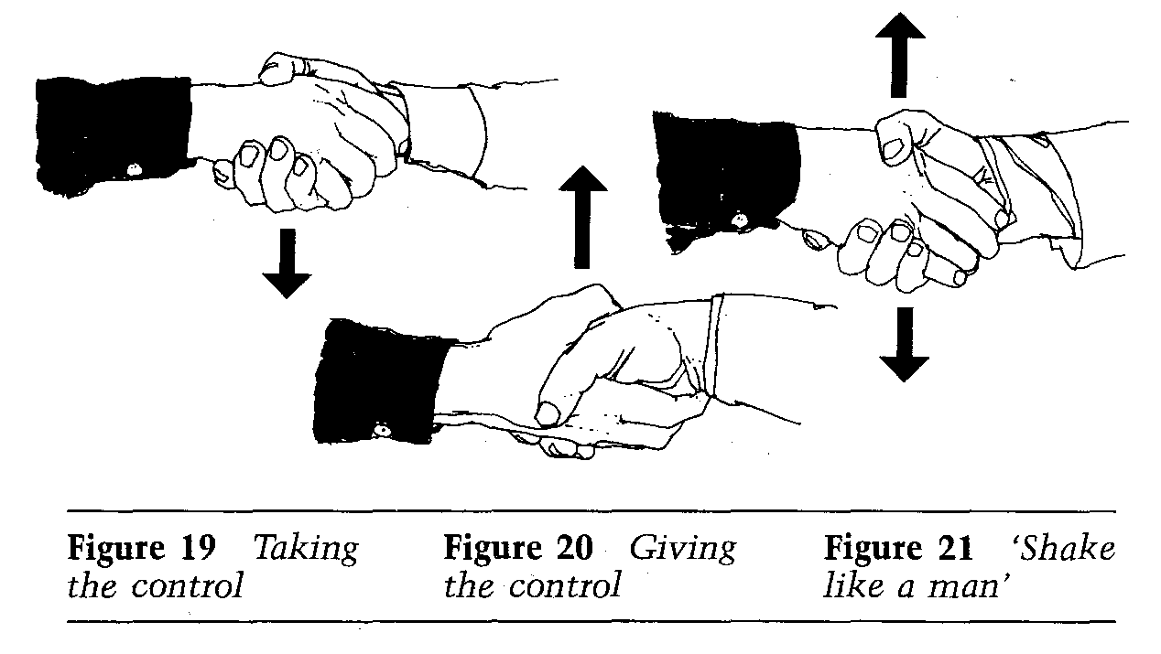
Palms

Slide 28
Arms, Hands and Legs
Positive Language
Uncrossed arms, hands and legs, palms up or otherwise visible to the other person. This is a sign of openness.
Negative Language
Arms folded in the front or hands on your hips. This can indicate dominance of the speaker over the audience, which can hinder the audience from listening to you.

Slide 29
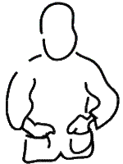
Arms, Hands and Legs
Positive Language
Negative Language

Slide 30
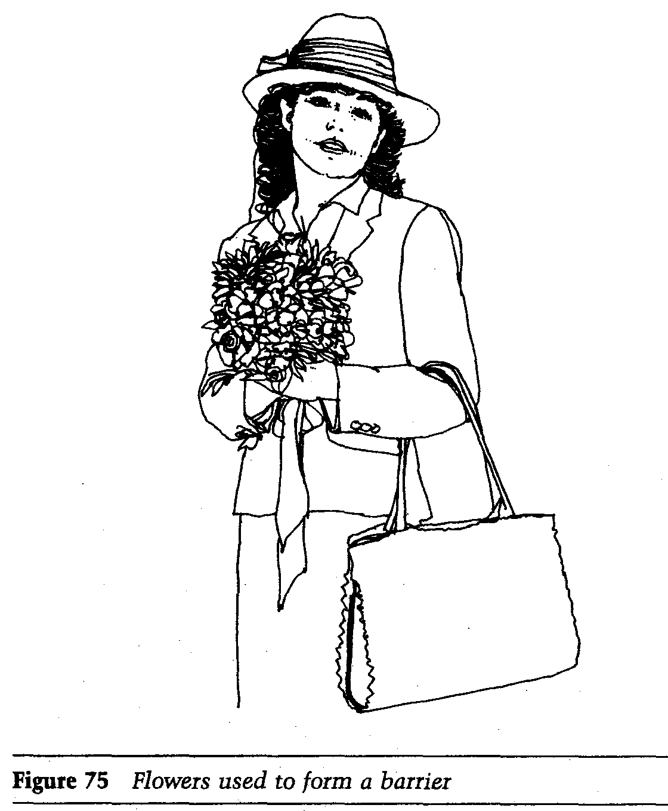
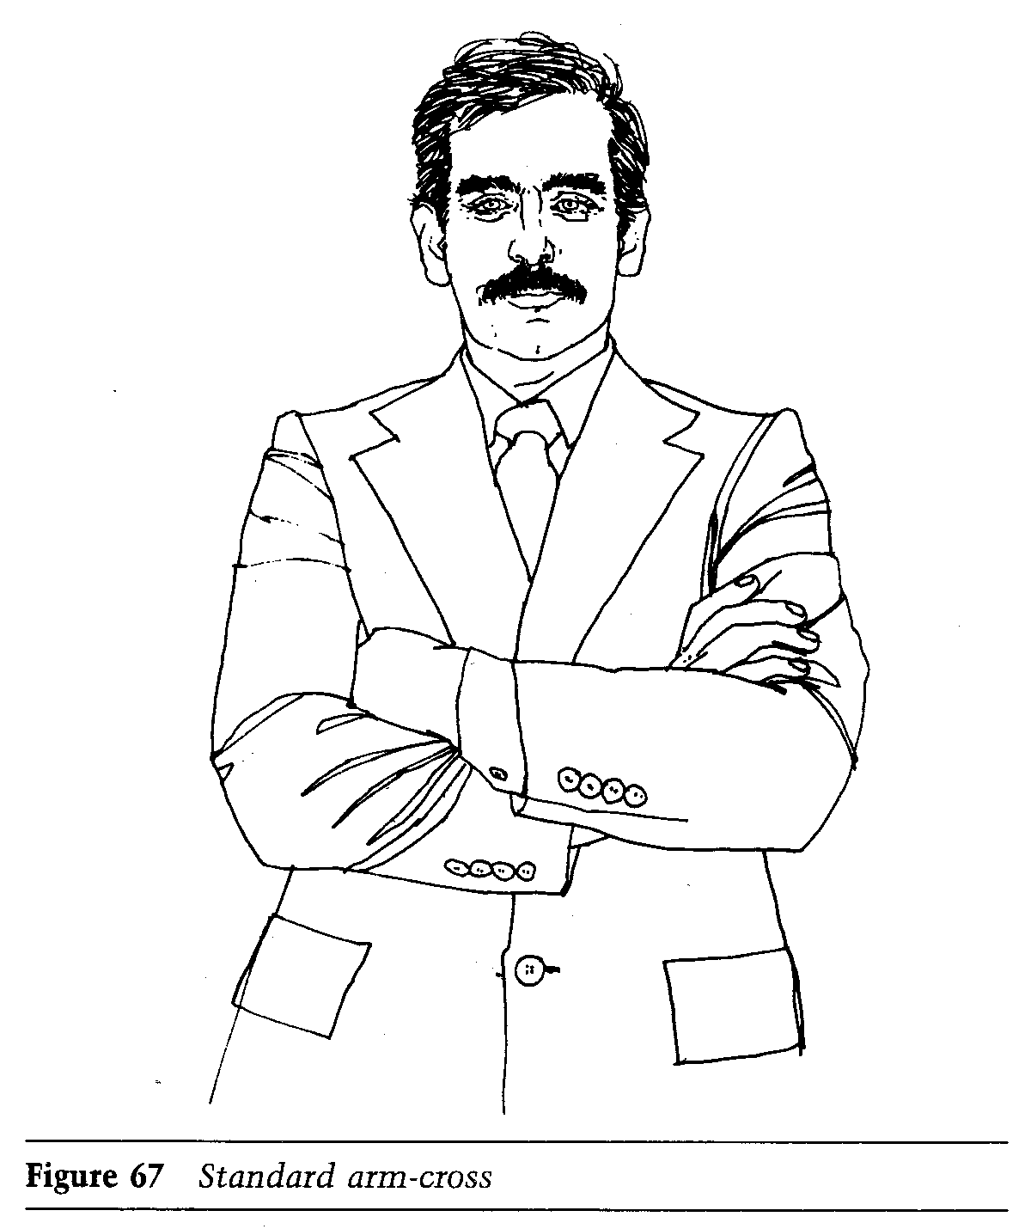
Negative Language

Slide 31
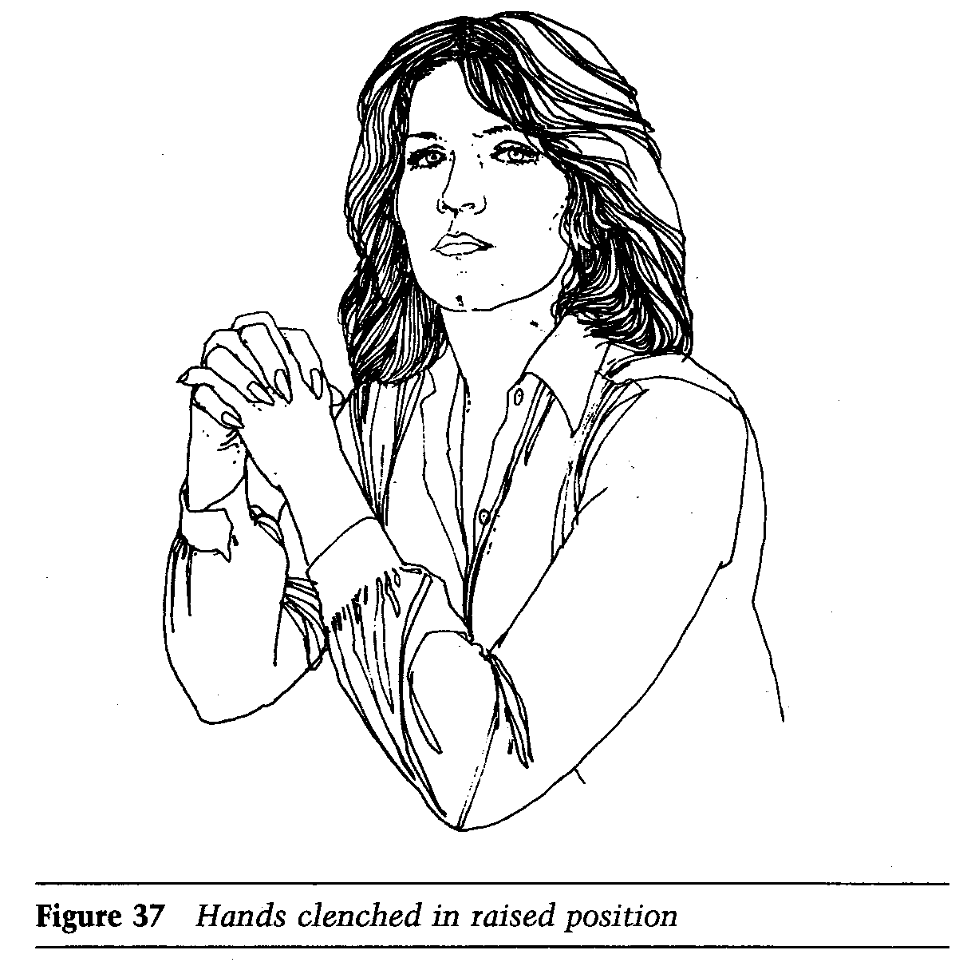
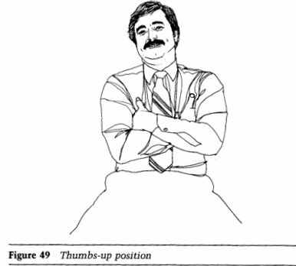
Negative Language

Slide 32
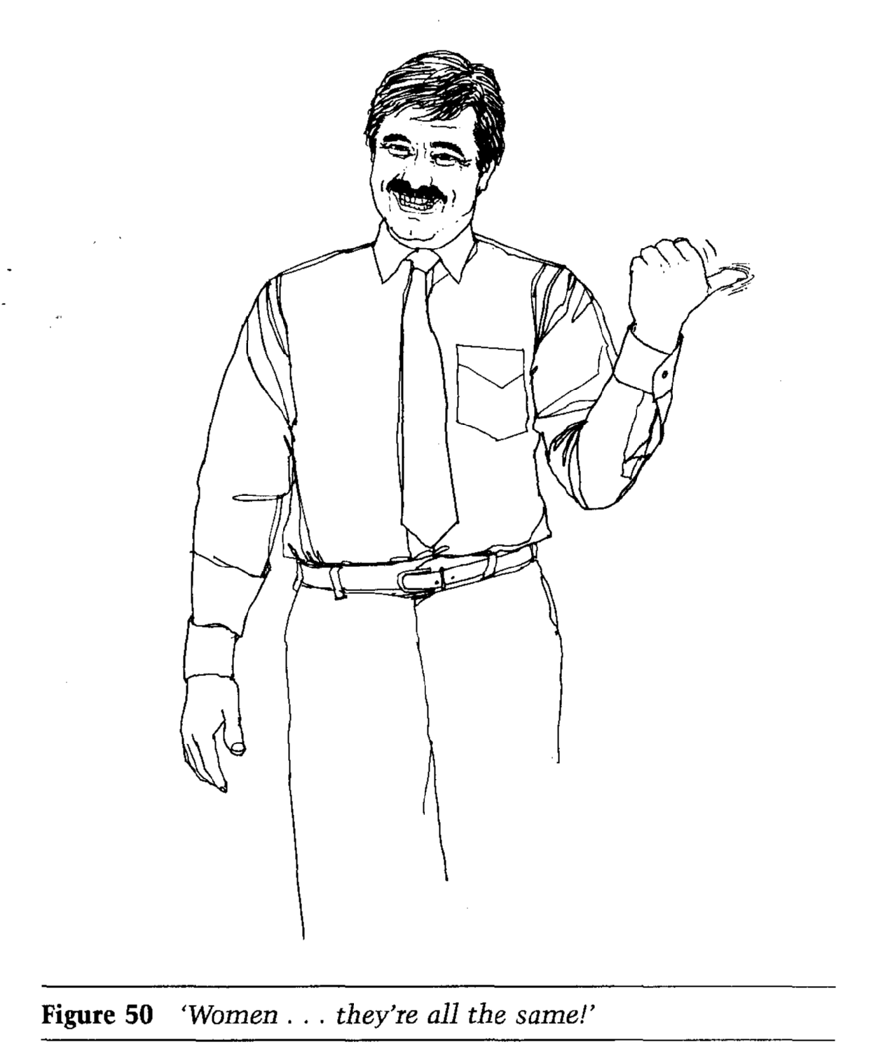
Negative Language

Slide 33
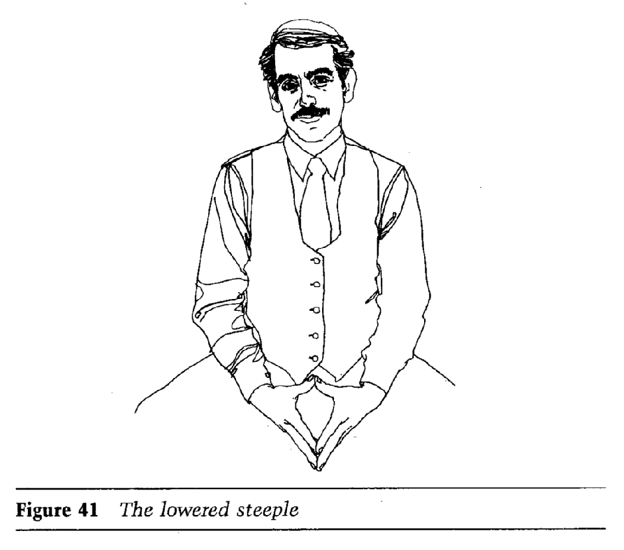
All Depends

Slide 34
Other Positive Signs
Negative Language
Talking in a monotonous tone and with a lack of facial expression.
Staying as far away as possible from the audience.
Not using your hands is a sign of stiffness, which can create boundaries in communication.
Positive Language
Smiling to the audience and/or adding humor to your speech.
Reducing the distance between you and your audience indicates an interest in your audience.
Talking with your hands, and particularly with palms open show sincerity.

Slide 35
Hand to Face Gestures
In general, during your presentation, avoid touching your face, head and neck. It can be interpreted as a negative sign or as a lie indicator.

Slide 36
https://www.youtube.com/watch?v=k4RRi_ntQc8

Slide 37
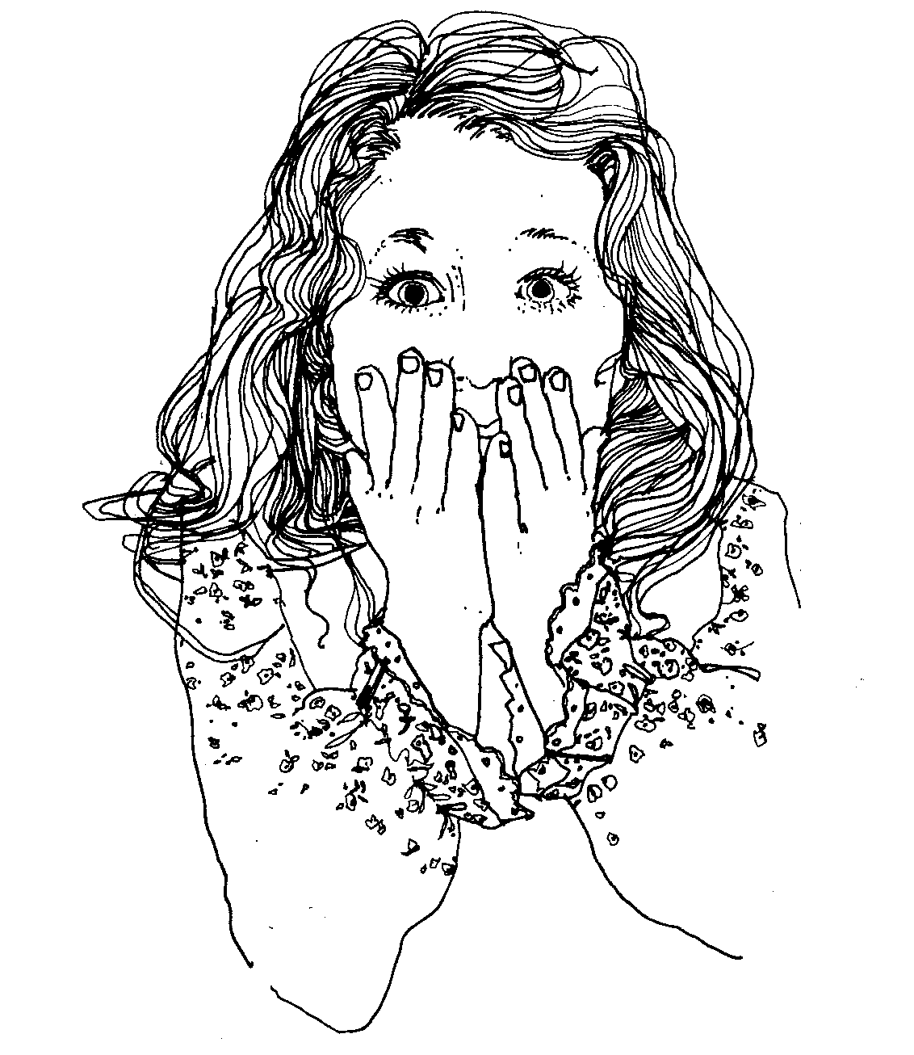
Speak no Evil

Slide 38
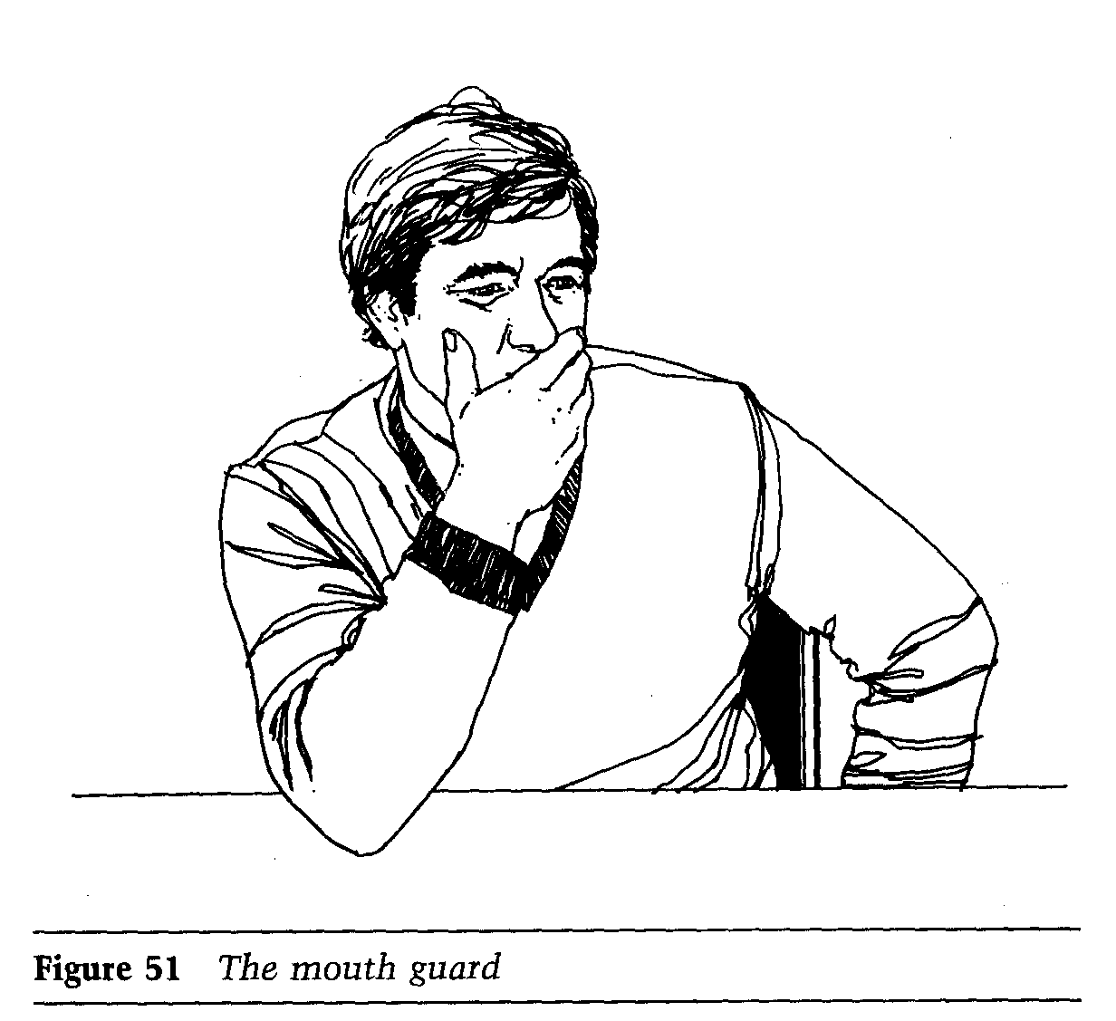
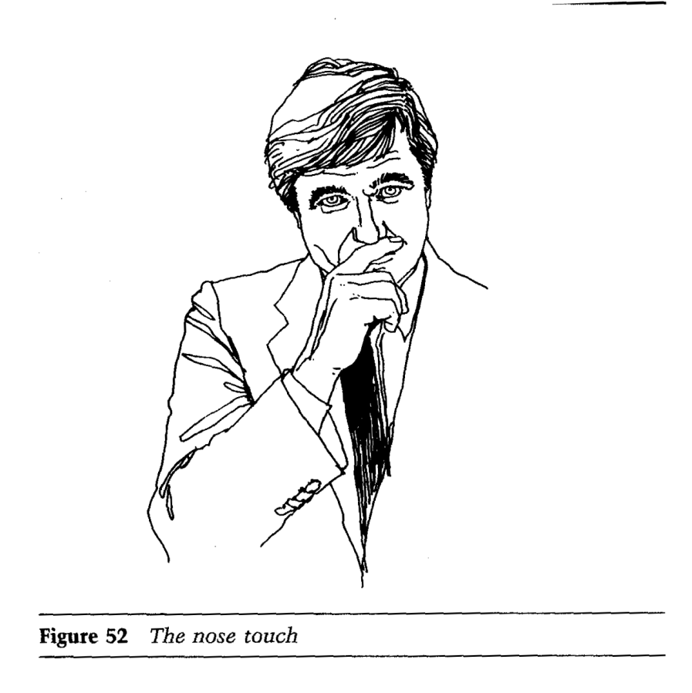

Slide 39
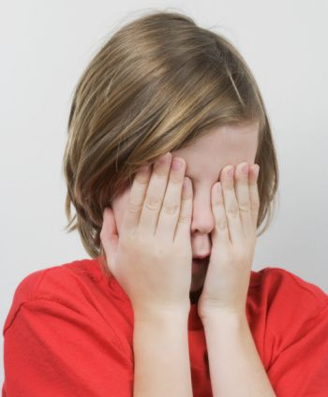
See no Evil

Slide 40
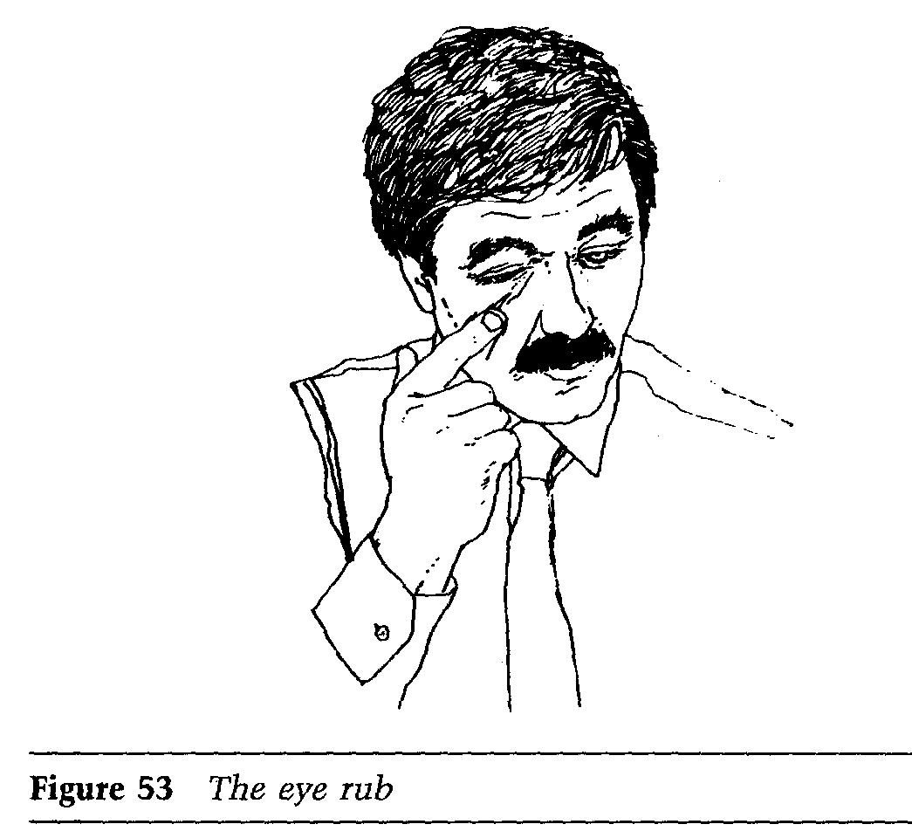

Slide 41
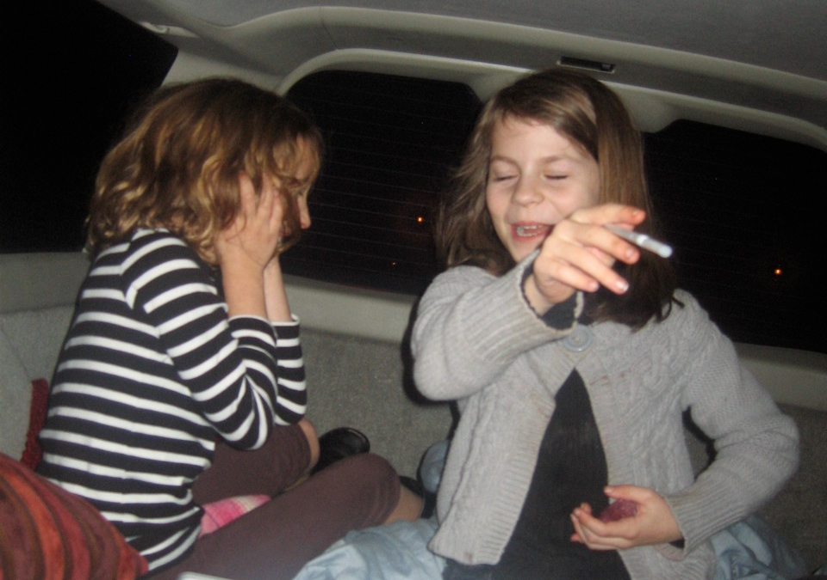
Hear no Evil

Slide 42
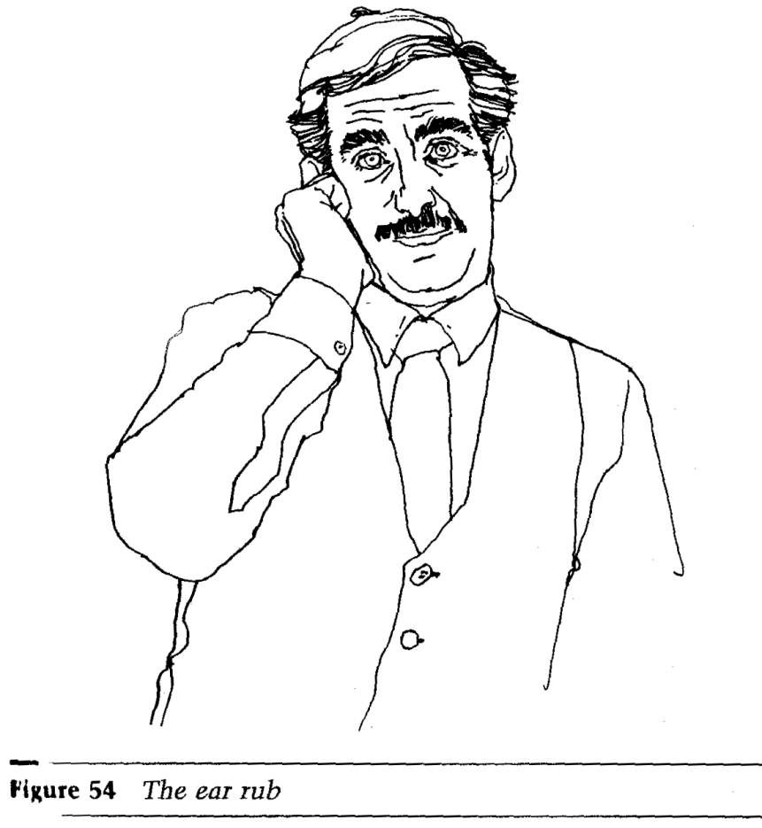
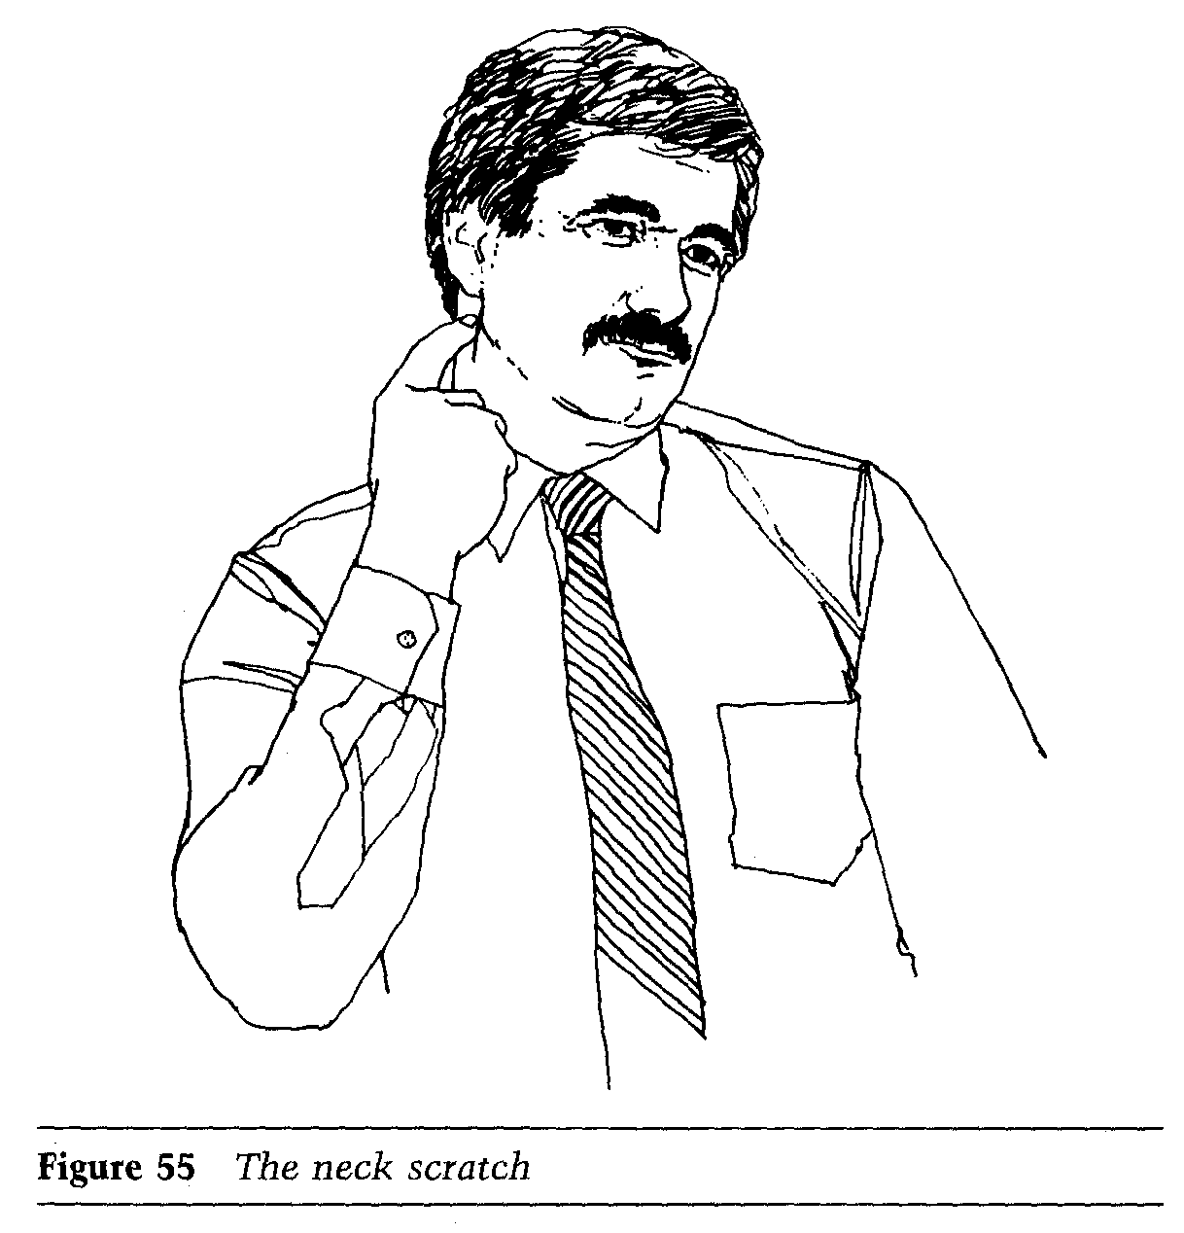
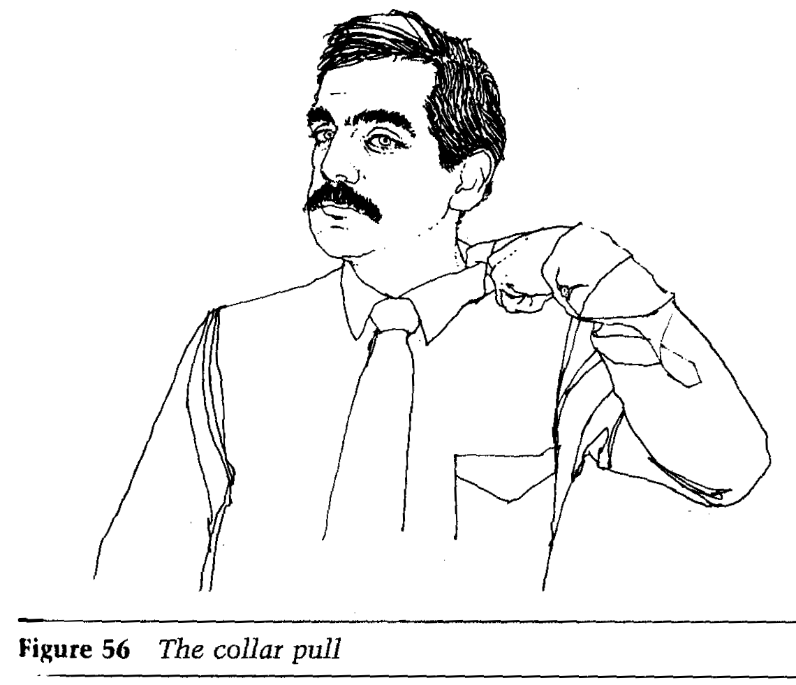

Slide 43
Your Mind Shapes Your Body Language
Your Body Language Shapes your Mind

Slide 45
Review
Kinesics
The Basics and the Origins
Gesture Clusters
Some Positive & Negative Expressions

Slide 46
&
Questions
Answers

