Slide 2
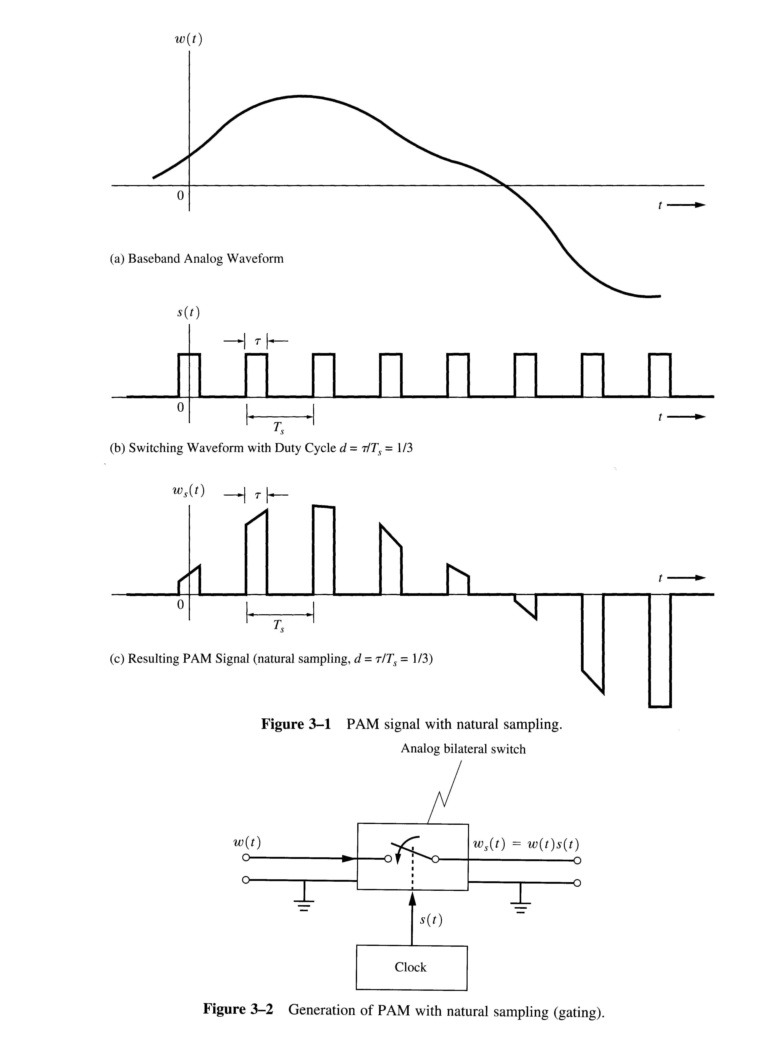
Natural Sampling Spectrum

Slide 3
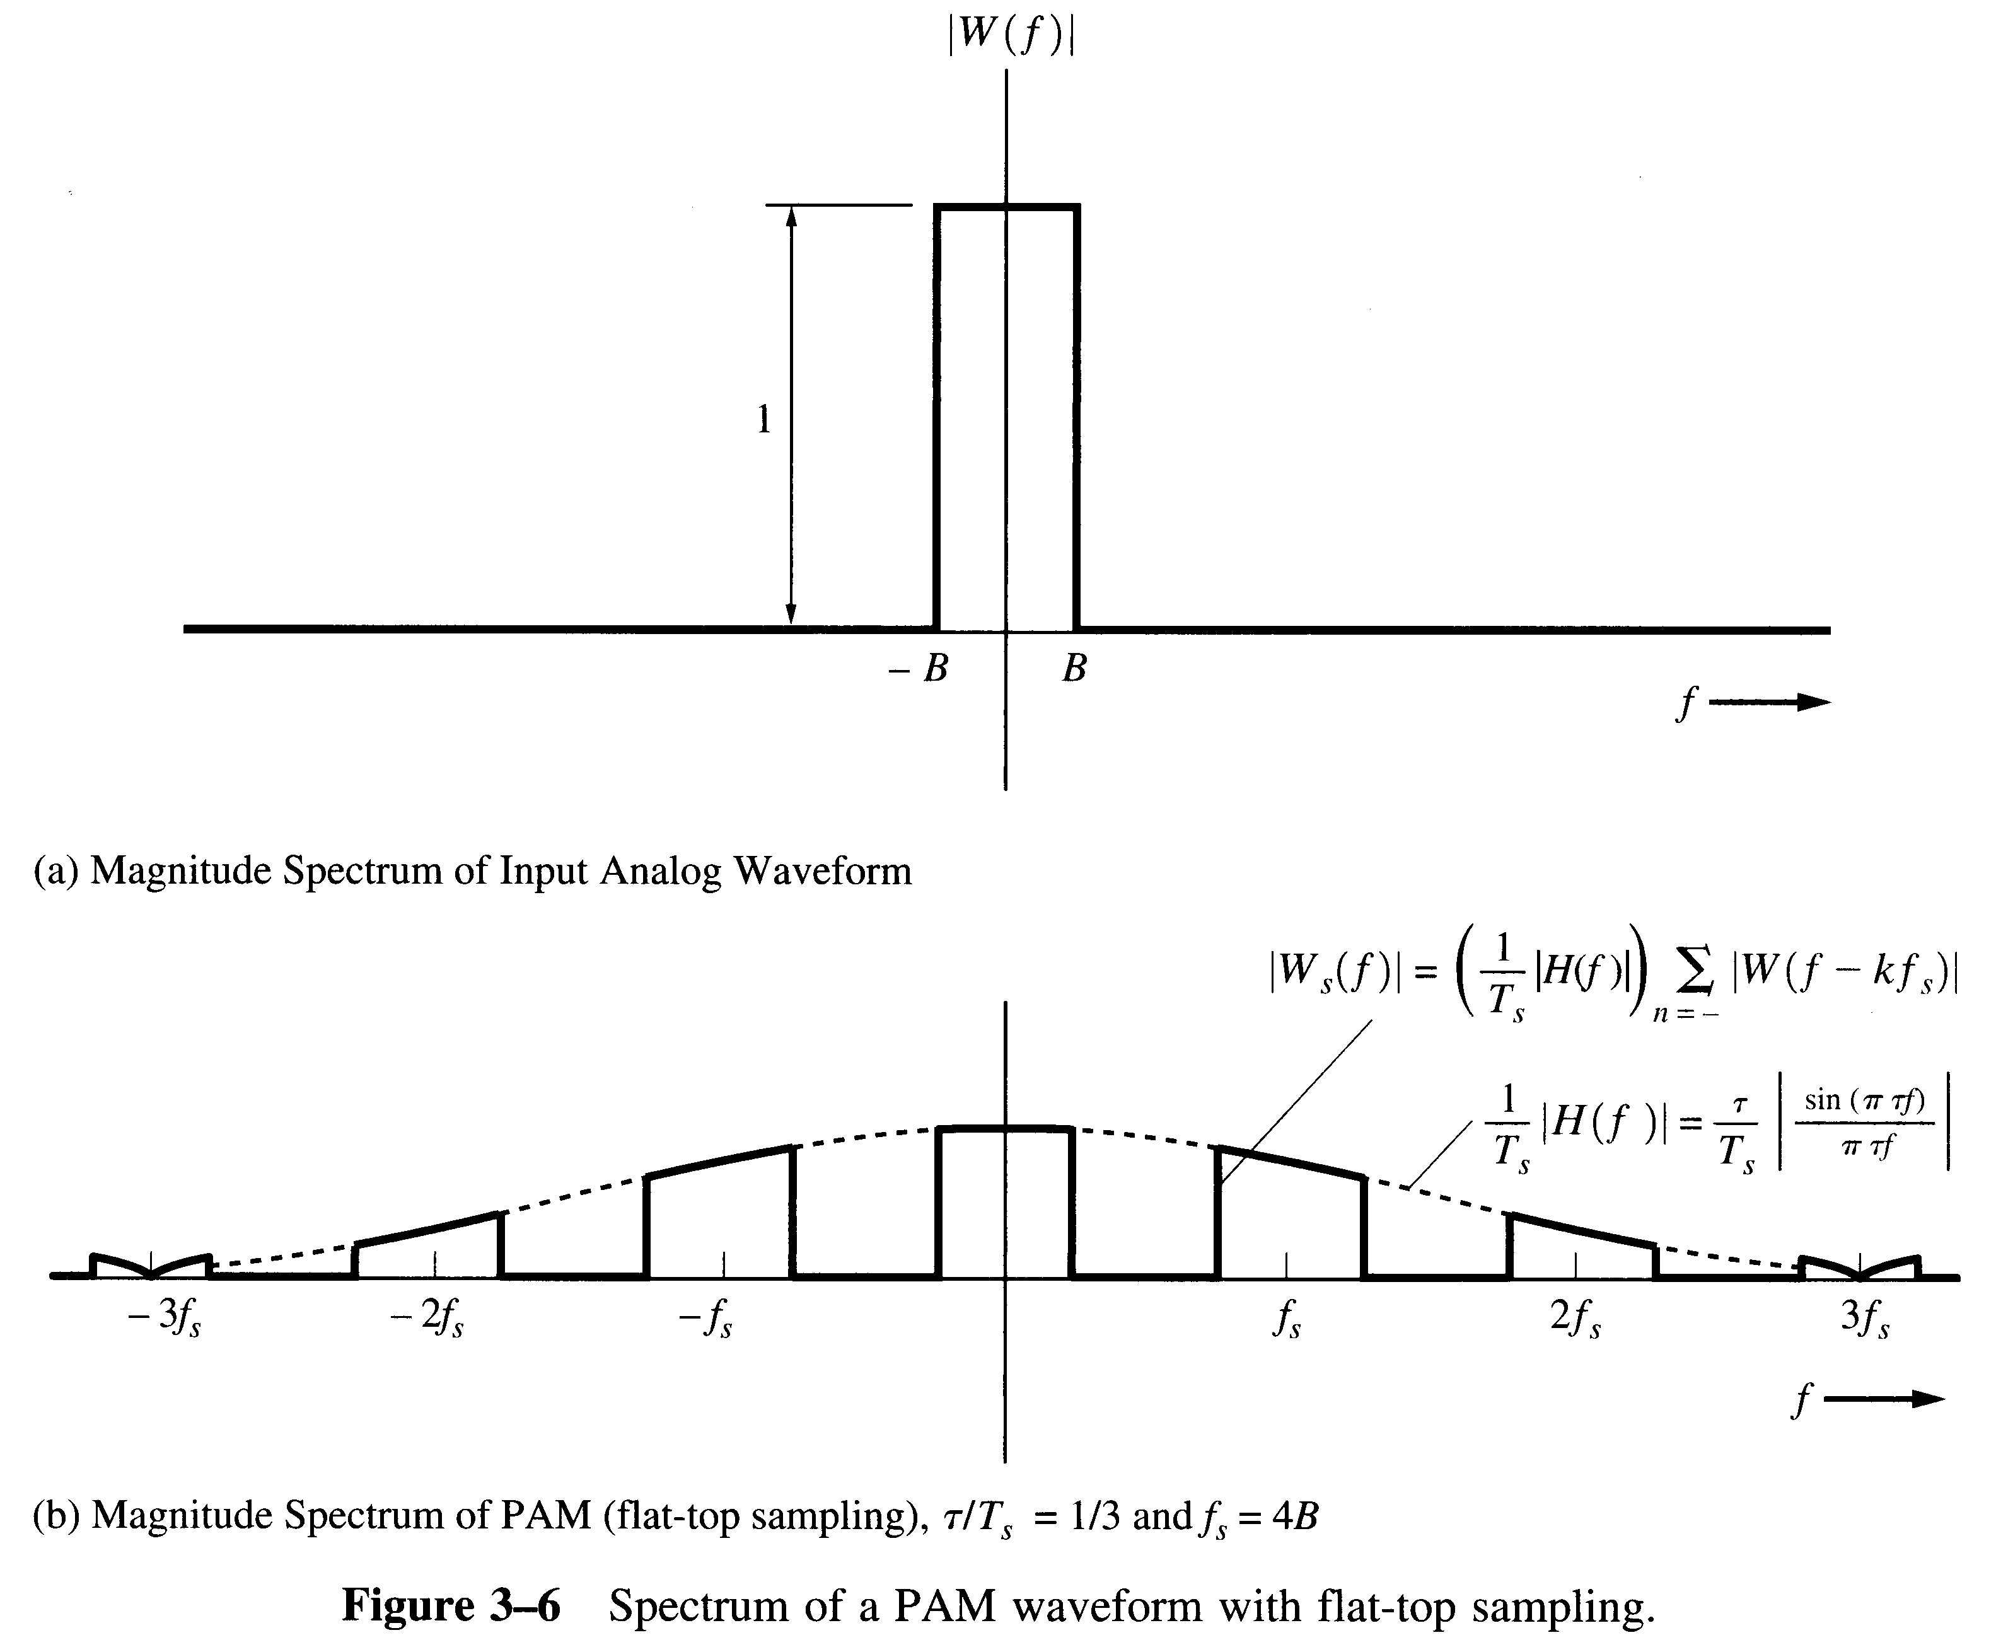
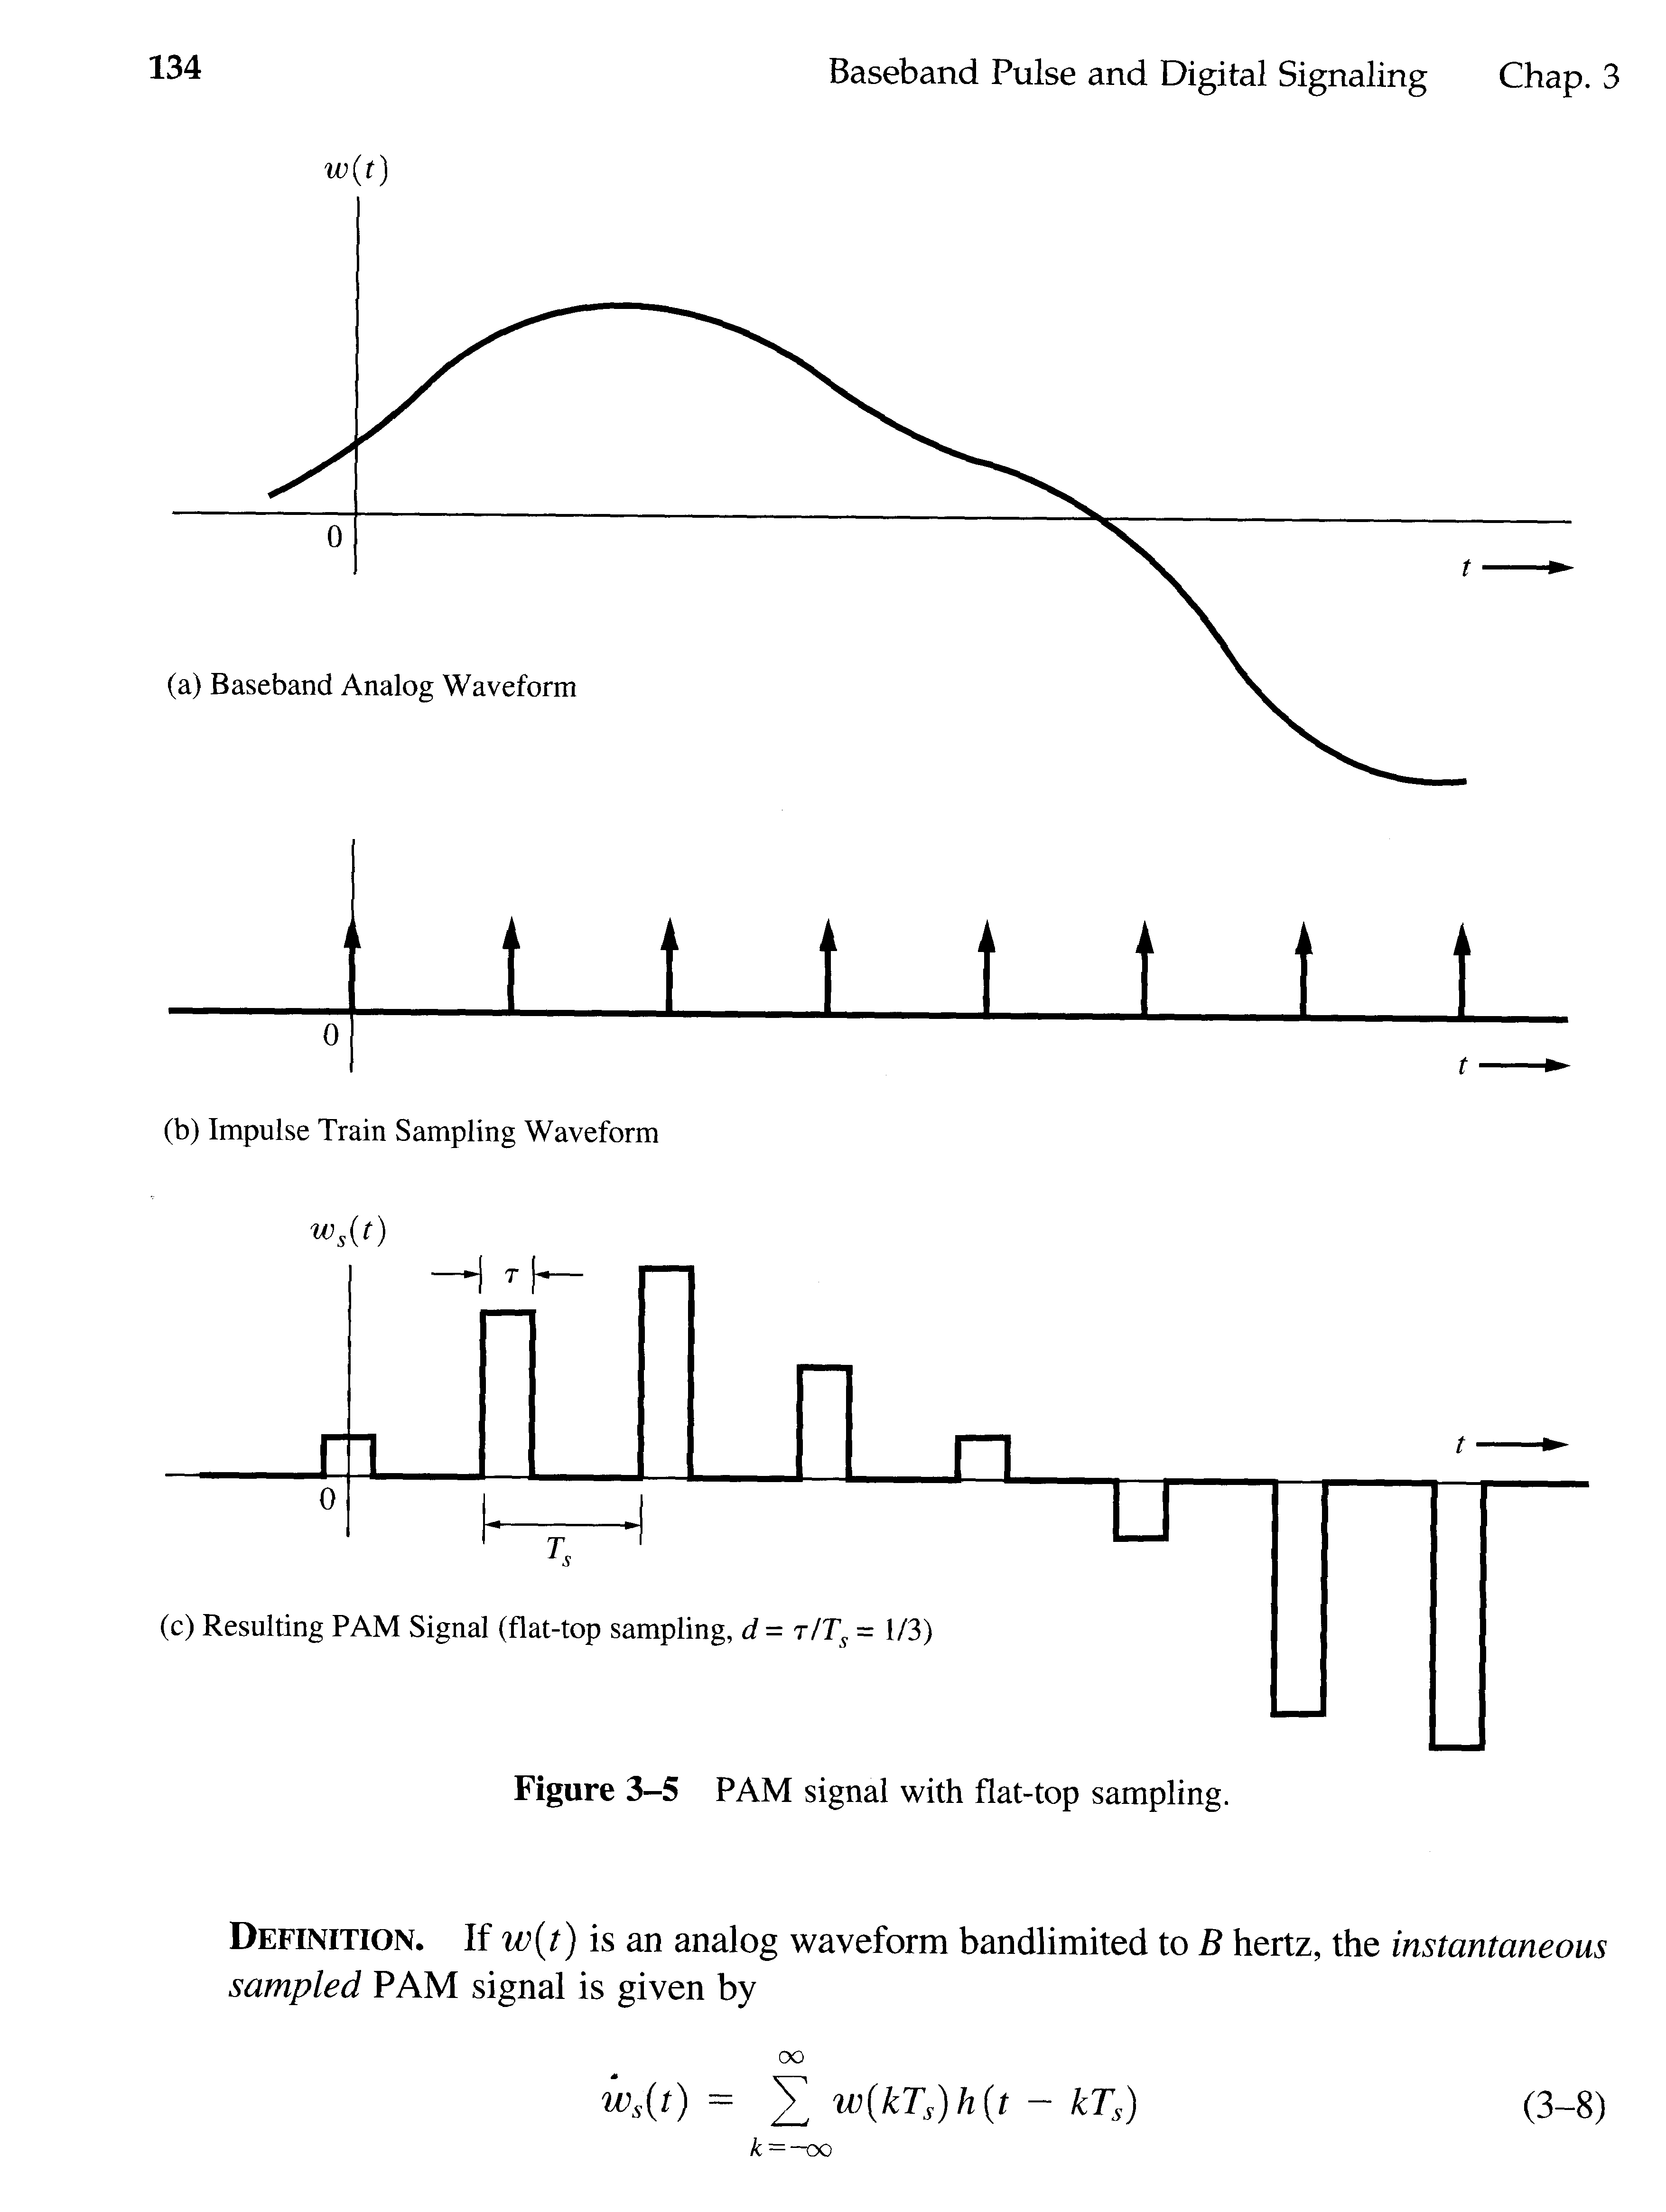
Instantaneous Sampling (Flat-Top PAM)

Slide 4
Transform of a Sa(t)

Slide 5
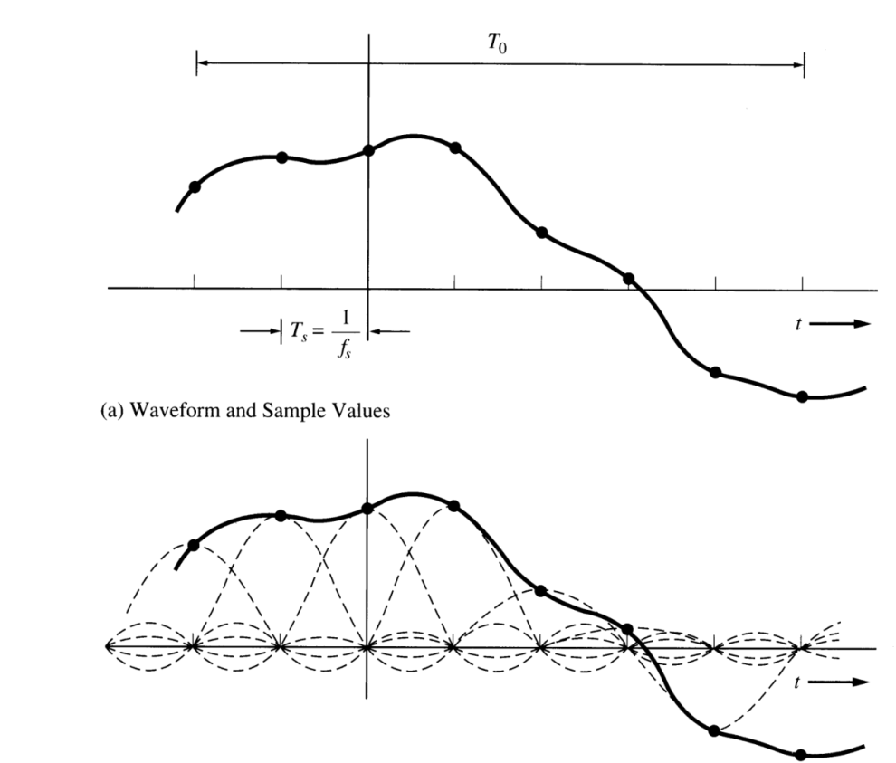
Using the sampling function

Slide 6
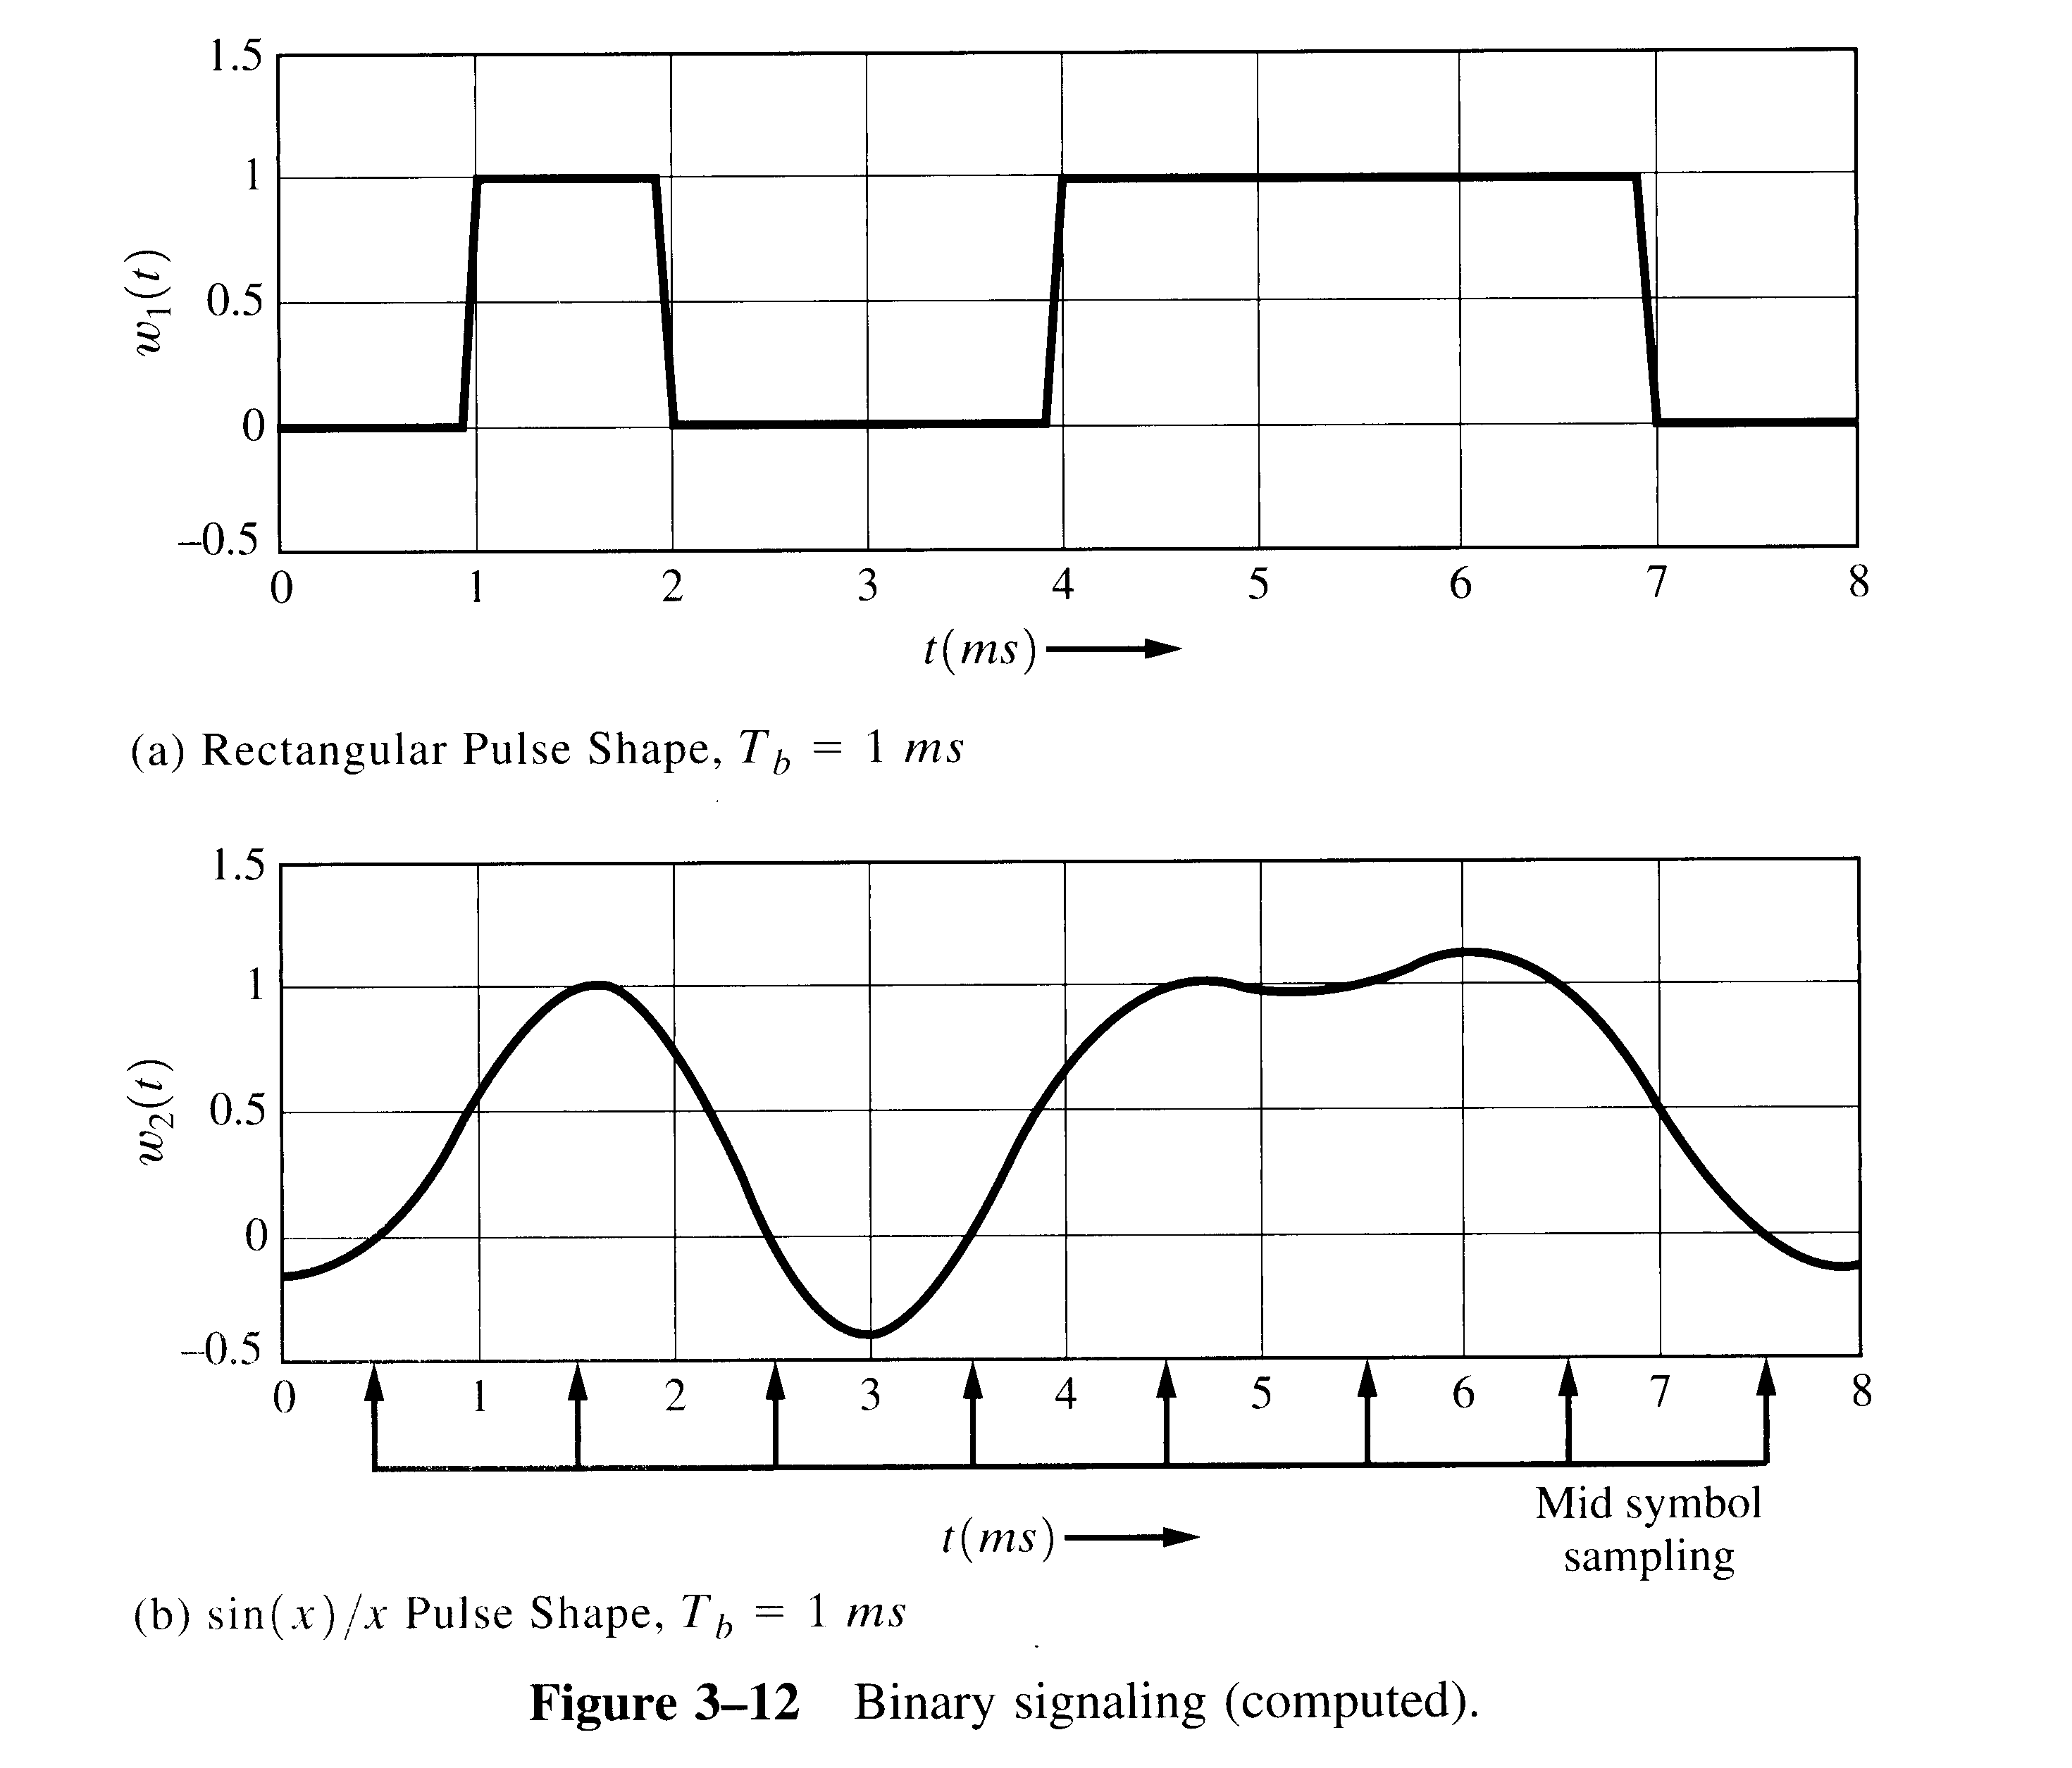
Example 3-3. Binary Signaling

Slide 7
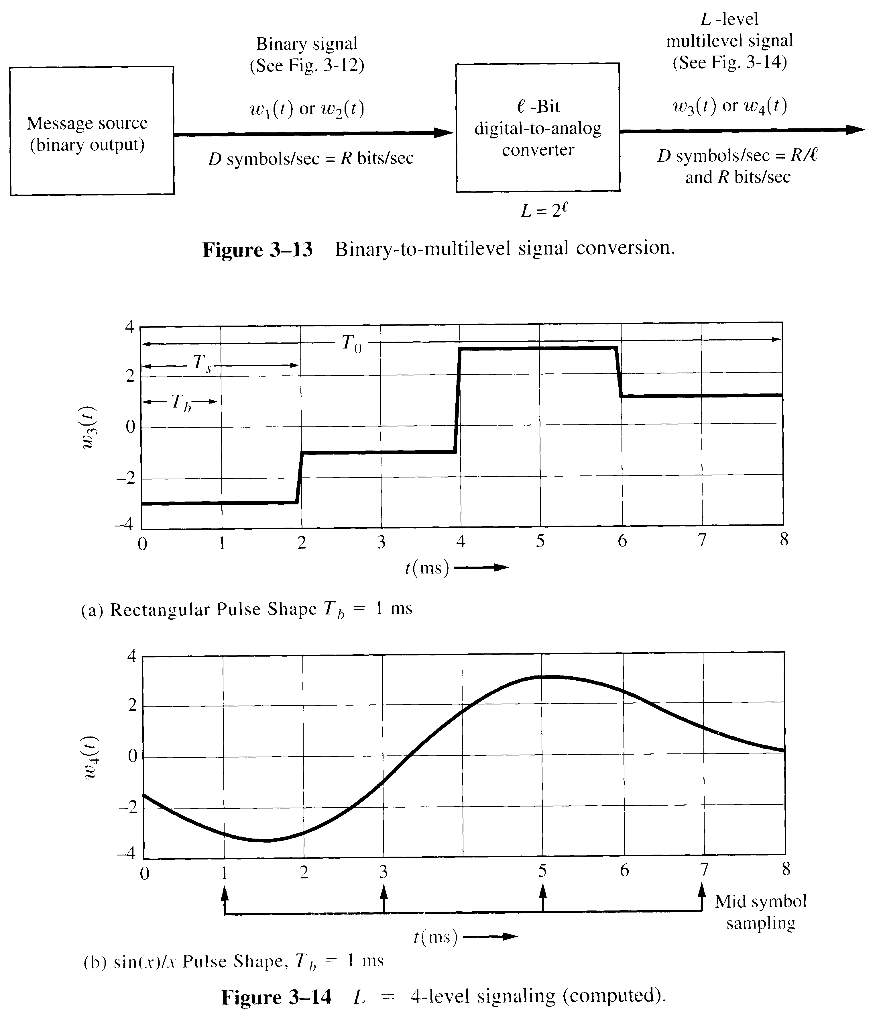
Multilevel Signaling

