Slide 1
EEL 4304: Electronics II Summer 2009
Dr. Jean H. Andrian

Slide 2
Reading assignment
Microelectronic circuits by Sedra and Smith
Chapter 4:
Sections 4.1 and 4.2 (pp 236-262)

Slide 3
MOSFET I-V Characteristics
Key questions
• How can carrier inversion be exploited to make a transistor?
• How does a MOSFET work?
• How does one construct a simple first-order model for the current-voltage characteristics of a MOSFET?

Slide 4
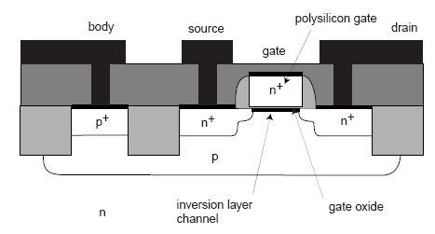
MOSFET: Cross-section

Slide 5
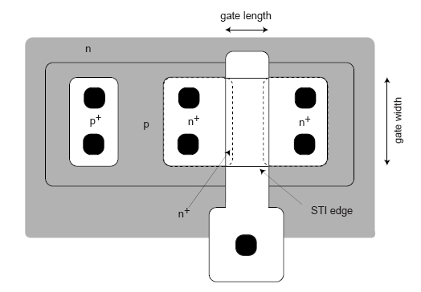
MOSFET: Layout

Slide 6
Key elements:
• inversion layer under gate (depending on gate voltage)
• heavily-doped regions reach underneath gate → inversion layer electrically connects source and drain
• 4-terminal device: body voltage important

Slide 7
Circuit Symbols
Two complementary devices:
• n-channel device (n-MOSFET) on p-Si substrate (uses electron inversion layer)
• p-channel device (p-MOSFET) on n-Si substrate
(uses hole inversion layer)

Slide 8
Circuit symbols

Slide 9
Qualitative operation
Water analogy of MOSFET:
• Source: water reservoir
• Drain: water reservoir
• Gate: gate between source and drain reservoirs

Slide 11
Want to understand MOSFET operation as a function of:
• gate-to-source voltage (gate height over source water level)
• drain-to-source voltage (water level difference between reservoirs)
Initially consider source tied up to body (substrate or back).

Slide 12
Three regimes of operation:
Cut-off regime:
• MOSFET: VGS < VT , VGD < VT with VDS > 0.
•Water analogy: gate closed; no water can flow regardless of relative height of source and drain reservoirs.

Slide 14
Linear or Triode regime:
• MOSFET: VGS > VT , VGD > VT , with VDS > 0.
• Water analogy: gate open but small difference in height between source and drain; water flows.

Slide 16
Electrons drift from source to drain → electrical current!
• VGS ↑ |Qn| ↑ ID ↑
• VDS ↑ |Ey| ↑ ID ↑

Slide 18
Saturation regime:
• MOSFET: VGS > VT , VGD < VT (VDS > 0).
• Water analogy: gate open; water flows from source to drain, but free-drop on drain side → total flow independent of relative reservoir height!

Slide 21
I-V Characteristics

Slide 22
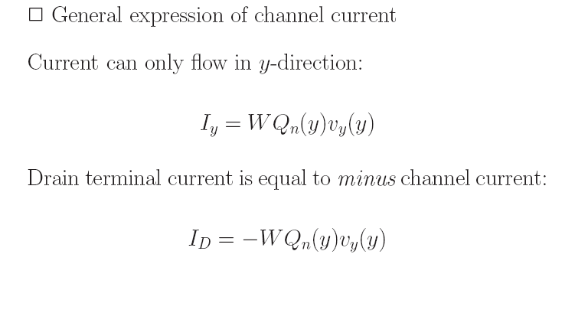

Slide 72
MOSFETs Equivalent circuit models
Reading assignment:
Section 4.6 (pp 287-298)

Slide 94
Reading assignment:
Section 4.8 (pp 320- 325)

Slide 107
Bipolar Junction Transistor
Reading assignment:
Chapter 5: sections 5.2 and 5.3

