Slide 1
EEL 5543: Random Signal Principles
Dr. Jean H. Andrian
Fall 2011

Slide 2
Reading: 1.1 to 1.4

Slide 3
Probability models and axioms

Slide 16
Conditioning and Bayes’ rule

Slide 17
Reading: 1.5

Slide 29
Reading: 1.6,1.7

Slide 30
Independence

Slide 41
Reading: 1.8,1.9

Slide 42
Counting sections

Slide 51
Reading: 2.1, 2.2, 2.3, 2.4, 2.5

Slide 52
Discrete random variables, Point Mass Functions, Expectations

Slide 64
Bernoulli Random Variable
Every Bernoulli trial, regardless of the event, is equivalent to the tossing of a biased coin with the probability of heads p. In this sense, coin tossing can be viewed as representative of a fundamental mechanism for generating randomness, and the Bernoulli random variable is the model associated with it.

Slide 65
The binomial random variable
The binomial random variable arises in applications where there are two types of objects (i.e. heads/tails, correct/erroneous bits, good /defective items, active/silent speakers ), and we are interested in the number of type 1 objects in a randomly selected batch of size n, where the type of each object is independent of the types of the other objects in the batch.

Slide 66
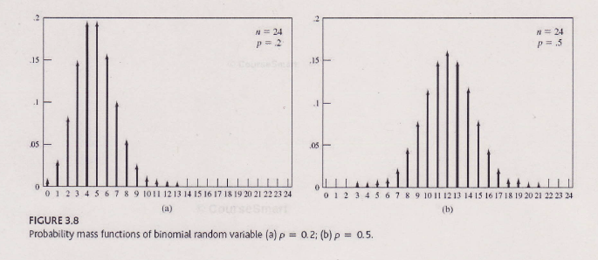
Binomial Random Variable

Slide 67
Geometric random variable
The geometric random variable arises in applications where one is interested in the time (i.e., number of trials) that elapses between the occurrence of events in a sequence of independent experiments.

Slide 68
The Poisson random variable
In many applications, we are interested in counting the number of occurrences of an event in a certain time period or in a certain region in space. The Poisson random variable arises in situations where the events occur “ completely at random” in time or space. For example the Poisson random variable arises in counts of emissions from radioactive substances, in counts of demands for telephone connections, and in counts of defects in a semiconductor chip.

Slide 69
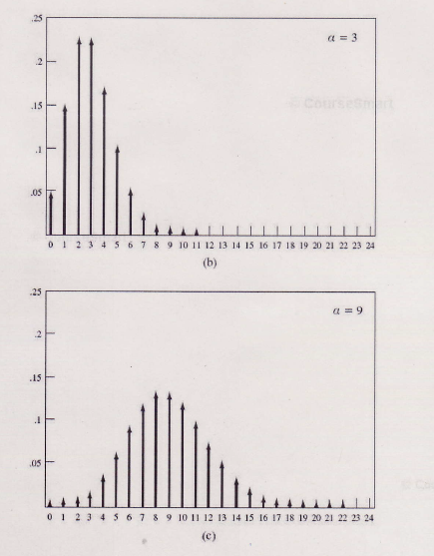
Poisson Random Variable

Slide 70
The Poisson r.v. (cont.)
One of the application of the Poisson probability is to approximate the binomial probabilities in case where p is very small and n is very large, that is, where the event of interest is very rare but the number of Bernoulli trials is very large. Show that if $α=np$is fixed, then as n becomes large

Slide 71
The cumulative distribution function
$F_{X}(x)=P\left[X≤x\right]$ for $−∞ <x < +∞$
That is, it is the probability that the random variable X takes on a value in the set $\left(−∞, x\right].$The event {$X≤x$ } and its probability vary as $x$ is varied; in other words, $F_{X}\left(x\right)$ is a function of the variable $x$. The cdf is simply a convenient way of specifying the probability of all semi-infinite intervals of the real line of the form $\left(−∞, b\right]$. The events of interest when dealing with numbers are intervals of the real line, and their complements, unions, and their intersections.

Slide 72
CDF (cont.)
$0≤ F_{X}\left(x\right)≤1$
$\lim_{x→+∞}{F_{X}\left(x\right)=1}$
$\lim_{x→−∞}{F_{X}\left(x\right)=0 }$
$F_{X}\left(x\right)$ is a nondecreasing function of x
$F_{X}\left(x\right)$ is continuous from the right

Slide 73
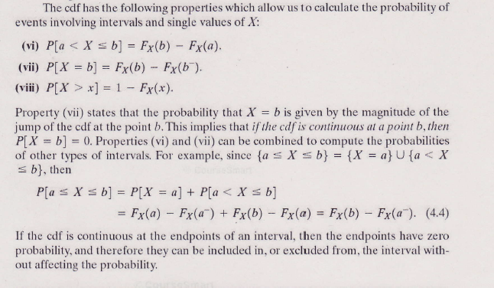
CDF (cont.)

Slide 74
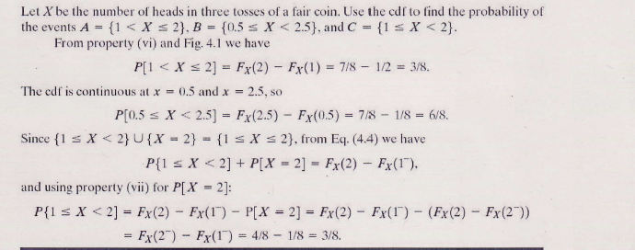
Example

Slide 75
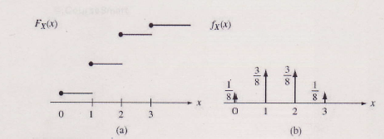
Example

Slide 76
Types of Random variables

Slide 77
Types of Random variables (cont.)

Slide 78
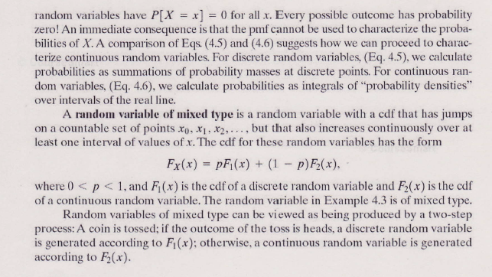
Types of Random variables

Slide 79
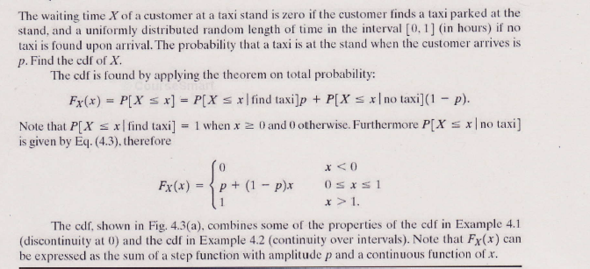
Example

Slide 80
Example of CDF (cont.)

Slide 81
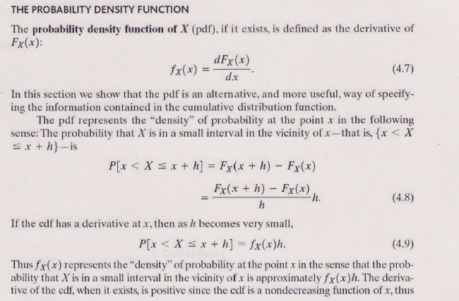
Probability density function

Slide 82
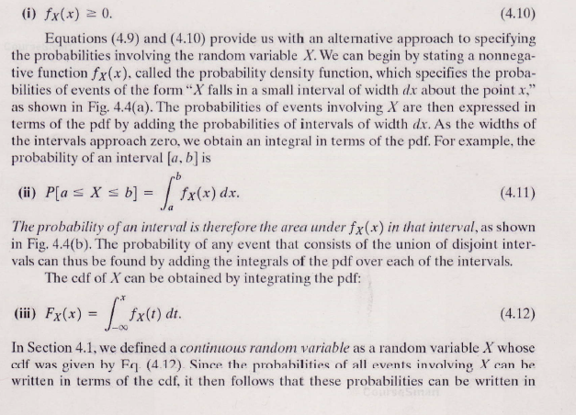
Probability density function

Slide 83
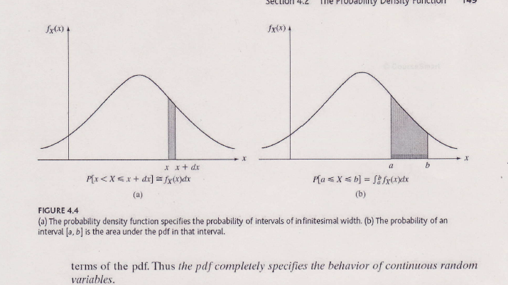
Probability density function (cont.)

Slide 84
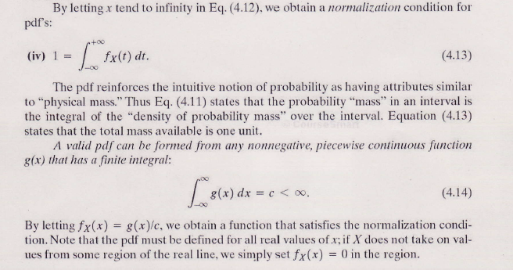
Probability density function (cont.)

Slide 85
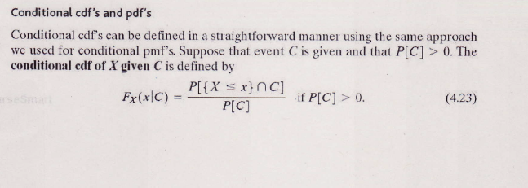
Conditional CDF and pdf

Slide 86
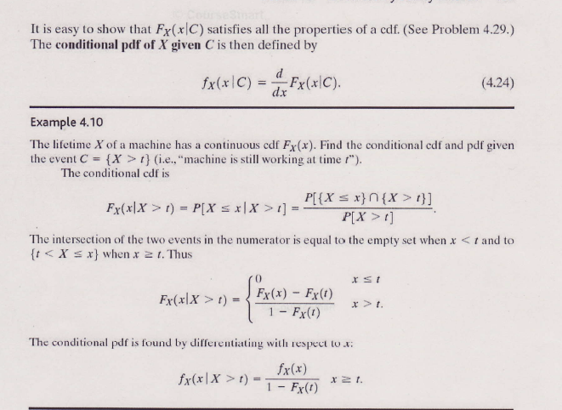
Conditional cdf’s and pdf’s

Slide 87
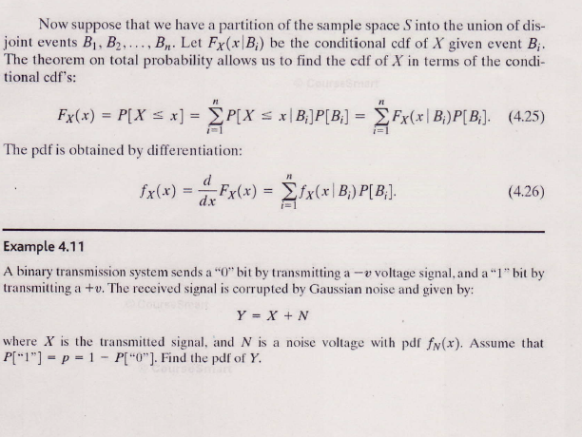
Conditional cdf and pdf

Slide 88
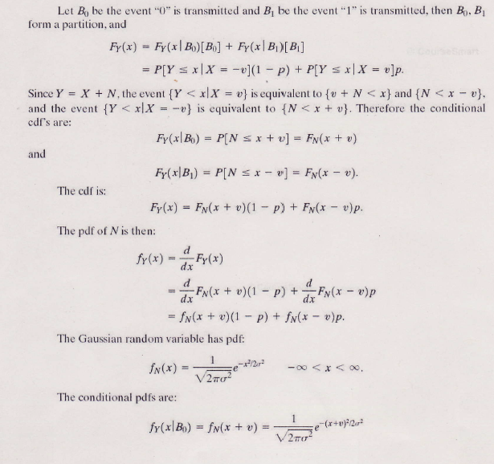
Example

Slide 89
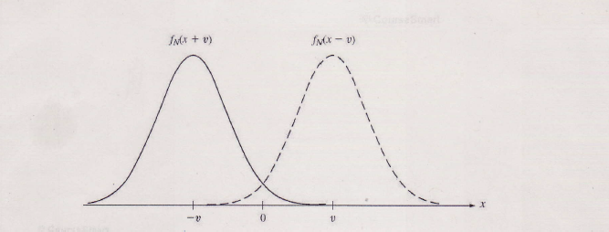

Slide 98
Multiple random discrete variables

Slide 99
Reading: 4.1,4.2,4.3

